Slide 1

Do The DBE
TOOLBOX V1.0

Slide 2
What DBE Toolbox?
Design-Based Education (DBE) is co-created learning, in close cooperation with businesses and employers.
In DBE, student teams learn from open challenges that arise in real life, which they solve by applying design thinking and co-creation methods and tools. The design thinking process includes six user-driven steps: (1) explore the question (2) define the core problem (3) generate ideas (4) design prototypes (5) test prototypes (6) explore and improve.
At HAMK, we are developing our own versions of DBE. This is done through an extensive co-design process involving all stakeholders. This toolkit is part of this process and is the first version of a set of tools that can be used in DBE projects. The tools can be printed on A4 or A3 paper and given to students to use, or they can be added to the course Moodle, Miro board or similar.
Please give us your feedback (to milla.makinen@hamk.fi) so that we can further develop it together!
Best regards,
DBE team

Slide 3








The DBE Process
DBE projects go through eight phases. A genuine and open real-life challenge is the engine of the process.
Real-life challenge from a work-life partner
Teaming up
Prototyping
Processing our data
Better-making
Team building & defining our learning goals
Finding and defining a problem that we can solve
Sketching and building possible solutions
Tuning the solutions based on the testing
Putting into practice
Gathering data
Ideation
Testing
Implementation of the solution by the work-life partner
Presentation & reflection
DIALOGUE-BASED TEAM WORK
Understanding the challenge & the needs and phenomenons related to it
Creative solution-generation
Real-life testing of the solutions
Presenting solutions to work-life partners & reflecting the learning journey and the solution

Slide 4





Tip: Google the tools and methods and find more examples of how to do things!
DBE tool selection
DBE projects can make use of a number of tools and methods to help them move forward.
What do we need to do?
Which tools should we use to do it?
We need to reflect on our individual and team skills
Dialogue principles
InnoCards & innovation flower
Stakeholder map
Benchmarking
Empathy map
Mystery shopping
Observation
Brainstorming
Value proposition canvas
Service Blueprint
Regional innovation impact assessment
How Might We
Point of View Statement
Future Visioning
Round Robin
Crazy 8
Prototyping & experimenting
Testing the prototype
Sustainable Business Model Canvas
InnoCards & innovation flower
We need to understand what the project relates to
We need to understand the key people
Which methods should we use with the tools?
We need to figure out the problem
  Thinking out loud
  Using existing documentation & data
  Netnography
  Observation
  Surveys
  Narrative interviews, thematic interviews, expert interviews
  Workshops and focus groups
We need to name the core problem
We need to generate ideas
We need to create solutions
We need to test and tune the solutions
We need to assess what we learnt in the project

Slide 5



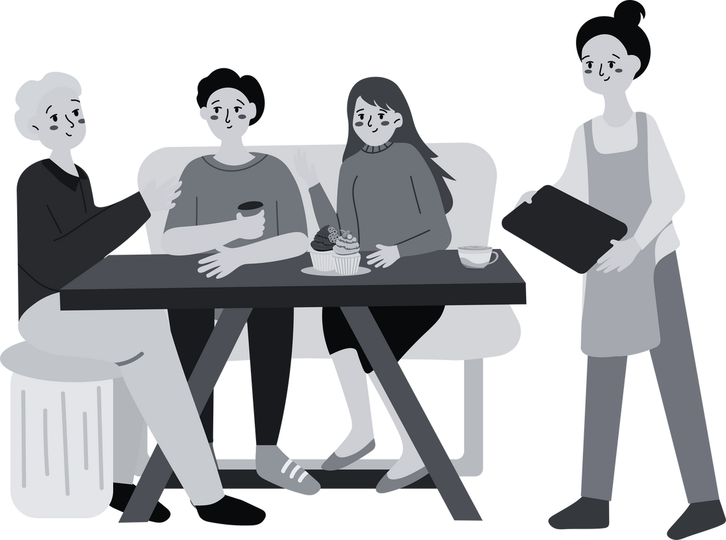




DBE methods to support tools
In DBE projects, it is important to gather information from real life and real people, not just from your own assumptions.
If project data is based only on the project team's own assumptions, the end results may not meet real needs or solve the DBE challenge. Therefore, it is important to use methods that help to get information from the right people and their experiences.
In this way, the results of the project will genuinely support the solution to the challenge.
Thinking out loud.
Thinking out loud is saying your thoughts out loud when you are doing something, for example, using a website, app or a service.
Making use of existing documentation & data.
Use the existing studies, surveys and statistics that are available online to help understand the context of the project.
Netnography.
Netnography is the search for information in people's real and everyday online environments, such as discussion forums and social media channels.
Observation.
Observation is watching and listening to what people do in real and everyday places, such as cafés, libraries or even in a particular neighbourhood.
Survey.
A survey allows information to be collected from a wide range of respondents on the basis of the same questions. They can be distributed, for example, via a social media or by e-mail.
Story interviews, thematic interviews, expert interviews. Interviews are one-to-one chats with key people involved in the project or affected by the challenge.
Workshops and focus groups. Workshops are planned moments of shared work, where new knowledge is generated through workshop methods. Focus groups are group interviews.
User testing.
User testing is the evaluation of the usability of a solution conceived in a project with the user of the solution.

Slide 6


DBE DIALOGUE PRINCIPLES
DBE project work is guided by Sitra’s principles of constructive dialogue.
DIALOGUE = aspiration to understand each other
Listen to others, don't interrupt or start side conversations.
Everyone must have the opportunity to express their views in peace. It is important that we do not interrupt each other or the person next to us.
Join in with others and use everyday language.
The aim of dialogue is to try to relate what we say to what others have said in the debate. We try to speak in everyday language and avoid difficult terms.
Tell us about your own experience.
In order to better understand the issue at hand and each other, it is good to talk about our own experiences. This means telling others what issues, events and situations have influenced your own views.
Talk directly to others and ask for their views.
It is easier to build up a common conversation if we address each other, talk to each other and ask each other directly for their views.
Be present and respectful of others and the atmosphere of trust.
In a dialogue, it is important to focus on each other and on understanding what is being discussed. Respect people's different views. Keep the discussion confidential so that everyone can speak as freely as possible.
Search and size. Work boldly on the conflicts that arise and look for the hidden issues.
A dialogue should be a safe situation where conflicts can be addressed. It is also important to look for issues that have been overlooked. Finally, we can explore how the perspectives that emerge in the discussion relate to each other.
  Equal participation
  Openess of expression
  Empathic listening
  Mutual trust
  There are no winners and no loosers
  Meeting others as peers
  Respect for different ideas and interests
DEBATE= proving who is right
  Power games
  Winners and loosers
  Defending one’s own point of view just because it is one’s own
  Criticizing un-constructively
  Trying to prove wrong the views of others
Text and illustration: Sitra, translation by DBE team

Slide 7

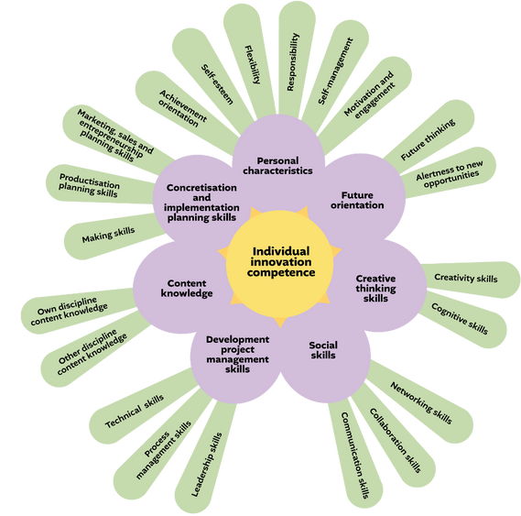



When to use?
    We don't really know what skills and strengths we have in our team that we could use in our project (we need to strengthen our teamwork)
    We need time to get to know each other and understand each other's strengths (we need to strengthen mutual understanding)
How do we do it?
What might it look like?
What should we do with it?
Meet as a team (online or offline). Print or place the flower on a virtual whiteboard.
Each team member first selects five things from the flower that describe their strengths. Each person then takes turns telling the others about them. This shows the team what they can do together.
In the second round, everyone chooses five topics that describe their areas for development. Each person takes a turn to talk about them, and then we have a joint discussion about where we want to improve as a team during the project.
Reflect together as a team:
  What are the overall competencies of your team?
  What are your team's strengths and weaknesses?
  Where do you need to develop, what skills do you need to acquire?
As you move forward with your DBE project, build on your strengths and divide tasks so that you can each develop your weaknesses and build on your strengths. The best teamwork happens when everyone's strengths are allowed to flourish!
hkjhsk kjhjkh jkhkjhjkh
hkjhf abkjkjbs aoihohfhf
hkjhsk kjhjkh jkhkjhjkh
INNOVATION FLOWER
hjh ljhljhjh lhlhjkhkf
hkjhf abkjkjbs aoihohfhf
hkjhsk kjhjkh jkhkjhjkh
hkjhsk kjhjkh jkhkjhjkh
hkjhsk kjhjkh jkhkjhjkh
hjh ljhljhjh lhlhjkhkf
hjh ljhljhjh lhlhjkhkf
hkjhf abkjkjbs aoihohfhf
hkjhf abkjkjbs aoihohfhf
hkjhsk kjhjkh jkhkjhjkh
hjh ljhljhjh lhlhjkhkf
hkjhf abkjkjbs aoihohfhf
hjh ljhljhjh lhlhjkhkf
hkjhsk kjhjkh jkhkjhjkh
How can you succeed?
    When one person tells you about their strengths or weaknesses, listen – don’t criticize. This builds a respectful atmosphere!
    Write things down - this exercise will also be useful for the mid-term and final evaluation of the project.
    The whole Innocard set can be found from the libraries and at http://www.theseus.fi/handle/10024/851650
What can go wrong?
    If you talk over others and fail to listen, the tool can worsen the team atmosphere. It is therefore essential that the tool is used in a spirit of dialogue.
    If things are not written down in a common flower, it is not possible in the middle and at the end of the project to assess how everyone's innovation skills have developed during the project.

Slide 8
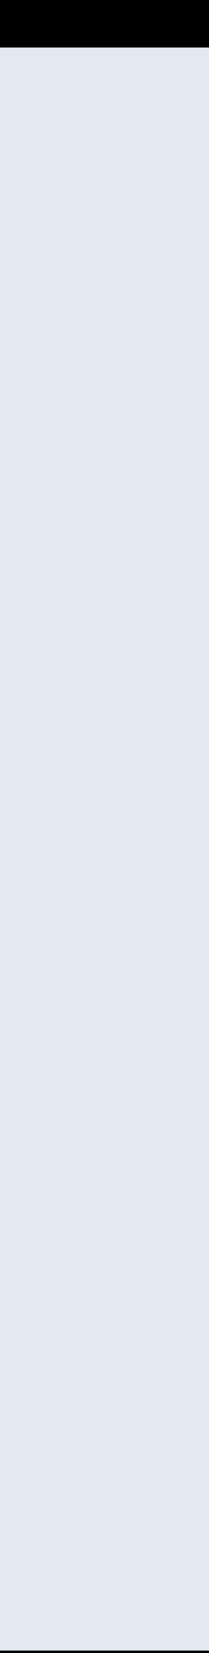
The Innovation Flower is a tool that helps members of a multidisciplinary team to get to know each other and to make their skills and development potential visible. At the beginning of a project, it is a good idea to give teams time to get to know each other and to make their competences and development potential visible. In the middle and final stages of the project, the flower can be used for a joint dialogue-based assessment of the development of the team's competences.
Reflection question for the early stages of the project: what are the strengths of our team?
What are the overall competencies of our team? How do our individual skills complement each other? What are our team's strengths?
Reflection question for the early stages of the project: what kind of development needs do we have as a team?
What are our team's weaknesses or what might we be missing? Where do we want to improve and what new skills do we want to acquire? Why do we think this is important and how can we develop and learn these things?
REFLECTION: INNOVATION FLOWER
A reflection question for the middle stages of the project: How will our team evolve during the project?
How will our skills and strengths develop during the project? What we have learnt during the project?
Reflection question for the end of the project: what changes do we notice in our skills after the end of the project?
Did we learn to identify our own weaknesses, strengths and skills development during our project work? How have our competences developed during the project? Where do we still need to improve?
What should we do next and who should do what? Why? How can we use our skills to do this?
Who will do what in our group to continue our project by incorporating the lessons learned from our reflection on the innovation flower? What do we know now that we didn't know before? What do we not yet know and how can we fill this knowledge gap? What should we do next?

Slide 9
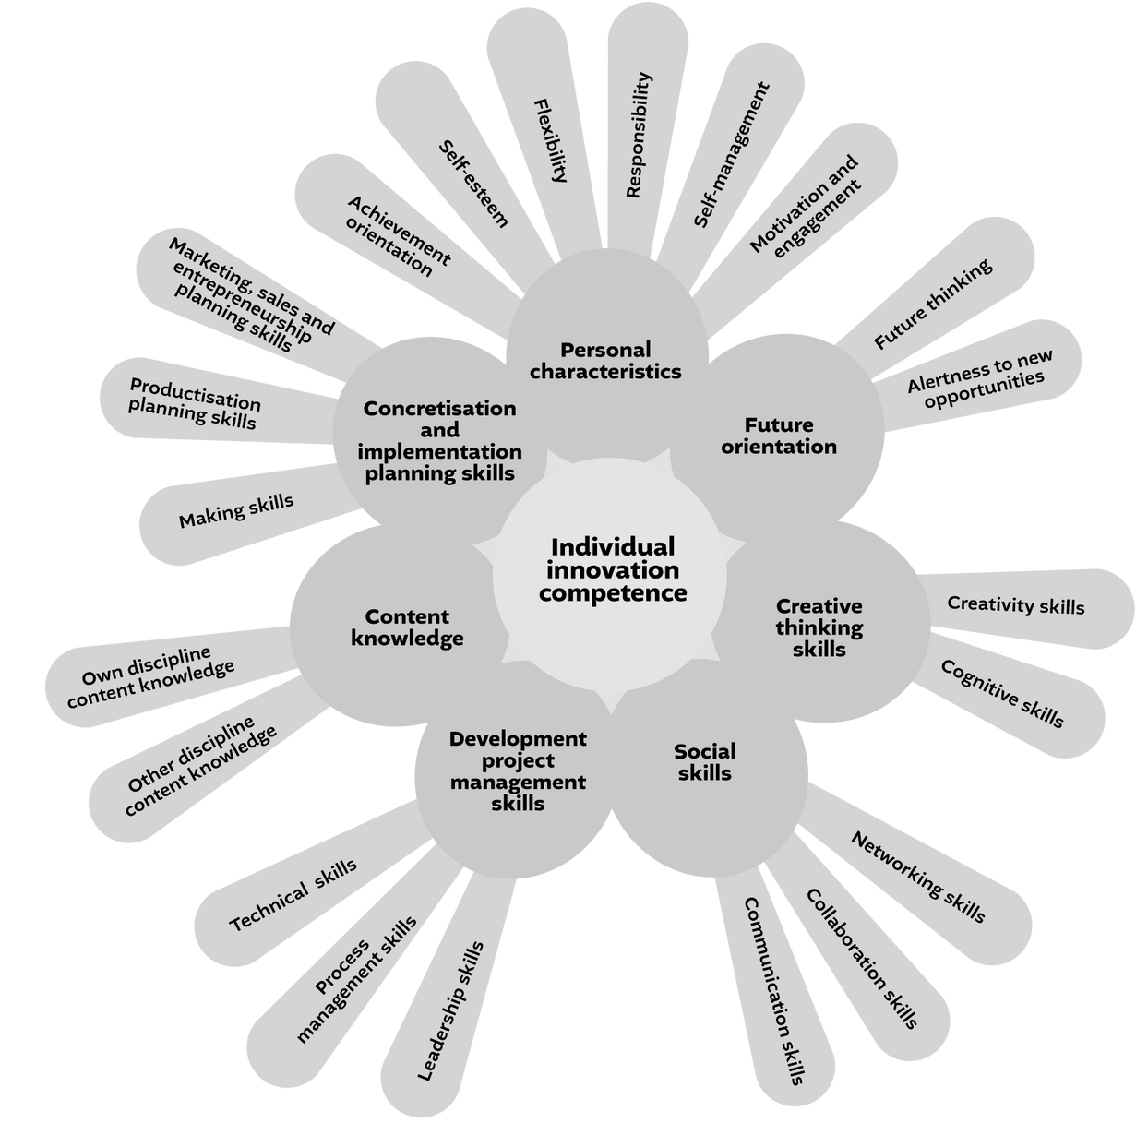
WORKSHEET: INNOVATION FLOWER
Hero, Laura-Maija (2024). InnoCards 2.0 DBE: Innovation competence in a multidisciplinary team in design-based education. Publications of Häme University for applied sciences.
Download: https://urn.fi/URN:ISBN:978-951-784-848-0

Slide 10
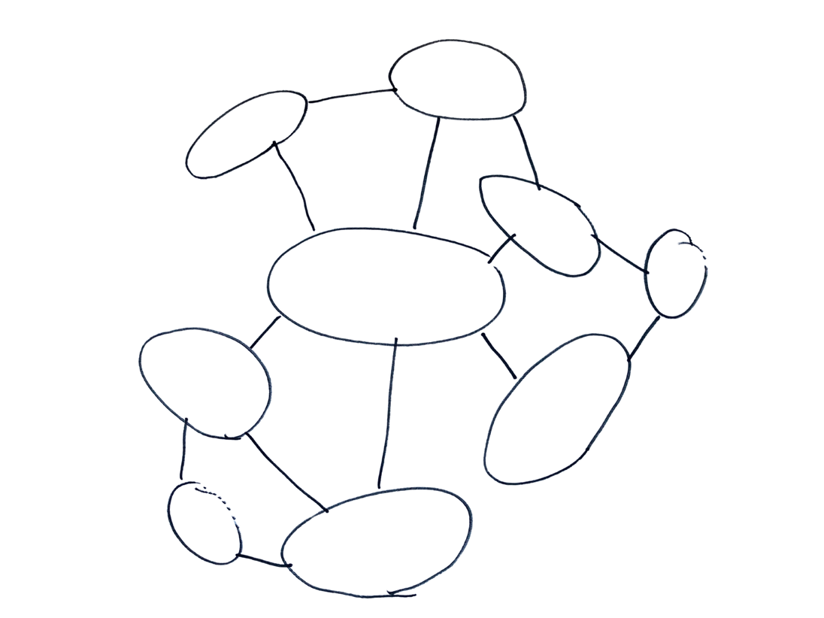
Why should we use it?
  We do not really know who are all the people and organizations that might influence or be influenced by the project (we need to grow our understanding)
  We need to strengthen our common understanding in our team about with whom we should work with and whose perspectives we should hear in the project (we need to strengthen our team work)
How do we do it?
What might it look like?
What should we do with it?
Gather as a team (online or offline). Write your project challenge in the center and start placing your stakeholders around it.
Stakeholders are organizations or people who can influence or be influenced by your project. Write one stakeholder on each sticky note and place the sticky notes on a whiteboard or flip chart and think about how they relate to each other.
You can use a variety of methods to gather the information you need for a stakeholder map. For example, you can use expert interviews, benchmarking, or document analysis.
Reflect on the results in relation to the project challenge. Write the challenge on the map.
Reflect together as a team:
Which ones are our primary stakeholders? What about secondary and tertiary?
What surprised us? What do we now know about who we need to work with and consult during our project? Why them? What should we do next?
STAKEHOLDER MAP
xxxxx
xxxx
xxxxx
Our project or challenge
xxx
xxxxx
xxxxx
xxx
xxxxx
How do we get it right?
  Write the project problem in the middle of the map, it helps you to start
  Start with the stakeholders that you already know and then look for new ones from the background material
  This can be done in group, but make sure that everyone gets to say something!
What could go wrong with it?
  If the map is based on assumptions instead of authentic data, we might recognize the wrong stakeholders.
  If the map is not created together and reflected in the team, it will not contribute to advancing common understanding.

Slide 11
A stakeholder is any person, group of people, or organization that has an interest in, or is affected by, the outcome of a project or decision. This can include people who benefit from or are impacted by the project, as well as those who have influence over it. For example, in healthcare, stakeholders include patients, nurses, and hospital administrators. In other organizations they might be employees, customers, clients, investors, regulators, suppliers and the community.
Who are the stakeholders of the project and how do they interact with each other?
Who are the key people involved in your project or challenge (e.g., patients, providers, administrators, patient care support staff or customers, users, project managers, team members, and external vendors)? How do they interact?
What influence do the stakeholders have on the project and how they might be influenced by the project?
Which stakeholders have decision-making power over your project or challenge, and what kind of decision-making power do they have (e.g., over customer care, timeline, budget)? What about how your project might influence them?
REFLECTION: STAKEHOLDER MAP
Who we need to involve in the project and why?
Which stakeholders are key to understanding the challenge or issue we are working on, and why?
How can we effectively communicate with the stakeholders during our project?
How should we tailor our communications to different groups of people we need to hear from or involve in our project?
Based on our stakeholder map, what should we do next and who should do what? Why?
Who does what in our group in order to continue our project in such a way that we include our learnings from the stakeholder map reflection? What do we now know that we didn’t know before? What do we still not know and how could we fill that knowledge gap? What should we do next? What actions can we take right now (e.g. gathering more data, conducting interviews, doing onsite-observation, creating prototypes, running small tests, or consulting with experts)?

Slide 12

Why should we use it?
  We are just starting and we do not know much about the project context or about what others have already done relating to solving similiar issues (we need to grow our understanding)
  We need to strengthen our common understanding in our team about what is the wider context of the project (we need to strengthen our common understanding)
How do we do it?
What could it look like?
What should we do with it?
BENCHMARKING
Before you start, decide as a team what you are looking for and define your benchmarking criteria. The idea of benchmarking is to compare the qualities of different solutions, services or products that already exist. Create a chart in a digital format that everyone in the team can access.
You can use a variety of methods to gather the information, which you should then structure into a table so that you have all the information in one place that everyone on the team can access. You can do Internet searches, document analysis, visit different services, or try products yourself (if your project is about developing a new product).
Reflect on the results in relation to the project challenge. Write the challenge at the top of the benchmarking chart.
Reflect together as a team:
What surprised us? What caught our attention and why? What types or existing solutions did we find? What could we learn from them for our project? What should we do next?
Challenge: how to create the best flying experience?
CRITERIA
FINNAIR
NORWEGIAN
Check-in & boarding
xxx x xxaasxxx
xxx x xxaasxxx
Customer service
xxx x xxaasxxx
xxx x xxaasxxx
Physical comfort
xxx x xxaasxxx
xxx x xxaasxxx
Sound world
xxx x xxaasxxx
xxx x xxaasxxx
Food & drinks
xxx x xxaasxxx
xxx x xxaasxxx
Visual appeal
xxx x xxaasxxx
xxx x xxaasxxx
How do we get it right?
  Agree in your team first that what are you looking for. This way you make sure that you use your time well!
  Divide tasks in the team. When everyone has a clear niche to benchmark, you’ll have very rich information in the end!
  Once you divided the tasks, work on your own first and then get back to the group. This way you’re the most efficient!
What could go wrong with it?
  If the benchmaking is based on memory instead of authentic information, we might recognize the wrong issues.
  If the information is not collected into one chart and if the chart is not reflected in the team, it will not contribute to advancing common understanding.

Slide 13
Benchmarking is the process where you compare your project, product, or service to the best practices or standards already established in similar situations.
What are the current best practices related to our project?
For example, what are the most effective treatment protocols, patient care techniques, management strategies, or leading design, manufacturing or project management practices, or customer solutions that companies or other organisations are using to solve problems similar to those we are investigating?
What did you find out about how do existing solutions perform?
How well do current products or services in the market do in terms of customer, patient or user satisfaction, marketing and communication, efficiency and cost-effectiveness compared to each other and the project we’re working on? What are the curiosities, innovations and success factors of existing solutions?
REFLECTION: BENCHMARKING
What gaps or weaknesses you could find in existing solutions?
Where are existing solutions fall short (e.g., high failure rates, customer complaints, customer care levels, social or environmental impact), and how could we address these issues in our own project?
What lessons can we learn from the failures and challenges faced by and the improvements and success factors of the existing solutions?
What can we learn in relation to our project from the mistakes and successes of others? How can we incorporate the best features or processes from existing solutions to our project? How does our solution measure up to competitors’ solutions? Are we more or less customer-centric, innovative, efficient, or cost-effective?
Based on our benchmarking, what should we do next and who should do what? Why?
Who does what in our group in order to continue our project in such a way that we include our learnings from the benchmarking reflection? What do we now know that we didn’t know before? What do we still not know and how could we fill that knowledge gap? What should we do next?

Slide 14



Why should we use it?
  We do not really know who are the people that the solution is being created for and what kind of needs they have and why (we need to grow our empathy)
  We need to strengthen our common understanding in our team about what they are doing (we need to strengthen our empathy and teamwork)
How do we do it?
What could it look like?
What should we do with it?
EMPATHY MAP
Get together as a team (online or offline) to use the empathy. Draw the map on a flap paper or in a virtual whiteboard or use a ready template.
Discuss what you know about the experience of your project’s end beneficiary based on your findings about them. What do they think, see say, do, feel and hear about the issue you are working on? What frustrates them or makes them happy in relation to the existing solutions?
You can use several different methods to collect the information that you need for the empathy map, e.g., quantitative data, benchmarking, observation, mystery shopping, interviews or prototype testing.
Reflect on the results in relation to the project challenge. Write the challenge on top of the map.
Reflect together in the team:
What surprised us? What did we learn about the user and their needs in relation to the problem or issue we are working on? What do we now know that can help us to go forward with the project? What do we not know yet? Who should we ask or how should we find it out? Should we modify or reframe our challenge somehow because of what we found out and if so, how? What should we do next?
hkjhsk kjhjkh jkhkjhjkh
What they THINK and FEEL?
hkjhf abkjkjbs aoihohfhf
What do they DO?
What would they like to do differently?
What FRUSTRATES THEM?
hkjhf abkjkjbs aoihohfhf
What MOTIVATES them?
How do they work? What do they need to get done? What decisions do they have to take?
hjh ljhljhjh lhlhjkhkf
hkjhf abkjkjbs aoihohfhf
hkjhsk kjhjkh jkhkjhjkh
hjh ljhljhjh lhlhjkhkf
hkjhsk kjhjkh jkhkjhjkh
hjh ljhljhjh lhlhjkhkf
What do they HEAR?
How do they BEHAVE?
What do they hear others say? What do they hear from their friends? What do they hear from their colleagues? What do they hear on the bush radio, where?
hjh ljhljhjh lhlhjkhkf
hjh ljhljhjh lhlhjkhkf
FROM WHICH point of view are we looking at this?
Who are our primary stakeholders?
What kind of behaviour have we observed?
What do they SEE?
What are they SAYING and TALKING about?
What do they see in the market? What do they see in their local environment? What do they see others saying and doing? What do they watch, what social media channels do they follow and what do they read?
What have we heard them say?
What can we imagine them saying to others?
hkjhf abkjkjbs aoihohfhf
hkjhf abkjkjbs aoihohfhf
hkjhsk kjhjkh jkhkjhjkh
What might the natural environment feel, think, see, do, hear and say about it?
What might the surrounding communities - other stakeholders - feel, think, see, do, hear and say about it?
hjh ljhljhjh lhlhjkhkf
hkjhf abkjkjbs aoihohfhf
hkjhf abkjkjbs aoihohfhf
hjh ljhljhjh lhlhjkhkf
hkjhsk kjhjkh jkhkjhjkh
How do we get it right?
  Add only one idea per sticky note - it helps you to organize the ideas better!
  More is more. In the beginning try to add as many sticky notes as possible -it helps you to find insights!
  Use me-you-us technique. Work with your own ideas first and then share with others -it helps you to find more ideas!
What could go wrong with it?
  If the map is based on assumptions instead of authentic data, we might recognize the wrong problems.
  If the map is based on oversimplifications, it might not give any useful information.
  If the map is not shared and reflected in the team, it will not contribute to advancing common understanding.
  Note: if problems are understood wrong, solutions most likely will be wrong or useless!

Slide 15
An empathy map is a tool to help you understand how people (such as customer, patients or users) experience a problem. It focuses on their thoughts, feelings, and behaviors, giving insight into their perspective.
What do the people see and hear?
What do the patients, customers or users see when they use or interact with a service your project is related to? What do they notice in the physical service environment, about the people, the digital solutions (websites, apps, etc.) they use, etc.? What do they hear from the service providers, other customers, or other people such as friends or family? Do they hear clear instructions, understandable words, or confusing jargon in the service? Do they hear support or complaints from other users or customers? Who influences them?
What do the people say and do?
What are the people expressing about the service or other solution? What do users say about their experience with the product? Are they communicating needs, frustrations, or suggestions for improvement? Are they voicing concerns, satisfaction, or frustration? How do the people interact with the products or behave in the service? Are they using the products easily, making errors, or avoiding certain features? Are they following instructions, asking questions, or becoming disengaged in the service?
REFLECTION: EMPATHY MAP
What do the people think and feel?
What do the people feel when they use the service or product? Are they feeling anxious, frustrated, confused, or reassured? Are they feeling empowered, happy or positively surprised? What makes them feel this?
What are the people’s pains and gains?
What difficulties and challenges do the people face when using the service or product? Why they use the service or product -what are they trying to achieve (for example, comfort, pleasure, easing their life in some way etc.)?
Based on our empathy map, what should we do next and who should do what? Why?
Who does what in our group in order to continue our project in such a way that we include our learnings from the empathy map reflection? What do we now know that we didn’t know before? What do we still not know and how could we fill that knowledge gap? What should we do next?

Slide 16
What they THINK and FEEL?
What do they DO?
What would they like to do differently?
What FRUSTRATES THEM?
What MOTIVATES them?
How do they work? What do they need to get done? What decisions do they have to take?
What do they HEAR?
How do they BEHAVE?
What do they hear others say? What do they hear from their friends? What do they hear from their colleagues? What do they hear on the bush radio, where?
What kind of behaviour have we observed?
FROM WHICH point of view are we looking at this?
Who are our primary stakeholders?
WORKSHEET: EMPATHY MAP
What do they SEE?
What are they SAYING and TALKING about?
What do they see in the market? What do they see in their local environment? What do they see others saying and doing? What do they watch, what social media channels do they follow and what do they read?
What have we heard them say?
What can we imagine them saying to others?
What might the surrounding communities - other stakeholders - feel, think, see, do, hear and say about it?
What might the natural environment feel, think, see, do, hear and say about it?

Slide 17

Why should we use it?
  We do not really know who are the people that the solution is being created for and how the service or activity feels from the customer’s or user’s point of view (we need to grow our empathy)
  We need to strengthen our common understanding in our team about how it feels to use the service or activity, which is at the core of our project (we need to strengthen our team work)
How do we do it?
What could it look like?
What should we do with it?
Decide in the team which services you should try to find out the user's or customer's experience. The idea is to become familiar with the customer experience of a service as a mystery shopper. The mystery shopper behaves like any other customer (visits the physical spaces of the service, interacts with the people who work in the service, makes phone calls, googles and uses the website, etc.). In the process, the mystery shopper collects information about the service.
NOTE: You can use the empathy map to write down your experiences!
Reflect on the results in relation to the project challenge. Write the challenge on top of the map.
Reflect together in the team:
What surprised us? What did we learn about the customer or user experience and their needs in relation to the service and our project? What do we now know that can help us to go forward with the project? What do we not know yet? Should we modify or reframe our challenge somehow because of what we found out and if so, how? What should we do next?
MYSTERY SHOPPING
How do we get it right?
  Decide in the group which services or activities you should visit. This strengthens your team work!
  Divide the tasks in the group. One can go to one service, the other one to another. The more places you visit, the richer will your information be in the end!
  Write down your observations immediately after the visit in the service. This way you make sure that you don’t forget anything important!
What could go wrong with it?
  If you don’t write down your observations as soon as possible, you will forget them and then you might just invent something. This can drive your project into a wrong direction.
  If the information you gathered is not shared and reflected in the team, it will not contribute to advancing common understanding.
  Note: you might have very different experiences in the same service because we experience things differently. Be mindful or other’s experiences.

Slide 18
Mystery shopping is a tool where someone acts as a customer or user to evaluate a service or product, helping to understand the real-world experience of people.
What is the overall experience from the user’s or customer’s perspective and how does it meet your expectations?
What do you see, hear, feel and think as you try or interact with the product or service? What stands out from the experience (e.g. waiting times, communication with staff, ease of use and navigation etc.)? Does the service or product work as you expected and as was advertised? Does something surprise you in a good or bad way? What and why?
How consistent is the experience across different interactions?
Are the experiences similar when using the service or product in different times or when you interact with, for example, different members of staff? Do you receive the same level of attention and care from customer service at different times or locations of the company? Are the elements in the product consistent in terms of ease of use and the features they have?
REFLECTION: MYSTERY SHOPPING
How easy or difficult is it to access and use the service or product?
How easy is it to schedule appointments, understand instructions, or access your information? How intuitive is the product or service for users or customers? Can they easily navigate through the product’s features or the service without needing help or are there difficulties that make the product or service hard to use?
What improvements could be made to enhance the user or customer experience?
What difficulties and challenges do the people face when using the service or product? Why they use the service or product -what are they trying to achieve (for example, comfort, pleasure, easing their life in some way etc.)? Could the waiting times in the service be reduced, communication improved, or the environment made more comfortable? Could some features of the product be simplified, or is there a need for better instructions?
Based on our mystery shopping experiences, what should we do next and who should do what? Why?
Who does what in our group in order to continue our project in such a way that we include our learnings from the mystery shopping reflection? What do we now know that we didn’t know before? What do we still not know and how could we fill that knowledge gap? What should we do next?

Slide 19

Why should we use it?
  We do not really know how people that the solution is being created for do in the current service or the physical environment which relates to our project (we need to grow our understanding)
  We need to strengthen our common understanding in our team about what people do and how they behave in the service, which is at the core of our project (we need to strengthen our team work)
How do we do it?
What could it look like?
What should we do with it?
Discuss in the team where the people whose behaviour you need to understand hang out in their daily lives, or focus on the actual service your project relates to. The idea is to familiarise yourself with the behaviour of people in the service you are developing or in a service, physical space or activity related to your project. Hanging out in the field means unstructured observation. You go to the actual place and observe how people behave there. You gather information about the service.
Reflect on the results in relation to the project challenge.
Reflect together in the team:
What surprised us? What did we learn about the customer or user experience and their needs in relation to the service and our project? What did we notice about their behaviour? What do we now know that can help us to go forward with the project? What do we not know yet? Should we modify or reframe our challenge somehow because of what we found out and if so, how? What should we do next?
ONSITE OBSERVATION
How do we get it right?
  Decide in the group which services or activities you should visit. This strengthens your team work!
  Divide the tasks in the group. One can go to one service, the other one to another. The more places you visit, the richer will your information be in the end!
  Write down your observations immediately after the visit in the service. This way you make sure that you don’t forget anything important!
What could go wrong with it?
  If you don’t write down your observations as soon as possible, you will forget them and then you might just invent something. This can drive your project into a wrong direction.
  If the information you gathered is not shared and reflected in the team, it will not contribute to advancing common understanding.
  Note: you might have very different experiences in the same service because we experience things differently. Be mindful or other’s experiences.

Slide 20
Onsite observation is un-structured onsite observation, which helps you to understand the real-world behaviour of people.
What is the overall customer or user experience as you observe it and how does it meet your expectations?
What do you see, hear, feel and think as you observe and listen to the people who are interacting with the product or service? What stands out from the experience (e.g. waiting times, communication with staff, ease of use and navigation etc.)? Do people (customers and staff) and online service elements behave as you expected and as was advertised? Does something surprise you in a good or bad way? What and why?
How consistent seems the experience be across different interactions?
What do you observe about how similarly the people behave when using the service or product in different times they interact with, for example, different members of staff? Do they receive the same level of attention and care from customer service at different times or locations of the company? Does the service or product look easy to use and run smoothly?
REFLECTION: ONSITE OBSERVATION
How easy or difficult is it to access and use the service or product?
How easy is it to schedule appointments, understand instructions, or access your information? How intuitive is the product or service for users or customers? Can they easily navigate through the product’s features or the service without needing help or are there difficulties that make the product or service hard to use?
What improvements could be made to enhance the user or customer experience?
What difficulties and challenges do the people face when using the service or product? Why they use the service or product -what are they trying to achieve (for example, comfort, pleasure, easing their life in some way etc.)? Could the waiting times in the service be reduced, communication improved, or the environment made more comfortable? Could some features of the product be simplified, or is there a need for better instructions?
Based on our observation experiences, what should we do next and who should do what? Why?
Who does what in our group in order to continue our project in such a way that we include our learnings from the observation reflection? What do we now know that we didn’t know before? What do we still not know and how could we fill that knowledge gap? What should we do next?

Slide 21

Why should we use it?
  We need to reflect on the impacts of our project on the region (we need to understand the problem impacts)
  We need to strengthen our common understanding in our team about the potential impacts of our project (we need to strengthen common understanding and teamwork)
How do we do it?
What could it look like?
What should we do with it?
Get together as a team (online or offline) to use the impact model. Draw the impact model on a flap paper or in a virtual whiteboard or use a ready template.
Look at the DBE impact model and write the DBE challenge you are working on top of it, where everyone can see it and
Write down as many ideas as come to your mind on about the potential impacts of the problem you are working on. Brainstorm on the objectives, expected results, inputs and outputs of project. Visualize the impact model, i.e. your project strategy.
Reflect on the results in relation to the project challenge.
Reflect together in the team:
What surprised us? What did we learn about the phenomenon or wider change that we are trying to create with our DBE project? What kind of change process are we creating? What do we now know that can help us to go forward with the project? What do we not know yet? Should we modify or reframe our challenge somehow because of what we found out and if so, how? What should we do next?
IMPACT ASSESSMENT
What regional sustainability impact our DBE project might have?
IMPACT
hkjhsk kjhjkh jkhkjhjkh
hkjhf abkjkjbs aoihohfhf
Which results we should achieve in order to have the sustainability impact?
EXPECTED RESULTS
hjh ljhljhjh lhlhjkhkf
hjh ljhljhjh lhlhjkhkf
Which inputs we can have that help us to achieve the results?
INPUTS
hkjhsk kjhjkh jkhkjhjkh
hkjhf abkjkjbs aoihohfhf
hkjhsk kjhjkh jkhkjhjkh
hjh ljhljhjh lhlhjkhkf
Which outputs we are expecting from our DBE project that contribute to the results and impact?
OUTPUTS
hkjhsk kjhjkh jkhkjhjkh
hjh ljhljhjh lhlhjkhkf
hkjhf abkjkjbs aoihohfhf
hkjhf abkjkjbs aoihohfhf
How do we get it right?
  Add only one idea per sticky note - it helps you to organize the ideas better!
  More is more. In the beginning try to add as many sticky notes as possible -it helps you to find insights!
  Use me-you-us technique. Work with your own ideas first and then share with others -it helps you to find more ideas!
What could go wrong with it?
  If the brainstorming is based on assumptions instead of authentic data, we might recognize the wrong problems.
  If the brainstorming is not shared and reflected in the team, it will not contribute to advancing common understanding.
  Note: if problems are understood wrong, solutions most likely will be wrong or useless!

Slide 22
Project Impact Assessment is a tool used to evaluate how an innovation impacts a specific region, considering social, economic, and environmental factors. It helps in understanding how a new solution or system affects sustainability and can identify areas where improvement is needed.
How might the solution we are working on impact the local community and environment ?
How might the innovation affect the wellbeing, job situation, health, infrastructure or quality of life in the region or enhance regional development? How might the innovation impact the natural environment? What kind of footprints and handprints might the innovation have in the society and the environment in long-term?
How does the solution align with regional policies and goals?
Does the solution align with regional policies and regional development plans on promoting sustainability? How does our DBE project relate to UN’s Sustainable Development Goals?
REFLECTION: PROJECT IMPACT
What short term sustainability results might we contribute to with our solution?
What small results can our project achieve that advance the bigger possible sustainability impact? How can we keep track of these along the way, as we advance with out DBE project?
What inputs and outputs do we expect from our project?
What inputs do we need for our project to advance (for example, what kind of knowledge, information, materials, networks etc.)? What outputs are we expecting (for example, a concrete product, model, service etc.)?
Based on our impact analysis, what should we do next and who should do what? Why?
Who does what in our group in order to continue our project in such a way that we include our learnings from the impact reflection? What do we now know that we didn’t know before? What do we still not know and how could we fill that knowledge gap? What should we do next?

Slide 23
EXPECTED SUSTAINABILITY IMPACT
What regional sustainability impact our DBE project might have? What do we wish it would impact?
EXPECTED RESULTS
Which results we should achieve in order to have the sustainability impact?
OUTPUTS
WORKSHEET: IMPACT ASSESMENT
Which outputs we are expecting from our DBE project that contribute to the results and impact?
PLANNED ACTION
What will we do?
INPUTS
Which inputs we need that help us to achieve the expected outputs, results and impact?

Slide 24

Why should we use it?
  We need to understand the problem we’re working on or we need to generate ideas for our project (we need to define the problem or ideate)
  We need to strengthen our common understanding in our team about what we already know and what ideas we already have (we need to strengthen teamwork)
How do we do it?
What could it look like?
What should we do with it?
BRAINSTORMING
Get together as a team (online or offline). You need lots of sticky notes and a whiteboard.
Write the project or problem you are working on on top of the board where everyone can see it. Write down as many ideas as come to your mind on the board. Make sure that everyone in the group participates and writes all their ideas down. Generate as many ideas as possible.
Reflect on the results in relation to the project challenge.
Reflect together in the team:
What surprised us? What ideas were born or what problems arose? How are they related to each other? What do we now know that can help us to go forward with the project? What do we not know yet? Should we modify or reframe our challenge somehow because of what we found out and if so, how? What should we do next?
How do we get it right?
  Add only one idea per sticky note - it helps you to organize the ideas better!
  More is more. In the beginning try to add as many sticky notes as possible -it helps you to find insights!
  Use me-you-us technique. Work with your own ideas first and then share with others -it helps you to find more ideas!
What could go wrong with it?
  If the brainstorming is based on assumptions instead of authentic data, we might recognize the wrong problems.
  If the brainstorming is not shared and reflected in the team, it will not contribute to advancing common understanding.
  Note: if problems are understood wrong, solutions most likely will be wrong or useless!

Slide 25
Brainstorming is a tool for generating ideas, exploring different perspectives, and identifying the core problem in a larger issue. It involves free-flowing discussion and idea generation to better understand the problem at hand. It can be used in any stage or your project.
What wider problems relating to our project have we noticed so far and what are the smaller issues contributing to the larger problem?
What are the visible signs of a larger issue related to our project (e.g., long wait times, frequent complaints, frequent system failures, poor user feedback, or inefficiency in production)? What specific challenges (e.g., communication gaps, resource shortages, or inefficient workflows, design inconsistencies, supply chain issues, or coding errors) are fueling the larger technical issue) are contributing to the bigger issue? How do these affect our stakeholders?
What might be the causes and consequences of the problems?
What underlying factors could be causing the issues (lack of staffing, outdated procedures, poor communication, poor quality control, design flaws, or a lack of proper testing etc.)? What are the potential technical, financial, or user experience impacts if we don’t solve the core problem?
REFLECTION: BRAINSTORMING
What patterns or recurring issues do we find?
Are there common trends customer complaints, staff feedback, or service outcomes that point to a deeper problem? Are there recurring failures, user complaints, or production delays that reveal a pattern in the technical issue?
What solutions or ideas have we not yet explored?
Are there models, new technologies, or workflow improvements that haven’t been considered in addressing the problem? Are there alternative designs, materials, or testing methods we haven’t tried yet that might solve the problem? Could the brainstorming generate creative solutions we haven’t thought of?
Based on our brainstorming, what should we do next and who should do what? Why?
Who does what in our group in order to continue our project in such a way that we include our learnings from the brainstorming session? What do we now know that we didn’t know before? What do we still not know and how could we fill that knowledge gap? What should we do next?

Slide 26
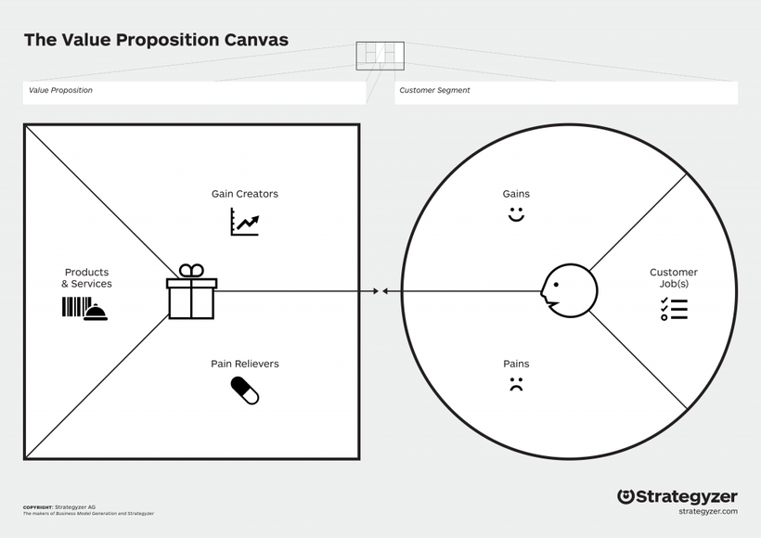
Why should we use it?
  We need to understand the problem we’re working on or we need to generate ideas for our project (we need to define the problem or ideate)
  We need to strengthen our common understanding in our team about what we already know and what ideas we already have (we need to strengthen teamwork)
How do we do it?
What could it look like?
What should we do with it?
Get together as a team (online or offline) to use the value proposition canvas. Draw the value proposition canvas on a flap paper or in a virtual whiteboard or use a ready template.
Write down with what product or service you’re working (1). Write down the gains (benefits and motivators) and pains (challenges or problems with using a product or service) of the customer or user, based on your research so far (2, 3). Add what the customer or user does in the service or with the product (4). Brainstorm on what can be done to create more gains (5) and to relief or eliminate the pains (6). Then think about the impacts on the society and environment.
Reflect on the results in relation to the project challenge.
Reflect together in the team:
What surprised us? What did we learn about the customer or user experience and their needs in relation to the service or product and our project? How well your product, service, or solution meets the needs of the people you're designing it for? What do we now know that can help us to go forward with the project? What do we not know yet? Should we modify or reframe our challenge somehow because of what we found out and if so, how? What should we do next?
hkjhsk kjhjkh jkhkjhjkh
hkjhf abkjkjbs aoihohfhf
hkjhsk kjhjkh jkhkjhjkh
hjh ljhljhjh lhlhjkhkf
hjh ljhljhjh lhlhjkhkf
hjh ljhljhjh lhlhjkhkf
VALUE PROPOSITION CANVAS
hkjhsk kjhjkh jkhkjhjkh
hkjhf abkjkjbs aoihohfhf
hkjhsk kjhjkh jkhkjhjkh
3
4
1
5
hkjhf abkjkjbs aoihohfhf
hkjhf abkjkjbs aoihohfhf
hjh ljhljhjh lhlhjkhkf
2
hkjhf abkjkjbs aoihohfhf
hjh ljhljhjh lhlhjkhkf
hjh ljhljhjh lhlhjkhkf
hkjhsk kjhjkh jkhkjhjkh
How do we get it right?
  Add only one idea per sticky note - it helps you to organize the ideas better!
  More is more. In the beginning try to add as many sticky notes as possible -it helps you to find insights!
  Use me-you-us technique. Work with your own ideas first and then share with others -it helps you to find more ideas!
What could go wrong with it?
  If the value proposition canvas is based on assumptions instead of authentic data, we might recognize the wrong problems and opportunities.
  If the value proposition canvas is not shared and reflected in the team, it will not contribute to advancing common understanding.
  Note: if problems are understood wrong, solutions most likely will be wrong or useless!

Slide 27
The Value Proposition Canvas is a tool that helps you understand how well your product, service, or solution meets the needs of the people you're designing it for. It breaks down two key areas: the customer profile (what the users need, their pain points, and what they want) and the value map (how your solution addresses those needs, relieves pain points, and delivers value).
What is the product, service, or solution your are working on and who is it for, i.e. who is the user or customer?
Who are the people (e.g. patients, family members, users or customers, staff members etc.) who are affected by the problem, or who need the solution, product or service? Whose perspective you need to understand in order to create solutions in your project?
What jobs or tasks do the customers need to accomplish while using the service, product or other solution?
What are the key tasks that the people whose perspective you want to reflect want to complete when they are using the product or service your project relates to (e.g. reserving an appointment for something, receiving treatment, getting something done faster (thanks to an app), etc.)?
REFLECTION: VALUE PROPOSITION CANVAS
What are the customers’ pain points, problems, expectations and wishes in relation to the service, product or other solution?
What are the specific challenges, struggles and problems customers face (e.g., complex procedures, high costs, difficulty in accessing the service, burnout, poor coordination, inefficiency, difficult interfaces, etc.)? What makes these problematic and frustrating? What do the people want from their experience (e.g. quicker service, personalized service, more transparent communication, easier operation, better performance, cost savings)? What would make the service, product, or other solution ideal for their needs?
How does the current solution address the customers' problems and wishes? How we could improve it so that it addresses the needs even better?
What gaps exist between the solution and the customer’s or user’s needs? What improvements could we make in the solution, service or product in order to make it more valuable to customers or users?
Based on our value proposition canvas, what should we do next and who should do what? Why?
Who does what in our group in order to continue our project in such a way that we include our learnings from the value proposition canvas? What do we now know that we didn’t know before? What do we still not know and how could we fill that knowledge gap? What should we do next?

Slide 28
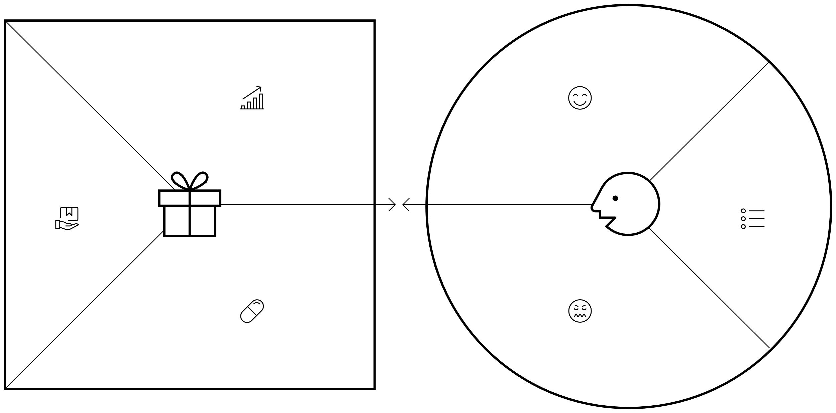
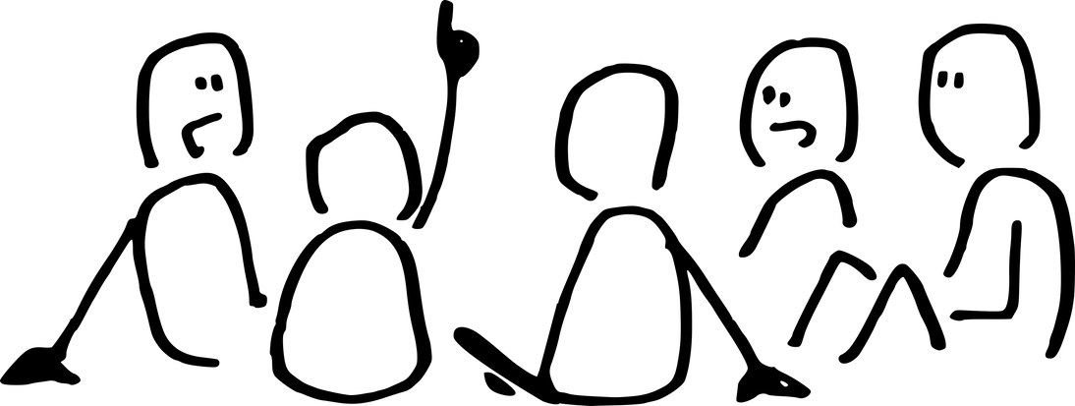

Gain Creators
Value Adders
Product, service or solution
Customer Jobs
WORKSHEET: VALUE PROPOSITION
Value
Customer
Pain Relievers
Value killers
Value to surrounding society
Value to surrounding environment

Slide 29
Why should we use it?
  We need to understand the service we’re working on (we need to identify problems related to running a service)
  We need to strengthen our common understanding in our team about what we already know (we need to strengthen teamwork and shared understanding)
How do we do it?
What could it look like?
What should we do with it?
Get together as a team (online or offline) to use the service blueprint model. Sketch the service blueprint structure on a flap paper or in a virtual whiteboard or use a ready template.
Write down with what product or service you’re working (1). Write down the touchpoints or steps the customers take on their service journey, add what they do and what they feel at each touchpoint (2). Add the steps that customer service takes that can be seen by the customer (3). Add the steps that are invisible to the customer, taken by the service provider on the backstage of the service stage.
Reflect on the results in relation to the project challenge.
Reflect together in the team:
What surprised us? What did we learn about the customer or user experience and their needs in relation to the service and our project? What did we learn about producing the service and the needs of the organization that produces the service? What do we now know that can help us to go forward with the project? What do we not know yet? Should we modify or reframe our challenge somehow because of what we found out and if so, how? What should we do next?
SERVICE BLUEPRINT
1
hkjhsk kjhjkh jkhkjhjkh
hjh ljhljhjh lhlhjkhkf
hkjhf abkjkjbs aoihohfhf
hjh ljhljhjh lhlhjkhkf
hjh ljhljhjh lhlhjkhkf
hjh ljhljhjh lhlhjkhkf
hjh ljhljhjh lhlhjkhkf
CUSTOMER JOURNEY
What are the customer’s touchpoints?
What the customer does at each touchpoint?
hkjhsk kjhjkh jkhkjhjkh
hjh ljhljhjh lhlhjkhkf
hkjhf abkjkjbs aoihohfhf
hjh ljhljhjh lhlhjkhkf
hjh ljhljhjh lhlhjkhkf
hjh ljhljhjh lhlhjkhkf
hjh ljhljhjh lhlhjkhkf
What the customer feels at each touchpoint?
hkjhsk kjhjkh jkhkjhjkh
hjh ljhljhjh lhlhjkhkf
hkjhf abkjkjbs aoihohfhf
hjh ljhljhjh lhlhjkhkf
hjh ljhljhjh lhlhjkhkf
hjh ljhljhjh lhlhjkhkf
hjh ljhljhjh lhlhjkhkf
2
LINE OF INTERACTION
hkjhsk kjhjkh jkhkjhjkh
hkjhf abkjkjbs aoihohfhf
hkjhsk kjhjkh jkhkjhjkh
FRONTSTAGE SERVICE PROVIDER ACTIONS
What the service staff does that is visible to the customer?
3
LINE OF VISIBILITY
hkjhf abkjkjbs aoihohfhf
hjh ljhljhjh lhlhjkhkf
hkjhf abkjkjbs aoihohfhf
hkjhf abkjkjbs aoihohfhf
BACKSTAGE SERVICE PROVIDER ACTIONS
What the service staff does in the background, that is not visible to the customer?
What the support staff does in the background, that is not visible to the customer?
hjh ljhljhjh lhlhjkhkf
hkjhsk kjhjkh jkhkjhjkh
hjh ljhljhjh lhlhjkhkf
How do we get it right?
  Add only one idea per sticky note - it helps you to organize the ideas better!
  More is more. In the beginning try to add as many sticky notes as possible -it helps you to find insights!
  Use me-you-us technique. Work with your own ideas first and then share with others -it helps you to find more ideas!
What could go wrong with it?
  If the service blueprint is based on assumptions instead of authentic data, we might recognize the wrong problems and opportunities. Make sure your service blueprint is based on authentic data!
  If the service blueprint is not shared and reflected in the team, it will not contribute to advancing common understanding.

Slide 30
Service Blueprint is a tool used to map out and visualize all the elements involved in delivering a service. It shows the frontstage (what the user experiences) and the backstage (internal processes of the service producer) to identify pain points and inefficiencies. It helps you pinpoint where issues related to delivering the service occur and how they relate to a broader problem.
What are the visible touchpoints where the customer interacts with the service and what do they feel when they are in contact with the service?
Where do the customers or users (or patients, beneficiaries, citizens, etc.) directly interact with the service (e.g., reception, customer support, billing, online platforms)? Are there touchpoints where they experience frustration, confusion, or long wait times? Are there touchpoints where they face difficulties or breakdowns in service?
What backstage processes support the service delivery?
What internal processes (e.g., scheduling, information management, staff communication, production, troubleshooting, technical support) are necessary for the service to run smoothly? Are there inefficiencies or breakdowns in these processes that affect the customer journey experience?
REFLECTION: SERVICE BLUEPRINT
What resources are required to support each part of the service?
What technical, human, or financial resources (e.g., staff, equipment, time) are necessary at each step of the customer journey? Are there gaps in resources that cause bottlenecks or negatively affect the customer journey experience? Are there resource shortages that create gaps in service quality or performance? Are there some resources or acts of the service provider that are critical in terms of creating a smooth and pleasant customer journey experience?
What gaps exist between what the customer expects and what is delivered by the service provider?
Is there a mismatch between the service's performance or service and what customers expect (e.g., ease of use, functionality)? How does this misalignment contribute to customer frustration or service underperformance?
Based on our service blueprint, what should we do next and who should do what? Why?
Who does what in our group in order to continue our project in such a way that we include our learnings from the service blueprint? What do we now know that we didn’t know before? What do we still not know and how could we fill that knowledge gap? What should we do next?

Slide 31
CUSTOMER JOURNEY
What are the customer’s touchpoints?
What the customer does at each touchpoint?
What the customer feels at each touchpoint?
LINE OF INTERACTION
FRONTSTAGE SERVICE PROVIDER ACTIONS
What the service staff does that is visible to the customer?
LINE OF VISIBILITY
EXAMPLE OF SERVICE BLUEPRINT STRUCTURE
BACKSTAGE SERVICE PROVIDER ACTIONS
What the service staff does in the background, that is not visible to the customer?
What the support staff does in the background, that is not visible to the customer?
WIDER IMPACTS
What impacts does the service have on surrounding community?
What impacts does the service have on the nature?

Slide 32
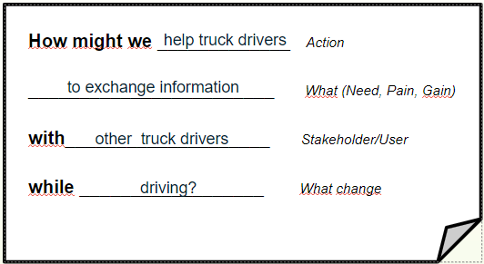
Why should we use it?
  We need to synthesize or name the core problem we’re actually working on (we need to define our problem)
  We need to strengthen our common understanding in our team about what we are actually working on (we need to strengthen teamwork)
How do we do it?
What could it look like?
What should we do with it?
HOW MIGHT WE
Get together as a team (online or offline) to use the How Might We tool. Sketch the How Might We worksheet on a flap paper or in a virtual whiteboard or use a ready template.
Decide who writes your ideas down. Think aloud in your group:
  who you are actually trying to solve something for,
  what need or problem that they have are you trying solve,
  who else do you need from your stakeholders to be involved in solving the problem, and
  what is the change you try to create.
Reflect on the results in relation to the project challenge.
Reflect together in the team:
What surprised us? What did we learn about the customer or user experience and their needs in relation to the service or product and our project? What do we now know that can help us to go forward with the project? How should we modify or reframe our challenge because of what we found out? What should we do next?
How do we get it right?
  Start with going through the problems you have discovered.
  Start with a draft. Work with sticky notes in the beginning in order to get your How Might We statement written.
  Use me-you-us technique. Work with your own ideas first and then share with others -it helps you to find the core problem!
What could go wrong with it?
  If the How Might We statement is based on assumptions instead of authentic data, we might recognize the wrong problems.
  If the How Might We thinking aloud is not done and reflected in the team, it will not contribute to advancing common understanding.
  Note: if problems are understood wrong, solutions most likely will be wrong or useless!

Slide 33
The "How Might We" (HMW) method is used to reframe challenges into actionable opportunities. It’s a powerful tool for naming and framing a problem, guiding you toward innovative solutions.
Who is your user or customer?
Who are the people (e.g. patients, family members, users or customers, staff members etc.) who are affected by the problem, or who need the solution, product or service? Whose perspective you need to understand in order to create solutions in your project?
What is the core problem of the user or customer that you are actually trying to solve?
What is the specific problem customers face that you can solve in your project? Are we dealing with something that means that we should improve existing products, services or solutions or should we create something totally new?
REFLECTION: HOW MIGHT WE
Who are the stakeholders without whom you cannot solve the problem?
Who needs to definitely be involved in solving the problem? How could we involve them in our project? How could we solve the core problem in a way that benefits all stakeholders involved?
What is the change that you try to create?
What are we actually trying to change or do differently?
Based on our How Might We statement, what should we do next and who should do what? Why?
Who does what in our group in order to continue our project in such a way that we include our learnings from the How Might We statement? What do we now know that we didn’t know before? What do we still not know and how could we fill that knowledge gap? What should we do next?

Slide 34
How might we
(how: action)
(what: need, pain, gain)
WORKSHEET: HOW MIGHT WE STATEMENT
for
(who: stakeholder)
in order to
(why: change that is needed)

Slide 35
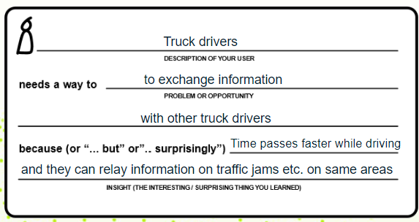
Why should we use it?
  We need to synthesize or name the core problem we’re actually working on (we need to define our problem)
  We need to strengthen our common understanding in our team about what we are actually working on (we need to strengthen teamwork)
How do we do it?
What could it look like?
What should we do with it?
Get together as a team (online or offline) to use the Point of View Statement tool. Sketch the Point of View Statement worksheet on a flap paper or in a virtual whiteboard or use a ready template.
Decide who writes your ideas down. Think aloud in your group:
  who you are actually trying to solve something for (who is the customer or user),
  what need or problem that they have are you trying solve,
  who else do you need from your stakeholders to be involved in solving the problem, and
  why you try to solve it.
Reflect on the results in relation to the project challenge.
Reflect together in the team:
What surprised us? What did we learn about the customer or user experience and their needs in relation to the service or product and our project? What do we now know that can help us to go forward with the project? How should we modify or reframe our challenge because of what we found out? What should we do next?
POINT OF VIEW STATEMENT
How do we get it right?
  Start with going through the problems you have discovered.
  Start with a draft. Work with sticky notes in the beginning in order to get your Point of View statement written.
  Use me-you-us technique. Work with your own ideas first and then share with others -it helps you to find the core problem!
What could go wrong with it?
  If the Point of View statement is based on assumptions instead of authentic data, we might recognize the wrong problems.
  If the Point of View thinking aloud is not done and reflected in the team, it will not contribute to advancing common understanding.
  Note: if problems are understood wrong, solutions most likely will be wrong or useless!

Slide 36
The Point of View method is used to reframe challenges into actionable opportunities. It’s a powerful tool for naming and framing a problem, guiding you toward innovative solutions.
Who is your user or customer?
Who are the people (e.g. patients, family members, users or customers, staff members etc.) who are affected by the problem, or who need the solution, product or service? Whose perspective you need to understand in order to create solutions in your project?
What is the core problem of the user or customer that you are actually trying to solve?
What is the specific problem customers face that you can solve in your project? Are we dealing with something that means that we should improve existing products, services or solutions or should we create something totally new?
REFLECTION: POINT OF VIEW STATEMENT
Who are the stakeholders without whom you cannot solve the problem?
Who needs to definitely be involved in solving the problem? How could we involve them in our project? How could we solve the core problem in a way that benefits all stakeholders involved?
What is the insight or suprising information that you have realized while doing your project that relates to the customers’ problem?
What should we try to change or do differently?
Based on our Point of View statement, what should we do next and who should do what? Why?
Who does what in our group in order to continue our project in such a way that we include our learnings from the Point of View statement? What do we now know that we didn’t know before? What do we still not know and how could we fill that knowledge gap? What should we do next?

Slide 37


(who: description of your customer)
needs a way to
(what: problem or opportunity that you have identified
WORKSHEET: POINT OF VIEW STATEMENT
because (or “...but” or “...surprisingly)
(insight: the interesting or surprising thing that you have learned about the customer)

Slide 38
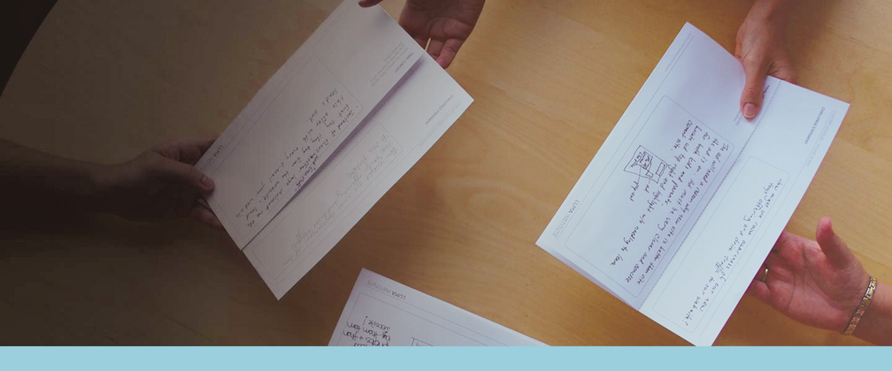
Why should we use it?
  We need to generate many ideas that we can choose the best ones from (we need to ideate)
  We need to strengthen our common understanding in our team about possibilities and move on to the solution stage (we need to ideate)
ROUND ROBIN
How do we do it?
What could it look like?
What should we do with it?
Get together as a team (online or offline). Write the problem you are working on somewhere where everyone can see it.
Set the ground rules for the excercise. In Round Robin all ideas are welcome and there should be no talking while the clock is running. Set the alarm at 5 minutes.
Everyone takes an empty A4 paper and writes the problem you are working on on it. Everyone writes 1-3 possible solutions to the problem and passes the paper to the person on their left. The next person writes why the might fail. Everyone passes the paper to the person on their left. Everyone writes a solution to the problem identified by the previous person.
Reflect on the results in relation to the project challenge.
Reflect together in the team:
What surprised us? What kind of ideas were born? What could be further developed as a solution? What do we now know that can help us to go forward with the project? How should we modify or reframe our challenge because of what we found out? What should we do next?
How do we get it right?
  Start with going through the problems you have discovered.
  Stick to the times because they help you to write things down.
  Remember to be respectful and work based on dialogue, even if we are looking for things to be improved.
What could go wrong with it?
  If not enough information about the problems has been collected, it can be difficult to switch to the solution mode.
  If you get too worried about your ideas, the start will be difficult. Write down whatever comes to your mind!
  If you fail to identify useful details from each other’s ideas, you might forget to include them in your final solution-

Slide 39
Round Robin is a brainstorming technique where participants take turns contributing ideas, either in writing or aloud, building on each other's suggestions. It promotes creativity and collaboration, ensuring that everyone’s perspective is heard.
What are potential solutions to the problem, from different stakeholder perspectives?
What are ways to improve a service, from the perspective of the users, patients, citizens, or customers, service workers, and management? What are potential design improvements that can make a product more efficient, considering input from design engineers, technicians, and product managers?
What new ideas can we generate by building on someone else’s idea?
How can we build on the ideas that we have collected from different stakeholders?
What are the possible challenges or barriers to each proposed solution?
What challenges might arise when implementing a new system related to services based on the insights we have gathered from the stakeholders? What technical or logistical barriers might we face when introducing a new product feature, and how can each team member’s insight help overcome these challenges?
REFLECTION: ROUND ROBIN
How can we modify existing ideas to better fit the needs of the stakeholders and to meet real-world constraints?
How can we modify a proposed design solution to meet specific customer requirements or to work better in a particular environment?
Based on our Round Robin exercise, what should we do next and who should do what? Why?
Who does what in our group in order to continue our project in such a way that we include our learnings from the Round Robin exercise? What do we now know that we didn’t know before? What do we still not know and how could we fill that knowledge gap? What should we do next?

Slide 40
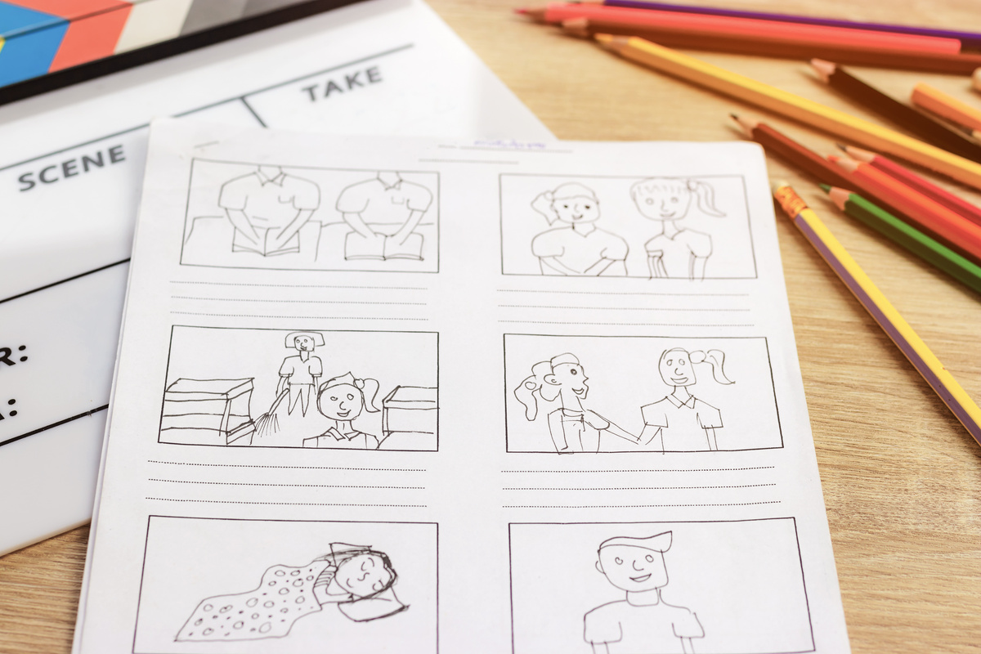
When to use?
    We need to switch to solution mode, i.e., start generating ideas to solve the problem (we need to ideate)
    We need to make visible the different solution options within the team (we need to strengthen the team's common idea of possible solutions)
CRAZY 8
So, what do we do?
What could it look like?
What's next?
Get together as a team (online or offline). Each team member needs one A3 paper and a pen. Write down the problem you want to create solutions for, for all to see.
First, each team member writes down silently for 5 minutes whatever comes to mind to solve the problem, in a format of their choice. After 5 minutes, each team member turns the paper over.
Each team member now folds his/her paper into 8 parts or use the ready-made 8-part worksheets. Now everyone draws what they were thinking before into 8 different solutions. One solution idea is drawn in each box.
After the drawings are ready, everyone presents them to each other.
Each team member presents his/her drawings to the others after a silent one-to-one session. Discuss which elements of the solution ideas should be included in the common solution. If something might not work, come up with a better solution together and draw it!
Think about it together as a team:
What surprised us? What bits and pieces from the different solution ideas will we at least take forward? What do we leave out and why? What should we do next?
    Stick to the schedule. The first stage is 5 minutes, the second 8 minutes, or one minute per drawing.
    Don't worry about the artistic quality of the drawings. Stick figures will do. So, if you can draw lines, spheres and squares, you can draw!
    The drawing can be warmed up! First you can draw lots of lines, balls, squares, triangles and stick figures for 3 minutes and then start drawing your ideas.
How can you succeed?
What can go wrong?
    If not enough information about the problems has been collected, it can be difficult to switch to the solution mode.
    If you skip the writing phase, drawing can feel awkward. So, it's worth doing both!
    Don't judge the artistic value of each other's drawings but think about what you could include in a joint solution based on each drawing. It is about visualising thought, not making art!

Slide 41
Crazy 8 is a quick brainstorming technique where participants are given 8 minutes to come up with 8 different ideas to solve a problem. The aim is to stimulate creativity and generate different ideas quickly, helping to break away from traditional ways of thinking.
What quick and easy, creative solutions did you find to the problem?
What kind of easy and low-effort solutions can you find in your drawings? What is the easiest solution that can be found in your drawings? What are the smallest and cheapest solutions that can be found in your drawings?
What small pieces of solutions can you find in your drawings?
What small pieces of solutions can you find in your drawings that could be combined to increase their size? When you break down your drawings into smaller pieces, i.e., when you look at the details of each drawing, what solution ideas can you find? How could you combine the pieces of the different drawings into a single solution?
RELECTION: CRAZY 8
What different perspectives on the solution to your problem can you find in your drawings?
From which perspective do the pieces in the drawings solve the problems of the people at the heart of your project?
What radical solutions to the problem did you find?
What kind of unorthodox and unconventional solution ideas can you find in your drawings? What kind of bold and futuristic (i.e., future-looking) solutions can be found in your drawings?
What should we do next with our crazy ideas and who should do what? Why?
Who will do what in our team to continue our project, taking the lessons learned from thinking about crazy ideas? Which solution idea do we go from a drawn or built sketch version to a draft version, and why? What should we do next?

Slide 42

When to use?
    We don't know how our initial solution idea will be perceived by the people concerned (we want to create solutions)
    We need to get one real and user-oriented solution idea to materialise (we want to create a solution)
So, what do we do?
What might the output look like?
What's next?
Get together as a team (online or offline).
Bring along some drawing and building materials - paper, pens and craft materials. You can also use ready-made pictures, stickers, modelling clay or even legos. Include a how-to summary of the problem you are trying to solve. If you work online, use virtual visual material.
Go back to your best idea or pieces of ideas so far and start drawing and building them. Produce one common drawing or construction that illustrates what your solution would look like. The drawing can be in cartoon form, for example, the structure can resemble a scale model of the solution.
Once a test version of the solution idea has been drawn or built, it can be used to finalise the solution idea with the people for whom the solution is being created.
Think about it together as a team:
What surprised us? What bits and pieces from the different solution ideas will we at least take forward? What do we leave out and why? What kind of test situations could we develop, i.e., where do we find people who need or could use our solution and how do we take the sketched or built draft version of our solution to them?
PROTOTYPING
How can you succeed?
    Start drawing and combining different materials right away - making hands on will help you visualise!
    Don't think about the artistic quality of the drawings or structures. The idea of the test versions is to illustrate to a potential user what the solution might look like, and thereby gain further insight for further development of the solution.
What can go wrong?
    If you haven't already done some quick brainstorming before drawing and building, it can be difficult to make a test version of the solution, or prototype.
    Don't judge the artistic value of each other's constructions and drawings but reflect on what you could include in a common solution. Encourage others to draw and build!

Slide 43
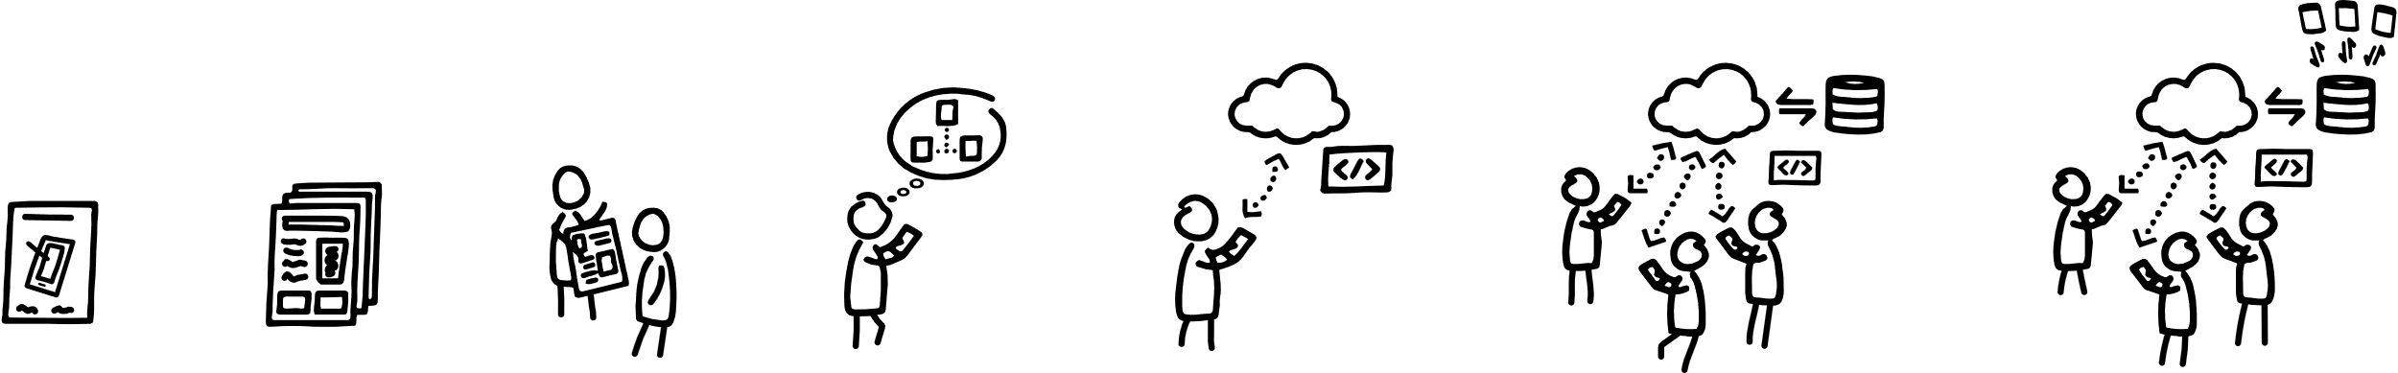
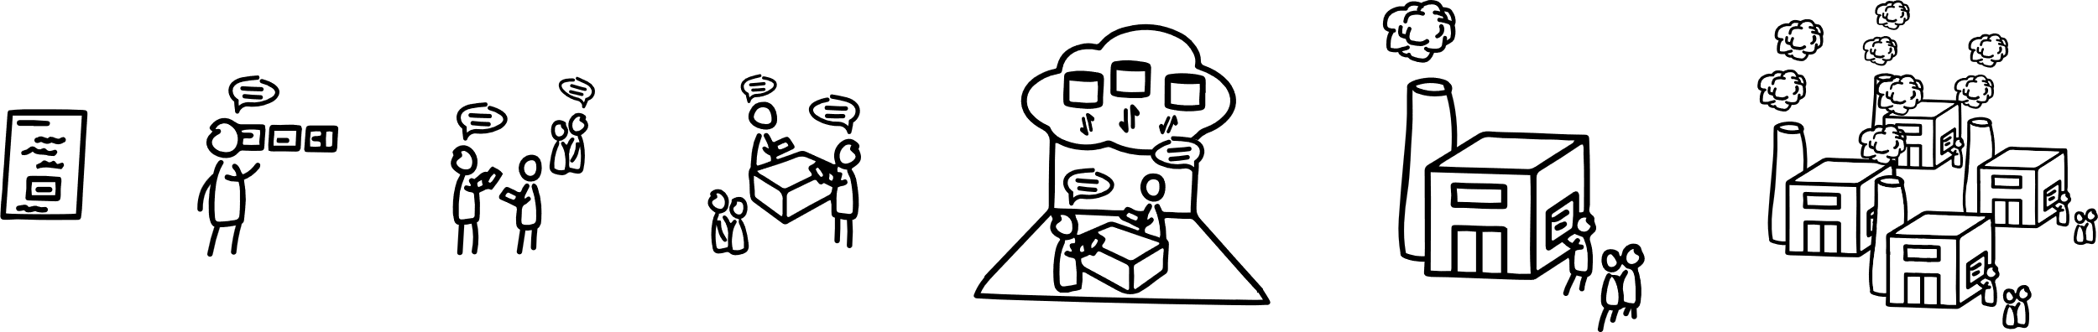
Physical
2D/3D sketch
Paper/cardboard mock-up
3D print/small scale size
Hand-made in unique material
Small scale production
Scalable mass production
Digital
Idea sketch
Wire-frames
Paper prototype
Interactive click-on model
Proof-of-concept prototype
Prototype pilot
Scaled product on scaled system
EXAMPLES OF PROTOTYPES
Service/process
Sketch
Storyboard/storytelling
Investigative rehearsal
Rehearsal using cardboard prototypes
Technical mock-up
Pilot
Rollout
Fidelity
Fast to create
Feels real
Works
Adapted from Lawrence, A., Stickdorm, M. (2017). This is Service Design Doing. O’REILLY.

Slide 44
Creating test versions, or prototypes, of drawn or built solution ideas is a powerful tool for creating a concrete representation of a solution to test, refine and improve ideas. By building a sketch version of an idea, you can explore how the solution works in practice, identify potential shortcomings and gather feedback.
Which parts of the solution work well in practice and which need further tuning so that we can use it for further development of solutions?
What in the sketch of the solution we drew or built seemed to work well and smoothly already at the drawing or building stage? What could still be tweaked a little?
How could the feedback be used to improve the prototype? Who do we need feedback from, i.e., with whom should we test our solution idea now with our draft version?
What kind of feedback do you need on how well your solution works or what could be improved and from whom, i.e., who is affected by it? How and where could you approach them with a draft of your drawn or constructed solution?
REFLECTION: PROTOTYPING
How would it be possible to implement a solution like the draft version in reality?
Could the solution idea be easily put into practice? What would it take? How can we find out? Who should we consult?
How can a sketch version of our drawn or built solution idea evolve into a final product or solution?
What steps do we need to take to move our solution from a draft to an implemented solution?
What should we do next with the drawn or built sketch version of our solution and who should do what? Why?
Who will do what in our group to continue our project by incorporating the lessons learned from drawing or building our draft version? With whom should we now test the solution idea? What should we do next?

Slide 45

When to use?
    We don't know how our solution will affect the people for whom we have produced it
    We need to strengthen our common understanding of how the draft version still needs to be tweaked and how it can be turned into a final solution idea.
So, what do we do?
What might the situation look like?
What's next?
Get together as a team (online or offline). Create a list of people whose feedback you need to develop a final version of the draft version of your drawn or built solution idea, the testers.
Take your drawn or built version of the design and approach the people it was created for (customers, users, patients, employees, cyclists, elderly people, etc.) with it. You can also use your own contacts or call a friend to test your idea!
Let the tester examine the drawing or construction. You can help him by asking: what is already good or working in the solution and why? What could be improved, how and why? Should anything be removed, why?
Improve your solution idea based on the feedback received on the draft version and draw or build a version of your solution idea that you are ready to present as the final product of your project.
As a group, reflect: what surprised us? What kind of feedback did we get from the people for whom the solution was created? What worked, what didn't and why? What should we change and how do we do it? What should we do next?
TESTING THE PROTOTYPES
How can you succeed?
    Assign different roles to team members for the test situation: someone can write down the tester's comments, another can present, a third can observe how the tester works with the draft solution, etc. This way you can make use of everyone's resources and create a test situation that is as varied and useful as possible!
What can go wrong?
    If the draft solution has not been drawn or constructed, the tester may perceive your solution idea differently than you intended.
    If a draft solution that has been drawn or built is not tested on real potential users, the feedback may result in a solution that is not useful to those affected.

Slide 46
Prototype or draft testing helps you to tune the concrete or visual model of a solution and to understand how well it will work in practice. It allows you to gather feedback, identify weaknesses and refine your design.
How well does your draft, or prototype, solve the core problem we identified earlier for our project?
To what extent does the process, product, service or any part of it we design solve the problem we are solving in our project? What worked particularly well in our draft solution?
Which parts of the draft solution we have drawn or built work well as they are, and which need improvement?
What things were already working well, what things did the tester still seem to be stumbling over, i.e., which parts did not work as smoothly and easily as we had hoped? Where did they not yet work well enough?
REFLECTION: TESTING THE PROTOTYPES
How did the testers interact with the drawn or constructed solution? What was expected, what was surprising?
How was the solution used or what was done with it? What did the tester(s) say while testing the solution idea? What direct feedback did they give you on the draft version of your drawn or built solution?
How easy and responsible is our solution?
How easy and smooth did the tester find it to use or work with our solution? Is there anything else to consider about our solution in terms of its environmental and social sustainability?
What should we do next after testing and who should do what? Why?
Who is doing what in our team to keep the project moving forward, so that we incorporate the lessons learned from testing our draft version? What should we do next? Can we already create a finished idea, or do we need a new draft version and more rounds of testing?

Slide 47
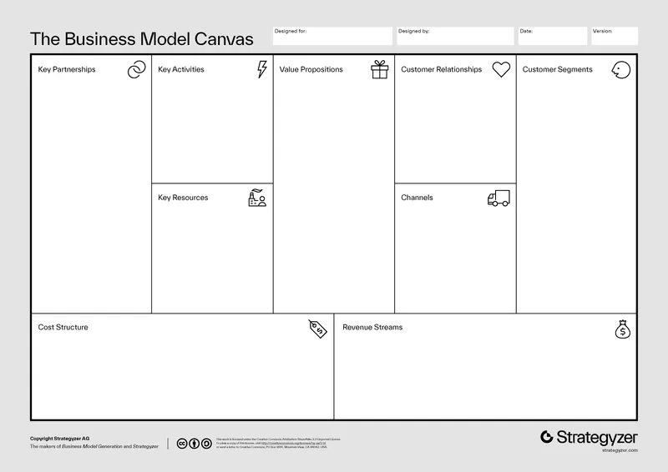
Why should we use it?
  We know what we know, but we do not really know how to turn our knowledge into a business or a concrete action plan (we need to advance our ideation)
  We need to strengthen our common understanding in our team about what we should do (we need to strengthen our team work)
How do we fill it?
What could it look like?
What should we do with it?
BUSINESS MODEL
Get together as a team (online or offline) to create your business model. Sketch the business model structure on a flap paper or in a virtual whiteboard or use a ready template.
You can use a variety of methods to gather the information you need to write down and structure in the business model canvas. For example, you can use quantitative data, benchmarking, workshops or interviews to fill the canvas.
Fill the business model together as a team.
Reflect on the information on the canvas in relation to what you know.
Reflect together in the team:
What do we now know that can help us to go concretize our ideas? What do we not know yet? Who should we ask or how should we find it out? Should we modify or reframe our idea somehow because of what we found out and if so, how? Is our idea actually a potential business opportunity or not? What should we do next?
hkjhsk kjhjkh jkhkjhjkh
hkjhsk kjhjkh jkhkjhjkh
hkjhf abkjkjbs aoihohfhf
hkjhf abkjkjbs aoihohfhf
hjh ljhljhjh lhlhjkhkf
hkjhsk kjhjkh jkhkjhjkh
hjh ljhljhjh lhlhjkhkf
hkjhf abkjkjbs aoihohfhf
hjh ljhljhjh lhlhjkhkf
hkjhsk kjhjkh jkhkjhjkh
hjh ljhljhjh lhlhjkhkf
hkjhf abkjkjbs aoihohfhf
hkjhf abkjkjbs aoihohfhf
hkjhf abkjkjbs aoihohfhf
hjh ljhljhjh lhlhjkhkf
hjh ljhljhjh lhlhjkhkf
hkjhf abkjkjbs aoihohfhf
hjh ljhljhjh lhlhjkhkf
hkjhsk kjhjkh jkhkjhjkh
How do we get it right?
  Start from the value proposition and move next to the customer segments -these will help you to fill in the other parts!
  Add only one idea per sticky note - it helps you to organize the ideas better!
  Use me-you-us technique. Work with your own ideas first and then share with others -it helps you to get a bigger picture!
What could go wrong with it?
  If the canvas is based on assumptions instead of authentic data, you might recognize a wrong opportunity.
  If the canvas is based on oversimplifications, it might not give enough information.
  If the canvas is not shared and reflected in the team, it will not contribute to advancing common understanding.
  Note: if customers’ needs are understood wrong, the business idea will most likely not work!

Slide 48
Business Model Canvas is a strategic tool used to map out the key elements of a business or solution. It helps test, analyze, and refine how each component contributes to solving a problem and creating value. By examining different aspects such as customer segments, value propositions, and cost structures, you can fine-tune your solution for better performance and impact.
What is the unique value of the solution?
What makes the solution valuable and distinct for users or customers, and how does it address their specific needs better than alternatives?
Who are the primary users or customers for this solution?
Who will benefit most from the solution, and how can their needs and preferences shape its design and delivery?
What channels are being used to deliver the solution?
Through which methods or platforms is the solution provided to users or customers, and are these the most effective and scalable options?
REFLECTION: BUSINESS MODEL CANVAS
What is the cost structure and potential revenue or benefit stream of the solution?
What are the main costs involved in creating and delivering the solution, and how does it generate revenue or provide measurable value?
What are the impacts on the surrounding communities and the natural environment if the solution is launched to the market?
What are the main costs to the surrounding community and natural environment in delivering the solution?
Based on our business model, what should we do next and who should do what? Why?
Who does what in our team in order to continue our project in such a way that we include our learnings from the business model reflection? What do we now know that we didn’t know before? What do we still not know and how could we fill that knowledge gap? What should we do next?

Slide 49








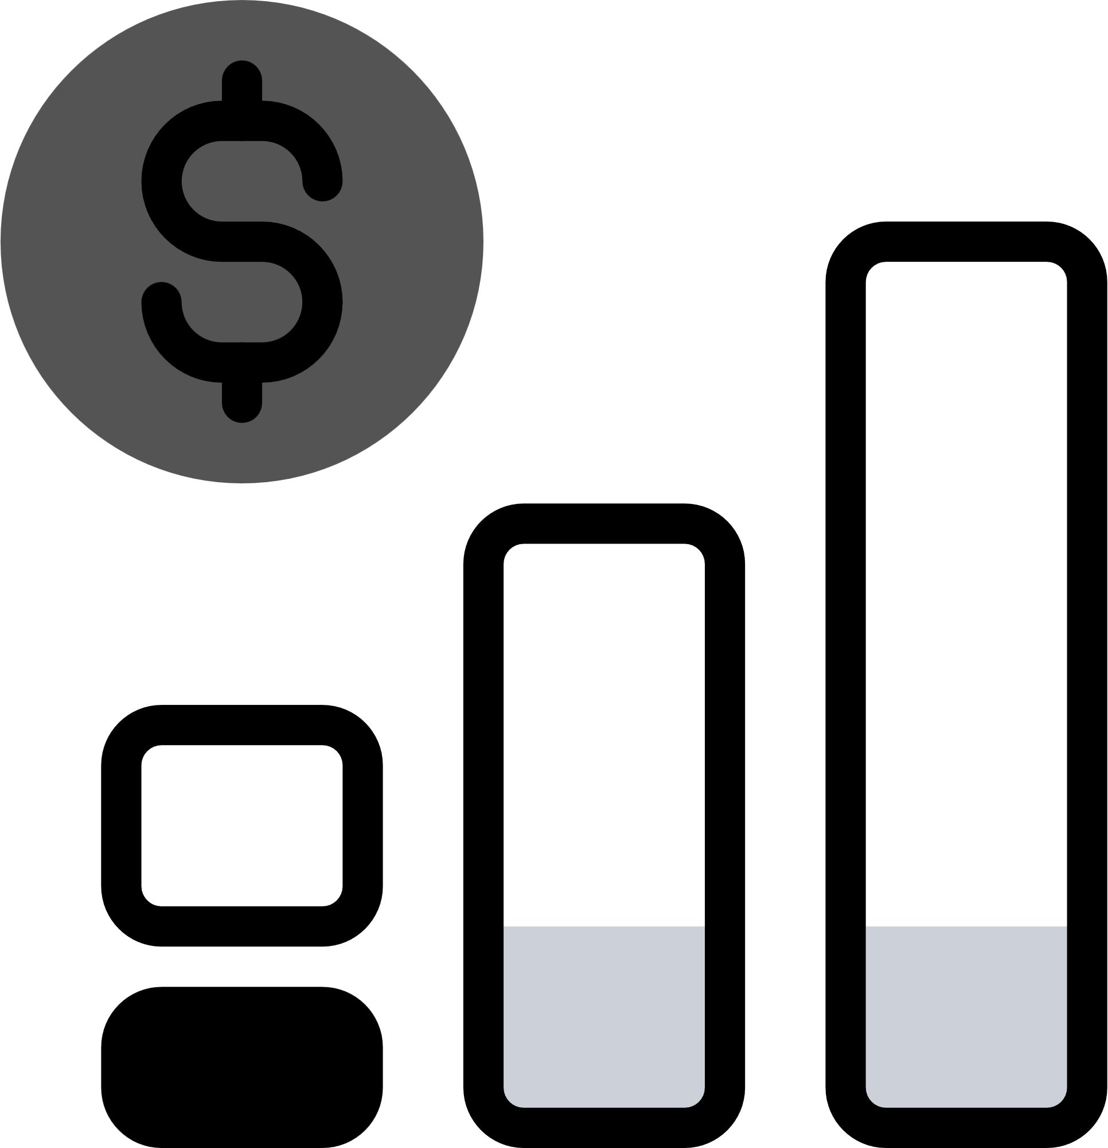


Solution:
Date:
Version:
KEY PARTNERS
KEY ACTIVITIES
VALUE PROPOSITIONS
CUSTOMER RELATIONSHIP
CUSTOMER SEGMENTS
KEY RESOURCES
CHANNELS
WORKSHEET: BUSINESS MODEL CANVAS
COST STRUCTURE
REVENUE STREAM
ECOLOGICAL AND SOCIAL COSTS
ECOLOGICAL AND SOCIAL BENEFITS

Slide 50


DBE GLOSSARY
Benchmarking = comparing your project, product, or service to the best practices or standards already established in the market
Empathy = stepping into another person’s shoes and feeling their frustration
Prototype = visualized draft of an idea or solution
Stakeholder = any person, group of people, or organization that has an interest in, or is affected by, the outcome of a project or decision.

