Slide 1
User research
Sanna-Maaria Siintoharju
Jari Jussila
HAMK Design Factory

Slide 2
Consent to participate in and be informed about the research
Whenever a subject interacts with a researcher, informed ethical consent is required to participate in the research. Research interactions include interviewing and observing subjects, or asking subjects to complete questionnaires, write questionnaires, requesting information or permission to use information about them, or other forms of participation. In order to give consent, the subject must be adequately informed about the research and his or her rights as a subject.
The following information should always be given to the person being examined:
the author(s) of the study and the organisation behind it
processing of personal data in research
what participation in research means in concrete terms
Source: Kallinen & Kinnunen 25.10.2023 Research authorisation, consent, information and data protection

Slide 3
Consent to participate in the study and information about the study.
Whenever the subject interacts with the researcher, informed ethical consent is required to participate in the research. Research interactions include interviews and observations of research subjects or studies in which subjects are asked to complete questionnaires, write articles, request information or permission to use information about them, or otherwise participate. In order to give consent, the subject must be adequately informed about the research and his or her rights as a subject of the research.
The following information must always be provided for the site:
the author(s) of the study and the organisation behind it
processing of personal data in research
what participation in research means in concrete terms
Source: Kallinen & Kinnunen 25.10.2023 Research authorisation, consent, information and data protection

Slide 4
Do you need a research premission?
Research permission is permission to approach an organisation, its staff and students with a research project aimed at them. A research permit is required for all research, development and thesis projects involving HAMK staff or students (e.g. surveys).
If the research is to be conducted in a way that requires an ethical review, the ethical review must be included in the application for authorisation.
If personal data are processed in the study, a data protection notice must also be attached to the application.
Source: https://www.hamk.fi/research/research-permit/?lang=en

Slide 5
Data protection - Informing the data subject (privacy notice)
The Data Protection Regulation requires that the individual is informed when personal data is collected. However, information does not need to be provided if it has already been provided in the past. For example, information must be provided if:
Collecting registrations for an event, for example via Webropol
Collecting survey data where personal data are
The information is provided through a privacy notice, which is linked to the data collection form. In addition, the most important issues related to the processing of personal data can be added to the form.
Basis for research / RDI activities: HAMK Oy GDPR scientific research.docx

Slide 6
Data protection - information to the data subject (privacy notice)
The General Data Protection Regulation requires that a person is informed when personal data are collected. However, the person does not have to be informed if this has already been done in the past. The person must be informed if, for example:
For the event, registrations are collected using tools such as Webropol.
Survey data containing personal data are collected
The information is provided in a privacy notice attached to the data collection form. In addition, the form may include the main issues related to the processing of personal data.
Model research/RDI activities: model research privacy statement

Slide 7
Questionnaires.

Slide 8
Questionnaire
Used to collect people's subjective experiences, opinions, values, attitudes, beliefs, behaviour and actions from a large group of people.
Both qualitative and quantitative data collection
Closed and open questions
Pros: practicality, low cost, use of technologies, rapid quantification
Cons: Development of a good questionnaire takes time, loss of respondents, superficial responses → Qualitative methods may provide better data at this stage.

Slide 9
Questionnaire - questions and answers

Slide 10
Questionnaire - questions and answers
What are your experiences with this product?
Self-assessment dummy test
(Bradley & Lang, 1994)

Slide 11
Questionnaire - questions and answers
Evaluate the product by ticking one circle per line:
https://www.ueq-online.org/

Slide 12
Tips for the questionnaire
General information
Structure: grouping by themes
Keep it short! Up to 15 minutes to complete the survey
Tools: Google Forms, Microsoft Forms, Webropol...
Plan a way to reach your target audience

Slide 13
Tips for the questionnaire
Good questions
Easy to understand! Short!
Avoid leading questions: "Is my concept good?"
Ask one question at a time
Be aware of the language (clear, consistent, respectful, target audience).
Avoid negative questions
Avoid the extremes of "I would never use...".
Let's test it!

Slide 14
Questionnaires
Need a tool to create a survey, feedback or opinion poll? In this list you will find a variety of options and applications for both larger and smaller surveys.
Webropol survey and reporting tool
Teams surveys with the Forms app
Polls in Zoom
Microsoft Forms for creating surveys
Source: https://digipedaohjeet.hamk.fi/kb/questionnaires/?lang=en

Slide 15
Interview.

Slide 16
Written consent
The purpose of this form is to inform you of the nature of the research being carried out and to ask for your informed consent to participate.
The aim of the research is to gather information to support the design of new products and services.
During the survey, you will take part in interviews.
Participation in this survey is completely voluntary. You may choose not to participate in the study and you may withdraw at any time during the study. If you are in any doubt about your participation or have any questions about the study, please feel free to ask the researcher.
Audio and/or video recordings and/or photographs taken during the survey will be recorded and notes and/or photographs will be taken or sent. All data obtained will be treated and reported anonymously. Images may be used for the purposes of this study, related research or training. Otherwise, the original data will be destroyed within three months. The researcher has explained more about this study to you.
I have read and understood this consent form and have been given the opportunity to ask questions. I agree to participate in the study conducted by HAMK students.
(You can show or read this to the participant and ask them to accept it.)

Slide 17
Consent
The aim of this interview is to understand/develop...
Participation is voluntary and you have the right to withdraw at any time. The data generated will be used for research and product development. The original material will not be disclosed to third parties. The original material (recordings) will be destroyed within 3 months.
I give my permission for the interview to be audio-recorded and for photographs to be taken.
Päiväys_________________ Allekirjoitus _________________________

Slide 18
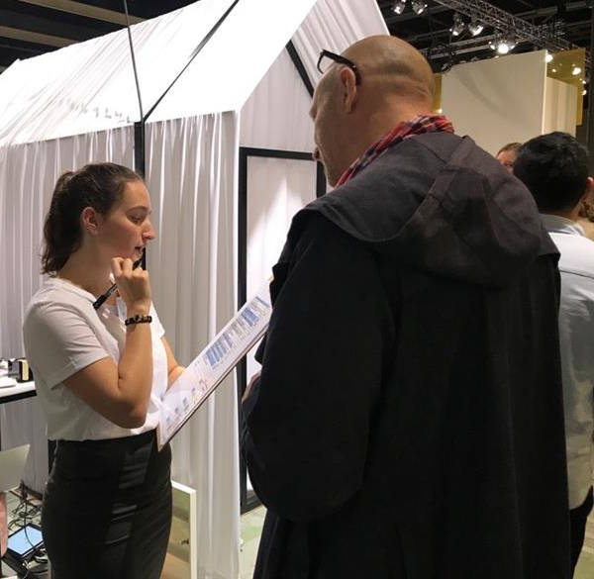
Interviews
"a conversation with a purpose" (Kahn & Cannell, 1957).
Exploring attitudes, experiences, perceptions, opinions and facts.
Different formats
Individual or group
Structured, semi-structured, open.
Semi-structured or open surveys in the early stages of development.
Structured interview, Photo: Jumisko-Pyykkö, DDW 2019

Slide 19
Invitation to an interview
What this study is about
Why participation is important
What the participant gets for participating (incentives, rewards)
Where the research is carried out
When should they appear

Slide 20
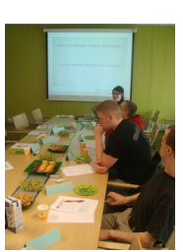
Planning interviews
Structure, number of interviews, duration...
Themes or order of themes
Planning questions
Data collection: notes, audio, video - e.g. use of Zoom / Teams.
Remember written consent!
Run pilot projects and improve
As an interviewer: become aware of your role (e.g. objective role and listening).
http://sp.cs.tut.fi/mobile3dtv/results/tech/D4.1_Mobile3DTV_v1.0.pdf

Slide 21
Structure of the interviews
1. Introduction
Introduction of the people, purpose of the study
Written consent
2. Warm-up
Getting to know each other, a neutral topic
3. Main part: questions with pre-defined themes
Logic: Logic: From general to specific topics
4. Main body
Summarise and check if anything is missing
Ask for feedback
Photo by You X Ventures, Unsplash

Slide 22
INTERVIEW FRAMEWORK
Introduction People Purpose of the study Warm-up
Theme 1:
Theme 2:
Theme 3:
Theme 4:
Summary of topics Thank you. Ask for feedback

Slide 23
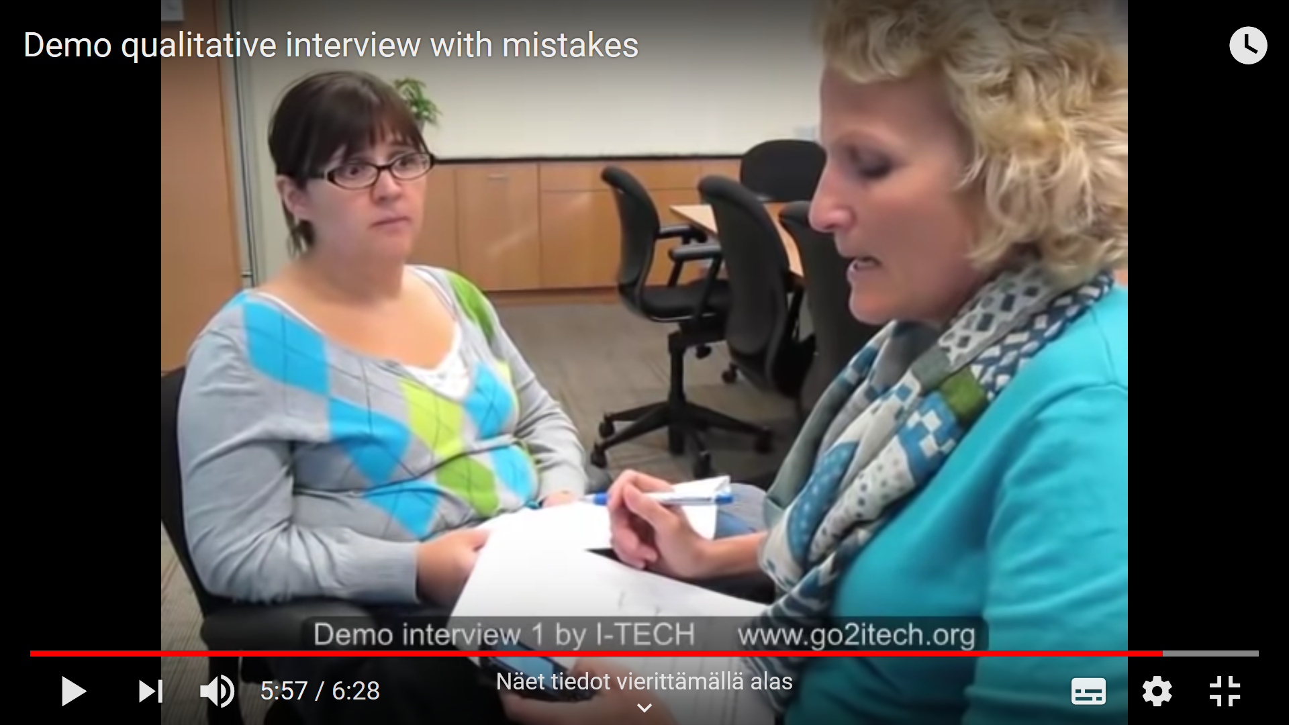
Example of interviews
GOOD ☺
https://www.youtube.com/watch?v=W4hBOxS0Pb0
GOOD ☹
https://www.youtube.com/watch?v=U4UKwd0KExc

Slide 24
References
Bradley, M. M., & Lang, P. J. (1994). Measuring emotion: the self-assessment dummy and the semantic differential. Journal of behavior therapy and experimental psychiatry, 25(1), 49-59.
Kallinen, Timo & Kinnunen, Taina (2021). Ethnography. In Jaana Vuori (ed.)Online Handbook of Qualitative Research. Tampere: Social Science Information Archive [administrator and producer]. <https://www.fsd.tuni.fi/fi/palvelut/menetelmaopetus/>. [Accessed 15.09.2024.]
Strohmeier, D., Jumisko-Pyykkö, S., Weitzel, M., & Schneider, S. (2008). A report on user needs and expectations for mobile stereo video. Tampere University of Technology.

