Slide 1









SUSTAINABLE, HIGH-PERFORMANCE BUILDING SOLUTIONS IN WOOD
2020-1-LV01-KA203-077513
ERASMUS+ Strategic Partnerships For Higher Education
7. Timber technology, construction, connections, structural systems - connection systems Rothoblaas
Santi Davi‘ – santi.davi@rothoblaas.com +44 7774476536
Stephan Schindlauer - stephan.schindlauer@rothoblaas.com +43 6642428545
09 September 2021

Slide 2

Topics for today
7. Timber technology, construction, connections, structural systems - connection systems Rothoblaas Santi Davi‘
Rothoblass company
Fastening
Mass timber connections
Waterproofing and Airtightness Incorporating - Fire range products
Acoustic requirements into structural design

Slide 3

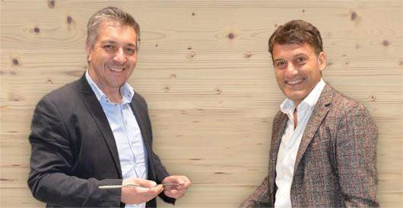

7. Timber technology, construction, connections, structural systems - connection systems Rothoblaas Santi Davi‘
ALPINE HEART, INTERNATIONAL SPIRIT
Rothoblaas is an Italian multinational with its roots in the Alpine region; a leading developer and provider of high technology solutions for all those involved in the construction with wood sector.
Always engaged in finding solutions for the improvement of the sector, today Rothoblaas is one of the leading companies worldwide in the development of products and services dedicated to the wood carpentry industry and continues to export know-how from the heart of the Italian Alps to the world.

Slide 4
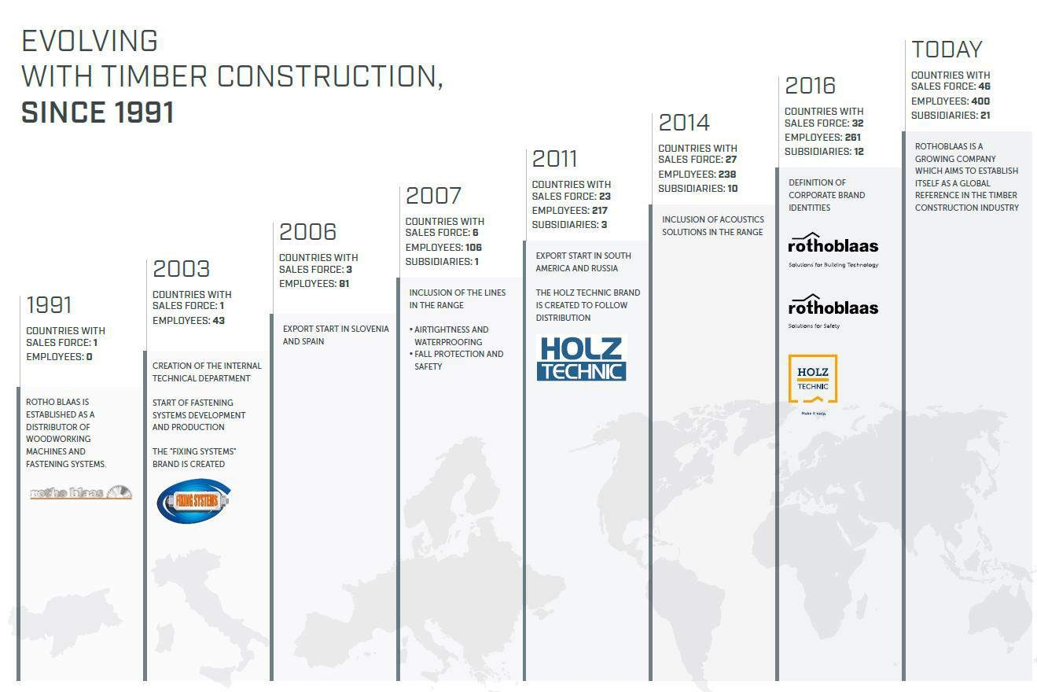
7. Timber technology, construction, connections, structural systems - connection systems Rothoblaas Santi Davi‘

Slide 5
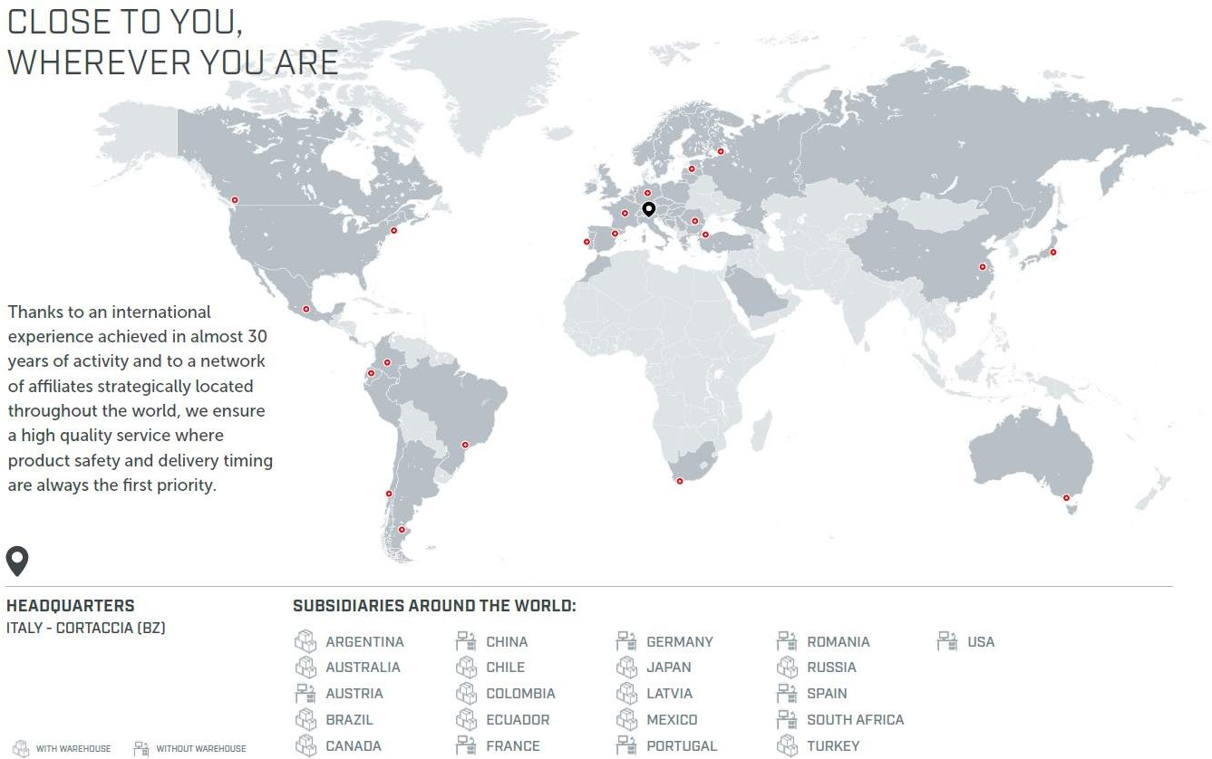
7. Timber technology, construction, connections, structural systems - connection systems Rothoblaas Santi Davi‘

Slide 6
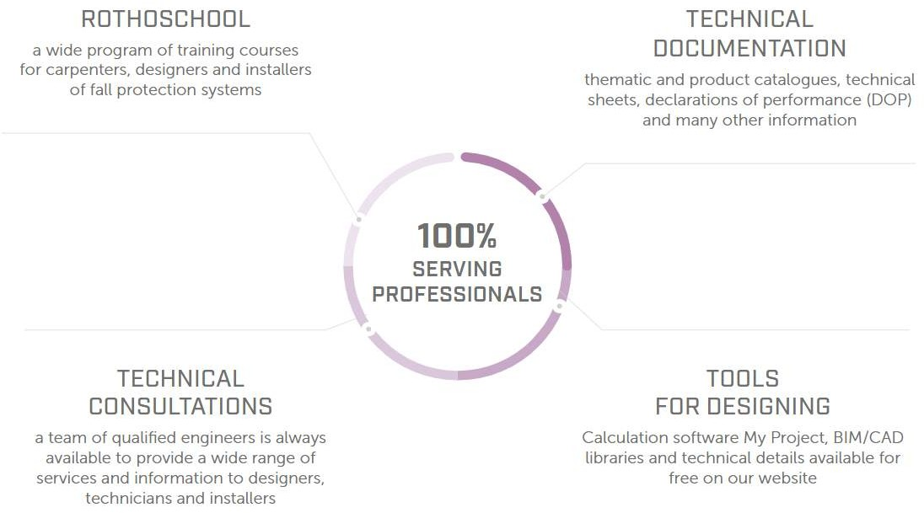
7. Timber technology, construction, connections, structural systems - connection systems Rothoblaas Santi Davi‘

Slide 7
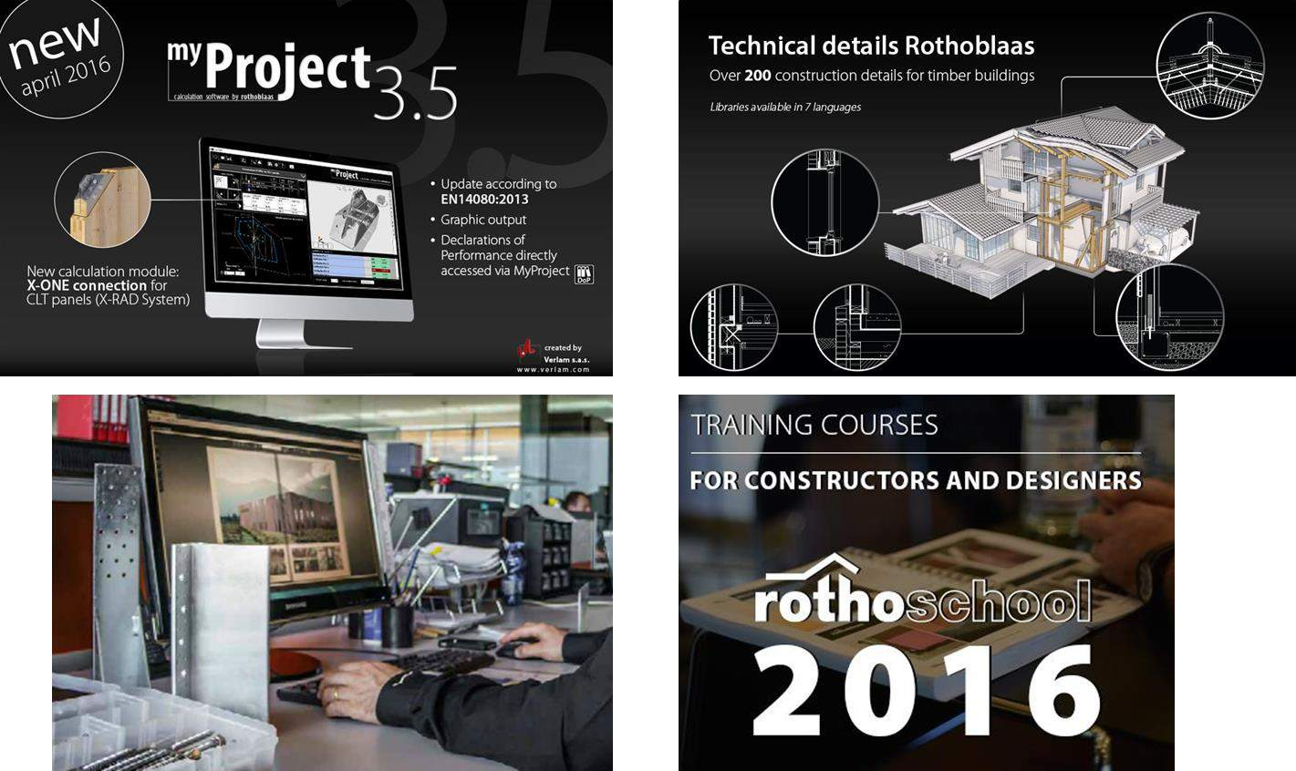
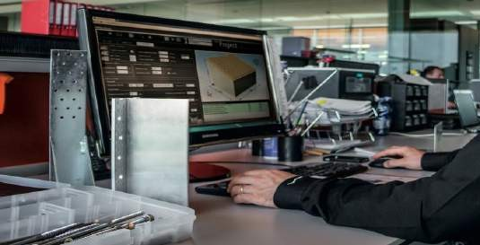
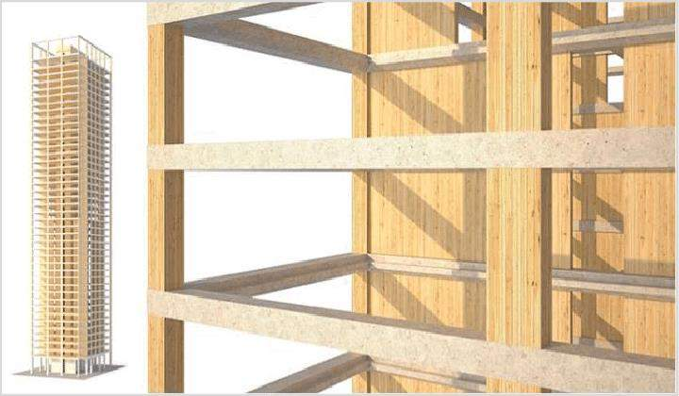
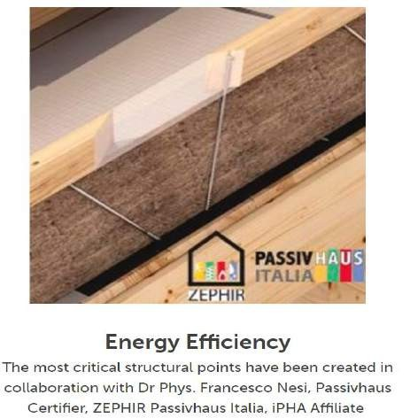
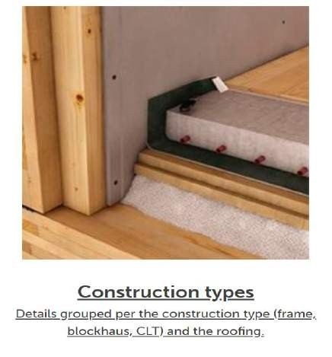
7. Timber technology, construction, connections, structural systems - connection systems Rothoblaas Santi Davi‘
Technical details: Technical Details (rothoblaas.com)
Construction Type: Construction Types
(rothoblaas.com)
BIM/CAD file: BIM/CAD (rothoblaas.com)
Calculation Software: MYPROJECT
STRUCTURAL CALCULATION SOFTWARE
(rothoblaas.com)

Slide 8
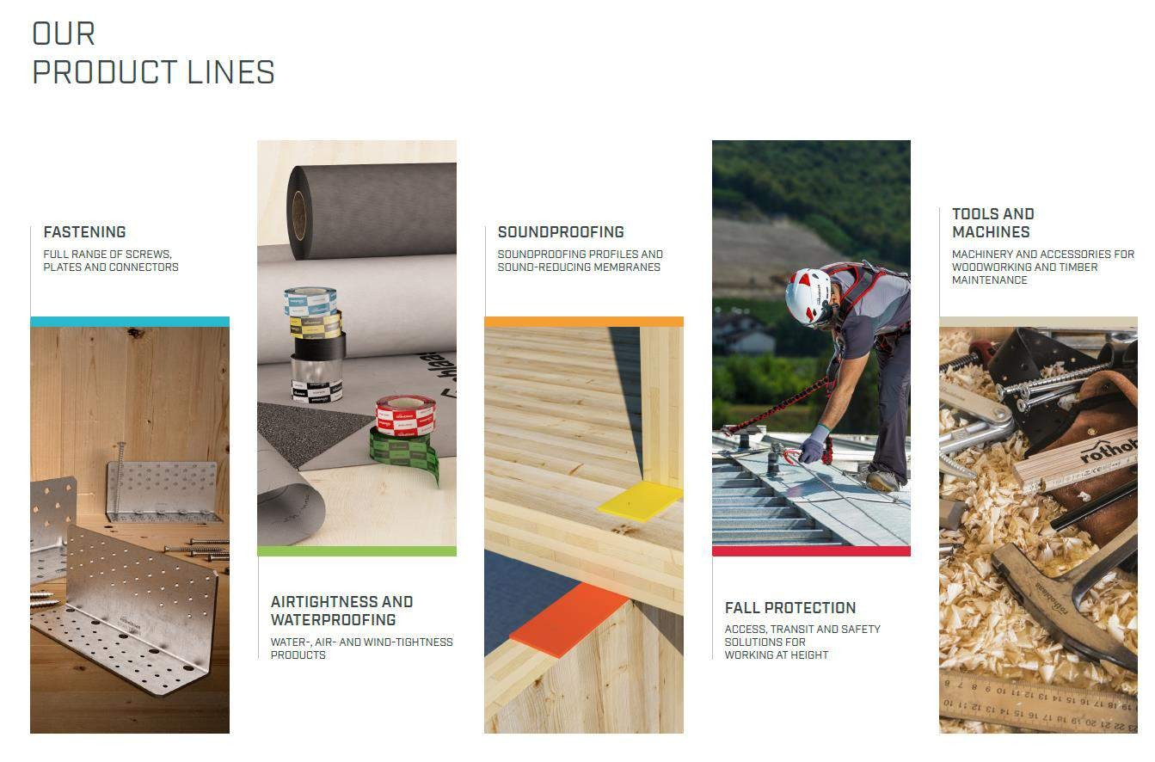
7. Timber technology, construction, connections, structural systems - connection systems Rothoblaas Santi Davi‘
Catalogues - Rothoblaas

Slide 9
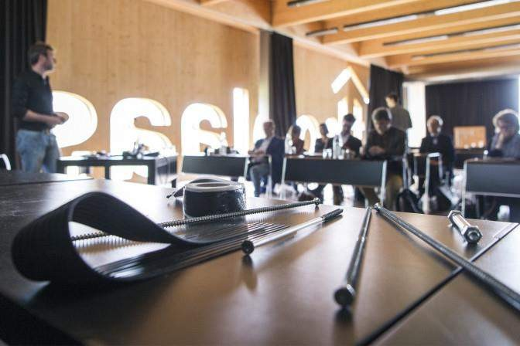
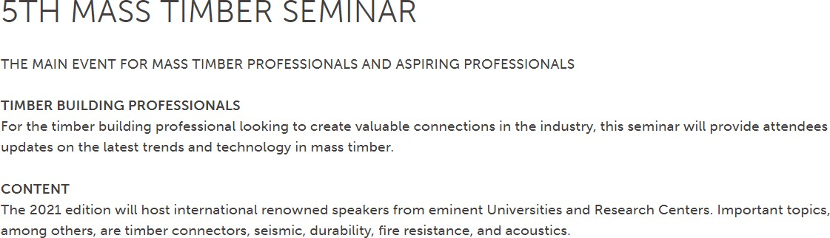
RothoSchool
Training courses and seminars Training opportunities for professional growth
7. Timber technology, construction, connections, structural systems - connection systems Rothoblaas Santi Davi‘
09.09.2021
9
TRAINING COURSES | ROTHOBLAAS

Slide 10
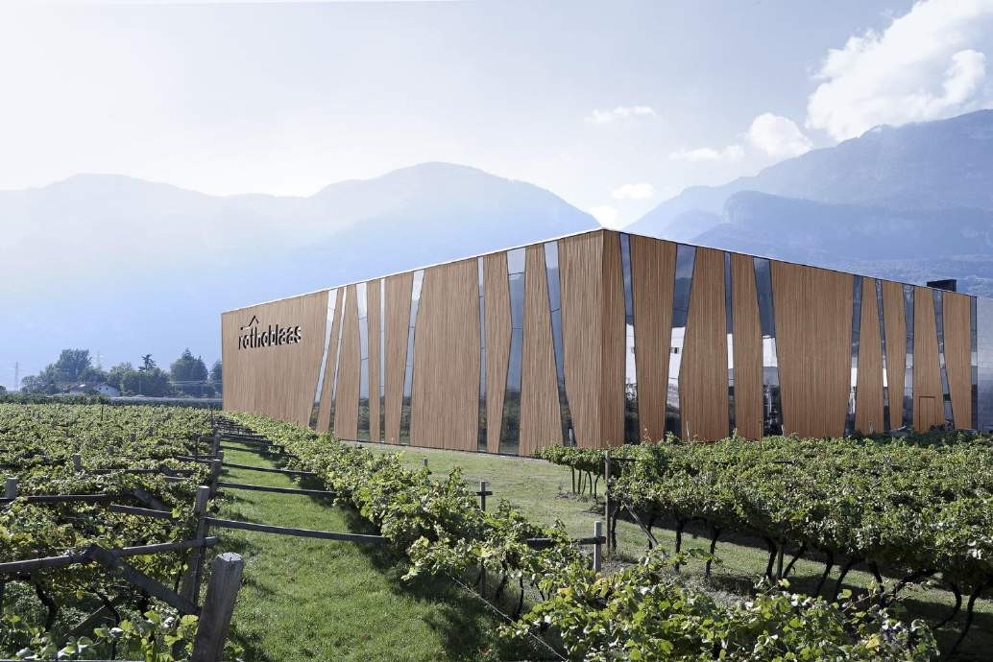
SUSTAINABLE GROWTH AND CARE
FOR THE ENVIRONMENT
7. Timber technology, construction, connections, structural systems - connection systems Rothoblaas Santi Davi‘
Rothoblaas is aware of the importance of a responsible economic strategy, attention to health and safety of workers and the environment, essential for the preservation of all the stakeholders. Therefore, the management is committed to:
Analyse the risks and dangers for employees;
Providing health and safety of all workers;
Ensure continuous improvement of product quality, safety, and environmental impact;
Respect the laws in the sphere of quality, safety, and
environment;
Provide information and training for all workers
Rothoblaas is housed in a modern, functional energy-efficient building, constructed in wood and glass on a wooden frame and steel. Designed to identify with the product range and to foster team spirit among the departments, it covers an area of over 17,000 m2 and fits harmoniously in the natural, local environment.

Slide 11
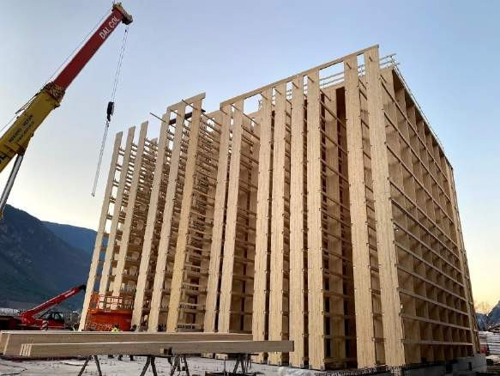
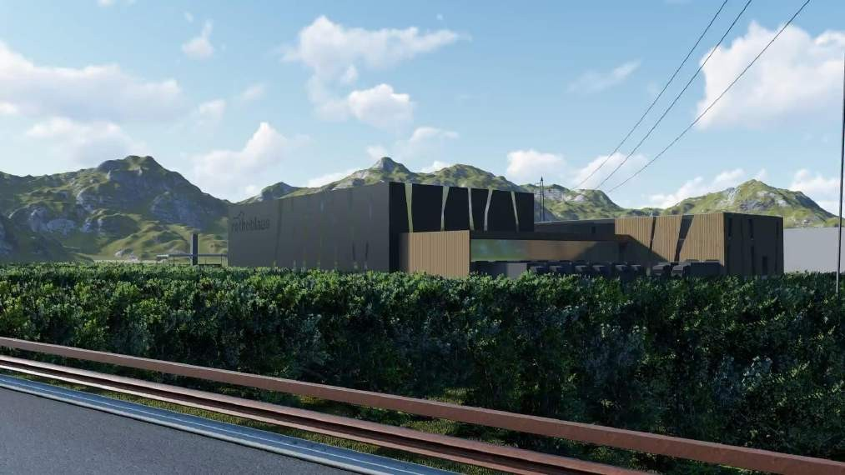
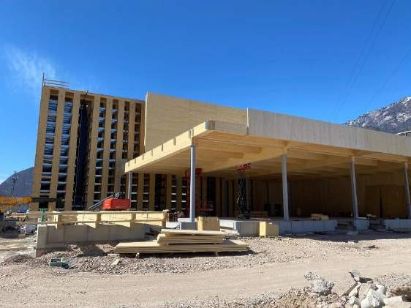
7. Timber technology, construction, connections, structural systems - connection systems Rothoblaas Santi Davi‘
“The automated warehouse that we are building will be made entirely of timber processed in Alto Adige, including the roof and walls, and this means that we have an increased attention to sustainability," says CEO Robert Blaas. “For us, the building's sustainability is important”.

Slide 12
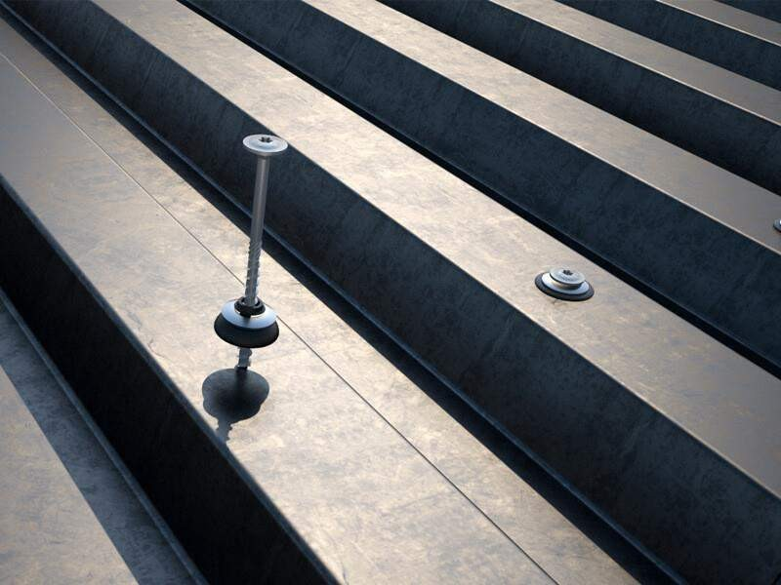
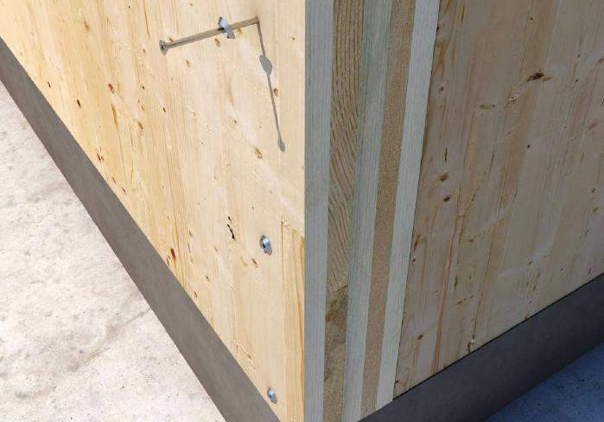
7. Timber technology, construction, connections, structural systems - connection systems Rothoblaas Santi Davi‘
Fastening

Slide 13
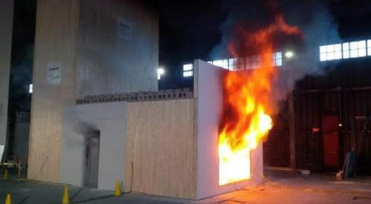
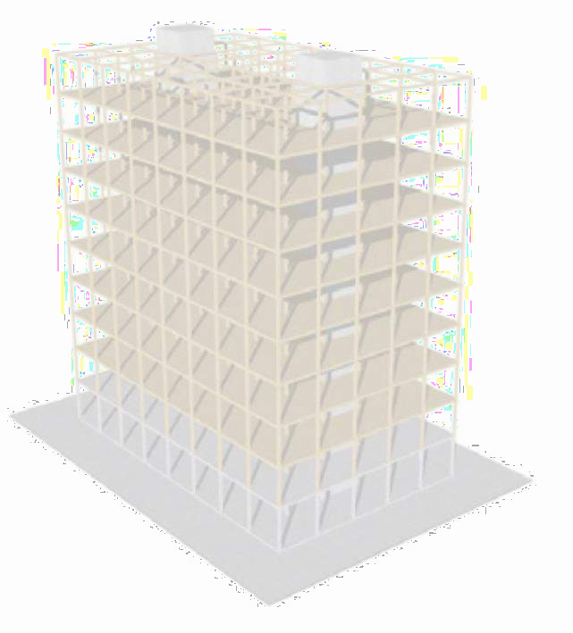
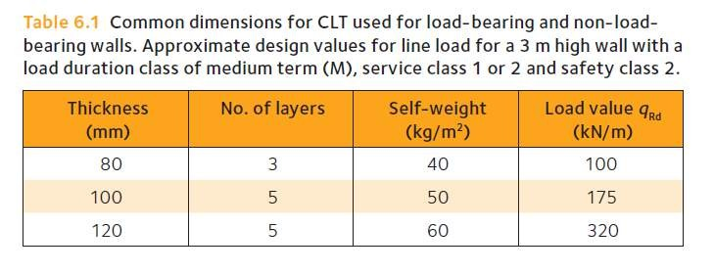
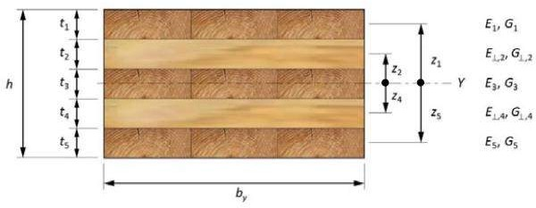
CLT elements - key critical design characteristics to consider
7. Timber technology, construction, connections, structural systems - connection systems Rothoblaas Santi Davi‘
In-plane and out-of-plane bending strength, shear strength, and stiffness
Short-term and long-term behavior:
o instantaneous deflection
o long-term deflection (creep deformation)
o long-term strength for permanent loading
Vibration performance of floors
Compression perpendicular to grain (bearing) deformations
Fire performance
Sound insulation
Durability
Energy efficiency

Slide 14
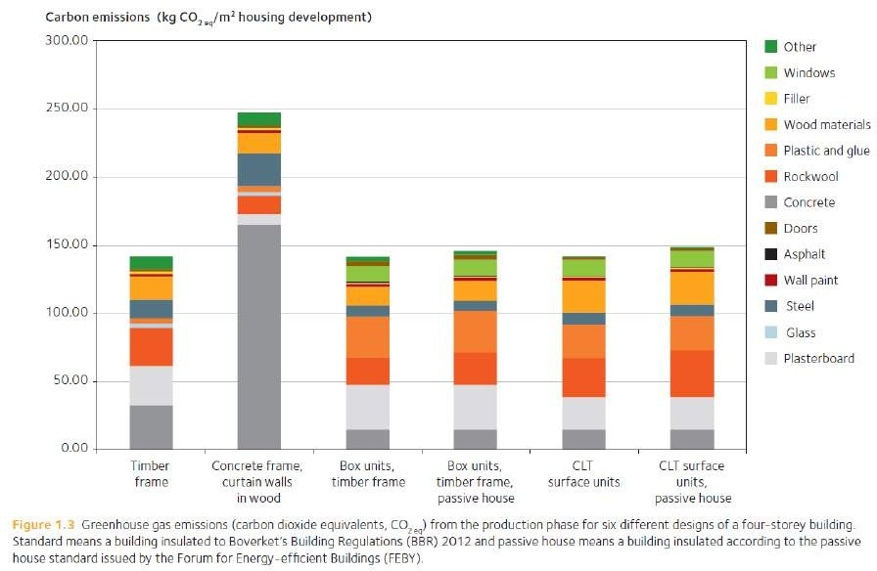
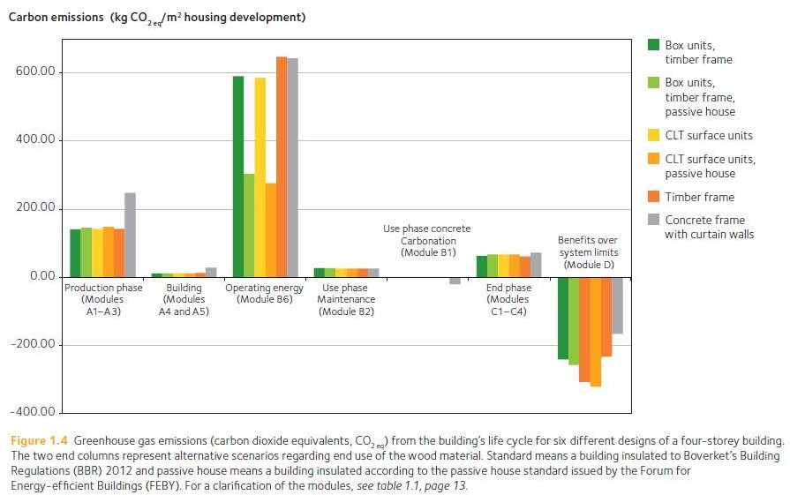
Environmental benefit of Mass timber
7. Timber technology, construction, connections, structural systems - connection systems Rothoblaas Santi Davi‘
As part of a European project in Sweden, life cycle assessments were carried out on a four-storey building
design that used different construction techniques.

Slide 15
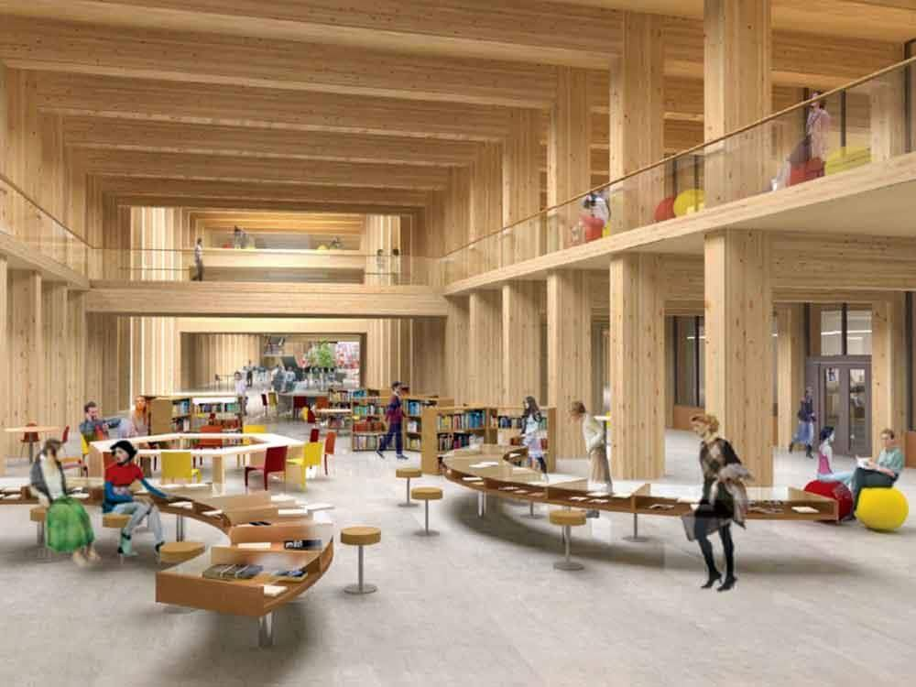
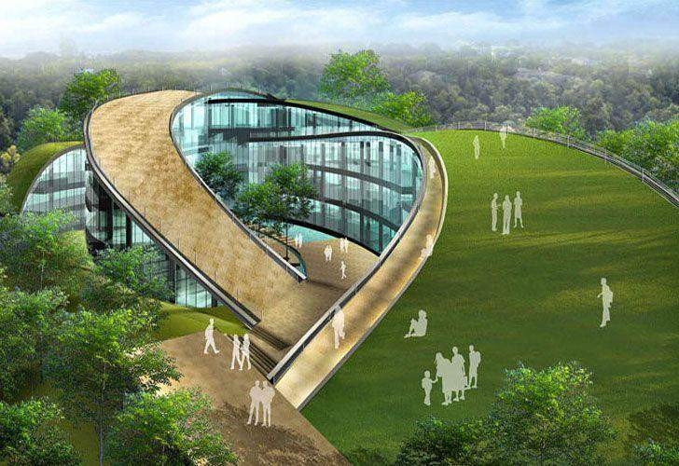
7. Timber technology, construction, connections, structural systems - connection systems Rothoblaas Santi Davi‘
NTU Project – Shanghai

Slide 16
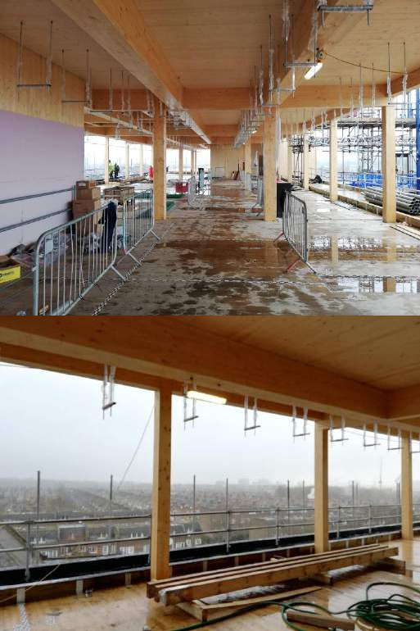
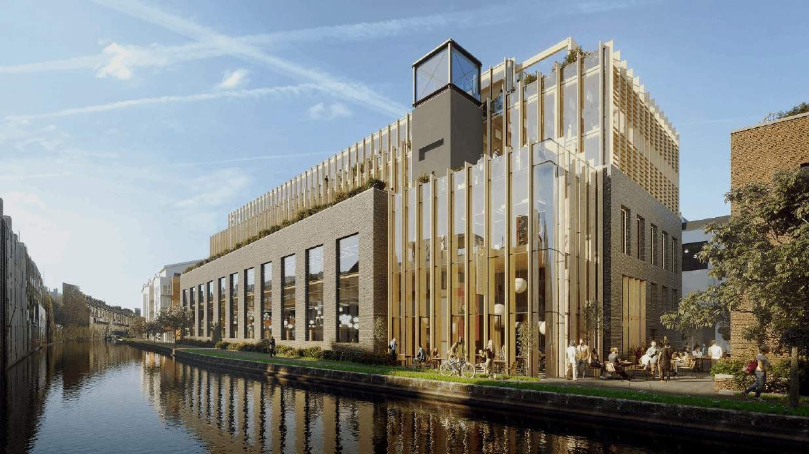
Gramophone works - London
7. Timber technology, construction, connections, structural systems - connection systems Rothoblaas Santi Davi‘

Slide 17
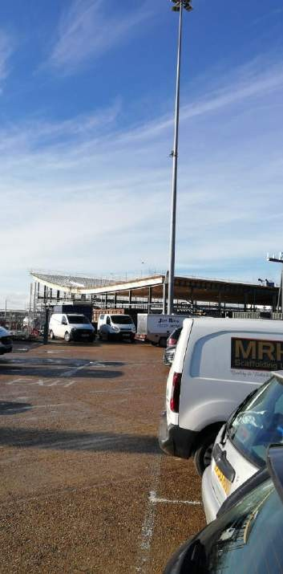
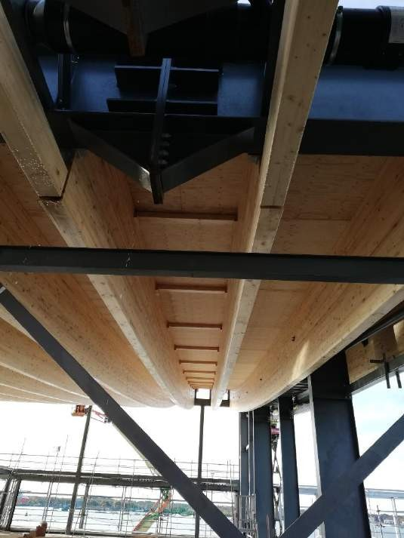
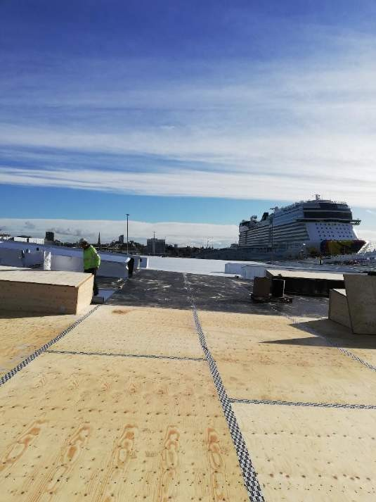
Dock station - Southampton
7. Timber technology, construction, connections, structural systems - connection systems Rothoblaas Santi Davi‘

Slide 18
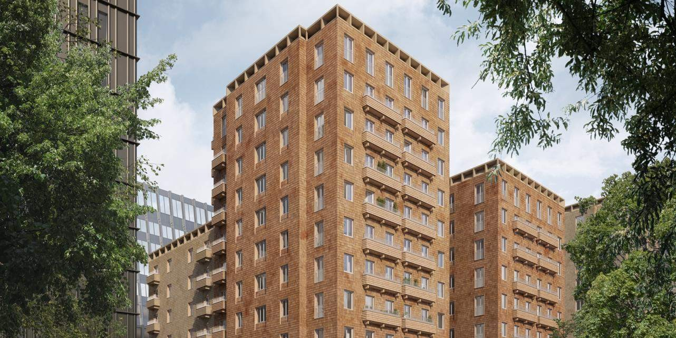
Cederhusen Residential Building - Stockholm
7. Timber technology, construction, connections, structural systems - connection systems Rothoblaas Santi Davi‘

Slide 19
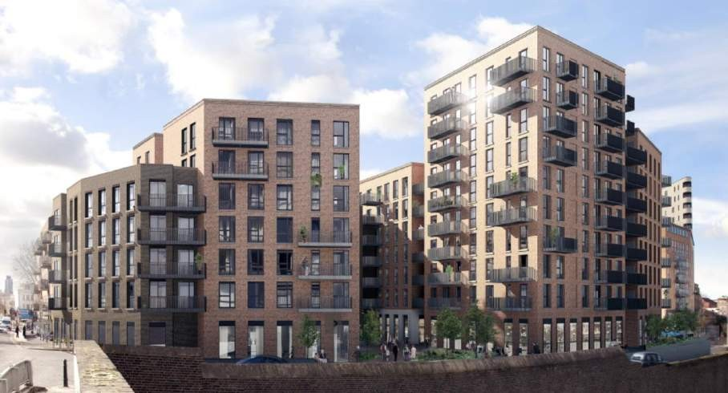
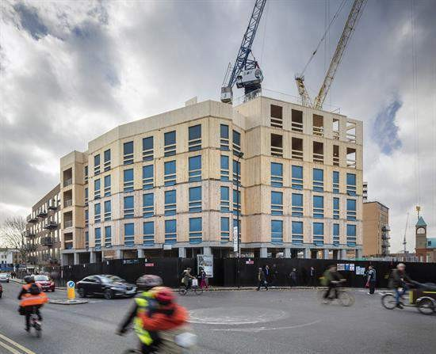
Dalston Lane is the world’s largest cross-laminated timber (CLT) building
7. Timber technology, construction, connections, structural systems - connection systems Rothoblaas Santi Davi‘
London, UK
33m height, 10- storey
Hybrid CLT, concrete ground floor
Largest for surface
TIMBER IS ALL ABOUT CONNECTIONS

Slide 20
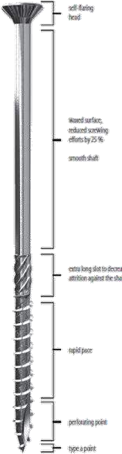

Structural and Carpentry Screws
7. Timber technology, construction, connections, structural systems - connection systems Rothoblaas Santi Davi‘
HBS - For structures and carpentry. Standard profile.
TBS - Used in carpentry and structures, strong head withdrawal capacity.
VGZ - Screw for concealed structures and joints, reinforcement in beams and has a “Lost head”/narrow profile.
VGS - Screw for structures and reinforcement in glulam. Has a head suited for use in plates.
DGZ – Used for fastening battens over compressible
insulation.

Slide 21
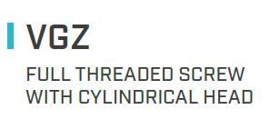
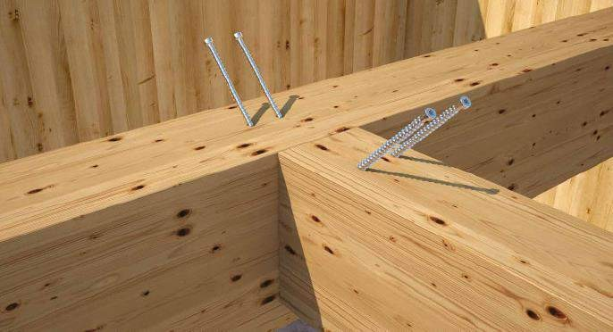
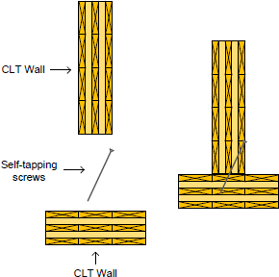

7. Timber technology, construction, connections, structural systems - connection systems Rothoblaas Santi Davi‘
Primary to secondary beam connections with high shear capacity can be easily realised with just 1-2-or-4 screws

Slide 22
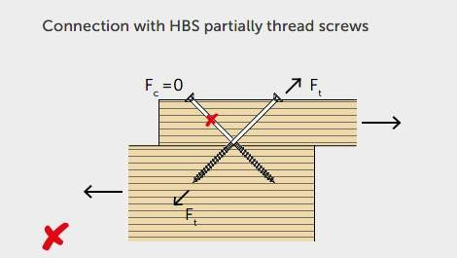
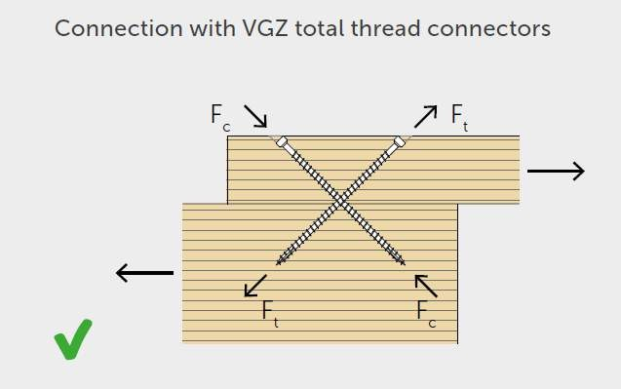
Why a use a fully threaded screw coaxially and not a partial thread?
7. Timber technology, construction, connections, structural systems - connection systems Rothoblaas Santi Davi‘
The smooth part of a partial thread would not participate
The head is not embedded.
There is uncontrolled displacement
All the thread is working axially
High rigidity: no uncontrolled movement between the two beams
Fire resistance is easily reached (R60, R90 depending on the timber thickness)
Low element dimensions and minimum distances
Invisible connection

Slide 23
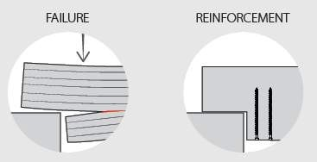
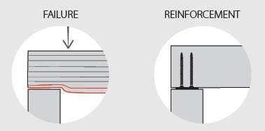
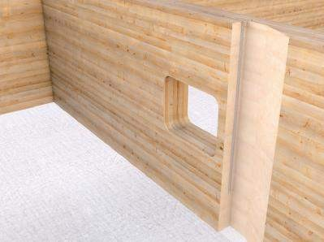
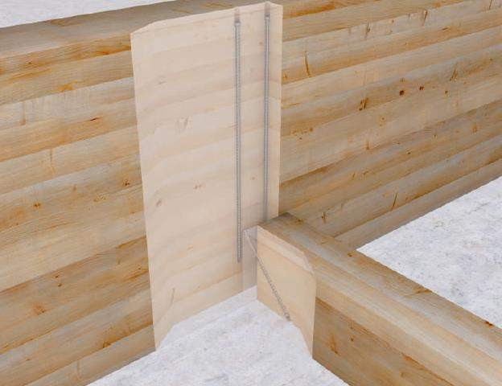
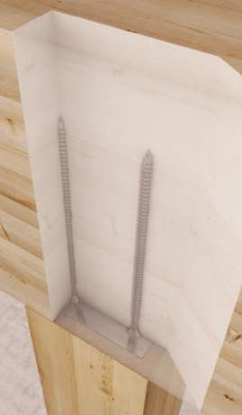
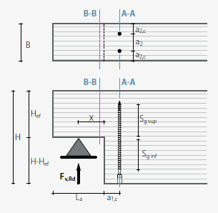
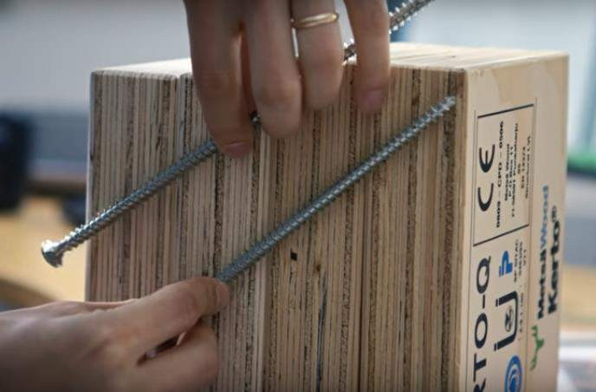
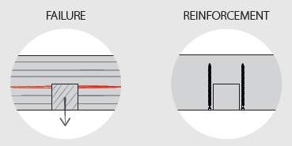
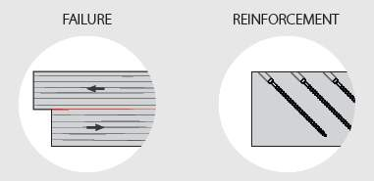
REINFORCEMENT
7. Timber technology, construction, connections, structural systems - connection systems Rothoblaas Santi Davi‘

Slide 24
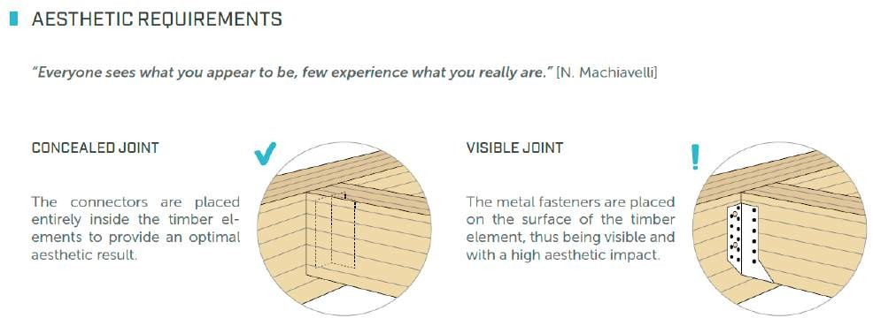


7. Timber technology, construction, connections, structural systems - connection systems Rothoblaas Santi Davi‘

Slide 25





7. Timber technology, construction, connections, structural systems - connection systems Rothoblaas Santi Davi‘
Concealed connectors

Slide 26





7. Timber technology, construction, connections, structural systems - connection systems Rothoblaas Santi Davi‘
CONCEALED HOOK TIMBER-TO-TIMBER CONNECTOR (rothoblaas.com)

Slide 27


7. Timber technology, construction, connections, structural systems - connection systems Rothoblaas Santi Davi‘

Slide 28


7. Timber technology, construction, connections, structural systems - connection systems Rothoblaas Santi Davi‘

Slide 29

7. Timber technology, construction, connections, structural systems - connection systems Rothoblaas Santi Davi‘
Mass timber connections

Slide 30




7. Timber technology, construction, connections, structural systems - connection systems Rothoblaas Santi Davi‘
A radical innovation in timber constructions. It redefines the standard for shear, resistance, transportation the assembling and resistance of CLT panels. X-RAD offers excellent static and seismic performance.
Handling and assembly of ultra-rapid CLT walls and floors. Drastic reduction of assembly time, construction site errors and risk of injury.

Slide 31

7. Timber technology, construction, connections, structural systems - connection systems Rothoblaas Santi Davi‘

Slide 32
7. Timber technology, construction, connections, structural systems - connection systems Rothoblaas Santi Davi‘

Slide 33



7. Timber technology, construction, connections, structural systems - connection systems Rothoblaas Santi Davi‘
CONNECTOR FOR STRUCTURAL PANELS (rothoblaas.com)

Slide 34

7. Timber technology, construction, connections, structural systems - connection systems Rothoblaas Santi Davi‘

Slide 35


7. Timber technology, construction, connections, structural systems - connection systems Rothoblaas Santi Davi‘
09.09.2021
ALUMINIUM SYSTEM FOR THE CONNECTION OF BUILDINGS TO THE GROUND (rothoblaas.com)
35

Slide 36





7. Timber technology, construction, connections, structural systems - connection systems Rothoblaas Santi Davi‘
XEPOX EPOXY ADHESIVE (rothoblaas.com)

Slide 37



7. Timber technology, construction, connections, structural systems - connection systems Rothoblaas Santi Davi‘

Slide 38




Multi-rise Timber Construction – Pillar and Spider
7. Timber technology, construction, connections, structural systems - connection systems Rothoblaas Santi Davi‘

Slide 39


7. Timber technology, construction, connections, structural systems - connection systems Rothoblaas Santi Davi‘

Slide 40



7. Timber technology, construction, connections, structural systems - connection systems Rothoblaas Santi Davi‘
SPIDER CONNECTOR
CONNECTION AND REINFORCEMENT SYSTEM FOR COLUMNS AND FLOORS (rothoblaas.com)

Slide 41



Pre-dimensioned table to indicate design possibilities
7. Timber technology, construction, connections, structural systems - connection systems Rothoblaas Santi Davi‘
With the Spider you can achieve predicted 13 storey height using a mixture of glulam, beech LVL and steel columns working with a 50 m2 grid (7x7m)
With the Pillar you can achieve predicted 30 storey hight using a mixture of glulam and beech LVL columns with a 10m2 grid

Slide 42

Post and beam construction compared to SPIDER columns and slab design
7. Timber technology, construction, connections, structural systems - connection systems Rothoblaas Santi Davi‘

Slide 43


7. Timber technology, construction, connections, structural systems - connection systems Rothoblaas Santi Davi‘
Waterproofing and Airtightness

Slide 44

Wind tightness
7. Timber technology, construction, connections, structural systems - connection systems Rothoblaas Santi Davi‘
The role of the wind tightness layer is to prevent the outside air from reaching the inside of the building (hot damp air in summer; cold air in winter).
Airtightness
The purpose of the airtightness layer is to prevent the air from flowing from the inside towards the outside. (hot damp air in winter, conditioned air in summer).

Slide 45

7. Timber technology, construction, connections, structural systems - connection systems Rothoblaas Santi Davi‘
Air - Airtightness
Vapour – Wind protection
Heat – Heat Transmittance
Sound - Soundproofing
Tightness:
to avoid heat losses in winter due to uncontrolled air leakage.
to avoid hot air penetration in summer.
to avoid uncontrolled vapor migration with possible formation of condensation
to avoid air leakage and the consequent lack of comfort.

Slide 46



Passivhaus
7. Timber technology, construction, connections, structural systems - connection systems Rothoblaas Santi Davi‘
Tape Flexi Band, Seal Band, Speedy Band
Membrane with Variable Diffusion Clima control
AIRTIGHTNESS AND WATERPROOFING (rothoblaas.com)

Slide 47


Fire prevention and classification
7. Timber technology, construction, connections, structural systems - connection systems Rothoblaas Santi Davi‘

Slide 48




7. Timber technology, construction, connections, structural systems - connection systems Rothoblaas Santi Davi‘
INTUMESCENT THERMO-INFLATABLE FLEXIBLE GASKET | FIRE STRIPE (rothoblaas.com)

Slide 49

7. Timber technology, construction, connections, structural systems - connection systems Rothoblaas Santi Davi‘
Incorporating Acoustic requirements into structural design

Slide 50

Airborne excitation
7. Timber technology, construction, connections, structural systems - connection systems Rothoblaas Santi Davi‘
Structure-borne
excitation

Slide 51




The principle of disconnection
7. Timber technology, construction, connections, structural systems - connection systems Rothoblaas Santi Davi‘
MASS
+ SPRING
+ MASS

Slide 52





7. Timber technology, construction, connections, structural systems - connection systems Rothoblaas Santi Davi‘
Acoustic solutions
09.09.2021
52
SOUNDPROOFING OF WOODEN FLOORING (rothoblaas.com)

Slide 53





7. Timber technology, construction, connections, structural systems - connection systems Rothoblaas Santi Davi‘
09.09.2021
53
FLANKSOUND PROJECT (rothoblaas.com)

Slide 54



Thank you for your attention
7. Timber technology, construction, connections, structural systems - connection systems Rothoblaas Santi Davi‘
Engineer Santi Davì m. +44 7774476536
santi.davi@rothoblaas.com
Engineer Stephan Schindlauer m. +43 6642428545
stephan.schindlauer@rothoblaas.com
09.09.2021
54
Rothoblaas - materials for timber construction

