Slide 1








SUSTAINABLE, HIGH-PERFORMANCE BUILDING SOLUTIONS IN WOOD
2020-1-LV01-KA203-077513
ERASMUS+ Strategic Partnerships For Higher Education
FAÇ ADE FINISHING TYPES construction/materials Prof. Waclaw Celadyn, PhD.,D.Sc
12 May 2022

Slide 2
FACADE FINISHING TYPES construction/materials
Prof. Waclaw Celadyn, PhD.,D.Sc
THEORETICAL ASPECTS
11.09.2023 Sources: 2

Slide 3








Criteria for selection of materials and finishing technologies
1/ local zoning codes 2/ local tradition
3/ function of the building (semantics) 4/ fire resistance of materials
5/ owner`s and building`s prestige
6/ design concept (esthetics)
7/ cost of this building component 8/ wall structure
9/ resistance to vandalism
11.09.2023 3

Slide 4
Technical requirements for the systems of faç ade finishing
1/ water tightness
2/ possibility of thermal extension
3/ durability (slow aging) 4/ adequate fixing method
5/ thermo – insulating properties

Slide 5
FACADE FINISHING TYPES construction/materials
Prof. Waclaw Celadyn, PhD.,D.Sc
Average durability of buildings depends on the following factors:
function of the building
applied technology
environmental conditions
local culture
political and economic situation
11.09.2023 Sources: 5

Slide 6
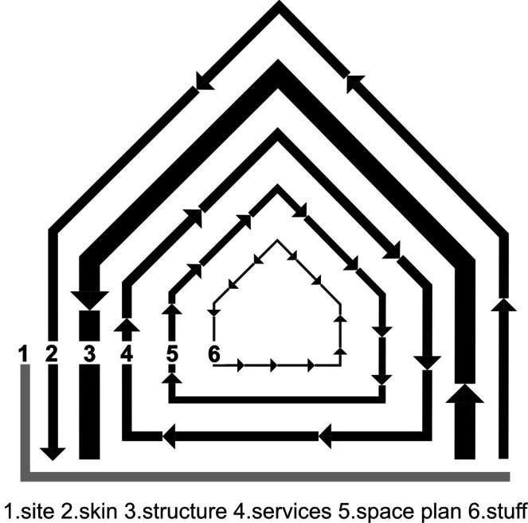
FACADE FINISHING TYPES construction/materials
Prof. Waclaw Celadyn, PhD.,D.Sc
11.09.2023
Theory of building`s la^{S}yºe^{ur}r^{c}s^{es:}by Stewart Brand
6

Slide 7
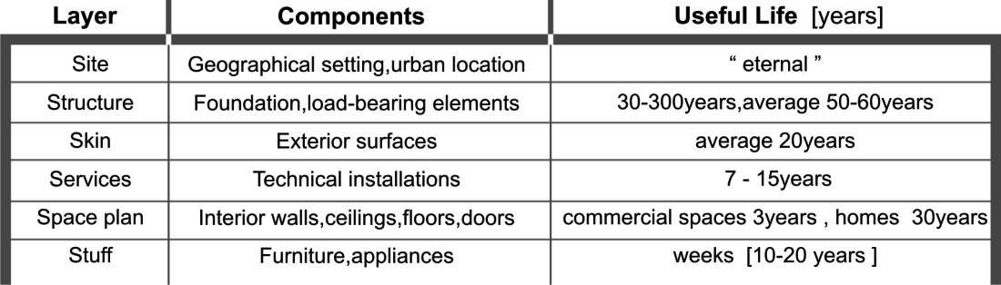
FACADE FINISHING TYPES construction/materials
Prof. Waclaw Celadyn, PhD.,D.Sc
11.09.2023
Sources:
7

Slide 8
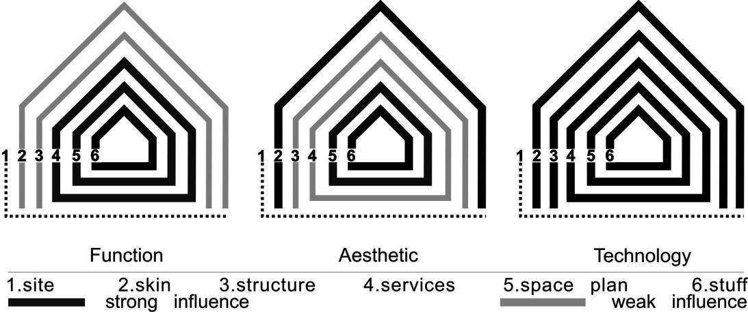
FACADE FINISHING TYPES construction/materials
Prof. Waclaw Celadyn, PhD.,D.Sc
11.09.2023
Sources:
8

Slide 9
FACADE FINISHING TYPES construction/materials
Prof. Waclaw Celadyn, PhD.,D.Sc
FEATURES OF BUILDING SUSTAINABLE
functional effectiveness (low cost and simple technologies)
adaptability ( potential for relocation in the future)
easiness of demountability
separation of combined materials
selection of materials susceptible to recycling
aptitude for maintenance
transparency (clarity of applied technical solutions and easy inspection)
evolutive capacity (possibility of future improvements)
dynamism of systems allowing for ecological risks instead of their stability
11.09.2023
Sources:
9

Slide 10
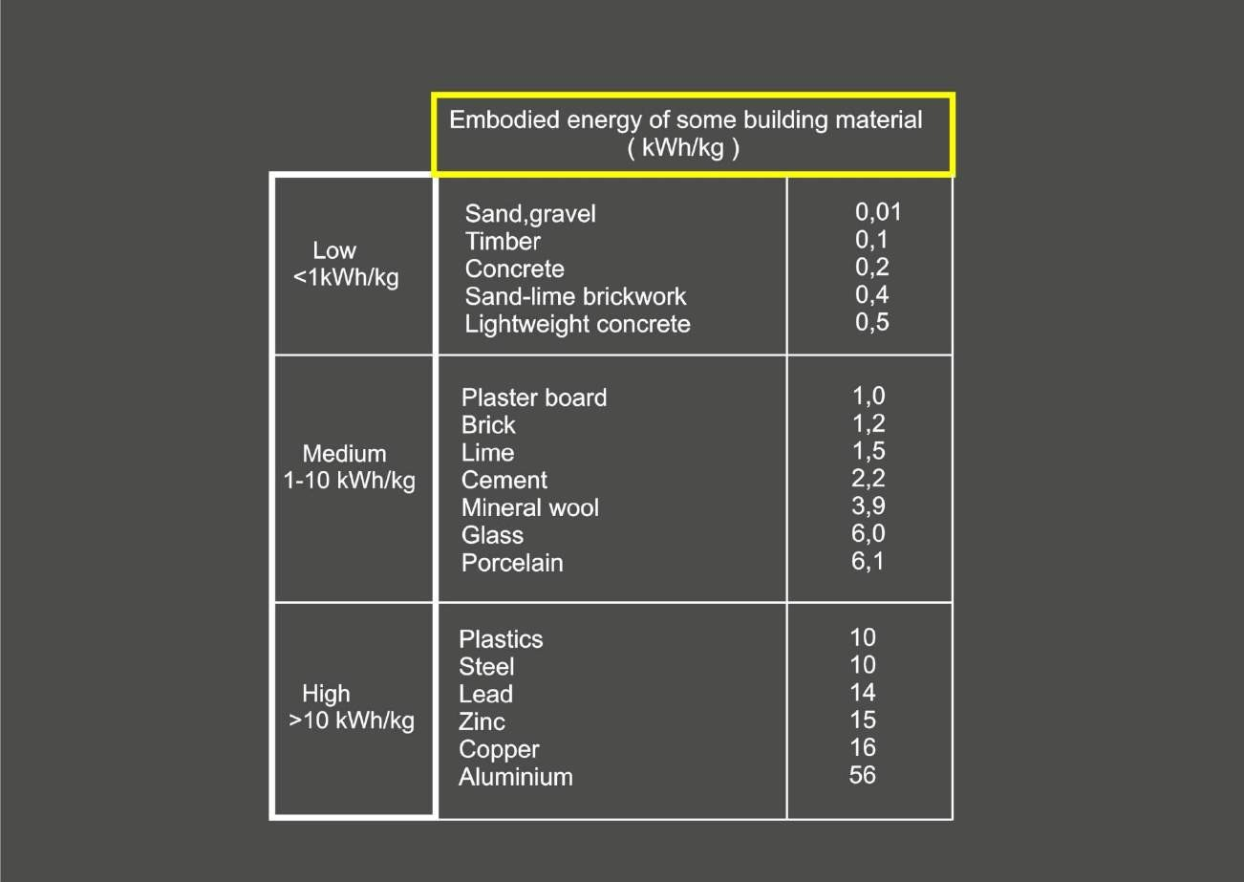

Slide 11
FACADE FINISHING TYPES construction/materials
Prof. Waclaw Celadyn, PhD.,D.Sc
FACADE FINISHING APPLICATIONS
11.09.2023 Sources: 11

Slide 12
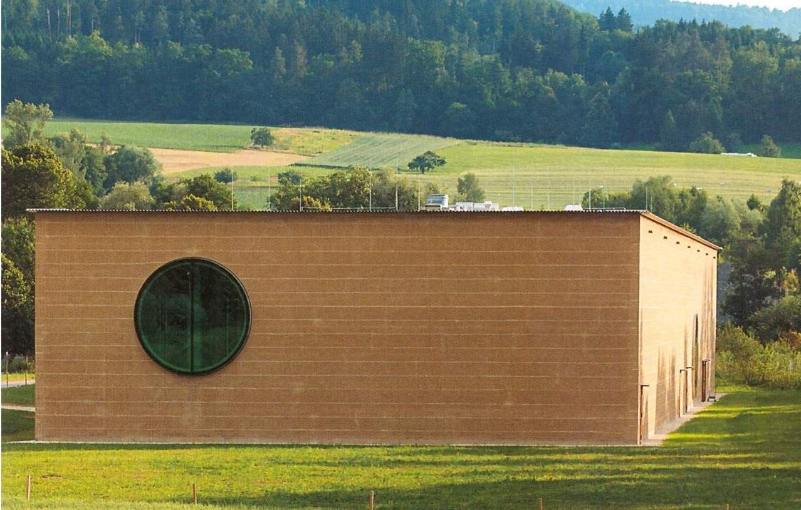
Manufacturing plant Ricola.
Laufen (CH)

Slide 13
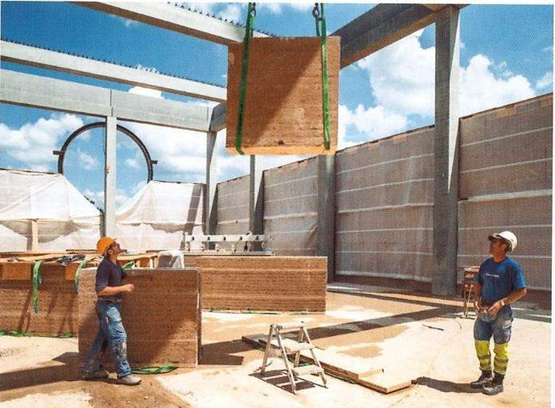
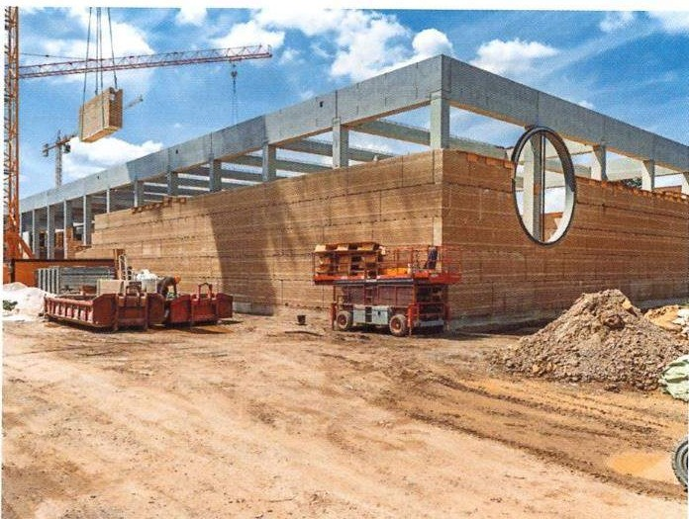

Slide 14
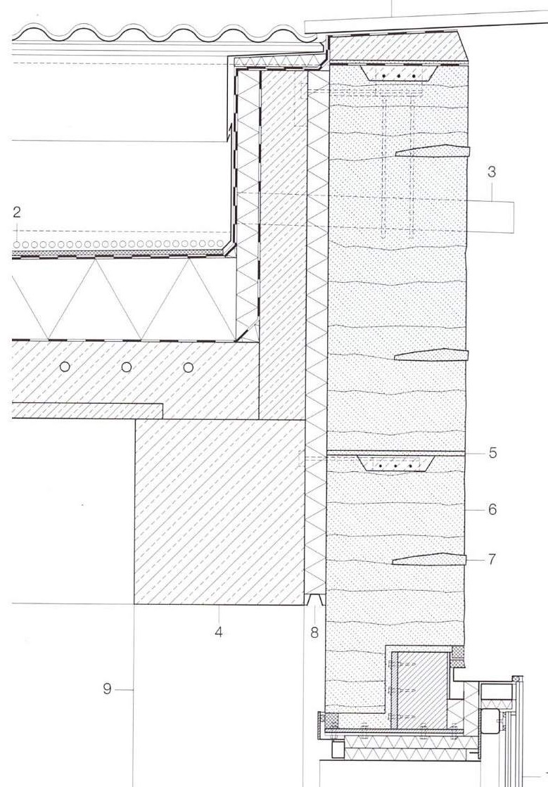
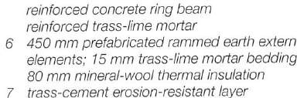

Slide 15
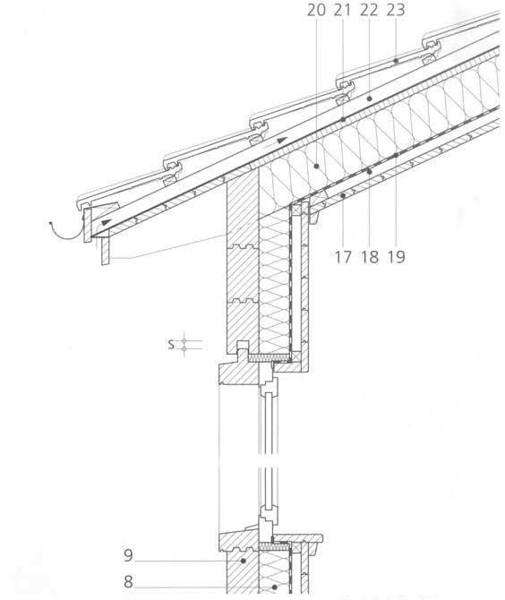
Log construction

Slide 16
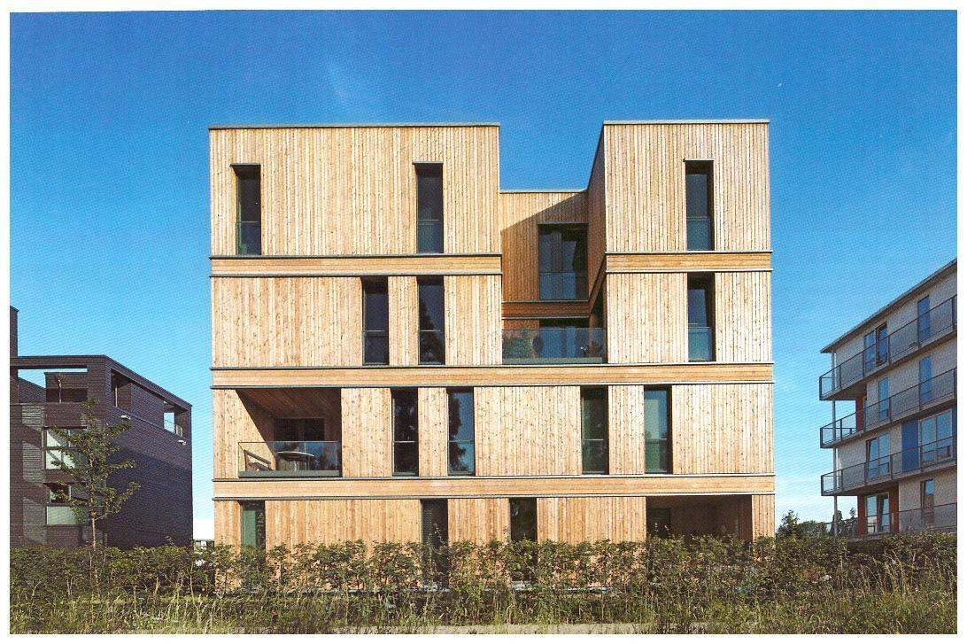
Residential building IBA. Hamburg

Slide 17
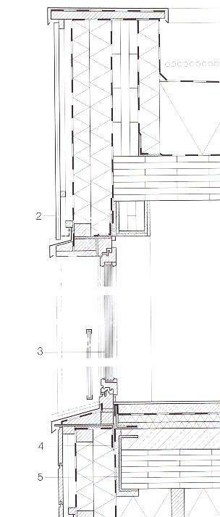
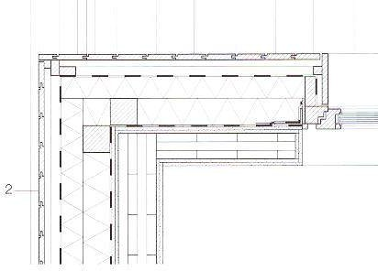
Residential building IBA. Hamburg

Slide 18
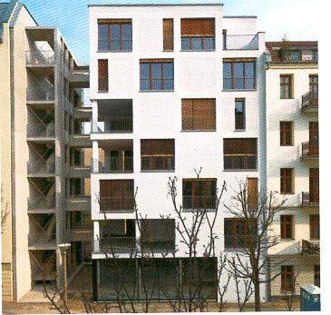
Residential building.
Berlin

Slide 19
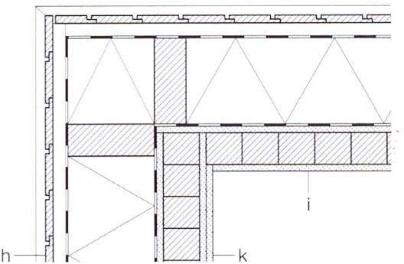
Residential building. Berlin (arch.Klingbeil)

Slide 20
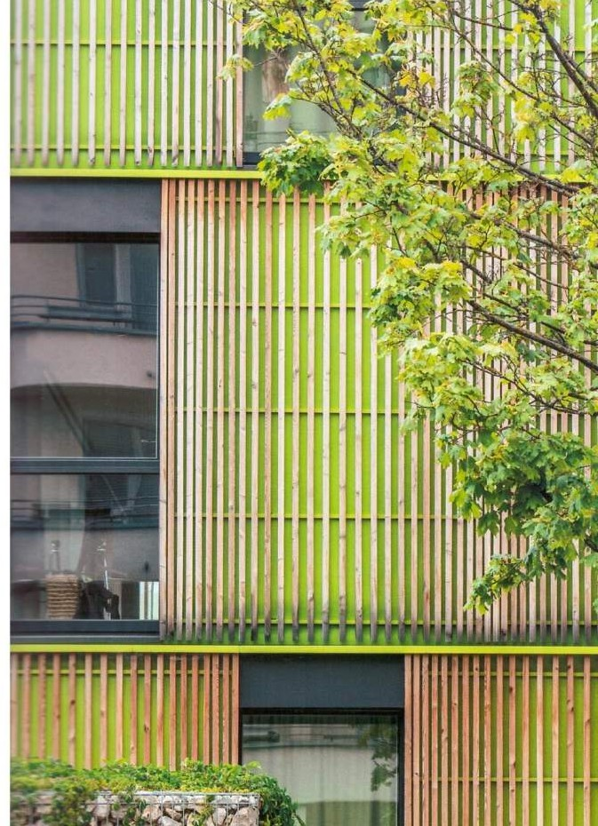
Home for Children
and Young People.
Ingolstadt

Slide 21
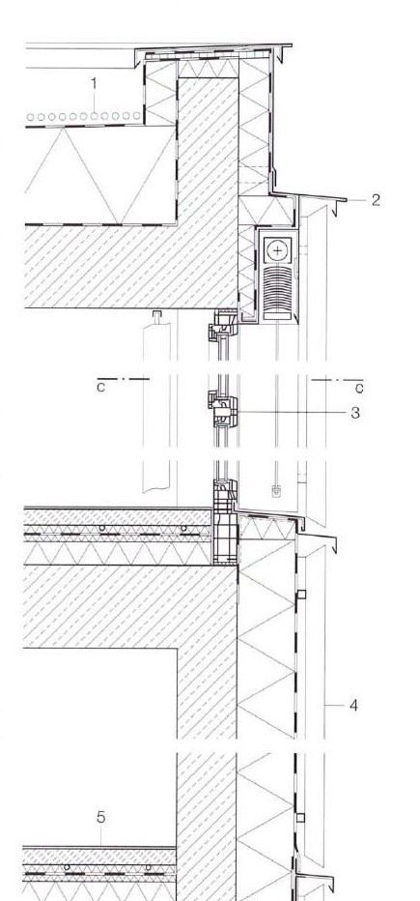
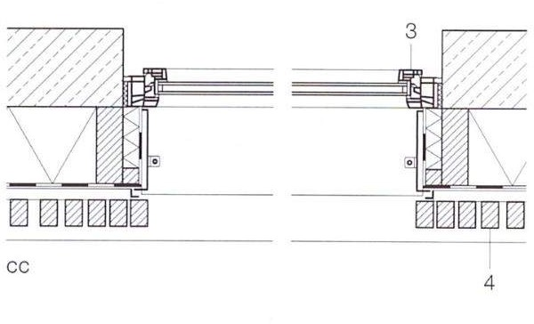
Home for Children and Young People.
Ingolstadt

Slide 22
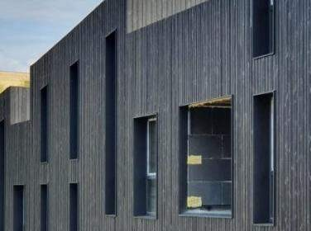
Charring wood facade

Slide 23
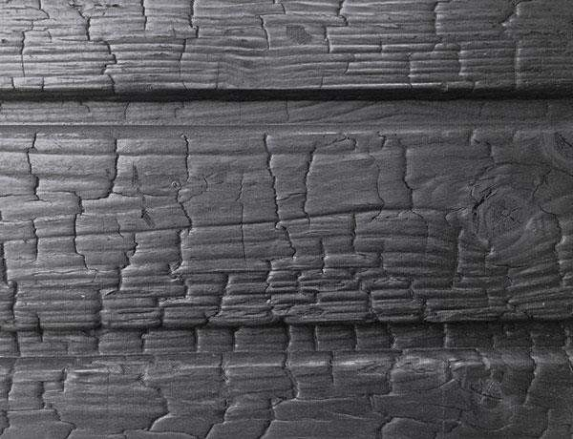
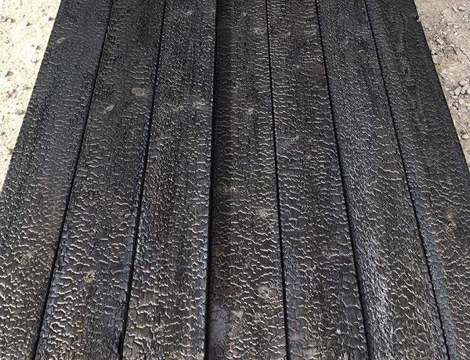
11.09.2023
23

Slide 24
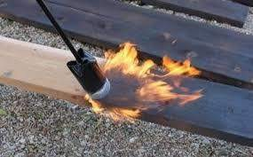
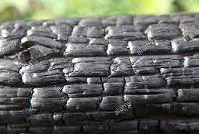
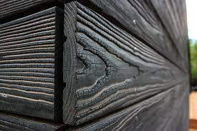
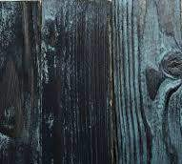

Slide 25
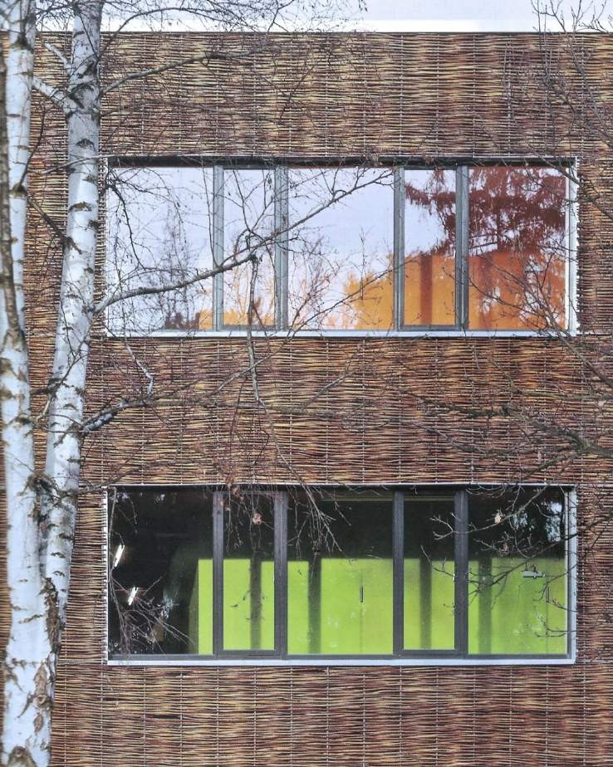
Wickerwork facade

Slide 26
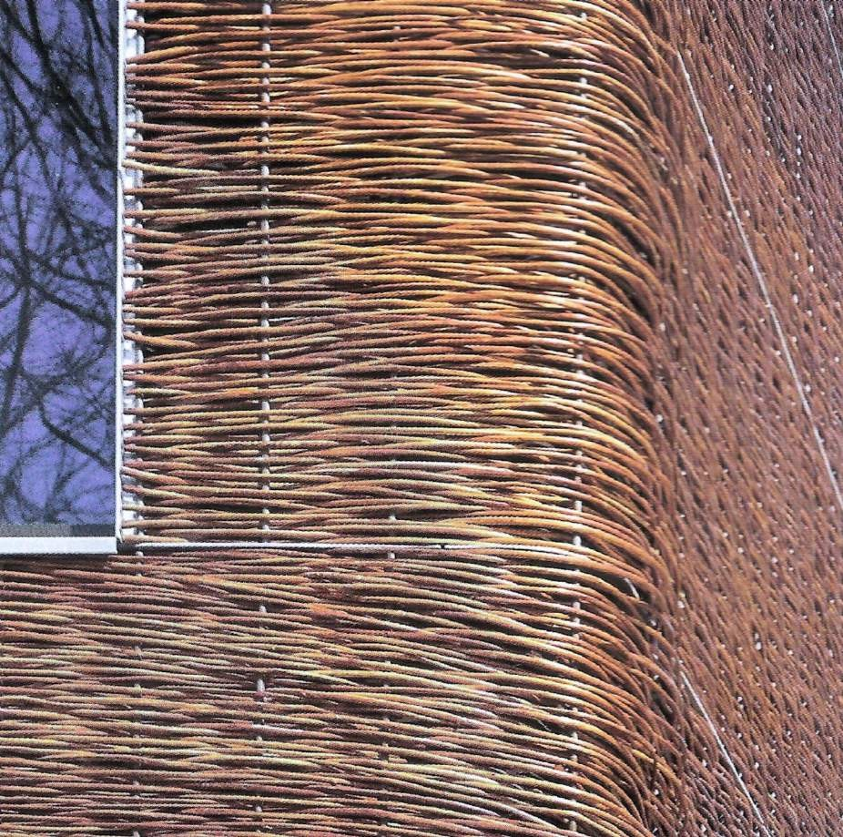

Slide 27
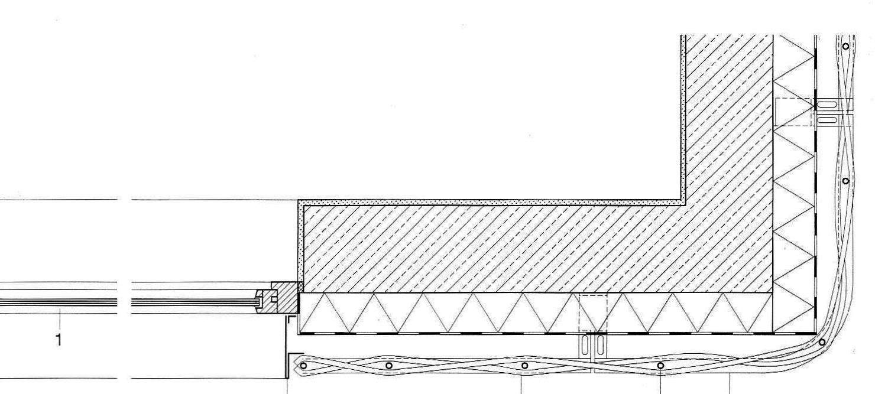
Wickerwork facade

Slide 28
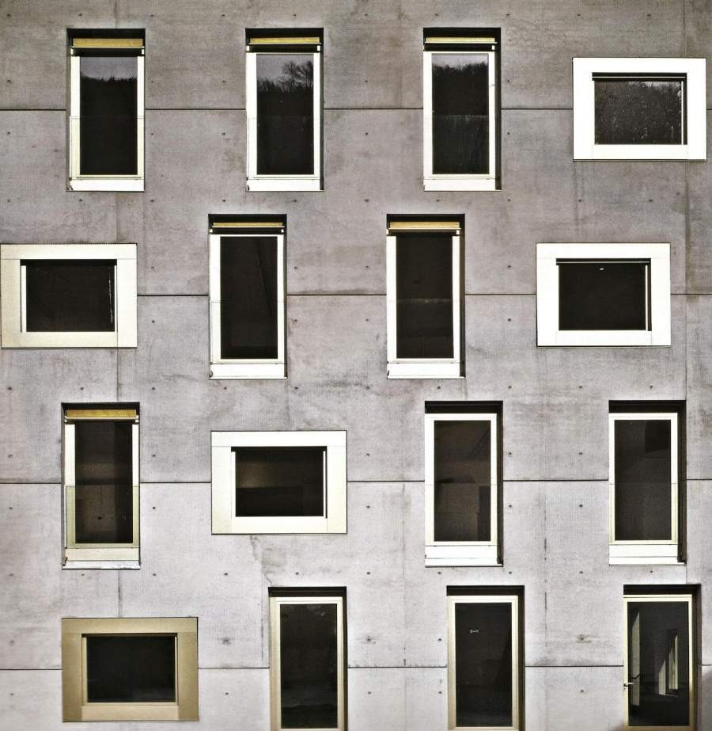

Slide 29
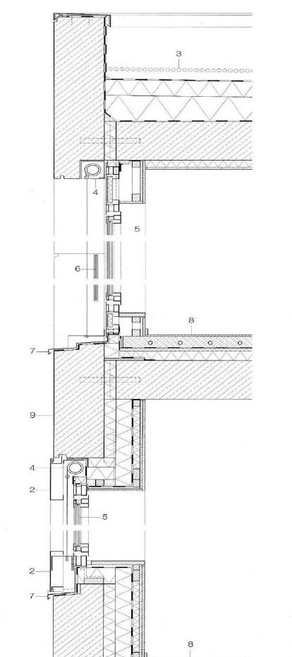
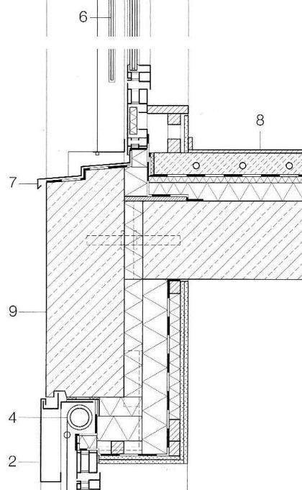

Slide 30
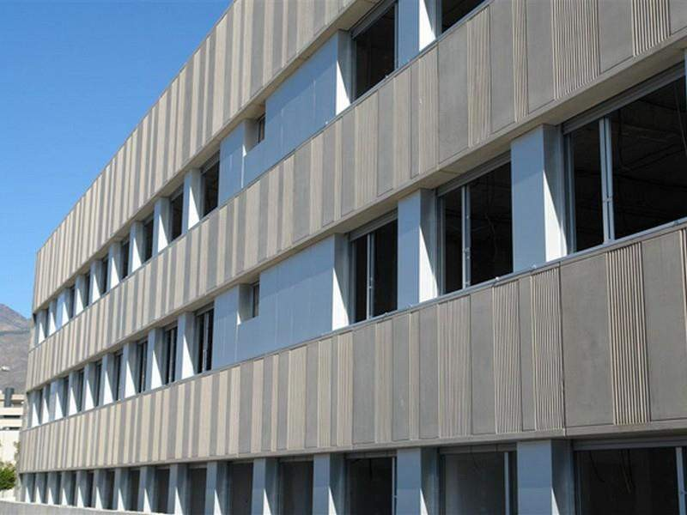

Slide 31
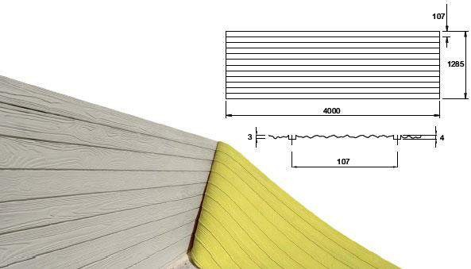

Slide 32
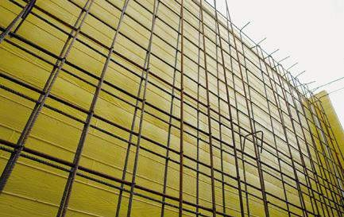

Slide 33
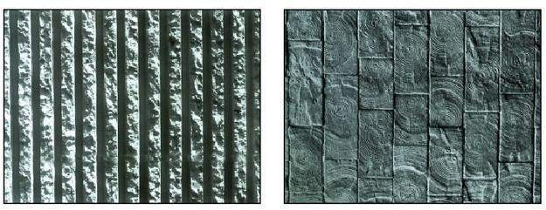

Slide 34
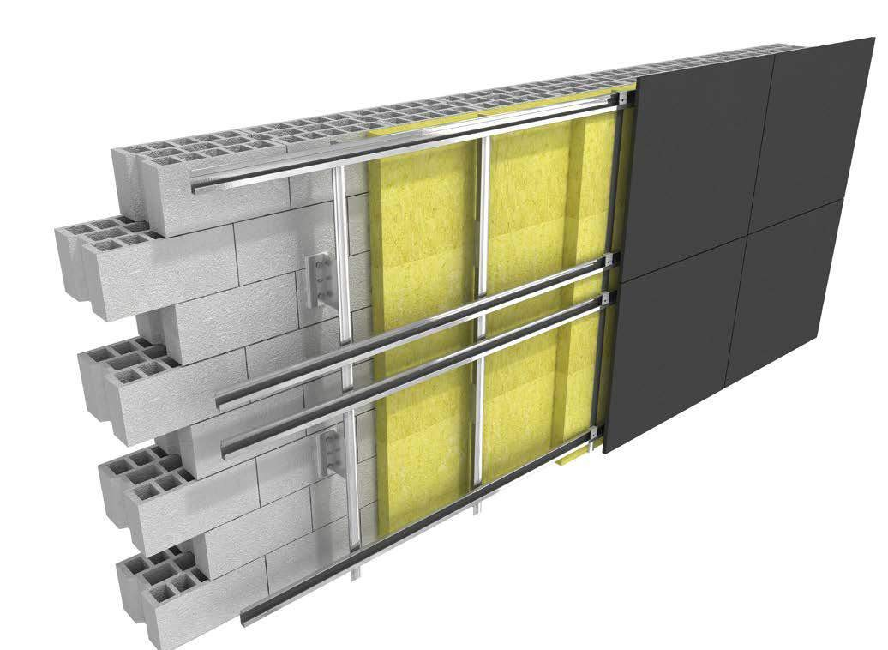

Slide 35
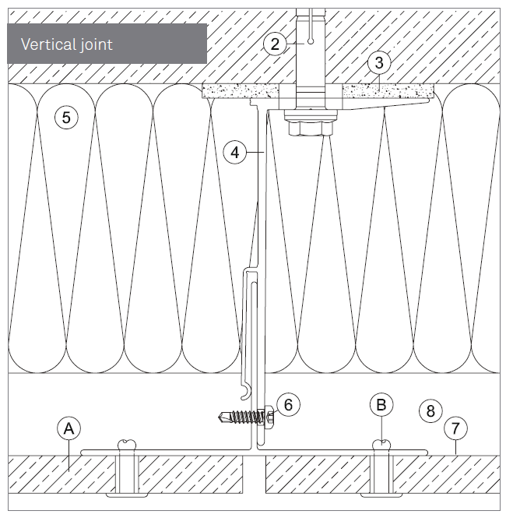

Slide 36
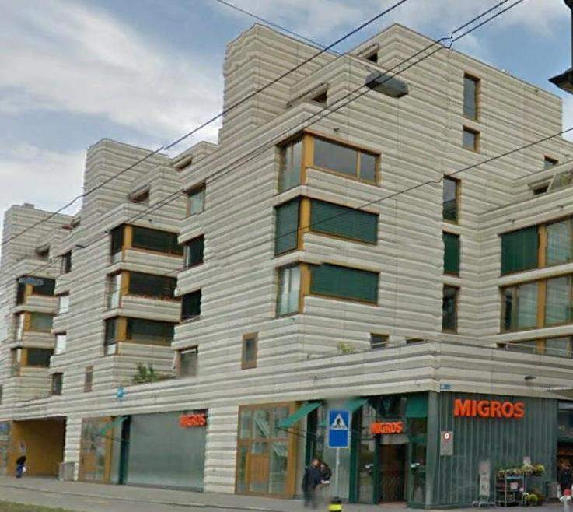
Residential building. Zurich

Slide 37
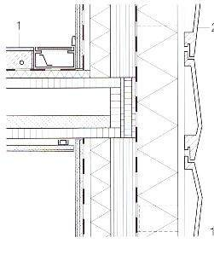
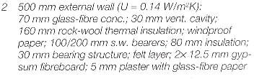
Residential building. Zurich
Residential building. Zurich

Slide 38
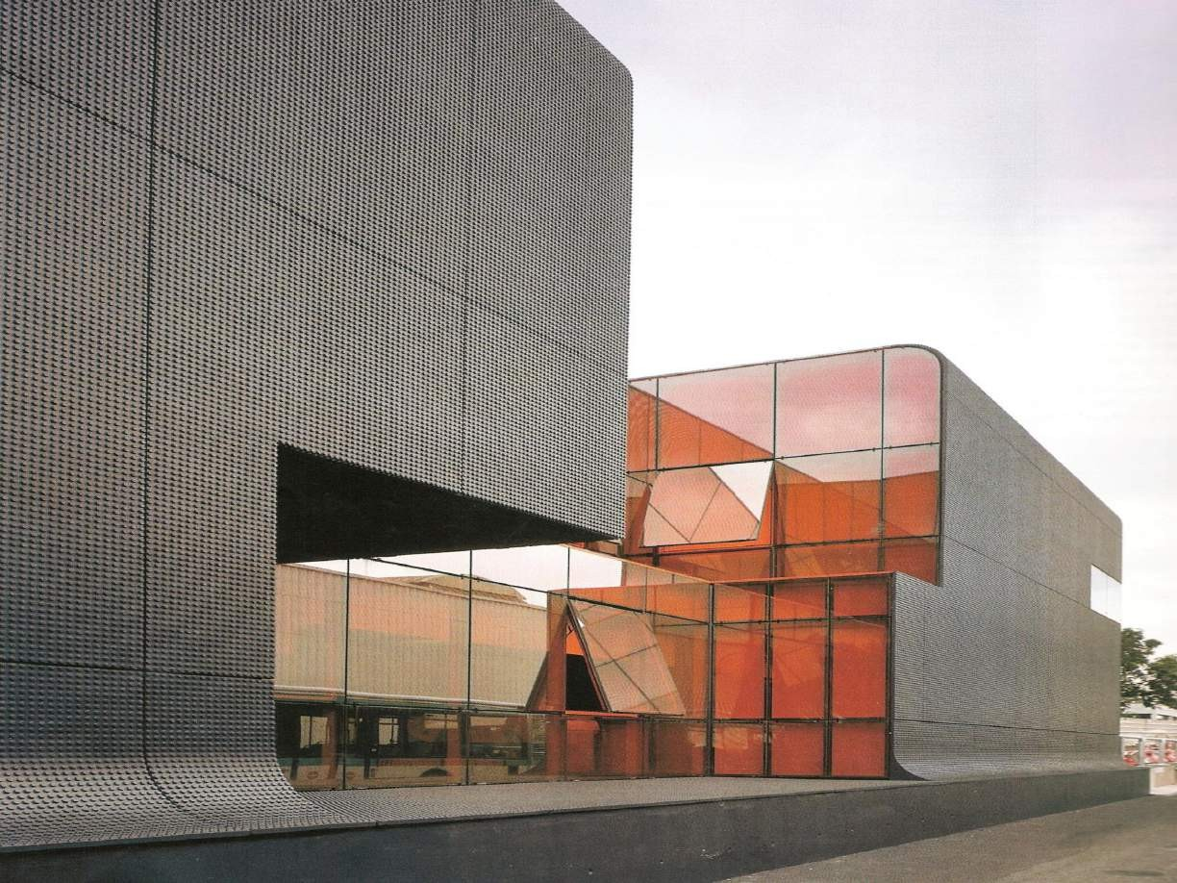

Slide 39
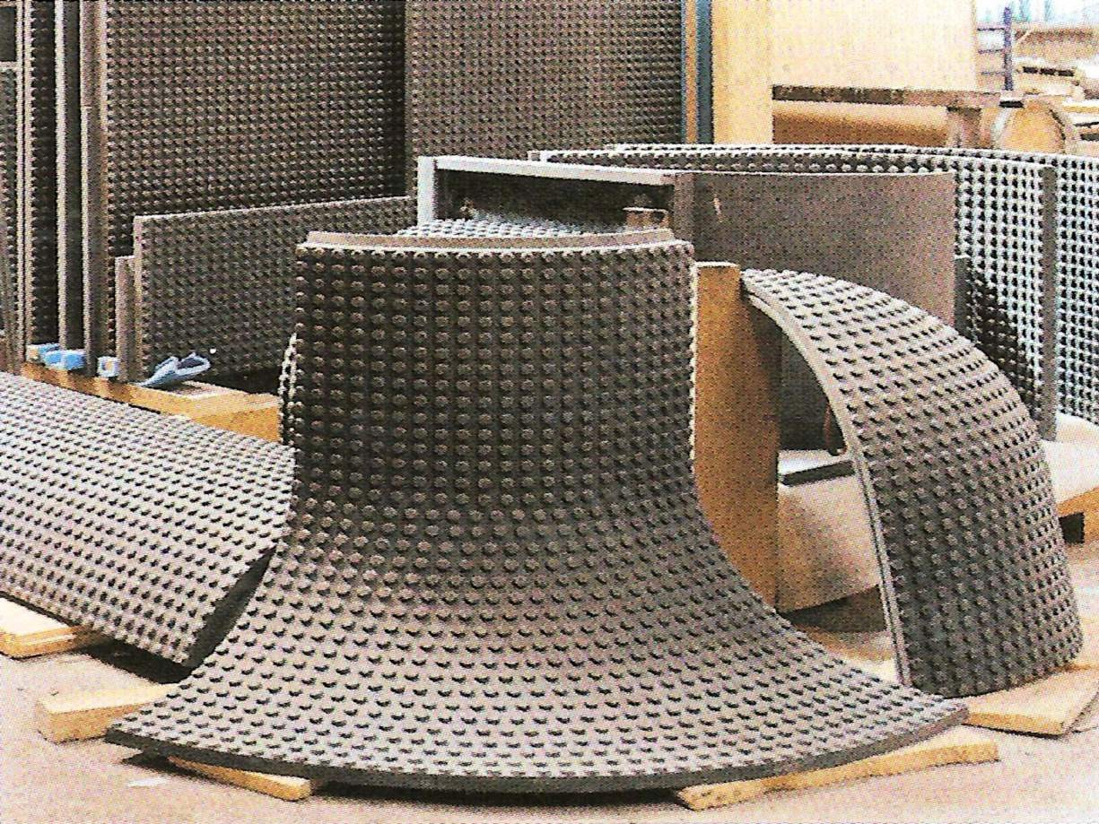

Slide 40
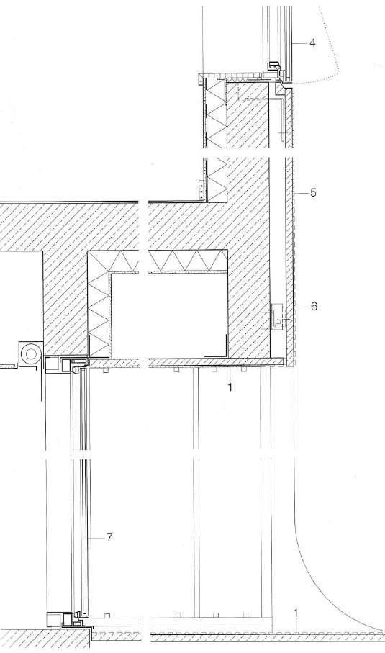
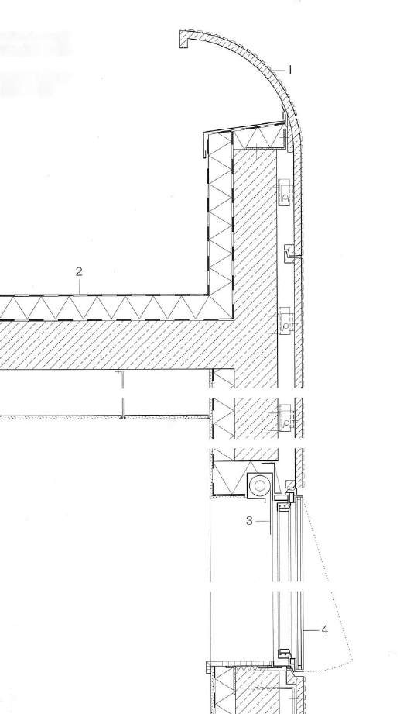

Slide 41
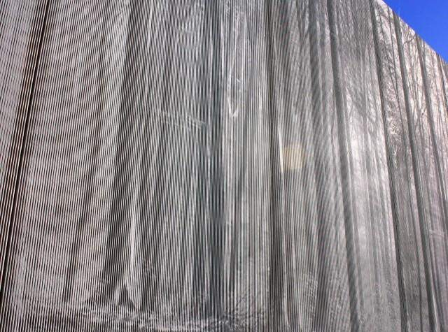
Photo-concrete

Slide 42
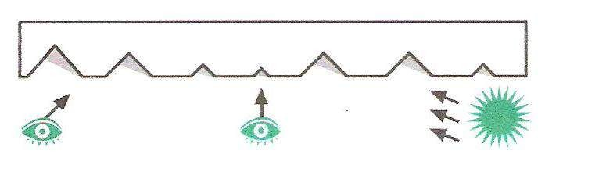
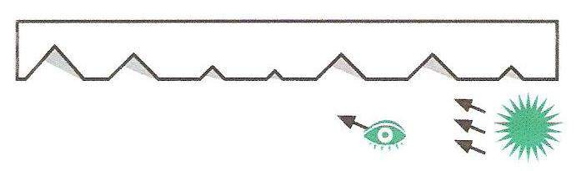
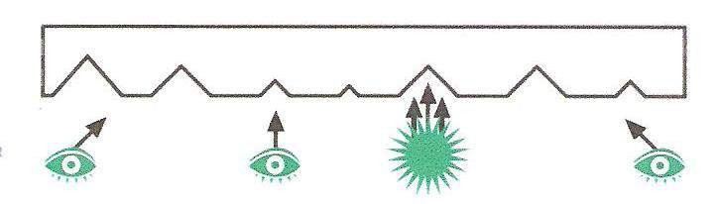

Slide 43
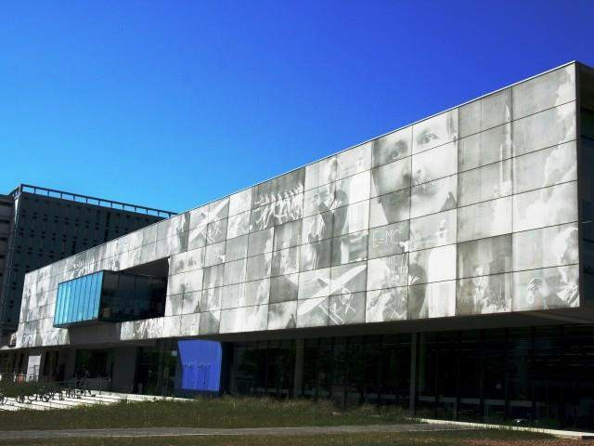

Slide 44
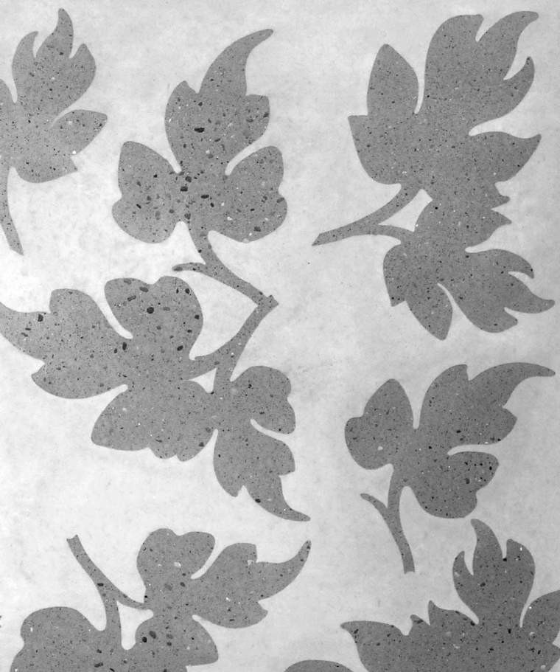
Photo-concrete.
A technology based on the use of hardening retarder and flushing of concrete mass

Slide 45

Fiber cement facade. Residential building. Murray Grove. London

Slide 46


Residential building. Murray Grove.

Slide 47


Slide 48


Slide 49

FACADE FINISHING TYPES construction/materials
Prof. Waclaw Celadyn, PhD.,D.Sc
11.09.2023
Sources:
49

Slide 50

Light concrete facade. Residential building.
Chur

Slide 51

Light insulation concrete: cement, light aggregate, expanded glass (instead of sand)
Exterior walls - 45 cm U=0,58 W/m2K
Roof – 60 cm U=0,4 W/m2K
Residential building.
Chur

Slide 52


Slide 53


Slide 54

System ETICS

Slide 55


Slide 56


Slide 57


Slide 58


Slide 59


Slide 60


Slide 61


Slide 62


Slide 63


Slide 64

Culture Center.
^{To}1^{r}1^{u}.0^{n}9.2023
Picado system
64

Slide 65


Slide 66


Slide 67


Slide 68

Light wet technology

Slide 69


Slide 70


Slide 71



Slide 72


Slide 73


Slide 74


Slide 75

Observation and research Centre on Furnas Lake. Sao Miguel

Slide 76

Observation and research Centre on Furnas Lake.
Sao Miguel

Slide 77


Slide 78


Slide 79

Winery Dominus. Yountville, CA,USA

Slide 80


Slide 81

Anti-graffiti system

Slide 82

Facade with Corian panel cladding. Hotel Seeko`o – Bordeaux

Slide 83


1- Corian panel – acrylic composite ( 2,2x5,5m, 13mm thick) on aluminium substructure

Slide 84

Façade with transparent insulation strips

Slide 85

Transparent insulation on masonry wall

Slide 86

Bayerischer Landesbank. Munich

Slide 87


Slide 88


Slide 89

Polycrystalline PV cells

Slide 90


Building glazed envelope with paraffin filling (Phase Change Material) as a method of enhancement of thermal accumulation

Slide 91

Glazed building skin with integrated phase change material (PCM)

Slide 92

Residential building with bioreactor facades- Hamburg

Slide 93


Slide 94


Slide 95


Slide 96


Slide 97


Slide 98


Slide 99

Corten cladding with anti-graffiti treatment.
Congress Center. Barcelona

Slide 100

Sandwich plate

Slide 101



Slide 102


Slide 103


Steel cassette system – regular and noise suppression profiles

Slide 104


Slide 105


Slide 106


Slide 107


Slide 108


Slide 109




Slide 110


Slide 111

Center for Visual Arts. Sainsbury

Slide 112


Slide 113


Slide 114


Slide 115


Slide 116

Culture Centre in Dhahran (arch. Snohetta)

Slide 117



Slide 118




Slide 119

11.09.2023
119

Slide 120


Slide 121


Slide 122


Slide 123


Slide 124


Slide 125


Slide 126


Slide 127


Slide 128


Slide 129


Slide 130


Slide 131

Palace. Guangzhou. China

Slide 132


Slide 133


Slide 134


Slide 135


Slide 136


Slide 137

Water power plant Power Plobb. Seefeld (A)

Slide 138

Water power plant Power Plobb.
Seefeld

Slide 139

Water power plant Power Plobb. Seefeld

Slide 140

Cork facade. House in Catalonia

Slide 141


Slide 142



Cork – 5 cm glued to CLT panels with lime screed
Cork facade. House in Catalonia

Slide 143

Cork – 5 cm glued to CLT panels with lime screed
Cork facade. House in Catalonia

Slide 144

De Young Museum – San Francisco

Slide 145


Slide 146


Slide 147

Garden pavillion. Basel.
Building paper with sand topping

Slide 148


Garden pavillion. Basel.
Building paper with sand topping

Slide 149

Youth Center. De hood Osdorp – Amsterdam

Slide 150


- UV protection layer ochronna UV
hard foam PUR – 12 cm
steel structure/sandstone – 15cm
vapoufr retarder
wooden battens 2,5x5 cm
2x gypsum board – 2,5 cm
Youth Center. De hood Osdorp – Amsterdam

Slide 151

Culture Center Joue-les-Tours. Syntethic membrane reinforced with polyester mesh

Slide 152



Slide 153

PVC membrane. Supermarket „Im Viadukt”. Zurich

Slide 154


2 – folia EPDM
6 – folia EPDM na 30 mm
wełnie mineralnej
Supermarket „Im Viadukt” Zurich

Slide 155

Heat exchanger building nr 8. Utrecht

Slide 156

Vandal-proof polyurethane membrane.
Heat exchanger building nr 8. Utrecht

Slide 157


Slide 158



Slide 159


Slide 160

GFRP panel cladding – 4 mm thick

Slide 161

GFRP panel cladding – 4 mm thick

Slide 162


Slide 163

Residential building „Silodam”. Amsterdam

Slide 164


Slide 165

11.09.2023
Sources:
165

Slide 166

11.09.2023
Sources:
166

Slide 167


Slide 168

White acrylic glass 6,5 mm thick fixed to
aluminium substructure with silicone

Slide 169



Slide 170

Printed plastic mesh. Industrial building

Slide 171

Printed plastic mesh. Industrial building

Slide 172


Slide 173


Slide 174


Slide 175


Slide 176


Slide 177


Slide 178


Slide 179

Transforming station. Augsburg - Stadtbergen

Slide 180


Slide 181

„La Miroiterie” building. Lausanne

Slide 182



Slide 183

Training Center. Gaissach.

Slide 184



Slide 185

Nano-vent-skin

Slide 186


Slide 187


Slide 188

Patrick Blanc`s green wall system

Slide 189


Slide 190


Slide 191

Evolution of building envelopes from massive walls toward spatial systems

