Slide 1
Cost estimation: Dimensions, transport, montage, and logistics
Erasmus+ Project: Sustainable, High-performance Building Solutions in Wood (HiBiWood)
Project Number: 2020-1-LV01-KA203-077513
Ingars Strazdins

Slide 2
1. Cost-effective materials
1st to do a cost-effective building we need to decide which materials would be most cost-effective.
What includes or makes a material cost effective?
Price per m³?
Delivery distance?
Built on site/Prefabricated?
Time to build/assemble it?
How many builders needed?
What equipment needed?

Slide 3
Examples (links)
Construction site plan
Prefabricated concrete panels
What includes or makes a material cost effective?
Price per m³/m²?
Delivery distance/how many trucks needed?
Built on site/Prefabricated (faster to erect the building)?
Time to build/assemble it?
How many builders needed?
What equipment needed to build it?
Seq Plan
EUR/m²
Delivery plan
Prefabricated
Time
3x
Crane
Supports

Slide 4
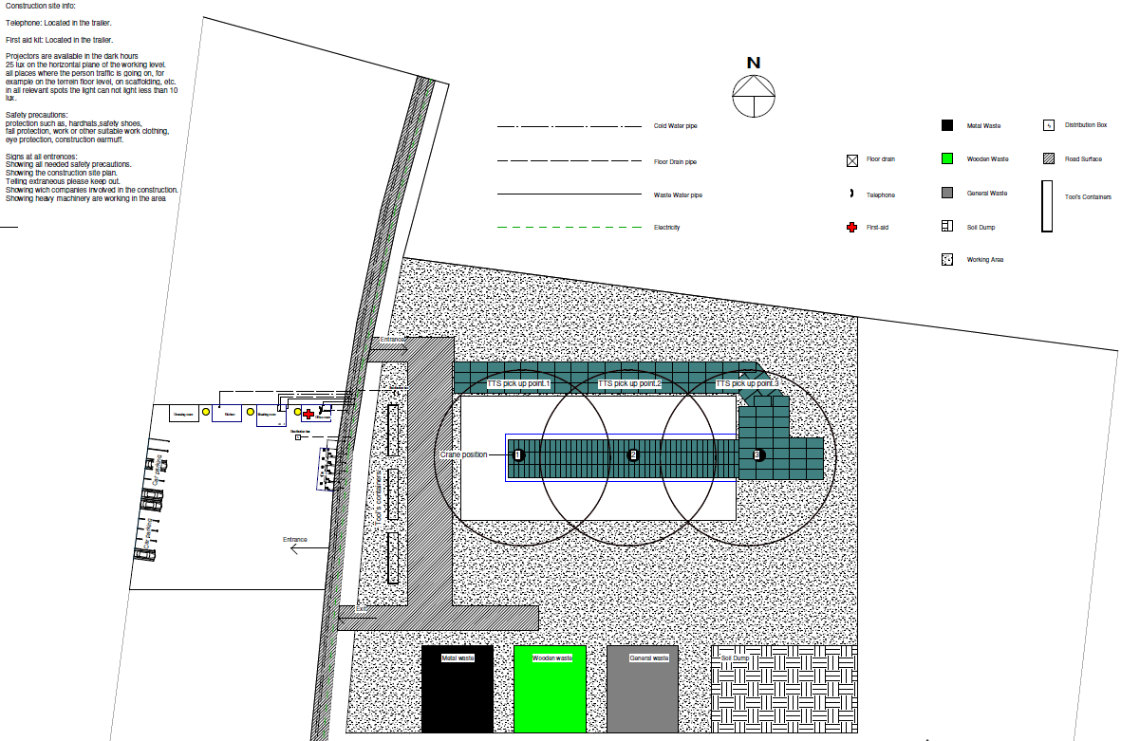
Back

Slide 5
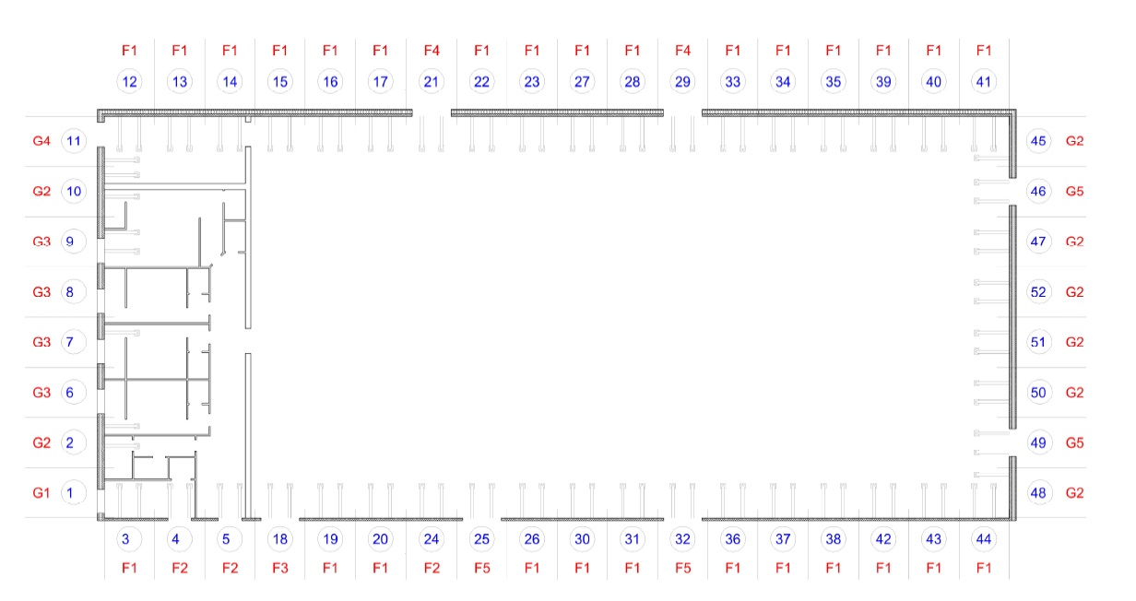
Back

Slide 6
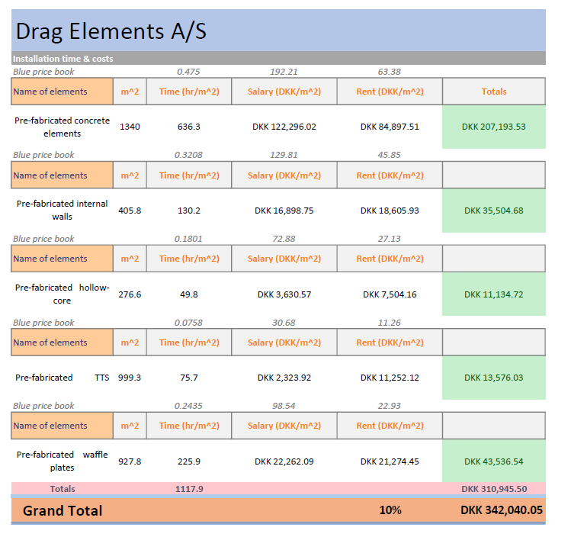
Back

Slide 7
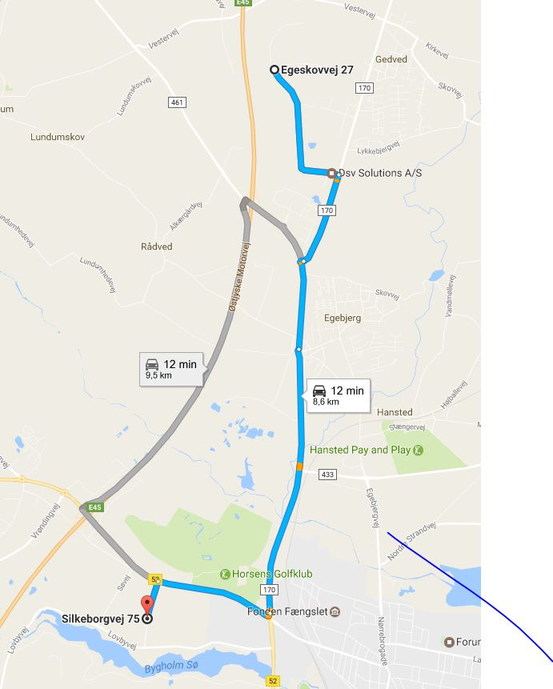
Back

Slide 8
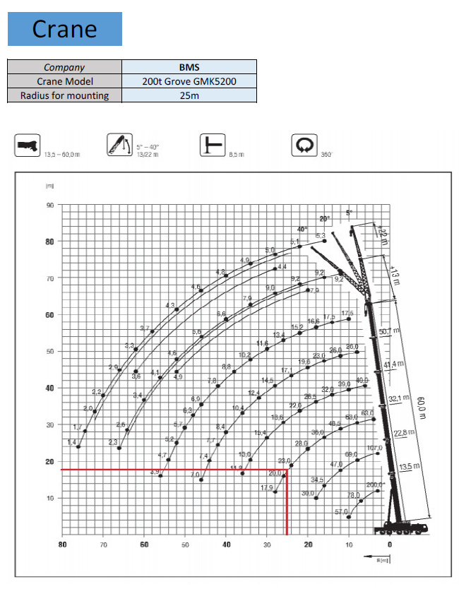
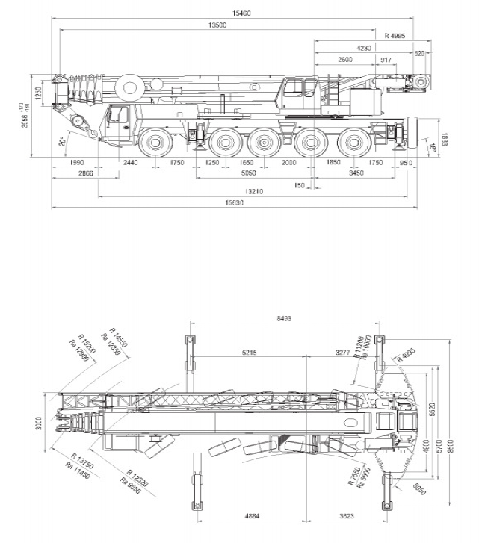
Back

Slide 9
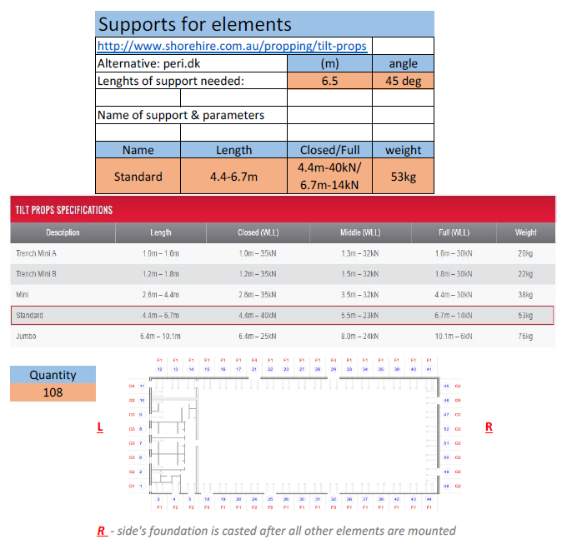
Back

Slide 10
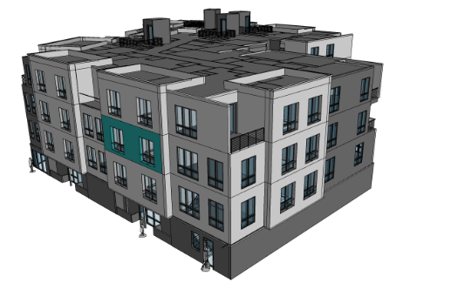
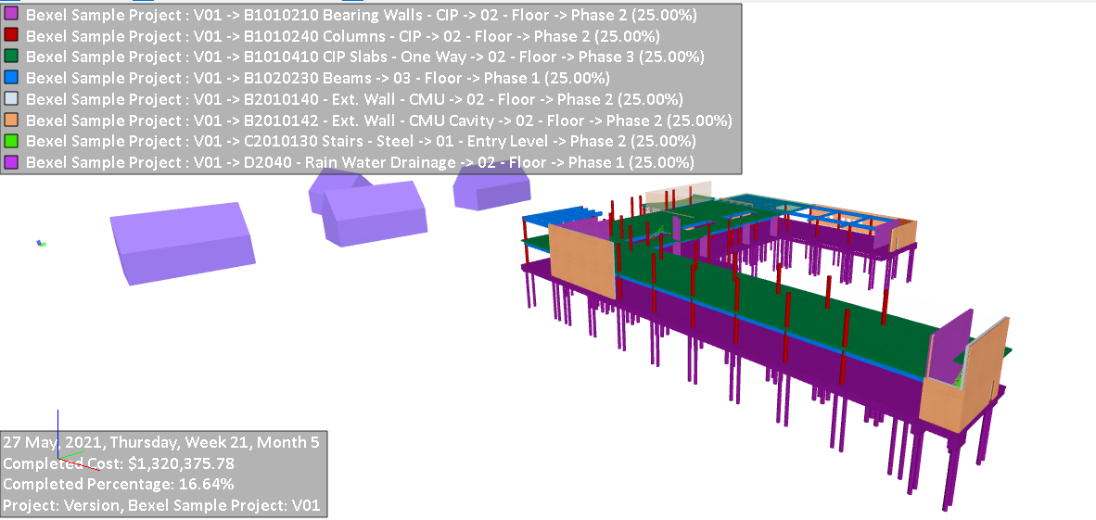
4D/5D
3D - Elements (3D model of the project)
4D – Elements and Time added (+ schedule)
5D – Elements, Time and Money (costs per elements and time)

Slide 11
To optimize costs of the building
10k
35k
3k
5k
2k
10k
60k
1k
*To reduce the cost of the building, you have to look at the “big squares” which takes the most percentage of the total cost, not to the expensive small things – for example expensive tiles in 2m² bathroom. And of course don’t forget about the expenses of the logistics.

Slide 12
Thank you for your attention!

