Slide 1
Timber BIM modelling. IFC and Operation and Maintenance
Erasmus+ Project: Sustainable, High-performance Building Solutions in Wood (HiBiWood)
Project Number: 2020-1-LV01-KA203-077513
Ingars Strazdins

Slide 3
Topics to cover:
How to open and export IFC file
IFC Viewers
Basics of optimal IFC File and its classification
IFC Classification
Correct Modeling
Examples
LOD = LOI + LOG
IFC Use cases
IFC Communication (BCF)

Slide 4
How to export IFC file (Revit)
*It is important to give out the most information as possible, by exporting IFC,
That’s why always ask your BIM coordinator – for any additional tick marks:

Slide 5
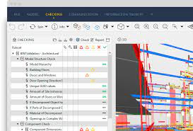
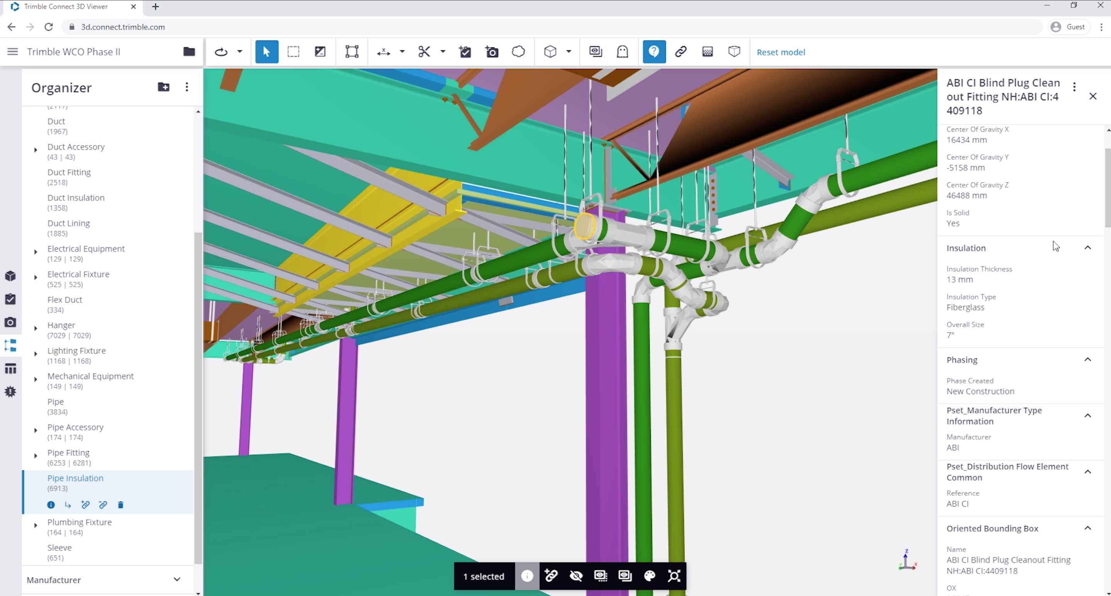
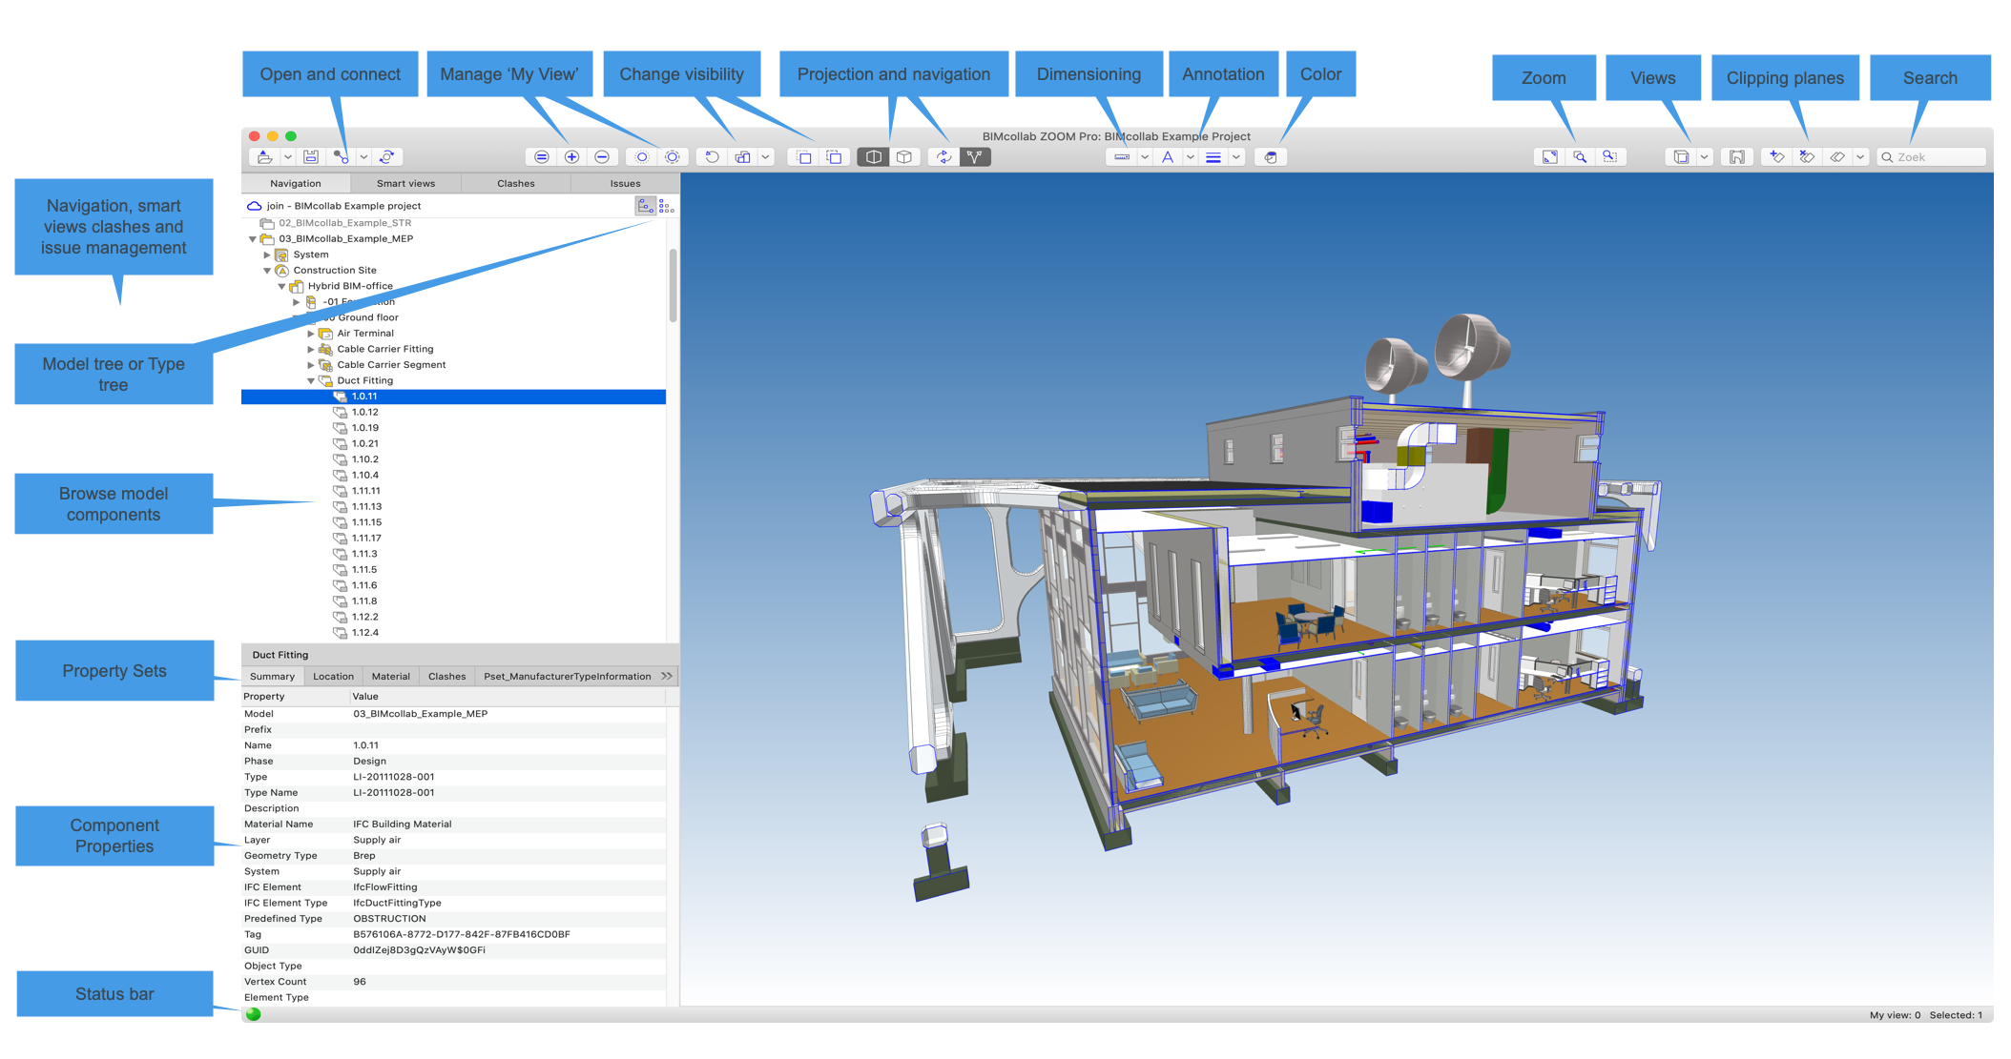
IFC Viewers
*IFC is OPEN standart, so anyone can open it as PDF document, to open IFC you need IFC viewer like:
Solibri, Trimble Connect, BIMcollab ZOOM or just go online and see the IFC file - https://wikiifc.com/

Slide 6
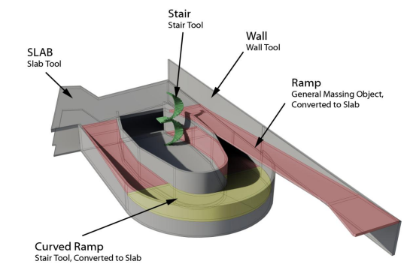
Basics of optimal IFC File and its classification /Correct Modeling
*It is important to make sure – IFC doesn’t contain unclassified elements – objects, that’s why it is important
To model with tools which are shown in application, or at least then give necessary classification, if modelled
By authoring tools, it must export correctly - automatically
Columns exports as IfcColumn by default

Slide 7
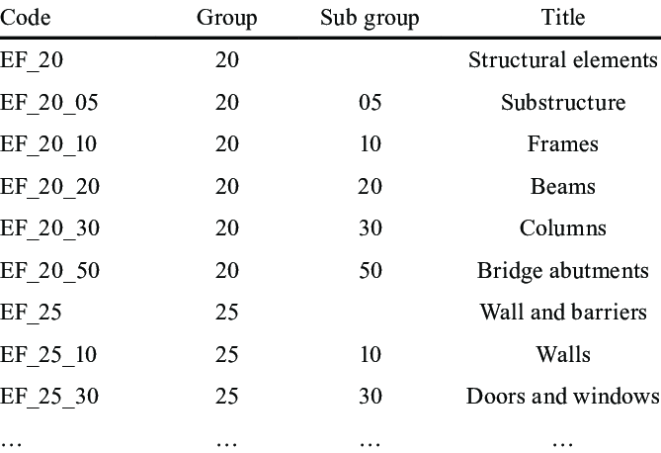
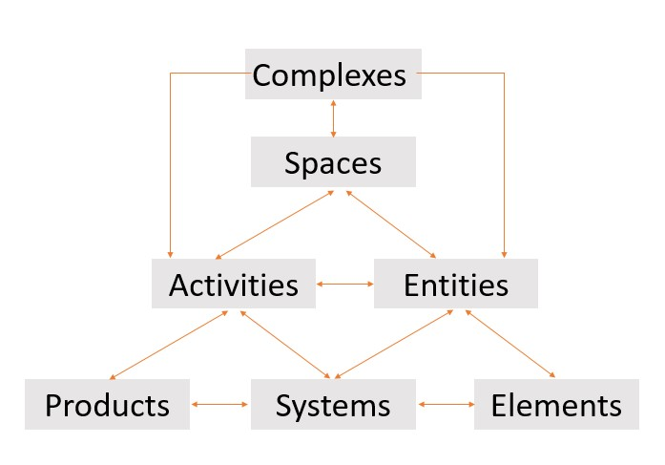
IFC Classification
*Sometimes it is necessary to add additional IFC classification as Uniclass 2015 or other, depending on where
The project is located. These classifications help to categorize elements by system, function and product (material etc)

Slide 8
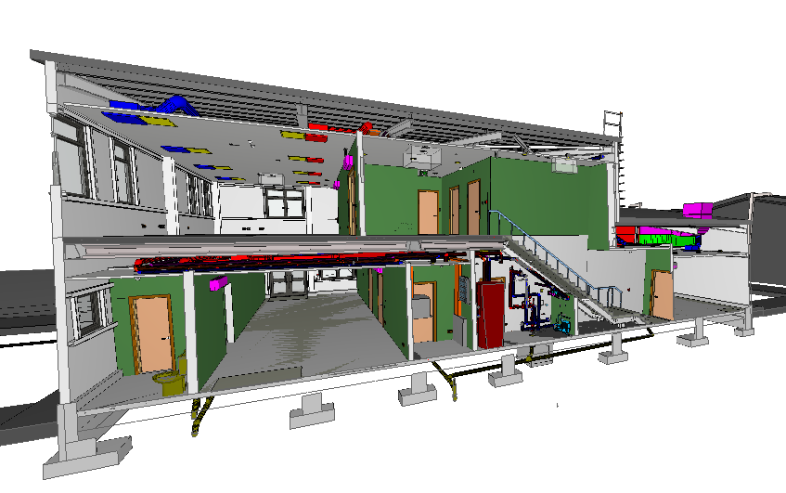
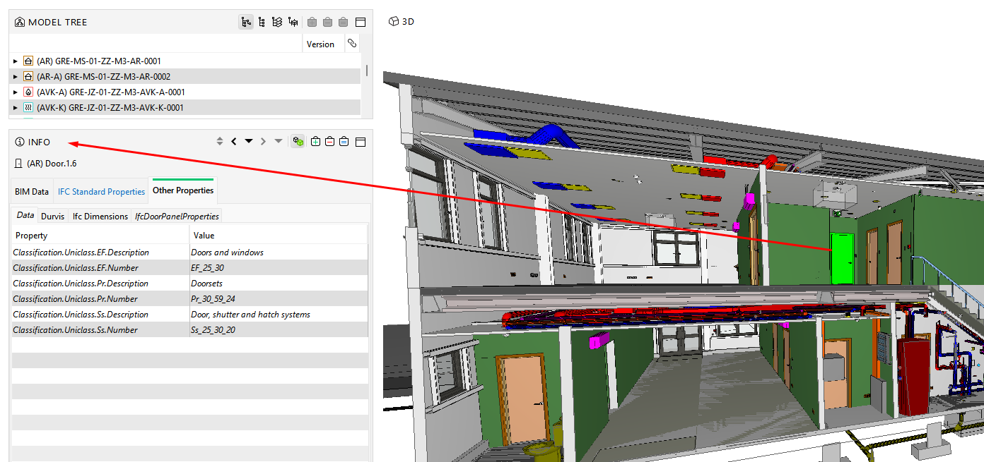

Slide 9
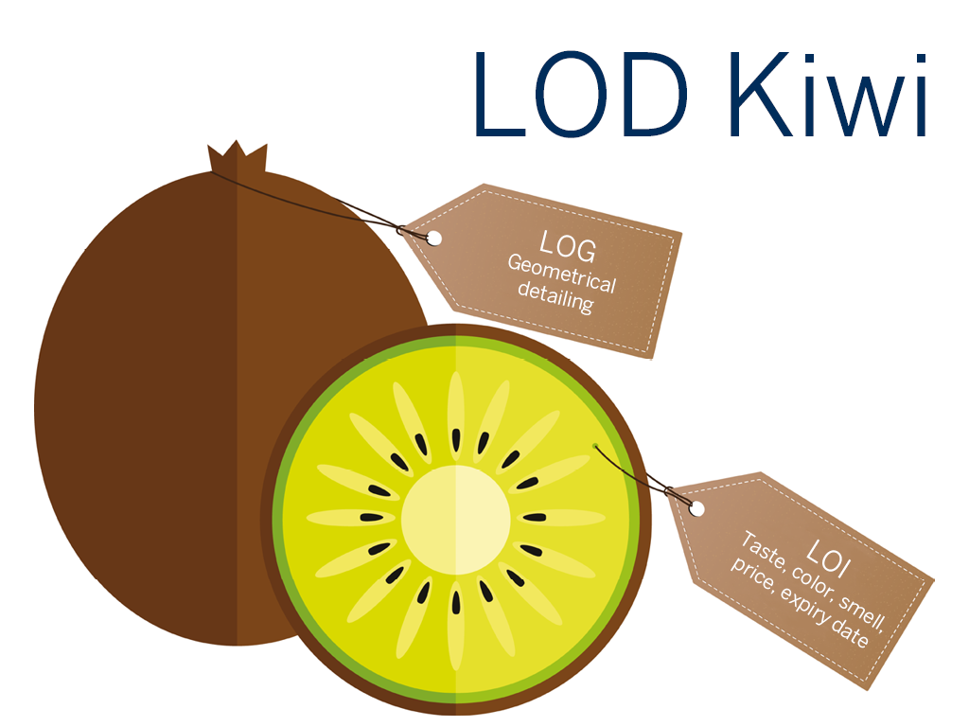
LOD = LOI + LOG
LOD = LOG + LOI
For this simplified representation of LOD = LOG + LOI, we have chosen a kiwi that is divided into the LOG (Level of Geometry) and LOI (Level of Information).
LOG: Level of Geometry
The outside, the visible part of the LOD-kiwi, is the Level of Geometry (also called level of detail). It tells us something about the appearance (the geometry) of the element.
LOI: Level of Information
The invisible, non-geometric part of the kiwi is the LOI or Level of Information. In the example of the LOD kiwi, this is the taste, the colour, the smell, the price, and the expiry date.

Slide 10
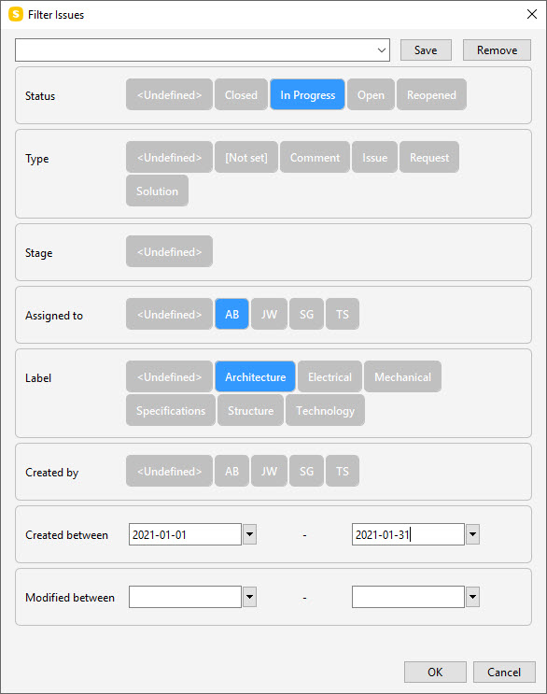
IFC Communication (BCF)
BIM Collaboration Format (BCF)
When you exchange BIM data using IFC, you probably also want to communicate about the objects in your model. Doing this over email, or using the phone to comment about 'the 3rd column from the right on the 2nd floor' brings risks and unclarities. This is why the "BIM Collaboration Format" (BCF) was created.
The BCF contains information about the problem/issue/collision as you can see on the right, and as well the actual IFC element GUID numbers, the camera angle and coordinates of the view.

Slide 11
Thank you for your attention!

