Slide 1
Timber technology - Structural Systems
DI Matthias Doubek, B.Sc.
Baumeister, Zimmermeister
2023

Slide 2
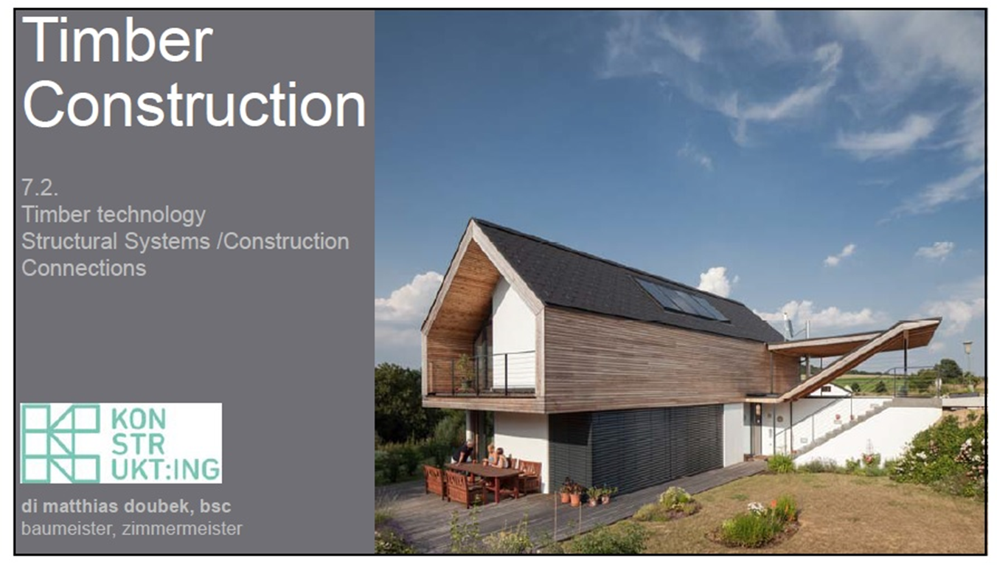
Timber technology - Structural Systems
DI Matthias Doubek

Slide 3
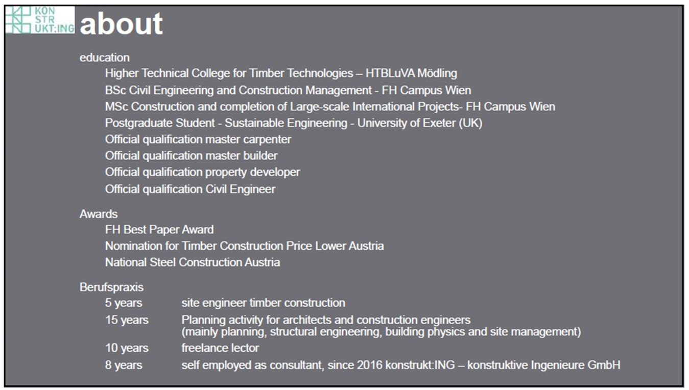
Timber technology - Structural Systems
DI Matthias Doubek

Slide 4
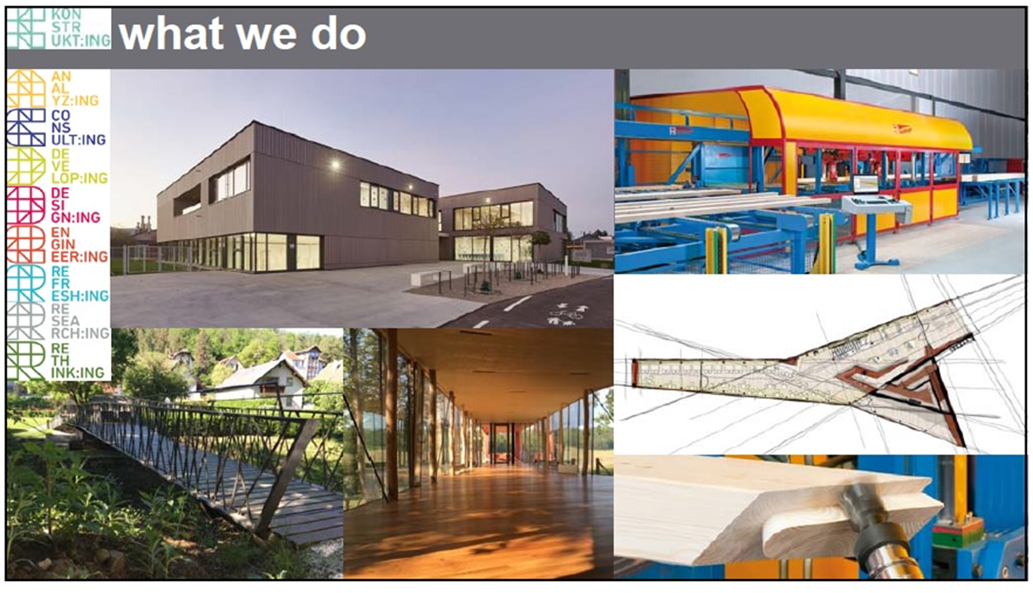
Timber technology - Structural Systems
DI Matthias Doubek

Slide 5
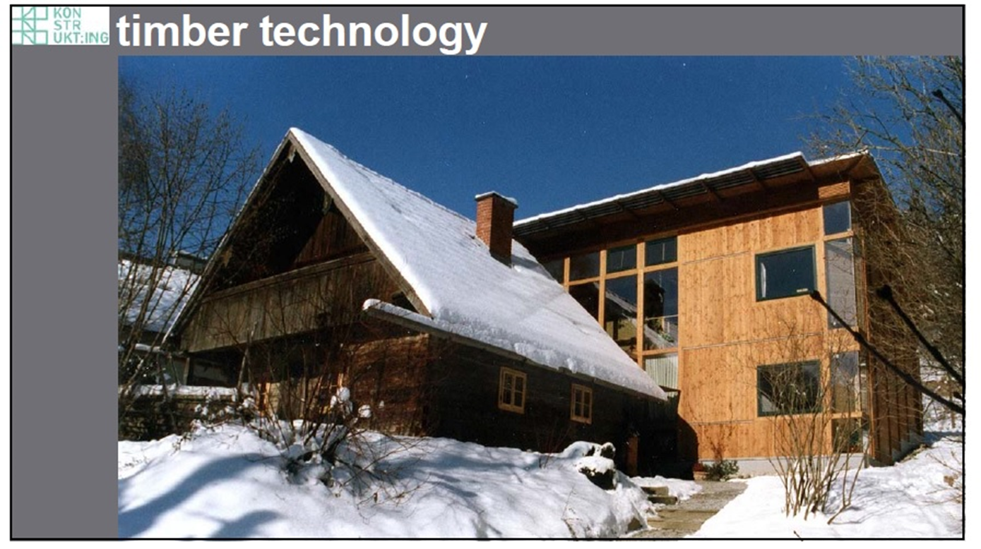
Timber technology - Structural Systems
DI Matthias Doubek

Slide 6
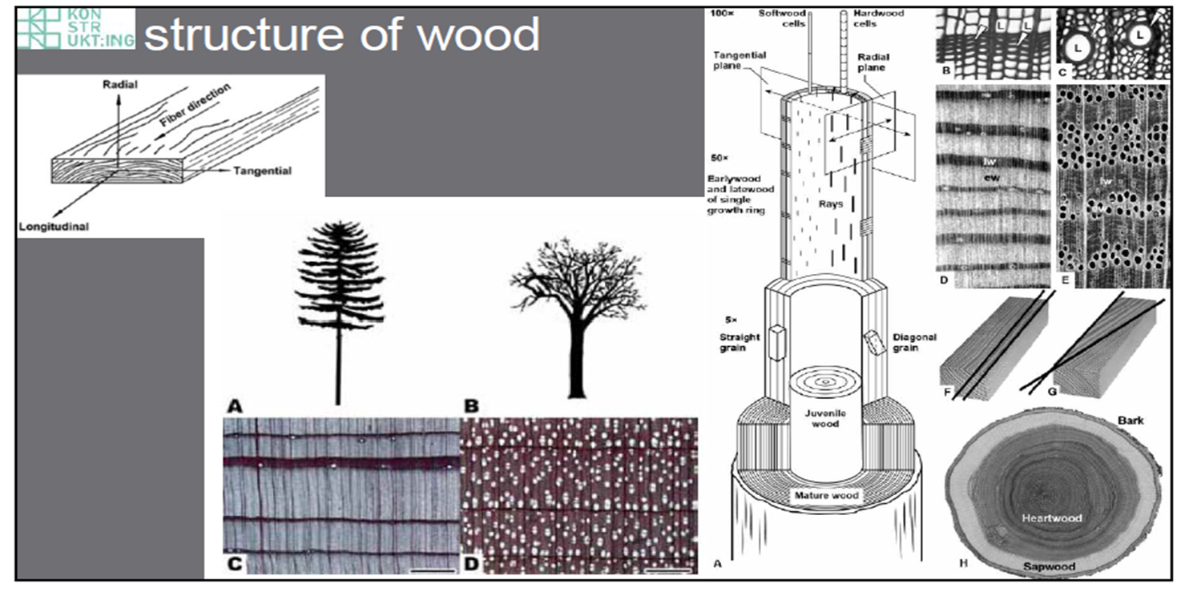
Timber technology - Structural Systems
DI Matthias Doubek

Slide 7
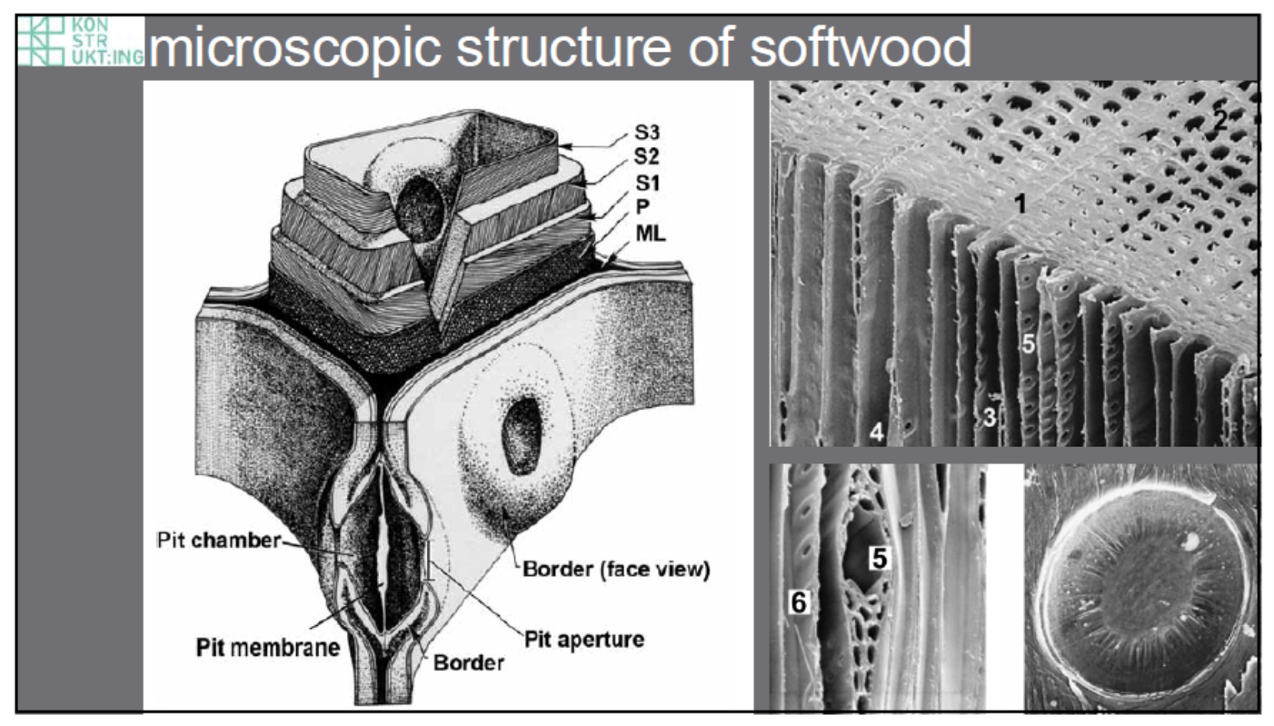
Timber technology - Structural Systems
DI Matthias Doubek

Slide 8
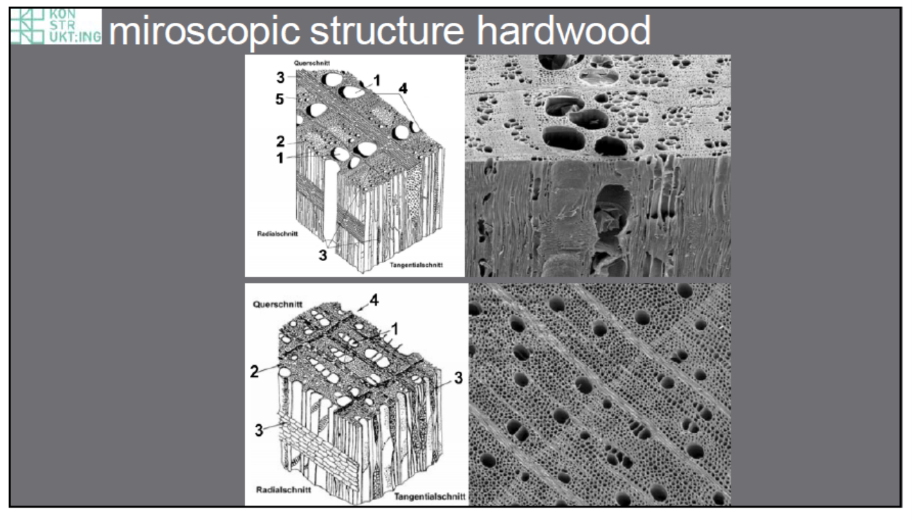
Timber technology - Structural Systems
DI Matthias Doubek

Slide 9
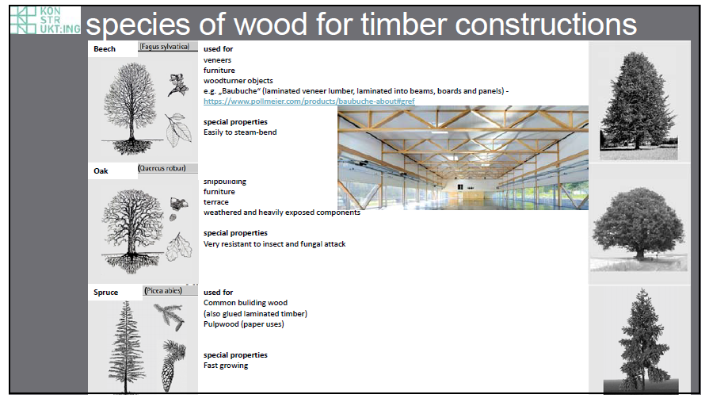
Timber technology - Structural Systems
DI Matthias Doubek

Slide 10
Timber technology - Structural Systems
DI Matthias Doubek

Slide 11
Timber technology - Structural Systems
DI Matthias Doubek

Slide 12
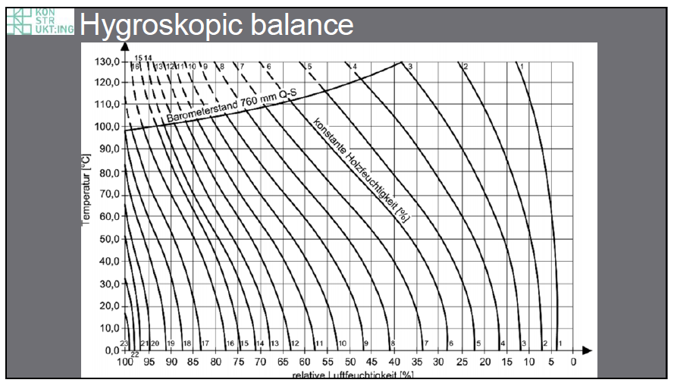
Timber technology - Structural Systems
DI Matthias Doubek

Slide 13
Timber technology - Structural Systems
DI Matthias Doubek

Slide 14
Timber technology - Structural Systems
DI Matthias Doubek

Slide 15
Timber technology - Structural Systems
DI Matthias Doubek

Slide 16
Timber technology - Structural Systems
DI Matthias Doubek

Slide 17
Timber technology - Structural Systems
DI Matthias Doubek

Slide 18
Timber technology - Structural Systems
DI Matthias Doubek

Slide 19
Timber technology - Structural Systems
DI Matthias Doubek

Slide 20
Timber technology - Structural Systems
DI Matthias Doubek

Slide 21
Timber technology - Structural Systems
DI Matthias Doubek

Slide 22
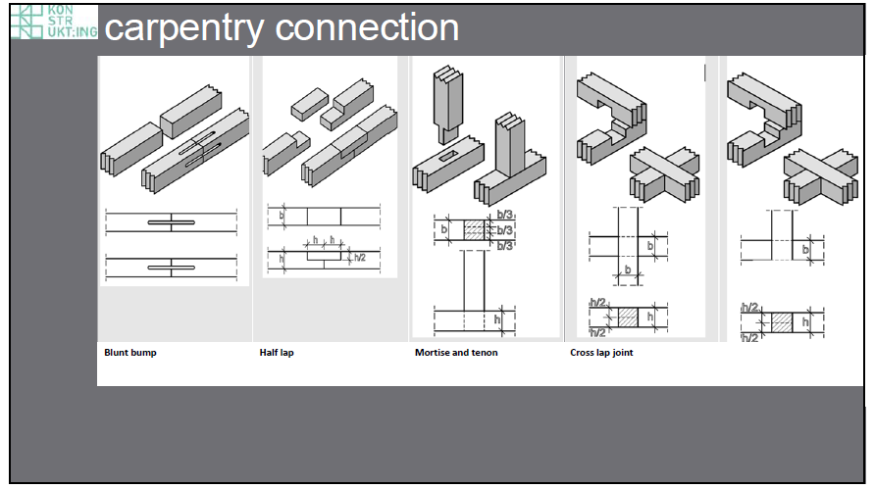
Timber technology - Structural Systems
DI Matthias Doubek

Slide 23
Timber technology - Structural Systems
DI Matthias Doubek

Slide 24
Timber technology - Structural Systems
DI Matthias Doubek

Slide 25
Timber technology - Structural Systems
DI Matthias Doubek

Slide 26
Timber technology - Structural Systems
DI Matthias Doubek

Slide 27
Timber technology - Structural Systems
DI Matthias Doubek

Slide 28
Timber technology - Structural Systems
DI Matthias Doubek

Slide 29
Timber technology - Structural Systems
DI Matthias Doubek

