Slide 1








SUSTAINABLE, HIGH-PERFORMANCE BUILDING SOLUTIONS IN WOOD
2020-1-LV01-KA203-077513
ERASMUS+ Strategic Partnerships For Higher Education
WHY IT IS CRITICAL THAT WE BUILD IN WOOD AND IMPLEMENT PBL TEACHING METHODOLOGY
Roger Howard Taylor
09 05 2022, Cracow

Slide 2
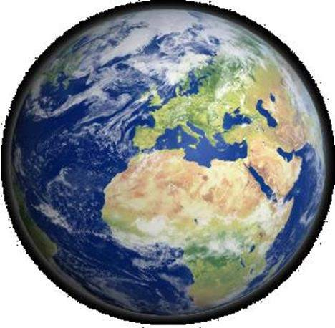
THE PLANET EARTH
The planet Earth formed over 4.5 billion years ago.
Water covers roughly 71% of Earth's surface
About a fifth of Earth's atmosphere consists of
produced by trees and plants.
oxygen,
Humans emerged 300,000 years ago
The Earths population is almost 8 billion today
Until the 1850s the Earth was in balance
Today, humanity's impact on Earth's climate, soils, waters, and ecosystems is unsustainable, threatening people's lives and causing widespread extinction of life.

Slide 3
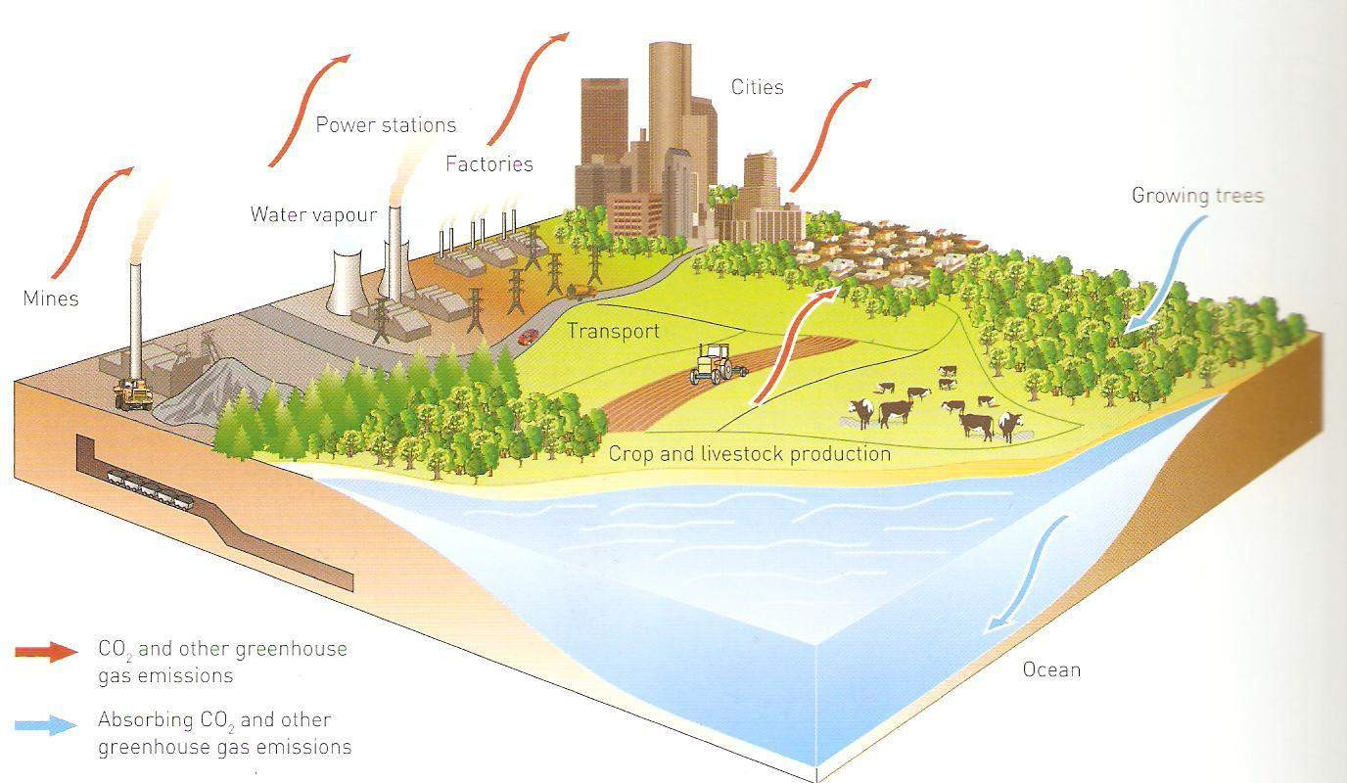
ENERGY AND GLOBAL WARMING

Slide 4
EU CLIMATE CHANGE POLICY AND REALITIES
The EU is already on track to meet greenhouse gas emissions reduction target by 2030 of 55% and the EU becoming (CO₂) climate neutral by 2050 in order to keep the global temperature increase well below 2 degrees C.
The year 2020 was the warmest year on record across the world.
July 2021 was the hottest month ever recorded throughout the world.
Greenland situated near the north pole received rain on Saturday, August 14 for the first time ever recorded
Europe's annual temperature in 2020 was the highest on record at least 0.4 degrees C warmer.
Several heavy rainfall events brought record rainfall across much of Europe in turn causing extreme floods in many countries.

Slide 5
IPCC CLIMATE CHANGE REPORT KEY POINTS
Seven key points from the IPCC Climate Change report:
Climate change is definitely man-made
Global warming is unprecedented
Global warming will continue
Global warming can be stopped based on the world hitting net zero emissions
The weather has already changed as a result of green house gasses
The weather will continue to change
Changes to the weather will be worse, if global warming is not limited to 1.5C

Slide 6
IPCC CLIMATE CHANGE REPORT KEY POINTS
The consequences get worse and worse and worse as we get warmer and warmer, every tonne of CO2 matters and every bit of warming matters.
The IPCC states as every tonne of CO2 adds to global warming, every tonne makes a difference.
1 m3 of wood sequests (absorbs) 1 Ton CO2

Slide 7









GREENHOUSE EFFECT
To understand exactly how the greenhouse effect works, imagine the following: a warm, sunny day where the sun shines bright on the Earth. This sunlight (shortwave radiation) passes into the planet's atmosphere and warms the Earth.

Slide 8

GREENHOUSE EFFECT
9

Slide 9
GREENHOUSE EFFECT
Part of this energy is absorbed by the Earth's surface, transformed into heat (longwave radiation) and radiated back towards space.
But as this heat goes up through the atmosphere, some of it is trapped by the different greenhouse gases and doesn't escape into space.
This in turn warms up the Earth's atmosphere; just like the windows of a greenhouse that lets light in and keeps the heat within to warm the plants growing inside.

Slide 10
ENERGY AND GLOBAL WARMING
Are all greenhouse gases equal?
Carbon dioxide (CO2) is the most abundant greenhouse gas. Other greenhouse gases, methane, ozone, nitrous oxide, and fluorocarbons
Even though we send far more CO2 into the atmosphere than any of these other gases, they are still extremely powerful global warming agents.
Rather than listing them all, scientists calculate for each greenhouse gas how much carbon dioxide it would take to produce the same amount of warming. This equivalent amount of carbon dioxide is called CO2-e, where the e stands for equivalent.

Slide 11
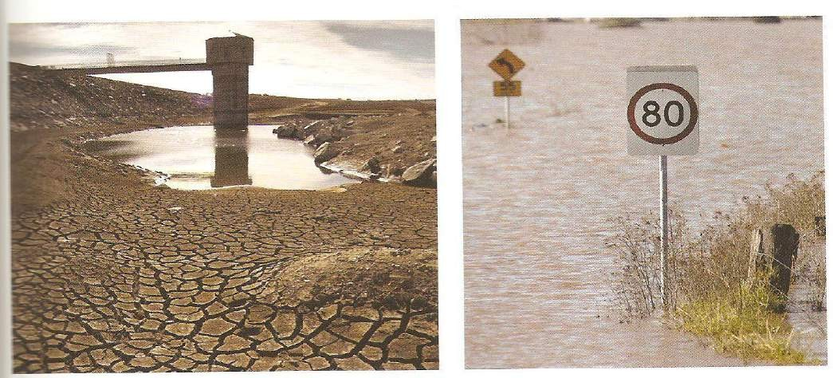
ENERGY AND GLOBAL WARMING
With the release of this carbon dioxide, the temperature of the atmosphere and ocean has increased by 1.0 degrees C, with the result that snow and polar ice are melting and the sea level is rising. Rainfall patterns are changing as well.

Slide 12
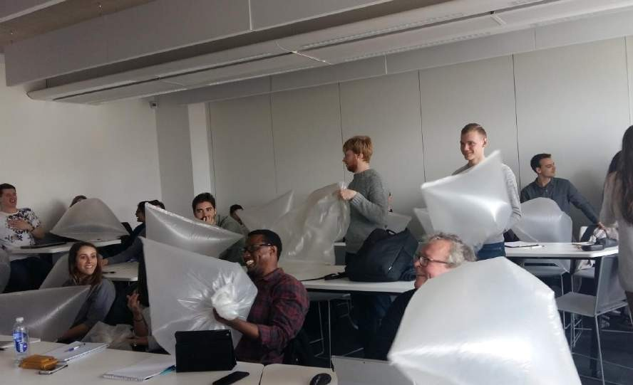
WHAT DOES A KILOGRAM OF CO2 LOOK LIKE?
Each group blow up your garbage plastic bag, like in the photo above, each bag contains 100 grams of greenhouse gas, CO2.

Slide 13
VISUALIZING CO2-E:
Traditionally, scientists measure CO2-e by its mass, in kilograms or tonnes.
10 garbage bags of CO2-e have a mass of about one kilogram
10 garbage bags of CO2-e are produced from a kilowatt-hour (kWh) of electrical energy use, our electricity bills are measured in kWh and switching on a 100 watt light for 10 hours would use one 1kWh.
24 garbage bags of CO2-e are produced by using a litre of petrol
45,000 garbage bags of CO2-e for food, adds to a person’s
footprint.
A household of three people could easily produce enough CO2-e in a year to fill 500,000 garbage bags.

Slide 14
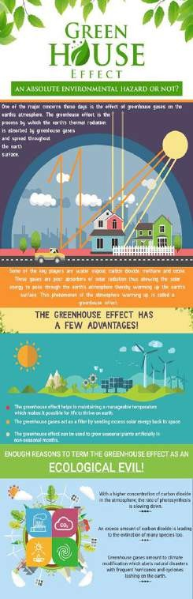
IS TIMBER EXPENSIVE?
Gradually over the past 150 years, focus has been on a shift from locally grown/produced building construction materials to centralised large-scale production and global distribution, and from traditionally produced materials.
Abundant global resources and in expensive labour in developing countries have shifted the production from Europe, of many building materials overseas because of cheaper costs.
But the real costs of cheap abundant resources are to our ecosystems destruction and pollution, are not always considered and calculated.

Slide 15

MICHAEL’S GREEN INSPIRATION
16

Slide 16
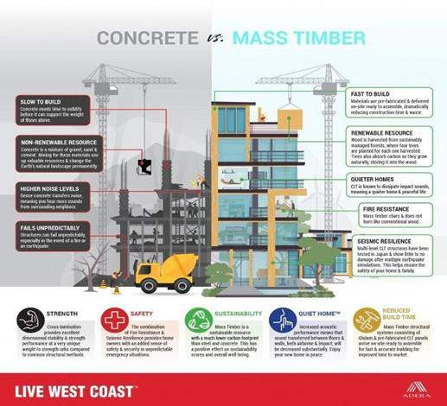

Slide 17
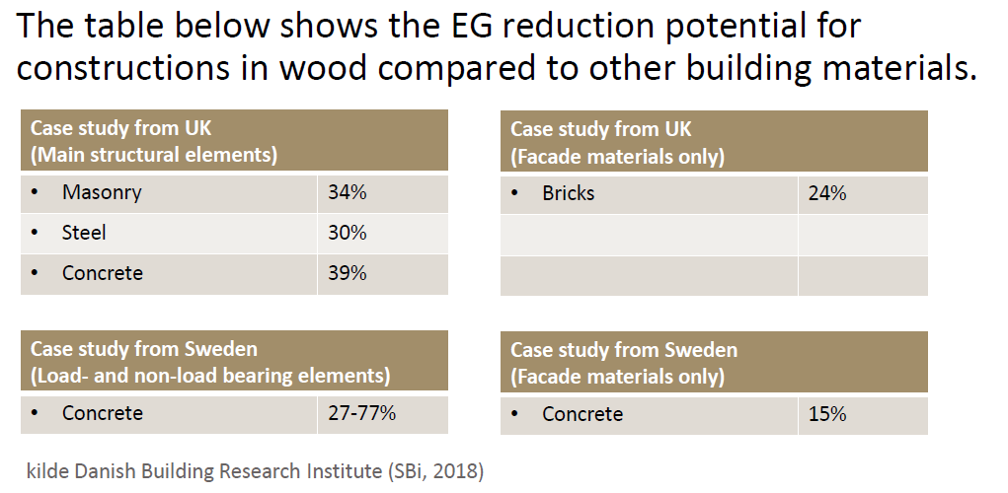
DESIGN STRATEGIES FPR REDUCTION OF EMBODIED GHG-EMISSION (EG)
18

Slide 18
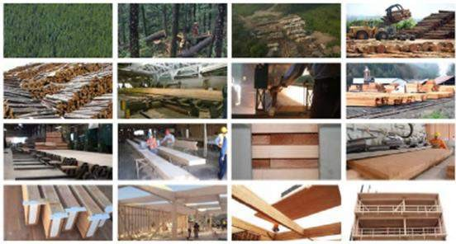
TIMBER IS AN SUSTAINABLE BUILDING MATERIAL PUBLIC CONCEPTION ABOUT WOOD?
Durability?
Fire protection?
Life span ?
Sound?
Costs?
Moisture?
Thermal?

Slide 19
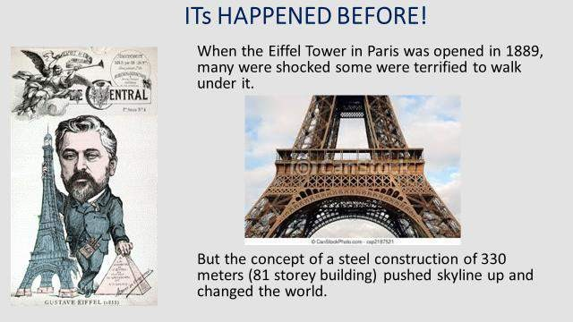

Slide 20
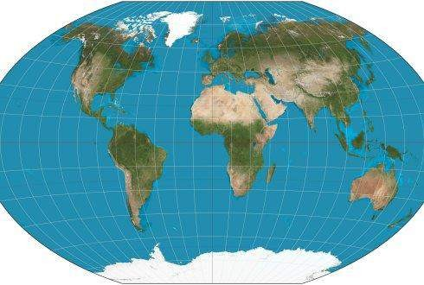
FORESTS AND OUR PLANET
WE LIVE ON A BLUE-GREEN PLANET:
blue defined by our vast oceans
green by our forests, which today comprise around 31 % of our planet’s surface area. 1/3 of the planets is total woodland
21

Slide 21
FORESTS AND CLIMATE CHANGE
Forest role in climate change is often misunderstood, the fact is that forests neither produce or remove CO2
Wood sequests and stores CO2 the more trees that are planted the more CO2 is stored
It is only released again when the wood rots and decays or burns.
If the amount of forests decrease the amount of CO2 storage from our atmosphere decreases
A tree can sequests many tons of CO2 during its life
1 cubic meter of wood sequests approximately 1 ton of CO2

Slide 22

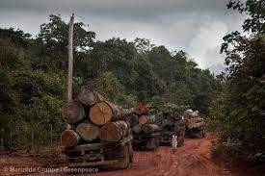
Tropical forests sequests the much CO2 the countries that cutting the rain forests are countries like Brazil and Indonesia for agriculture increases the amount of CO2 in the atmosphere increasing climate change and global warming, seriously changing weather patterns around the planet.
Under the European Green Deal, the EU biodiversity strategy for 2030 commits to planting at least 3 billion additional trees in the EU by 2030 in full respect of ecological principles.
The EU 3 Billion Trees Pledge

Slide 23
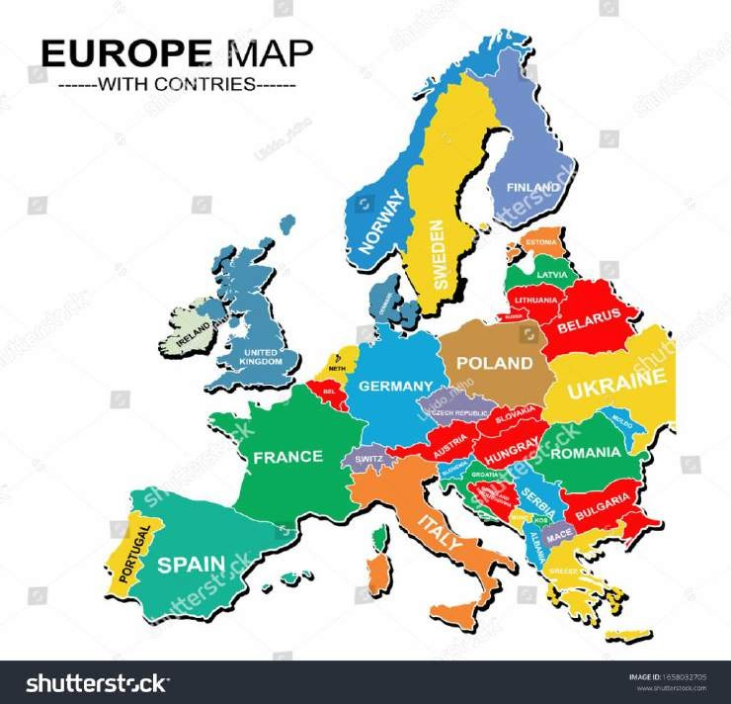
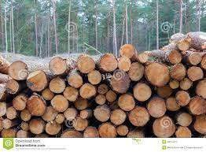
FORESTS AND CLIMATE CHANGE
Wood is the only major building material that grows its self with the power of the sun
240,000 square km of forest is felled over the past 5 years, which equals the size of Romania

Slide 24
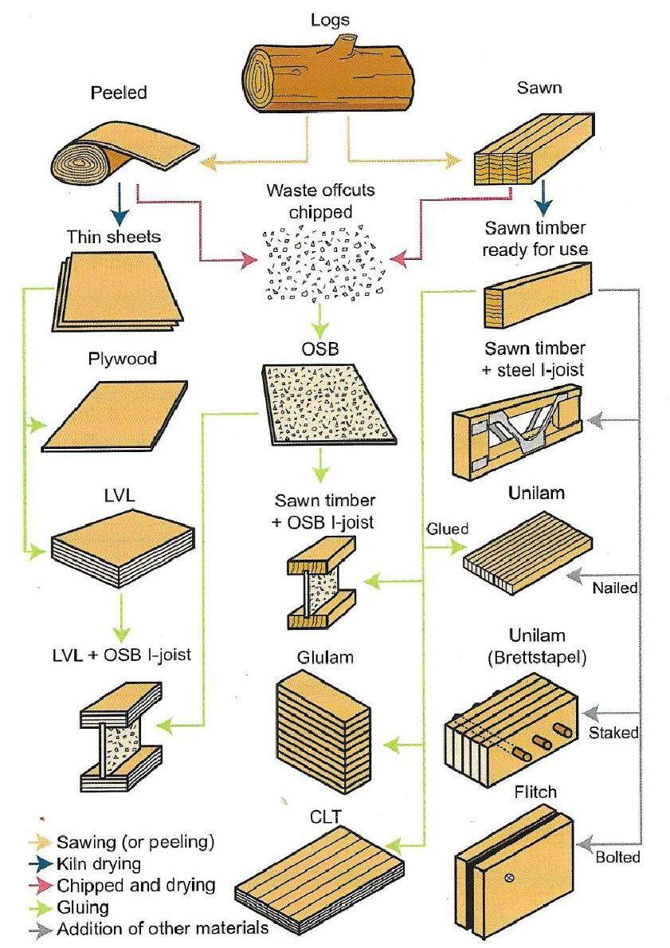

Slide 25
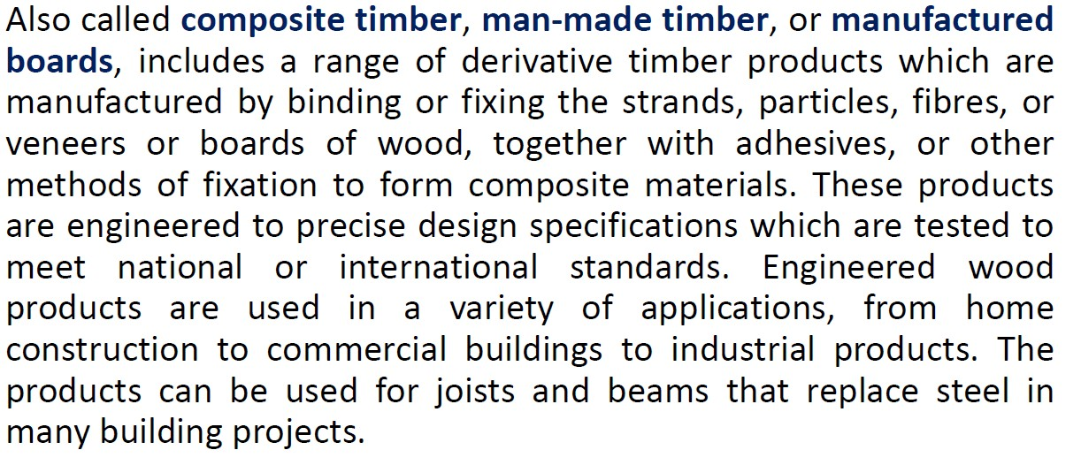

SUSTAINABLE ENGINEERED TIMBER

Slide 26
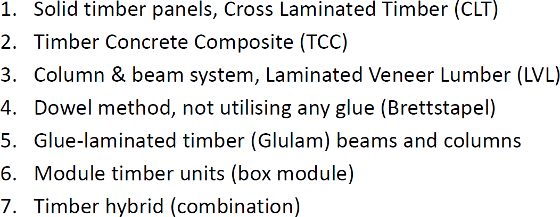
EXAMPLES OF ENGINEERED TIMBER COMPONENTS

Slide 27
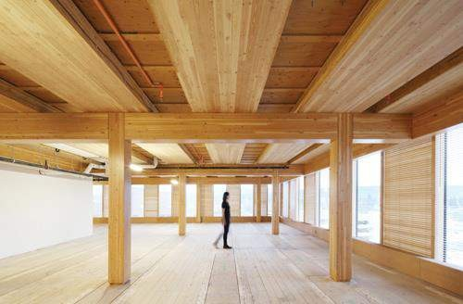
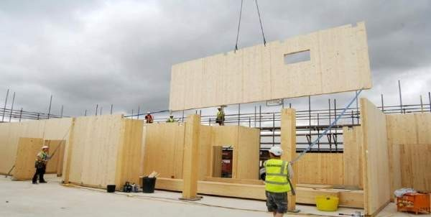
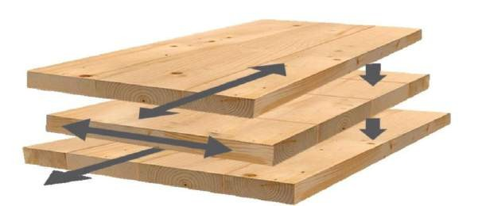
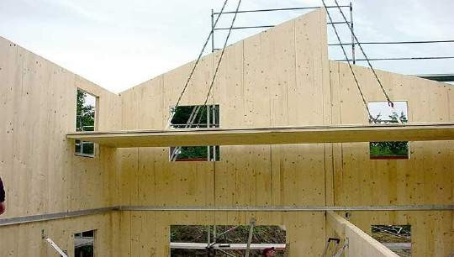
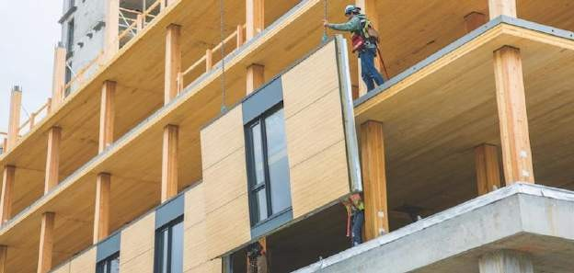
2

Slide 28

PROBLEM/PROJECT BASED LEARNING (PBL)
P (problem, project) B (based, oriented)
L (Learning)

Slide 29
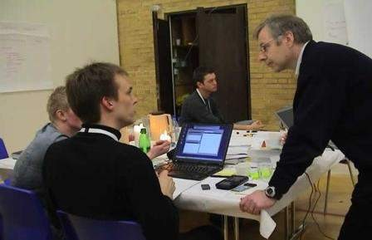

PBL - WHAT
A Teaching methodology
Student centred learning
Interpersonal/social skills development (soft skills)
Team work
Multi-disciplinary understanding
“Real Life” problems
Organization
Problem solving skills
Critical thinking

Slide 30


INSTRUCTION BASED LEARNING
CONTENT
KNOWLEDGE
ASSIGNMENT
SOLUTION

Slide 31






ORGANISING PERSPECTIVE – INSTRUCTION BASED
TEACHER
Objectives | knowledge | Production/ solution | Evaluation
STUDENT

Slide 32

PROJECT BASED LEARNING (PBL)
Solution A
PROBLEM
KNOWLEDGE
Solution B
Solution C

Slide 33






ORGANISING PERSPECTIVE - PBL
Teacher
Objectives | knowledge | Production/ solutions | Evaluation
Student

Slide 34
NEW REQUIRED
(soft skills)
International knowledge
Teamwork
Languages
Building Design
Building Services
Building Physics
Structural Design
Planning & Management
Materials science
Physics
Mathematics
Problem solving skills
Sustainability
Interpersonal/ Social skills
Intercultural competences

Slide 35
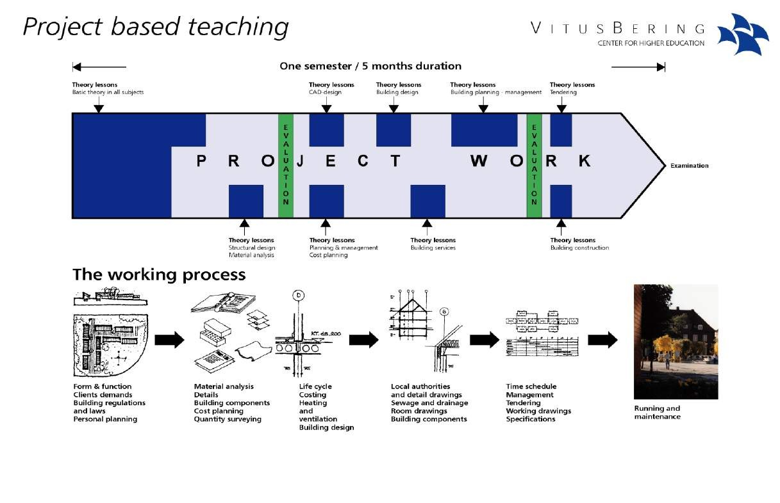
PROJECT BASED LEARNING DELIVERY PROCESS

Slide 36
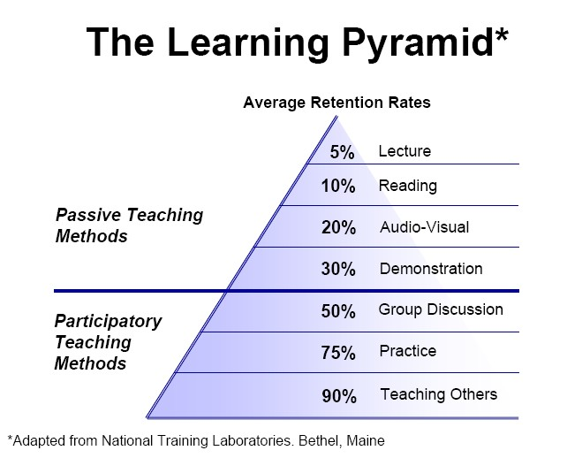
PBL – WHY?

Slide 37
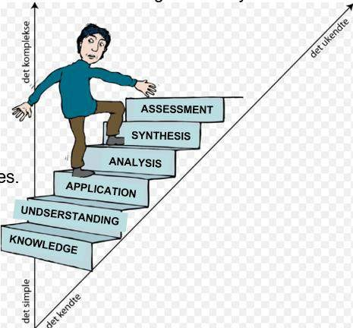
COMPENTENCIES, SKILLS & KNOWLEDGE
Comptencies
Skills
Knowledge
Source: semester syllabus

Slide 38
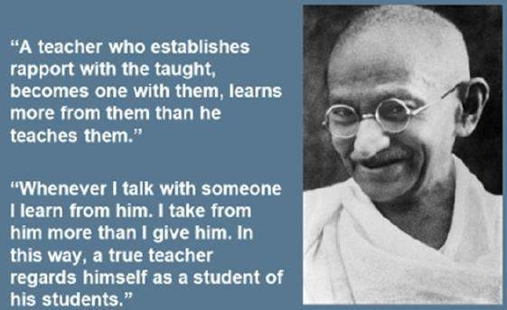
YOU MUST BE THE CHANGE, YOU WISH TO SEE IN THE WORLD
2

Slide 39
Thank you for your attention!
Questions?

