Slide 1
Tendering Structural - Systems Eléments
DI Matthias Doubek, B.Sc.
Baumeister, Zimmermeister
2023

Slide 2
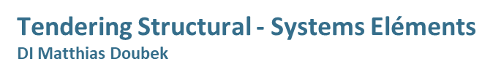
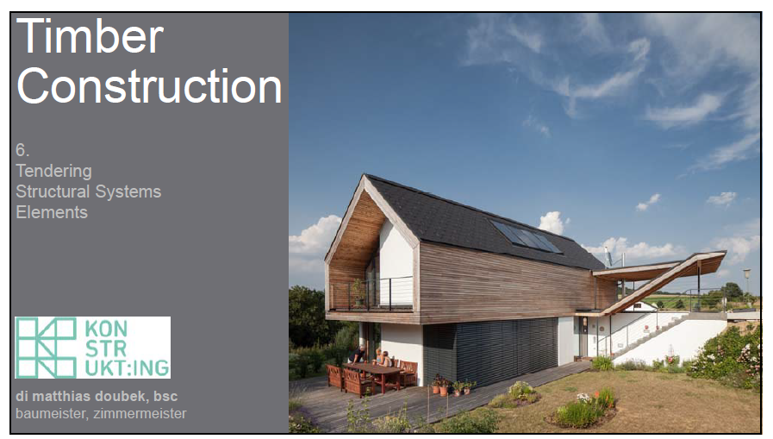

Slide 3
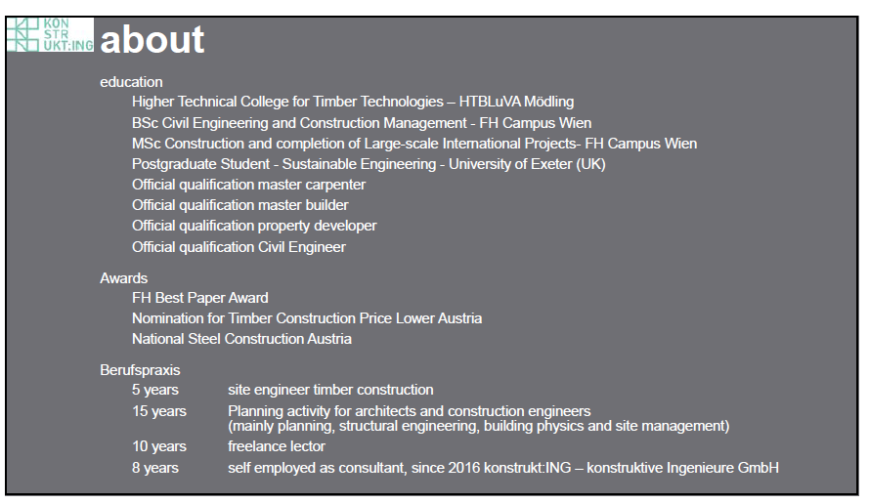
Tendering Structural - Systems Eléments
DI Matthias Doubek

Slide 4
Tendering Structural - Systems Eléments
DI Matthias Doubek

Slide 5
Tendering Structural - Systems Eléments
DI Matthias Doubek

Slide 6
Tendering Structural - Systems Eléments
DI Matthias Doubek

Slide 7
Tendering Structural - Systems Eléments
DI Matthias Doubek

Slide 8
Tendering Structural - Systems Eléments
DI Matthias Doubek

Slide 9
Tendering Structural - Systems Eléments
DI Matthias Doubek

Slide 10
Tendering Structural - Systems Eléments
DI Matthias Doubek

Slide 11
Tendering Structural - Systems Eléments
DI Matthias Doubek

Slide 12
Tendering Structural - Systems Eléments
DI Matthias Doubek

Slide 13
Tendering Structural - Systems Eléments
DI Matthias Doubek

Slide 14
Tendering Structural - Systems Eléments
DI Matthias Doubek

Slide 15
Tendering Structural - Systems Eléments
DI Matthias Doubek

Slide 16
Tendering Structural - Systems Eléments
DI Matthias Doubek

Slide 17
Tendering Structural - Systems Eléments
DI Matthias Doubek

Slide 18
Tendering Structural - Systems Eléments
DI Matthias Doubek

Slide 19
Tendering Structural - Systems Eléments
DI Matthias Doubek

Slide 20
Tendering Structural - Systems Eléments
DI Matthias Doubek

Slide 21
Tendering Structural - Systems Eléments
DI Matthias Doubek

