Slide 1
Structural systems / Building mechanics
Cristina Tirteu
2023

Slide 2
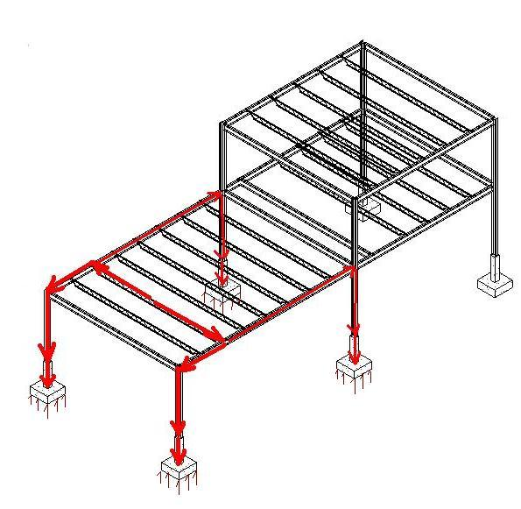
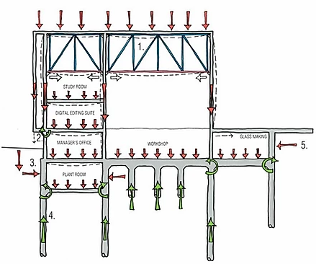
Vertical Load Path
During the initial stages of a project, the designer makes assumptions regarding the way loads (forces) are transferred through the structure to the foundation (ground).
These loads travel along load paths.
The analysis method is known as load tracing
For box systems, the gravity loads are transferred to the ground using a simply supported "post and beam" type system where the walls act as axial-loaded, (or combined axial plus bending), members.

Slide 3
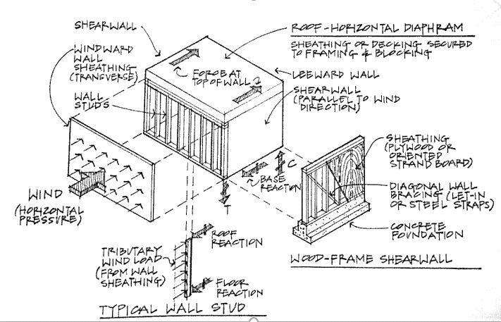
Horizontal Loads - Wind
The main idea when thinking about distributed horizontal load forces, is that they are “collected” concentrated forces that act like shear on the structures.
V

Slide 4
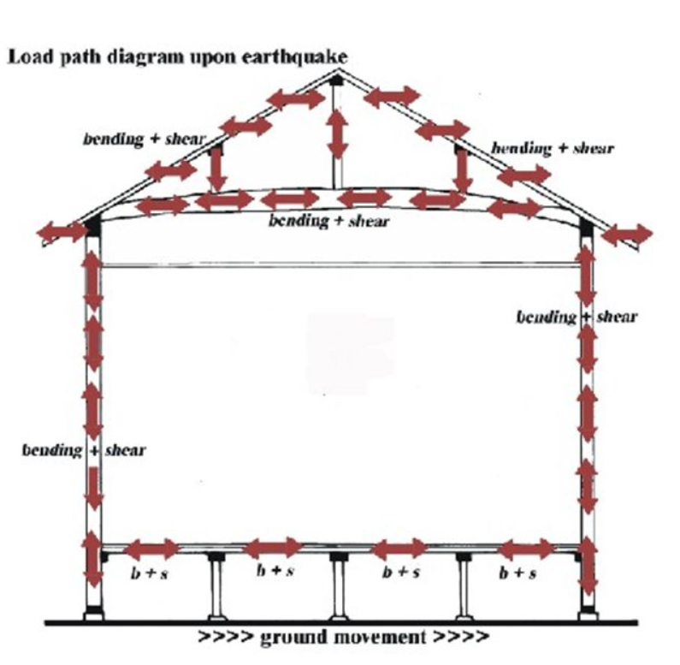
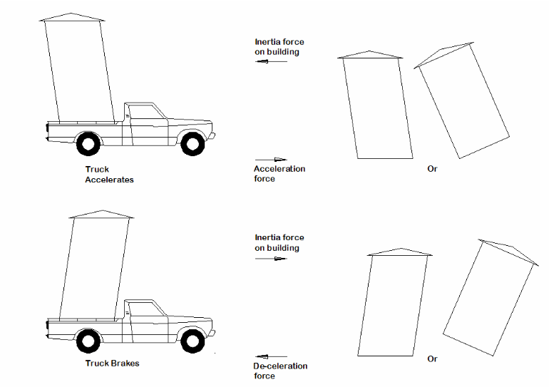
Horizontal Loads - Earthquake

Slide 5
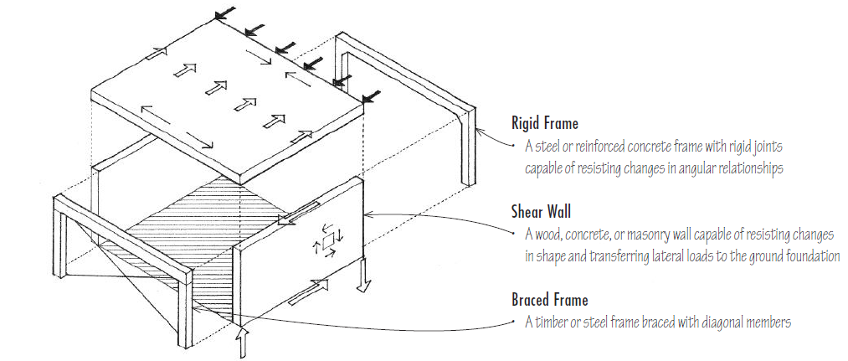
Stability of Structures
An important characteristic of a building is the relative importance of the lateral load-resisting and stabilizing systems.
In broad terms there are three fundamental types of lateral resisting elements:
The resistance to horizontal forces is provided by two orthogonal bracing systems:
Vertical bracing. Bracing in vertical planes (between lines of columns) provides load paths to transfer horizontal forces to ground level and provide lateral stability.
Horizontal bracing. At each floor level, bracing in a horizontal plane, generally provided by floor plate action, provides a load path to transfer the horizontal forces (mainly from the perimeter columns, due to wind) to the planes of vertical bracing.
Notes:
An important characteristic of a building is the relative importance of the lateral load-resisting and stabilising systems. The normal lateral loads are those due to wind and earthquake. The columns of a tall building must be stabilised, or laterally supported, by a lateral bracing system. The lateral bracing system must resist deformations associated with the out-of-straightness and out-of-plumb of the structural members and the deformation associated with lateral forces (P-D effect).
For low and medium-rise structures, analysis and design generally involves checking the vertical load-resistant system for its ability to resist lateral forces.
In broad terms there are three fundamental types of lateral resisting elements:
Moment resistant frames
Braced frames
Shear walls
The three fundamental elements are generally in vertical planes and may be placed in one or more of three locations: (1) Exterior (perimeter); (2)interior; and (3) core. Most building structures include several of these elements. The first two types are relevant to long span buildings.

Slide 6
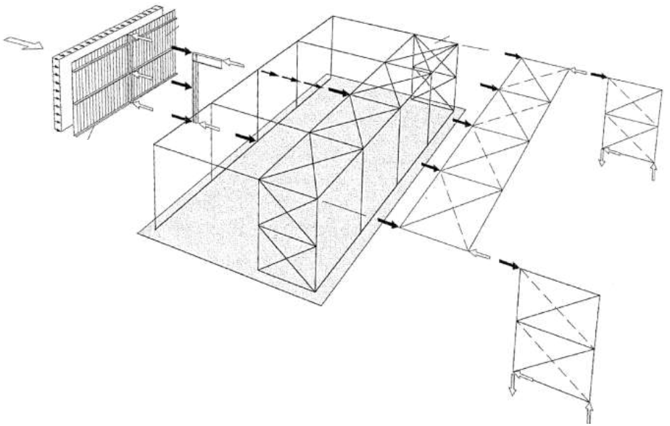
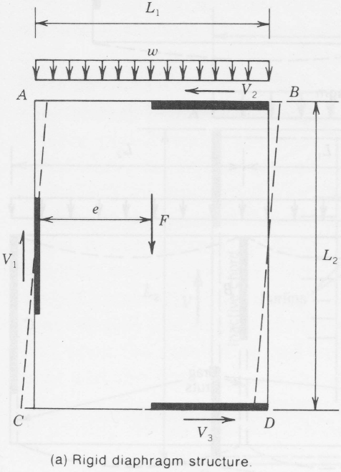
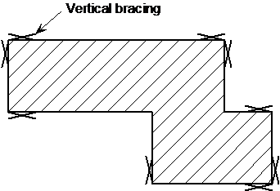
Load Transfer Path
As a minimum, three vertical planes of bracing are needed, to provide resistance in both directions in plan and to provide resistance to torsion about a vertical axis.
Notes:
Typically, horizontal bracing systems span between the 'supports', which are the locations of the vertical bracing. This arrangement often leads to a truss spanning the full width of the building, with a depth equal to the bay centres, as shown in the figure on the left.
The horizontal bracing is frequently arranged as a Warren truss, or as a Pratt truss, or with crossed members acting only in tension.
At the preliminary design stage, it is convenient to calculate the overall longitudinal load on the structure. This shear must be the horizontal component of the load carried by the vertical bracing. The most heavily loaded roof bracing will be the member nearest the eaves. The longitudinal eaves member carries the load from the roof bracing to the vertical bracing. Bracing members may be hollow sections, angle sections or flat steel. Flat steel is assumed to resist tension forces only.

Slide 7
Vertical Bracing
The primary functions of vertical bracing in the side walls of the frame are:
To transmit the horizontal loads to the ground. The horizontal forces include forces from wind and cranes.
To provide a rigid framework to which side rails may be attached so that they can in turn provide stability to the columns.
To provide temporary stability during erection.
According to EN 1993-1-1, the bracing will have to satisfy the requirement for global analysis and imperfections within the bracing system.
The bracing may be located:
At one or both ends of the building, depending on the length of the structure
At the center of the building
In each portion between expansion joints (where these occur).
Where the side wall bracing is not in the same bay as the horizontal bracing in the roof, an eaves strut is required to transmit the forces from the roof bracing into the wall bracing.

Slide 8
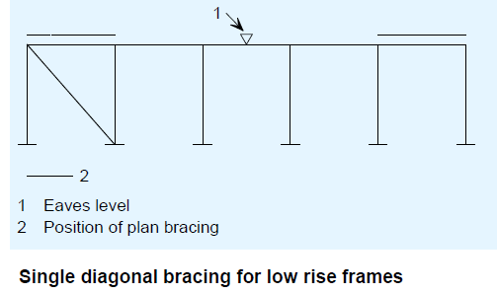
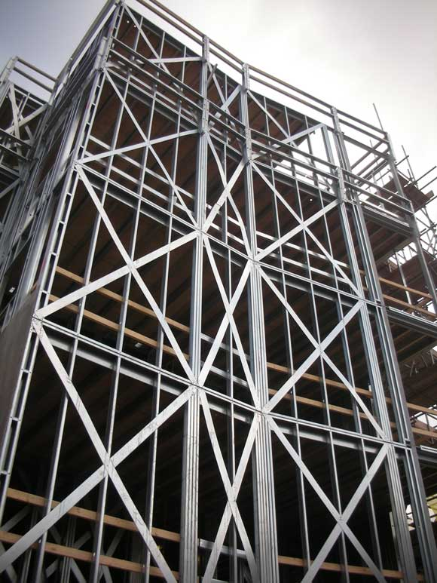
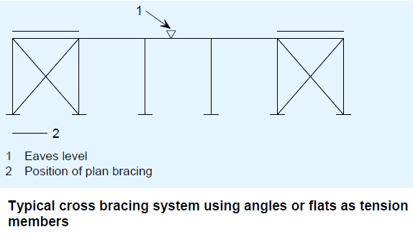
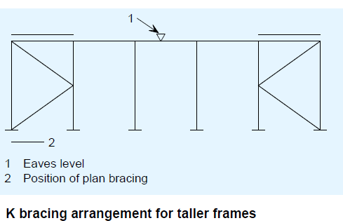
Vertical Bracing
Notes:
Bracing using circular hollow sections
Hollow sections are very efficient in compression, which eliminates the need for cross bracing. Where the height to eaves is approximately equal to the spacing of the frames, a single bracing member at each location is economic (Figure.1). Where the eaves height is large in relation to the frame spacing, a K brace is often used (Figure 2).
An eaves strut may be required in the end bays, depending on the configuration of the plan bracing.
The eave strut is located at the intersection of the roof and the exterior wall, so that it acts as both the first purlin and the last (highest) girt. The term strut refers to another important function of this element: it typically serves as a compression member in the wall cross-bracing assembly and as a tie between such bracing assemblies located along the same wall. Accordingly, eave struts are often designed for the combined effects of flexure and axial compression.
Bracing using angle sections or flats
Cross braced angles or flats (within a masonry cavity wall) may be used as bracing (as shown in Figure 3). In this case, it is assumed that only the diagonal members in tension are effective.

Slide 9
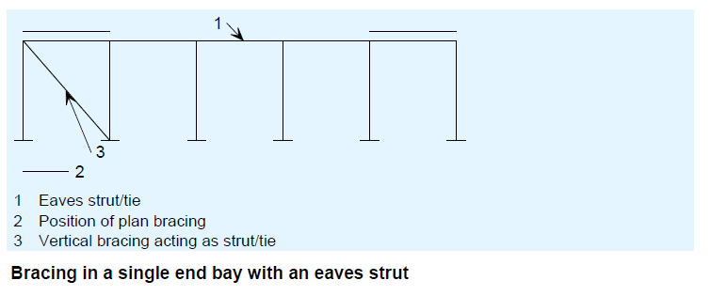
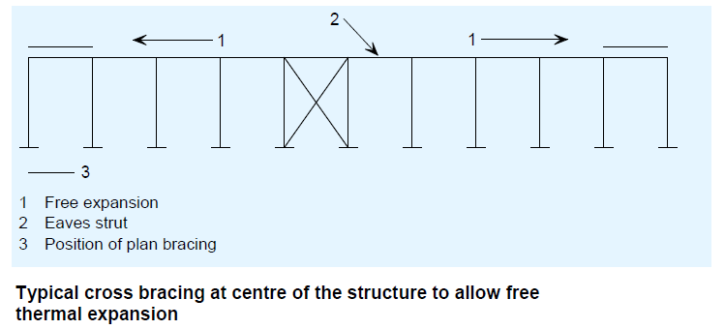
Vertical Bracing
Notes:
Bracing in a single bay
For vertical bracing provided in a single bay, an eaves strut is required to transmit wind forces from the roof bracing into the vertical bracing
(Figure 4).
Single central braced bay
The concept of providing a single braced bay near the centre of a structure (Figure 5) is unpopular because of the need to start erection from a braced
bay and to work down the full length of a building from that point. However, bracing in the middle of the building has the advantage that it allows free
thermal expansion of the structure, which is particularly valuable in locations such as Southern Europe and the Middle East where the diurnal temperature
range is very large. In most of Europe, the expected temperature range is more modest, typically -5°C to +35°C, and overall expansion is not generally
considered to be a problem. If a central braced bay is used, it may be necessary to provide additional temporary bracing in the end bays to assist in erection.

Slide 10
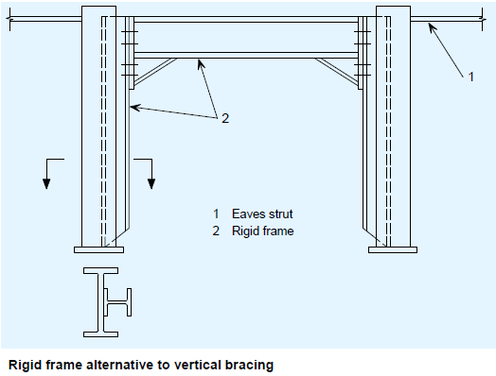
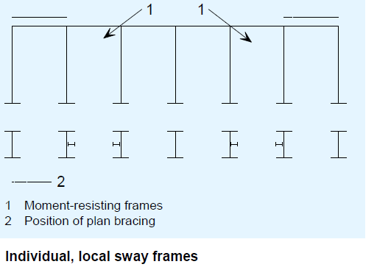
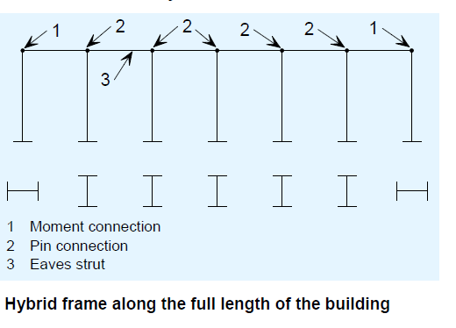
Vertical Bracing
Where it is difficult or impossible to brace the frame vertically by conventional bracing, it is necessary to introduce moment-resisting frames in the elevations.
There are two basic possibilities:
A moment-resisting frame in one or more bays
Use of the complete elevation to resist longitudinal forces, with moment resisting connection often located in the end bays, where the end column is turned through 90° to provide increased stiffness in the longitudinal direction.
In design of both systems, it is suggested that:
The bending resistance of the portalised bay (not the main portal frame) is checked using an elastic frame analysis
The stiffness is assured by restricting serviceability deflections to a maximum of h/360, where h is the height of the portalised bay.
Notes:
Where it is difficult or impossible to brace the frame vertically by conventional bracing, it is necessary to introduce moment-resisting frames in the elevations.
There are two basic possibilities:
A moment-resisting frame in one or more bays, as shown in Figure 9.6.
Use of the complete elevation to resist longitudinal forces, with moment resisting connection often located in the end bays, where the end column is turned through 90° to provide increased stiffness in the longitudinal direction, as shown in Figure 9.7. This arrangement is only possible if the end frame (the gable) is constructed from a beam and column arrangement, rather than a portal frame. Gable frames are discussed in Section 10.
Deflection under the equivalent horizontal forces is restricted to h/1000. ??????????????

Slide 11
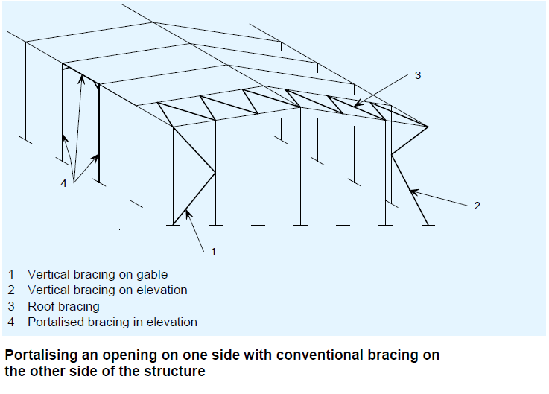
Vertical Bracing
In some cases, it is possible to provide conventional bracing on one elevation, and provide moment resisting frames on the other. The effects of racking action due to the difference in stiffness of the sides is generally negligible due to the diaphragm action of the roof.

Slide 12
Horizontal Bracing
The horizontal / Plan bracing is placed in any horizontal plane, or in the plane of the roof.
The primary functions of the horizontal bracing are:
To transmit horizontal wind forces from the gable posts to the vertical bracing in the walls,
To transmit any drag forces, form wind on the roof to the vertical bracing,
To provide stability during erection,
To provide a stiff anchorage for the purlins which are used to restrain the rafters.
In order to transmit the wind forces efficiently, the plan bracing should connect to the top of the gable posts.
According to EN 1993-1-1, the bracing will have to satisfy the requirement for global analysis and imperfections within the bracing system.
Notes:
Drag forces – Friction forces on the roof

Slide 13
Wind Load – Structure Without Wind Columns
If there are no wind columns, the wind load is collected by the column of the portal, from a length equal with the distance between the spans and transmitted further to the load bearing elements.

Slide 14
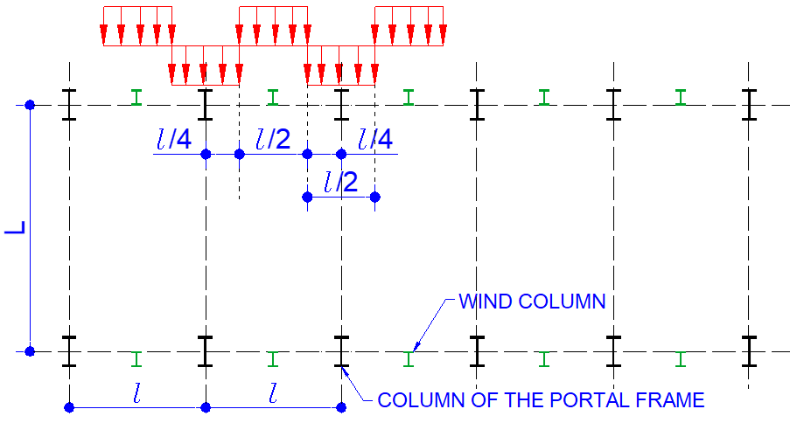
Wind Load – Structure With Wind Columns
If there are wind columns, they will collect the load from half of the distance between the portals. The upper part of the wind columns could be totally unsupported (fixed connection to the foundation).

Slide 15
Wind Load – Structure With Wind Columns
The load is transmitted further from the wind column to the load bearing structure by the horizontal bracing located at the roof level. Now the upper parts of the wind columns are pinned.
Notes:
Transmitted

Slide 16
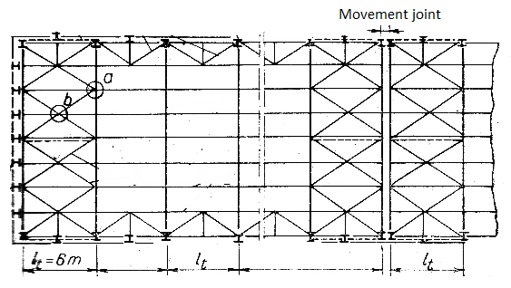
Roof Stability
The roof bracing are designed to ensure the stability and rigidity of the roof as well as the whole construction.
There are three types:
Transverse horizontal bracing
Longitudinal horizontal bracing
Vertical /lateral bracing.

Slide 17
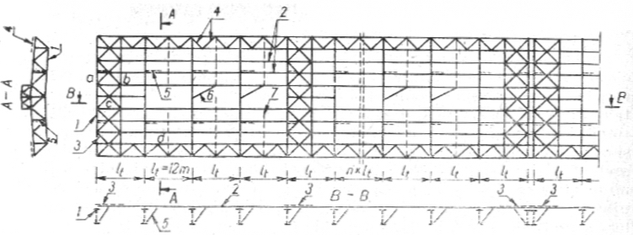
Transverse Horizontal Bracing
In general, the form of a transverse wind truss is as follows:
The wind truss is arranged as a Warren or Pratt truss, parallel to the roof plane,
The chords of the wind truss are the upper chords of two adjacent vertical trusses. This means that the axial forces in these members due to loading on the vertical truss and those due to loads on the wind girder loading must be added together (for an appropriate combination of actions)

Slide 18
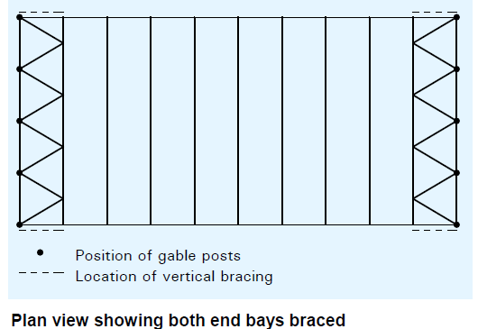
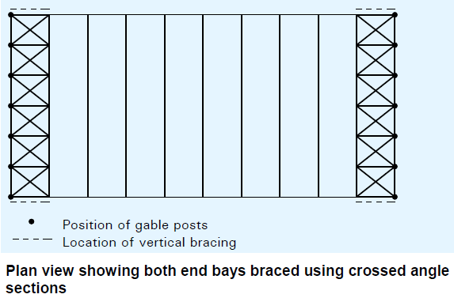
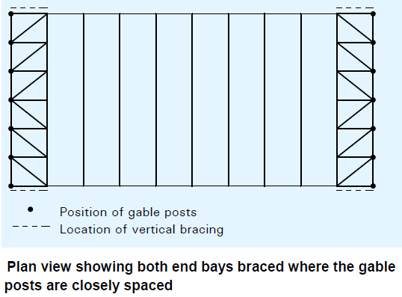
Transverse Horizontal Bracing
Notes:
It is convenient to arrange a transverse wind girder at each end of the building, but it is then important to be careful about the effects of thermal expansion which can cause significant forces if longitudinal elements are attached between the two bracing systems, especially for buildings which are longer than about 60 m.

Slide 19
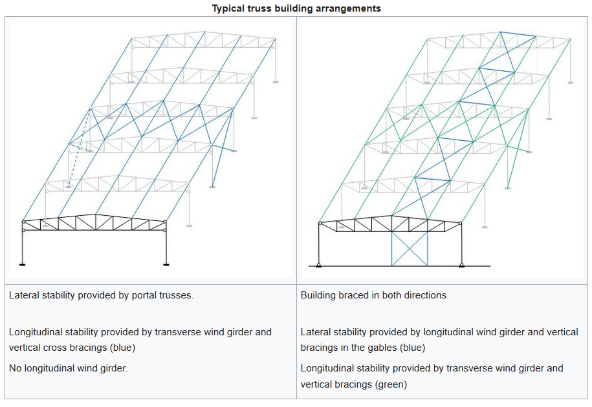
Bracing systems
Notes:
In the first case (left) the lateral stability of the structure is provided by a series of portal trusses; the connections between the truss and the columns provide resistance to a global bending moment. Loads are applied to the portal structure by purlins and side rails.
In the second case, (right) each truss and the two columns between which it spans, constitute a simple structure; the connection between the truss and a column does not resist the global bending moment, and the two column bases are pinned. Bracing in both directions is necessary at the top level of the simple structure; it is achieved by means of a longitudinal wind girder which carries the transverse forces due to wind on the side walls to the vertical bracing in the gable walls. Longitudinal stability is also provided by a wind girder in the roof and vertical bracing in the elevations.

Slide 20
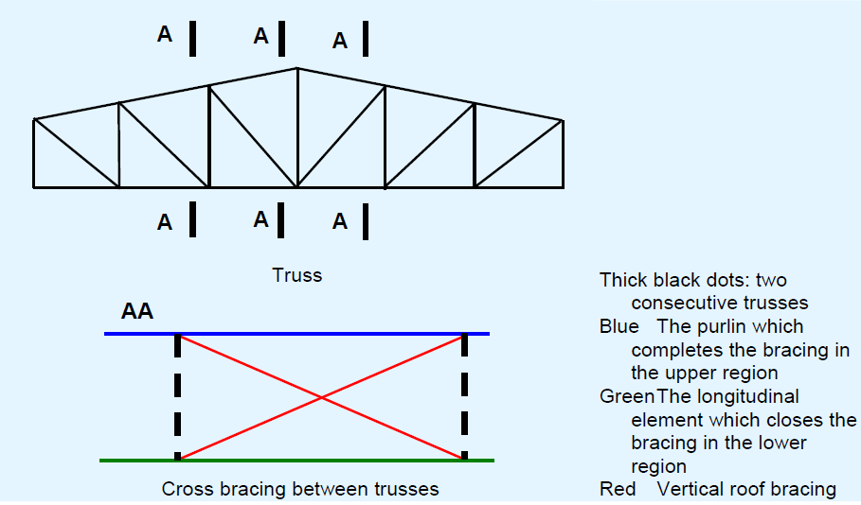
Vertical / Lateral Bracing
It is necessary to design members in compression against out-of-plane buckling.
Lateral restraint of the upper chord is generally given by the purlins and the transverse roof wind girder.
For the restraint of the bottom chord, additional bracing may be necessary.
Such bracing allows the buckling length of the bottom chord to be limited out of the plane of the truss to the distance between points laterally restrained; the diagonal members transfer the restraint forces to the level of the top chord, where the general roof bracing is provided.
Notes:
The roof purlins often serve as part of the bracing at the top chord. Introduction of longitudinal members at the lower chord allows the trusses to be stabilised
by the same vertical bracing.
It is possible to create a horizontal wind girder at the level of the bottom chords, with longitudinal elements to stabilize all the trusses.

Slide 21
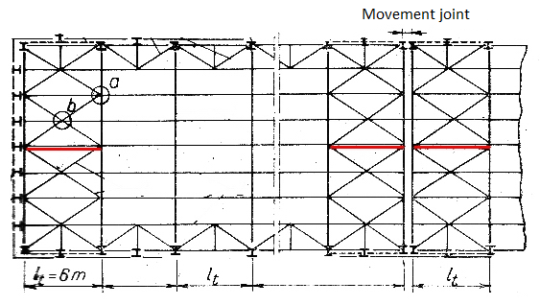
Vertical / Lateral Bracing

Slide 22
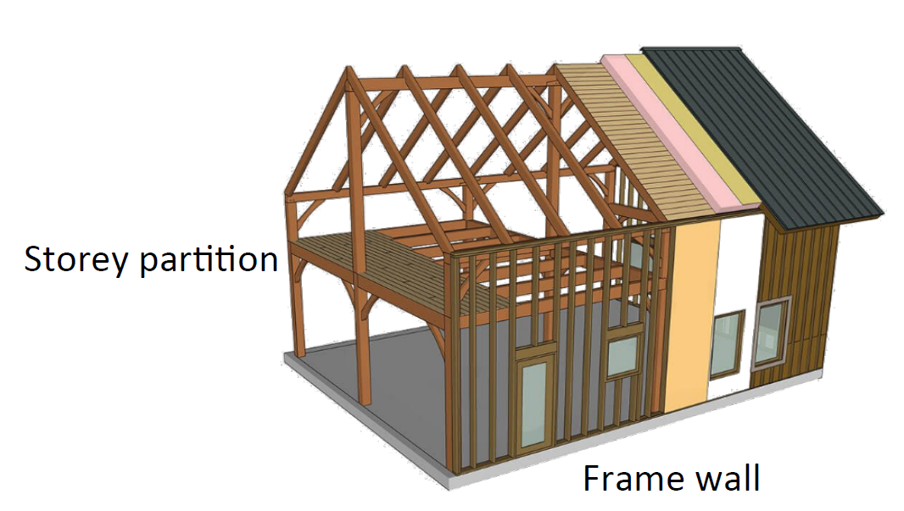
Timber frame constructions
The oldest and most common structural timber construction is the timber frame system.
The system supports load‐bearing wall elements and storey partitions as well.
The storey partitions are constructed from beams with sheets (stressed skin) for vertical load and as diaphragm for lateral load.

Slide 23
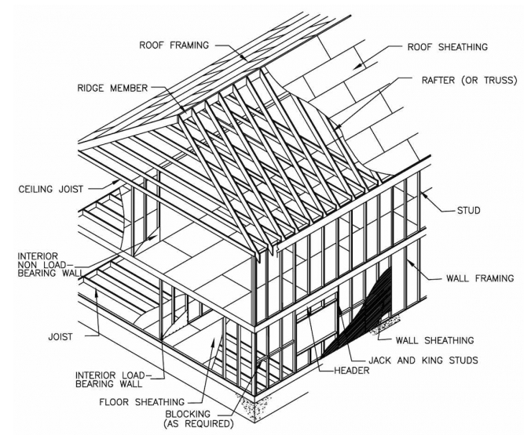
Building systems
Geometrically, building systems belong to one of the following categories:
Panel systems are based on planar building elements, for example walls or floors.
Modular systems (volumetric modules): utilize the light frame system mainly, but examples exist where solid wood elements apply.
Post and beam systems are sometimes named big frame structures and are very common for industrial and commercial buildings. These systems are also used for buildings or parts of buildings, where the load-carrying structure is visible.
Notes:
Timber buildings systems can be used to construct a multitude of buildings. Single-family homes have a relatively simple structure, while greater challenges meet the material when facing multi-storey or long-span buildings. Multi-storey timber construction started with the traditional on-site construction utilizing the platform system. Relatively soon, prefabricated systems emerged. In the Nordic countries, prefabricated systems dominate, while systems with a larger degree of craftsmanship are used in central Europe. Timber building systems are common in the Nordic countries and the German speaking countries in central Europe; Germany, Switzerland and Austria and to some extent Italy. Also, timber building systems exist in the United Kingdom, while timber is less used in countries around the Mediterranean.
Panel systems: are based on planar building elements, for example walls or floors.
These systems utilise either light frames or solid wood elements as their basic technology.
The panels can be full size or partitioned in widths of 1 200 mm for ease of transportation.
Floor elements are not suitable for long-span structures, the limitation in span length is about 8 – 10 m. Roof elements however, can have longer spans.
• Modular systems (volumetric modules): utilize the light frame system mainly, but examples exist where solid wood elements apply. The main principle is that the entire volumetric box consisting of walls, floor and ceiling, as well as inner claddings and all services are assembled in a factory and delivered to the building site for erection. Modular systems are not suitable for long-span structures, limitations on span is about 4 m due to transportation limitations.
Post and beam systems: are sometimes named big frame structures and are very common for industrial and commercial buildings. These systems are also used for buildings
or parts of buildings, where the load-carrying structure is visible. The post and beam system is a system based on a structural grid of beams and columns, typically with pinned connections. The structure is instead stabilised through diagonal bracing or shear walls. Post and beam systems are suitable for long-span structures and are used for arenas.

Slide 24
FLOOR SYSTEMS

Slide 25
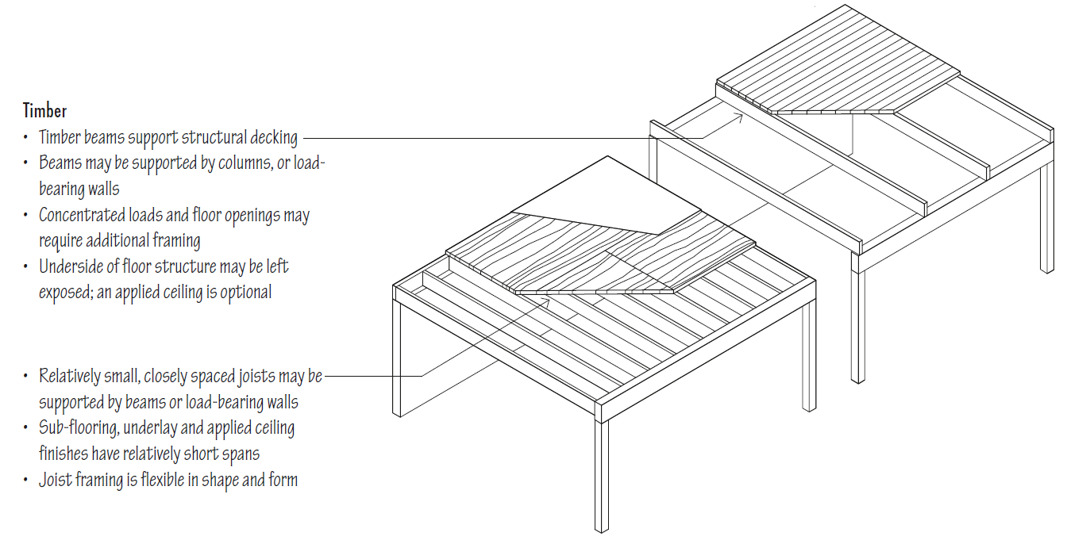
Timber floor systems
Notes:
Floor systems are the horizontal planes that must support both live loads – people, furnishings and movable equipment – and dead loads – the weight of the floor construction itself. Floor systems must transfer their loads horizontally across space to either beams and columns or to load-bearing walls. Rigid floor planes can also be designed to serve as horizontal diaphragms that act as thin, wide beams in transferring lateral forces to shear walls. A floor system may be composed of a series of linear beams and joists overlaid with a plane of sheathing or decking, or consist of a nearly homogeneous slab of reinforced concrete. The depth of a floor system is directly related to the size and proportion of the structural bays it must span and the strength of the materials used. The size and placement of any cantilevers and openings within the floor plane should also be considered in the layout of the structural supports for the floor. The edge conditions of the floor structure and its connection to supporting foundation and wall systems affect both the structural integrity of a building and its physical appearance. Because it must safely support moving loads, a floor system should be relatively stiff while maintaining its elasticity. Due to the detrimental effects that excessive deflection and vibration would have on finish flooring and ceiling materials, as well as concern for human comfort, deflection rather than bending becomes the critical controlling factor. The depth of the floor construction and the cavities within it should be considered if it is necessary to accommodate runs of mechanical or electrical lines within the floor system. For floor systems between habitable spaces stacked one above another, additional factors to consider are the blockage of both airborne and structure-borne sound and the fire-resistance rating of the assembly.

Slide 26
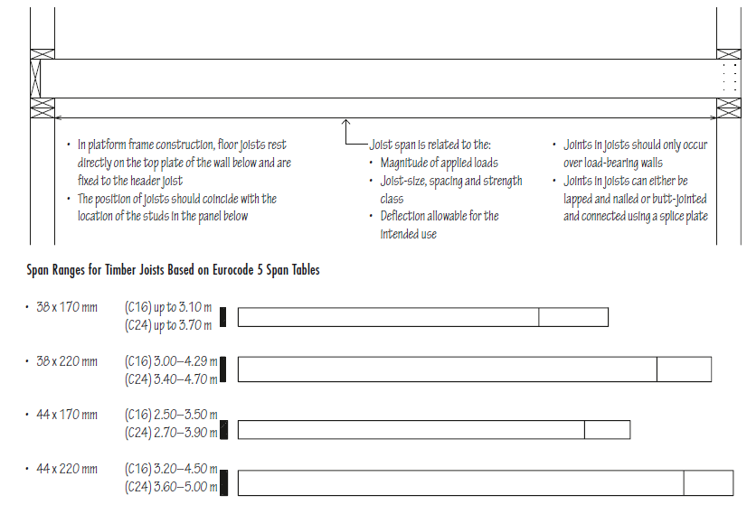
Timber joists
Timber joist floors are an essential subsystem of wood light frame construction.
The dimension timber used for joists is easily worked and can be quickly assembled on site with simple tools.
The stiffness of the joist framing under stress is more critical than its strength.
Because timber framing is combustible, it must rely on finish flooring and ceiling materials for its fire-resistance rating.
Notes:
If properly engineered, the resulting floor structure can serve as a structural diaphragm to transfer lateral loads to shear walls; consult the building regulations for specific requirements. • Because timber framing is combustible, it must rely on finish flooring and ceiling materials for its fire-resistance rating • The susceptibility of timber framing to decay and insect infestation requires positive site drainage, adequate separation from the ground, appropriate use of pressuretreated timber and ventilation to control condensation in enclosed spaces

Slide 27
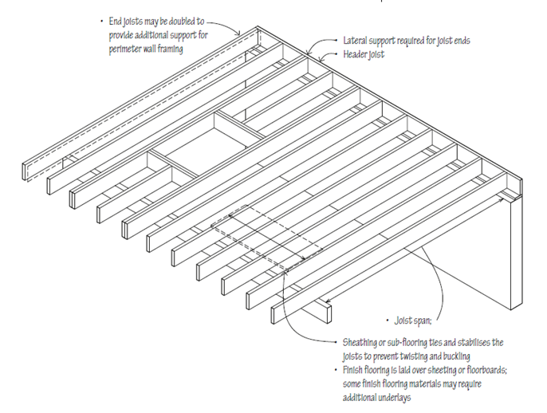
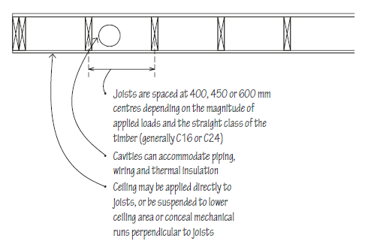
Timber joists
The susceptibility of timber framing to decay and insect infestation requires positive site drainage, adequate separation from the ground, appropriate use of pressure treated timber and ventilation to control condensation in enclosed spaces
Notes:
Timber joist floors are an essential subsystem of wood lightframe construction. The dimension timber used for joists is easily worked and can be quickly assembled on site with simple tools. Together with timber panel sheathing or sub-flooring, the timber joists form a level working platform for construction. If properly engineered, the resulting floor structure can serve as a structural diaphragm to transfer lateral loads to shear walls; consult the building regulations for specific requirements. • Because timber framing is combustible, it must rely on finish flooring and ceiling materials for its fire-resistance rating • The susceptibility of timber framing to decay and insect infestation requires positive site drainage, adequate separation from the ground, appropriate use of pressuretreated timber and ventilation to control condensation in enclosed spaces
Pressure treatment is a preservative process that enhances the timber’s protection. The process includes placing the timber in a vacuum chamber, which removes all the air from the cells in the timber. Once this has been completed, the vacuum will force chemical preservatives into the wood. The treatment uses new chemicals that don’t harm the soil and the treatment boasts impressive results and benefits.

Slide 28
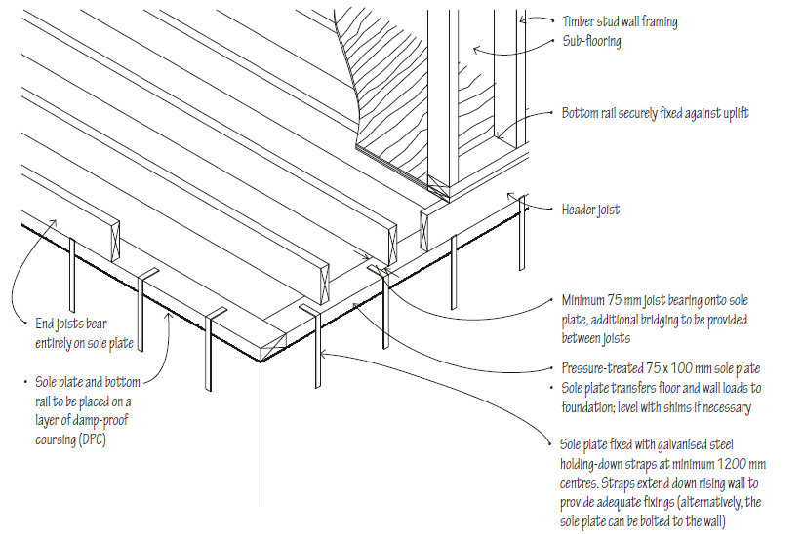
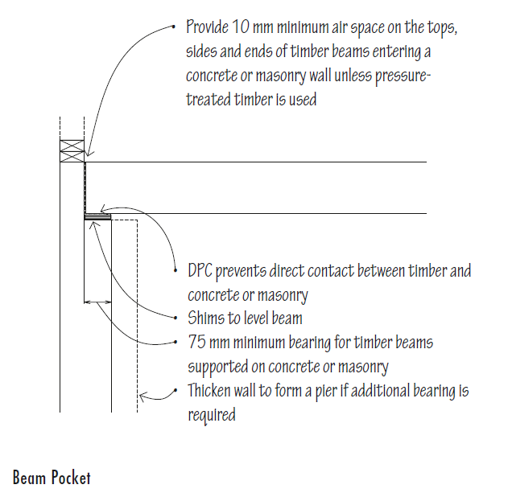
Platform Floor
Notes:
A platform floor provides a working platform for the builder as the floor is laid before erecting the wall and roof framing. However, this method is not recommended for feature floors because the flooring is exposed to the weather during construction.
The platform floor should be protected from getting wet by rain and/or wet trades, however, as it is difficult to provide adequate protection, degradation due to the effects of sunlight, wetting or work practices may occur.
Plywood panels are laid with the face grain of the plies at right angles to the line of the supporting joists. They must be continuous over at least two spans. Ends of sheets are butted over joists.
Edges of sheets, unless tongued and grooved, are to be joined over noggings between joists. Noggings are timber of not less than 70 x 35 mm sections. They are set flush with the top of the joists.
Sole plate = sill plate
Pressure treatment is a preservative process that enhances the timber’s protection. The process includes placing the timber in a vacuum chamber, which removes all the air from the cells in the timber. Once this has been completed, the vacuum will force chemical preservatives into the wood. The treatment uses new chemicals that don’t harm the soil and the treatment boasts impressive results and benefits.
Nogging = is a horizontal bracing piece used between wall studs or floor joists to give rigidity to the wall or floor frames of a building. Noggings may be made of timber, steel, or aluminium or block between studs.
A flush or header beam is a structural member positioned at the same level as the joists and uses joist hangers for attachment just as you would at the ledger board. Flush beams are commonly used for framing angled deck forms such as octagons or on stair landings where a cantilevered beam would be less practical.

Slide 29
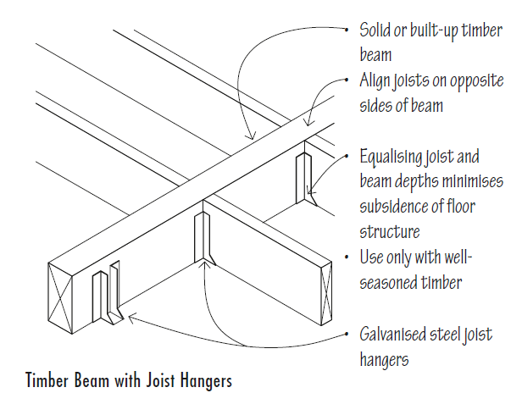
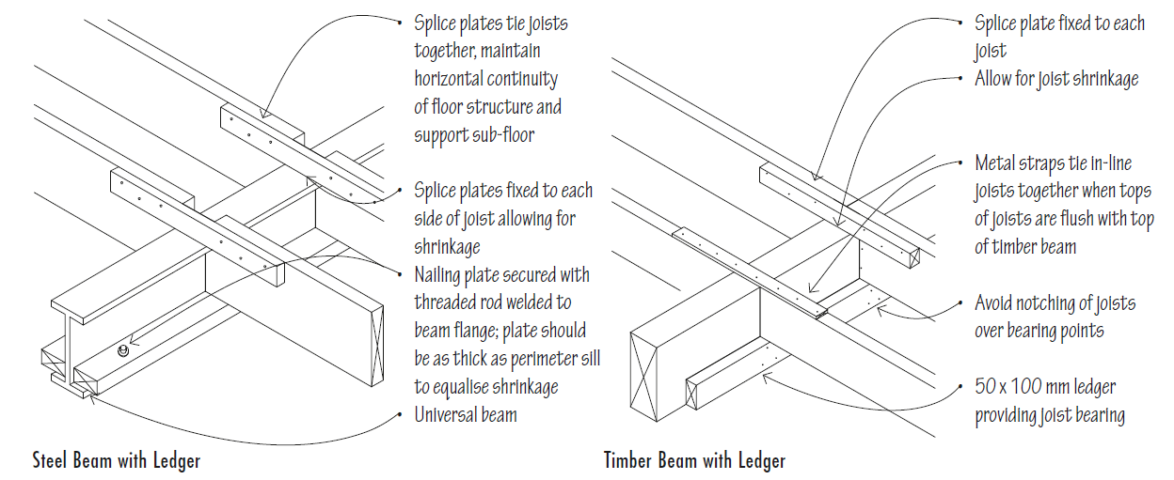
Timber joist framing
Wood joists may be supported by wood or steel beams. In either case, the elevation of the beam should be coordinated with the perimeter sill condition and how the beam supports the floor joists.
Notes:
Timber is susceptible to shrinkage perpendicular to its grain. For this reason, the total depth of timber construction for both the bearing condition and the joist–beam connection should be equalised to avoid subsidence of the floor plane.
The sill is the piece of wood closest to the ground, either on a foundation or piers, and is usually a “timber-sized” board: 3×6, 3×8, 4×6, 4×8, and so on. The studs often rest directly on the sill and are toe-nailed in with no bottom plate as you'd find in a modern house.
sill plate or sole plate in construction and architecture is the bottom horizontal member of a wall or building to which vertical members are attached. The word "plate" is typically omitted in America and carpenters speak simply of the "sill". Other names are ground plate, ground sill, groundsel,^{[1]} and midnight sill. Sill plates are usually composed of lumber but can be any material. The timber at the top of a wall is often called a top plate, pole plate, mudsill, wall plate or simply "the plate".

Slide 30
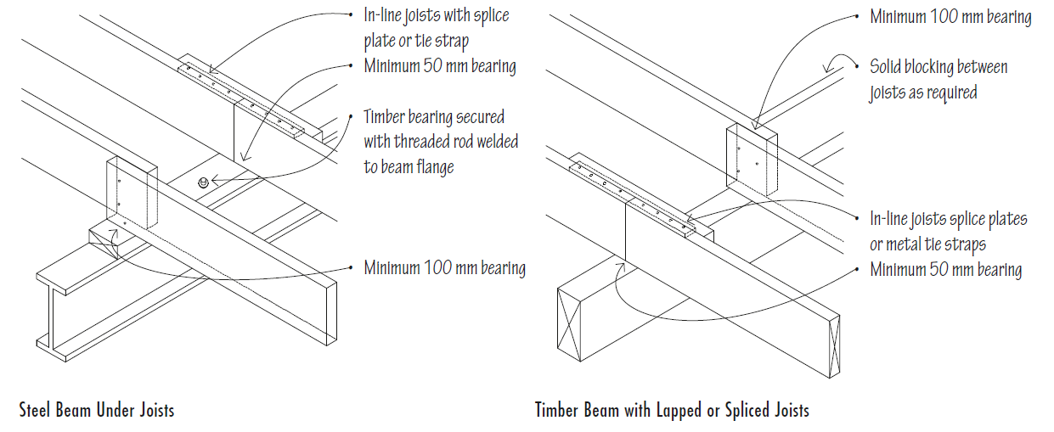
Timber joist framing

Slide 31
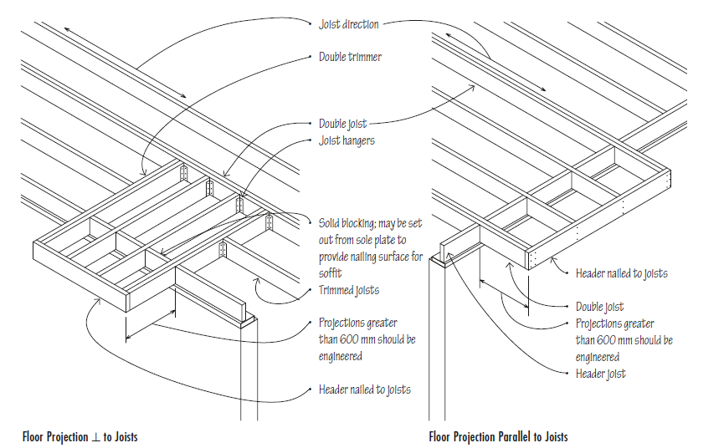
Floor projections

Slide 32
Wall systems

Slide 33
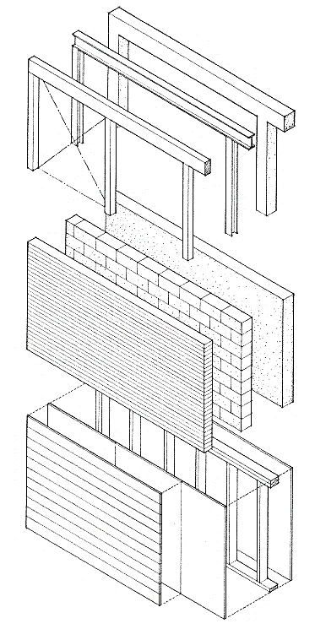
Wall systems
Walls are the vertical constructions of a building that enclose, separate and protect its interior spaces.
They may be:
Loadbearing structures of homogeneous or composite structures designed to support loads
Structural frames - framework of columns and beams with nonstructural panels attached to or filling between them.
Stud walls where studs carry vertical loads, while sheathing or diagonal bracing stiffens the plane of the wall.
Notes:
In addition to supporting vertical loads, exterior wall constructions must be able to withstand horizontal wind loading. If rigid enough, they can serve as shear walls and transfer lateral forces to the foundations and ground.
Because exterior walls serve as a protective shield against the weather for the interior spaces of a building, their construction should control the passage of heat, infiltrating air, sound, moisture and water vapour. The exterior skin, which may be either applied to or integral with the wall structure, should be durable and resistant to the weathering effects of sun, wind and rain. Building regulations specify the fire-resistance rating of exterior walls, load-bearing walls and interior partitions.
The interior walls or partitions, which subdivide the space within a building, may be either structural or non-load-bearing. Their construction should be able to support the desired finish materials, provide the required degree of acoustic separation and accommodate, when necessary, the distribution and outlets of mechanical and electrical services.
Openings for doors and windows must be constructed so that any vertical loads from above are distributed around the openings and not transferred to the door and window units themselves. Their size and location are determined by the requirements for natural light, ventilation, view and physical access, as well as the constraints of the structural system and modular wall materials.

Slide 34
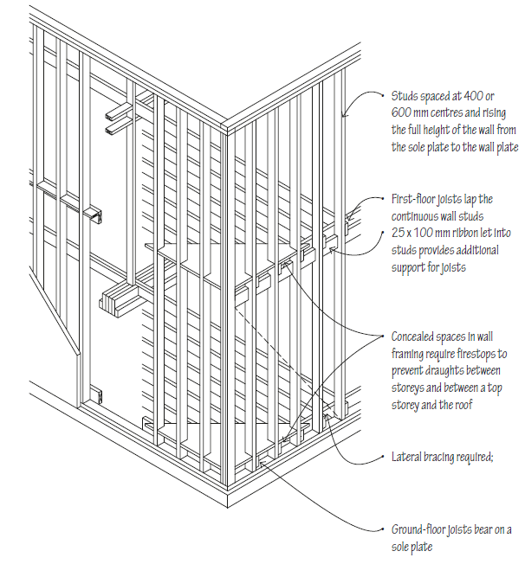
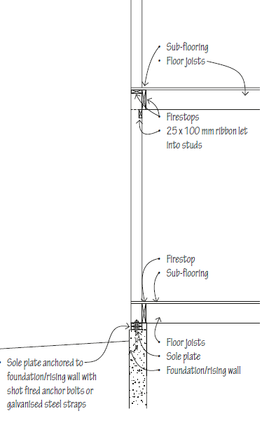
Balloon framing
Balloon framing utilizes studs that rise the full height of the frame from the sill plate to the roof plate with joists nailed to the studs and supported by sills or by ribbons let into the studs.
Notes:
Factors to consider in the selection of an exterior wall finish for
stud wall frames include:
• Stud spacing required
• Sheathing or backing requirements
• Colour, texture, pattern and scale desired
• Detailing of corners and vertical and horizontal joints
• Integration of door and window openings into wall pattern
• Durability, maintenance requirements and weathering
characteristics
• Heat conductivity, reflectance and porosity of the material
• Airtightness strategy
• Expansion joints, if required

Slide 35
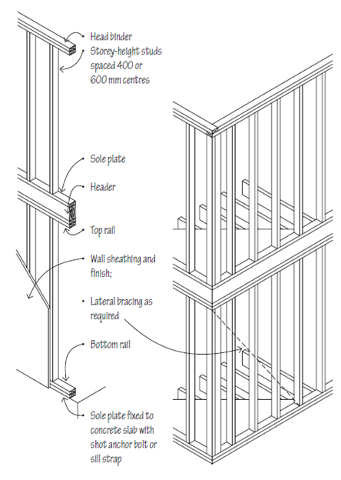
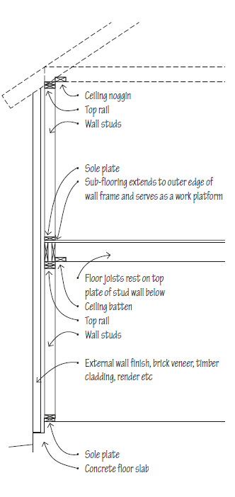
Platform framing
Platform framing is a light timber frame having studs only one storey high, regardless of the storeys built, each storey resting on the platform created by the storey below or on the sole plates of the foundation wall.
Notes:
• Stud walls are adaptable to off-site fabrication as panels or as tilt-up construction
• Although vertical shrinkage is greater than in balloon framing, it is equalised between floors
Platform framing is a light wood frame having studs only one story high, regardless of the stories built, each story resting on the top plates of the story below, or on the sill plates of the foundation wall. Platform framing it is referred to as western framing.

Slide 36
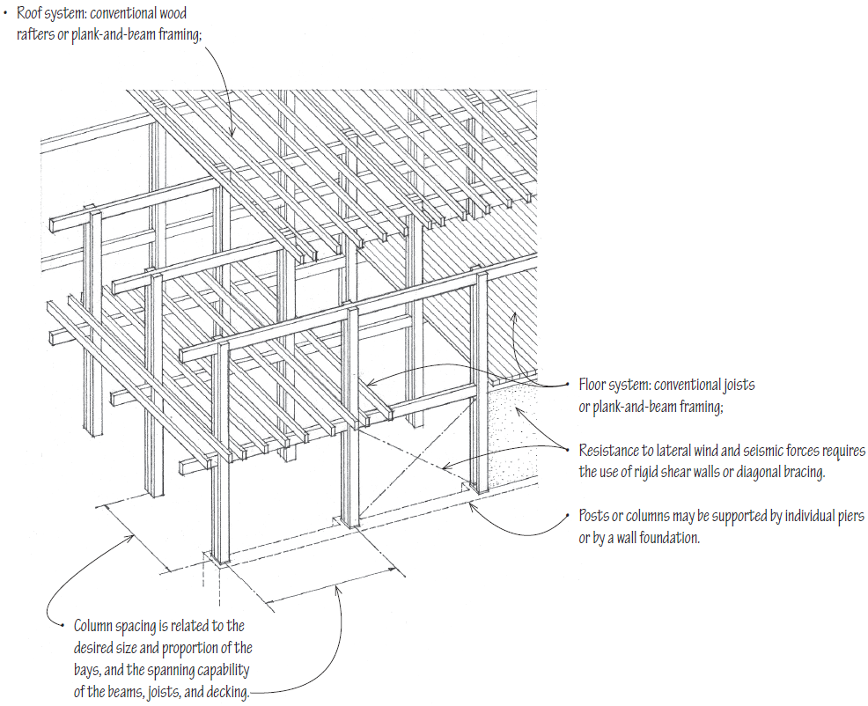
Wood post and beam structure
• Together with plank-and-beam floor and roof systems, the post-and-beam wall system forms a three-dimensional structural grid, which may be expanded vertically or horizontally.
• The skeleton frame of posts and beams is often left exposed to form a visible framework within which nonbearing wall panels, doors, and windows are integrated.
• When the post-and-beam frame is left exposed, as is often the case, careful attention must be paid to the species and grade of wood used, the detailing of joints, especially at beam-to-beam and beam-to-post connections, and the quality of workmanship.
Notes:
Post-and-beam construction uses a framework of vertical posts and horizontal beams to carry both floor and roof loads. The beams supporting the floor and roof systems transmit their loads to posts or columns that, in turn, carry the loads down to the foundation system.
Heavy Timber Construction
• Post-and-beam framing may qualify as heavy timber construction if the plank-and-beam floor and roof structures are supported by noncombustible, fire-resistive exterior walls
and the wood members and decking meet the minimum size requirements specified in the building code

Slide 37
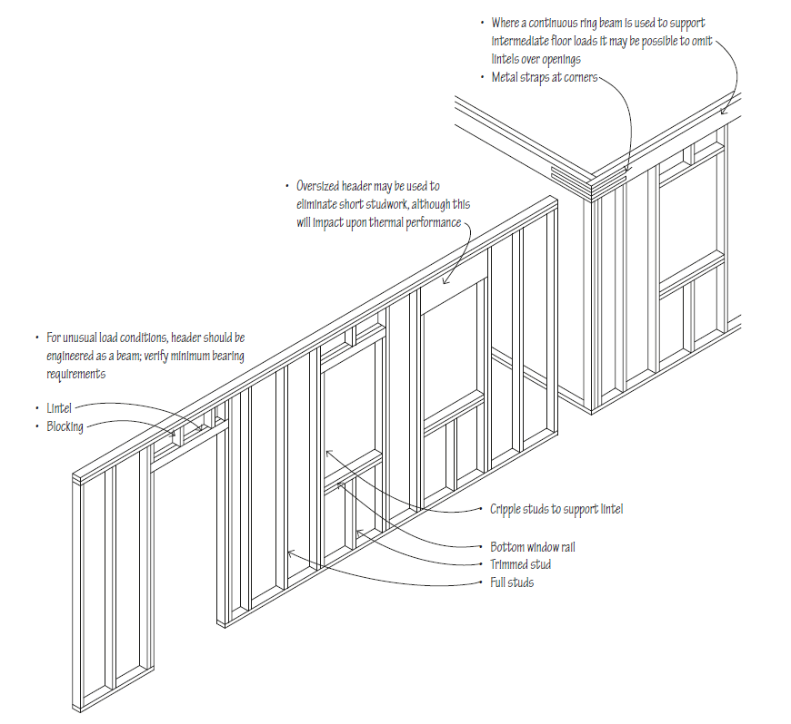
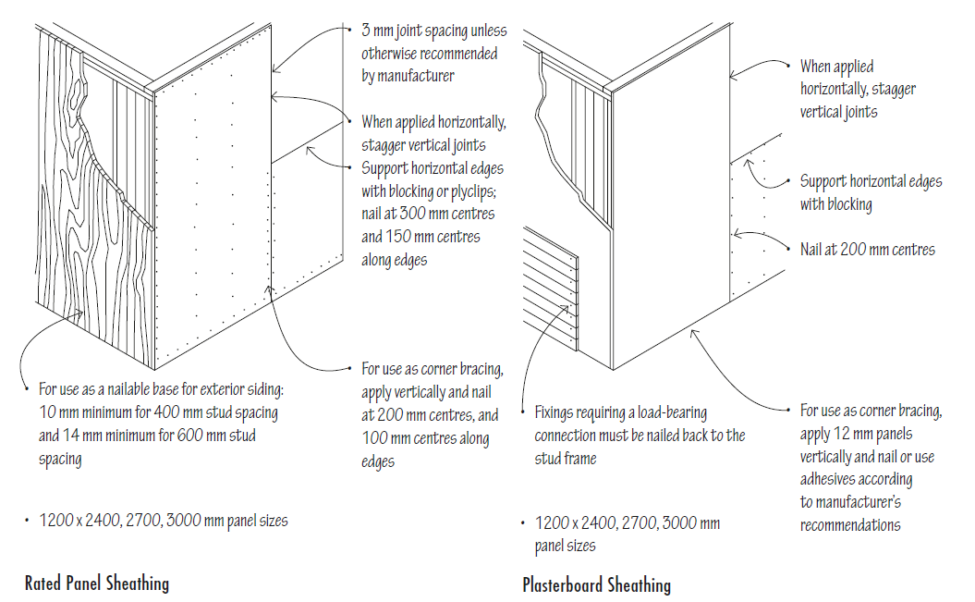
Timber stud wall elements
Notes:
Cripple stud = jamb stud

Slide 38
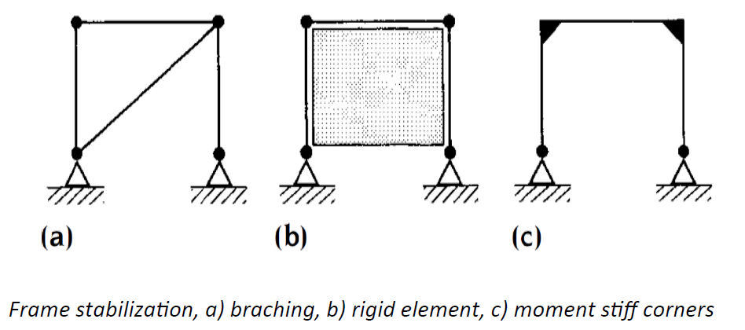
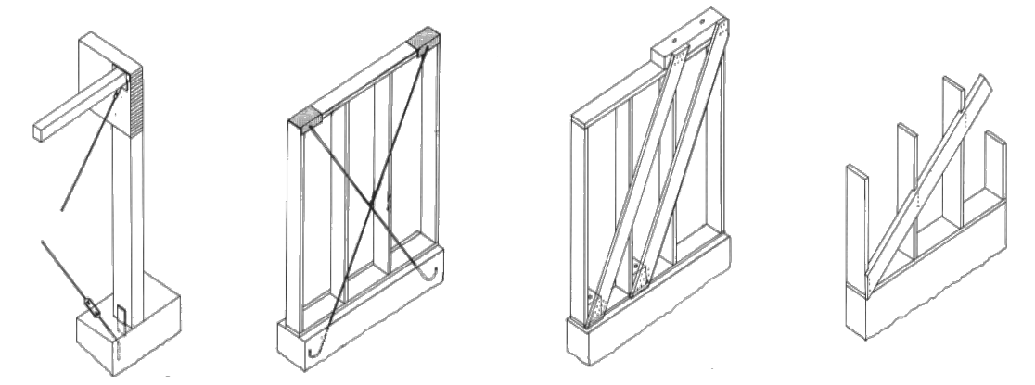
The bracing system
The wall bracing for timber structures is similar to the other structures and can be achieved by one of the three basic systems of by a combination of these.
Notes:
To establish a rigid element against racking, various type of rigid boards can be used. For maximum strength plywood is used, but also gypsum boards are common. The boards must be fixed to the posts for tranfering the shear force. generated by lateral loads
Rigid corners are made by using stiffeners that can be arranged asdiagonal branching or by plywood stiffeners. Metal connectors are also a popular choise.

Slide 39
Mass timber systems
Opposed to the timber frame system, the mass timber construction consists of solid elements for both floors and walls. This leads to heavier and more fire-resistant constructions.

Slide 40
Mass timber structural systems
The structural system for mass timber depends on the stability of the structure.
There are at least 4 rigid panels required (three vertical and one horizontal) for the structure to be stable
Not all wall are parallel
Not all walls are intersecting at the same point.

Slide 41
Roof systems

Slide 42
Roof systems
Flat roofs systems
The roof system function as the primary sheltering element for the interior spaces of a building. Because the gravity loads for a building, originate with the roof system, its structural layout must correspond to that of the column and bearing wall system through which its loads are transferred down to the foundation system.
Sloping roofs systems
Notes:
Flat roofs require a continuous membrane roofing material
• Minimum recommended design fall: 1:40
• The roof slope may be achieved by inclining the structural members or roof deck, or by tapering the layer of thermal insulation
• Depending on design, large roofs can incorporate interior drains, while smaller roofs normally use perimeter drainage
• Flat roofs can efficiently cover a building of any horizontal dimension, and may be structured and designed to serve as an outdoor space
• The structure of a flat roof may consist of:
• Reinforced-concrete slabs
• Flat timber or steel trusses
• Timber or steel beams and decking
• Timber or steel joists and sheathing
Pitched Roofs
• Pitched roofs range from 18o to 60o, generally any pitch less than 10o should be treated as a flat roof
• The roof slope determines the choice of roofing material, the requirements for underlay and eaves flashing, and design wind loads
• Low-slope roofs require roll or continuous membrane roofing; some sheet materials may be used on low pitch roofs
• Medium- and high-slope roofs may be covered with slates, tiles or sheet materials
• Sloping roofs shed rainwater easily to eaves gutters
• The height and area of a sloping roof increase with its horizontal dimensions
• The space under a sloping roof may be usable
• Sloping roof planes may be combined to form a variety of roof forms

Slide 43
Rafter framing
Notes:
Rafters are long wooden boards used for the frame of the roof, also known as stick framing. Rafters are made on the job site by the roofers and they are typically cut into 2x10 or 2x12 beams, which slope down from the peak of the roof. Ceiling joists then help secure the rafters and the exterior walls. The ridge beam or ridge board is placed at the center of the roof, which helps to support the roof rafters at the top.
It's important to understand the difference between ridge beams and ridge boards. Each requires different sizes of rafters and serves different purposes. The ridge beam is a structural piece that supports and holds up the rafters and is required by building code if your roof slope is less than 3/12. Ridge beams typically offer more stability than ridge boards and lengthen the lifespan of the rafters. They're also commonly used for buildings with vaulted ceilings or when you want to increase the amount of attic space.
Ridge boards
Ridge boards are thin, non-structural boards that don't carry the load as well as ridge beams do. These boards serve as a connecting point between the joists on each side and help with the spacing of the rafters as well as the transferring of the load through the joists to the external walls. Ridge boards are typically used for roof slopes between 3/12 and 12/12 and require collar ties to prevent pressure and collapse of the walls, whereas ridge beams don't require collar ties or purlins.

Slide 44
Timber roof elements
Roof structures framed with timber rafters are an essential subsystem of timber light-frame construction. The dimensioned timber used for roof joists and rafters is easily worked and can be quickly assembled on-site with simple tools.
Notes:
FRAMING ELEMENT Description
Barge board Barge boards are found on homes with a gabled roof. Their function is similar to that of a fascia board - however it runs parallel to the rafters, on an angle at the skillion end of a gable. A barge board disguises the rafters closest to the end of of a gable roof.
Ceiling joist Ceiling joists are the lengths of timber or metal that the ceiling is attached to.
Collar tie Collar ties are elements that are fitted between rafters to prevent them from spreading apart.
Hanging beam Hanging beams sit at a right angle directly above ceiling joists. They are attached to the ceiling joists by metal hoops or brackets. Their main purpose is to support the joists and allow for shorter joists to be installed.
Hip rafter A hip rafter extends from the wall plate to the ridge in the angle of a hip roof.
Purlin A purlin is a horizontal piece of timber or metal which supports the roof’s rafters or decking and helps to prevent your roof from sagging.
Rafter Rafters are sloped beams that run from the roof’s ridge to the eaves. They provide the support for the external roofing material.
Ridge beam Ridge beams are long, rectangular, rigid pieces of wood, metal or stone which are placed horizontally along the ridge of the roof.
Roofing batten Roofing battens run across or down a roof (sometimes both) to provide a fixing point for roofing cladding materials such as tiles or shingles.
Soffit bearer Soffit bearers sit between the wall and the fascia, providing a base for the soffit lining to be fixed to.
Struts and props Struts and props are vertical elements which support and transfer the load from the purlins to the strutting beams. Strutting beam Strutting beams support the roof members where there are no load bearing wall studs available. They transfer the load of the roof to load bearing walls.
Strutting beams should only support roof loads, and not be used as ceiling joists.
Top plate A top plate is nailed to the top of wall studs. This is the plate that the roofing elements sit on, and effectively the meeting point of the walls and the roof structure. It supports the roof load and helps transfer it down load bearing walls and into the foundations.
Truss A truss is a piece of framework using triangular shapes. Roof trusses are generally fabricated offsite, reducing price and speeding up the construction of your roof frame. Roof trusses provide support for the roof deck, the framing and counteract wind load.
Valley rafter A valley rafter extends diagonally at a 45° angle from the inside corner of two intersecting wall plates up to the ridge of the roof.

Slide 45
Flat roofs

Slide 46
Roof systems
Notes:
Ridge board is a non-structural horizontal member to which the upper ends of the rafters are aligned and fastened
• A purlin is used to reduce the overall span of the rafters

Slide 47
Roof systems

Slide 48
Wood plank and beam framing
Roof beams parallel to the slope
There are alternatives for how plank and beam roof structure can be framed, depending on the direction and spacing of the roof beams, the elements used to span the beam and the overall depth of the construction assembly.
Notes:
Stanga:
The roof beams may be spaced 4' to 8' (1220 to 2440) o.c. and spanned with solid or glue-laminated wood decking. The beams may be supported by girders, columns, or a reinforced concrete or masonry bearing wall.
Dreapta:
In this two-layer system, the roof beams may be spaced farther apart and support a series of purlins. These purlins, in turn, are spanned with wood decking or a rigid, sheet roofing material.

Slide 49
Wood plank and beam framing
Roof beams perpendicular to the slope
Notes:
Stanga:
In this example of a two-layer structure, the roof beams support a conventional system of wood rafters.
Dreapta:
The roof beams may be spaced close enough to be spanned with wood decking. Spaced farther apart, the beams can support a series of secondary beams parallel with the slope.

Slide 50
Wood trusses
Most residential projects and wood framed commercial projects utilize roof trusses.
A roof truss is generally cheaper and less time consuming than a roof framed with rafters because it is created from smaller pieces of lumber and it is fabricated in a shop and then only has to be set up in the field.
Notes:
In contrast to monoplanar trussed rafters, heavier timber trusses can be assembled by layering multiple members and joining them at the panel points with split-ring connectors. These timber trusses are capable of carrying greater loads than trussed rafters and are spaced further apart. Consult a suitably qualified engineer for design, bracing and anchorage requirements.
Roof trusses are similar to traditional rafters in the sense that they provide support but are made and structured differently. Trusses feature prefabricated lightweight wood that's made in a factory, typically from larger pieces of wood like 2x8s or 2x10s, and delivered to the home construction site. While rafters are constructed in a stick framing pattern, trusses feature chords on the top and bottom and an arrangement of webbing which allows it to distribute the load more broadly to the outside walls. There are many different types of roof trusses where the webbing posts are arranged in different patterns, providing different uses. The most basic roof truss is the King Post truss, which requires fewer materials, and costs less than the others.

Slide 51
Wood trusses

Slide 52
Thank you! ☺

