Slide 1
Introduction to Eurocodes / Eurocodes / EC5
Cristina Tirteu
2023

Slide 2
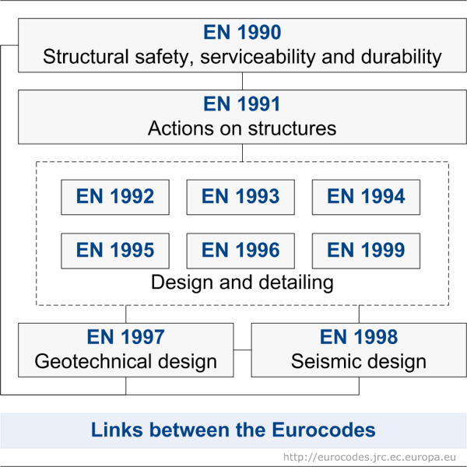
The Eurocode system
The structural Eurocodes are produced by the European Committee for Standardisation (CEN), its members being the national standards bodies of the EU and EFTA countries. The EN Eurocodes include 10 standards (EN 1990 - 1999) covering various subjects related to construction.
EN 1990 Eurocode: Basis of structural design
EN 1991 Eurocode 1: Actions on structures
EN 1992 Eurocode 2: Design of concrete structures
EN 1993 Eurocode 3: Design of steel structures
EN 1994 Eurocode 4: Design of composite steel and concrete structures
EN 1995 Eurocode 5: Design of timber structures
EN 1996 Eurocode 6: Design of masonry structures
EN 1997 Eurocode 7: Geotechnical design
EN 1998 Eurocode 8: Design of structures for earthquake resistance
EN 1999 Eurocode 9: Design of aluminium structures
Each Eurocode is referenced by a European standard number (EN), by example EN 1995 for Eurocode 5, EN 1998 for Eurocode 8.
Note! 1998 is not the year of validation of the standard. When the year of Eurocode publication is added, it is specified at the end of the index, separated from it by a colon or parentheses: EN 1995-1-1: 2005 (Eurocode 5 published in 2005).
Notes:
The Eurocodes are a new set of European structural design codes for building and civil engineering works. Conceived and developed over the past 30 years, they are arguably the most advanced structural codes in the world.
The Eurocodes are intended to be mandatory for European public works and likely to become the standard for the industry – both in Europe and worldwide.
The structural Eurocodes are produced by the European Committee for Standardization (CEN), its members being the national standards bodies of the EU and EFTA countries. The EN Eurocodes include 10 standards (EN 1990 - 1999) covering various subjects related to construction.
The 10 structural Eurocodes areas are named EC0 to EC9 orEN 1992 to 1999. These are broken down into a further 58 parts. EC0 is a key Eurocode that form the basis of the structural design. EC1 guides the designer through the process of determining the design values for loads, now called actions on structures. EC 2 to 9 cover the design and detailing for different materials, as well as geotechnical and seismic design.

Slide 3
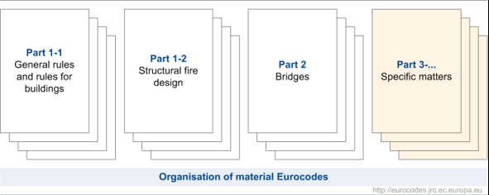
The Eurocode system
National Annexes
A national Annex can supplement the Eurocodes.
It contains information on parameters left pending such as:
- values ​​and / or classes where alternatives appear in the Eurocode, for example admissible deflection values;
- values ​​to be used when there is only one symbol in the Eurocode;
- climatic data such as snow and wind maps;
- procedures to be used where alternative procedures are given in the eurocode;
- procedures on the use of informative annexes;
- references to additional non-contradictory information for help the user to apply the eurocode.
Parts
Each of the codes (except EN 1990) is divided into a number of parts covering specific aspects of the subject. They are referenced by a reference number.
EN 1995, Design of timber structures, has three parts:
1. EN 1995-1-1 General. Common rules for buildings
2. EN 1995-1-2 General rules. Structural fire design
3. EN 1995-2 Bridges
Notes:
Each country is required to publish a Eurocode with a national title page and forward, but the original text of the eurocode must appear as originally produced. In Finland the Eurocodes are published by the Finnish Standard association (SFS). A national annex, containing country specific values can be included at the back of the document. A distinct feature of the Eurocodes is that they describe the overall aims of the design and provide specific guidance on how to achieve these aims in practice.
A national Annex can supplement the Eurocodes.
It contains information on parameters left pending such as:
- values ​​and / or classes where alternatives appear in the Eurocode, for example admissible deflection values;
- values ​​to be used when there is only one symbol in the Eurocode;
- climatic data such as snow and wind maps;
- procedures to be used where alternative procedures are given in the eurocode;
- procedures on the use of informative annexes;
- references to additional non-contradictory information for help the user to apply the eurocode.
Each of the codes (except EN 1990) is divided into a number of parts covering specific aspects of the subject. They are referenced by a reference number.
All of the EN Eurocodes relating to materials have a Part 1-1 which covers the design of buildings and other civil engineering structures and a Part 1-2 for fire design. The codes for concrete, steel, composite steel and concrete, and timber structures and earthquake resistance have a Part 2 covering design of bridges. These Parts 2 should be used in combination with the appropriate general Parts (Parts 1).
EN 1995, Design of timber structures, has three parts:
1. EN 1995-1-1 General. Common rules for buildings
2. EN 1995-1-2 General rules. Structural fire design
3. EN 1995-2 Bridges

Slide 4
The Eurocode system
The following standards are required for the use of EN 1995-1-1:
General reference Eurocodes:
EN 1990: Basis of structural design
EN 1991: Actions on structures (all parts)
EN 1995-1-2: Structural fire design
CEN standards
EN 338 - Timber strength classes
EN 1912 - Visual grades (assignment to strength classes)
EN 336 - Timber size tolerances
EN 1194 - Glulam strength classes
EN 12369: Part 1 - Strength properties of oriented strand board (OSB)/chipboard/fiberboards
EN 12369: Part 2 - Strength properties of plywood
Eurocode 5 has two main notations throughout its contents for certain rules and requirements:
‘Principle requirements’ are annotated by the suffix ‘P’. This means that you must comply with the requirement. They are general statements and definitions for which there is no alternative permitted unless specifically stated.
‘Application Rules’ are generally recognized rules which comply with and satisfy the ‘Principle requirements’.
Notes:
EN 1995 is a limit state concept code that, for the design of new structures, has to be used in conjunction with EN 1990: Basis of structural design and the relevant parts of EN 1991 Actions on structures (all parts)
Other CEN standards used are:
EN 338 - Timber strength classes
EN 1912 - Visual grades (assignment to strength classes)
EN 336 - Timber size tolerances
EN 1194 - Glulam strength classes
EN 12369: Part 1 - Strength properties of oriented strand board (OSB)/chipboard/fiberboards
EN 12369: Part 2 - Strength properties of plywood
Eurocode 5 has two main notations throughout its contents for certain rules and requirements:
‘Principle requirements’ are annotated by the suffix ‘P’. This means that you must comply with the requirement. They are general statements and definitions for which there is no alternative permitted unless specifically stated.
‘Application Rules’ are generally recognized rules which comply with and satisfy the ‘Principle requirements’.

Slide 5
Basis of structural design (the use of EN 1990 for timber structures design)
EN 1990 Basis of structural design, establishes and provides comprehensive information and guidance for all the Eurocodes, on the principles and requirements for safety and serviceability, describes the basis of their design and verification and gives guidelines for related aspects of structural reliability and durability of structures.
It is based on the limit state concept and used in conjunction with the partial factor method.
The requirements of EN 1990 which need to be adhered to by EN 1995 are:
Fundamental requirements.
Reliability differentiation.
Design working life.
Durability.
Quality assurance.
Design situations.
EN 1990 classifies design situations for ultimate limit state verification as follows:
persistent situations (conditions of normal use)
transient situations (temporary conditions, e.g. during execution)
accidental situations
seismic situations.
Notes:
EN 1990 is the head key Eurocode for the harmonised Structural Eurocodes and is required for the verification of both ultimate and serviceability limit states as it provides the information for safety factors for actions and combination of superimposed actions.
EN 1990 establishes and provides comprehensive information and guidance for all the Eurocodes, on the principles and requirements for safety and serviceability, describes the basis of their design and verification and gives guidelines for related aspects of structural reliability and durability of structures. It is based on the limit state concept and used in conjunction with the partial factor method.
EN 1995 does not give the material-independent clauses required for design. These are only included in EN 1990. Hence it is very important that EN 1990 is used with all the Eurocode parts. In the Eurocode system the safety and reliability concept is to be chosen and developed by the designer.
The requirements of EN 1990 which need to be adhered to by EN 1995 are:
. Fundamental requirements. These relate to safety, serviceability and robustness requirements.
The structures should:
withstand actions and influences occurring during their construction and anticipated use
remain fit o use under all expected actions and have adequate structural resistance, serviceability and durability
have adequate structural resistance for the appropriate required period of time, in case of fire
not be damaged by events such as explosions, impact or consequences of human errors, to an extent inconsistent with the original cause - robustness
. Reliability differentiation.
The term "reliability" is often used very vaguely and deserves some clarification. Often the concept of reliability is conceived in an absolute (black and white) way – the structure either is or isn’t reliable.
The positive statement is understood in the sense that “a failure of the structure will never occur“. This interpretation is unfortunately an oversimplification. Although it may be unpleasant and for many people perhaps unacceptable, the hypothetical area of “absolute reliability” for most structures (apart from exceptional cases) simply does not exist. Generally speaking, any structure may fail (although with a small or negligible probability) even when it is declared as reliable.
The interpretation of the complementary (negative) statement is usually understood more correctly:
failures are accepted as a part of the real world and the probability or frequency of their occurrence is then discussed. In fact in the design it is necessary to admit a certain small probability that a failure may
occur within the intended life of the structure. Otherwise designing of civil structures would not be possible at all. What is then the correct interpretation of the keyword “reliability” and what sense does the
generally used statement “the structure is reliable or safe.
. Design working life. For buildings and other common structures the recommended design working life (i.e. the assumed period for which a structure is to be used for its intended purpose with anticipated maintenance but without major repair being necessary) is 50 years. Design working life needs to be considered for material property deterioration, life-cycle costing and evolving maintenance strategies.
.
Durability. The durability of a structure is its ability to remain fit for use during the design working life, given appropriate maintenance. The structure should be designed in such a way that, or
provided with protection so that, no significant deterioration is likely to occur within the period between successive inspections.
• The intended and future use of the structure
• The required design criteria
• The expected environmental influences
• The composition, properties and performance of materials
• The choice of a structural system
• The shape of members and structural detailing
• The quality of workmanship and level of control
• The particular protective measures
• The maintenance during the intended life
. Quality assurance.
Is assured bty the maintenance of a desired level of quality in a service or product, especially by means of attention to every stage of the process of delivery or production.
. Design situations.
EN 1990 stipulates that a relevant design situation is selected taking account of the circumstances in which the structure may be required to fulfil its function.
EN 1990 classifies design situations for ultimate limit state verification as follows:
* persistent situations (conditions of normal use)
* transient situations (temporary conditions, e.g. during execution)
* accidental situations
* seismic situations.

Slide 6
Actions on Structures EN1991

Slide 7
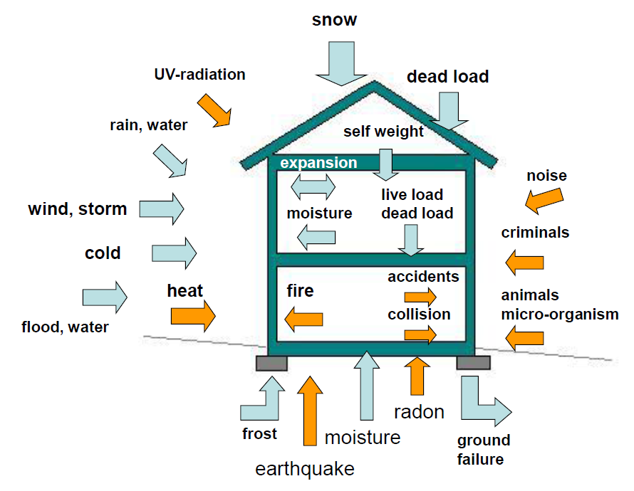
What kind of conditions need to be considered when designing a building?
The entire building, both substructure and superstructure, is made of construction elements divided in two main categories:
Structural elements
Non-structural elements
Notes:
Actions on Structures EN1991
The objective of a structural engineer is to design a structure that will be able to withstand all the loads to which it is subjected while serving its intended purpose throughout its intended life span.
In designing a structure, an engineer must, therefore, consider all the loads that can realistically be expected to act on the structure during its planned life span.
The loads that act on common civil engineering structures can be grouped according to their nature and source into three classes:
dead loads due to the weight of the structural system itself and any other material permanently attached to it;
live loads, which are movable or moving loads due to the use of the structure;
and (3) environmental loads, which are caused by environmental efects, such as wind, snow, and earthquakes.
In addition to estimating the magnitudes of the design loads, an engineer must also consider the possibility that some of these loads might act simultaneously on the structure. The structure is finally designed so that it will be able to withstand the most unfavorable combination of loads that is likely to occur in its lifetime.
In the eurocode series of European standards (EN) related to constructions, Eurocode 1: Actions on structures (informally, EC 1) describes how to estimate the load acting on a structure in order to design load-bearing elements of the structure.
It includes characteristic values for various types of loads and densities for all materials which are likely to be used in construction.

Slide 8
Loads on Structures
The objective of a structural engineer is to design a structure that will be able to withstand all the loads to which it is subjected while serving its intended purpose throughout its intended life span.
Once the dimensional requirements for a structure have been defined, it becomes necessary to determine the loads the structure must support.
The minimum design loads and the load combinations for which the structures must be designed are usually specified in building codes.
In the eurocode series of European standards (EN) related to constructions, Eurocode 1: Actions on structures (abbreviated EN 1991 or, informally, EC 1) describes how to estimate the load acting on a structure in order to design load-bearing elements of the structure.
It includes characteristic values for various types of loads and densities for all materials which are likely to be used in construction.
Notes:
Once the structural form has been determined, the actual design begins with those elements that are subjected to the primary loads the structure is intended to carry, and proceeds in sequence to the various supporting members until the foundation is reached. Thus, a building floor slab would be designed first, followed by the supporting beams, columns, and last, the foundation footings. In order to design a structure, it is therefore necessary to first specify the loads that act on it

Slide 9
Characteristic loads
The anticipated load levels due to self weight, contents and users, snow and wind are called characteristic loads.
• Buildings will be subject to loads from various sources and the principal ones can be classified as:
– dead load,
– imposed load,
– wind load and,
– snow load.
• In some cases, structures may be subject to other loads, such as those due to:
– earthquakes or
– floods
– explosions
! Generally, the expected maximum magnitude of each is referred to as the characteristic load.
Notes:
Although the load requirements of most local building codes are generally based on those of the national codes, local codes may contain additional provisions warranted by such regional conditions as earthquakes, tornadoes, hurricanes, heavy snow, and the like.
Local building codes are usually legal documents enacted to safeguard public welfare and safety, and the engineer must become thoroughly familiar with the building code for the area in which the structure is to be built.
The loads described in the codes are usually based on past experience and study and are the minimum for which the various types of structures must be designed. However, the engineer must decide if the structure is to be subjected to any loads in addition to those considered by the code, and, if so, must design the structure to resist the additional loads. Remember that the engineer is ultimately responsible for the safe design of the structure.

Slide 10
EUROCODE 1 – Actions on structures
Part 1-1: Densities, self-weight, imposed loads for buildings
Part 1-2: Actions on structures exposed to fire
Part 1-3: General actions - Snow loads
Part 1-4: General actions - Wind actions
Part 1-5: General actions - Thermal actions
Part 1-6: General actions - Actions during execution
Part 1-7: General actions - Accidental Actions
Part 2: Traffic loads on bridges
Part 3: Actions induced by cranes and machinery
Part 4 : Silos and tanks

Slide 11
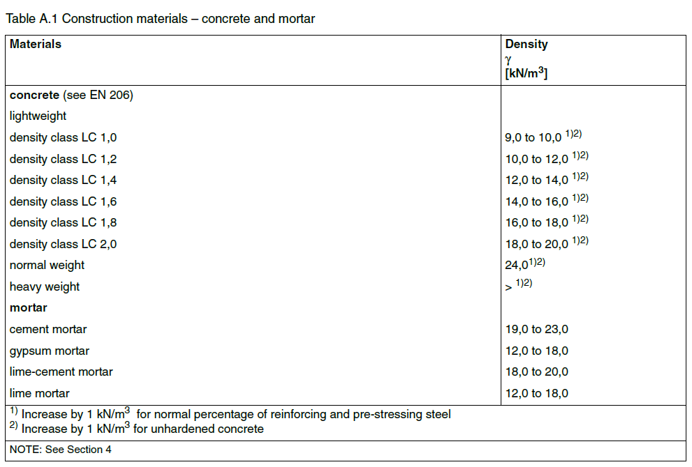
Permanent actions/ Dead loads - EN-1991-1-1
Permanent actions / Dead loads consist of the weights of the various structural members and the weights of any objects that are permanently attached to the structure.
Hence, for a building, the dead loads include the weights of the columns, beams, and girders, the floor slab, roofing, walls, windows, plumbing, electrical fixtures, and other miscellaneous attachments.

Slide 12
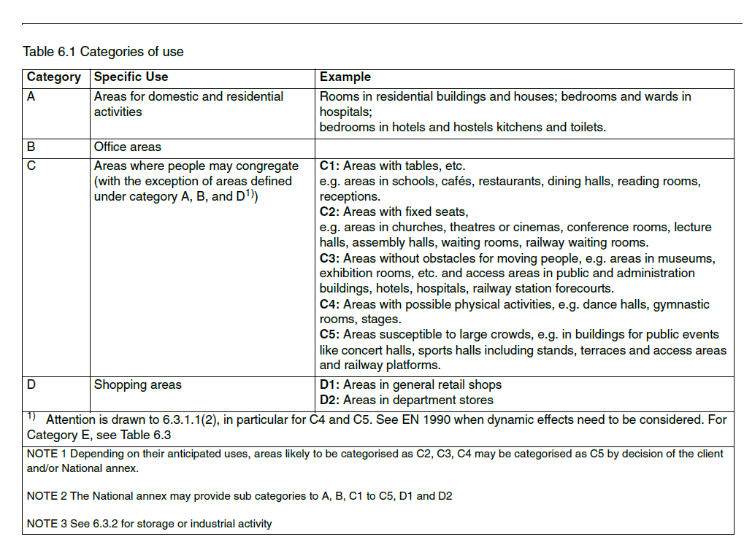
Imposed loads on buildings
(1) Imposed loads on buildings are those arising from occupancy. Values given in this Section of eurocode, include:
normal use by persons;
furniture and moveable objects (e.g. moveable partitions, storage, the contents of containers);
vehicles;
anticipating rare events, such as concentrations of persons or of furniture, or the moving or stacking of objects which may occur during reorganization or redecoration.
(2) The imposed loads specified in this part are modelled by uniformly distributed loads, line loads or concentrated loads or combinations of these loads.
(3) For the determination of the imposed loads, floor and roof areas in buildings should be sub-divided into categories according to their use.
(4) Heavy equipment (e.g. in communal kitchens, radiology rooms, boiler rooms etc) are not included in the loads given in this Section. Loads for heavy equipment should be agreed between the client and/or the relevant Authority.

Slide 13
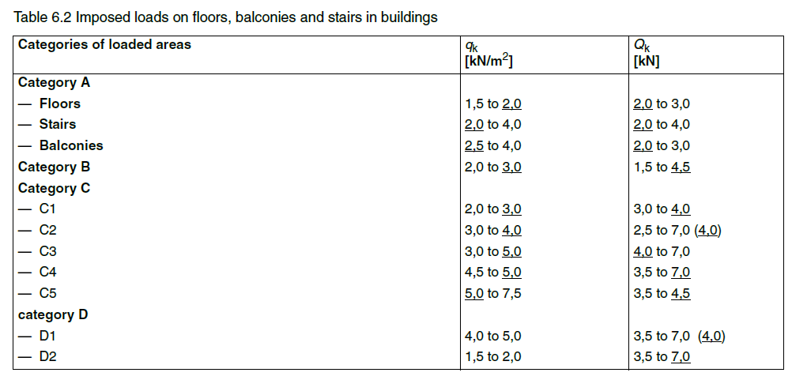
Imposed loads on buildings
(1)P The categories of loaded areas, as specified in Table 6.1, shall be designed by using characteristic values q_{k} (uniformly distributed load) and Q_{k} (concentrated load)
NOTE: Values for q_{k} and Q_{k} are given in Table 6.2 below. Where a range is given in this table, the value may be set by the National annex. The recommended values, intended for separate application, are underlined. q_{k} is intended for determination of general effects and Q_{k} for local effects. The National annex may define different conditions of use of this Table.

Slide 14
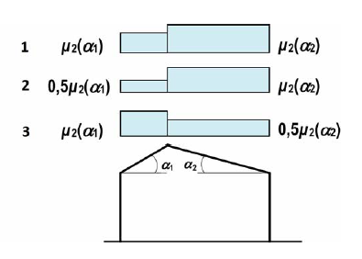
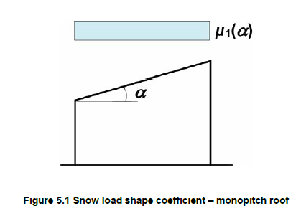
Snow loads - EN-1991-1-3
The characteristic value of the snow load depends on the geographical location and shape of the building.
The following equation is obtained for the characteristic value of snow load on roof structure:

Slide 15
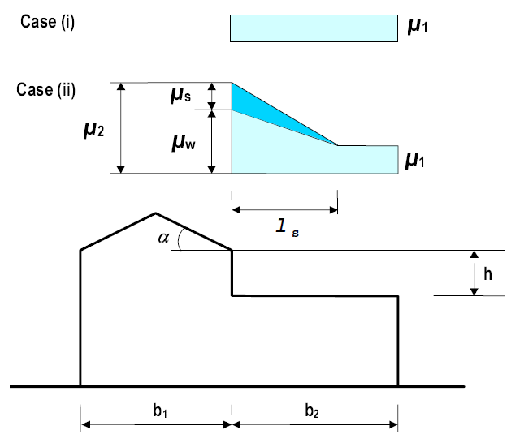
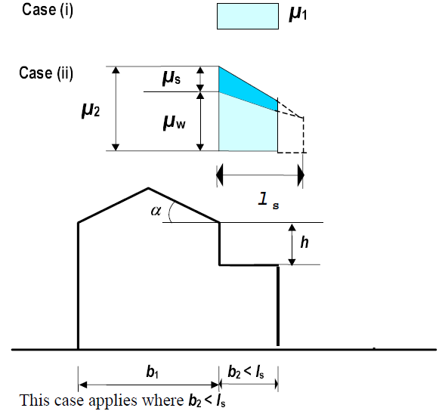
Snow loads continued

Slide 16
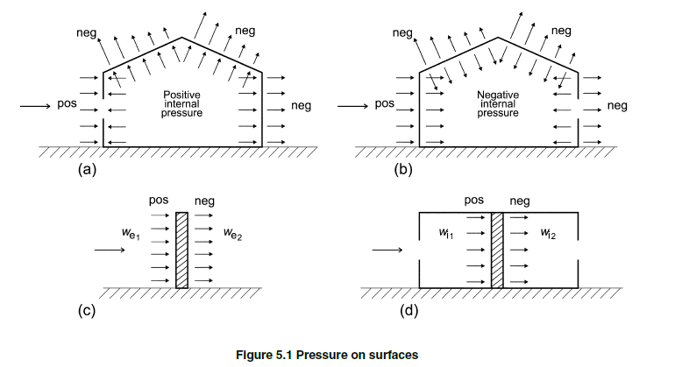
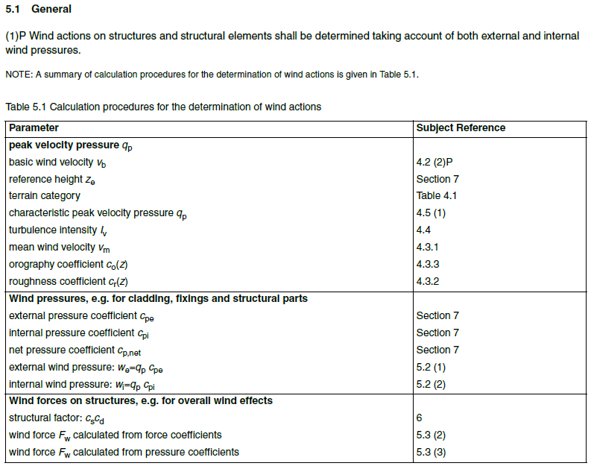
Wind loads - EN-1991-1-4
(1) The peak velocity pressure q_{p}(z) at height z, which includes mean and short-term velocity fluctuations, should be determined.
(1) The wind pressure acting on the external surfaces, w_{e}, should be obtained from Expression (5.1).
(2) The wind pressure acting on the internal surfaces of a structure, w_{i} , should be obtained from Expression (5.2)
Notes:
Wind loads are produced by the flow of wind around the structure. The magnitudes of wind loads that may act on a structure depend on the geographical location of the structure, obstructions in its surrounding terrain, such as nearby buildings, and the geometry and the vibrational characteristics of the structure itself.

Slide 17
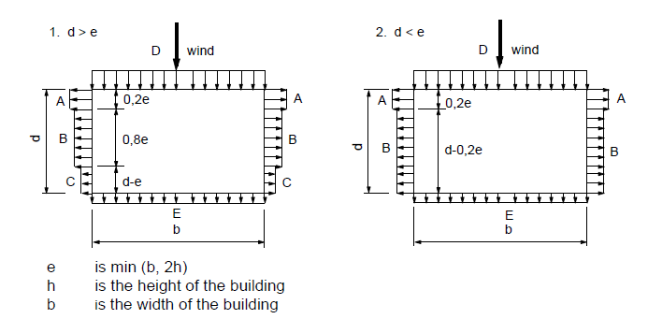
Wind loads cont.

Slide 18
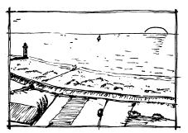
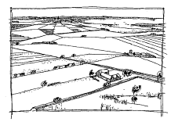
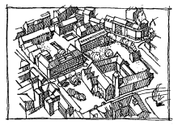
Wind loads - EN-1991-1-4
The total force due to wind can be expressed as follows:
$$F_{w}=c_{s}∙c_{d}∙c_{f}∙q_{p}\left(z_{e}\right)∙A_{ref}$$
Where:
c_{s} c_{d} - is a structural factor
c_{f} - is the force coefficient
q_{p}(z_{e}) – is the peak velocity pressure at reference height z_{e}
A_{ref} - is the area of the structure perpendicular to the wind
Terrain category 0
Sea, coastal area exposed to the open sea
Terrain category I
Lakes or area with negligible vegetation and without obstacles
Terrain category III
Area with regular cover of vegetation or buildings or with isolated obstacles with
separations of maximum 20 obstacle.
$$c_{f}=c_{f,0}∙ψ_{r}∙ψ_{λ}$$
Where:
c_{f,0} - is the force coefficient for shapes with sharp corners
ψ_{r} - is the reduction factor for rounded corners at rectangular structures
ψ_{λ} - is the end-effect factor for elements with free end flow
Terrain category II
Area with low vegetation such as grass and isolated obstacles with separations of at least 20 obstacle heights
Terrain category IV
Area in which at least 15 % of the surface is covered with buildings and their average height exceeds 15 m

Slide 19
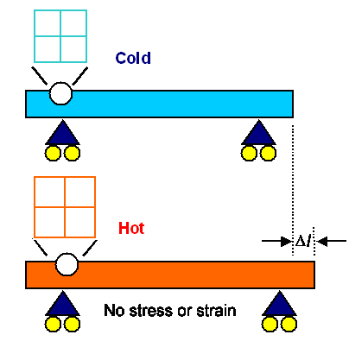
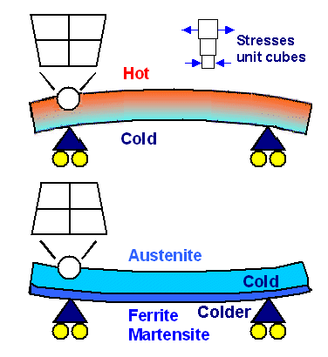
Thermal And Other Effects EN-1991-1-5
In general thermal variations cause deformations in single structural elements as well as in the overall structure itself. Therefore, the effects of thermal variations may involve aspects of a structure’s functionality as well as its safety.

Slide 20
Accidental loads - EN-1991-1-7
EN-1991-1-7 gives strategies and rules for safeguarding buildings and other civil engineering works against identifiable and unidentifiable accidental actions.
Identifiable accidental loads could be:
Fire
Explosions
Earthquakes
Impact
Floods
Landslides
Unidentifiable accidental loads could be:
Human errors in design and executing
Improper use
Exposure to aggressive agencies
Failure of equipment
Malicious attacks
Warfare
Notes:
Because of the nature of accidental loads the design approach is different from that of normal loads. Risk analysis!!!

Slide 21
Consequences and Reliability Classes
EN 1990, as do all the other Eurocodes, uses the concept of partial factor design and embodied in the values of the partial factors, there are implicit ‘acceptable’ or ‘accepted’ risk levels.
The reliability index is a function of the probability of failure
Notes:
Thus, the criterion for classification in EN 1990 is the importance in terms of consequences of failure of the structure or structural members. It is widely accepted that the reliability level of a structure should be higher the greater the consequences of failure. The selection of the consequence class and different levels of reliability requires consideration of a number of appropriate aspects, including:
the frequency of use
the cause and/or mode of attaining a limit state
the possible consequences of failure in terms of risk to life, injury and potential economic losses
political requirements and public aversion to failure
the expense and procedures necessary to reduce the risk of failure.
In Annex B of EN 1990, three reliability classes RC1, RC2 and RC3, which are defined by the reliability index concept beta - a function of the probability of failure , are associated with the three consequences classes CC1, CC2 and CC3 respectively.

Slide 22
Structural analysis
The design procedure using the limit state concept consists of setting up structural and load models for relevant ultimate and serviceability limit states which are considered in the various design situations and load cases.
Ultimate Limit State is related to the maximum design load capacity under extreme conditions.
The partial load factors are chosen to reflect the probability of extreme conditions, when loads act alone or in combination. The ultimate limit states are associated with collapse and other similar forms of structural failure.
Serviceability Limit State is related to the criteria governing normal use. Unfactored loads are used to check the adequacy of the structure.
The serviceability limit states are associated with conditions of normal use. In particular, they concern the functioning of the structure or structural members, comfort of people and appearance of the construction works.
Taking into account the time dependency of load effects, it is useful to distinguish two types of serviceability limit states:
irreversible serviceability limit states
reversible serviceability limit states
Notes:
In the Eurocodes, the safety requirements for structures are formulated in terms of limit states. A limit state is a state where the structure is on the point of not satisfying the necessary performance requirements.
A distinction is made between serviceability and ultimate limit states.
Action effects in cross-sections, joints or members determined through structural modelling and analysis, can be used to verify the reliability of buildings and civil engineering works at their various limit states.
Depending on the overall structural configuration, the structure may be considered as a three dimensional system or as a system of planar frames and/or beams. For example, a structure with no significant torsional response may perhaps be considered as consisting of a set of planar frames.
When considering the stability of the structure, it is not only individual members which should be dealt with but also the whole structure: a structure properly designed with respect to individual members can still be susceptible to overall instability as a whole (e.g. torsional buckling of a uniform-lattice tower crane column).

Slide 23
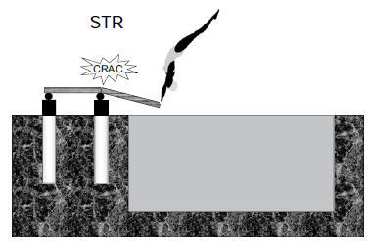
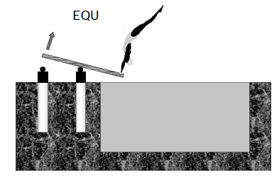
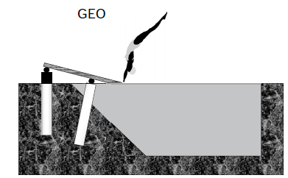
Limit state design - Ultimate limit states
Ultimate limit states are associated with collapse or with other forms of structural failure and concern:
the safety of people
the safety of the structure and its contents.
Ultimate limit state failure occurs when:
uplift, overturning or sliding of the whole or part of the structure takes place
failure of materials is evident
instability of members or structures (i.e. column failure, lateral torsion instability, overturning, etc.) occurs.
There are three types of ULS verifications:
STR: verification of the resistance and deformations of the different parts of the structure;
EQU: verification of the risk of loss of static equilibrium;
GEO: verification that the ground resistance has not been exceeded.

Slide 24
The partial coefficient method
The basic elements are characteristic actions F_{k}, and characteristic material parameters m_{k} (mechanical properties).
The basic principles are that:
design actions are found by multiplying the characteristic actions by partial safety factors (load factors); the design action effects are found from prescribed combinations of design action;
design material parameters are found by dividing the characteristic parameters by other partial coefficients (material factors) and design resistance is calculated with these design parameters
it shall then be verified that the design resistance is not less than the design action effects.
Actions
A distinction is made between four types of actions that are classified by their variation in time:
permanent actions (G), e.g. self-weight, fixed equipment and actions caused by shrinkage and uneven settlements
variable action (Q), e.g. imposed loads, wind and snow
accidental actions (A), e.g. explosions or impact from vehicles
seismic actions.
Notes:
The design acording to Eurocodes it is based on the partial coefficient method.
The basic elements of this method, are the characteristic actions and characteristic material parameters (mechanical properties).
All actions, including environmental influences, are introduced in design calculations as various representative values. The most important representative value of an action F is the characteristic value Fk. Depending on the available data and experience, the characteristic value should be specified in the relevant EN standard as a mean, an upper or lower value or a nominal value. Exceptionally, the characteristic value of an action can also be specified in the design or by the relevant competent authority, provided that the general provisions specified in EN 1990 are observed. So a characteristic load value is a value as we are taking from the code, before applying any load factors.
The properties of materials and soils are an important group of basic variables for determining structural reliability. In design calculations the properties of materials (including soil and rock)
or products are represented by characteristic values, determined from standardised tests performed under specified conditions. We will find these values in tables, in codes or provided by the producers.
Both types of characteristic values, for loads and materials, are used in design after applying of them specific partial coefficients.
The basic principles are that:
design actions are found by multiplying the characteristic actions by partial safety factors (load factors); the design action effects are found from prescribed combinations of design action;
design material parameters are found by dividing the characteristic parameters by other partial coefficients (material factors) and design resistance is calculated with these design parameters
it shall then be verified that the design resistance is not less than the design action effects.

Slide 25
Classification of actions
Permanent actions (G)
Variable actions (Q)
Accidental actions (A)
Notes:
Classifications of actions introduced in EN 1990 provide the basis for the modelling of actions and controlling structural reliability.
The aim of the classifications is to identify the similar or dissimilar characteristics of various actions and to enable the use of appropriate theoretical action models and reliability elements in structural design. A complete action model describes several properties of an action, such as its magnitude, position, direction and duration. In some cases, interactions between actions and the response of the structure should be taken into account (e.g. wind oscillations, soil pressures and imposed deformations).
Considering their variation in time, actions are classified as:
Permanent actions G (a permanent action is an ‘action that is likely to act throughout a given reference period and for which the variation in magnitude with time is negligible, or for which the variation is always in the same direction (monotonic) until the action attains a certain limit value’ –, for example, the selfweight of structures or the weight of fixed equipment and road surfacing, as well as indirect actions caused by shrinkage or uneven settlements.
Variable actions Q (a variable action is an ‘action for which the variation in magnitude with time is neither negligible nor monotonic’, for example, imposed loads on building floors or on bridge decks, wind actions or snow loads.
Accidental actions A (an accidental action is an ‘action, usually of short duration but of significant magnitude, that is unlikely to occur on a given structure during the design working life’ – for example, fire, explosions or impact loads.
Actions due to earthquakes are generally identified as accidental actions , and are identified by the symbol AE.

Slide 26
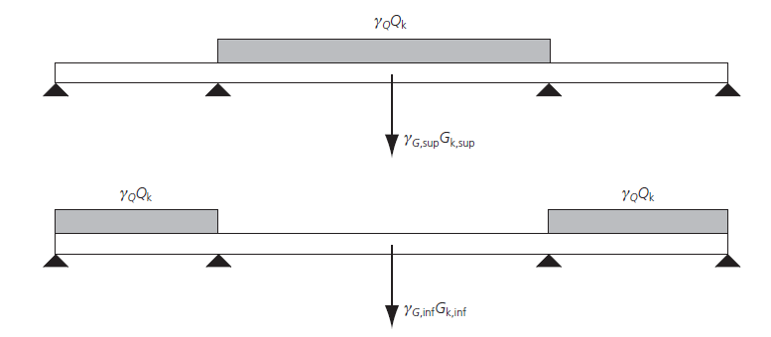
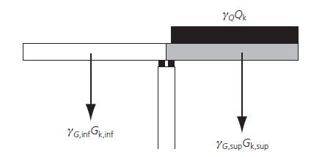
Load combinations – General Overview
1. The general principle adopted in EN 1990 is as follows: For each critical load case, the design values of actions (Ed) shall be determined by combining the values of actions that are considered to occur simultaneously.
2. Each combination of actions should include a leading variable action or an accidental action.
3. Where the results of a verification may be very sensitive to variations of the magnitude of a permanent action from place to place in the structure, the unfavorable and the favorable parts of this action shall be considered as individual actions. This applies in particular to the verification of static equilibrium and analogous limit states.
Notes:
For a given construction, several actions, considered as several natural or man-made phenomena, apply permanently. For example, a building is permanently subject to actions due to self-weight, loads on floors, wind, snow, thermal actions, etc.
However, for the verifications, only critical load cases need to be taken into account, and these critical load cases are closely linked to the design values selected for actions.
---
This clause is very important. It allows the designer to consider a clearly identified permanent action (e.g. the self-weight of a continuous beam) as a single action: in a combination of actions, this permanent action may be considered either as a favourable or an unfavourable action.

Slide 27
Action (load) combinations – STR, EQU
In most cases permanent actions and one or more variable actions act simultaneously.
According to [EN 1990] the following combination rules shall be used (a part of the equation in [EN 1990] prestressing
has been omitted because this is never applicable for ordinary timber structures).
There are two main design situations: fundamental and accidental.
1) Fundamental (persistent and transient) design situations (strength or equilibrium):
Q_{k,1} is the so-called leading variable action (live load).
Where it is not obvious which is the leading action, each action should in turn be taken as Q_{k,1} to determine the combination which produces the worst effect.
Self weight
Leading variable action
Other variable actions
For most materials the leading action is that which results in the largest action effect, but this is not necessarily so for timber structures because of the factor k_{mod}.
Notes:
For most materials the leading action is that which results in the largest action effect, but this is not necessarily so for timber structures because of the factor kmod.

Slide 28
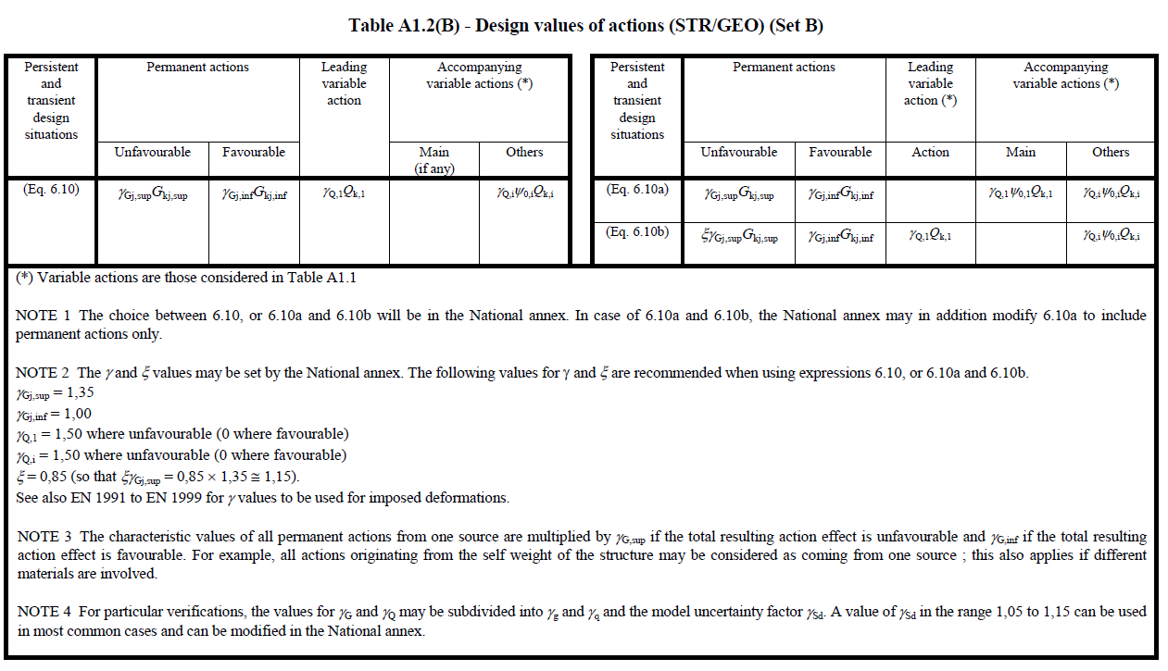
When calculating the design value for load in ultimate limit state, the following formulae are applicable when the structure is subjected to several variable actions

Slide 29
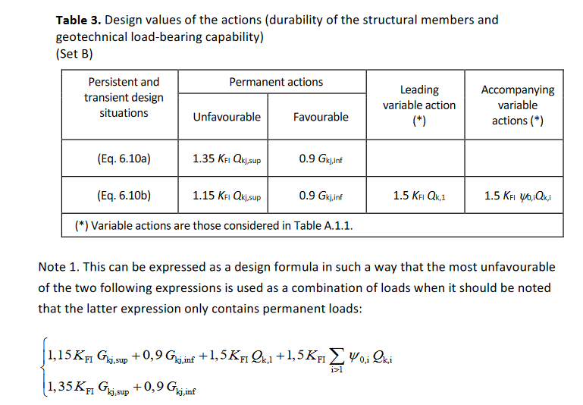
Design values of actions in persistent and transient design situations
1.15 =1,35 * 0.85 specific for some countries e.g. Finland

Slide 30
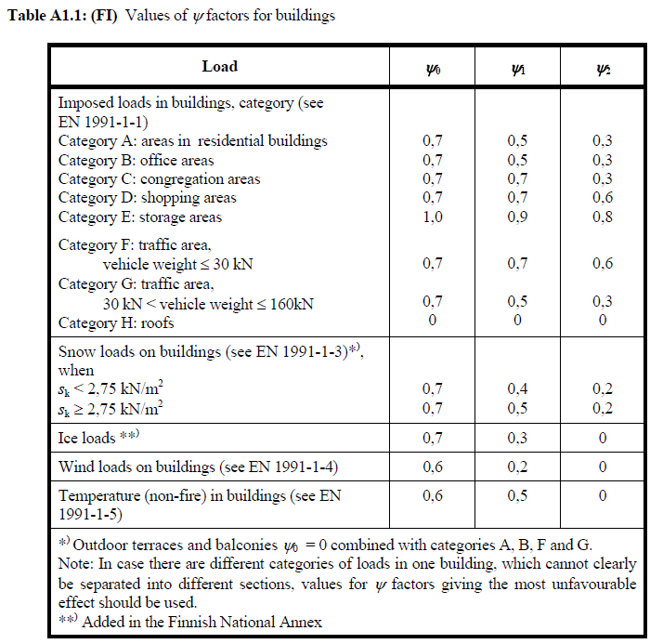
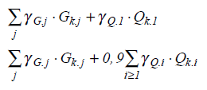
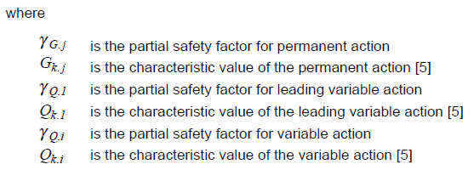
The values in the table can be written as equations:

Slide 31
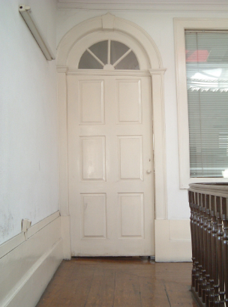
Limit state design - Serviceability limit states
Serviceability limit states concern:
the functioning of the construction works or parts of them
the comfort of people
the appearance.
Serviceability limit state failure occurs when:
deflection of a structure or a member is visually or functionally unacceptable (e.g., it may result in cracks of ceiling and walls or leakage of roofs)
sway or vibrations are unacceptable or uncomfortable
there are incipient attacks of rot or corrosion that may eventually contribute towards or lead to failure if remedial steps are not taken.
Example: W_{net},_{end} ≤ W_{vertical or horizontal limit}
W_{net},_{end} is the deformation caused by actions applied to the structure.
W_{vertical or horizontal} limit is the limit deflection.
Eurocode 5 contains some recommended deflection and vibration limits, but it is the designer’s responsibility in consultation with the client to detail the requirements.

Slide 32
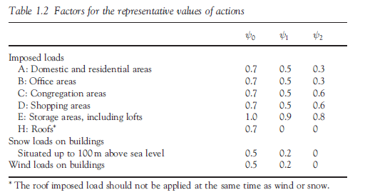
Factors for the representative values of actions
In addition to the characteristic value of an action (G_{k}, Q_{k} and A_{k}) other representative values are specified in EN 1990 for variable and accidental actions.
Three representative values commonly used for variable actions are:
the combination value ψ₀Q_{k},
for ultimate and irreversible serviceability limit states
the frequent value ψ₁Q_{k}
the frequent combination in the serviceability limit states and it is also assumed to be appropriate for verification of the accidental design situation of the ultimate limit states.
the quasi-permanent value ψ₂Q_{k}.
used for the assessment of long-term effects, for example in checking cracking or deflection
Notes:
The combination value ψ₀Q_{k} is associated with the combination of actions for ultimate and irreversible serviceability limit states (the serviceability limit states where some consequences of actions exceeding the specified service requirements will remain when the actions are removed) in order to take account of the reduced probability of simultaneous occurrence of the most unfavorable values of several independent actions. (Heavy snowfall and storm simultaneous.)
The frequent value ψ₀Q_{k} is primarily associated with the frequent combination in the serviceability limit states and it is also assumed to be appropriate for verification of the accidental design situation of the ultimate limit states. In both cases the reduction factor 1 is applied as a multiplier of the leading variable action. (Accidental snow (exceptional precipitation), high operating load )
The quasi-permanent value ψ₂Q_{k} is mainly used for the assessment of long-term effects, for example in checking cracking or deflection. But they are also used for the representation of variable actions in accidental and seismic combinations of actions (ultimate limit states) and for verification of frequent and quasi-permanent combinations (long term effects) of serviceability limit states. (Permanent part of operating loads)

Slide 33
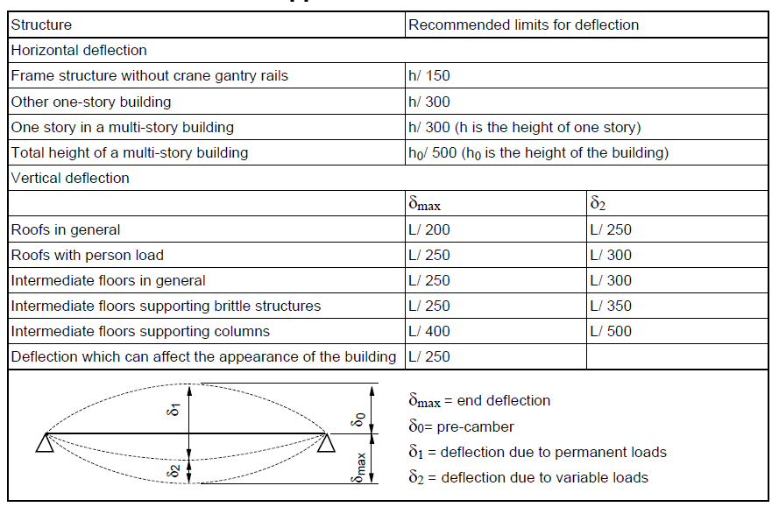
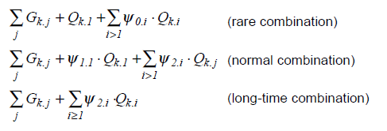
Combinations of actions for serviceability limit state
In the serviceability limit state, the equation for combined loads is the following :
Examples of permitted deflections for various structural elements can be seen in the table.

Slide 34
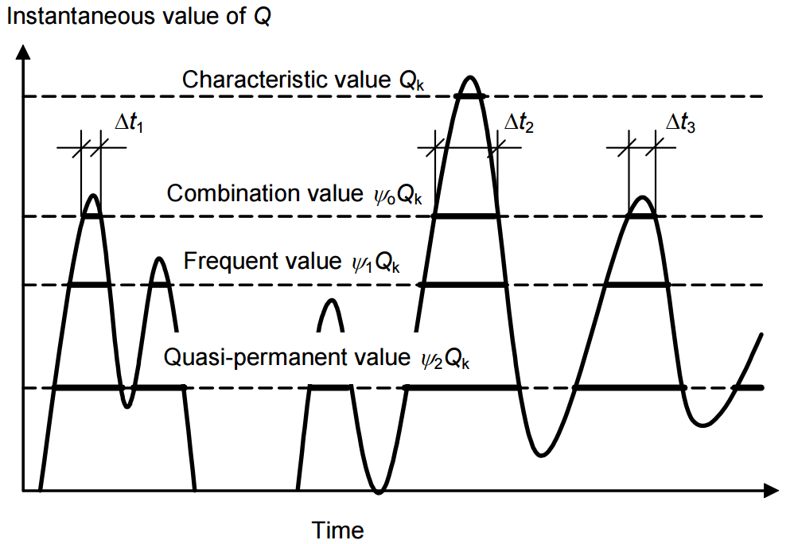
Notes:
Heavy snowfall and storm simultaneous combination
for road traffic loads on bridges, the frequent value is assessed on the basis of a return period of one week. It may be expressed as a determined part of the characteristic value by using a factor ψ1 ≤ 1
Quasi – one week traffic during holiday
Frequent – one week traffic during normal day
Combination – traffic during weekend
Characteristic – traffic during rush hour

Slide 35
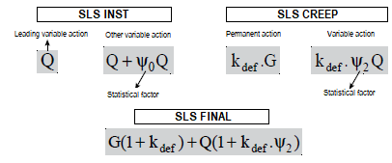
Action (load) combinations - SLS
Three categories of combinations of actions are proposed in EN 1990: characteristic, frequent and quasi-permanent. The appropriate combinations of actions should be selected depending on the serviceability requirements and performance criteria imposed for the particular project, the client or the relevant national authority
Characteristic combination (irreversible limit states / deformations)
EUROCODE 5
Frequent combination (reversible limit states / deformations)
Quasi-permanent combination (long-term effects and the appearance of the structure)

Slide 36
Action (load) combinations - Accidental
2) Accidental design situations (fire, impact or explosion):
The accidental action is in parenthesis because it should only be included when considering the direct effects on the structure of an explosion or impact.
It should not be included when considering the situation after the event or after a fire.
This combination considers that:
accidents are unintended events such as explosions, fire or vehicular impact, which are of short duration and have a low probability of occurrence
a certain amount of damage is generally acceptable in the event of an accident
accidents generally occur when structures are in use.

Slide 37
ULS combinations
SLS combinations
Accidental combinations

Slide 38
Limit State Design And Partial Safety Factors
The basic elements are characteristic actions and characteristic material parameters (mechanical properties).
The basic principles are that:
design actions are found by multiplying the characteristic actions by partial safety factors (load factors); the design action effects are found from prescribed combinations of design action;
design material parameters are found by dividing the characteristic parameters by other partial coefficients (material factors) and design resistance is calculated with these design parameters
it shall then be verified that the design resistance is not less than the design action effects.
The design criterion for the ultimate limit state is:
material

Slide 39
Partial safety factors
It must be checked that the design value of the internal force, the moment or the stress induced by the actions applied to the structure remains less than or equal to the design value of the corresponding resistance.
The effects of the actions must remain lower than the design resistances:
E_{d} ≤ R_{d}.
E_{d} is the effect determined from actions (internal force, moment or constraint).
R_{d} is the design value of the determined strength of the structure, expressed for a stress with the Eurocode annotations:
σ_{d} (F_{k}, γ_{F}, ψ_{i}) ≤ f_{d} (f_{k}, 1/γ_{M}, k_{mod})
σ_{d} stress induced by actions
F_{k} characteristic actions (G, Q, S, W, etc.)
γ_{F} normal partial coefficient of the action
ψ_{i} combination coefficient of actions
f_{d} calculated resistance stress
f_{k} characteristic resistance of the material
γ_{M} normal partial coefficient of the material
k_{mod} modifying coefficient
Notes:
In accordance with the above concepts, the safety format used in Limit State Codes is based on probable maximum load and probable minimum strengths, so that a consistent level of safety is achieved.
It should be noted that γ^{f} makes allowance for possible deviation of loads and the reduced possibility of all loads acting together. On the other hand γ^{m} allows for uncertainties of element behaviour and possible strength reduction due to manufacturing tolerances and imperfections in the material.

Slide 40
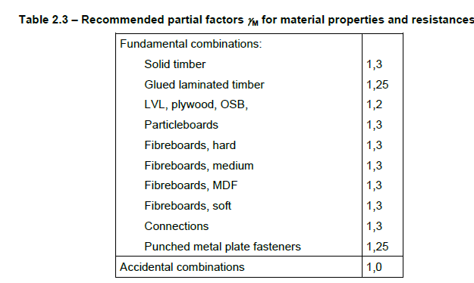
Material parameters (mechanical properties)
Material parameters (mechanical properties)
For strength properties, modulus of elasticity and density, the characteristic value m_{k} is taken as the 5 percentile, i.e. a probability of 5%of getting lower values is accepted.
For stiffness values (e.g. modulus of elasticity), the mean value E_{mean} is normally taken as the characteristic value.
Design material parameters
Design material parameters, m_{d} are determined as:
$$m_{d}=k_{mod}\frac{m_{k}}{γ_{M}}$$
Where:
k_{mod} - is a modification factor taking into account different conditions such as load duration (see Load duration class), moisture content (see Service class), temperature and size.
m_{k} – is the characteristic value of the material parameter m
ϒ_{M} - is the partial coefficient covering the uncertainty in determining of m (N.A.)
Similarly for stiffness:
$$E_{d}=k_{mod}\frac{E_{k}}{γ_{M}}$$
$$G_{d}=k_{mod}\frac{G_{k}}{γ_{M}}$$
Notes:
where kmod is the modification factor, Xk is the characteristic value of the strength property X and gM is the partial factor for a material property.
The function of kmod is to take into account the effects of load duration and moisture content as discussed in Section 2.3.1 and related subsections in this guide.
The characteristic strength, Xk, is obtained from product standards (e.g. EN 338 (BSI, 2009)), as this type of information is not given in EN 1995-1-1. A requirement of product standards is that strengths are derived under service class 1 conditions and that the duration of the load test should be a relatively short period, as stated in Section 2.3.2.1 in this guide.
The purpose of the material property factor, gama M, is to cover for unfavourable deviations in strength, and values for this factor are given in Table NA.3 in the National Annex to EN 1995-1-1.

Slide 41
Service classes
To take into account the moisture content in the timber and wood based materials, structures shall be assigned to one of the service classes given below
Service class 1 is characterized by a moisture content in the materials corresponding to a temperature of 20°C and the relative humidity of the surrounding air only exceeding 65 % for a few weeks per year.
Timber moisture content < 12 %
Typically, in case where timber at indoor conditions or inside insulation (warm roofs, intermediate floors, internal and party timber walls of buildings)
Service class 2 is characterized by a moisture content in the materials corresponding to a temperature of 20°C and the relative humidity of the surrounding air only exceeding 85 % for a few weeks per year.
Timber moisture content < 20 %
Typically, timber at dry outdoor conditions (cold roofs, ground floors, external timber frame walls, external uses where member is protected from direct wetting)
Service class 3 is characterized by climatic conditions leading to higher moisture contents than in service class 2.
Timber at wet conditions (external uses fully exposed)

Slide 42
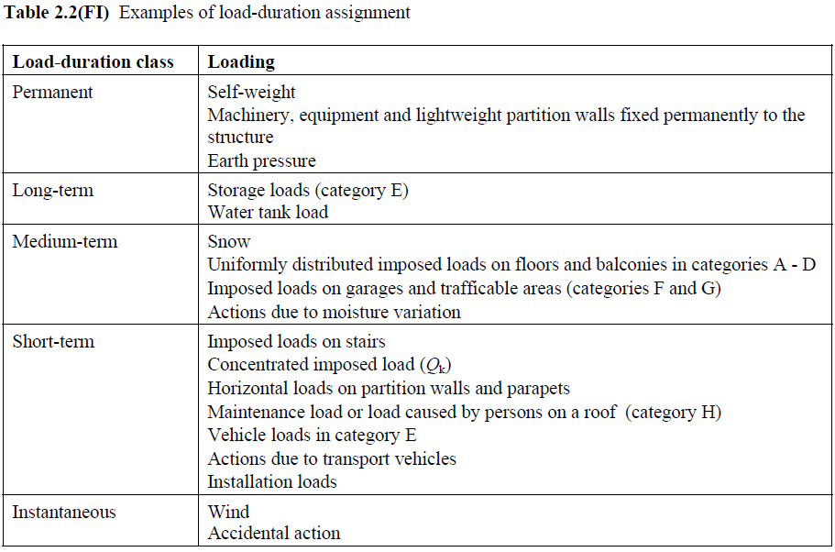
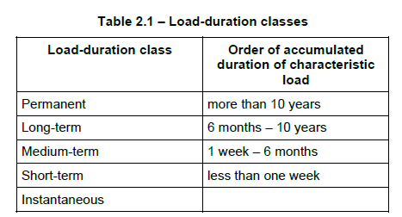
Load duration classes
(1)P The load-duration classes are characterized by the effect of a constant load acting for a certain period of time in the life of the structure. For a variable action, the appropriate class shall be determined on the basis of an estimate of the typical variation of the load with time.
(2)P Actions shall be assigned to one of the load-duration classes given in Table 2.1 for strength and stiffness calculations.

Slide 43
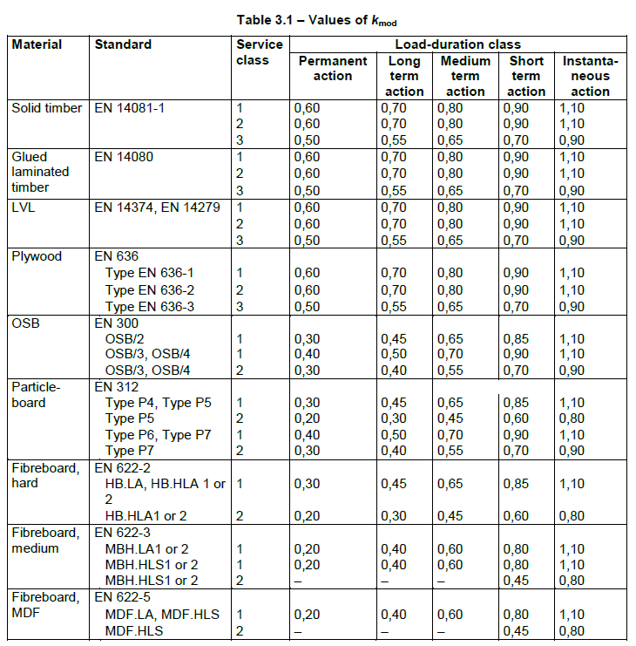
Modification factor k_{mod}
The resistance of a wood element (within the same resistance class) is influenced by two parameters:
the duration of application of the loads;
the average humidity of the wood when it is used.
Indeed, a dry wood supporting a short-term load will be more resistant than a wet wood supporting a load over a long period. These two characters are used to define the k_{mod} factor.

Slide 44
Modification factor k_{mod}
The values of the modification factor k_{mod} given in Table 3.1 should be used.
(2) If a load combination consists of actions belonging to different load-duration classes a value of k_{mod} should be chosen which corresponds to the action with the shortest duration, e.g. for a combination of dead load and a short-term load, a value of k_{mod} corresponding to the short-term load should be used.
Where a connection is constituted of two timber elements having different time-dependent behaviour, the calculation of the design load-carrying capacity should be made with the following modification factor k_{mod}
$$k_{mod}=\sqrt{k_{mod,1}∙k_{mod,2}}$$
where k_{mod,1} and k_{mod,2} are the modification factors for the two timber elements.

Slide 45
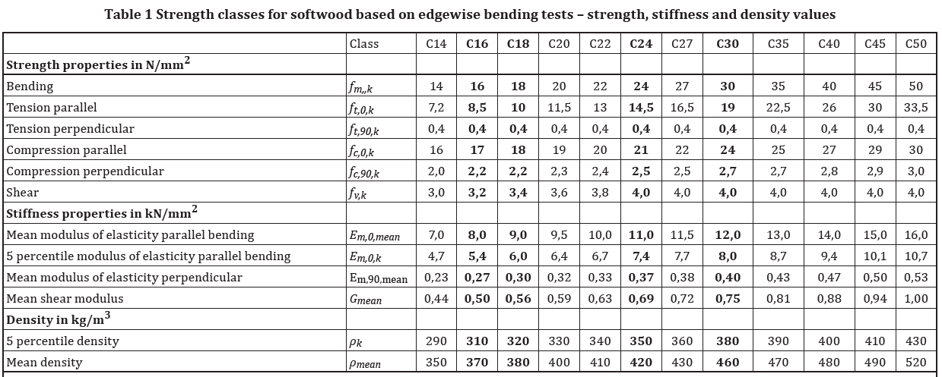
Strength classes of solid wood – Softwood
The wood material exhibits great variations in strength and elasticity. This variability is found from one species to another but also within a same tree. When testing, the majority of samples will have resistance close to the average resistance.
This property is used to calculate a value of mechanical strength so that 95% of the samples have a resistance greater than this calculated value and that 5% of the samples have a resistance less than this calculated value.

Slide 46
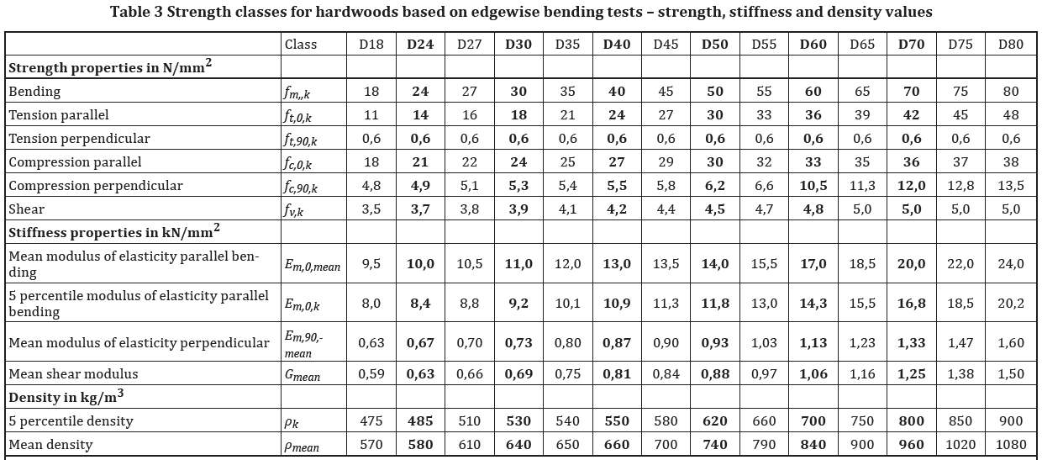
Strength classes of solid wood - Hardwood

Slide 47
Resistance design value
The design resistance is determined by the following formula, for flexural strength:
$$f_{m,d}=f_{m,k}\frac{k_{mod}}{γ_{M}}$$
Example:
Calculate the flexural strength of a coniferous joist classified C24 supporting a floor in a house (combination 1.35 G + 1.5 Q, service class 1)
Solution:
f_{m,k} = 24 MPa - the characteristic bending resistance value - wood C24
k_{mod} = 0.8 - loading taken into account is G permanent and Q variable, k_{mod} is a function of the duration of application of the load of the shortest exposure, here the variable load, medium term.
γ_{M} = 1.3 - solid wood.

Slide 48
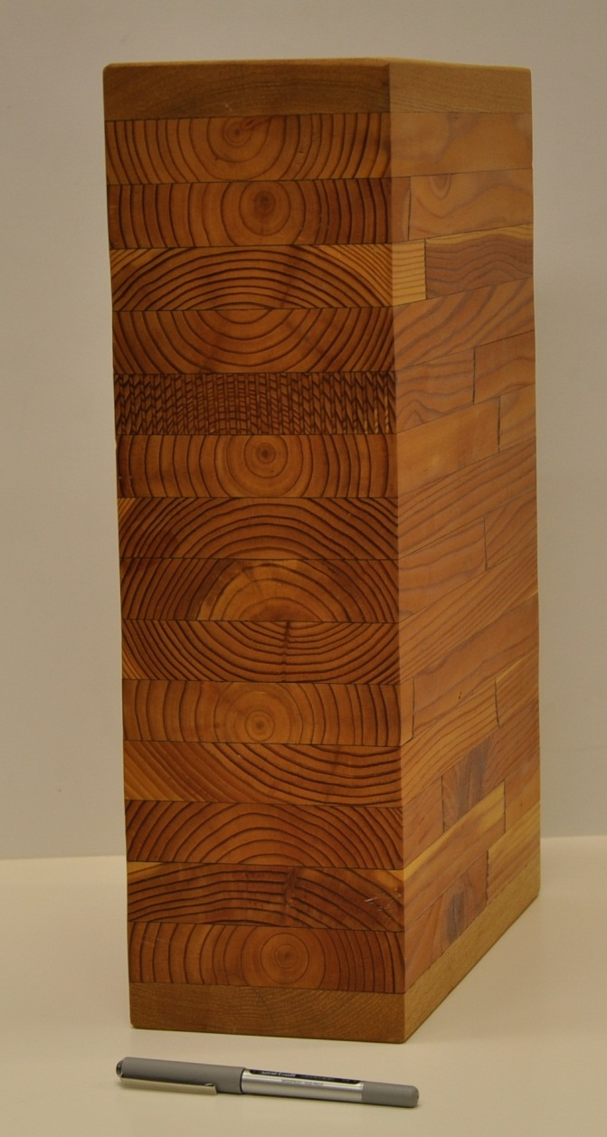
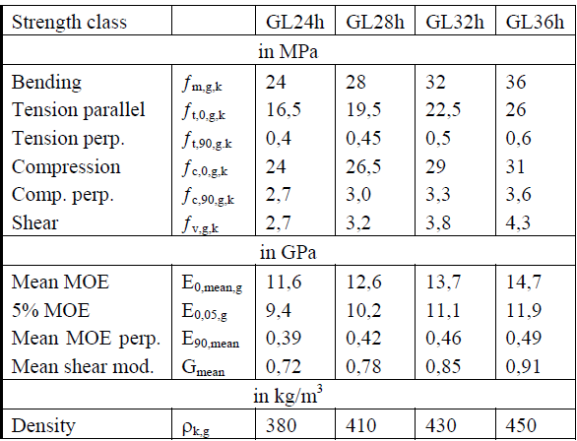
Strength classes and characteristic values of "homogeneous glulam“ according to EN1194
Homogenous glulam => Equal strength class lamellas

Slide 49
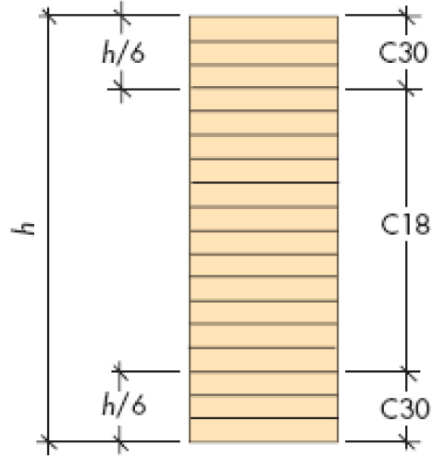
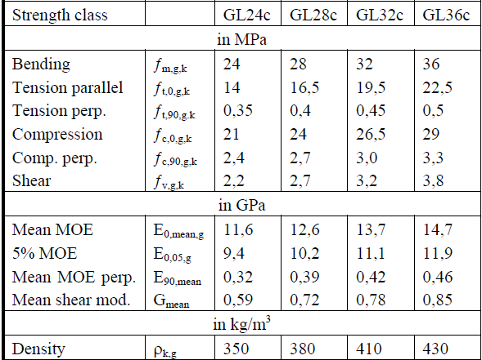
Strength classes and characteristic values of "combined glulam“ according to EN1194
Combined glulam => Non equal strength class lamellas. Outer lamellas have higher strength.
Figure: Example of combined glulam (Carling, Olle. 2002. Liimapuu käsikirja. Print & Media Center i Sundsvall AB.)

Slide 50
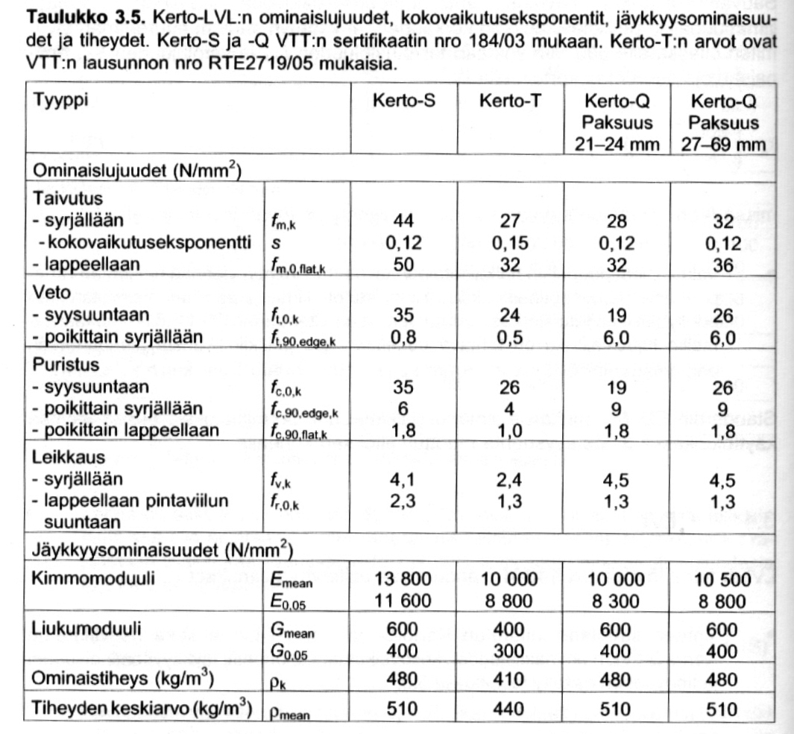
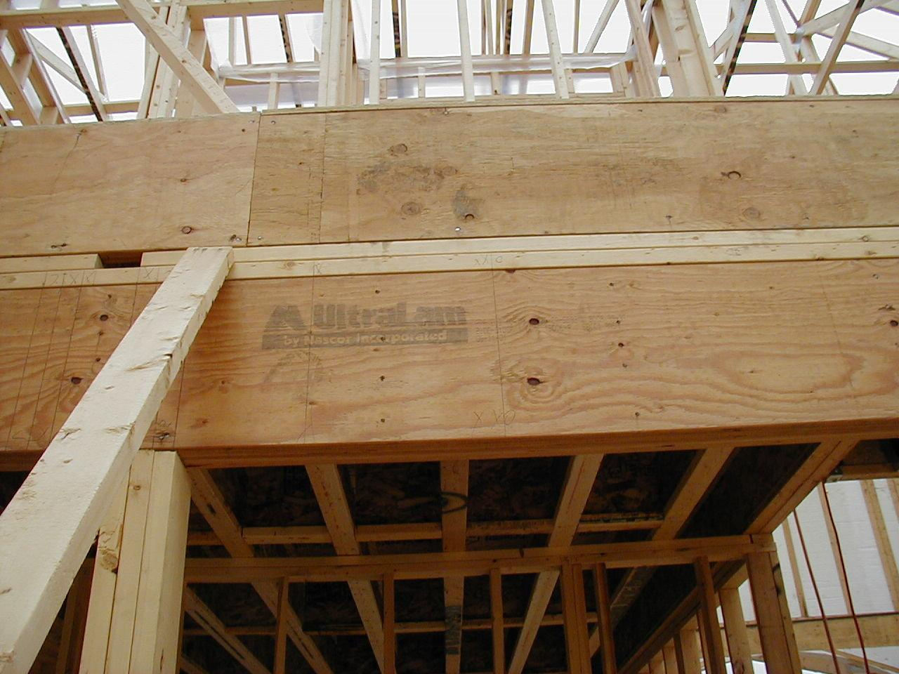
LVL - Veneering Wood
Veneer wood products:
Beams (Kerto-S, longitudinal grain direction)
Plates (Kerto-Q, grain direction changes))
Columns (Kerto-T, longitudinal grain direction)
Strength classes

Slide 51
Thank you! ☺

