Slide 1
Building systems and Site quality control
M.Sc. Cristina Tirteu - HAMK
15.03.2023

Slide 2
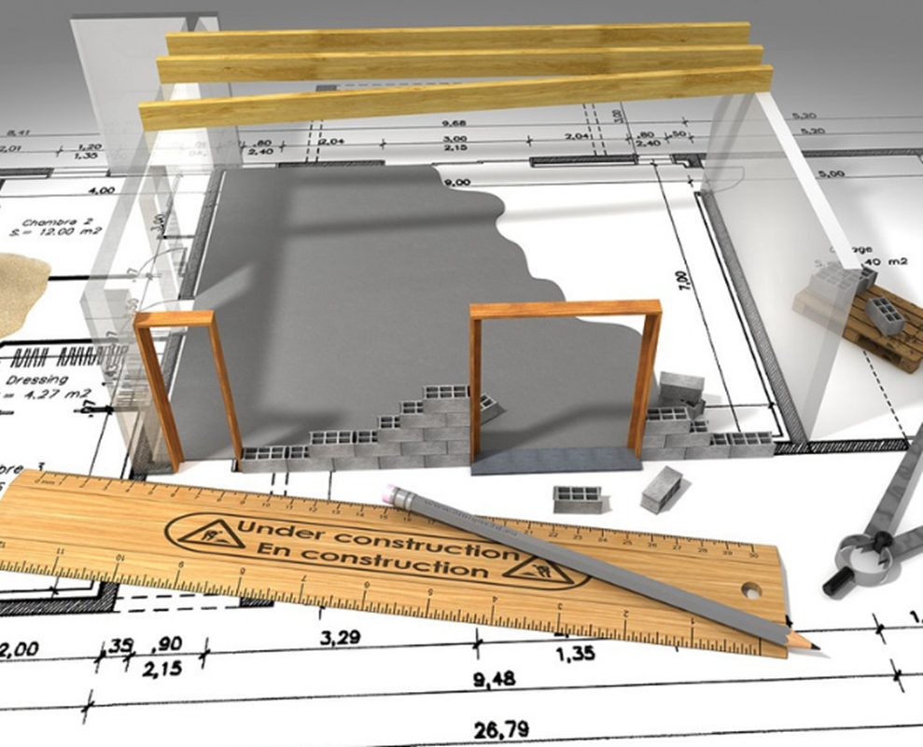
Introduction
Modern wood construction has increased remarkably after 2011. Many large wooden buildings have been built.
Recently there are several intentions to develop norms for more favourable usage of wood in construction.
Application of the EN Eurocodes regarding the design of load-bearing structures requires the establishment of national annexes.
With modern wood construction techniques, it is possible and often advantageous to build even large structures in wood.
Regardless of the type of the structural system, in order to achieve a high value level and avoid failure, a good quality system must be implemented.

Slide 3
The main differences between timber and other constructions
There are many different material, frame system and construction method options in wood construction.
There are no established solutions and practices in wood construction, but the solutions are often site- and manufacturer-specific.
Designing wooden structures requires more planning. Assembling the entire design team at the very beginning of the project is recommended. Planning the implementation is also important.
The fire regulations are quite complicated when it comes to the use of wood, and therefore it is important to understand them.
In a wooden frame building with more than two floors, an automatic extinguishing system (sprinkling) is mandatory. It can also be recommended in a building with no more than two floors.
In projects based on industrial wood element systems, it is recommended to involve the implementing parties in the design process. Traditionally contracted sites can be planned and tendered as in other construction.
The manufacturing and installation tolerances of wooden structures are more precise than other types of construction.
It is important to give particular consideration to the handling of weather conditions while constructing wooden structures.
Ensuring the know-how of the project parties in wood construction is important.

Slide 4
The most common structural systems
Light frame system
This is a layered frame system based on load-bearing walls as well as post to beam structures. Load-bearing walls can be realized with large elements of frame construction or solid wood. With wooden intermediate floor structures, spans of about 7 meters can be reached. The load-bearing lines are usually the outer walls of the building and part of the partition walls, usually the walls between the apartments. The floors and part of the walls serve as the stiffening structures of the building.
Mass-timber system
Mass timber is a category of framing styles typically characterized by the use of large solid-wood panels for wall, floor, and roof construction. Building with mass timber offers a reduced carbon footprint, construction efficiency, fire and life safety, and occupant well-being.
Modular timber systems
Modular construction units comprise of pre-finished timber framed module systems, which – when linked together – create finished buildings. These fabricated systems include mechanical and electrical services as well as internal and external finishes, all manufactured in our quality controlled environment.

Slide 5
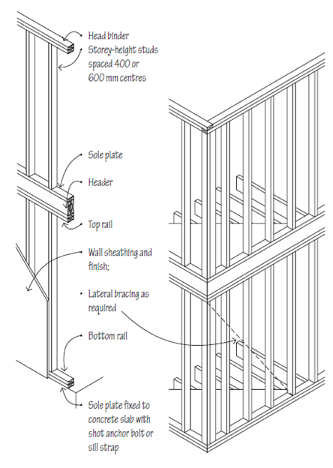
Light frame system - Platform framing
In platform construction, the floors are framed separately, and the walls of the story beneath each new level bear the load.
The rim board, which is typically made of structural composite lumber, transfers lateral and vertical loads.
Due to its relative ease of building, platform framing is the most common form of light-frame construction for residential buildings.

Slide 6
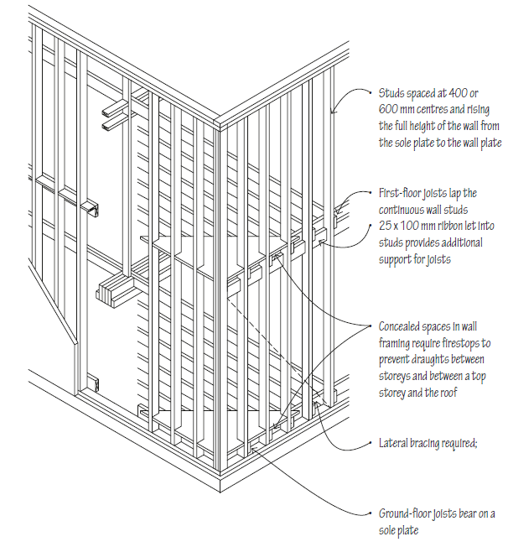
Light frame system - Balloon framing
In balloon framing, vertical structural members extend from the foundation to the rafters.
The wall extends two or more stories, and the floor is hung off a ledger connected to the wall. Balloon framing is often used in industrial and retail applications where a parapet is needed.

Slide 7
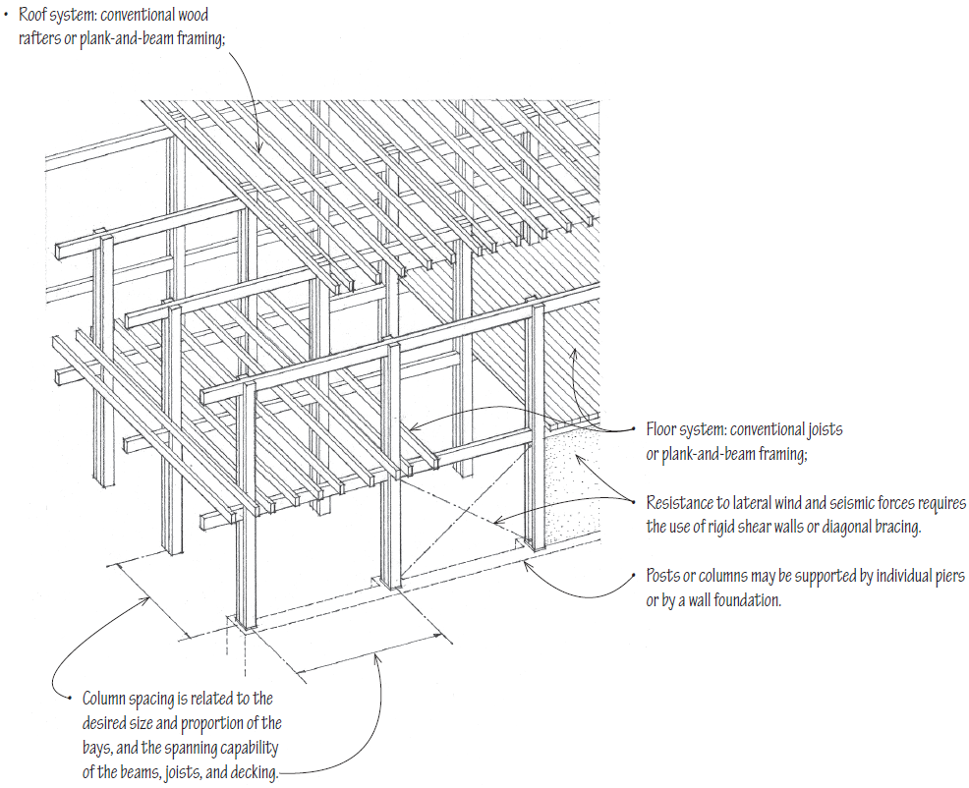
Light frame system - Post and beam structure
• Together with plank-and-beam floor and roof systems, the post-and-beam wall system forms a three-dimensional structural grid, which may be expanded vertically or horizontally.
• The skeleton frame of posts and beams is often left exposed to form a visible framework within which nonbearing wall panels, doors, and windows are integrated.
• When the post-and-beam frame is left exposed, as is often the case, careful attention must be paid to the species and grade of wood used, the detailing of joints, especially at beam-to-beam and beam-to-post connections, and the quality of workmanship.
Notes:
Post-and-beam construction uses a framework of vertical posts and horizontal beams to carry both floor and roof loads. The beams supporting the floor and roof systems transmit their loads to posts or columns that, in turn, carry the loads down to the foundation system.
Heavy Timber Construction
• Post-and-beam framing may qualify as heavy timber construction if the plank-and-beam floor and roof structures are supported by noncombustible, fire-resistive exterior walls
and the wood members and decking meet the minimum size requirements specified in the building code

Slide 8
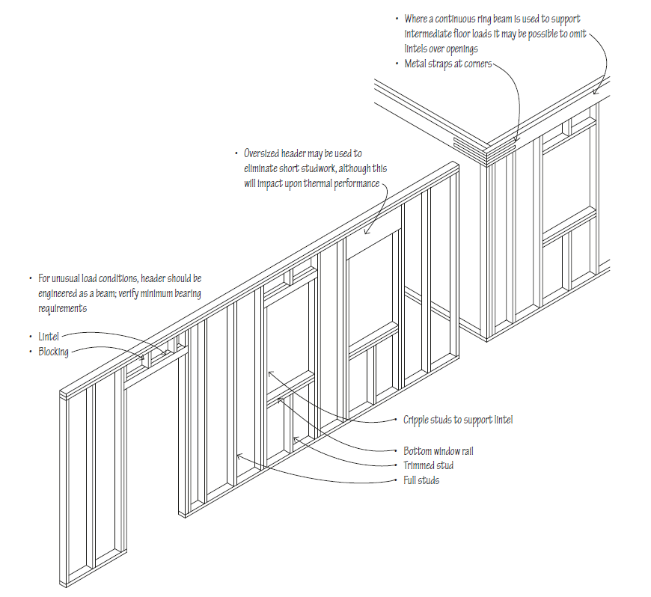
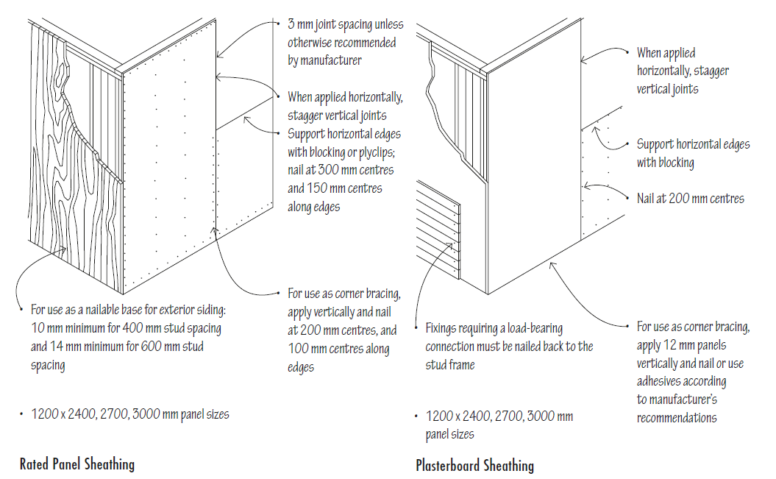
Light frame system - Timber stud wall elements
Notes:
Cripple stud = jamb stud

Slide 9
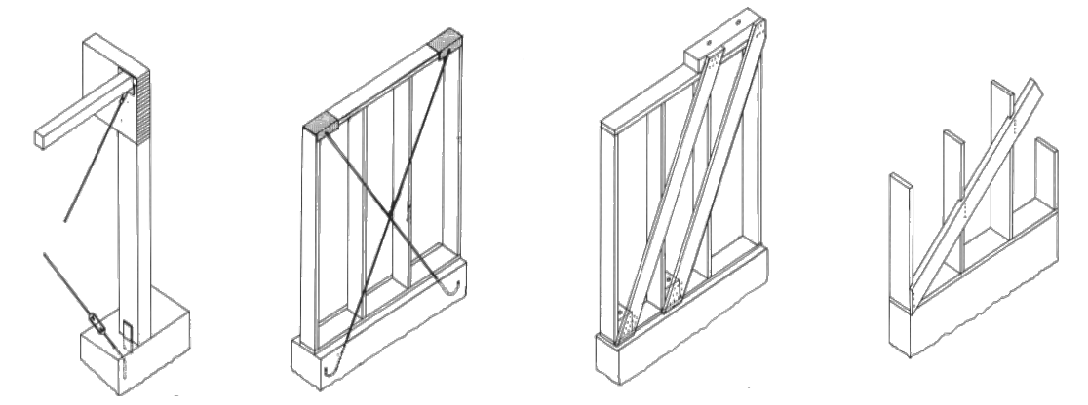
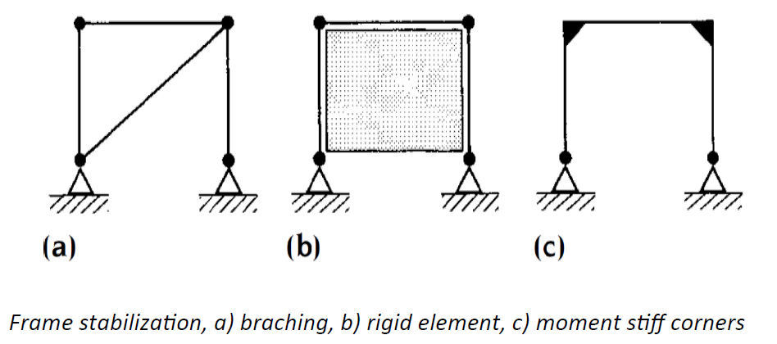
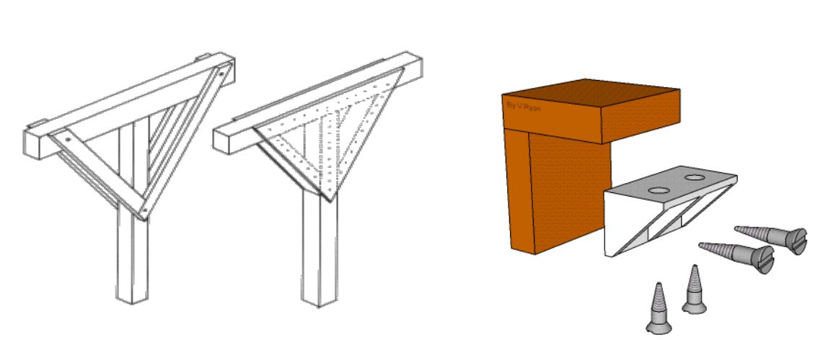
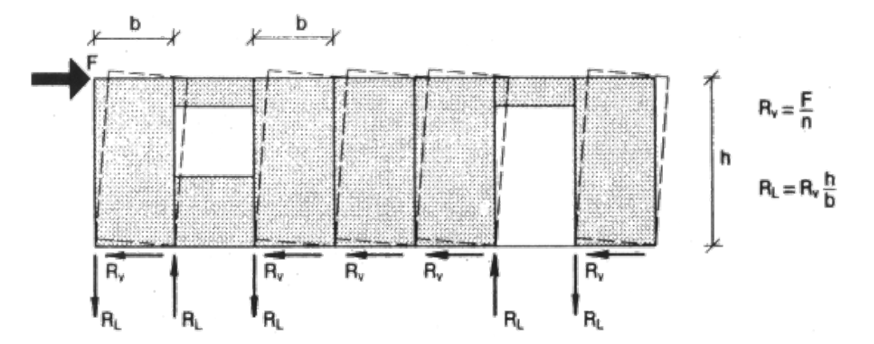
Light frame system - The bracing system
The wall bracing for timber structures is similar to the other structures and can be achieved by one of the three basic systems of by a combination of these.
Frame stabilization a) bracing, b) rigid elements c ) rigid connections
Notes:
To establish a rigid element against racking, various type of rigid boards can be used. For maximum strength plywood is used, but also gypsum boards are common. The boards must be fixed to the posts for tranfering the shear force. generated by lateral loads
Rigid corners are made by using stiffeners that can be arranged asdiagonal branching or by plywood stiffeners. Metal connectors are also a popular choise.

Slide 10
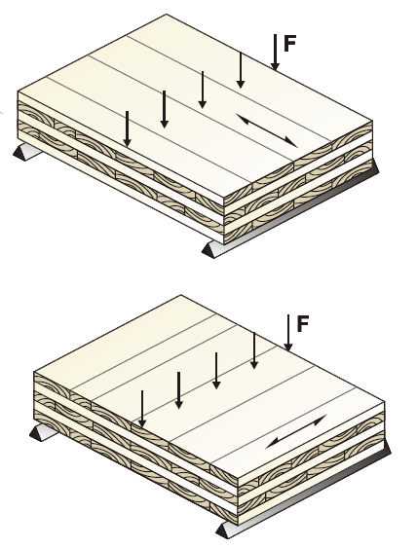
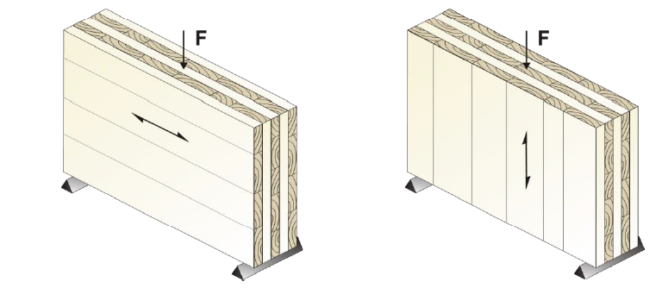
Mass timber systems
Opposed to the timber frame system, the mass timber construction consists of solid elements for both floors and walls. This leads to heavier and more fire-resistant constructions.

Slide 11
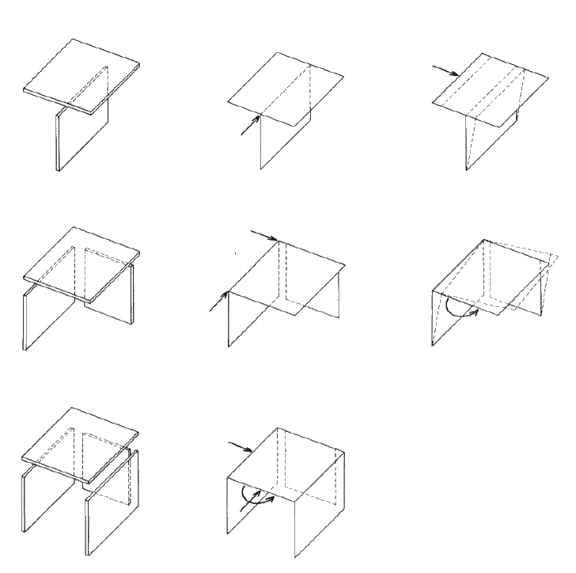
Mass timber structural systems
The structural system for mass timber depends on the stability of the structure.
There are at least 4 rigid panels required (three vertical and one horizontal) for the structure to be stable
Not all wall are parallel.
Not all walls are intersecting at the same point.

Slide 12
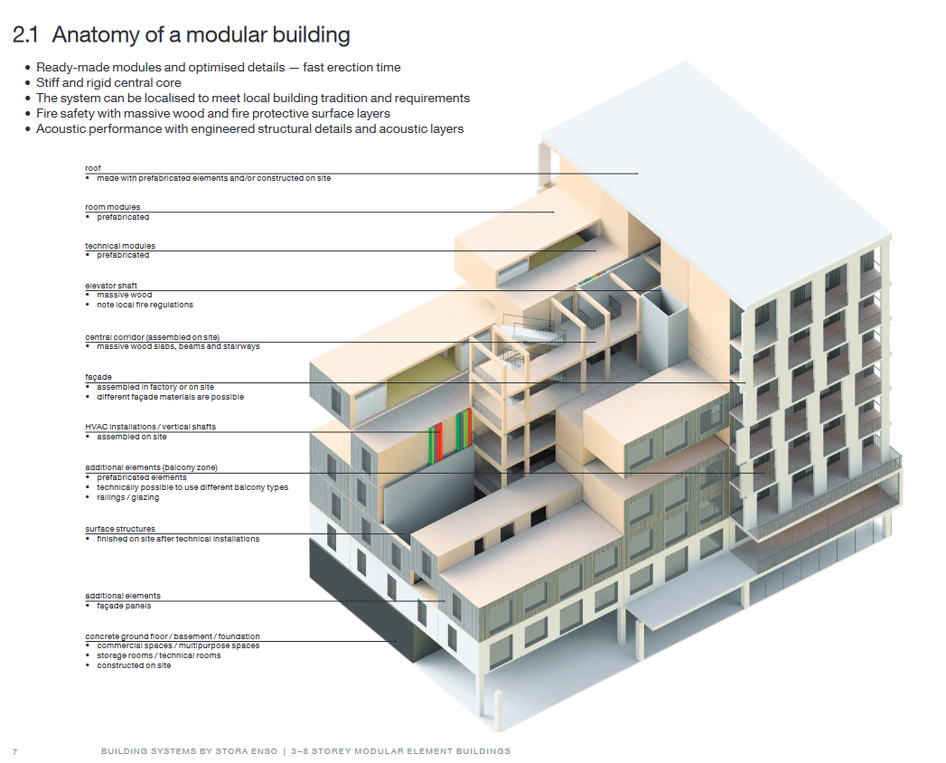
Modular systems
Finally complete rooms and apartments can be pre­‐constructed and assembled to taller buildings.
Structural wise the individual box is a self contained stable structure. Interconnections between the boxes ensures stability for the whole structure.

Slide 13
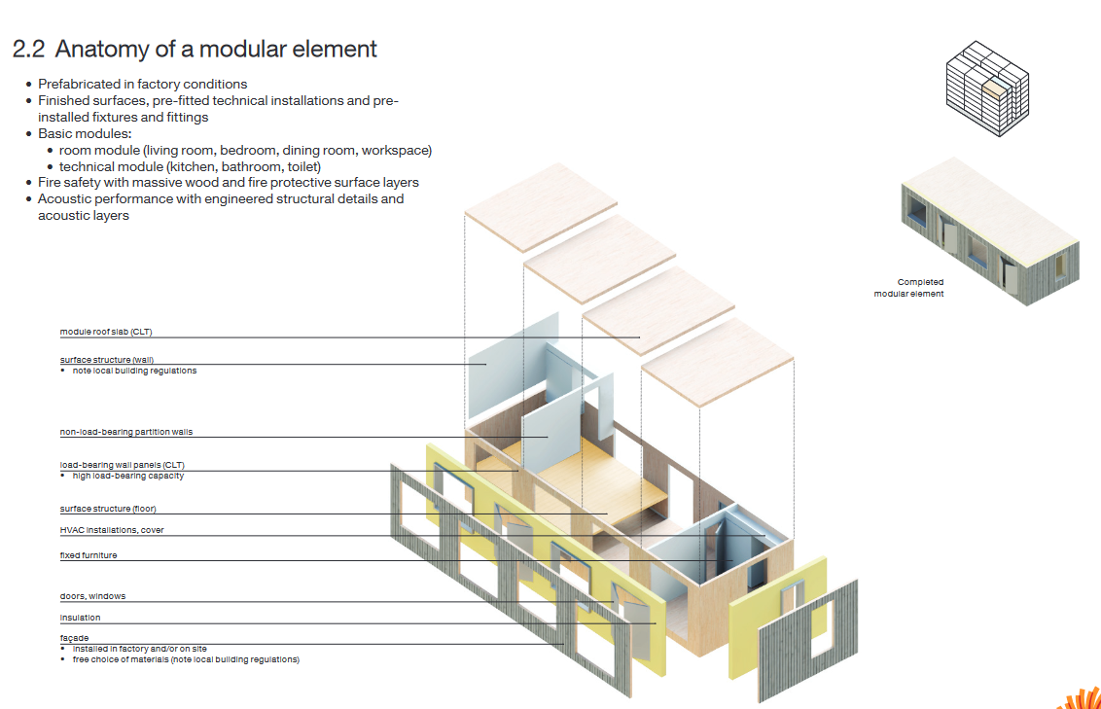
Modular systems

Slide 14
Quality Control In The Construction of Timber Buildings
The question of quality control within construction has been at the forefront of conversation within the industry recently.
Even as the vast majority of timber systems are manufactured off-site, this does not deny the site management team of responsibility during the construction phase.
If the structure is to achieve its design life a high standard of quality must be rigorously enforced, with all personnel on-site taking responsibility for quality.
General checks:
PRE-DELIVERY CHECKS
DELIVERY CHECKS
ON-SITE STORAGE AND HANDLING.
SOLE PLATE INSTALLATION.
WALL AND FLOOR INSTALLATION

Slide 15
Pre-delivery checks
Substructure Tolerances
The greatest issue faced by all timber frame erection teams is the substructure being out of tolerance for the design. Timber frame manufactures are highly unlikely to be willing for their product to be installed on a non-compliant substructure due to contractual design liabilities. Quality issues aside, an out of tolerance substructure will need to be made good, likely resulting in delays to the programme as timber frame installation typically forms part of the critical path.
In the event of no manufactures data being available, the following tolerances should be used:
Tolerances of building in plan
Tolerances of building in section
Tolerances of foundation walls
Notes:
a standard of comparison or point of reference.

Slide 16
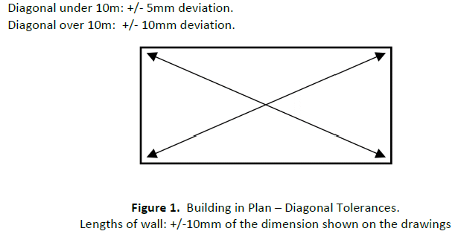
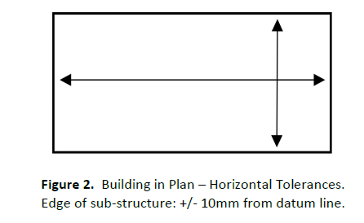
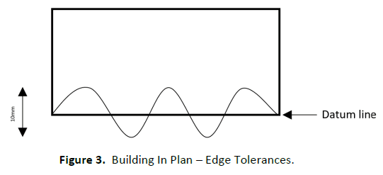
Tolerances of building in plan
The site engineer and trade operatives must be fully aware of the tolerances that need to be achieved prior to work commencing.
Constant checks should be made throughout the setting out process and production.
If the frame is to be installed on a concrete slab a post curing level check should be undertaken to confirm that the slab is within tolerance.
Formwork for concrete slabs must be checked for horizontal and vertical level and that diagonal tolerances are achieved. Extreme care must be taken by the steel fixing and concrete placing operatives not to strike the formwork with materials or tools.

Slide 17
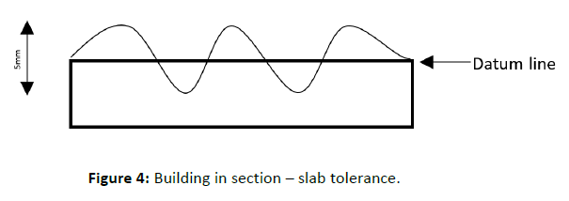
Tolerances of building in section
Concrete slabs must be within +/- 5mm of the datum. Over the entire slab the level must be not be out of tolerance by more than 10mm.

Slide 18
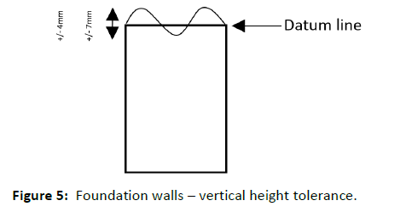
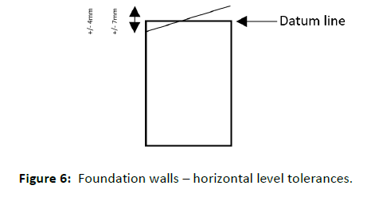
Tolerances of foundation walls
The tolerance of the foundation wall height will vary dependent on the overall width of the wall. For walls up to 150mm in width, +/- 4mm wall height is acceptable. For walls at 250mm wide and over, +/- 7mm wall height is acceptable.
In a similar manner to the tolerance of the wall in height, the tolerance for horizontal level in a wall depends on its width. For walls up to 150mm in width, +/- 4mm horizontal level is acceptable. For walls at 250mm wide and over, +/- 7mm horizontal level is acceptable.

Slide 19
Delivery checks
When the timber frame system arrives on site the following checks should be made:
Component Dimensions
Moisture Content
General Checks

Slide 20
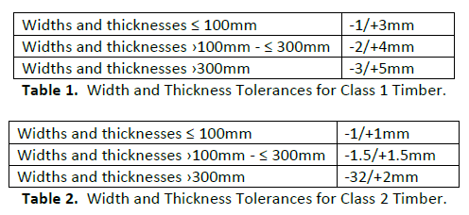
Component Dimensions
Spot checking of component dimensions against drawings. Width and thickness tolerances for class 1 and class 2 timbers are in the tables below.
When checking length, components less than the specified length are not allowed.

Slide 21
Moisture Content
Spot check of components to ensure they are either labelled as kiln dried or dry.
Moisture content checks should be made and should not exceed an average of 20%.
Moisture content is critical as this can result in swelling or shrinkage.
Softwood and poplar timber with a moisture content above 20%, the thickness and width of the timber will increase by 0.25% for every 1% of moisture content higher than 20% and up to 30%. Timber will decrease in size by 0.25% for every 1% of moisture content below 20%.
For hardwood timber the width and thickness can increase by 0.35% for every 1% of moisture content higher than 20% and up to 30%. The width and thickness will decrease by 0.35% for every 1% of moisture content below 20%.

Slide 22
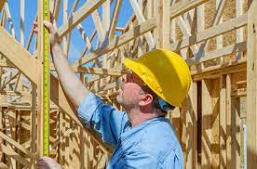
General Checks
Spot check components are the correct strength grade: i.e. C16, C24, etc.
Check that the correct sheathing has been installed.
Check that the correct nailing has been carried out.
Check that preservative schedules have been followed.
Check that wall tie runners are at the correct centres and adequately fixed.

Slide 23
On-site storage and handling
If a just in time approach to timber frame delivery is not being used and the panels are being stored on-site care must be taken to protect the products from moisture.
The storage area should be level, firm and well drained.
Panels and components must not be stored in direct contact with the ground to prevent moisture ingress or soiling. Ideally they should be 150mm above ground level. Panels and components are to be stored horizontally. Adequate packing should be positioned at no greater than 600mm centres to ensure that components do not bow. Packing should commence 150mm in from the outer edges of the panels or components. Packers should be all the same height and vertically aligned to prevent distortion.
Adequate ventilation between components should be allowed for. Timber packing between components should allow a minimum gap of 50mm: this should be increased if forklift tines are thicker. A wider gap will also make it easier for slingers to thread lifting slings between panels or components.
Panels and components should be covered with a heavy-duty tarpaulin sheet. The sheet should not fully cover the components in order to allow adequate ventilation. This will help prevent condensation.
Care must be taken if using a forklift to move panels. They should not be allowed to drag on either the vapour control layer or breather membrane. Components should only be lifted at designated lifting points or there is a significant risk of overstressing.

Slide 24
Sole plate installation
The sole plate is a structural member that the panels sit on. The sole plate is to be laid on top of a damp-proof course. Laps in the damp proof course should be a minimum of 100mm.
Sole plates should be pressure impregnated with preservative. This is to be checked. Where cuts are to be made on-site, the exposed timber is to be treated with two coats of timber preservative.
Where lap joints in sole plates are specified, check the length of the lap.
Sole plate timber must be thoroughly checked for damage or splits prior to installation. Damaged or split plates should not be installed.
Any inaccuracies in setting out the sole plate will have an adverse impact on overall building performance. As each storey is added inaccuracies are magnified therefore it is crucial that this is carried out to a very high standard.
The horizontal tolerance for the sole plate in relation to the datum is +/- 10mm.
The vertical tolerance for the sole plate over the entire structure is +/-2mm.
There are a variety of different methods of fixing the sole plate to the sub-structure. Checks must be carried out to ensure that the fixings are the correct specification (stainless steel or galvanised) and are at the correct centres.
The sole plate must be a minimum of 150mm above finished ground level except where there are ramps or suitable drainage around the perimeter of the building has been installed.

Slide 25
Wall, floor and roof installation
Wall panels must be inspected for damage prior to installation. Panels are usually butt jointed so damaged frames or out of square panels will have an impact on this.
Check that the vapour control layer and breather membrane are in good condition, tight to the sheathing and not ripped.
Horizontal laps in the breather membrane should be a minimum of 100mm horizontally and 150mm vertically.
If on-site patching of tears is required, the patch material should be to the same specification of the existing breather membrane.
The patch is positioned underneath the damaged breather membrane with the previously mentioned laps achieved.
The patch is fixed into place with stainless steel staples at 150mm centres.
The vapour control layer is usually critical to achieving the required level of airtightness. If the vapour control layer is damaged consult with the supplier. At floor level the vapour control layer should lap with the damp proof course.
Panel to panel fixings should be at 300mm centres maximum.
Rail to sole plate fixings should be at 60mm centres maximum.
If an open panel system is used and insulation is being installed on-site, insulation should be cross lapped and that there are no gaps between studs and plates.

Slide 26
Wall, floor and roof installation
Panels should not be overfilled with insulation as this can result in nail popping.
Before commencing floor installation ensure that the walls are accurately aligned, adequately braced and stable. Bracing should remain in place until the floor installation is complete to provide racking resistance.
Floor joists or panels should not protrude into the cavity by more than 10mm.
Joist hangers should be the correct specification and securely fixed.
Holes, notches and cuts made in structural member should be carried out in accordance with Eurocode 5:EN 1995-1-1.
Notching of structural studs is not permitted.
Service penetrations of the vapour control layer must be tightly sealed.
The vapour control layer is usually critical to achieving the required level of airtightness. If the vapour control layer is damaged consult with the supplier. At floor level the vapour control layer should lap with the damp proof course.
Panel to panel fixings should be at 300mm centres maximum.
Rail to sole plate fixings should be at 60mm centres maximum.

Slide 27
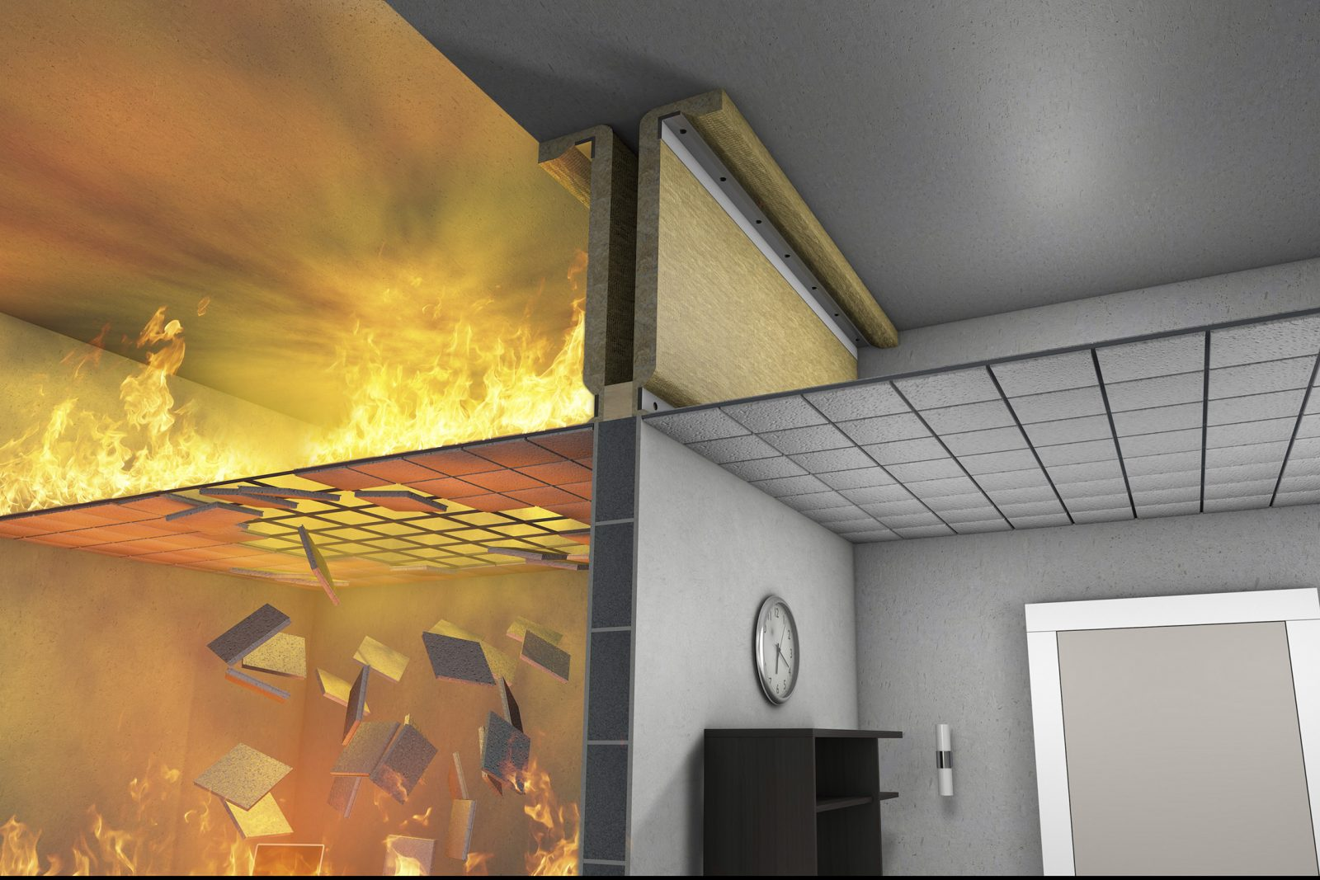
Fire Stopping
Fire stopping must be installed in accordance with the drawings and only using the specified materials. Fire stops are typically installed at wall junctions, penetrations between party walls and floors and other areas such as service risers.
Cavity barriers should be installed around all openings in external walls, at the top of the external wall cavity, the junction between compartment walls or floors and external walls, at junctions between compartment walls that separates buildings and a minimum of every 10m.

Slide 28
Roof Installation
All top storey walls must be accurately aligned, temporarily braced and stable prior to installing the roof. The bracing must remain in place until the roof is wind braced and battened.
Trussed rafters must be installed parallel and plumb within 10mm of the overall height.
Insulation must be cross-lapped, have no gaps and not interfere with roof space ventilation systems.
All bracing systems must be installed in accordance with the truss suppliers instructions. Bracing should be fixed with a minimum of two nails at each connection.

Slide 29
Summary – Key points:
Quality is everyone’s business, not just that of the site management team.
Accuracy in setting out and constructing the whole structure to within the given tolerances is key to avoiding structural failure.
Any inaccuracies in the sub-structure or lower superstructure will be magnified at higher levels so this should be a particular area of focus in the construction process.

Slide 30
Thank you! ☺

