Slide 1
Moisture management on the building site
Cristina Tirteu - HAMK
15.03.2023

Slide 2
Introduction
Moisture damage can affect all types of building materials, but it can cause particularly rapid deterioration and defects in structural timber.
Unlike some materials that can absorb moisture without harm, timber is vulnerable to the natural process of decay, which can weaken its structure and compromise the integrity of a building.
When timber products absorb more water than their intended in-service moisture content, they are likely to experience a loss of strength, dimensional changes, and an increased risk of decay.
Remedying moisture-related defects in timber structures can be a costly endeavor.
Therefore, it is essential to prevent water ingress or the accumulation of high humidity that can lead to moisture absorption by the wood.

Slide 3
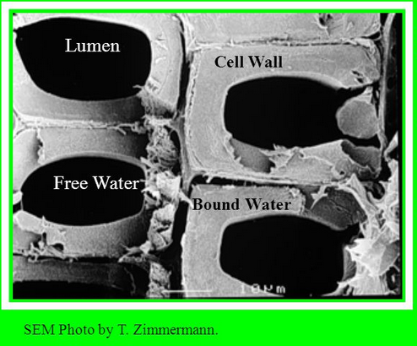
Moisture content
Timber has cells arranged in cellular tubes which makes wood hygroscopic, meaning it is a material that absorbs water.
Water is contained in wood as either bound water or free water.
Bound water is held within cell walls by bonding forces between water and cellulose molecules.
Free water is contained in the cell cavities and is not held by these forces –it is comparable to water in a pipe.
  Fiber saturation point (FSP)- moisture content when cells are completely saturated with bound water but no free water inside cell cavities.
FSP = 21-32%
Above FSP - changes affect only on weight
Below FSP - small changes strongly affect all physical and mechanical properties
The moisture content of timber used for frame structures is typically 15 …24 % (as an average 20 %)

Slide 4
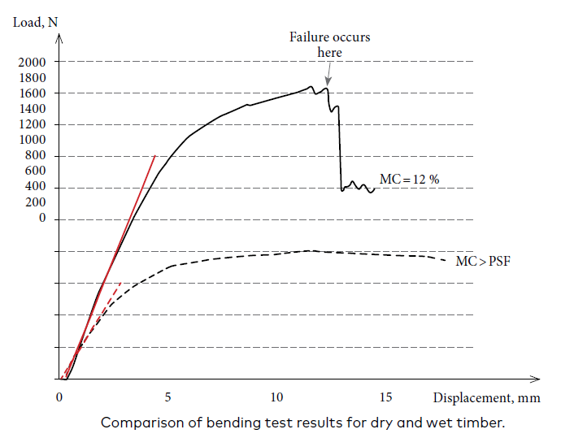
Moisture content
When wood has a moisture content below the FSP, significant changes start occurring to the wood:
dimensional changes start to take place - these may manifest themselves as radial and tangential shrinkage, which may lead to warping and splitting;
mechanical properties also change significantly – gains strength and stiffness, yet it also becomes more brittle;
the durability is also affected - at moisture content above 20 %, fungi can develop in the timber. Timber that has suffered fungal attack is also more susceptible to insect attack.
Therefore, the primary requirement to ensure timber can be considered a durable material is to keep its moisture content below 20 %.

Slide 5
Wood strength and stiffness depend on:
Variability
  The element will be weaker than most of the population of results – Characteristic values
Anisotropy
  Different strength test for different direction
Moisture content
  The moisture level is ( according to EC5) defined in Service classes
Time (Duration of the load)
  The duration of the load is defined in different Load durations categories

Slide 6
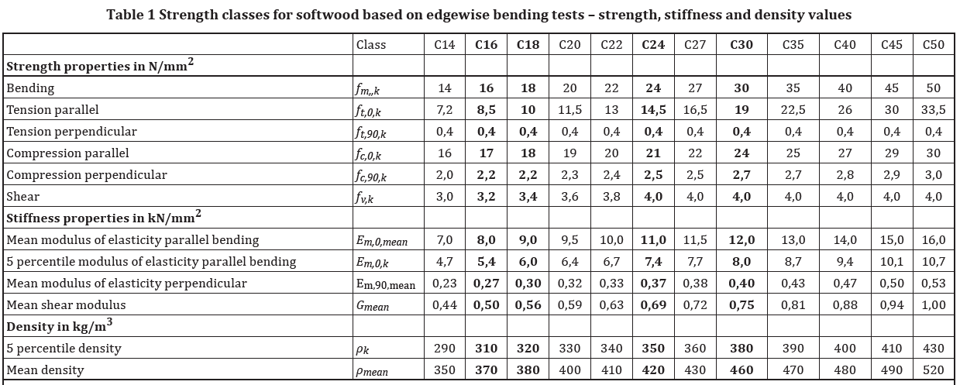
Characteristic values
One way in which this uncertainty can be addressed is to assume in design that the element will be weaker than most of the population of results.
In the Eurocodes we use the concept of characteristic values.
For strength and density, a characteristic value is the fifth percentile with a 75 % confidence. This means that if we tested 100 specimens, we would expect that 95 of them would be stronger than what we have assumed in design.
This ensures structures remain safe.

Slide 7
Service classes
Service class 1:
Indoor conditions
  This class is characterized by a MC% in the materials corresponding to a temperature of 20 C and RH% of the surrounding air only exceeding 65% for a few weeks per year
Service class 2:
Covered structures in ventilated non heated buildings and outdoor weather protected structures
  This class is characterized by a MC% in the materials corresponding to a temperature of 20 ∘C and RH% of the surrounding air only exceeding 85% for a few weeks per year
Service class 3:
Unprotected outdoor structures and structures in damp rooms or exposed to direct water
  This class is characterized by a MC% in the materials being higher than in Service Class 2

Slide 8
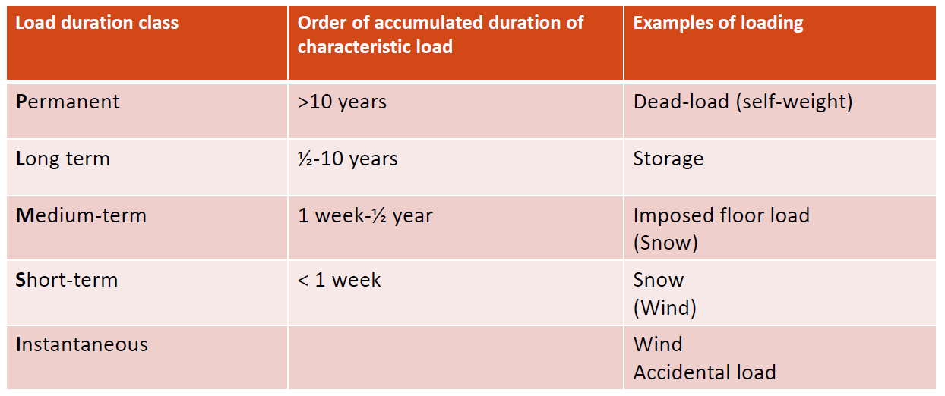
Duration classes
If a load combination with different load durations is investigated, the shortest duration governs the load duration class.

Slide 9
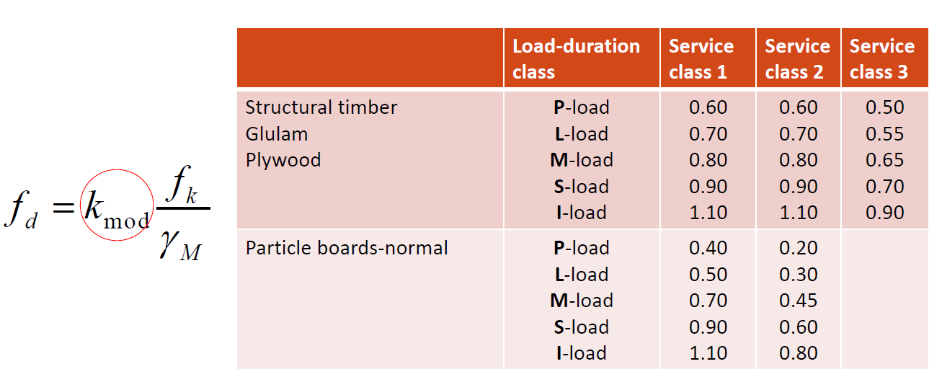
Definition of k_{mod}

Slide 10
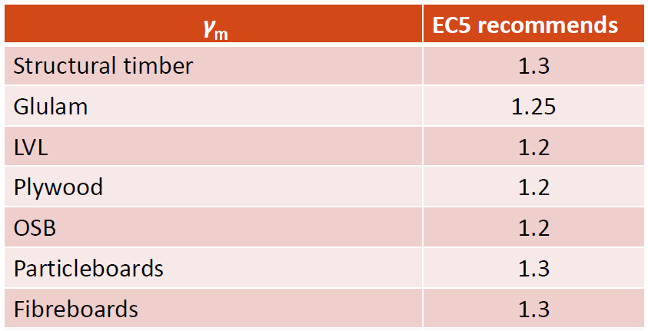
Definition of γ_{M}
The partial safety coefficient for the wood material γ_{M} takes account of :
failure modes
insecurity related to the calculation model
level of supervision (control class)
insecurity of measured strength parameter or resistance

Slide 11
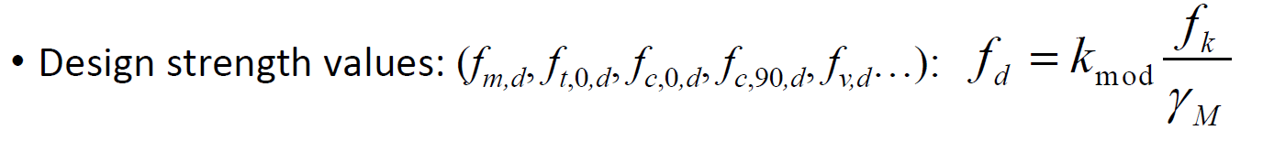
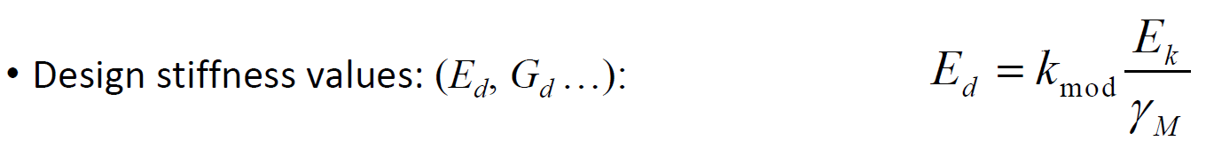
Wood strength and stiffness – Design values

Slide 12
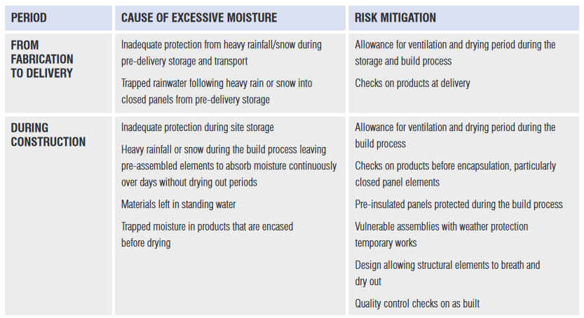
Key causes of excessive moisture

Slide 13
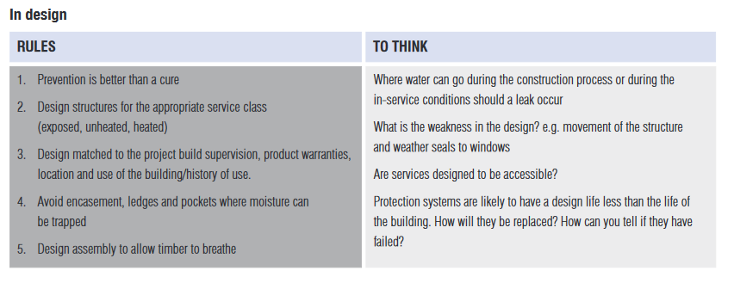
Design and build for durability rules to follow

Slide 14
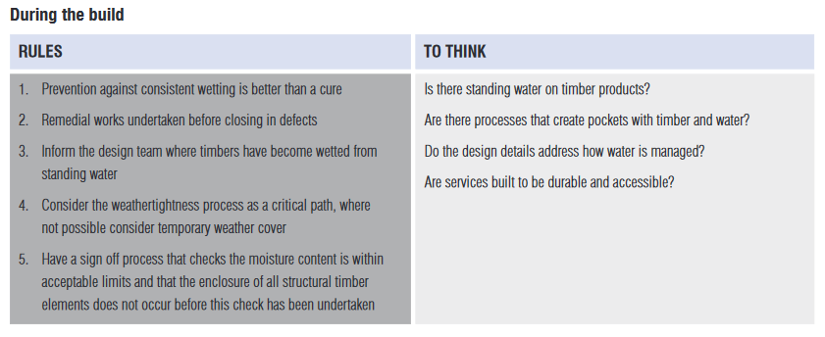
Design and build for durability rules to follow

Slide 15
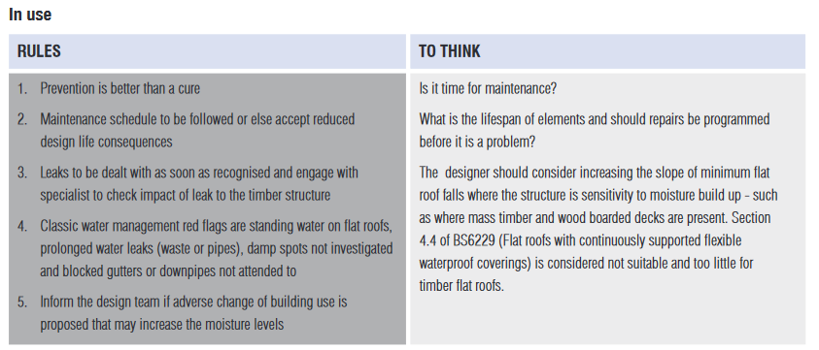
Design and build for durability rules to follow

Slide 16
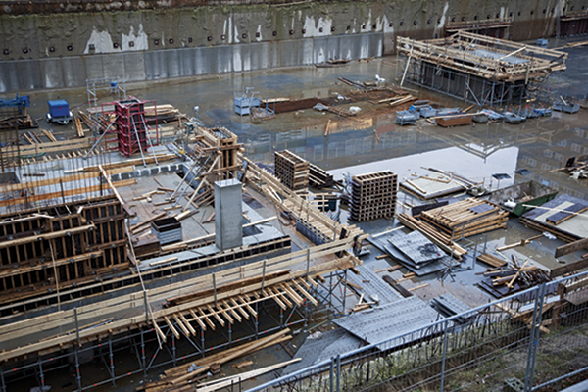
Moisture damage during construction
Moisture damage during construction typically results from the combination of multiple factors rather than a single fault.
A collaborative effort involving everyone working on the building can significantly reduce the risk of moisture damage.
This requires careful attention and cooperation from all involved parties. In large-scale projects, it is crucial to prioritize the strictness of schedules and planning to prevent moisture damage.
Personnel working on the construction site should be made aware of the proper operating methods from the outset, emphasizing the importance of preventing moisture damage during construction process.

Slide 17
Prevention of moisture damage
requires meticulous planning and implementation;
every work phase with protection must be carefully executed to prevent getting wet;
all packaged elements should be kept in their protective plastic as long as possible before installation;
schedules must be precise and adhered to by the entire organization to ensure that planned works are completed on time;
temporary or complete protection from the weather is the best solution to prevent moisture and mold damage;
These considerations must be taken into account comprehensively to avoid moisture damage during construction.
Since the beginning of 2018, guidelines for keeping building materials dry have been improved, and the moisture technical functionality of buildings has been tightened.
Notes:
Preventing moisture damage during construction requires meticulous planning and implementation. When building without weather protection, every work phase with protection must be carefully executed to prevent getting wet. Special attention should be given to weather conditions, and all packaged elements should be kept in their protective plastic as long as possible before installation. Schedules must be precise and adhered to by the entire organization to ensure that planned works are completed on time. Temporary protection or complete certainty from the weather is the best solution to prevent moisture and mold damage when building without a weather protection covering the entire house. These considerations must be taken into account comprehensively to avoid moisture damage during construction.
Since the beginning of 2018, guidelines for keeping building materials dry have been improved, and the moisture technical functionality of buildings has been tightened. By following these guidelines and implementing proper moisture management practices, construction teams can significantly reduce the risk of moisture damage during construction. With careful planning and execution, it is possible to ensure the long-term durability and safety of buildings, even when building without weather protection.

Slide 18

Weather protection
Weather protection is designed to safeguard building and construction materials from the harsh effects of weather conditions.
The construction method and seasonality of a project can significantly impact the need for weather protection, especially as building energy efficiency requirements increase and the drying time during construction slows down.
In wood construction, materials are already dry and must be shielded from moisture.
The specific method of protection utilized is influenced by various factors, including the construction site, building size and shape, and susceptibility of the structures to damage.
The selection of protection method is also influenced by the construction schedule, frame solution, required conditions, and costs, as well as customer requirements.
Notes:
Effective weather protection is a critical component of the dry chain during construction, and proper planning and protection methods can save both time and money during the building process.
In concrete construction, protection is typically not necessary, as the concrete must dry regardless. However, in

Slide 19
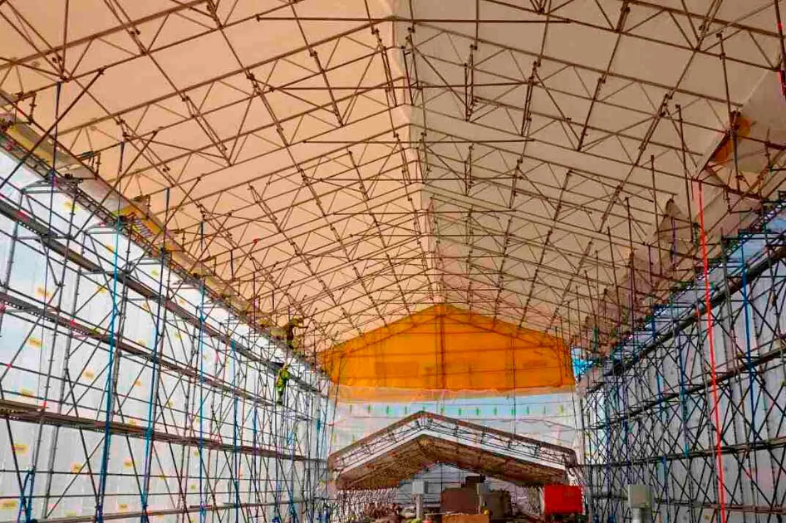
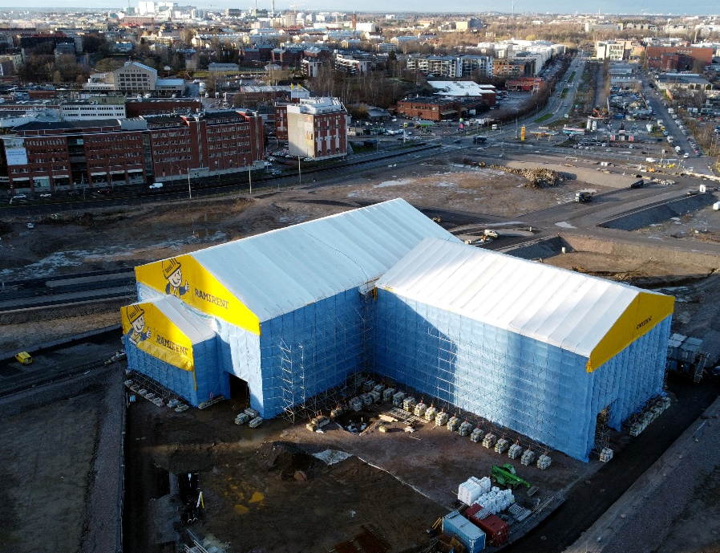
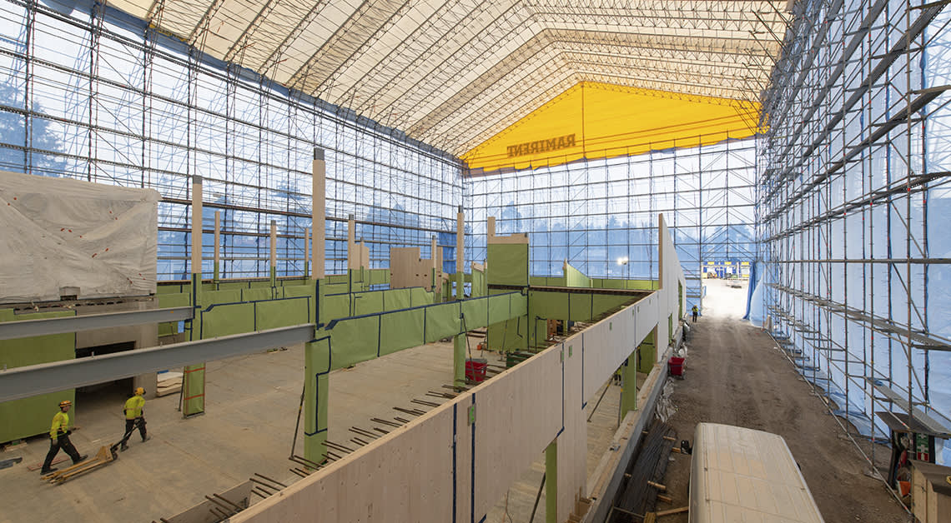
Ramirent
Ramirent offers a range of weather shelters for rent, suitable for various needs, from small workshops to covering entire buildings equipped with a bridge crane.
These shelters are designed to provide temporary weather protection and can be equipped with transfer rails that slide on top of each other, making them faster to lift and open.
The shelters feature an aluminum frame and come in blocks of 2.5 meters up to 25 meters, with the strongest shelters reaching up to 30-45 meters in width.

Slide 20
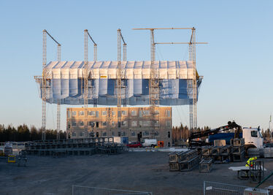
Ramirent
For the largest solutions, a combination of weather protection and crane is provided.
A weather shelter and an overhead crane combined, which does not require separate scaffolding.
The overhead crane can lift and mount building elements up to 3,200 kg at a time.
The construction site is protected for the whole project time as the lifts are performed through the shelter ends without any need to open the shelter itself.
When the work stage or floor is completed, the shelter is hoisted upward by using its motors.

Slide 21
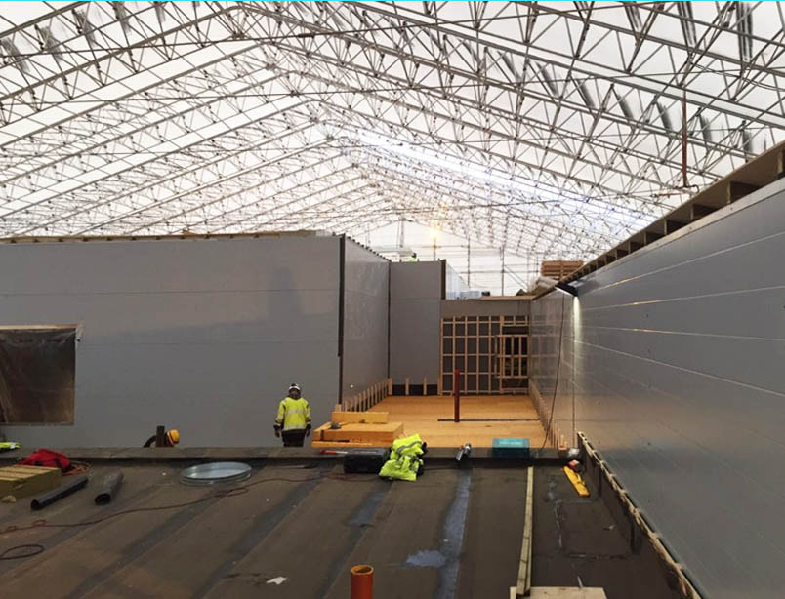
KRAG
KRAG offers to rent and install high-quality and aesthetic temporary roof constructions from the manufacturer Layher.
A temporary roof is a solution to protect the construction site from the effects of climatic conditions. The site will be protected from rain, snow, sunlight and other external climatic influences during your work process.
A temporary roof provides the opportunity to carry out repairs regardless of the weather, so the deadlines for the work are not subject to annual changes in climatic conditions.
The temporary roof is mounted on pre-installed scaffolding. It is a quick-to-assemble, lightweight and visually appealing design.

Slide 22
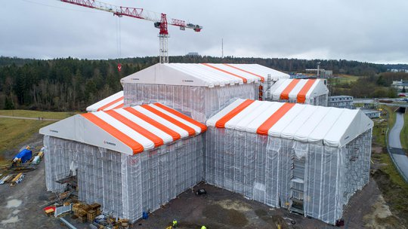
Telinekataja
Telinekataja offers weather protection solutions for rent or sale, ranging from small to large systems.
Their systems are similar to those offered by Ramirent, featuring aluminum frames and lightweight, openable designs.
The maximum span for their solutions without separate support towers is 40 meters.
The roof cover is pulled into grooves in the grids for a neat, tight, and durable end result.
Additionally, Telinekataja's Shelter roofs can be equipped with protective walls attached to the racks for added protection.

Slide 23
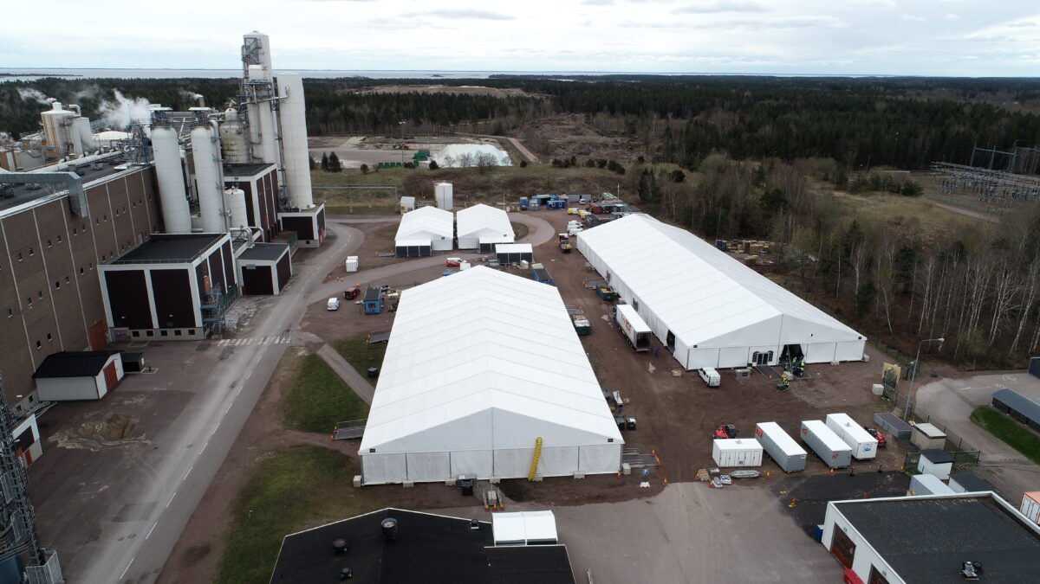
Hallgruppen
Hallgruppen’s industrial shelters provide effective protection against difficult weather.
These industrial shelters are designed with strong aluminium profiles with flame-retardant PVC fabric in a range of colours.
The structures are easy to transport and assemble.
They are also liftable and openable.

Slide 24
Benefits
By keeping the site dry:
construction companies can avoid costly delays and extra work due to weather-related issues
leads to improved efficiency and safety for workers, as well as better overall quality and smoothness of the construction process.
can save money on heating and drying costs during the winter months.
prevent moisture damage to materials and avoid dust damage to the environment.
Overall, weather protection is an important investment for any construction project, offering numerous advantages and benefits to both the construction company and its clients.

Slide 25
Disadvantages
Weather protection
requires careful planning and consideration of various factors such as technical solutions, usability, costs, and weather conditions.
may complicate certain construction events, (i.e. as lifts, where the wall or ceiling must be opened while taking into account the weather conditions to prevent moisture damage).
weather protection for prefabricated construction may be more complicated than traditional on-site construction or repair construction.
strong winds must also be taken into account, and the shelter must be anchored securely to prevent it from toppling over.
the shelter should have sufficient lighting and ventilation inside the shelter, marking access routes, preventing a rise in temperature inside the shelter during summer, and complying with tightening regulations

Slide 26
Risks and construction challenges of not using weather protection
Building with wood without weather protection requires special care to be taken with regards to weather conditions.
During the winter, it is generally safer to build wooden structures as the risk of getting wet is reduced, but heavy snowfall can still cause problems. Snow must be removed to prevent moisture damage to the structures.
Rain can be particularly challenging when building without weather protection, as materials must be protected quickly if the rain starts unexpectedly. Temporary shelters must be available to install quickly when needed, and it can be difficult to ensure that they are securely fastened in place to avoid damage to the environment. Tarpaulins or other similar materials may be used to protect the structures, but they can become perforated and leak if not handled carefully. This means that daily checks and care are essential to avoid damage and ensure that the protection remains effective.

Slide 27
Risks and construction challenges of not using weather protection
Building without weather protection can also cause delays and schedule changes due to weather conditions.
Foremen must closely monitor weather maps and forecasts and make adjustments to the schedule as necessary to prevent moisture damage and ensure that the structures remain dry.
The lifting days of wooden apartment building construction, for example, are directly related to weather forecasts. If the weather conditions remain good for an extended period, there is a risk that the temporary protection may be forgotten, leading to extensive moisture damage and economic loss.
Therefore, daily checks and care are critical to avoiding damage and human error.
Overall, building without weather protection requires careful planning, monitoring, and execution to ensure that the structures remain dry and undamaged.

Slide 28
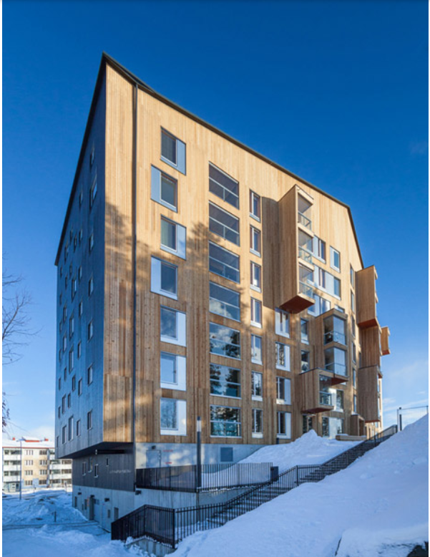
Case study - Puukuokka, Jyväskylä, Finalnd
The seven-story wooden apartment building under review was made of CLT space elements.
The foundation solution is traditional, solidly placed sensors cast on the rock, the outer walls are cast-in-place walls.
The pillars cast in the middle, on which the thick, intermediate floor separating the garage and the actual house is concreted.
The layers installed from CLT space elements and the roof structure are assembled from wooden roof trusses which are manufactured on the ground as block elements.
The construction time was about one year, of which the foundations and concrete parts accounted for about five months.

Slide 29
Protection during construction phases
The foundation was started in the fall. Favorable weather conditions were on the construction side, and most of the casting work did not require protection.
The preparation for winter was made by installing pipes for heating in sockels and cast-in-place walls. The columns were equipped with heating cables.
At the time of the first small frosts, the sockels were protected with cellular plastic and liquid was circulated in the pipeline to prevent freezing.
Not a single casting day had to be postponed because of too much frost. However, heating was a big expense during the foundation phase. The basement was protected with cellular plastics and tarpaulins after casting.

Slide 30
The CLT elements were well packed in protective plastic at the factory during transportation

Slide 31
After lifting, the space element modules were initially protected with tarpaulins on the first and second floors, which turned out to be the wrong solution because the water infiltrated beneath the protection.
For the second floor up to the top floor, temporary roof structures were used, which were wooden and covered with felt.
Even though all the seams between the modular elements were taped with vapor barrier tapes, tarpaulins had to be put in the seams of the roof elements, so that the water does not get inside, and run from there into the insulation or other places that are difficult to dry.

Slide 32
In the upper floors, rain and wind caused a slight headache in protection.
Rainwater was not completely avoided, but major damage was nevertheless caused.

Slide 33
The outer walls were protected with fiberglass-reinforced protective plastic intended for weather protection.

Slide 34
When all the roof structures were finished, the installation of the exterior cladding started.
The protection of the walls was removed as the exterior cladding progressed so thus the structures could remain dry.
All the work phases concerning the building on the outside were completed before the next fall's rains.

Slide 35
Weather protection success
During the foundation and concrete work phase, the weather protection went without any problems. The weather conditions were favorable and bad rains and severe frosts were avoided.
The castings dried within the planned schedule and the next work phases were reached on time.
The first CLT module elements arrived at the site at the end of March 2017, and the installation work started at the beginning of the following week.
The elements were well protected at the factory during transport.
The weather conditions were also favorable on the planned withdrawal days, so with the exception of one day, the withdrawals were made at the planned times.
Higher up, the wind and raindrops got a little water on the space elements. This did not cause any significant damage either, but only the surfaces of the CLT boards of the space elements got wet.
The structure dried before the next elements were installed and everything was put in place on time.
While the roof was being built, the weather was still favorable and the house was protected from the weather without any major problems.
Moving the temporary roofs back and forth and installing the necessary amount of space elements so that the roofs can be raised again was relatively laborious.

Slide 36
Thank you! ☺

