Slide 1
OPENINGS (WINDOWS AND DOOR FIXINGS)
Łukasz Wesołowski : Pawel Mika
12-05-2022

Slide 2
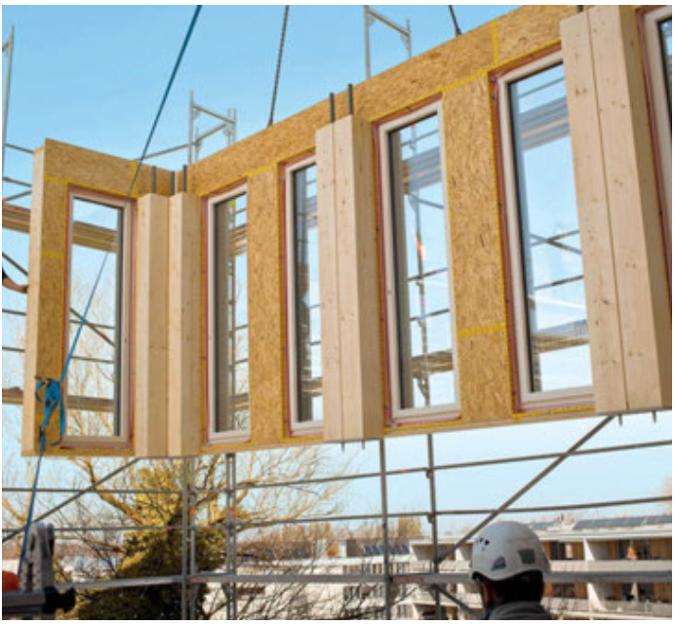
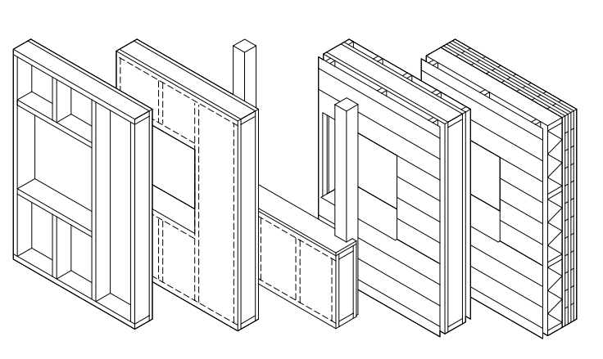
Openings (window and door fixing)
Łukasz Wesołowski
Prefab:

Slide 3
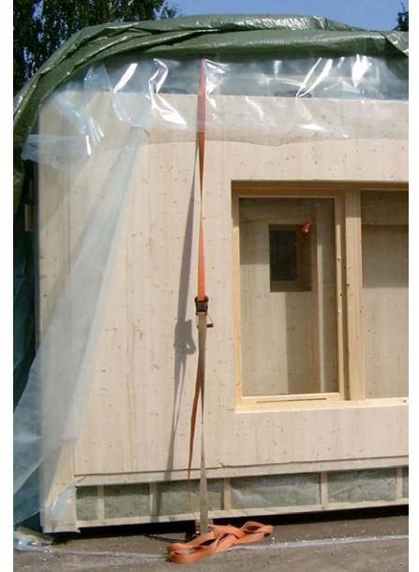
Openings (window and door fixing)
Łukasz Wesołowski
Prefab:

Slide 4
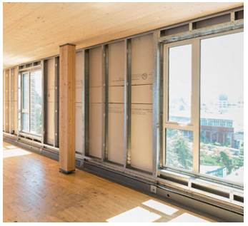
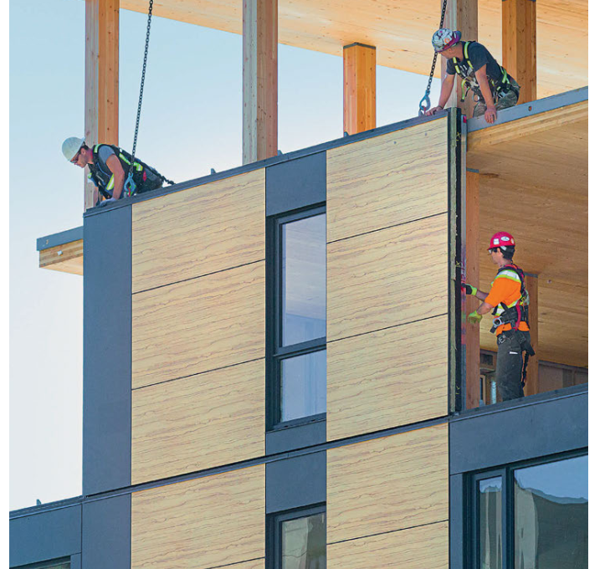
Openings (window and door fixing)
Łukasz Wesołowski
In panels:

Slide 5
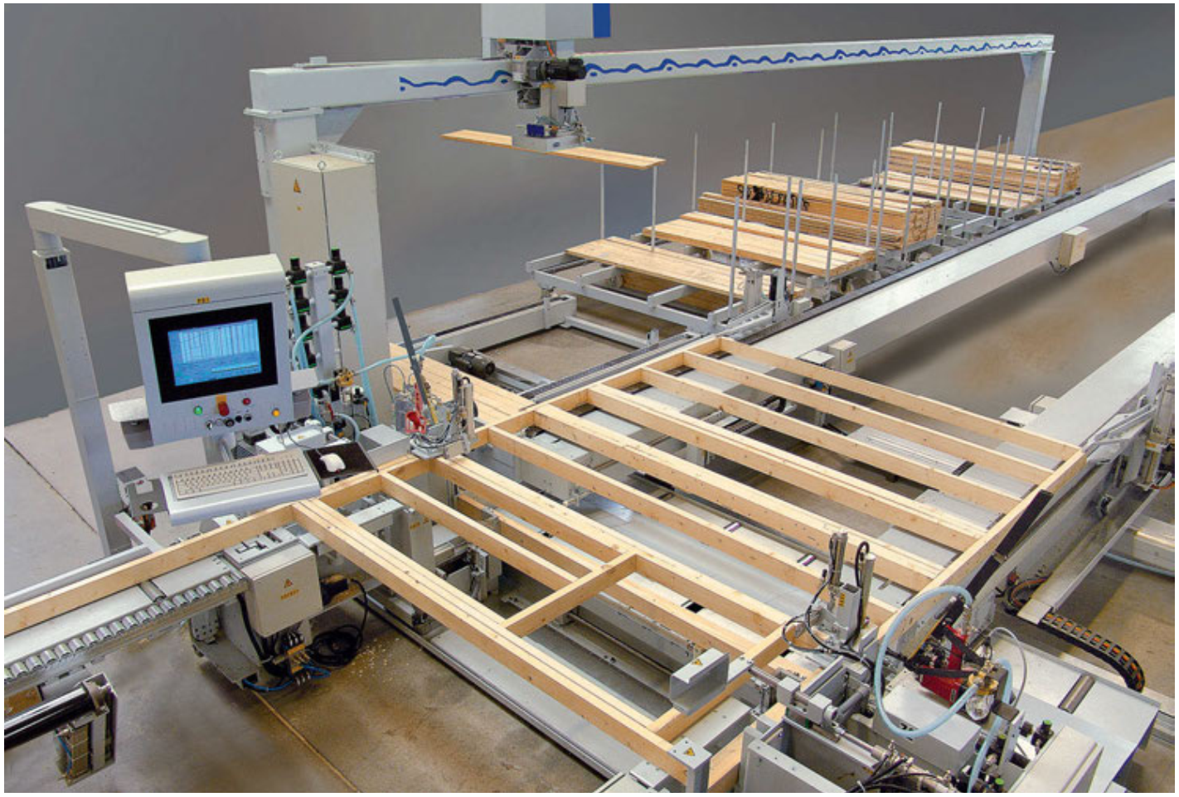
Openings (window and door fixing)
Łukasz Wesołowski
Paneling:

Slide 6
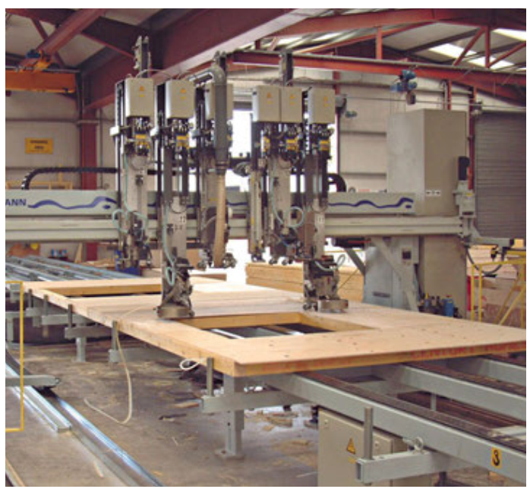
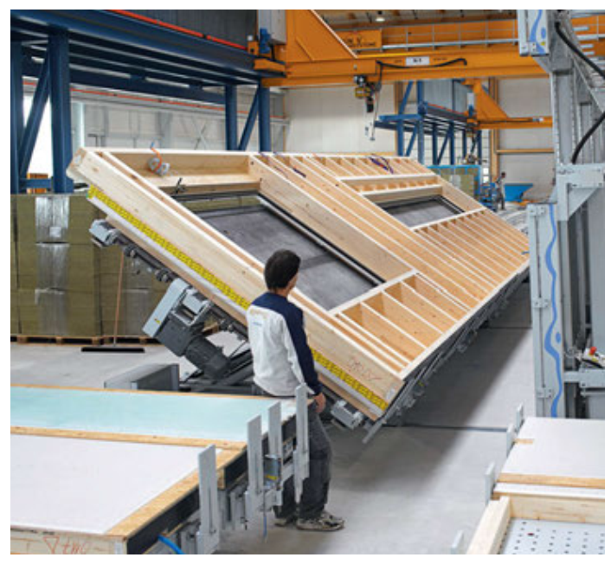
Openings (window and door fixing)
Łukasz Wesołowski
Paneling:

Slide 7
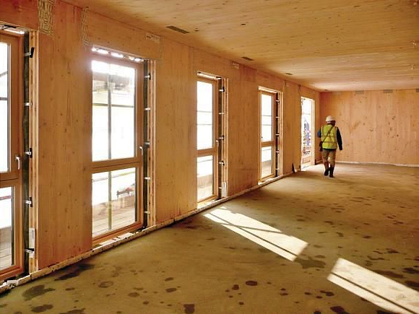
Openings (window and door fixing)
Łukasz Wesołowski
Regular fixing:

Slide 8
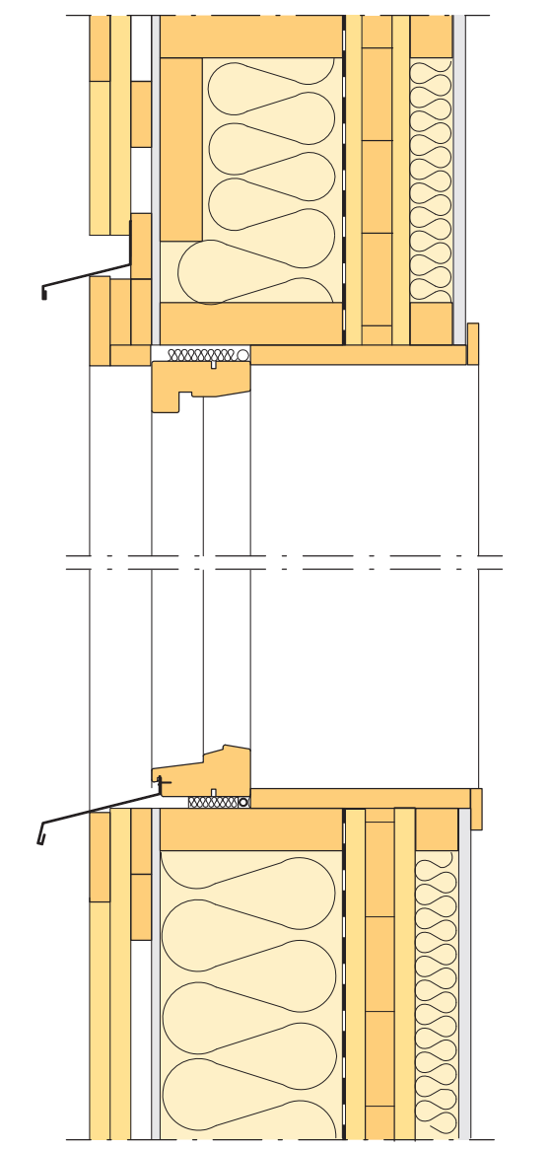
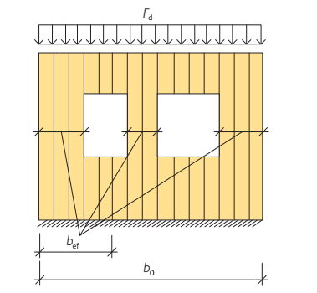
Openings (window and door fixing)
Łukasz Wesołowski
Window not in line with strucure:

Slide 9
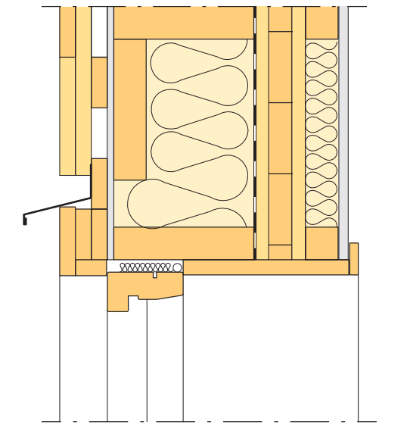
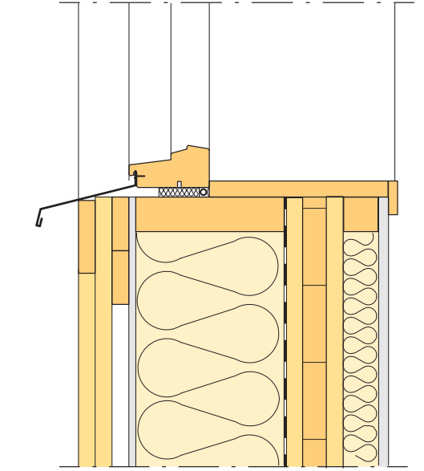
Openings (window and door fixing)
Łukasz Wesołowski
Window not in line with strucure:

Slide 10
Openings (window and door fixing)
Łukasz Wesołowski
Timber framing:

Slide 11
Openings (window and door fixing)
Łukasz Wesołowski
Timber framing:

Slide 12
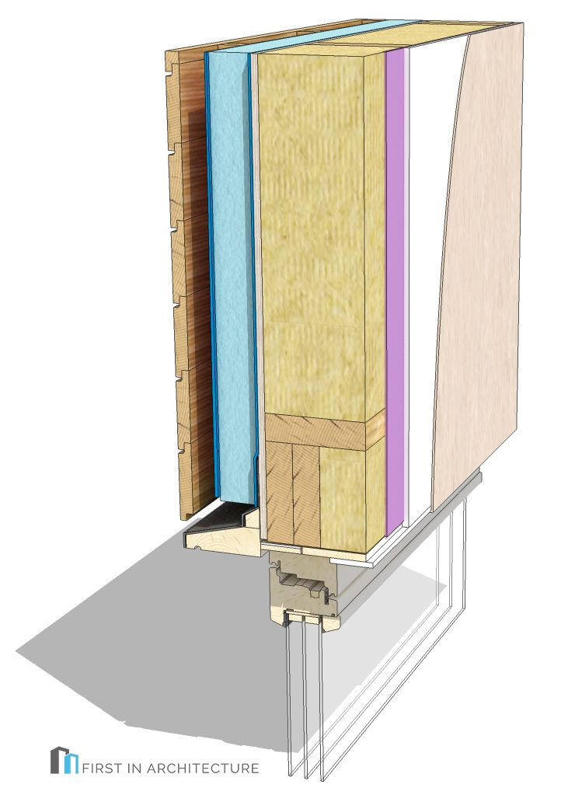
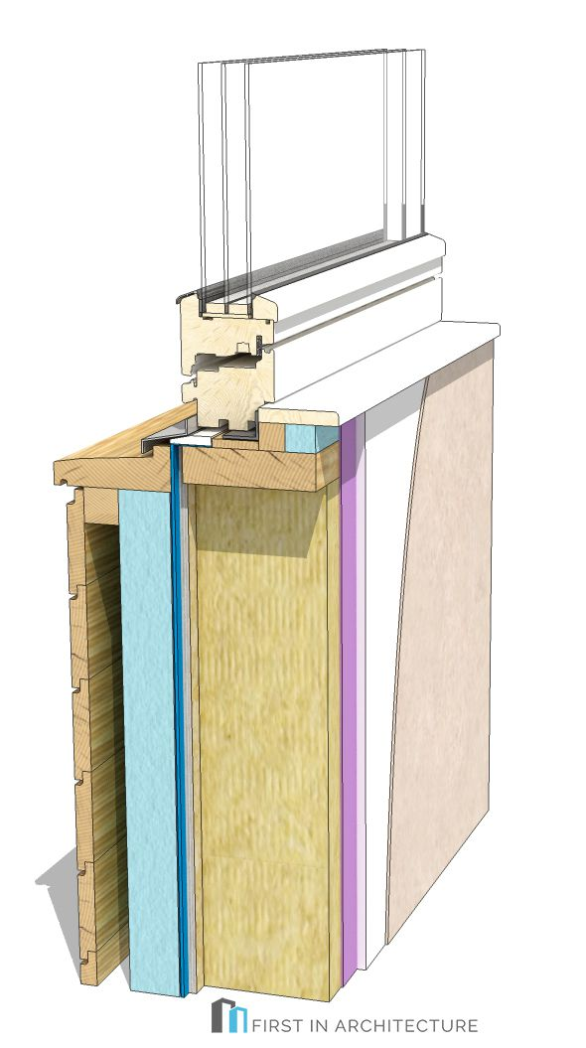
Openings (window and door fixing)
Łukasz Wesołowski
Wood structure:

Slide 13
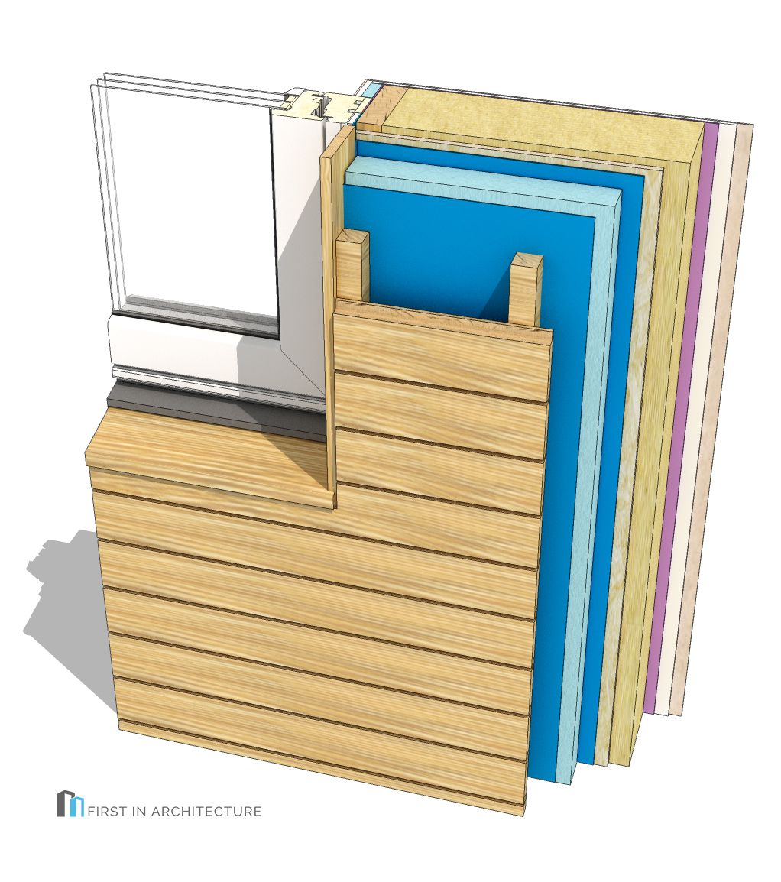
Openings (window and door fixing)
Łukasz Wesołowski
Wood structure:

Slide 14
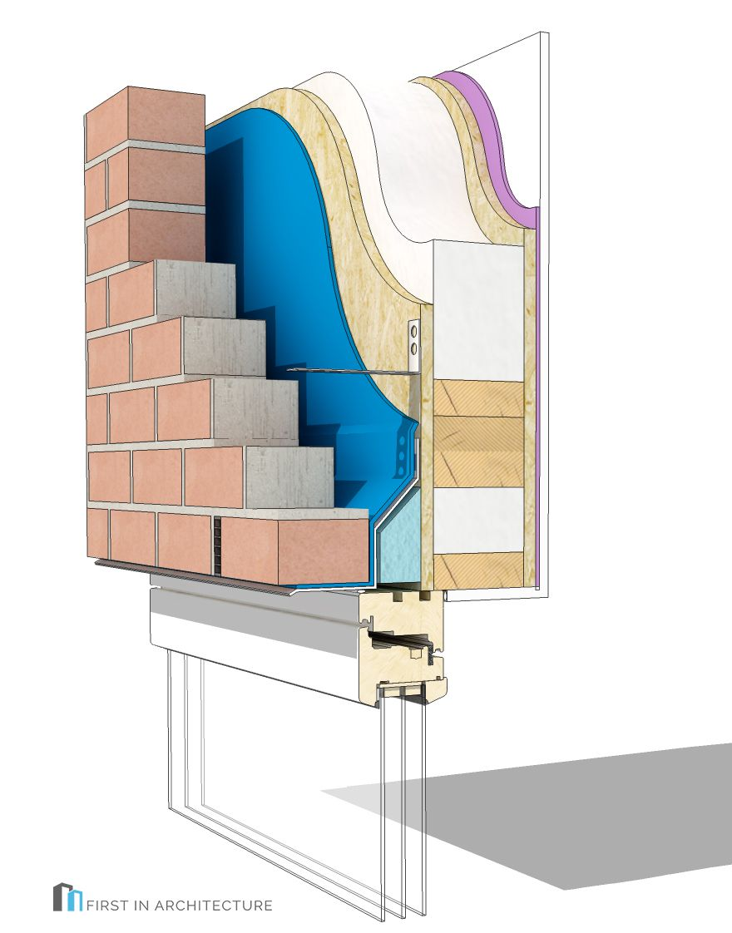
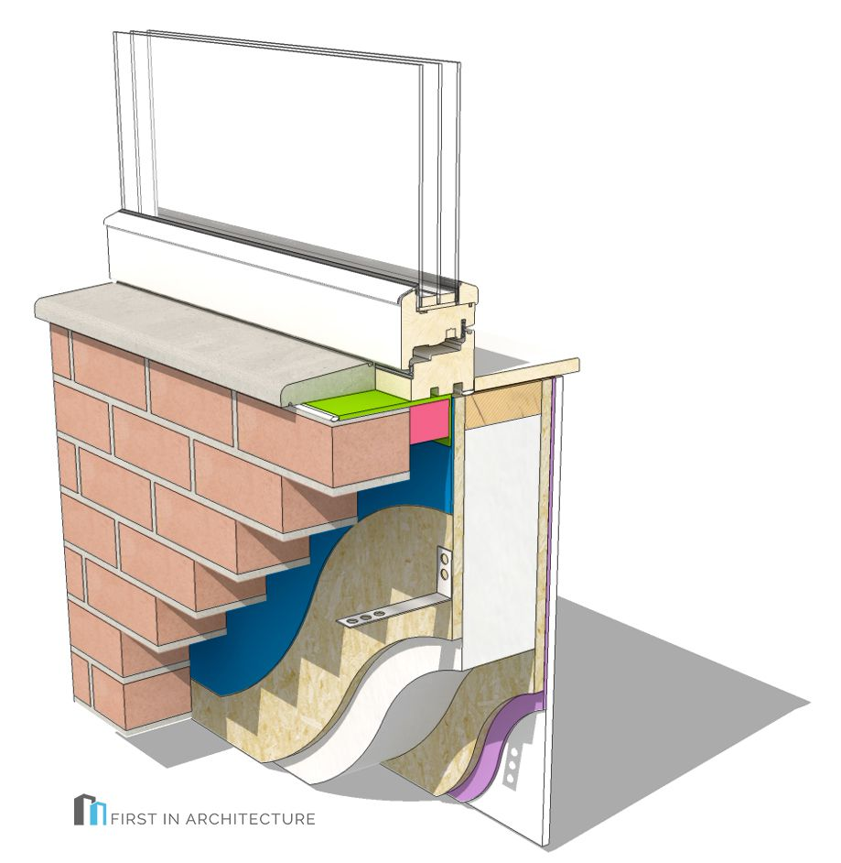
Openings (window and door fixing)
Łukasz Wesołowski
Wood structure:

Slide 15
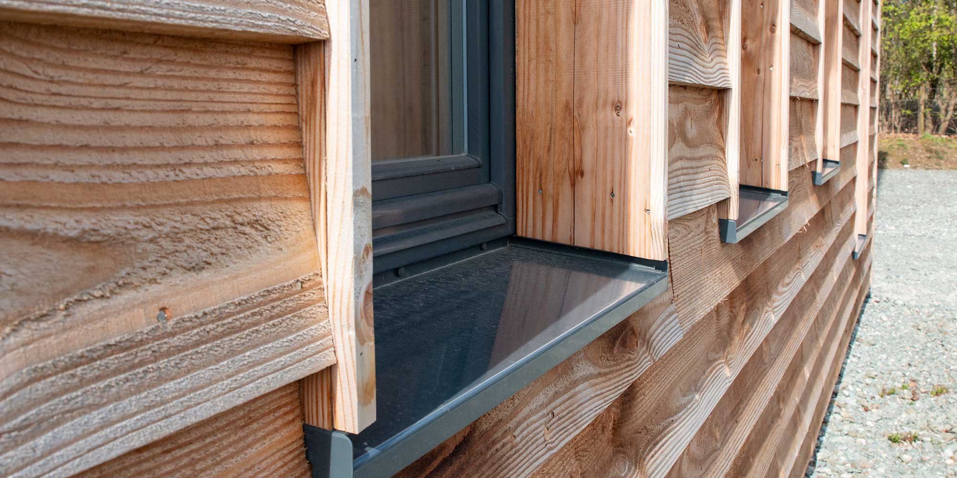
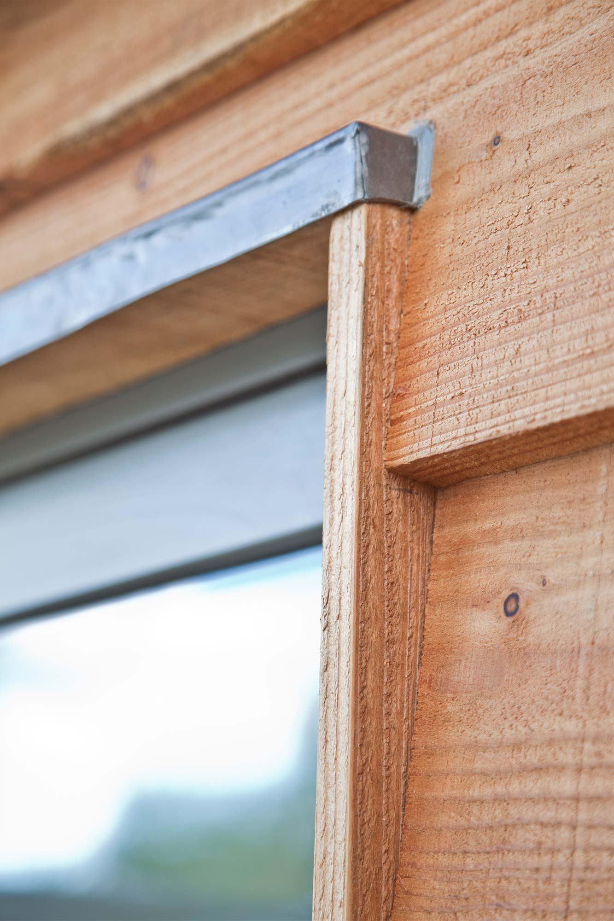
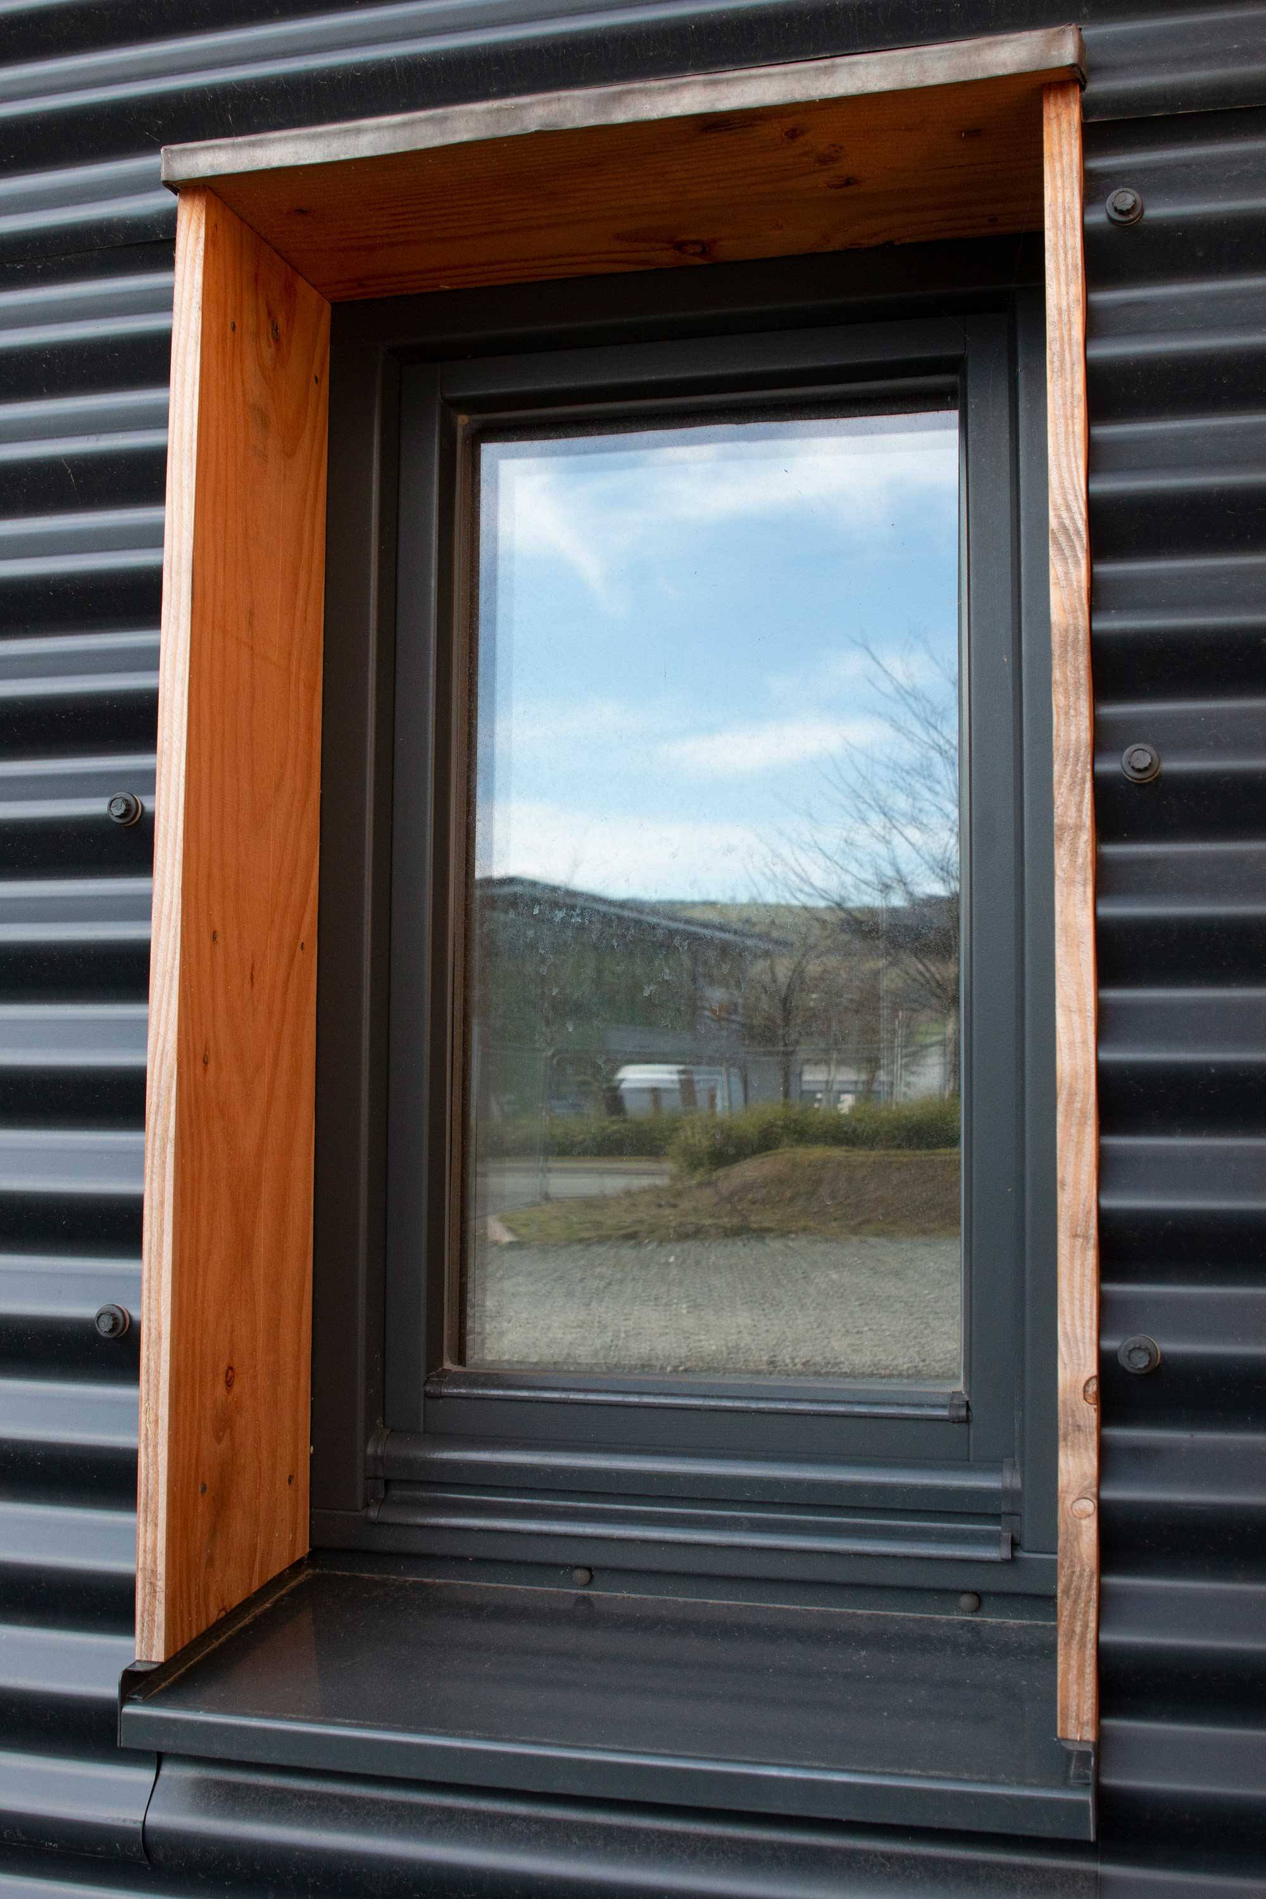
Openings (window and door fixing)
Łukasz Wesołowski
Wood structure:

Slide 16
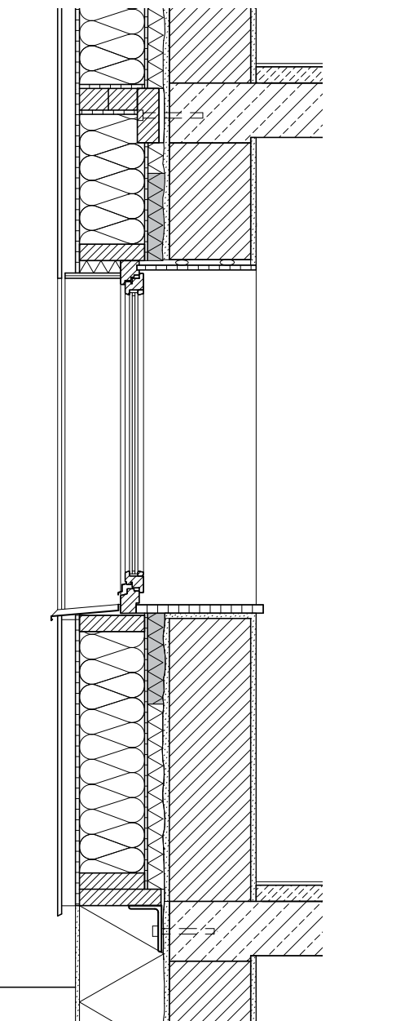
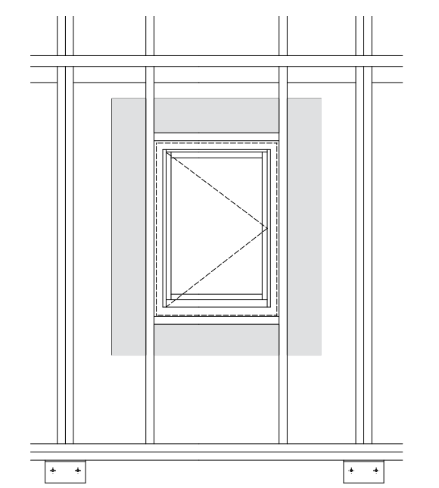
Openings (window and door fixing)
Łukasz Wesołowski
In panels:

Slide 17
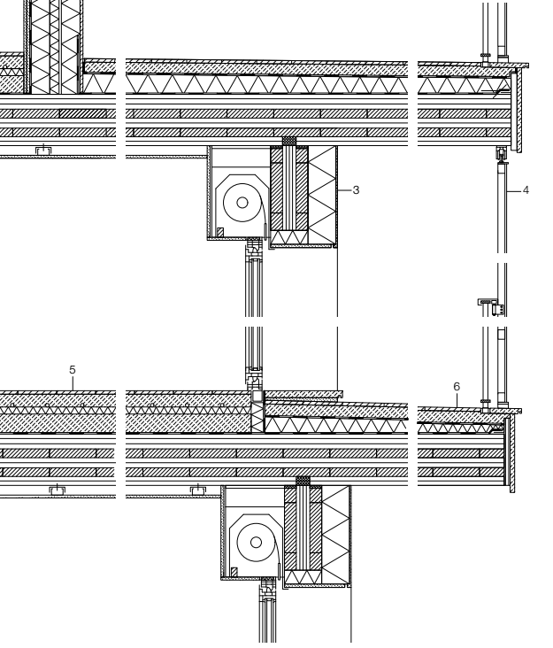
Openings (window and door fixing)
Łukasz Wesołowski
With sun protect:

Slide 18
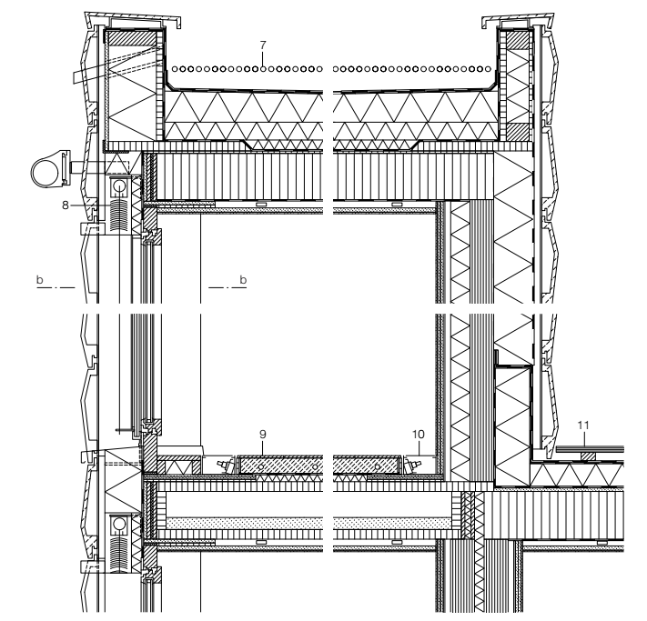
Openings (window and door fixing)
Łukasz Wesołowski
Floor high:

Slide 19
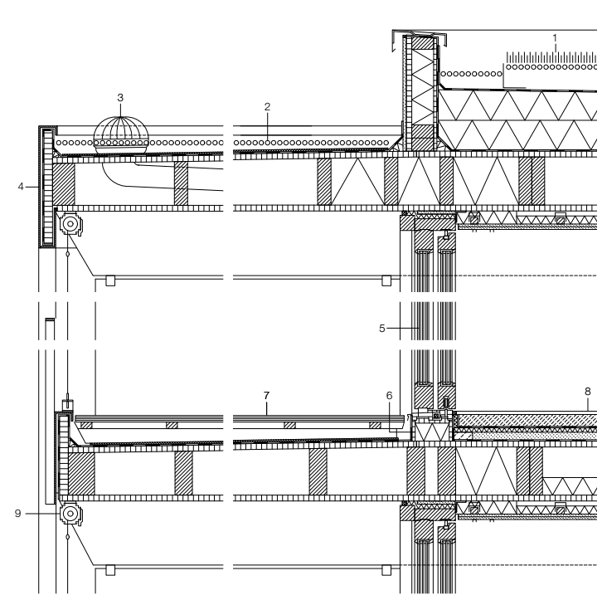
Openings (window and door fixing)
Łukasz Wesołowski
Sliding window:

Slide 20
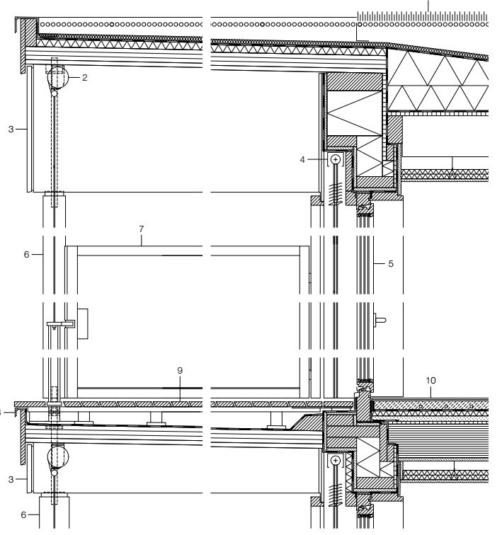
Openings (window and door fixing)
Łukasz Wesołowski
External sun protection:

Slide 21
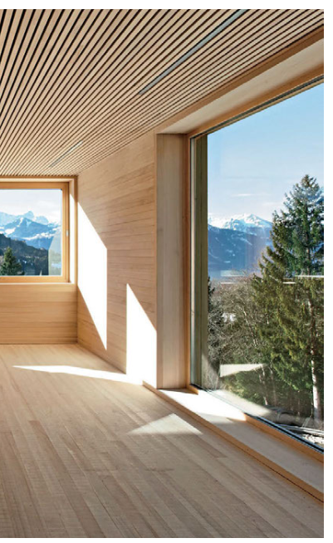
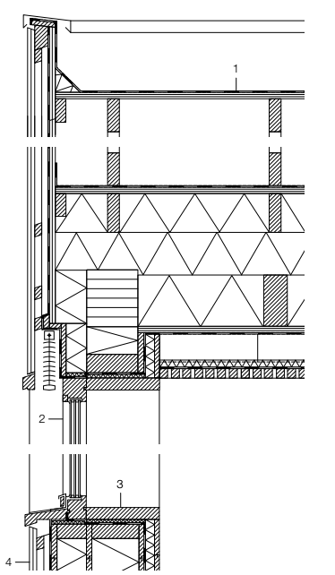
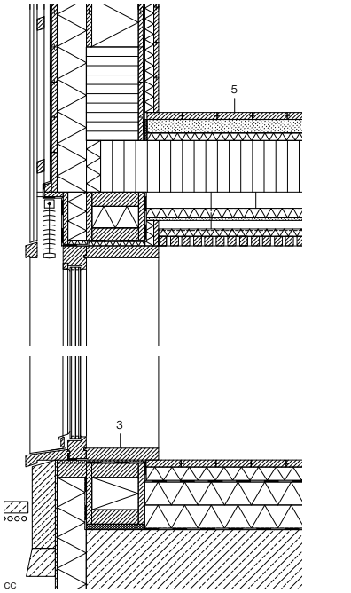
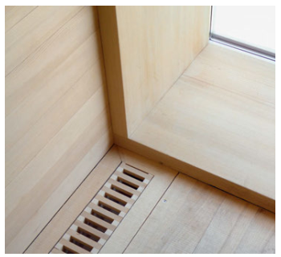
Openings (window and door fixing)
Łukasz Wesołowski
Detailed:

Slide 22
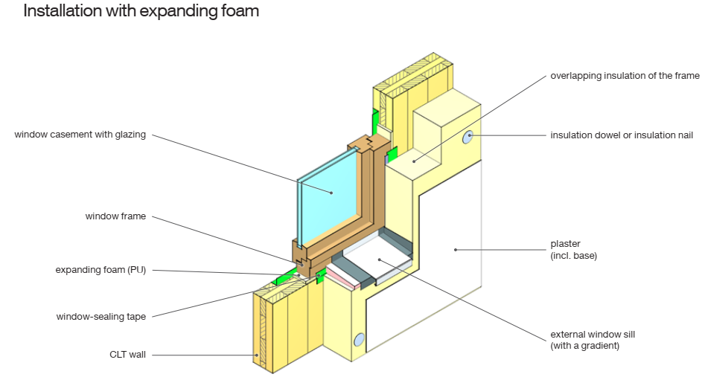
Openings (window and door fixing)
Łukasz Wesołowski

Slide 23
Openings (window and door fixing)
Łukasz Wesołowski

Slide 24
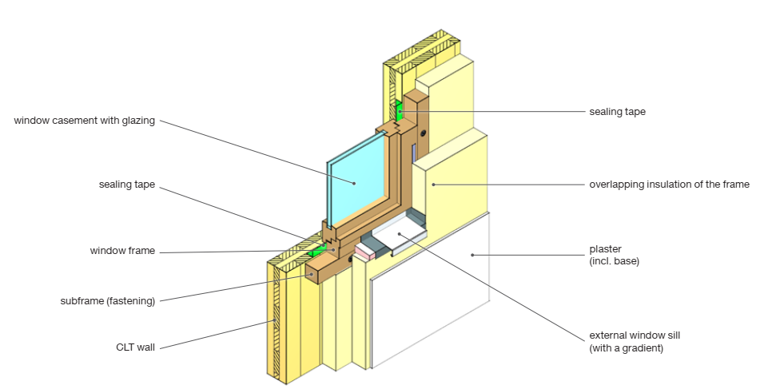
Openings (window and door fixing)
Łukasz Wesołowski

Slide 25
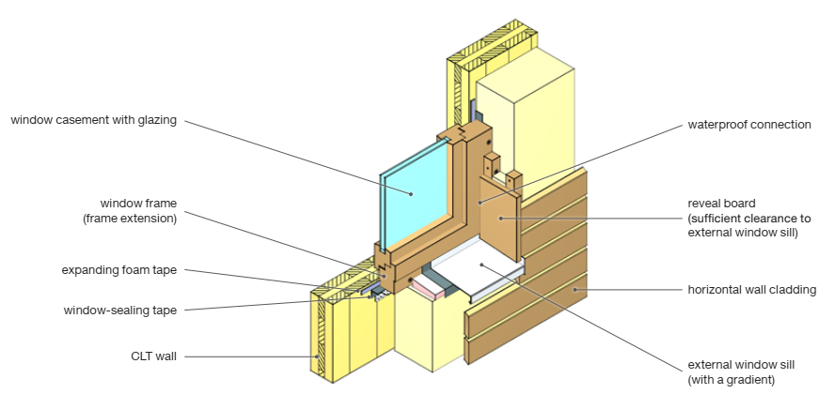
Openings (window and door fixing)
Łukasz Wesołowski

Slide 26
Openings (window and door fixing)
Łukasz Wesołowski

Slide 27
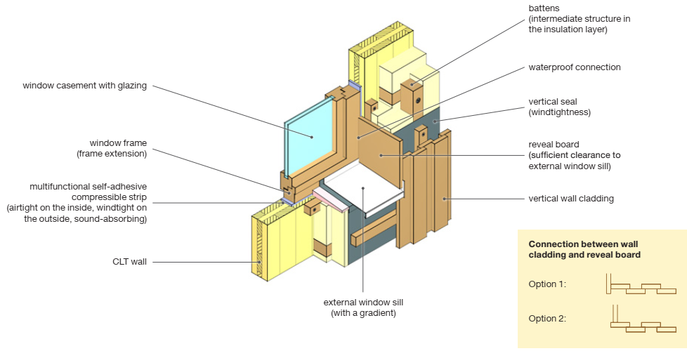
Openings (window and door fixing)
Łukasz Wesołowski

Slide 28
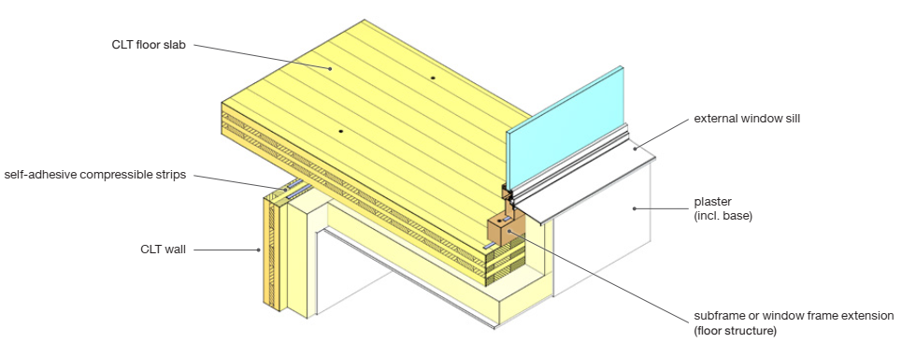
Openings (window and door fixing)
Łukasz Wesołowski

Slide 29
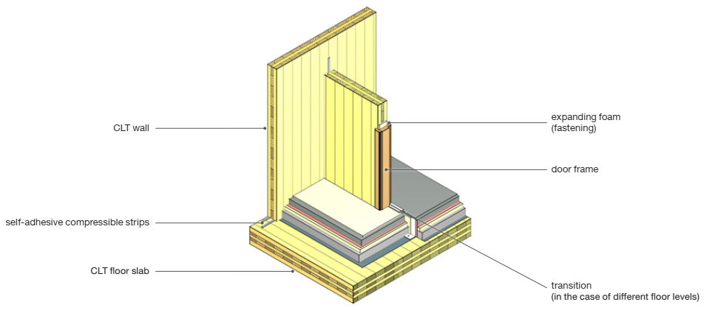
Openings (window and door fixing)
Łukasz Wesołowski

Slide 30
Openings (window and door fixing)
Łukasz Wesołowski

Slide 31
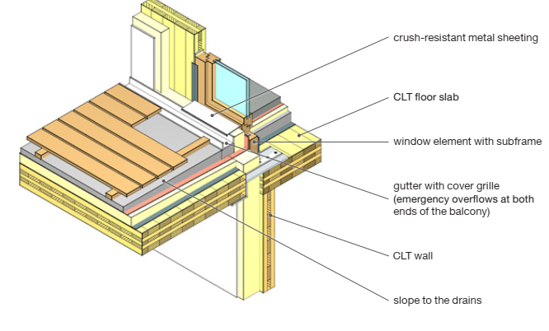
Openings (window and door fixing)
Łukasz Wesołowski

Slide 32
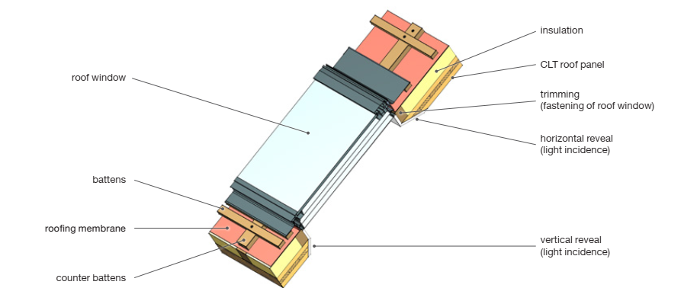
Openings (window and door fixing)
Łukasz Wesołowski

Slide 33
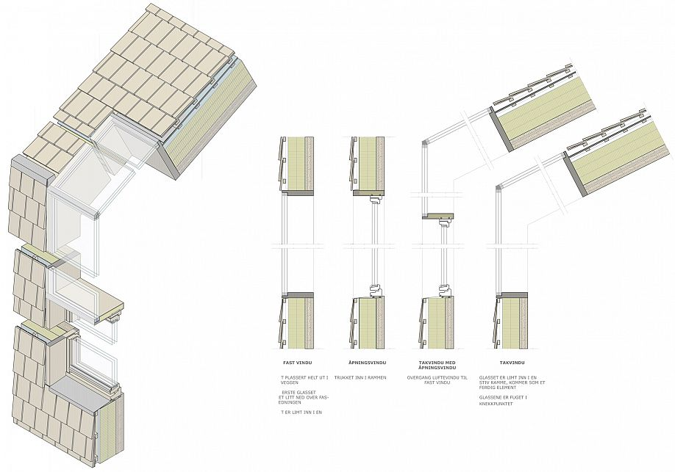
Openings (window and door fixing)
Łukasz Wesołowski
Wood structure:

Slide 34
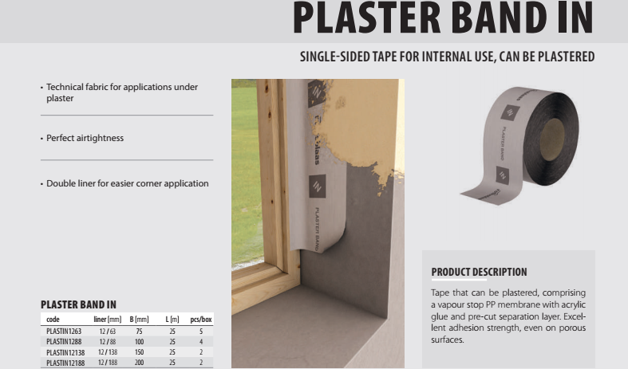
Openings (window and door fixing)
Łukasz Wesołowski

Slide 35
Openings (window and door fixing)
Łukasz Wesołowski

Slide 36
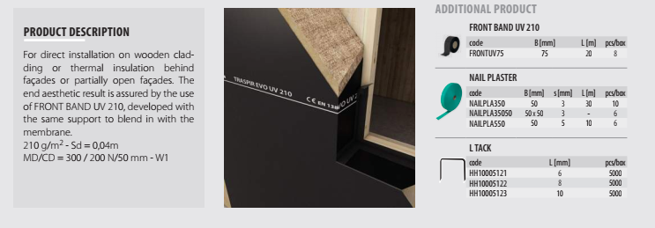
Openings (window and door fixing)
Łukasz Wesołowski

Slide 37
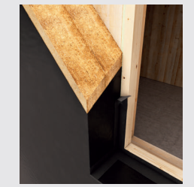
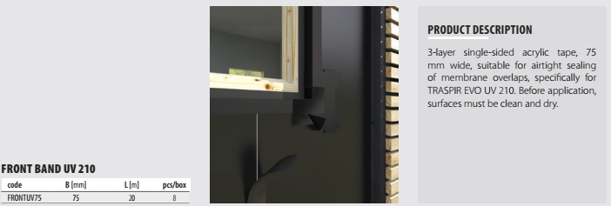
Openings (window and door fixing)
Łukasz Wesołowski

Slide 38
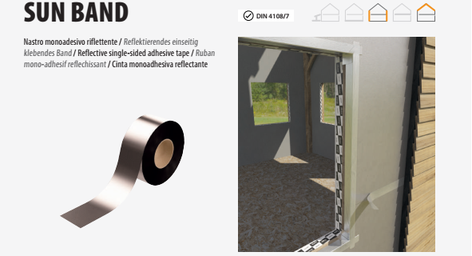
Openings (window and door fixing)
Łukasz Wesołowski

Slide 39
Openings (window and door fixing)
Łukasz Wesołowski

Slide 40
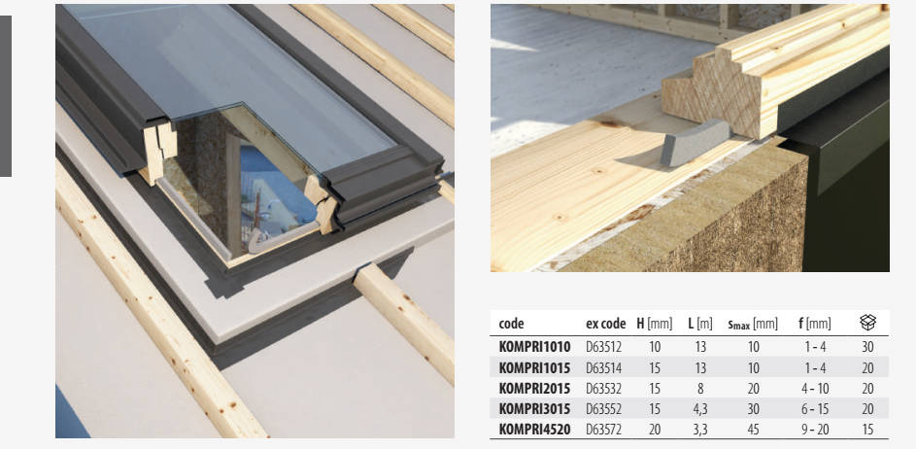
Openings (window and door fixing)
Łukasz Wesołowski

Slide 41
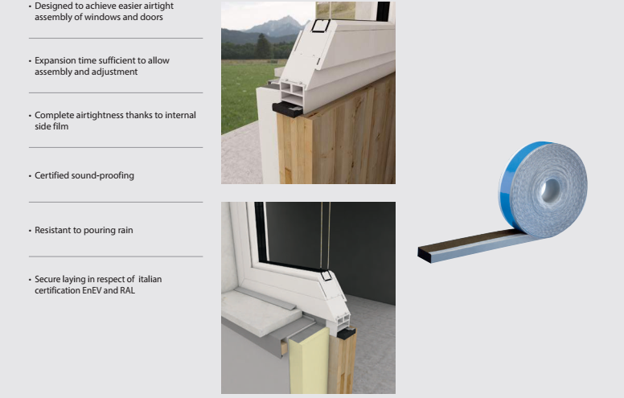
Openings (window and door fixing)
Łukasz Wesołowski

Slide 42
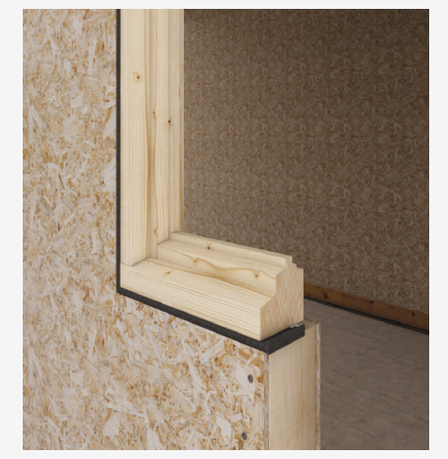
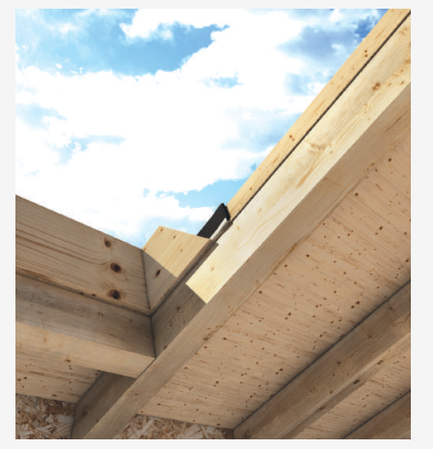
Openings (window and door fixing)
Łukasz Wesołowski

Slide 43
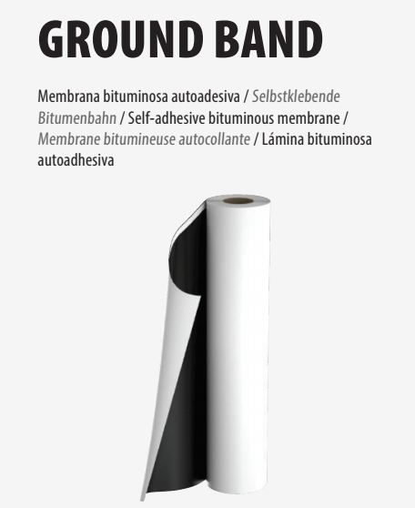
Openings (window and door fixing)
Łukasz Wesołowski

Slide 44
Openings (window and door fixing)
Łukasz Wesołowski

