Slide 1

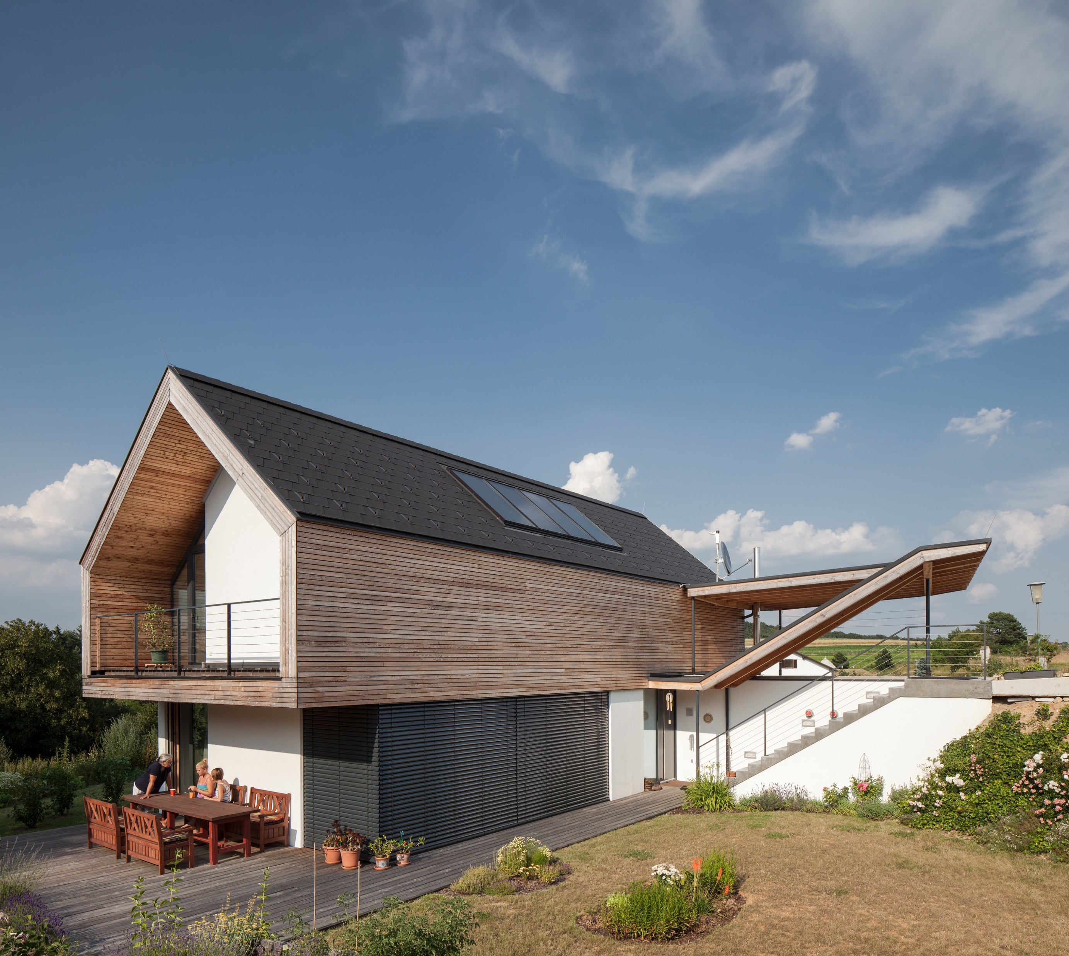







Timber
Construction
ERASMUS+ Strategic Partnerships For Higher Education
  SUSTAINABLE, HIGH-PERFORMANCE BUILDING SOLUTIONS IN WOOD
  2020-1-LV01-KA203-077513
01 Introduction
Timber-Systems-and-Components
di matthias doubek, bsc
civil engineer, master carpenter

Slide 2









about
education
  Higher Technical College for Timber Technologies – HTBLuVA Mödling
  BSc Civil Engineering and Construction Management - FH Campus Wien
  MSc Construction and completion of Large-scale International Projects- FH Campus Wien
  Postgraduate Student - Sustainable Engineering - University of Exeter (UK)
  Official qualification master carpenter
  Official qualification master builder
  Official qualification property developer
  Official qualification Civil Engineer
Awards
  FH Best Paper Award
  Nomination for Timber Construction Price Lower Austria
  National Steel Construction Austria
Berufspraxis
  5 years site engineer timber construction
  15 years Planning activity for architects and construction engineers
  (mainly planning, structural engineering, building physics and site management)
  11 years freelance lector
  9 years self employed as consultant, since 2016 konstrukt:ING – konstruktive Ingenieure GmbH

Slide 3

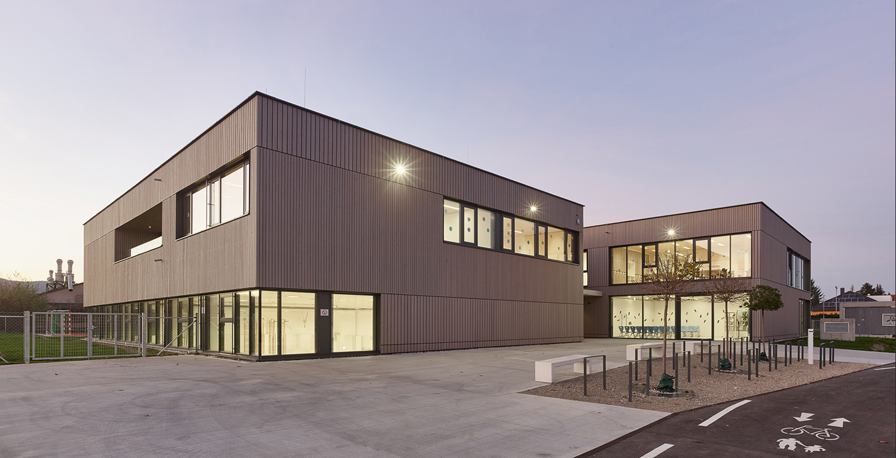
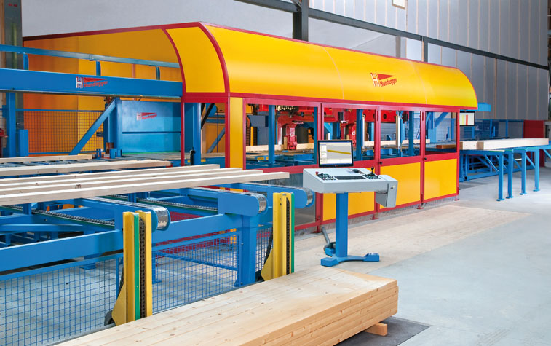
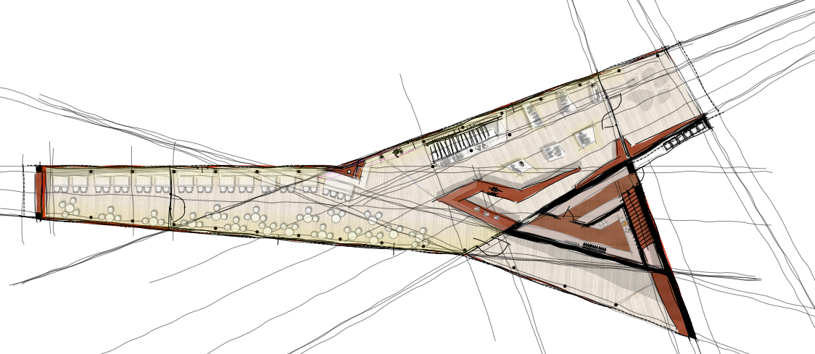
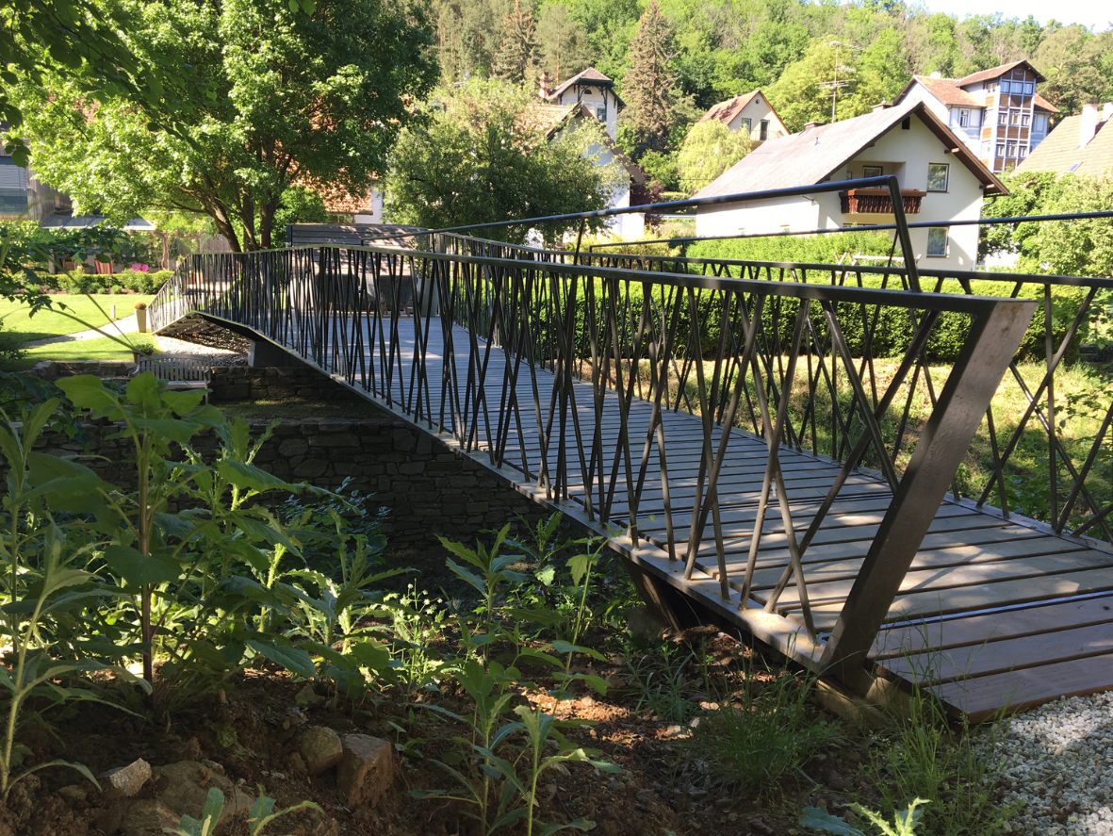
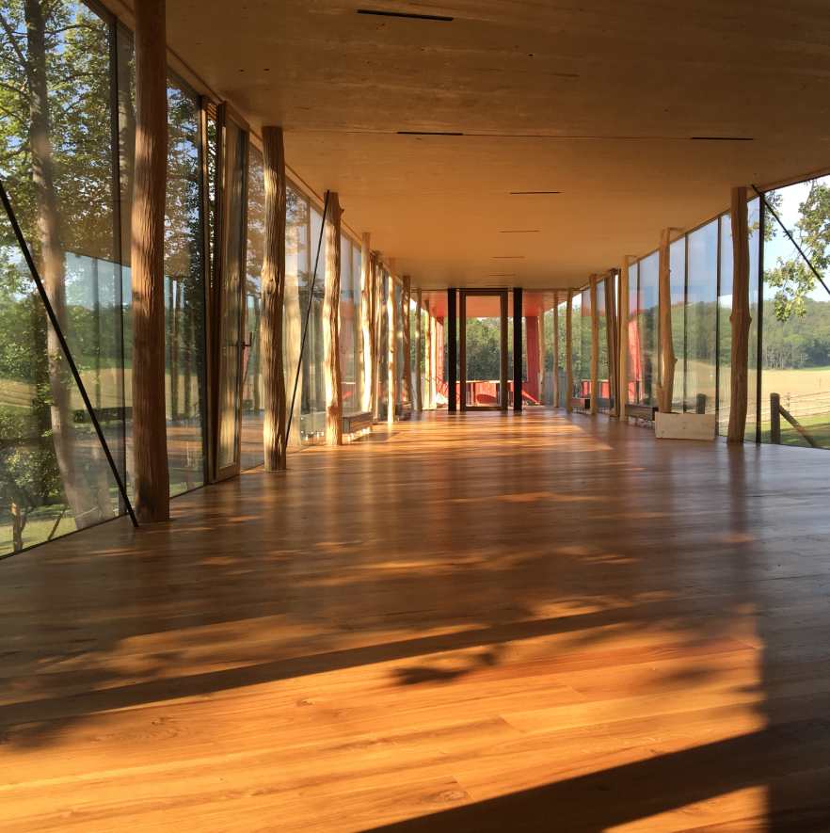
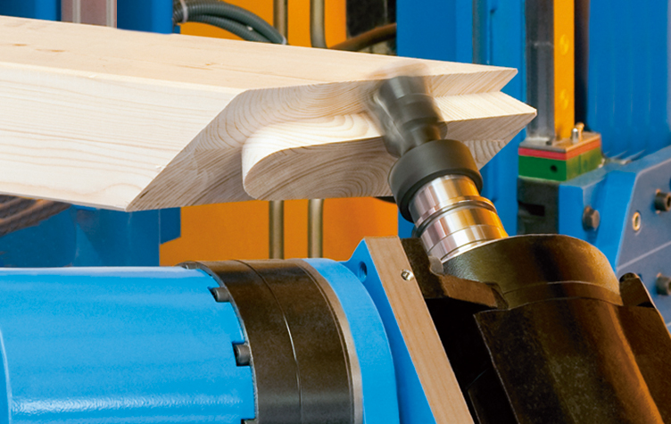
what we do

Slide 4
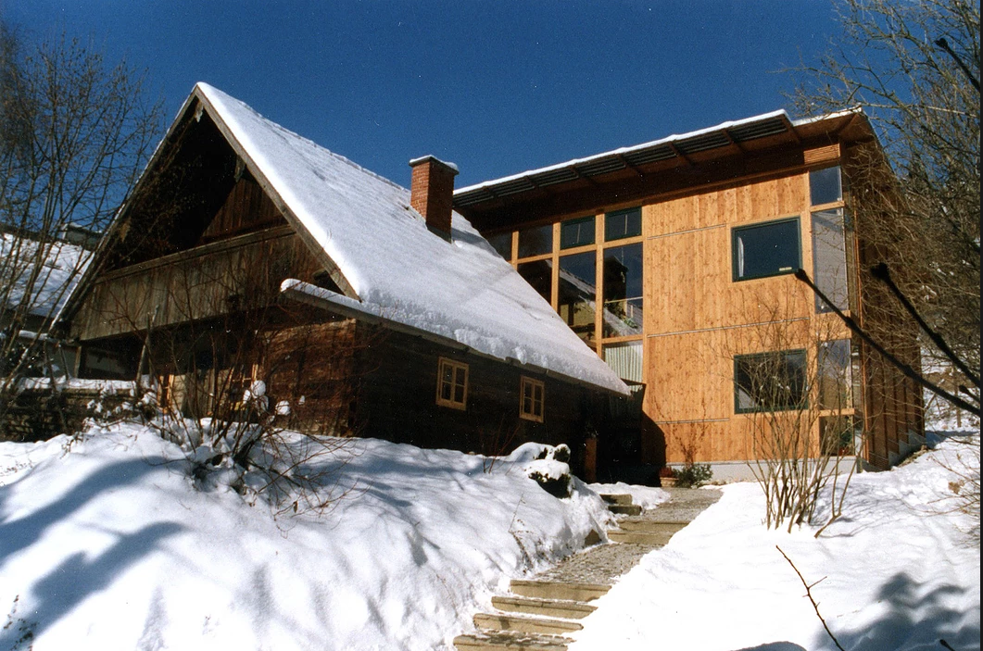
timber technology

Slide 5
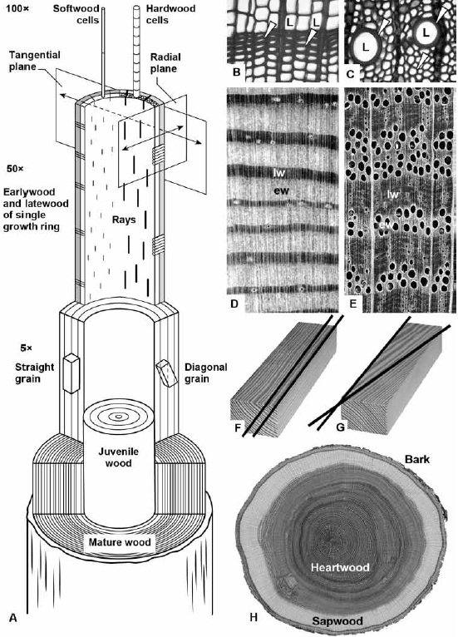
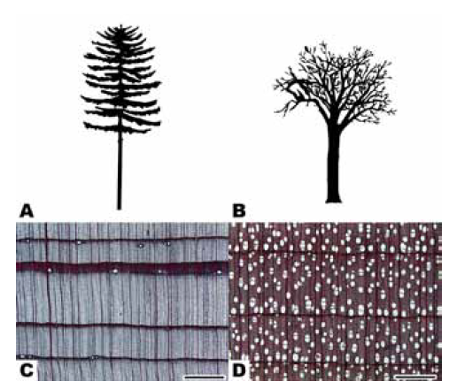
structure of wood

Slide 6
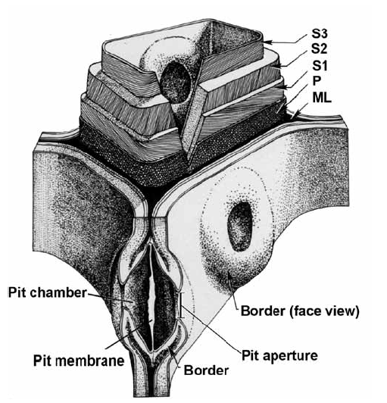
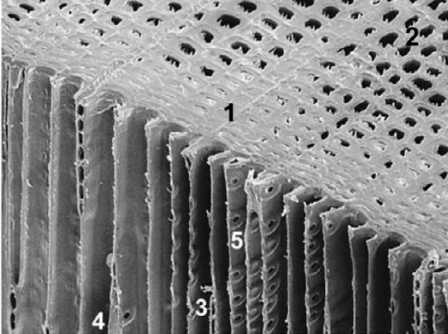
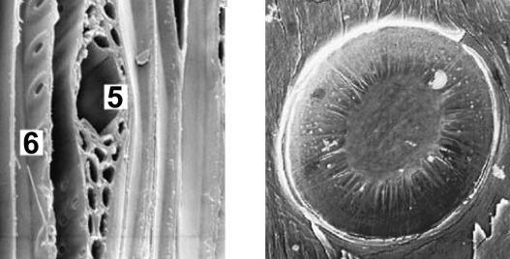
microscopic structure of softwood

Slide 7
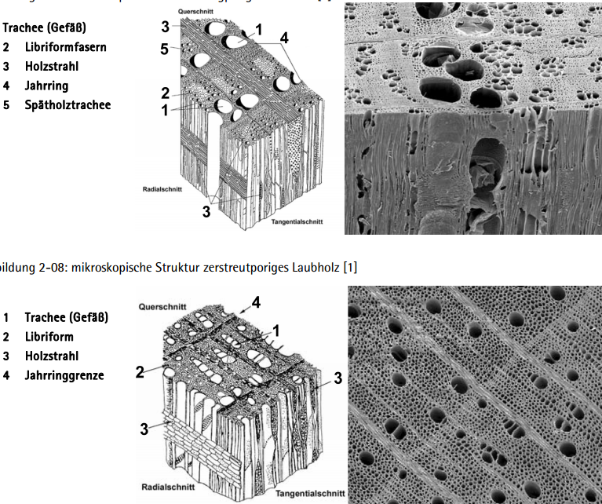
miroscopic structure hardwood

Slide 8
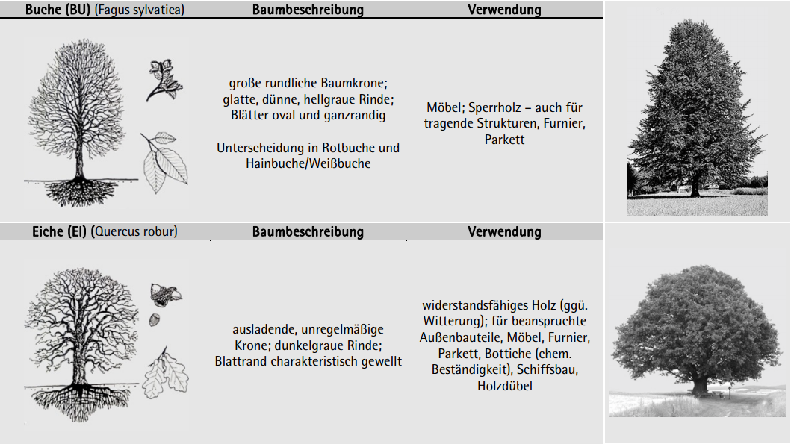
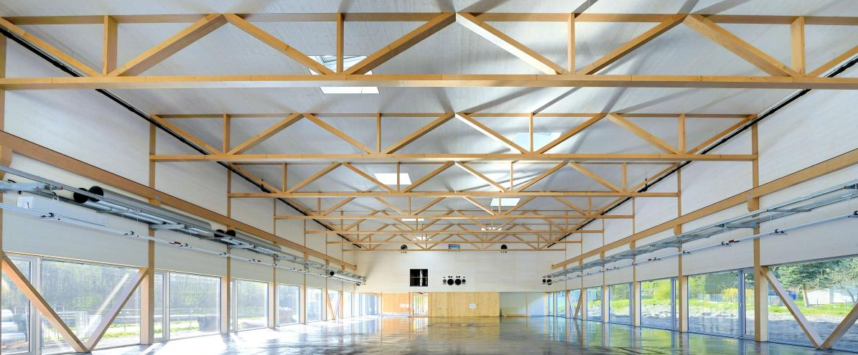
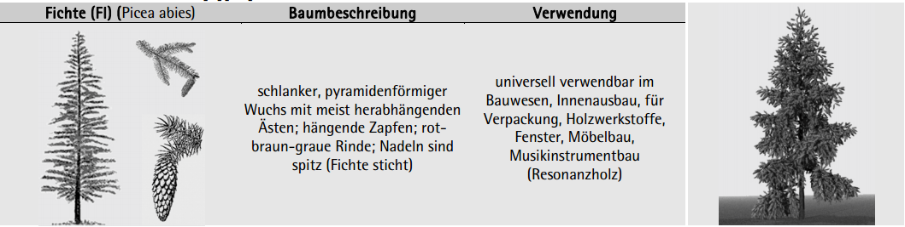
species of wood for timber constructions
Beech
used for
veneers
furniture
woodturner objects
e.g. „Baubuche“ (laminated veneer lumber, laminated into beams, boards and panels) - https://www.pollmeier.com/products/baubuche-about#gref
special properties
Easily to steam-bend
Oak
used for
shipbuilding
furniture
terrace
weathered and heavily exposed components
special properties
Very resistant to insect and fungal attack
Spruce
used for
Common buliding wood
(also glued laminated timber)
Pulpwood (paper uses)
special properties
Fast growing

Slide 9
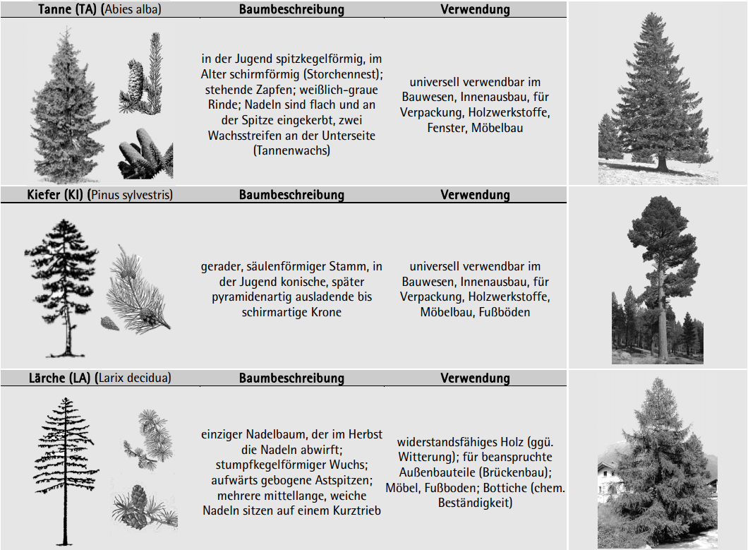
Species of wood for timber constructions
silver fir
used for
Common buliding wood
(also glued laminated timber)
furniture
special properties
Fast growing
pine
used for
Lumber and construction
(also glued laminated timber)
furniture
special properties
Blue fungus
larch
used for
Common buliding wood, esp. Outdoor
furniture
terrace
(small) windows
Furniture
special properties
Durable qualities

Slide 10
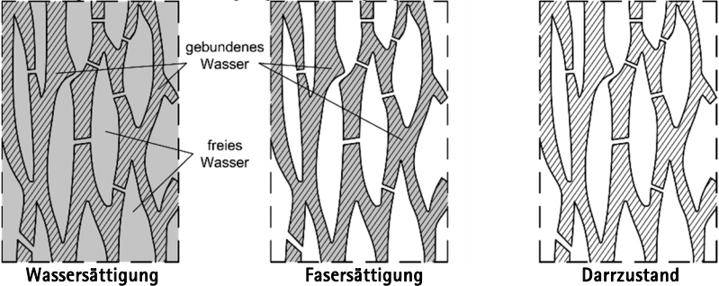
physics – wood moisture equilibrium
Bound water
free water
Water saturation
fiber saturation
Total dryness

Slide 11
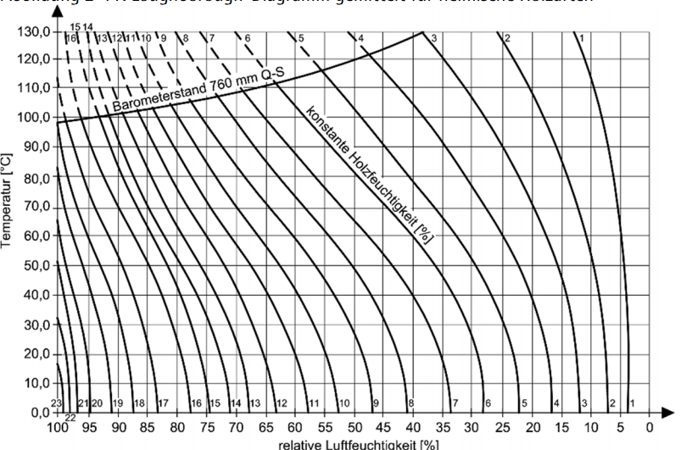
Hygroskopic balance

Slide 12
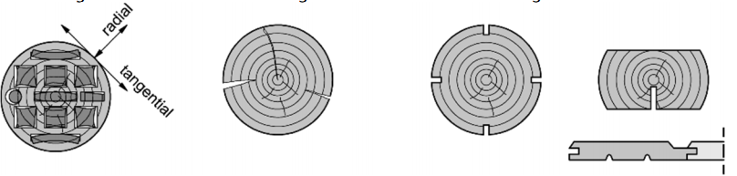
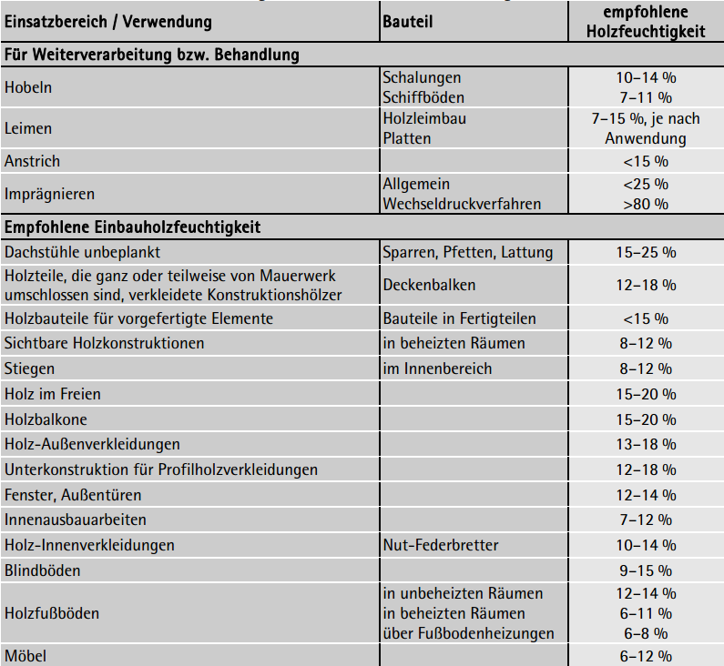
dimensionsstabilisierende maßnahmen

Slide 13
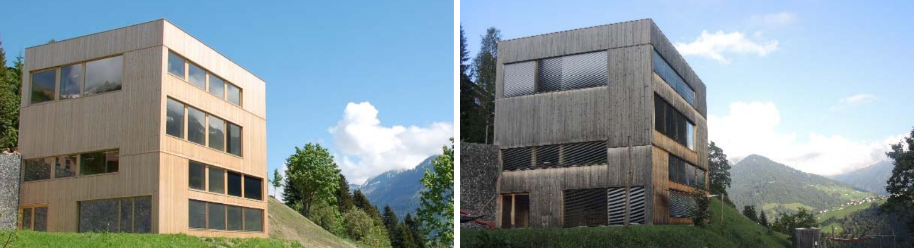
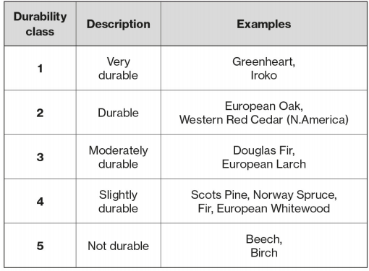
Natural durability
https://www.structuraltimber.co.uk/assets/InformationCentre/eb1.pdf

Slide 14
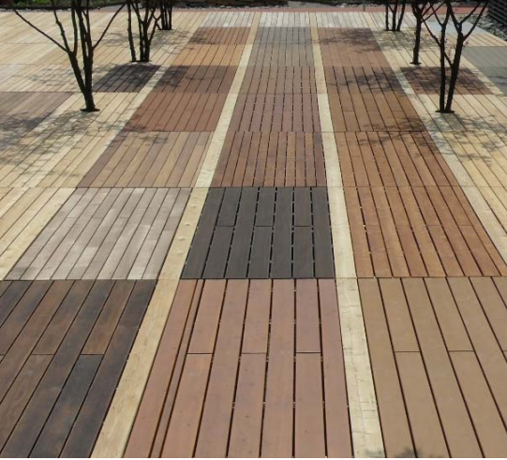
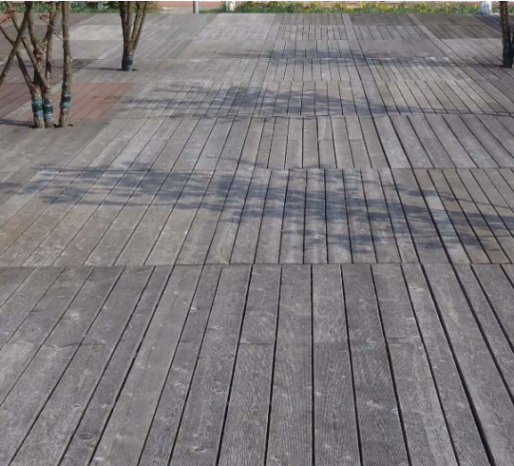
Natural durability

Slide 15
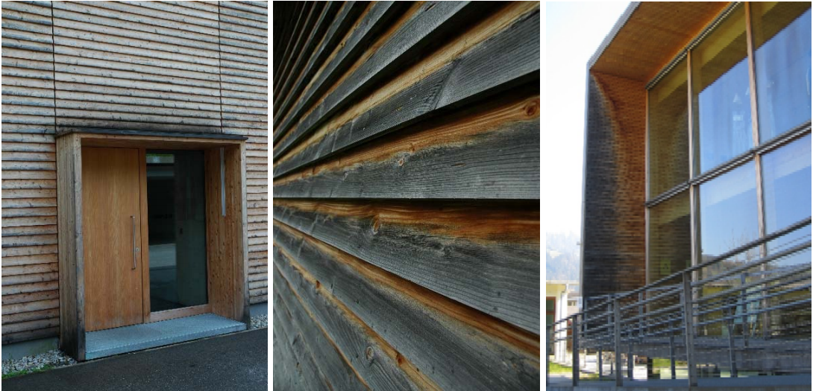
Constructive wood protection

Slide 16
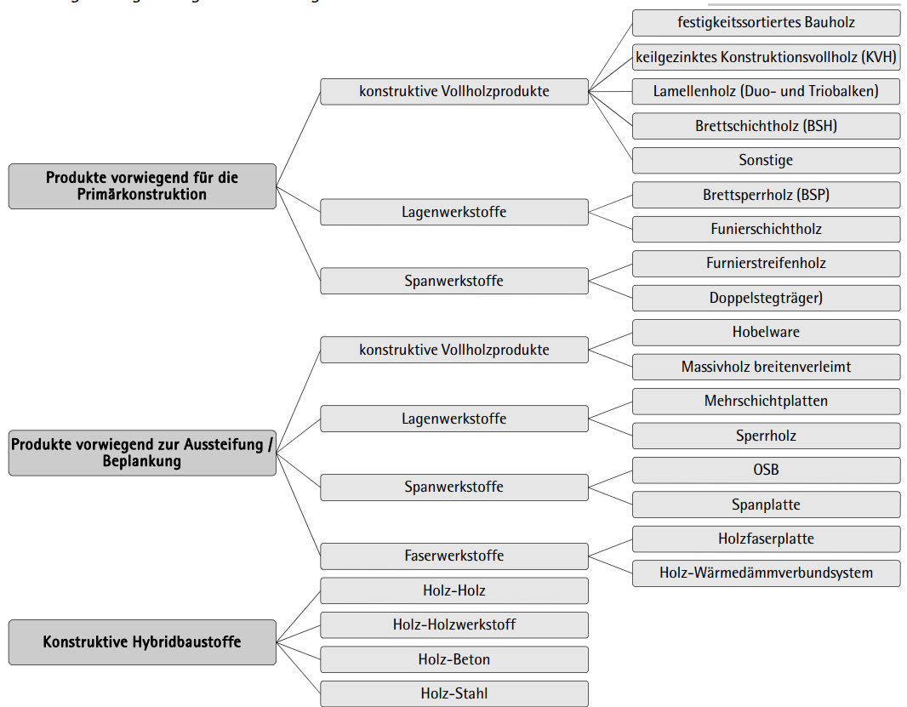
baustoffe und produkte

Slide 17
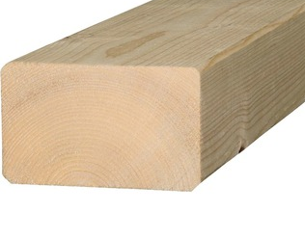
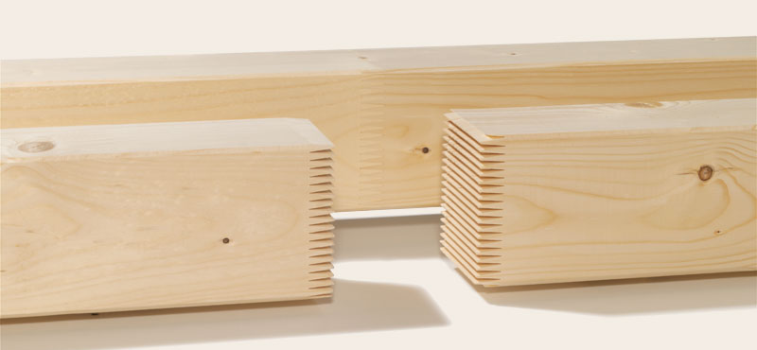
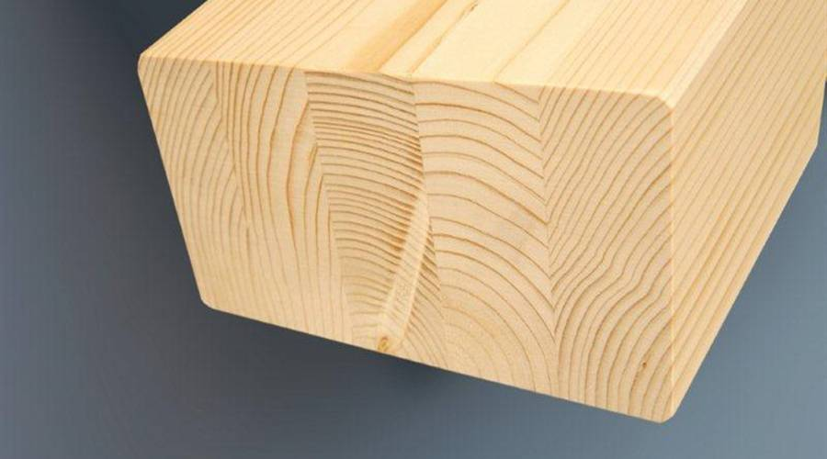
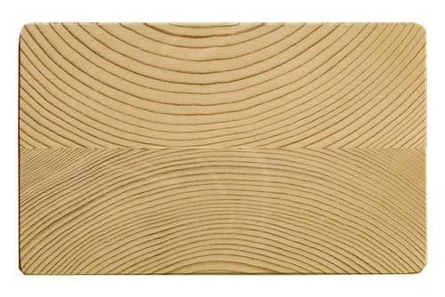
Constructive solid wood

Slide 18
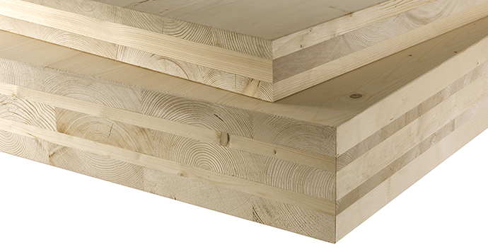
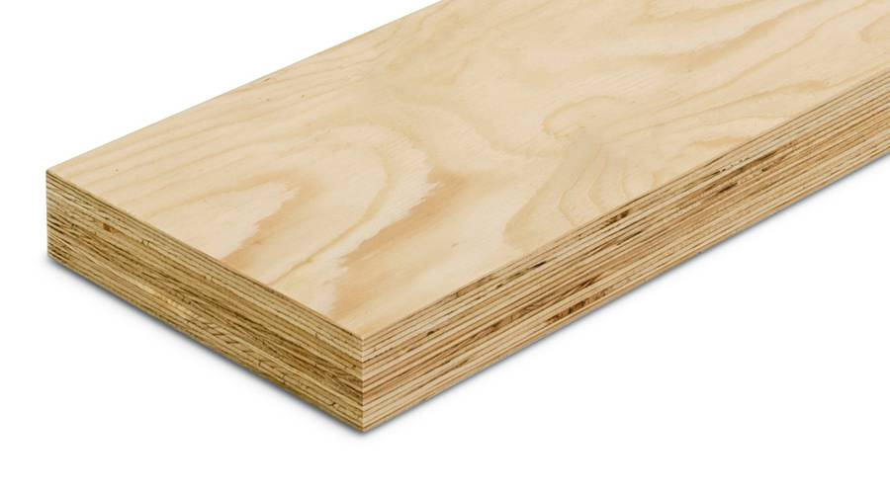
Layer material cross laminated timber / laminated veneer timber

Slide 19
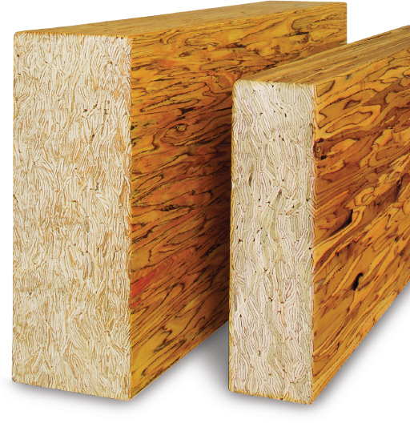
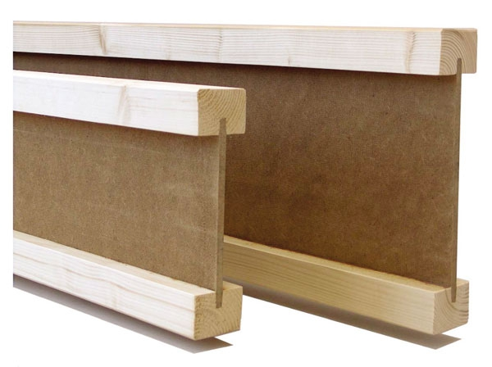
Chip material / i-beam

Slide 20
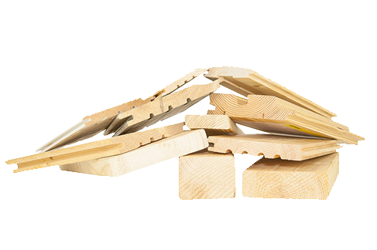
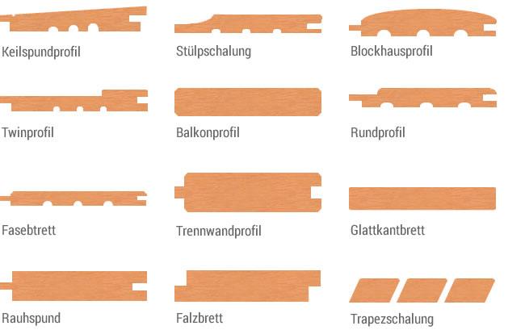
Planed goods

Slide 21
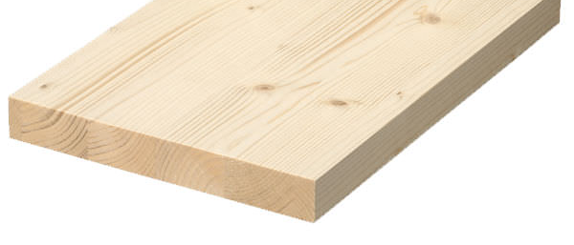
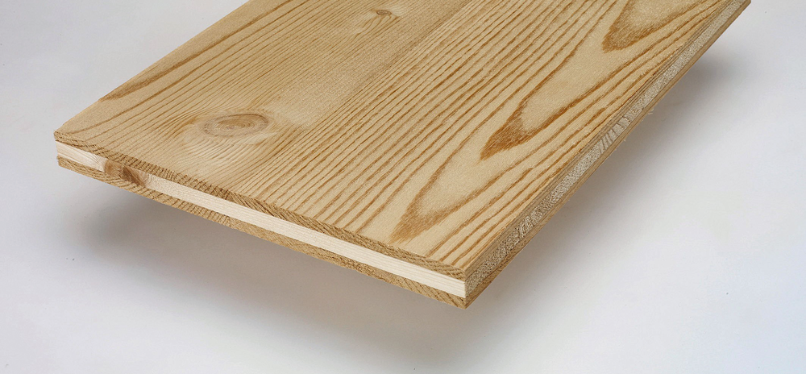
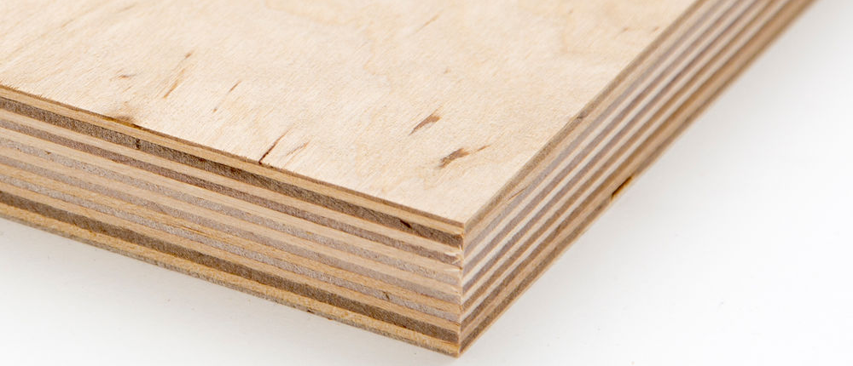
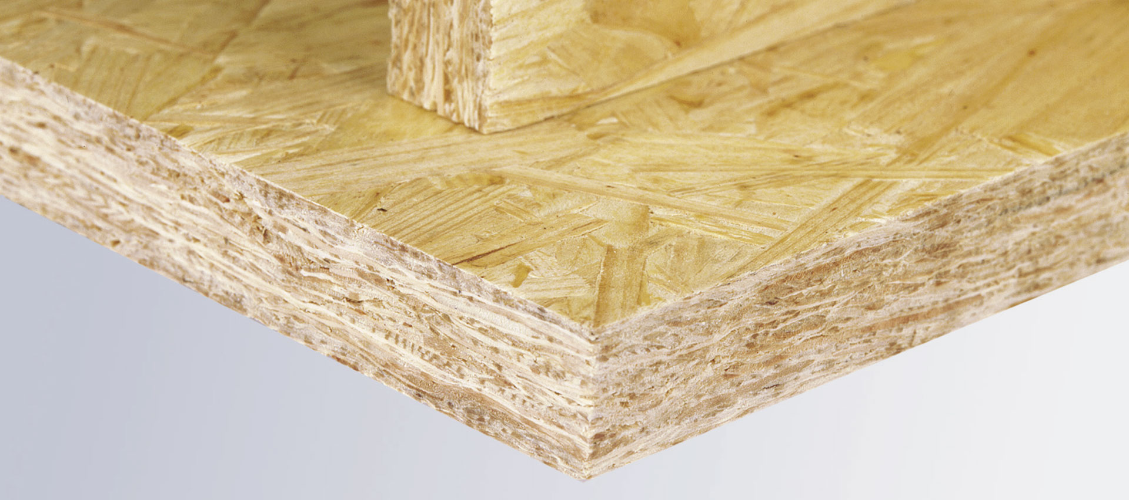
Solid wood wide glued / three-layer board plywood / osb (oriented strand board)

Slide 22
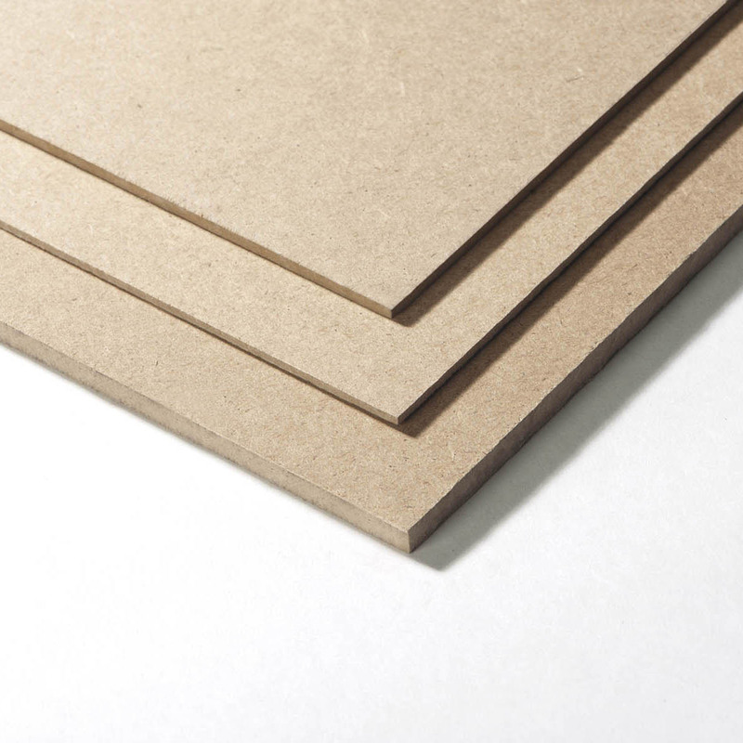
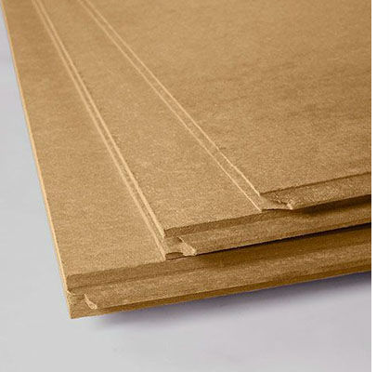
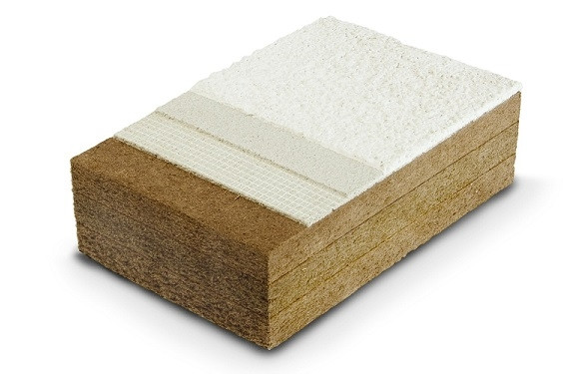
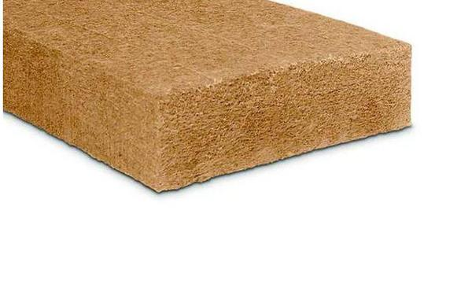
fiberboards - hdf / mdf / ldf

Slide 23
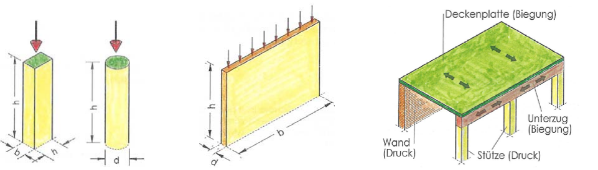
Load dissipation
Ceiling (bend)
Girder
(bend)
Wall
(compression)
column
(compression)

Slide 24
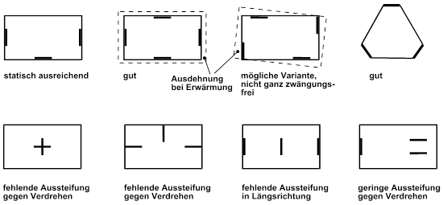
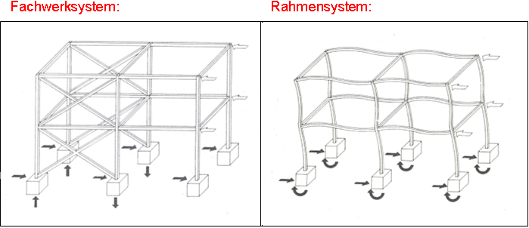
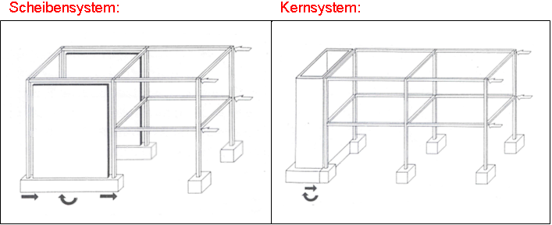
horizontal bracing
OK
GOOD
GOOD
GOOD
Lack of strengh against twist
Lack of strengh against twist
Lack of stiffening in longitudinal direction
Lack of strengh against twist
Truss system
Frame system
disc system
core system

Slide 25





connections

Slide 26
carpentry connection
Blunt bump
Half lap
Mortise and tenon
Cross lap joint

Slide 27
carpentry connection
Dovetail crossed lap
Face staggered joint
Notched housing
Obelique thrust joint with notched housing
Halved crossing joint

Slide 28

engineering wood joints
mechanical connection
(screws, sheets, steel parts)
force
Formfitting connection
glued connection
shift

Slide 29








Smooth nails
pin shaped connectors
But nails
brackets
Nail plates
dowel
Self driling dowels
screws
bolts
Fitting bolts

Slide 30





Pin-shaped connetions

Slide 31






Angle connector
System connectors
Perforated
steel strips
Beam shoe
Glued
connections
Beam girder
Support base
Tension rod systems

Slide 32
Examples system connectors / sources
www.strongtie.de/products
www.rothoblaas.de/produkte/verbindungstechnik
www.pitzl-connectors.com/produkte
www.halfen.com/at/780/produktbereiche/bau/stabsysteme/detan-stabsystem/einfuehrung/
www.sfs.ch/de/Holzbefestiger
www.sihga.com/
www.schrauben.at/schraubenwelten/produkte/uebersicht
www.sherpa-connector.com

Slide 33


bauteile-aufbauten

Slide 34

aufbautenrecherche

Slide 35


tragstrukturkombinationen / bauweisen

Slide 36

vorfertigungsgrade

Slide 37

konstruktionsvarianten

Slide 38


grundlegende schichtbildung im holzbau

Slide 39

bsp außenwand – zimmermannsmäßig

Slide 40

bsp außenwand – fertigteilbauweise

Slide 41

bsp außenwand – holzmassivbauweise

Slide 42


bsp innenwand (scheidewand)

Slide 43


bsp trennwand

Slide 44


bsp interne decke

Slide 45

bsp trenndecke (z.B. zw. wohneinheiten)

Slide 46

bsp steildach

Slide 47


bsp flachgeneigtes dach / flachdach

Slide 48

Bsp flachdach / terrasse / foliendeckung

Slide 49

7 goldene regeln für nachweisfr. flachdach

Slide 50




details

Slide 51

bsp sockel riegelwand

Slide 52

bsp sockel riegelwand holzfassade

Slide 53


bsp wandecke

Slide 54


anforderung decke / trennwand

Slide 55

bsp trenndecke / wohnungstrennwand

Slide 56


praxisbeispiel

Slide 57

praxisbeispiel - grundriss

Slide 58

praxisbeispiel - schnitt

Slide 59
anforderungsprofil / aufgabenstellung
Ziele:
Niedrigstenergiestandard
Hochwertige Aufbauten in Bezug auf Schall (intern)
Abgesehen von Schallschutz mittlere Ausstattungsqualitäten
OIB-Richtlinie Niederösterreich
Definieren Sie gem. angegebene Anforderungsprofil nachfolgende Aufbauten:
Außenwand Außenwand
Flachdach
Steildach
Trennwand
Trenndecke
Auswertung durch Diskussion

Slide 60
source directory
Pech, Anton (Hrsg.) Holz im Hochbau, Springer Verlag
Wood Handbook, Wood as Engineering Material United Dep. Of Agriculture, Wisconsin, US
Manual for Engineered Wood Construction American Wood Concil
Richtlinie Sockelanschluss im Holzhausbau Holz Forschung Austria
Atlas Mehrgeschossiger Holzbau Edition Detail 2017
Auszug aus Vortragsreihe Modulbau rwt+ (Richard Woschitz)
www.proholz.at
www.dataholz.eu
www.frischeis.com
www.steico.com
www.clt.info
www.bruck33.at
www.strongtie.de/products
www.rothoblaas.de/produkte/verbindungstechnik
www.pitzl-connectors.com/produkte
www.halfen.com/at/780/produktbereiche/bau/stabsysteme/detan-stabsystem/einfuehrung/
www.sfs.ch/de/Holzbefestiger
www.sihga.com/
www.schrauben.at/schraubenwelten/produkte/uebersicht
www.sherpa-connector.com

