Slide 1
BUILDING PHYSICS - HEAT / SOUND / MOISTURE MANAGEMENT
Łukasz Wesołowski
11-05-2022

Slide 2
Presentation Title
Name of the presenter
Wood structure:

Slide 3
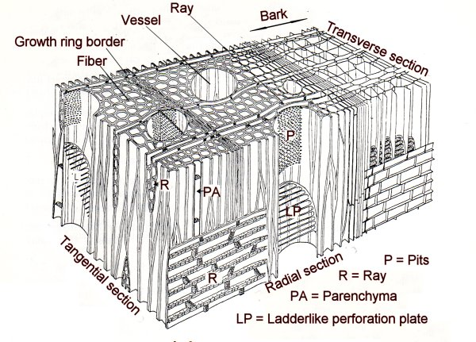
Presentation Title
Name of the presenter
Wood structure:

Slide 4
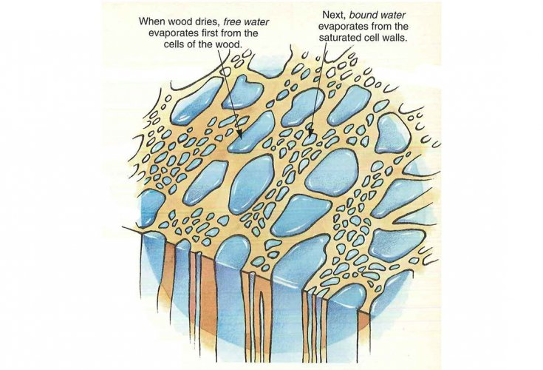
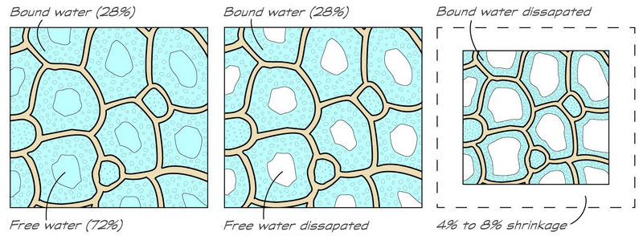
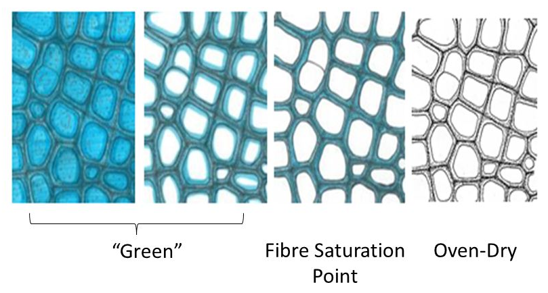
Presentation Title
Name of the presenter
Humidity:

Slide 5
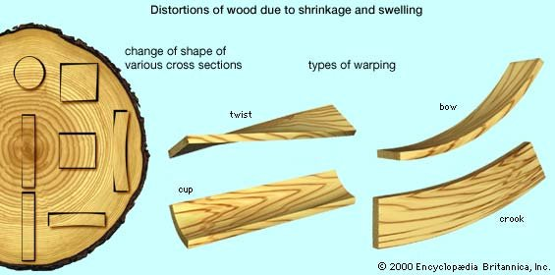
Presentation Title
Name of the presenter
Water removal effects:

Slide 6
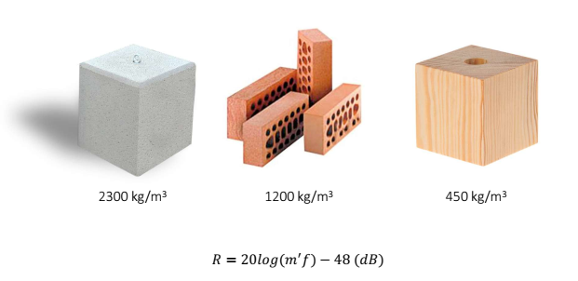
Presentation Title
Name of the presenter
Material:

Slide 7
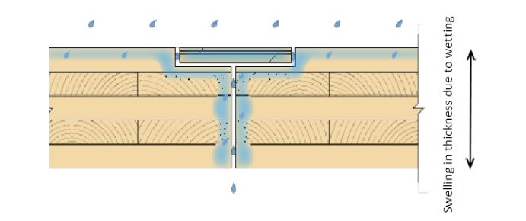
Presentation Title
Name of the presenter
Humidity after construction:

Slide 8
Presentation Title
Name of the presenter
Humidity while construction:

Slide 9
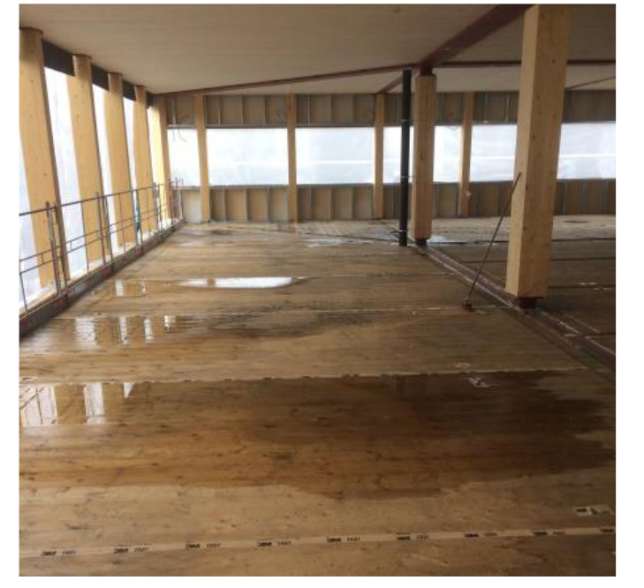
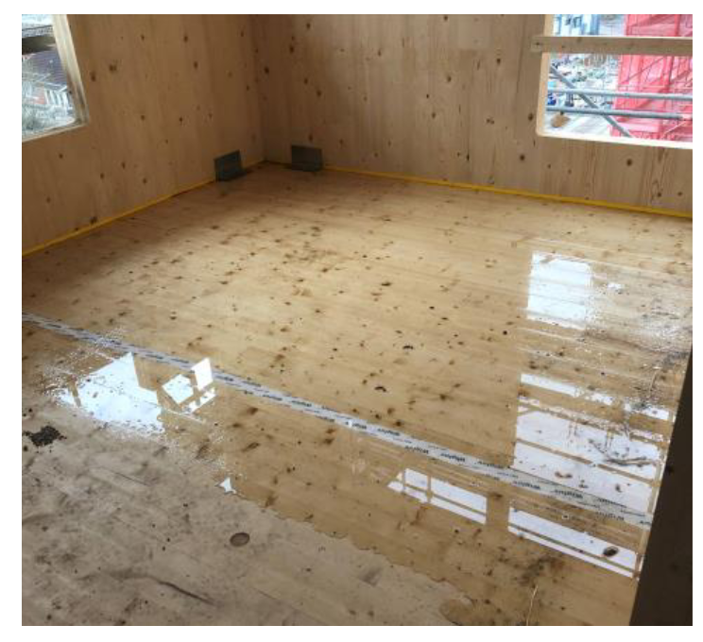
Presentation Title
Name of the presenter
Humidity – timber degradation:

Slide 10
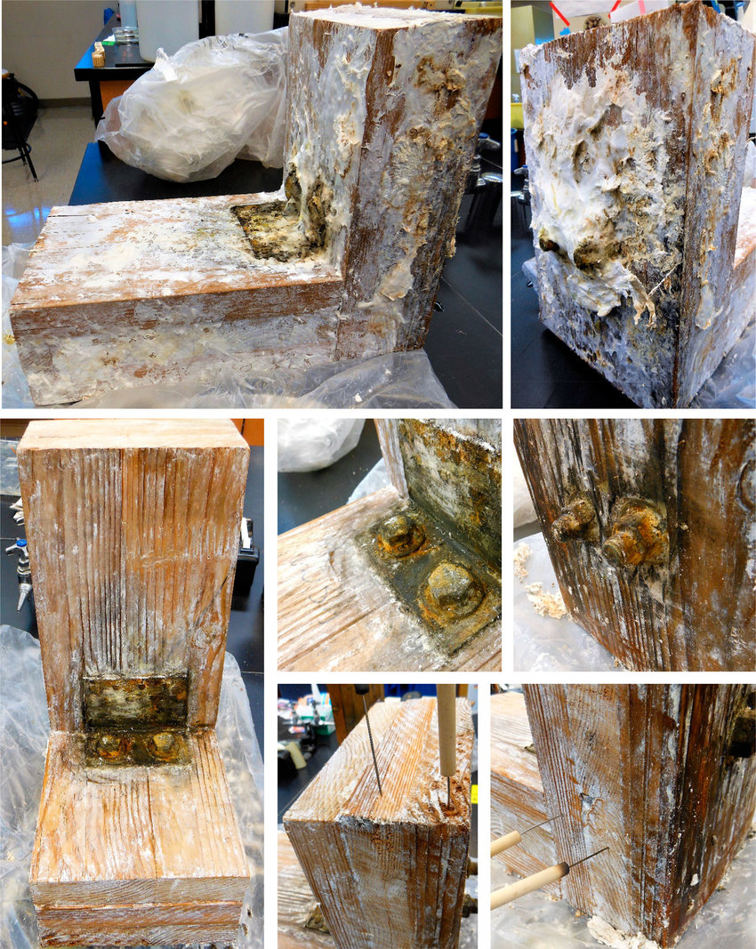
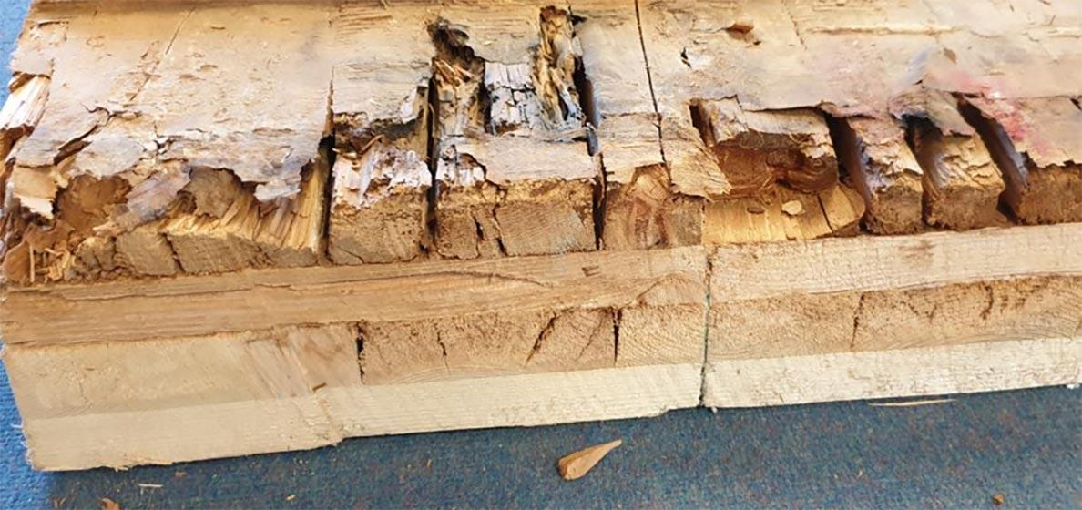
Presentation Title
Name of the presenter
Humidity – timber degradation:

Slide 11
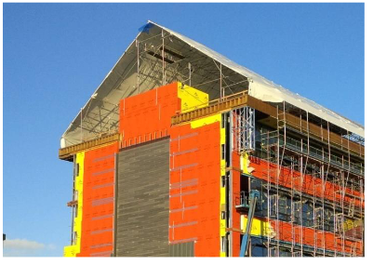
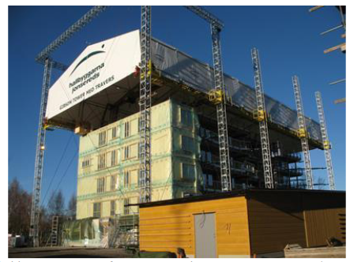
Presentation Title
Name of the presenter
Aura – timber protection:

Slide 12
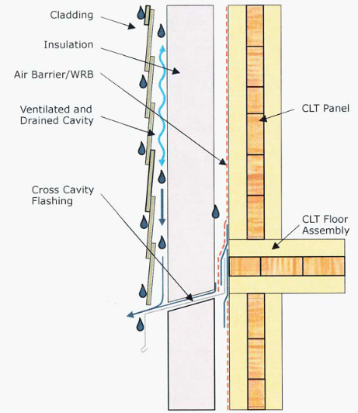
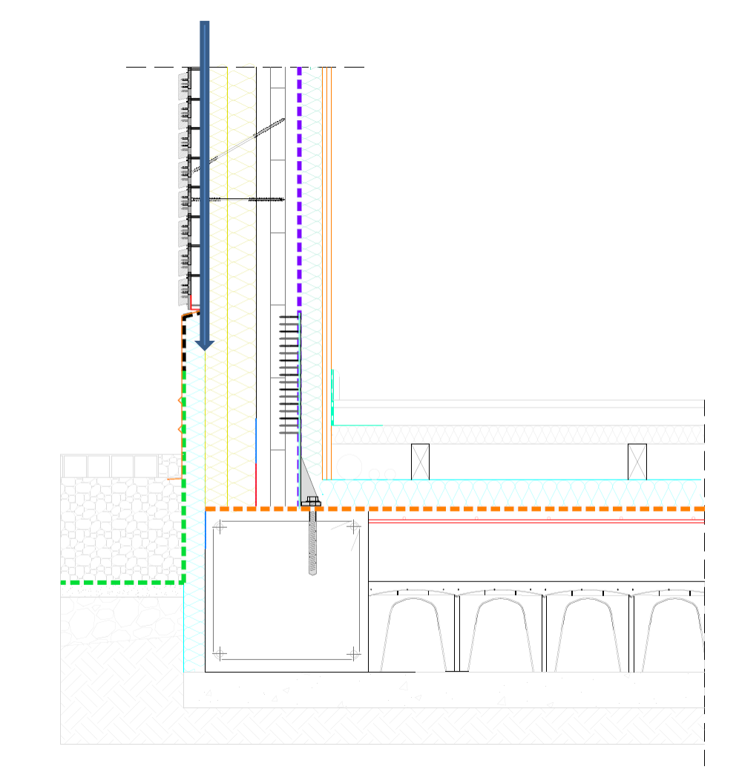
Presentation Title
Name of the presenter
Humidity – keep away from timber:

Slide 13
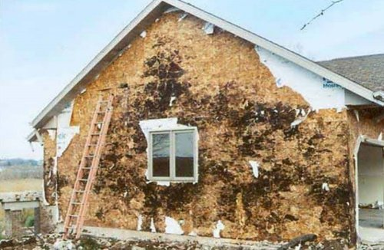
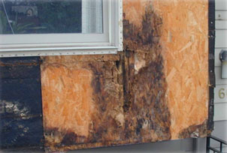
Presentation Title
Name of the presenter
Removing humidity:

Slide 14
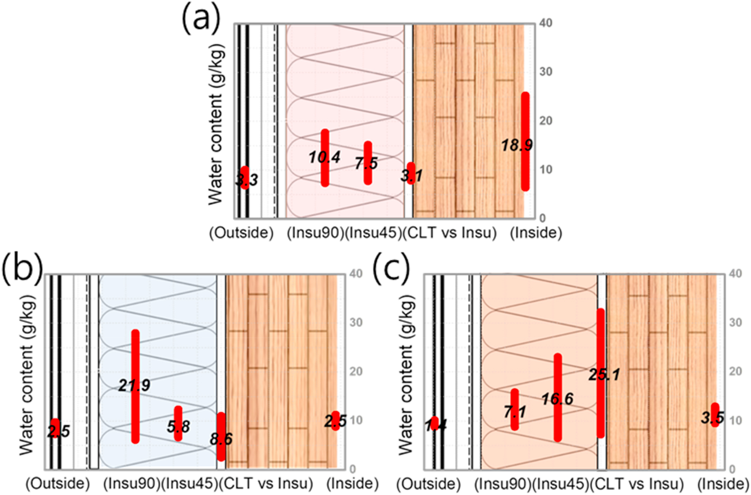
Presentation Title
Name of the presenter
Humidity – water content – thermal insulation:
XPS
Phenolic
Foam
Glass
Wool

Slide 15
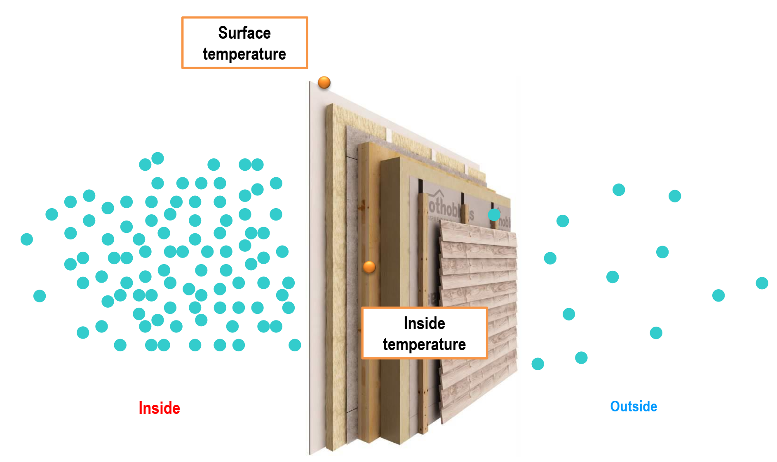
Presentation Title
Name of the presenter
Dew Point

Slide 16
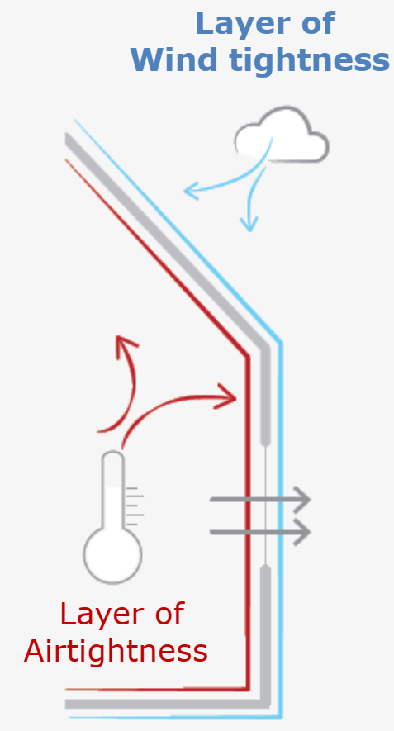
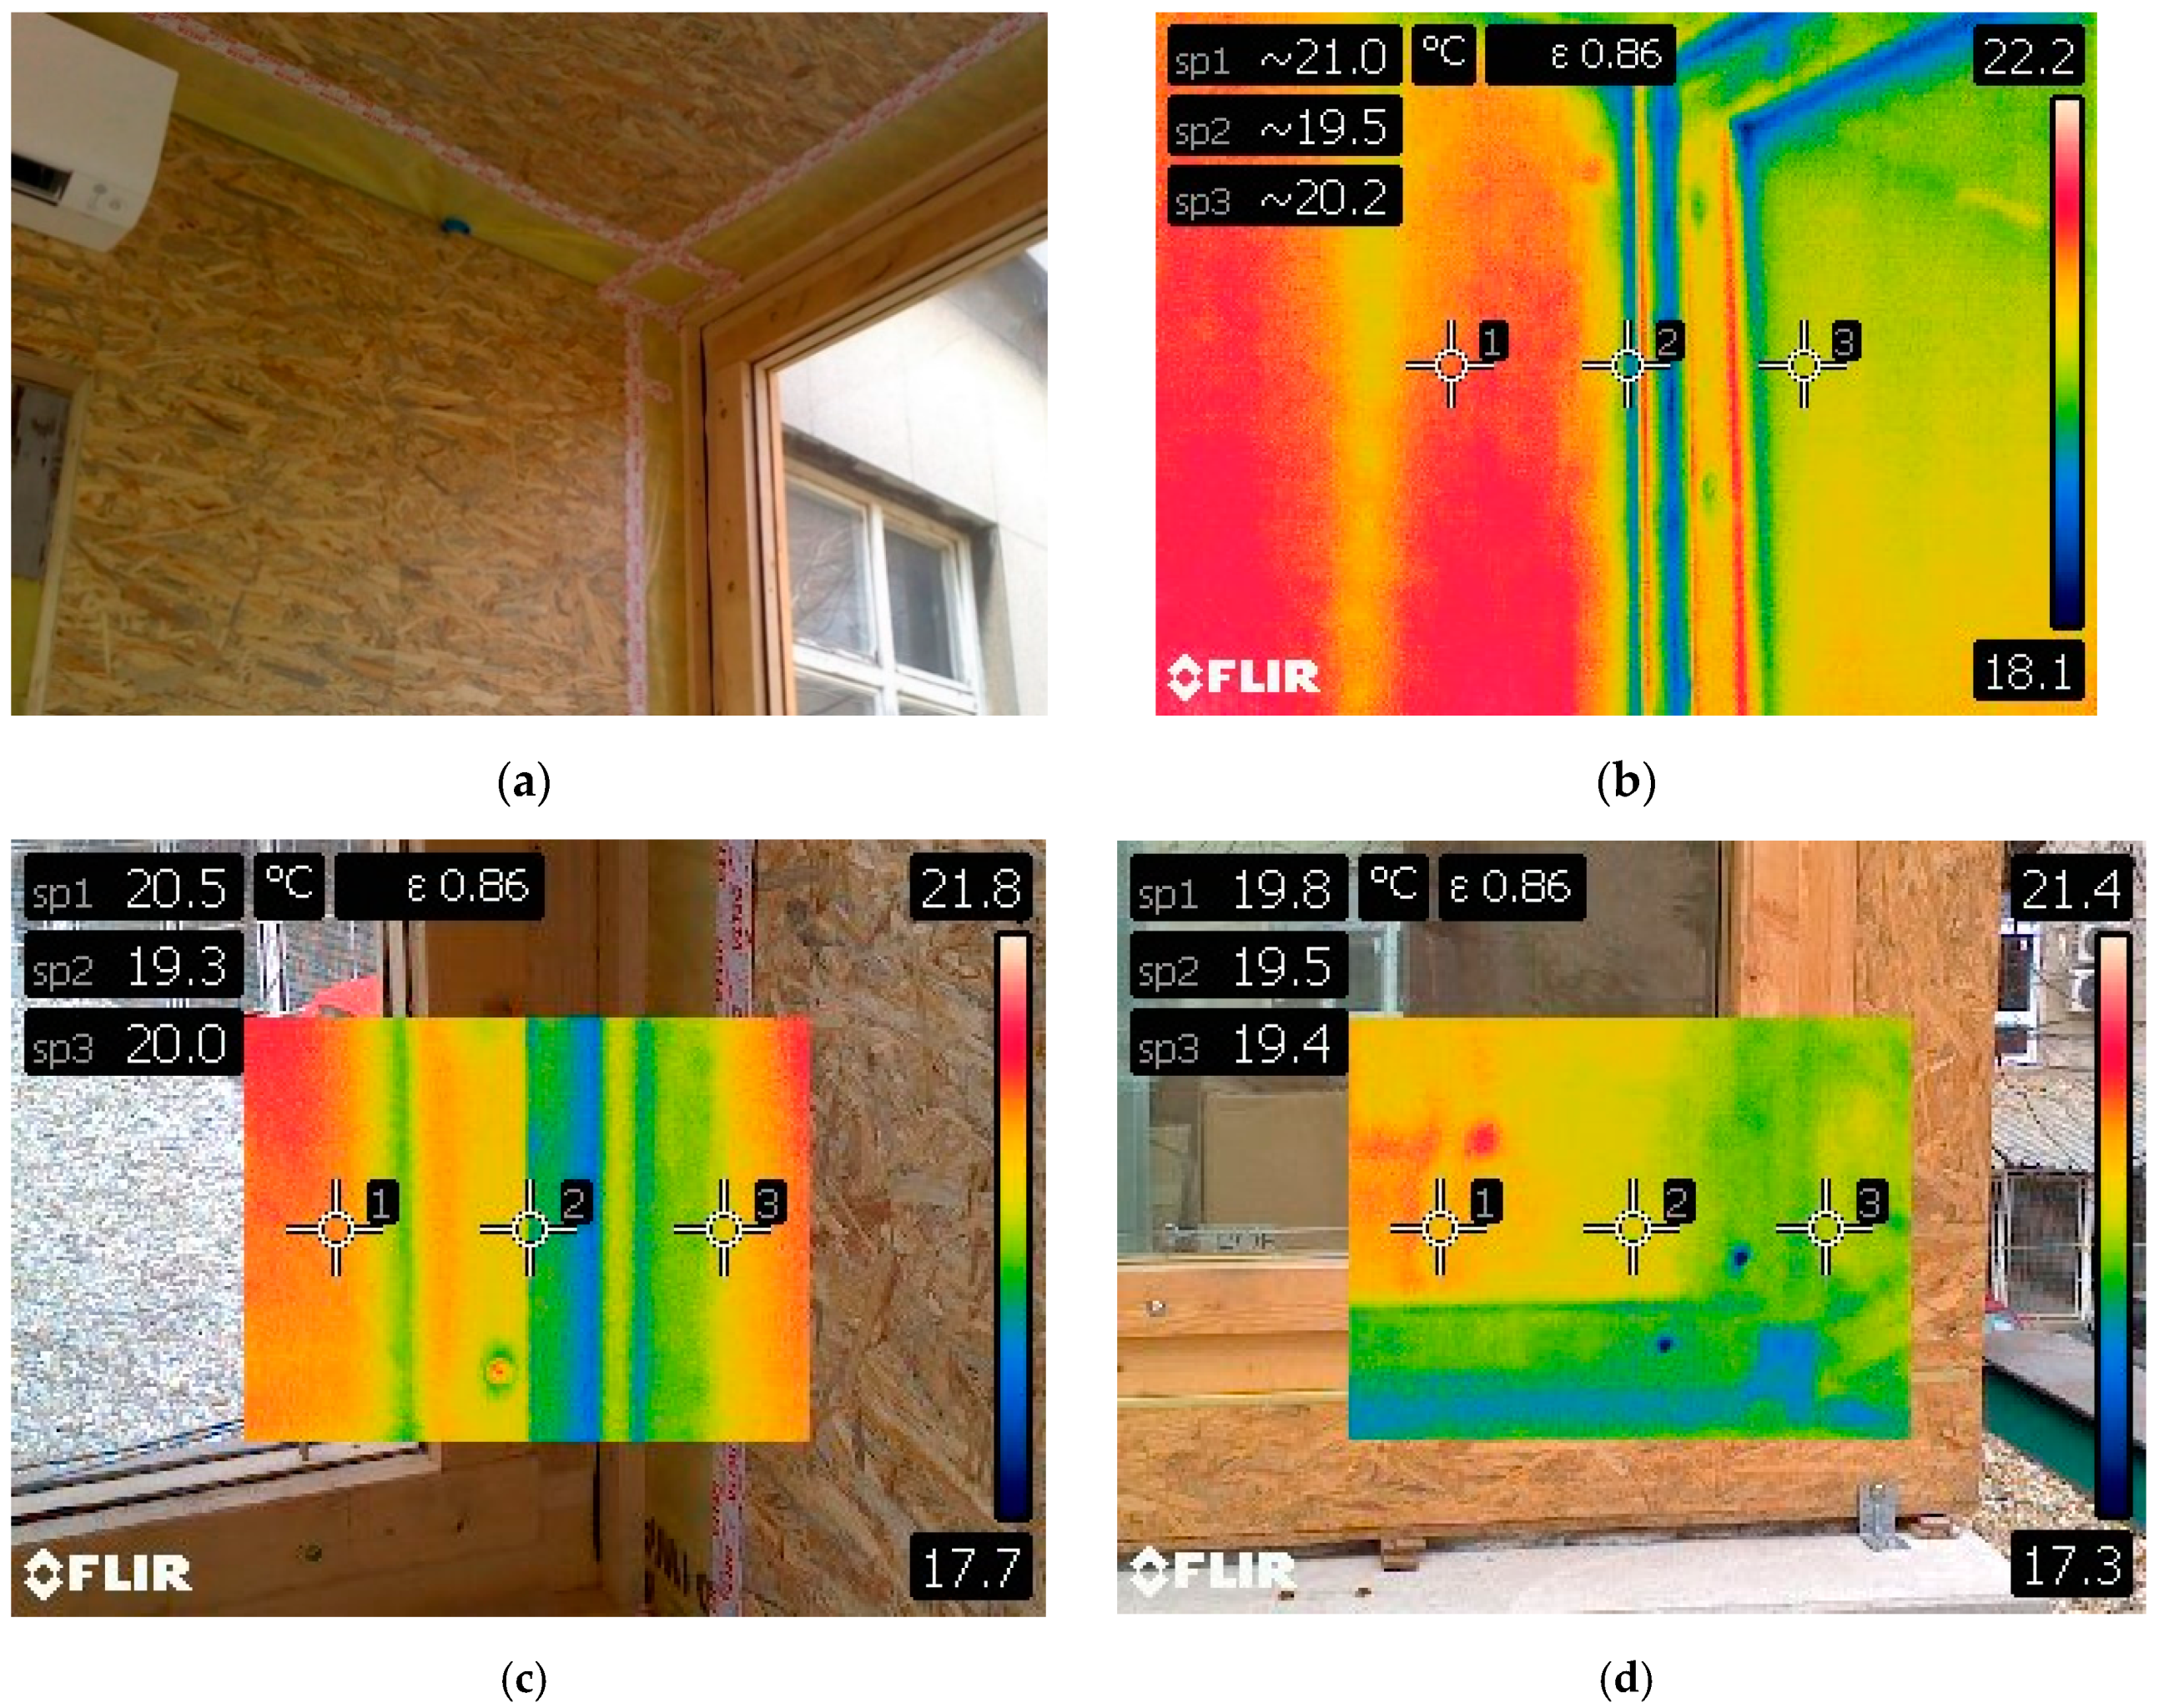
Presentation Title
Name of the presenter
Airtightness Windtightness

Slide 17
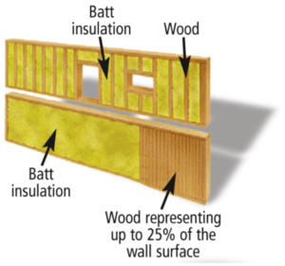
Presentation Title
Name of the presenter
Thermal issues:

Slide 18
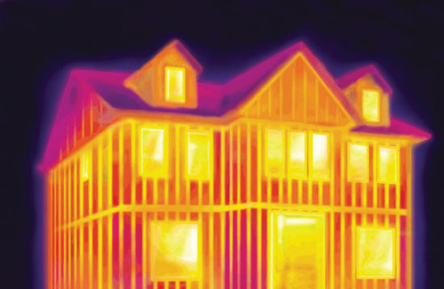
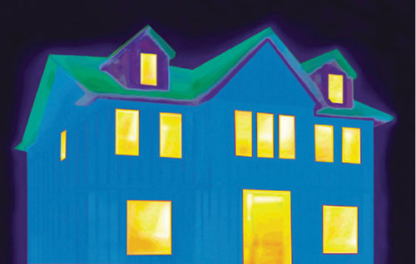
Presentation Title
Name of the presenter
Thermal issues:

Slide 19
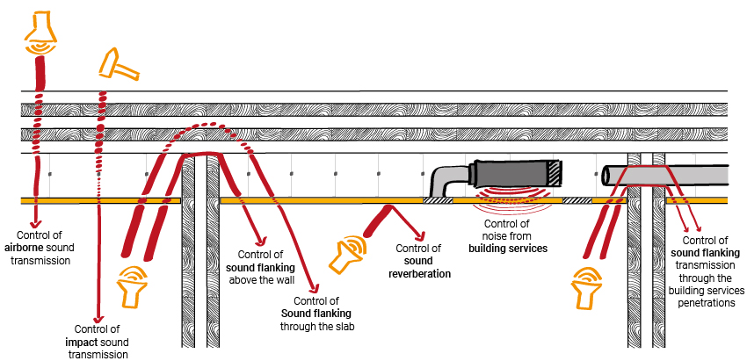
Presentation Title
Name of the presenter
Sound:

Slide 20
Presentation Title
Name of the presenter
Sound:

Slide 21
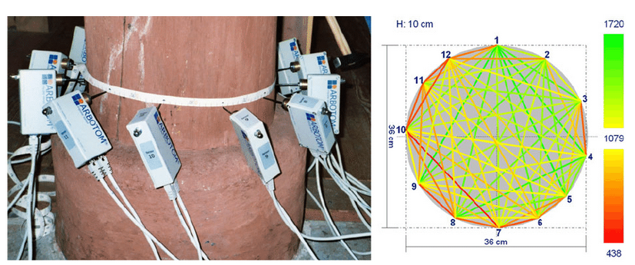
Presentation Title
Name of the presenter
Sound:

Slide 22
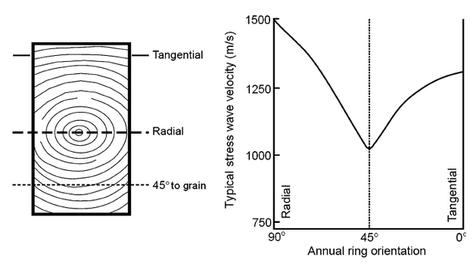
Presentation Title
Name of the presenter
Sound:

Slide 23
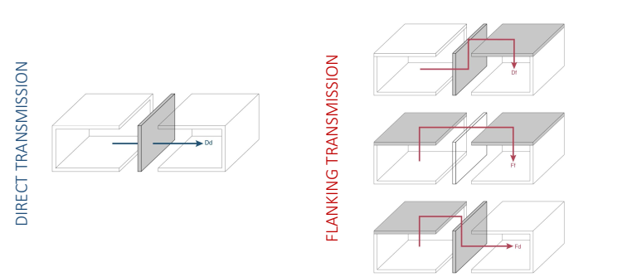
Presentation Title
Name of the presenter
Sound:

Slide 24
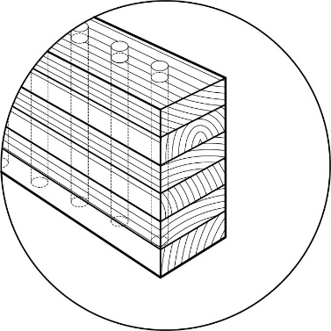
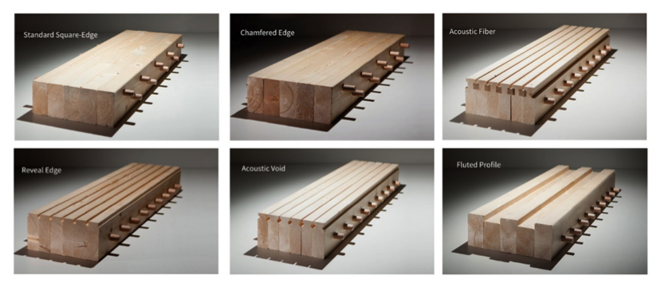
Presentation Title
Name of the presenter
DLT (dowels) -NLT (nais) (bar shaped material):n
No adhesive – mechanical fixing
For wood+concreto compositesctural components, ceiling elements, long-span structural components subject to heavy loads
Straight and curved beams with very stable forms and high visual quality

Slide 25
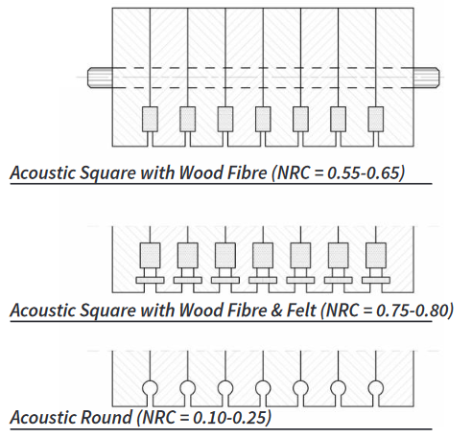
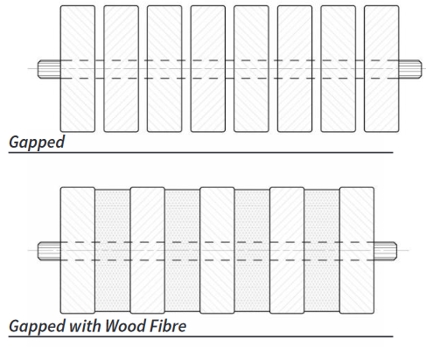
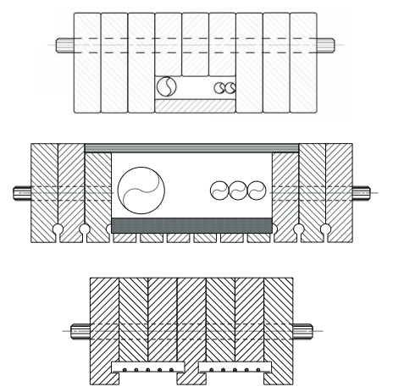
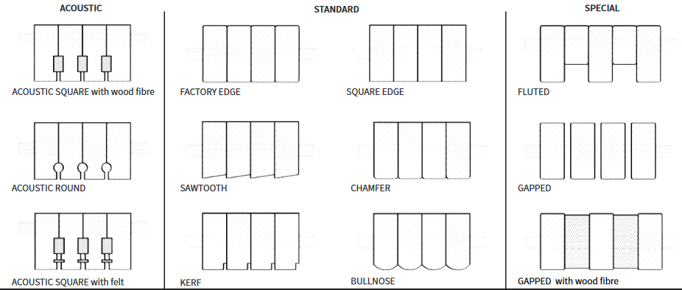
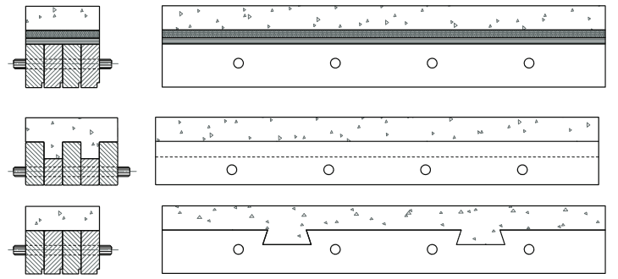
Presentation Title
Name of the presenter
DLT (dowels) -NLT (nais) (bar shaped material):n
heavy loads
Straight and curved beams with very stable forms and high visual quality
Sources: Structure Craft
25

Slide 26
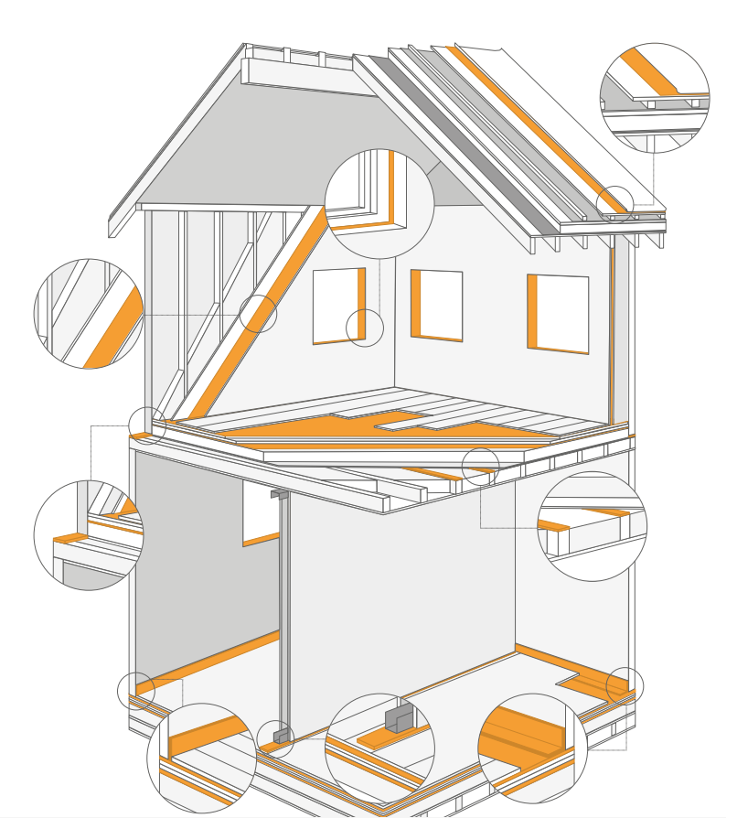
Presentation Title
Name of the presenter
Solving sollutions:

Slide 27
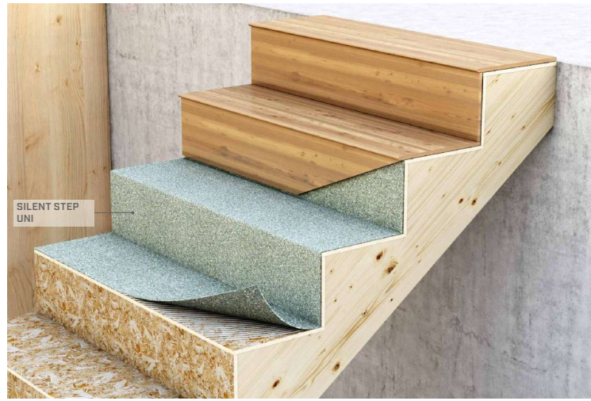
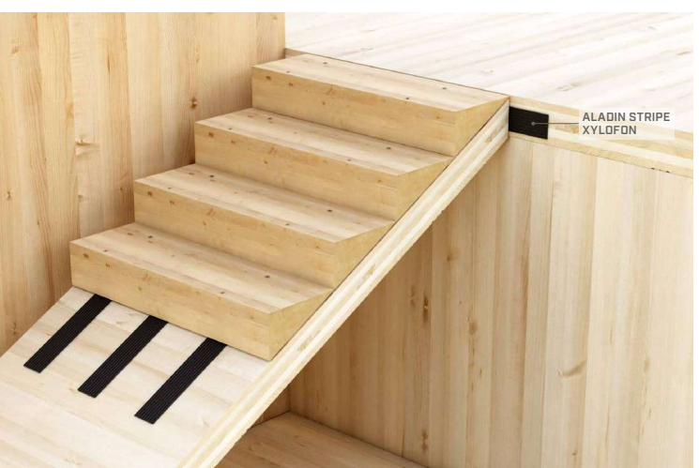
Presentation Title
Name of the presenter
Sound:

Slide 28
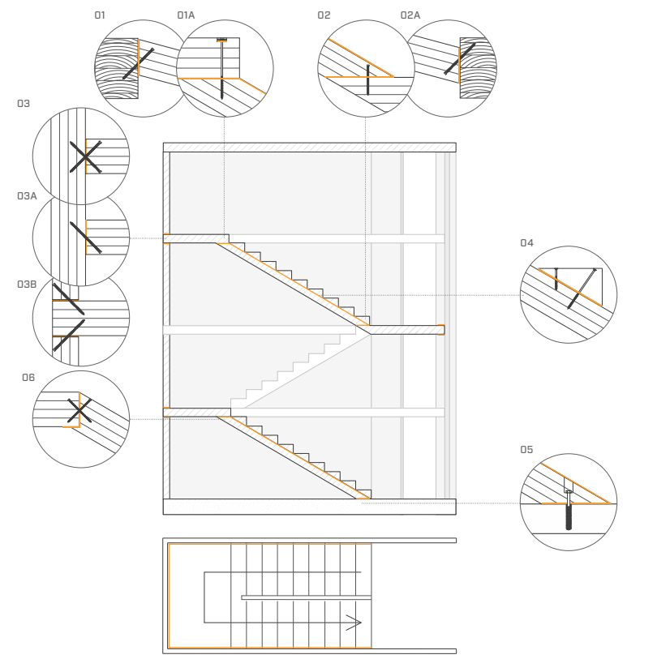
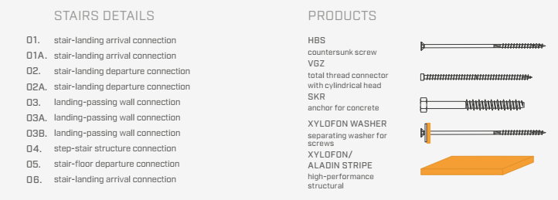
Presentation Title
Name of the presenter
Proofing:

Slide 29
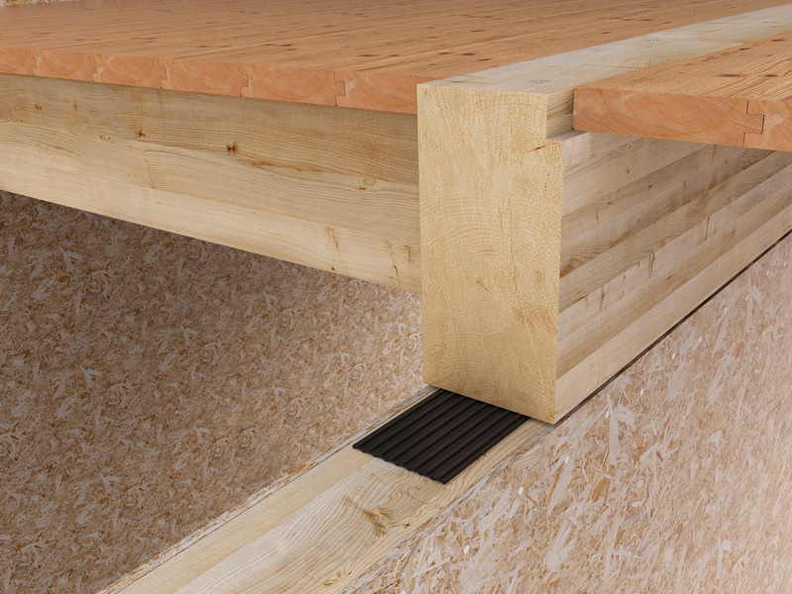
Presentation Title
Name of the presenter
Sound:

Slide 30
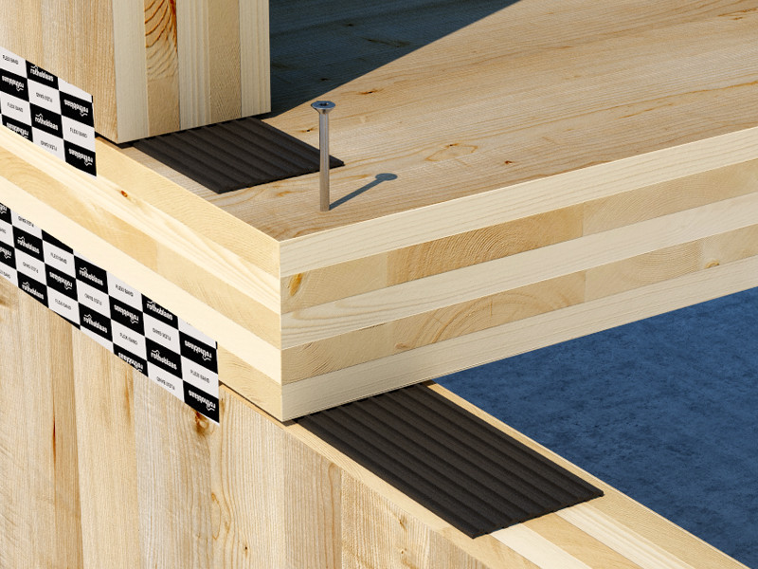
Presentation Title
Name of the presenter
Sound:

Slide 31
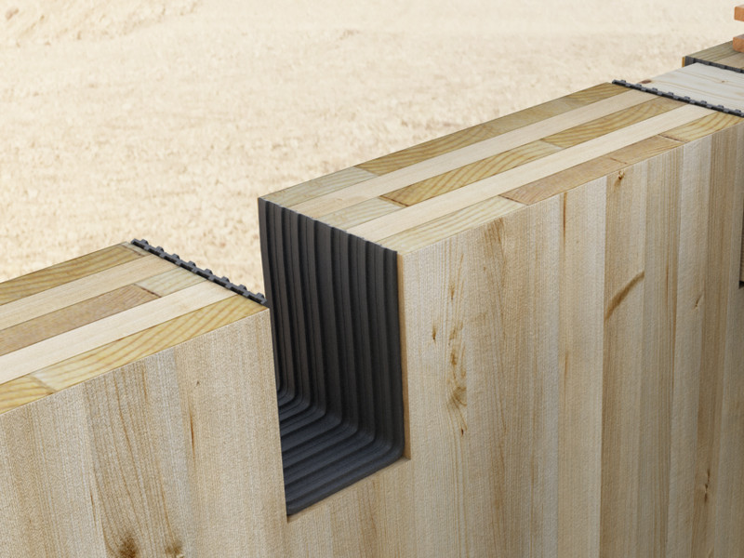
Presentation Title
Name of the presenter
Sound:

Slide 32
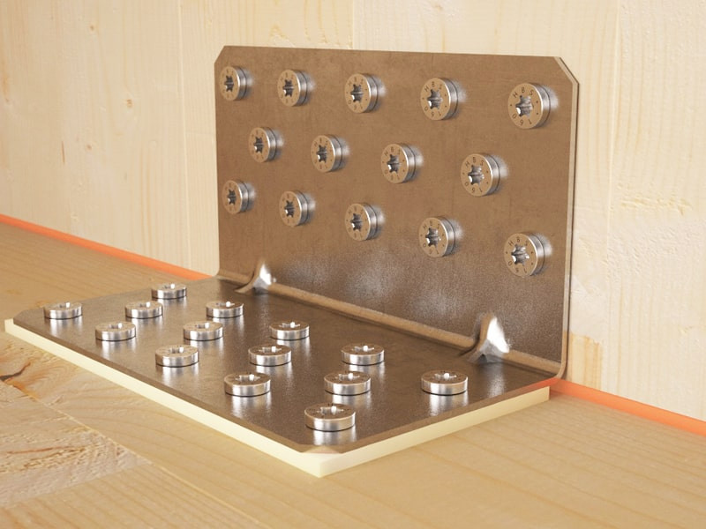
Presentation Title
Name of the presenter
Sound:

Slide 33
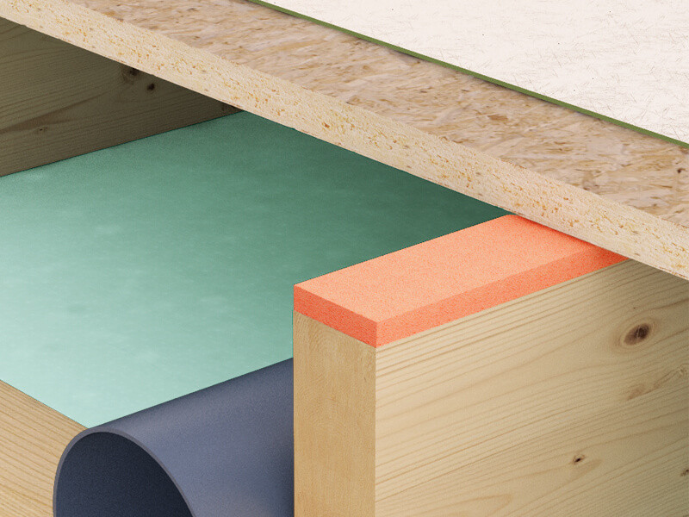
Presentation Title
Name of the presenter
Sound:

Slide 34
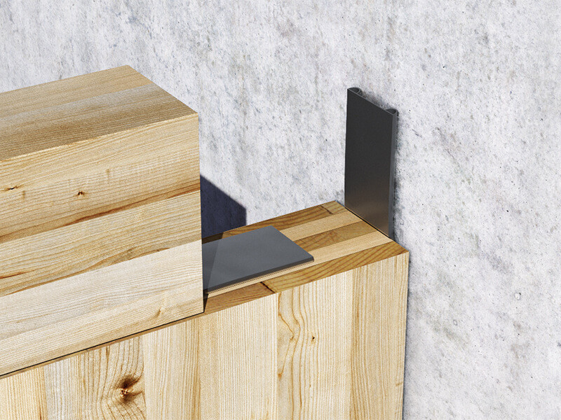
Presentation Title
Name of the presenter
Sound:

Slide 35
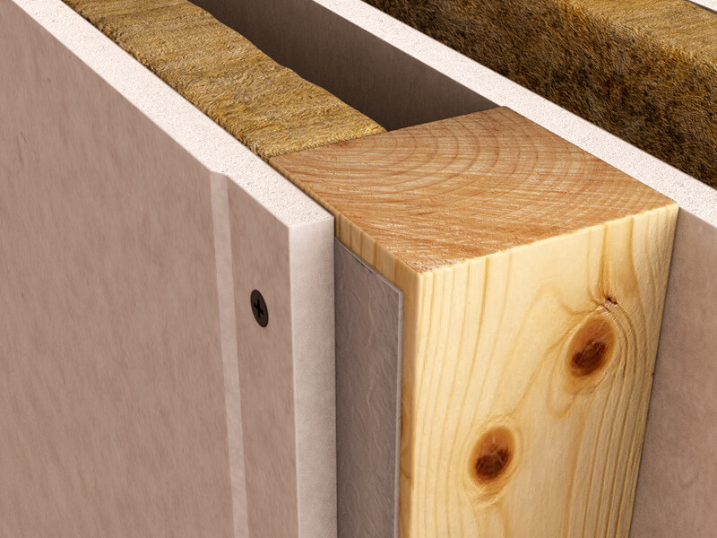
Presentation Title
Name of the presenter
Sound:

Slide 36
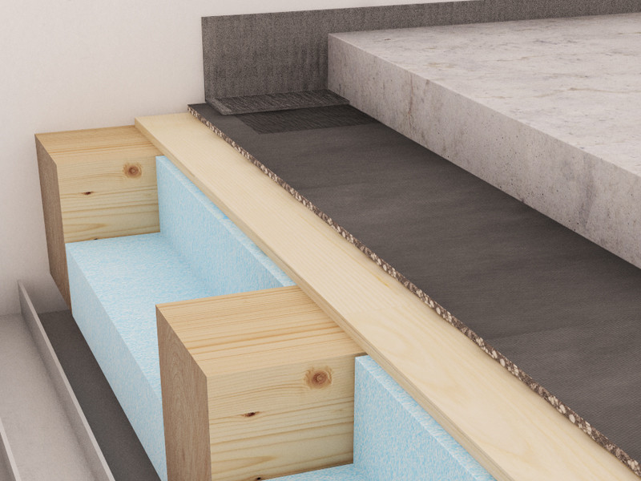
Presentation Title
Name of the presenter
Sound:

Slide 37
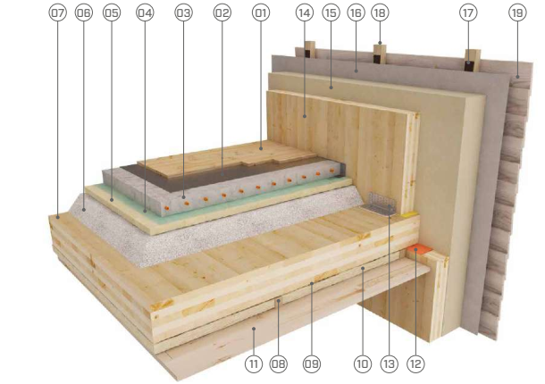
Presentation Title
Name of the presenter
Proofing:

Slide 38
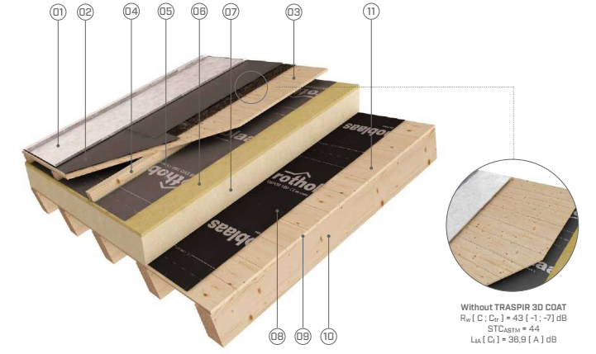
Presentation Title
Name of the presenter
Proofing:

Slide 39
Presentation Title
Name of the presenter
Proofing:

Slide 40
Presentation Title
Name of the presenter
Proofing:

Slide 41
Presentation Title
Name of the presenter
Proofing:

Slide 42
Presentation Title
Name of the presenter
Proofing:

Slide 43
Presentation Title
Name of the presenter
Proofing:

Slide 44
Presentation Title
Name of the presenter
Proofing:

Slide 45
Presentation Title
Name of the presenter
Proofing:

Slide 46
Presentation Title
Name of the presenter
Proofing:

