Slide 1

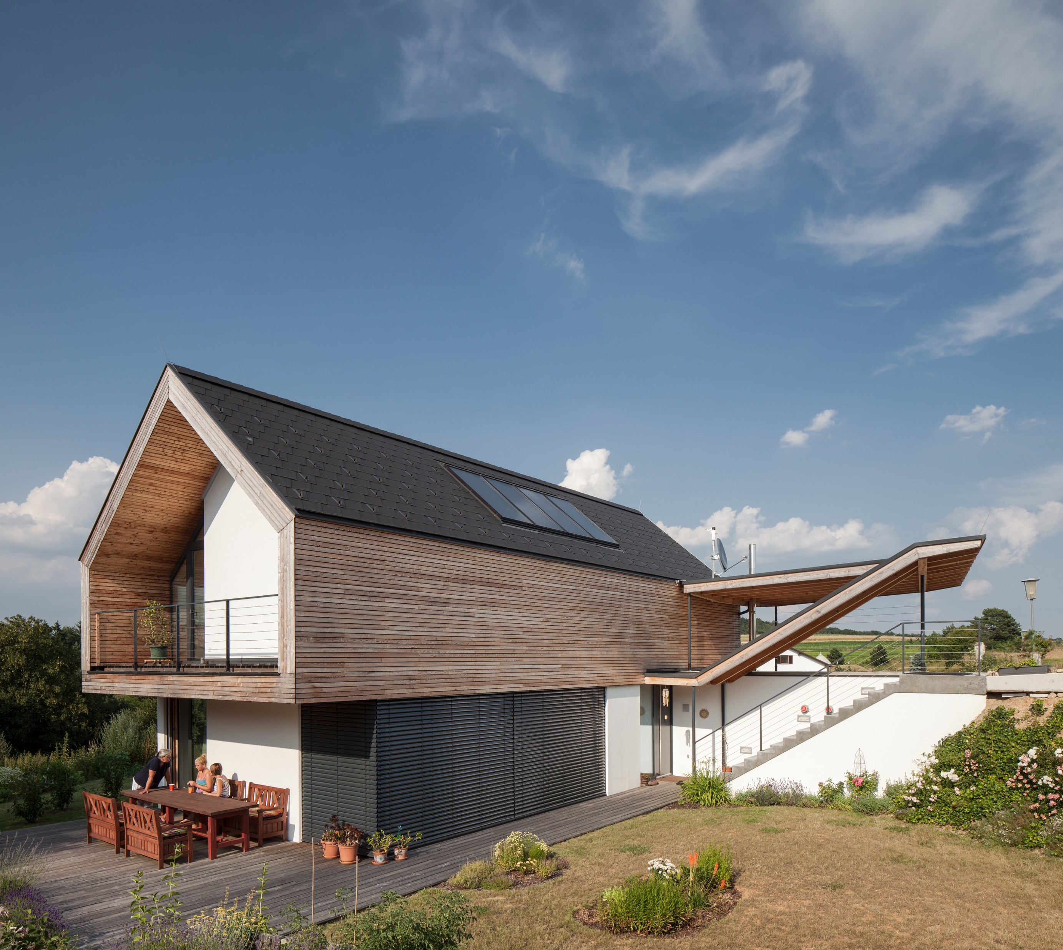







ERASMUS+ Strategic Partnerships For Higher Education
  SUSTAINABLE, HIGH-PERFORMANCE BUILDING SOLUTIONS IN WOOD
  2020-1-LV01-KA203-077513
Timber
Construction
02 Structural Systems
Elements (Building Mechanics)
di matthias doubek, bsc
civil engineer, master carpenter

Slide 2









about
about
education
  Higher Technical College for Timber Technologies – HTBLuVA Mödling
  BSc Civil Engineering and Construction Management - FH Campus Wien
  MSc Construction and completion of Large-scale International Projects- FH Campus Wien
  Postgraduate Student - Sustainable Engineering - University of Exeter (UK)
  Official qualification master carpenter
  Official qualification master builder
  Official qualification property developer
  Official qualification Civil Engineer
Awards
  FH Best Paper Award
  Nomination for Timber Construction Price Lower Austria
  National Steel Construction Austria
Berufspraxis
  5 years site engineer timber construction
  15 years Planning activity for architects and construction engineers
  (mainly planning, structural engineering, building physics and site management)
  11 years freelance lector
  9 years self employed as consultant, since 2016 konstrukt:ING – konstruktive Ingenieure GmbH

Slide 3
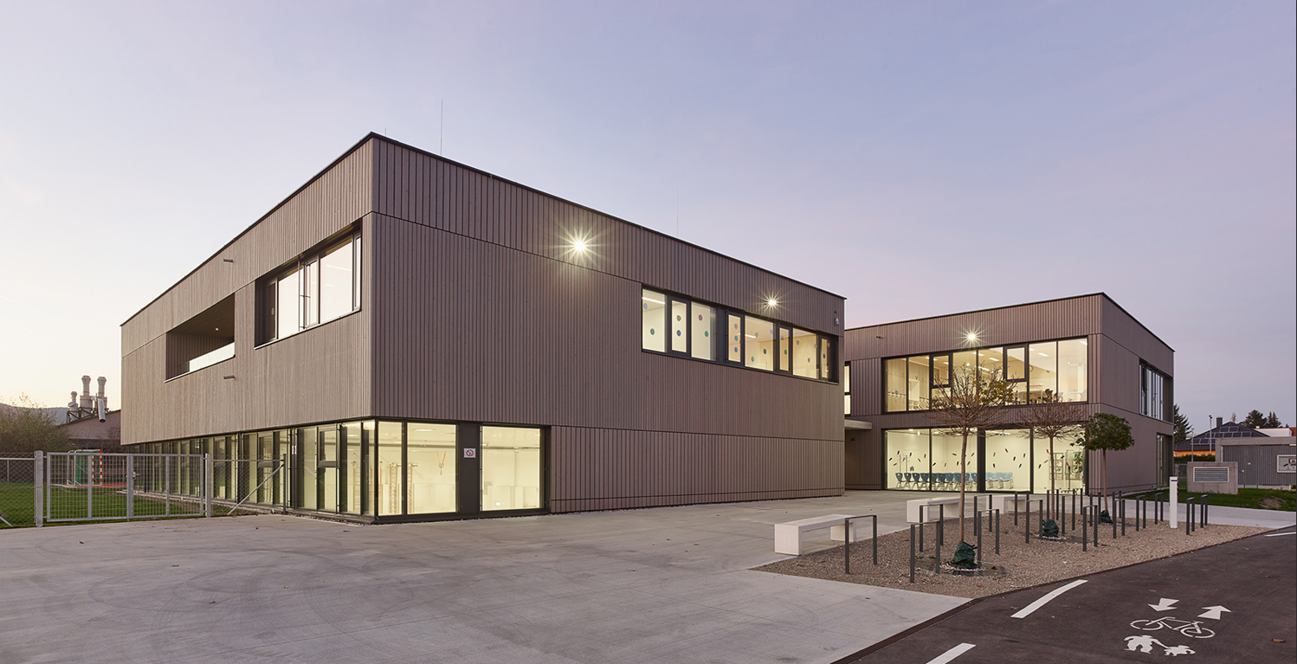
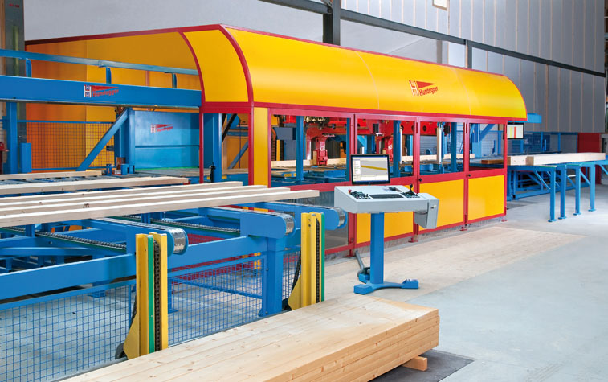
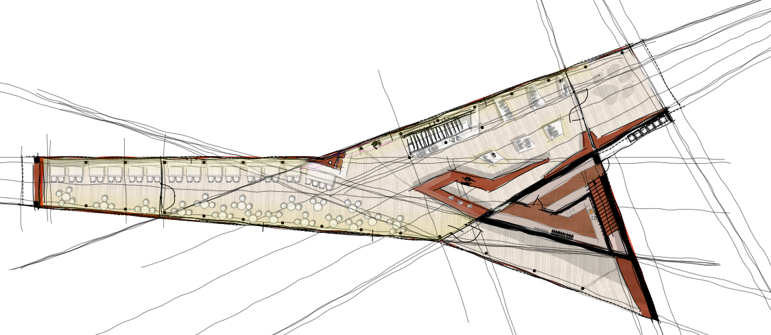
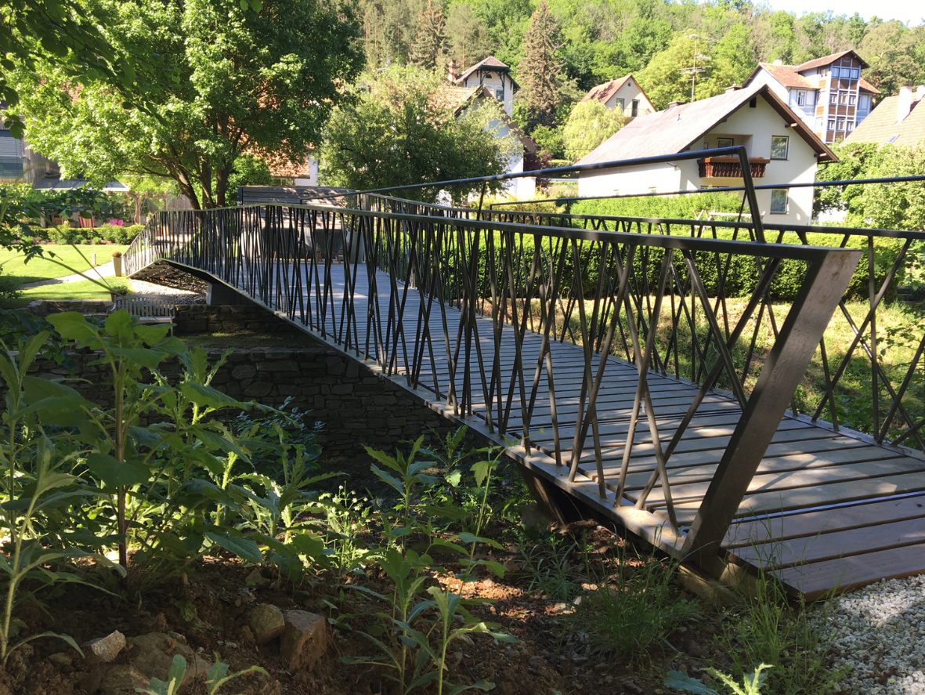
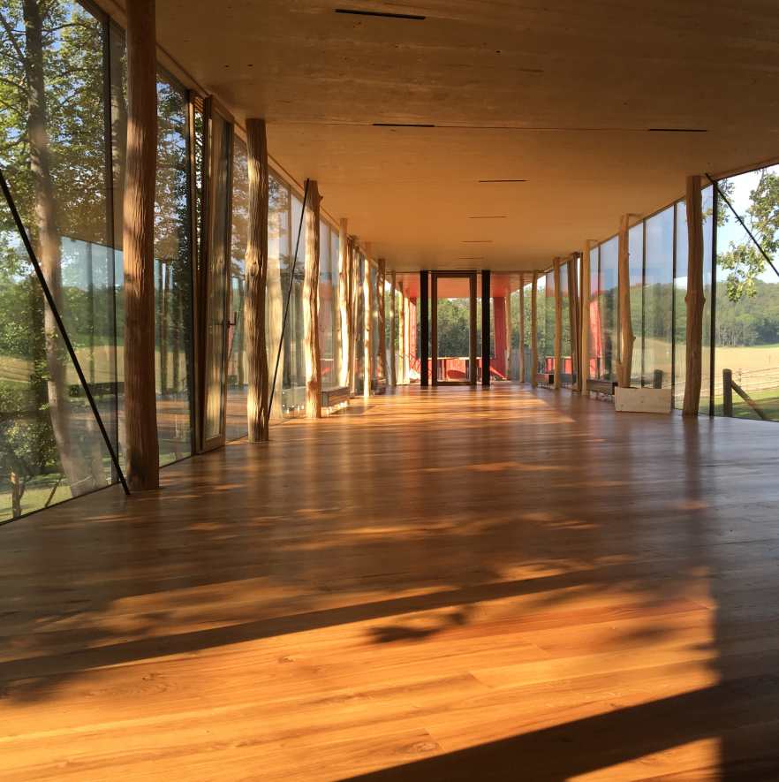
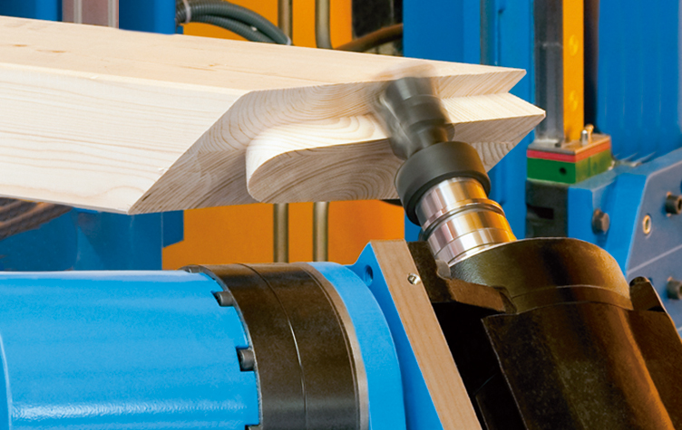
what we do

Slide 4
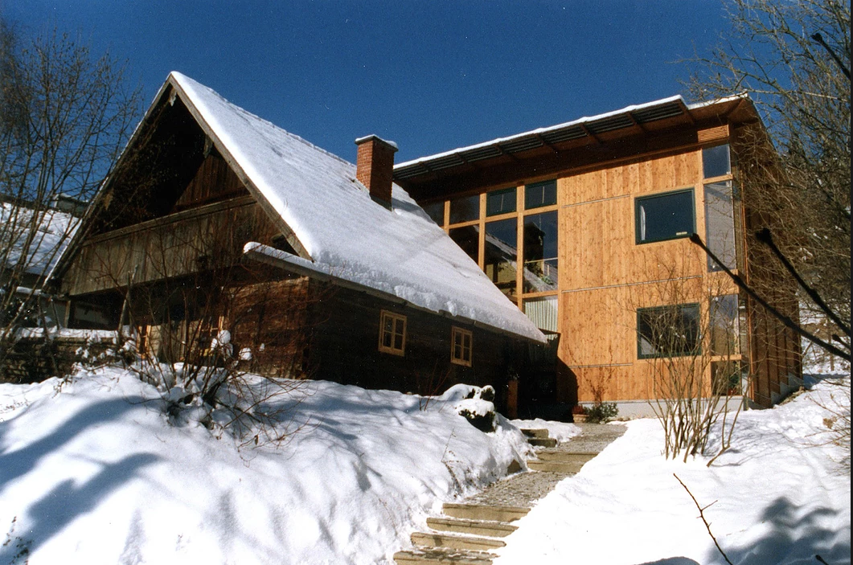
timber technology

Slide 5
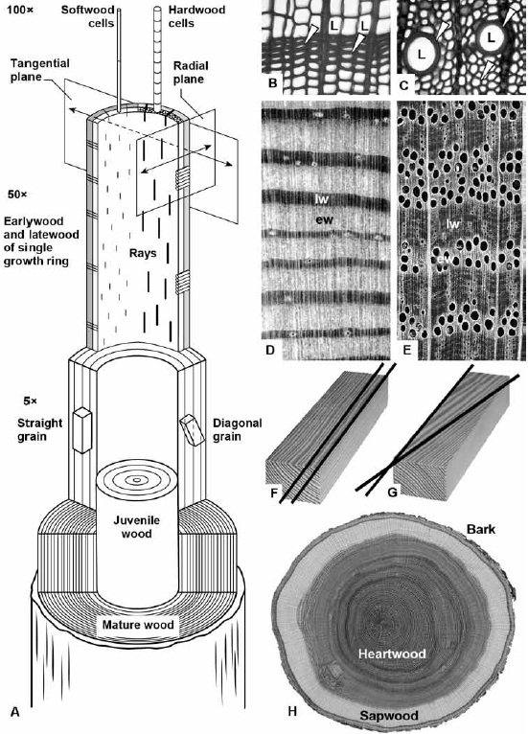
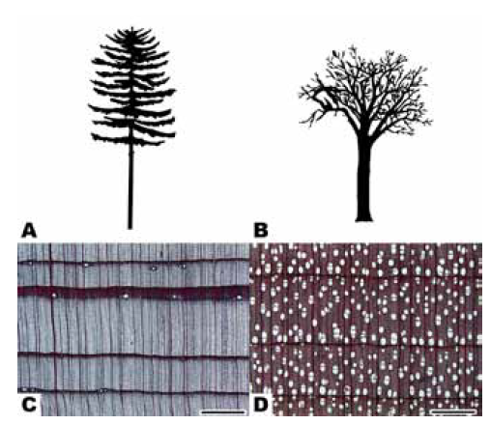
structure of wood

Slide 6
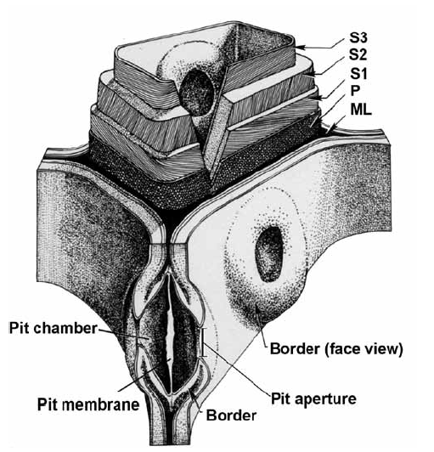
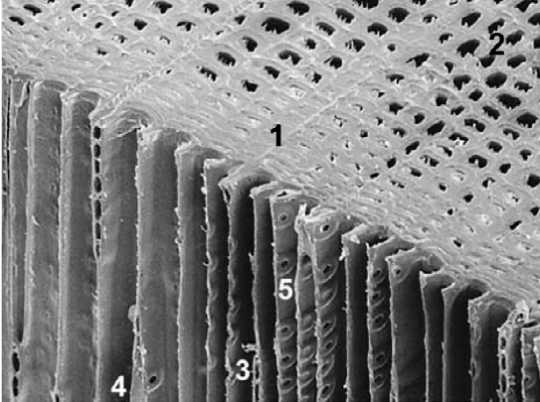
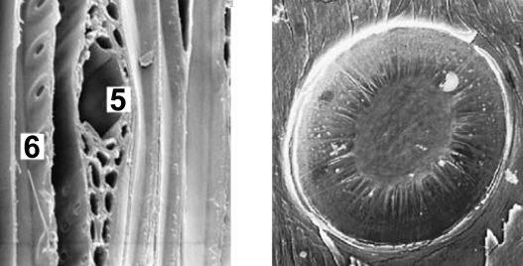
microscopic structure of softwood

Slide 7
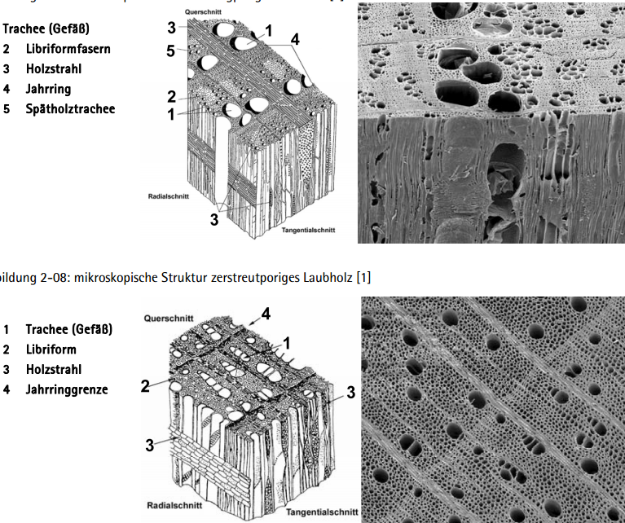
miroscopic structure hardwood

Slide 8
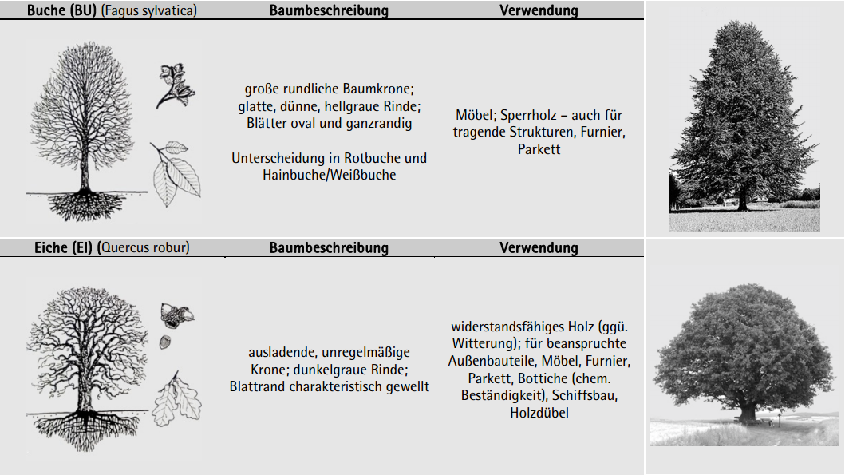
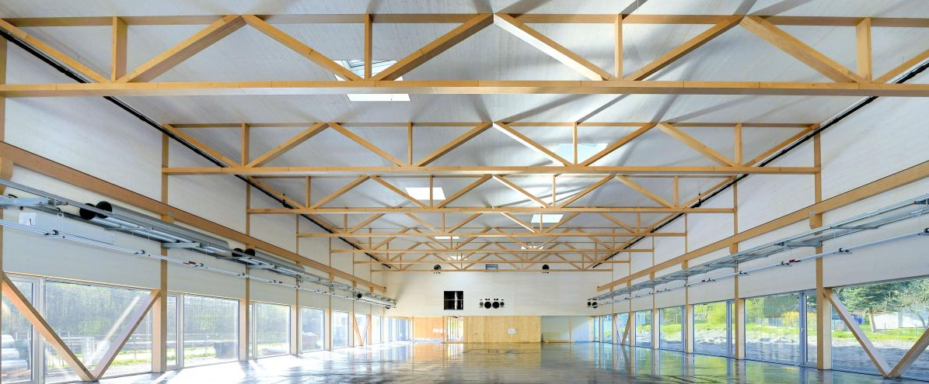
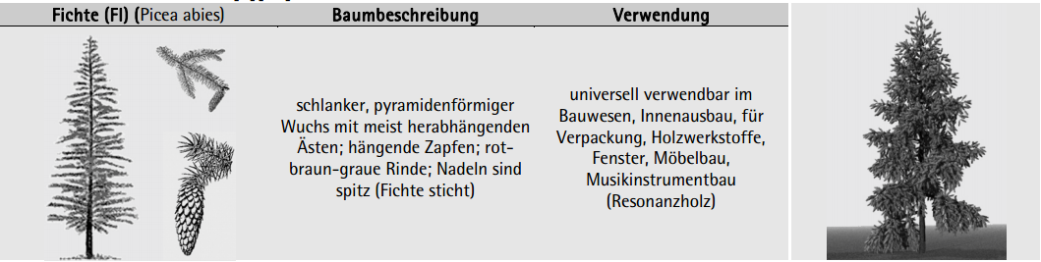
species of wood for timber constructions
Beech
used for
veneers
furniture
woodturner objects
e.g. „Baubuche“ (laminated veneer lumber, laminated into beams, boards and panels) - https://www.pollmeier.com/products/baubuche-about#gref
special properties
Easily to steam-bend
Oak
used for
shipbuilding
furniture
terrace
weathered and heavily exposed components
special properties
Very resistant to insect and fungal attack
Spruce
used for
Common buliding wood
(also glued laminated timber)
Pulpwood (paper uses)
special properties
Fast growing

Slide 9
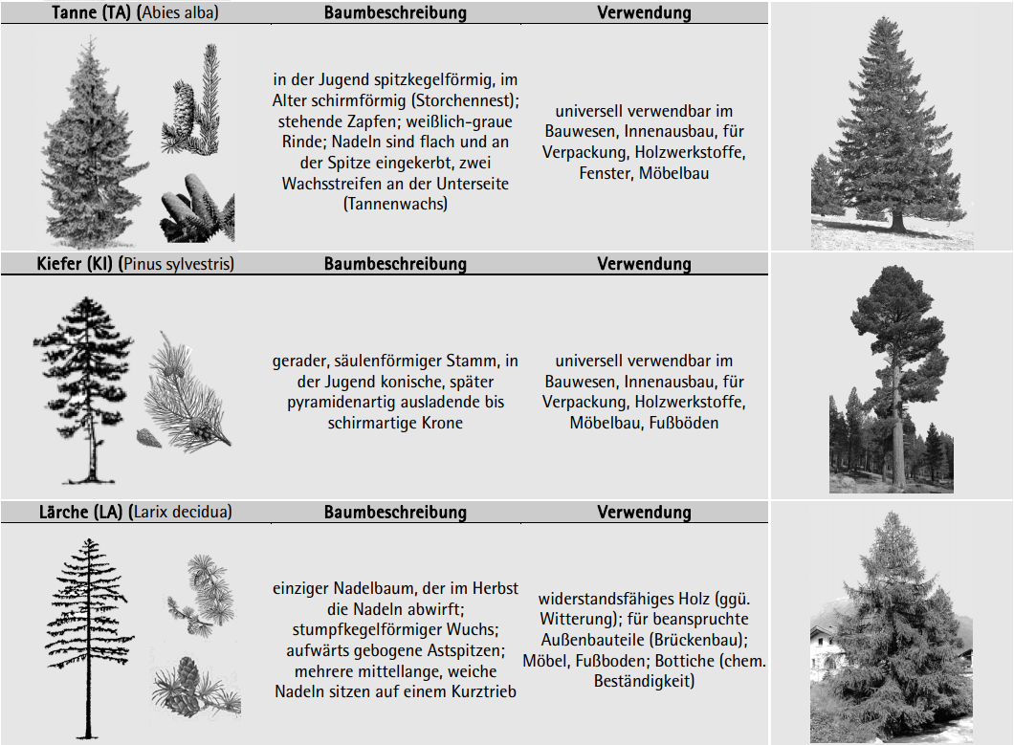
Species of wood for timber constructions
silver fir
used for
Common buliding wood
(also glued laminated timber)
furniture
special properties
Fast growing
pine
used for
Lumber and construction
(also glued laminated timber)
furniture
special properties
Blue fungus
larch
used for
Common buliding wood, esp. Outdoor
furniture
terrace
(small) windows
Furniture
special properties
Durable qualities

Slide 10
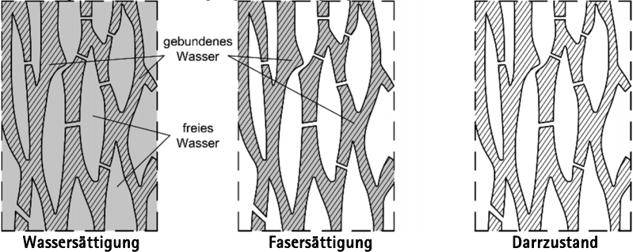
physics – wood moisture equilibrium
Bound water
free water
Water saturation
fiber saturation
Total dryness

Slide 11
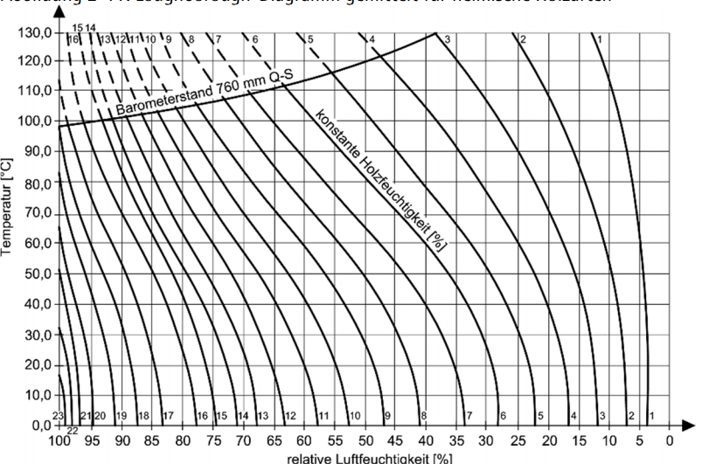
Hygroskopic balance

Slide 12
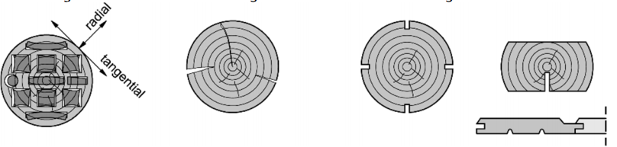
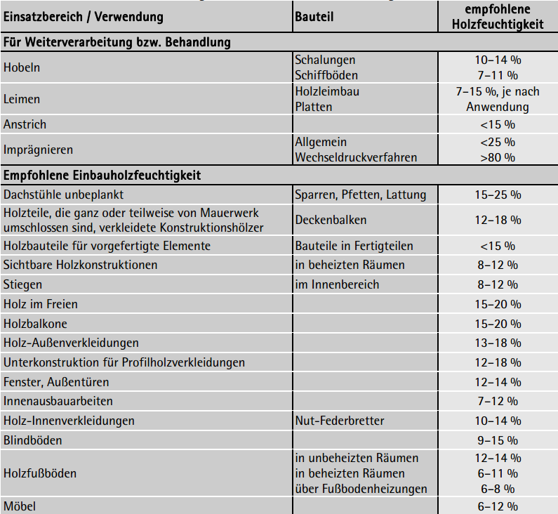
dimensionsstabilisierende maßnahmen

Slide 13
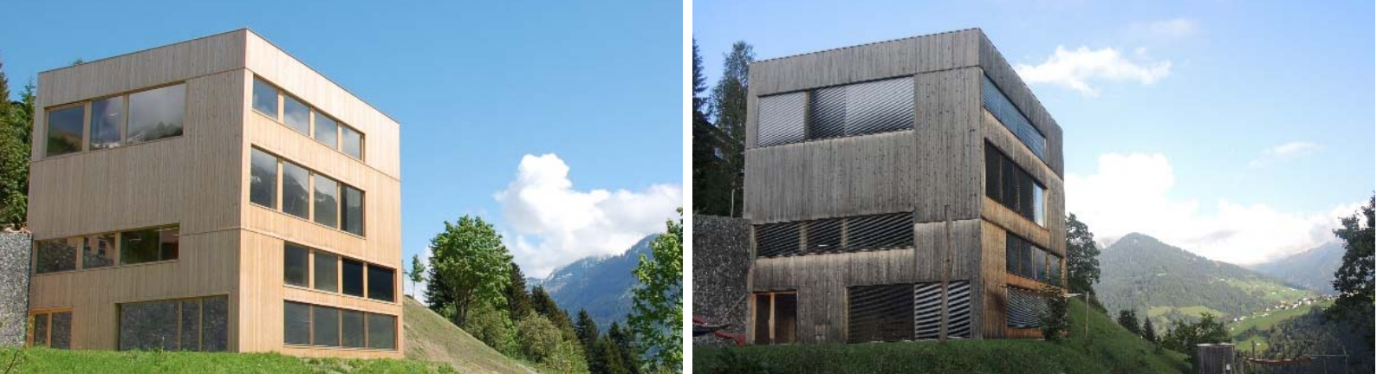
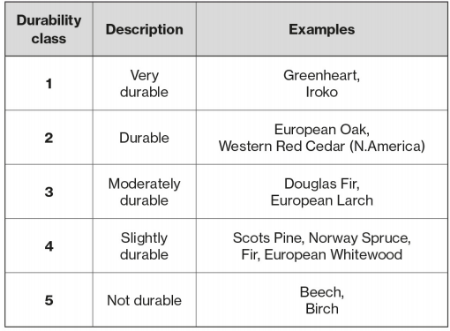
Natural durability
https://www.structuraltimber.co.uk/assets/InformationCentre/eb1.pdf

Slide 14
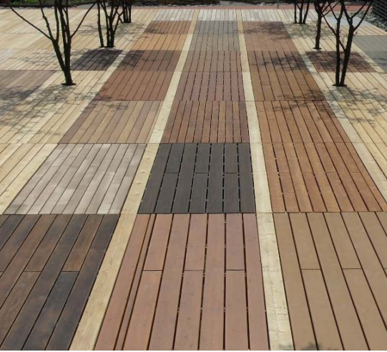
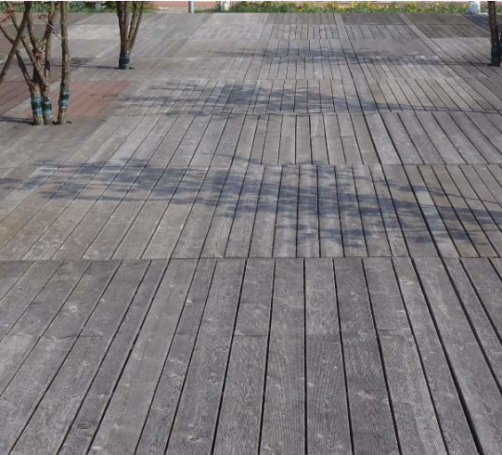
Natural durability

Slide 15
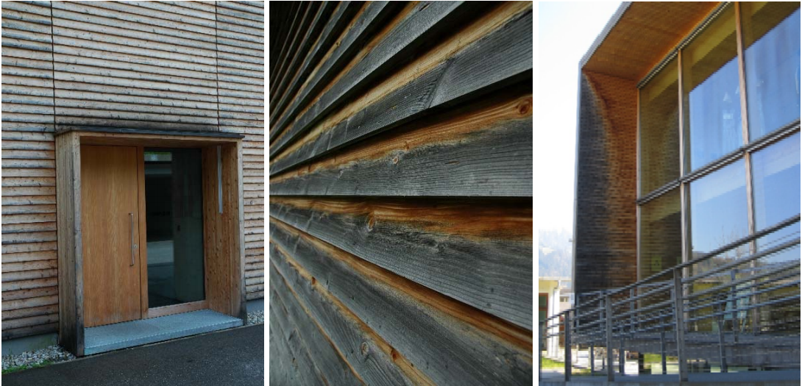
Constructive wood protection

Slide 16
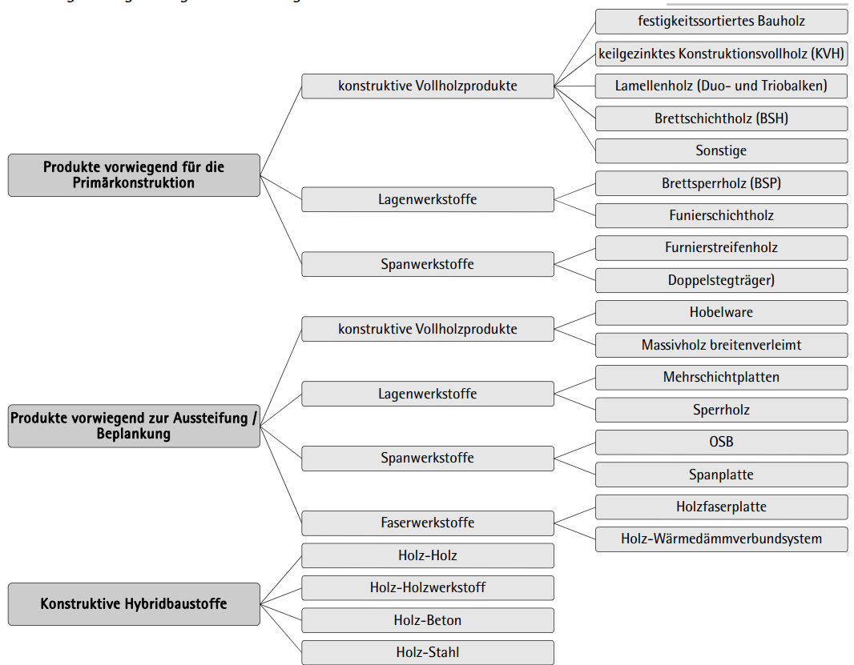
baustoffe und produkte

Slide 17
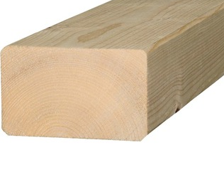
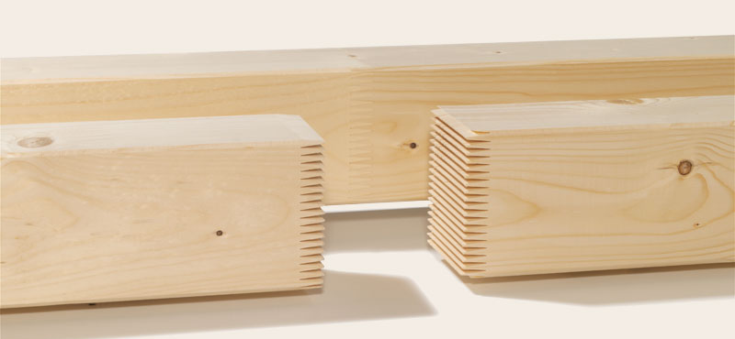
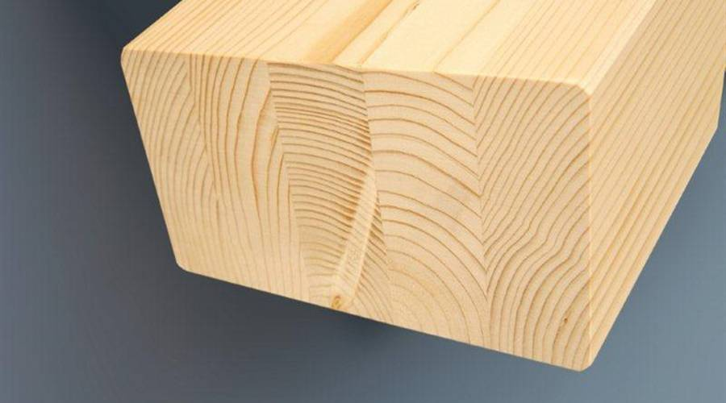
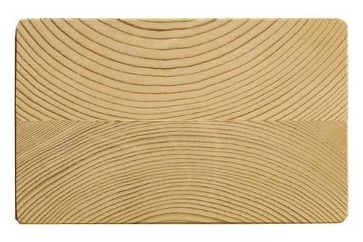
Constructive solid wood

Slide 18
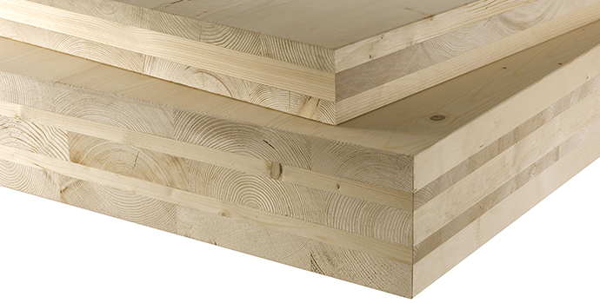
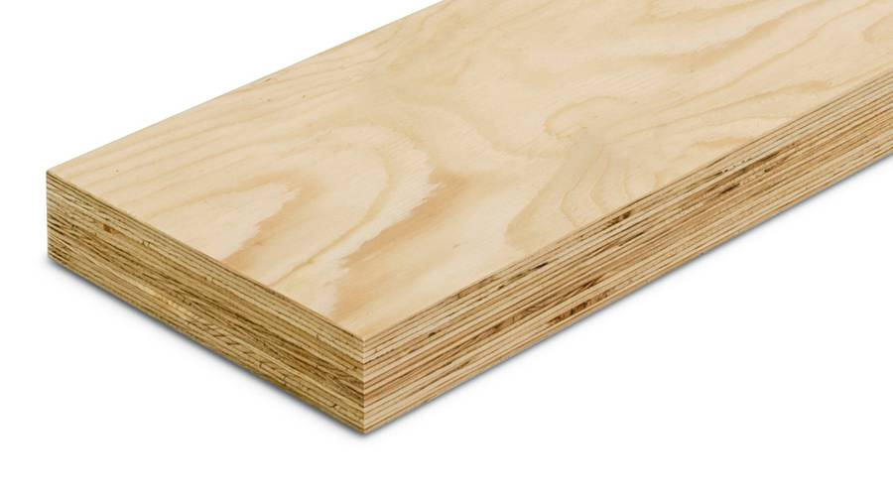
Layer material cross laminated timber / laminated veneer timber

Slide 19
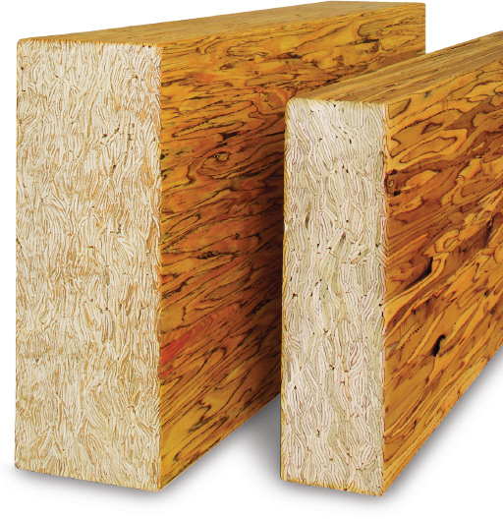
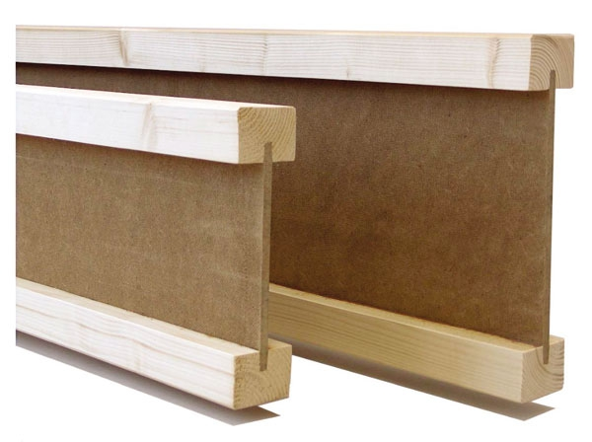
Chip material / i-beam

Slide 20
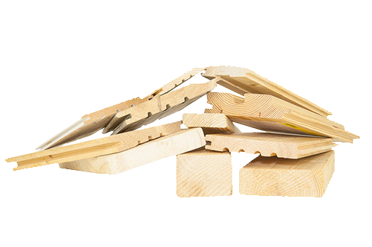
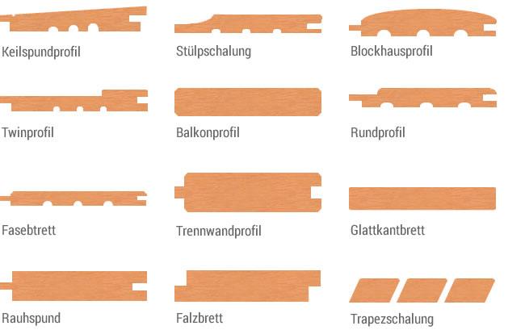
Planed goods

Slide 21
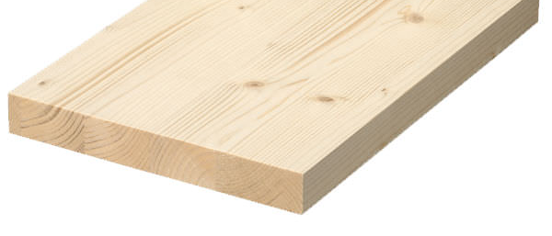
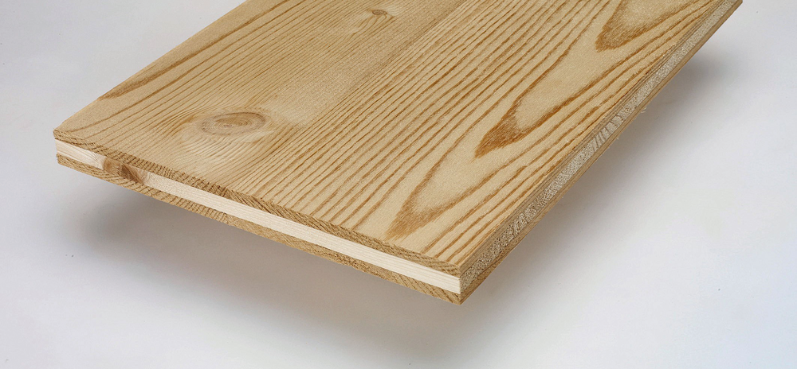
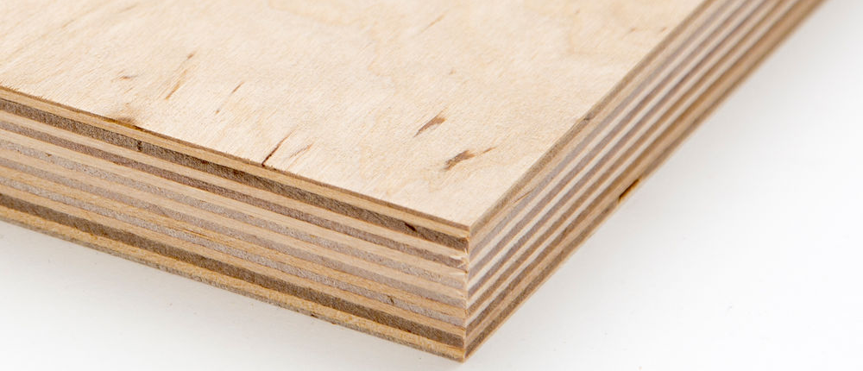
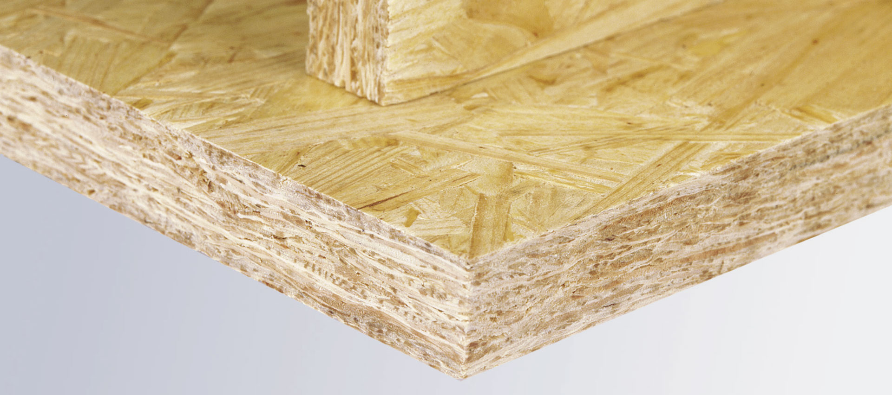
Solid wood wide glued / three-layer board plywood / osb (oriented strand board)

Slide 22
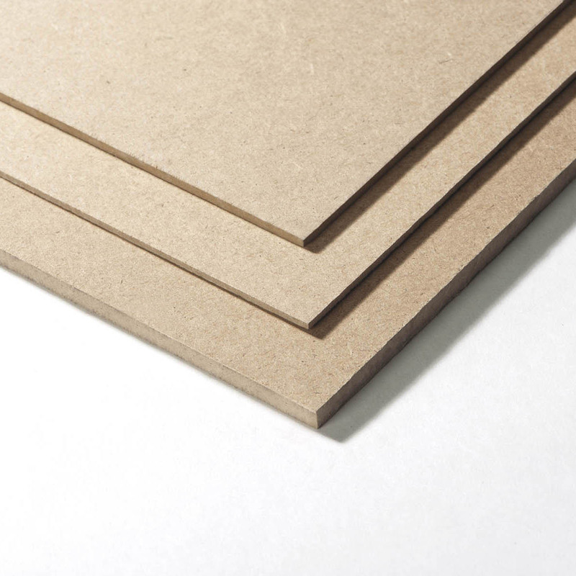
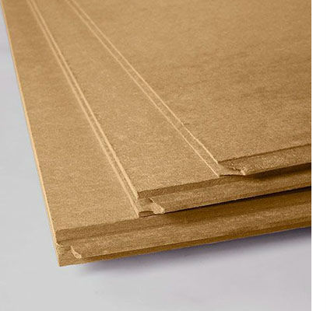
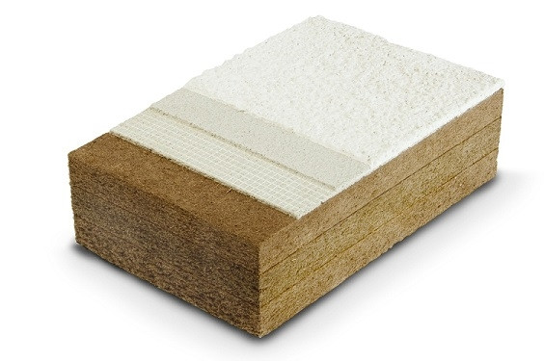
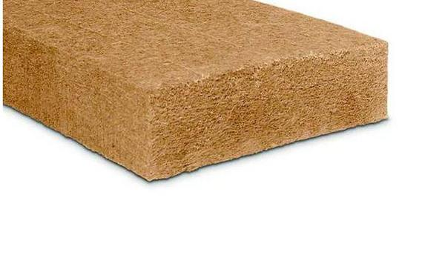
fiberboards - hdf / mdf / ldf

Slide 23
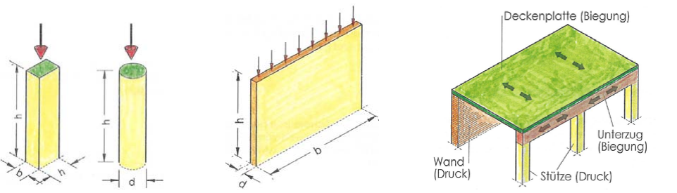
Load dissipation

Slide 24
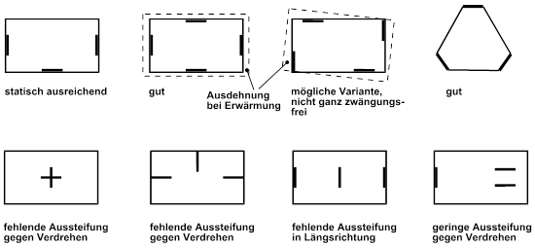
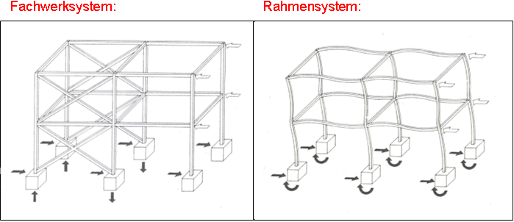
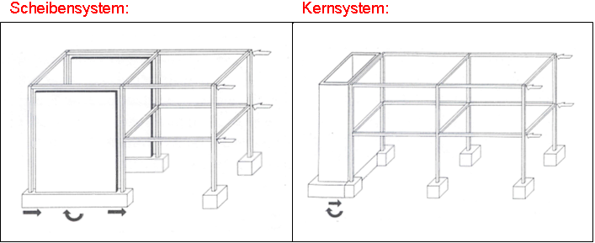
horizontal bracing
OK
GOOD
GOOD
GOOD
Lack of strengh against twist
Lack of strengh against twist
Lack of stiffening in longitudinal direction
Lack of strengh against twist
Truss system
Frame system
disc system
core system

Slide 25





connections

Slide 26
carpentry connection
Blunt bump
Half lap
Mortise and tenon
Cross lap joint

Slide 27
carpentry connection
Dovetail crossed lap
Face staggered joint
Notched housing
Obelique thrust joint with notched housing
Halved crossing joint

Slide 28

engineering wood joints
mechanical connection
(screws, sheets, steel parts)
force
Formfitting connection
glued connection
shift

Slide 29








Smooth nails
pin shaped connectors
But nails
brackets
Nail plates
dowel
Self driling dowels
screws
bolts
Fitting bolts

Slide 30





Pin-shaped connetions

Slide 31






Angle connector
System connectors
Perforated
steel strips
Beam shoe
Glued
connections
Beam girder
Support base
Tension rod systems

Slide 32
Examples system connectors / sources
www.strongtie.de/products
www.rothoblaas.de/produkte/verbindungstechnik
www.pitzl-connectors.com/produkte
www.halfen.com/at/780/produktbereiche/bau/stabsysteme/detan-stabsystem/einfuehrung/
www.sfs.ch/de/Holzbefestiger
www.sihga.com/
www.schrauben.at/schraubenwelten/produkte/uebersicht
www.sherpa-connector.com

Slide 33


elements

Slide 34

research (elements)

Slide 35


types of load bearing timber structures
Timber constructions systems (esp. housing)
cross laminated timber construction
timber frame construction
outside
inside
outside
inside
insulation
insulation
load bearing
load bearing
load bearing
load bearing
Rod-shaped (across the grain)
Flat-shaped
Rod-shaped
Flat-shaped (stiffening)
Block-construction
Half timberd construction (truss)
Timber frame construction
Cross laminated constr.

Slide 36

Level of prefabrication
- Assembly of individual parts / Assembly of elements
Parts of the load-bearing structure and at least one layer are pre-assembled
The elements are insulated an planked on both sides, empty conduits (e.g. hose) for the building systems may be inserted
Elements including fixtures such as doors and windows, glazing are prefabricated
Elements including the facade structure, outer and inner cladding / facade are preassembled

Slide 37

Types of construction - examples

Slide 38


basic layering in timber construction
1 – Facade
2 – Shell construction / -element
3 – Inner panneling
1 – Floor construction
2 – Shell construction / -element
3 – Ceiling soffit

Slide 39

examples - research

Slide 40

example exterior wall - carpentry

Slide 41

example exterior wall - industry

Slide 42

example exterior wall – cross laminated

Slide 43


example interior wall

Slide 44


example compartment wall (between flats)

Slide 45


example intermediate floor

Slide 46

example intermediate floor (between flats) wohneinheiten)

Slide 47

Example pitched roof

Slide 48


digression - rules for a flat roof
Hygro-
thermic-Simulation
Technical brochures (e.G. dataholz.eu
7 golden rules for flat roofs
(without specific analysis)
(in the normal climate according to UNI EN 15026)
The roof has a slope ≥ 3% in “undeformed” configuration or ≥ 2% in “deformed” configuration under load
Dark-colored (radiation absorption ≥ 80%), with no shade
no covering layer (gravel, green roof, terraced lining)
a vapor barrier with sd variable to humidity (inner side)
no uncontrollable cavity on the cold side of the insulating layer and
perfect air tightness and
moisture content of the bearing elements including decking boards (u ≤ 15% ± 3%) or wooden finishes (u ≤ 12% ± 3%) must be checked before the roof is enclosed. These values must be carefully and appropriately documented.

Slide 49


example flat roof

Slide 50

example flat roof / terrace

Slide 51




details

Slide 52


examples

Slide 53


Example corner

Slide 54


Ceiling / partition wall
High sound transmission
reduced sound transmission
(facing shell on the ceiling)
reduced sound transmission
(separeted construction elements)

Slide 55

separating ceiling / flat partition wall
In the case of wooden frames and wooden frame walls, as well as a suspended soffit of the ceiling
and decoupled cladding , no elastic bearings are required
With a suspended soffit on the ceiling and NO decoupled cladding on the walls, elastic bearings are recommended
on both sides - above and below
In the case of cross-laminated timber ceilings with a wooden soffit (without a suspended ceiling) and decoupled
cladding on the walls, elastic bearings above are recommended

Slide 56


practise

Slide 57

practise – ground plan

Slide 58

Practise – cross section

Slide 59
anforderungsprofil / aufgabenstellung
Ziele:
Niedrigstenergiestandard
Hochwertige Aufbauten in Bezug auf Schall (intern)
Abgesehen von Schallschutz mittlere Ausstattungsqualitäten
OIB-Richtlinie Niederösterreich
Definieren Sie gem. angegebene Anforderungsprofil nachfolgende Aufbauten:
Außenwand Außenwand
Flachdach
Steildach
Trennwand
Trenndecke
Auswertung durch Diskussion

Slide 60
Source directory
Pech, Anton (Hrsg.) Holz im Hochbau, Springer Verlag
Wood Handbook, Wood as Engineering Material United Dep. Of Agriculture, Wisconsin, US
Manual for Engineered Wood Construction American Wood Concil
Richtlinie Sockelanschluss im Holzhausbau Holz Forschung Austria
Atlas Mehrgeschossiger Holzbau Edition Detail 2017
Auszug aus Vortragsreihe Modulbau rwt+ (Richard Woschitz)
www.proholz.at
www.dataholz.eu
www.frischeis.com
www.steico.com
www.clt.info
www.bruck33.at
www.strongtie.de/products
www.rothoblaas.de/produkte/verbindungstechnik
www.pitzl-connectors.com/produkte
www.halfen.com/at/780/produktbereiche/bau/stabsysteme/detan-stabsystem/einfuehrung/
www.sfs.ch/de/Holzbefestiger
www.sihga.com/
www.schrauben.at/schraubenwelten/produkte/uebersicht
www.sherpa-connector.com

