Slide 1
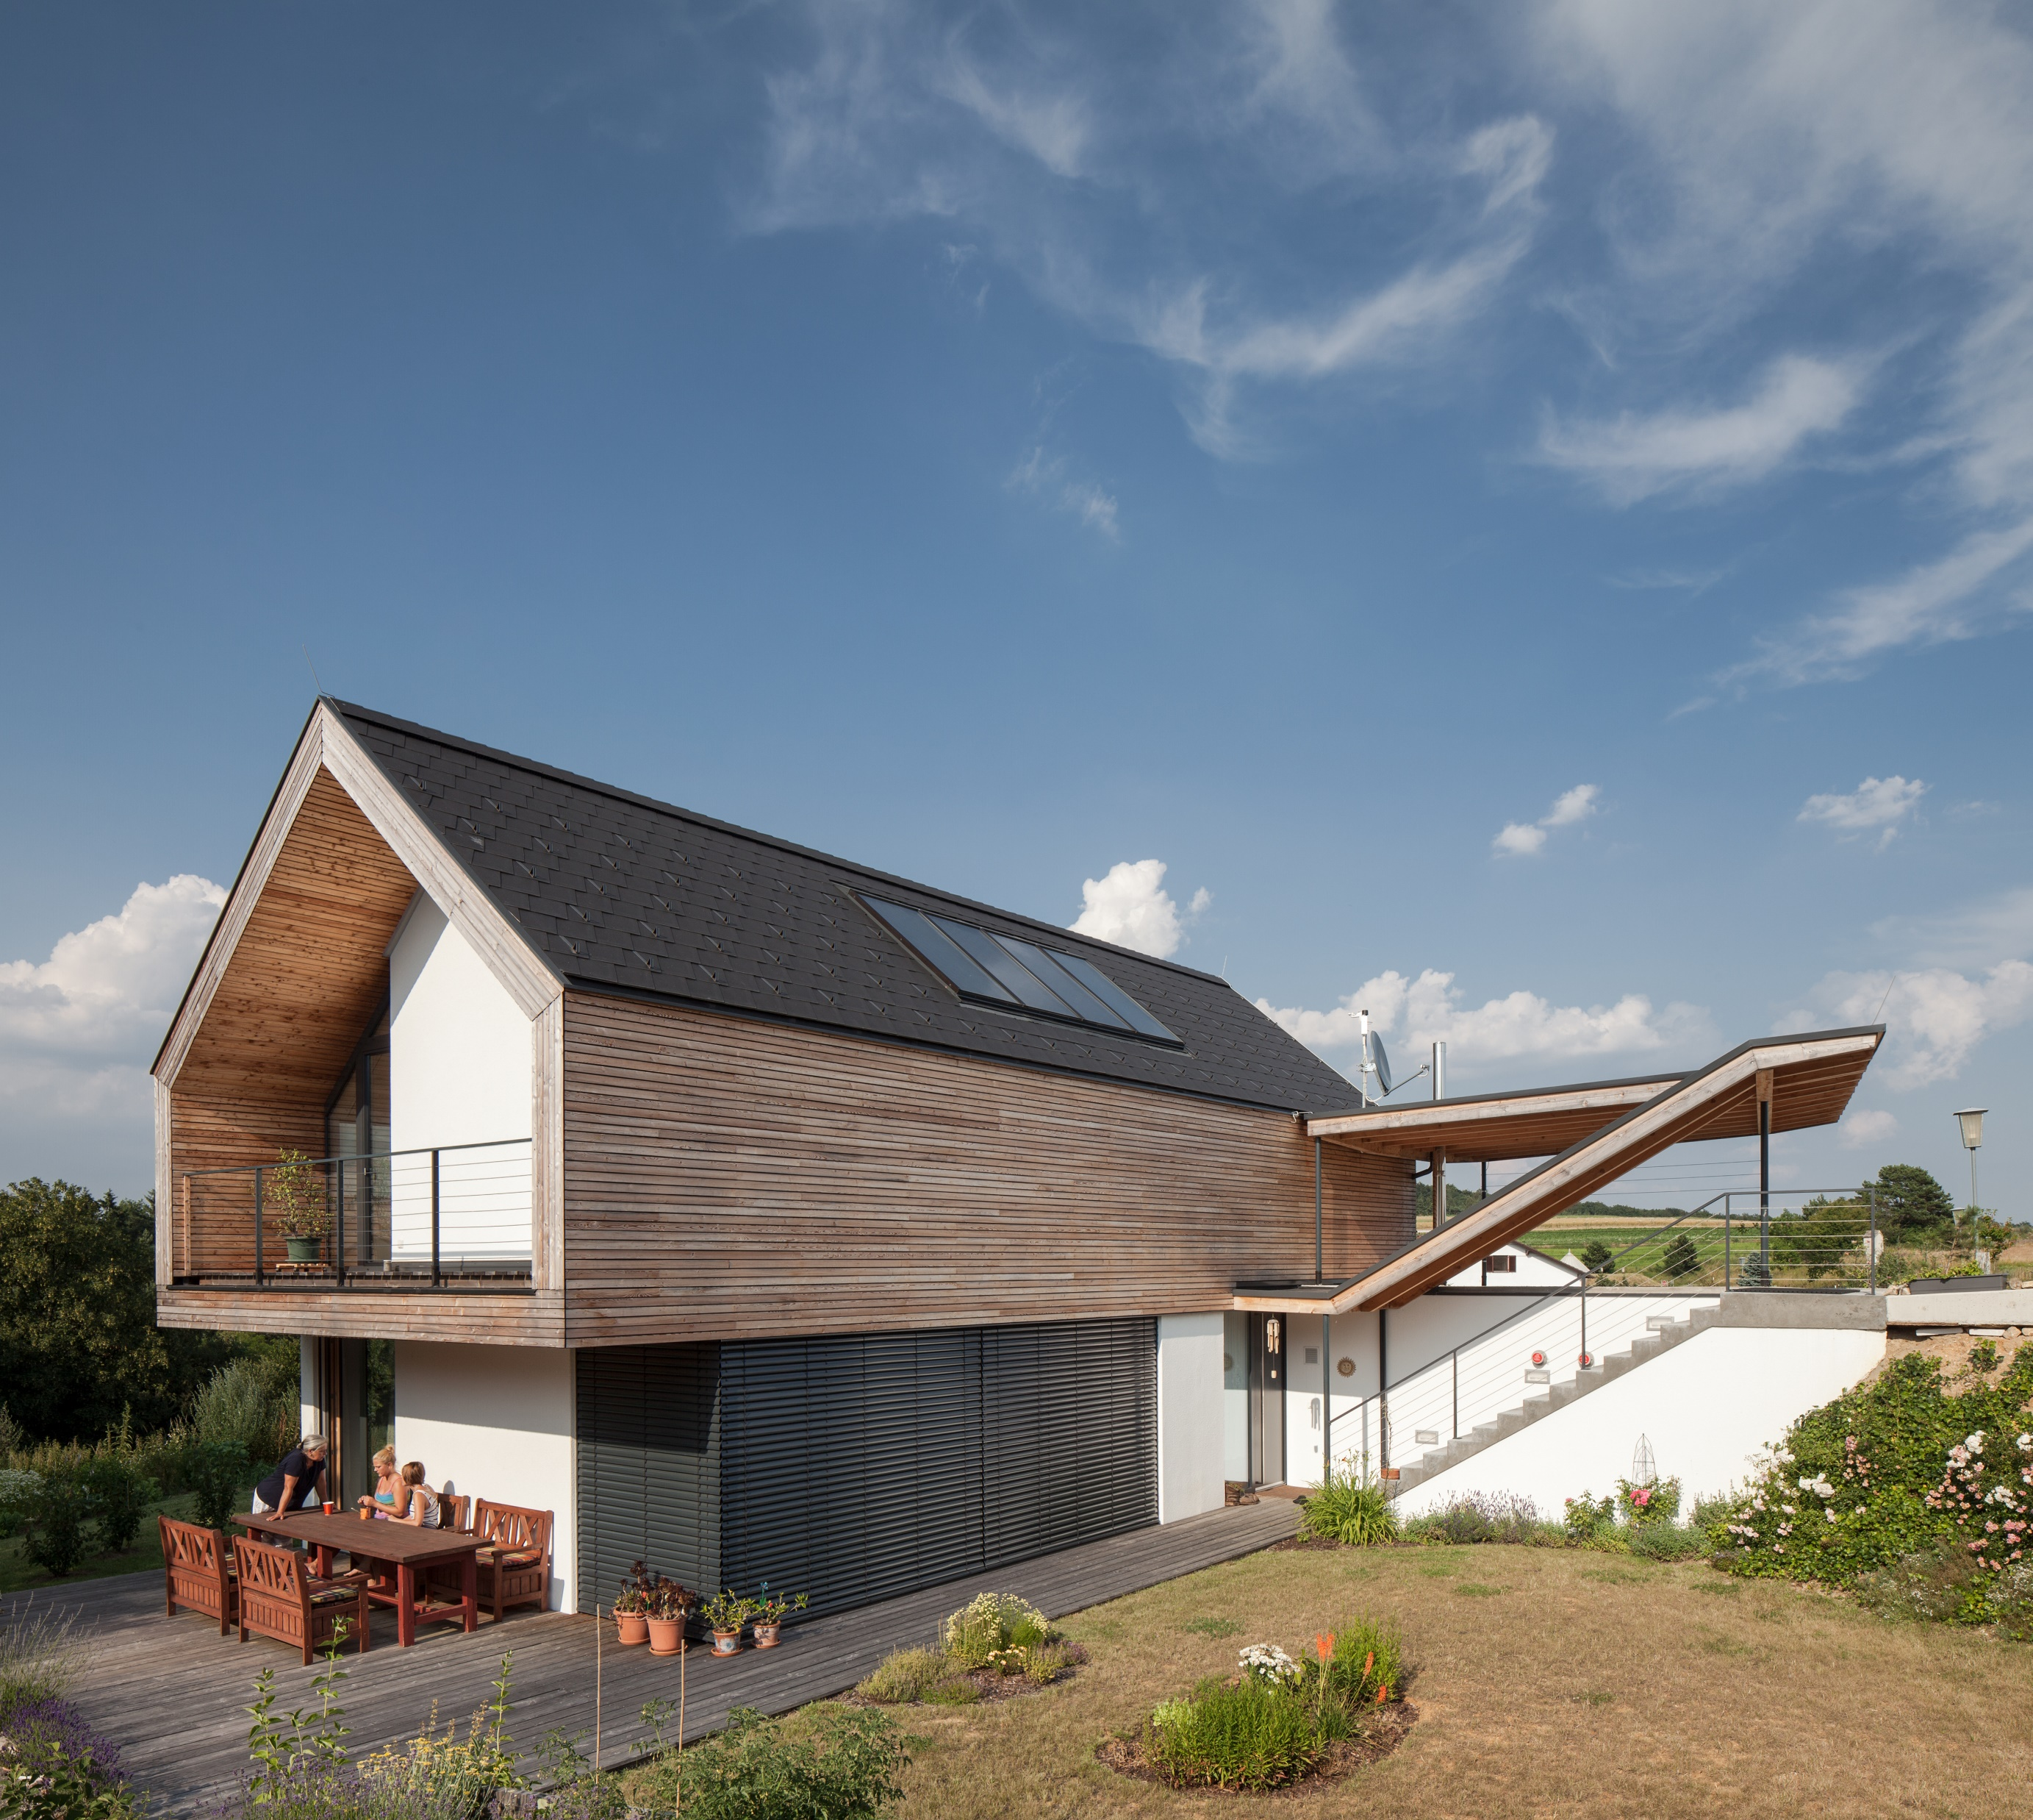
ERASMUS+ Strategic Partnerships For Higher Education
SUSTAINABLE, HIGH-PERFORMANCE BUILDING SOLUTIONS IN WOOD
2020-1-LV01-KA203-077513
Timber Construction
03 Wooden facades,
Plaster Systems
di matthias doubek, bsc
civil engineer, master carpenter

Slide 2
about
about
about
education
Higher Technical College for Timber Technologies – HTBLuVA Mödling
BSc Civil Engineering and Construction Management - FH Campus Wien
MSc Construction and completion of Large-scale International Projects- FH Campus Wien
Postgraduate Student - Sustainable Engineering - University of Exeter (UK)
Official qualification master carpenter
Official qualification master builder
Official qualification property developer
Official qualification Civil Engineer
Awards
FH Best Paper Award
Nomination for Timber Construction Price Lower Austria
National Steel Construction Austria
Berufspraxis
5 years site engineer timber construction
15 years Planning activity for architects and construction engineers (mainly planning, structural engineering, building physics and site management)
11 years freelance lector
9 years self employed as consultant, since 2016 konstrukt:ING – konstruktive Ingenieure GmbH

Slide 3
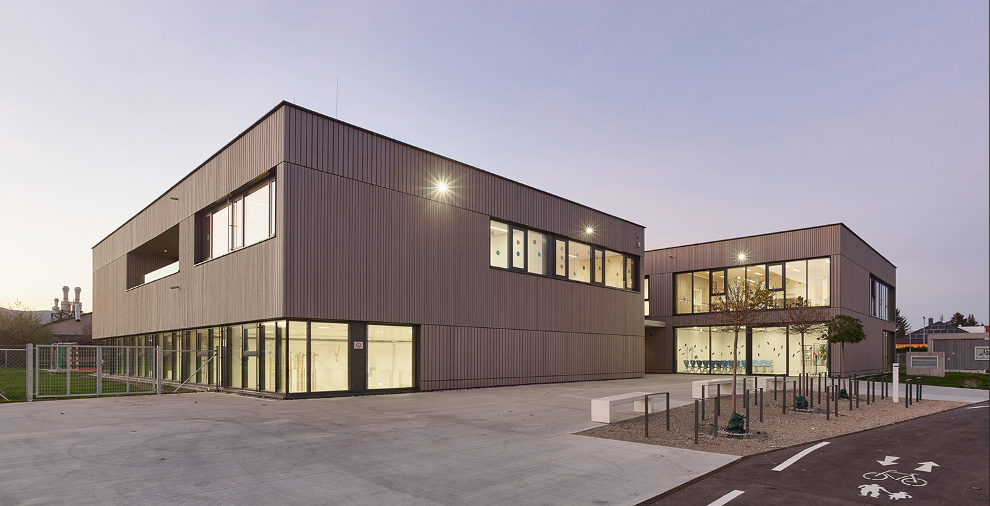
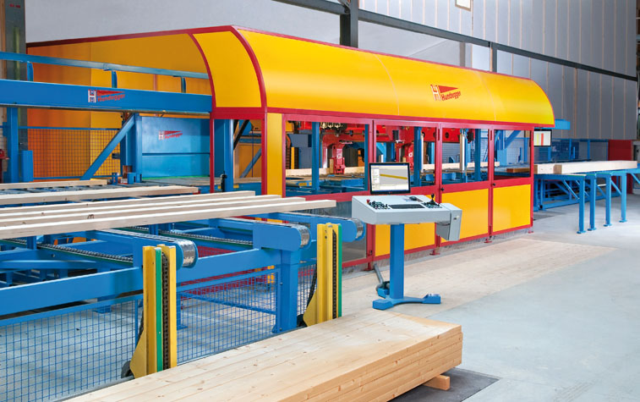
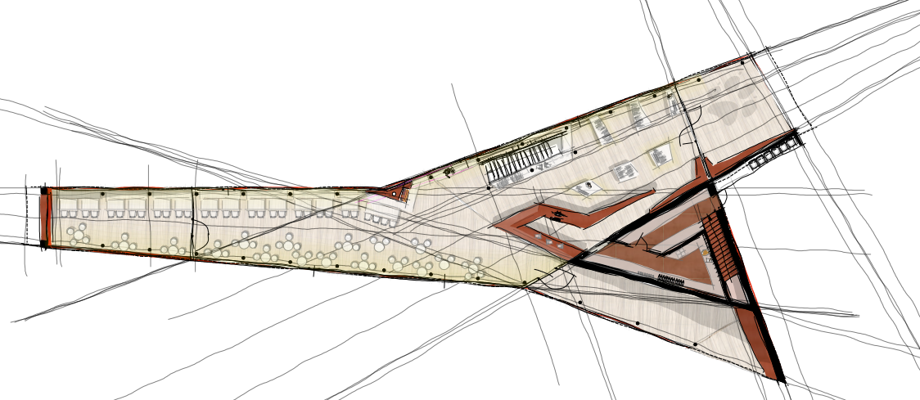
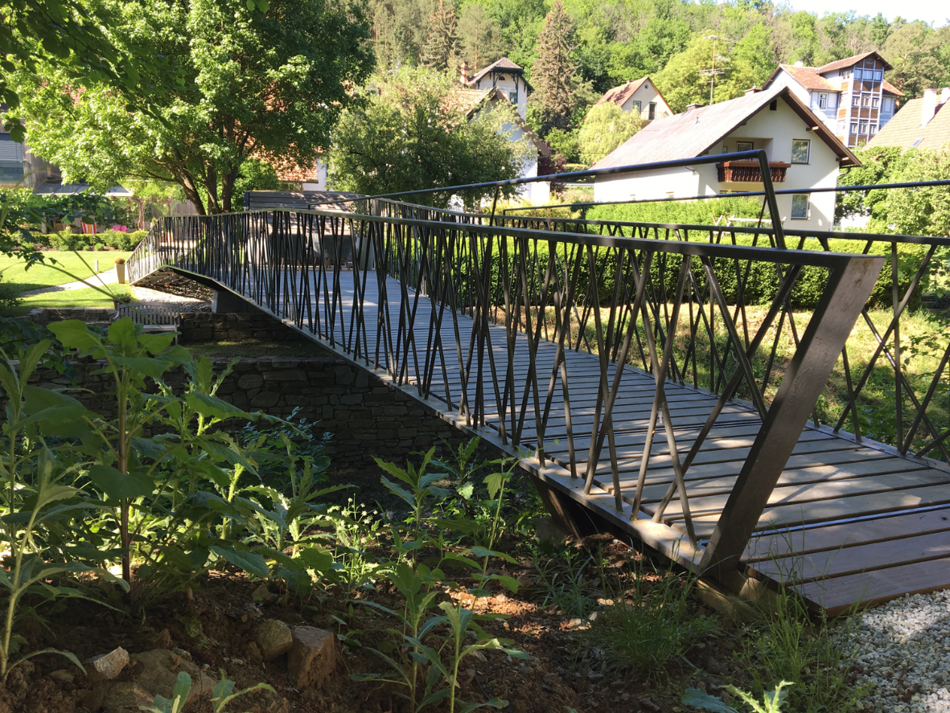
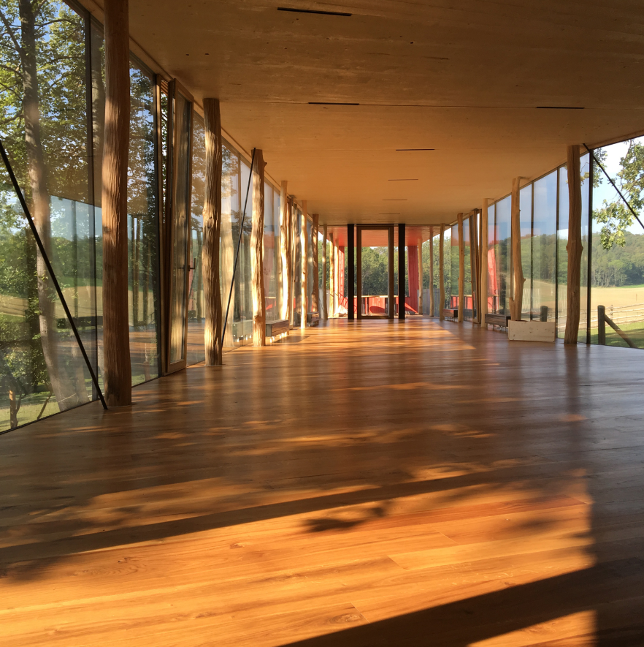
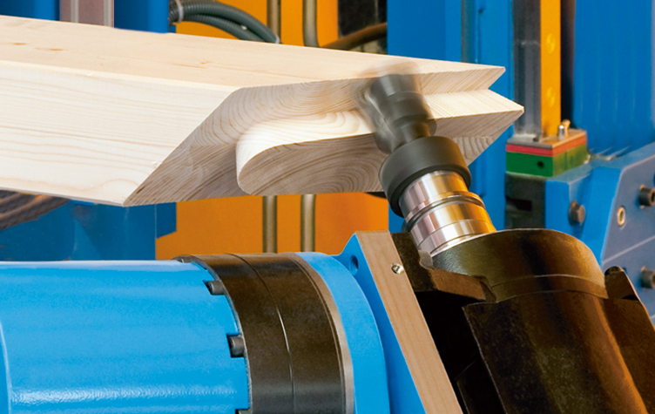
what we do

Slide 4
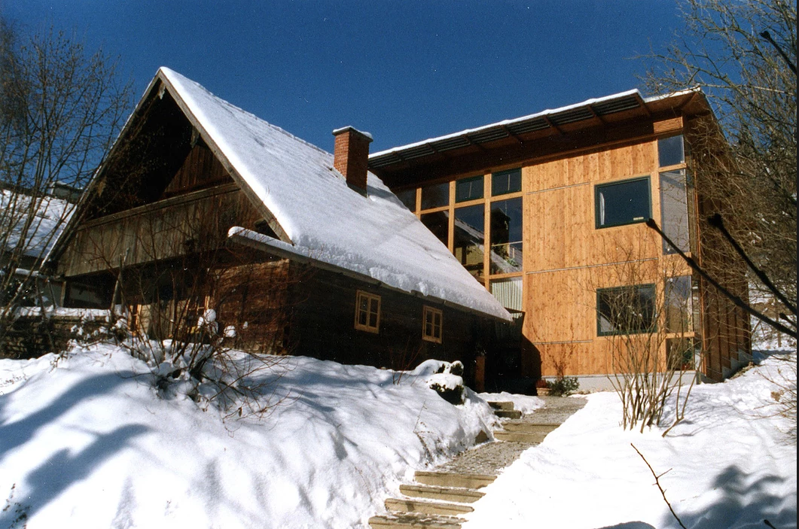
Wooden facades

Slide 5
Natural durability

Slide 6
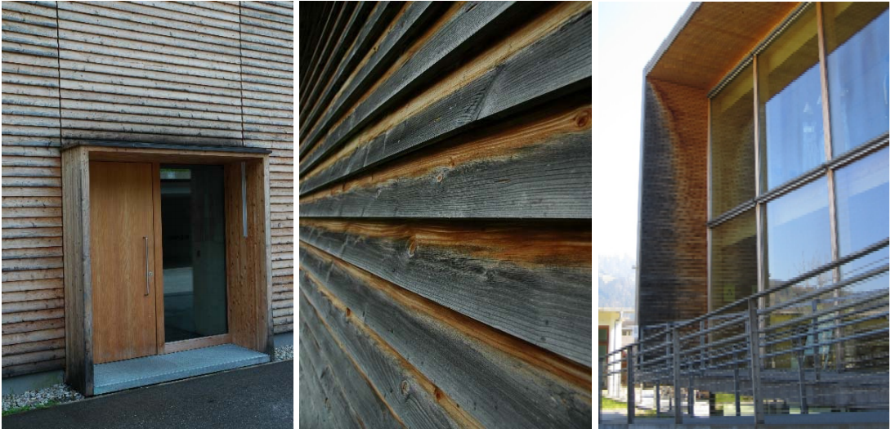
Constructive wood protection

Slide 7
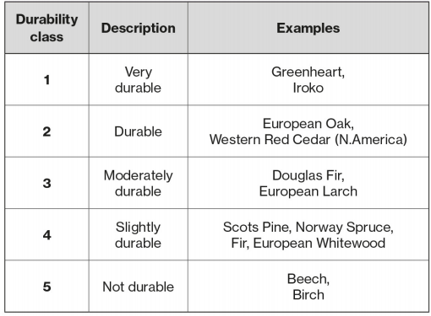
Choice of material
Type of wood (properties, natural durability (color)
Profile board shape - dimensions (thickness / width)
wood moisture
Sorting
Surface
substructure - attachment
https://www.structuraltimber.co.uk/assets/InformationCentre/eb1.pdf

Slide 8
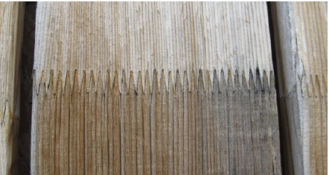
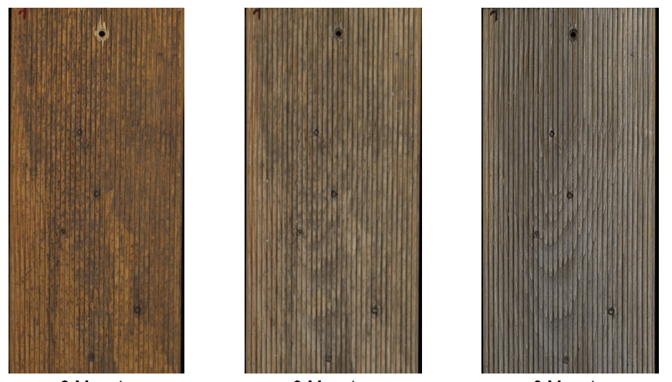
materials
„old but gold“
Solid wood
Profiled wood
Finger jointed wood
Iron discoloration and weathering
0m 3m 6m

Slide 9
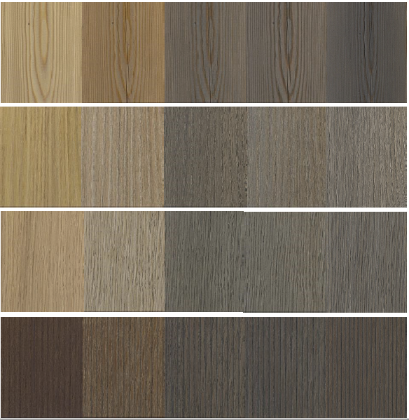
Natural durability
0m 12m
Larch
Robinia
Oak
Thermo-Ash

Slide 10
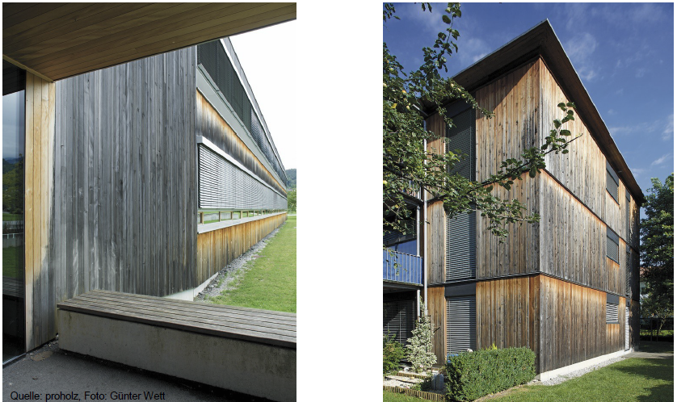
facade and time

Slide 11
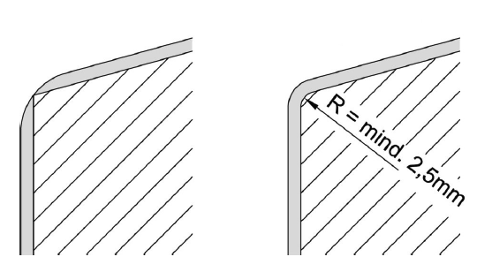
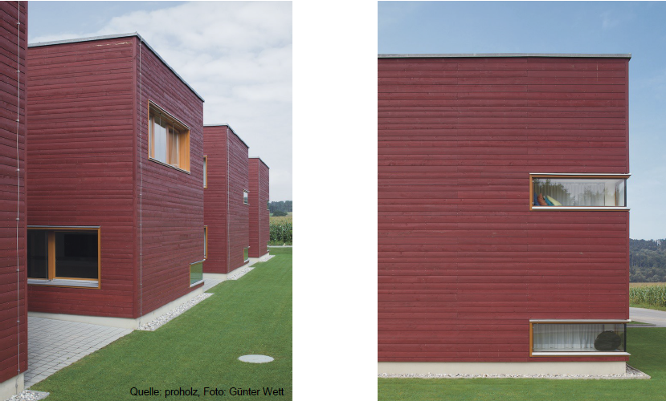
coating

Slide 12
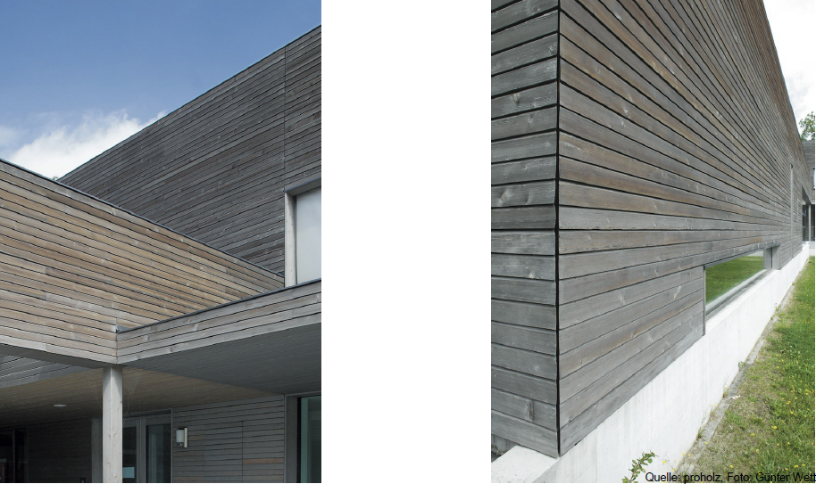
pre-graying

Slide 13
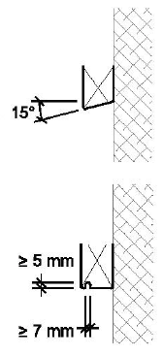
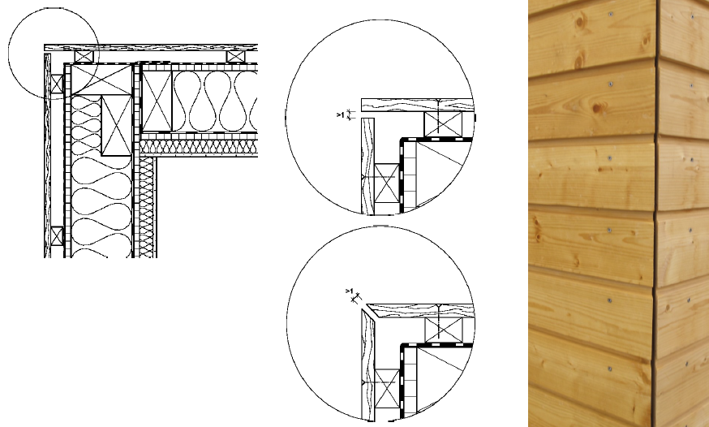
construction priciples

Slide 14
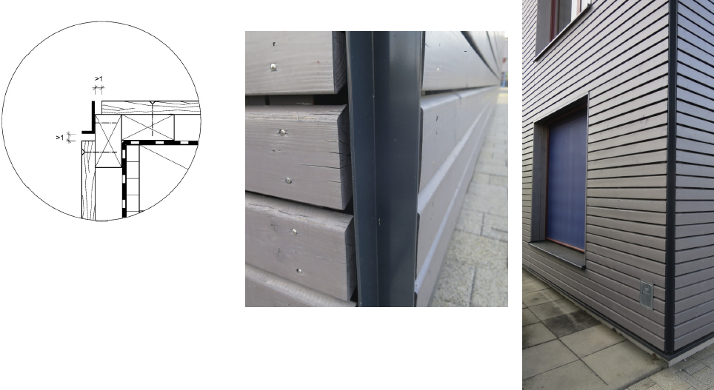
construction priciples

Slide 15
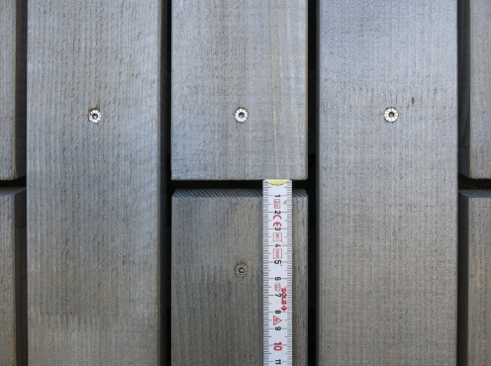
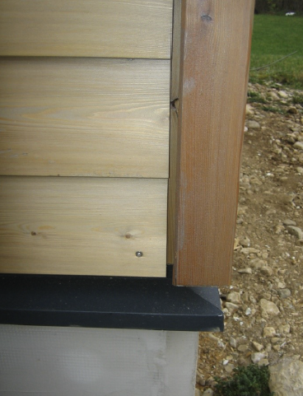
construction priciples

Slide 16
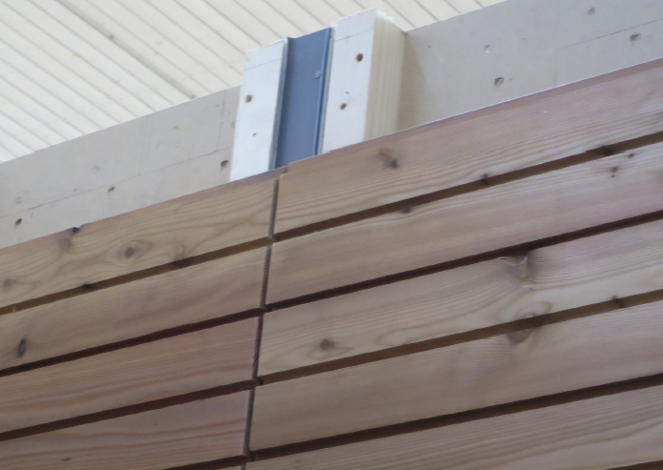
construction priciples

Slide 17
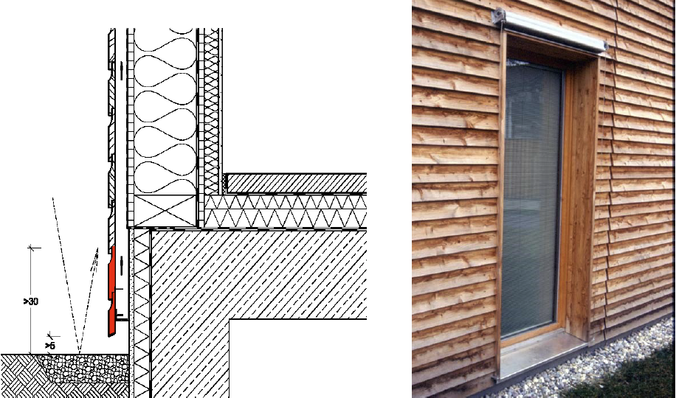
base

Slide 18
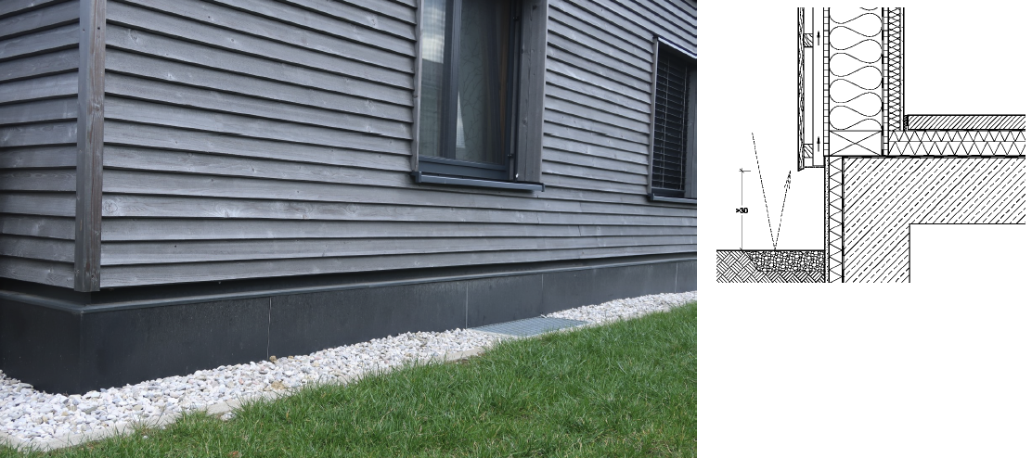
base

Slide 19
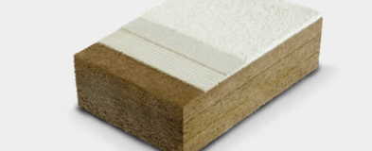
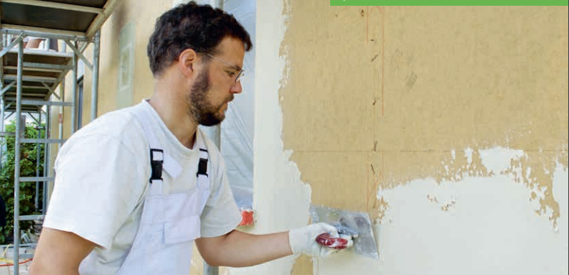
External thermal insulation composite systems

Slide 20
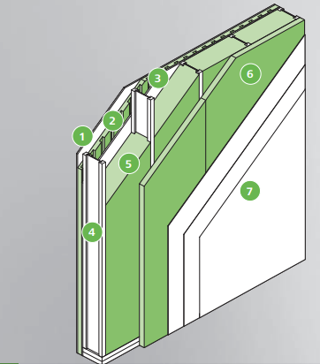
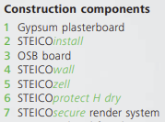
system structure (render carrying boards)

Slide 21
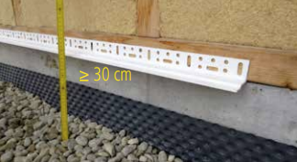
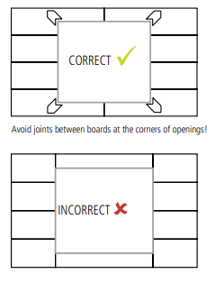
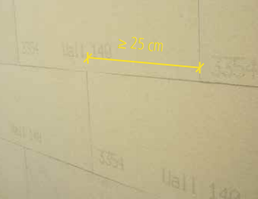
construction principles

Slide 22
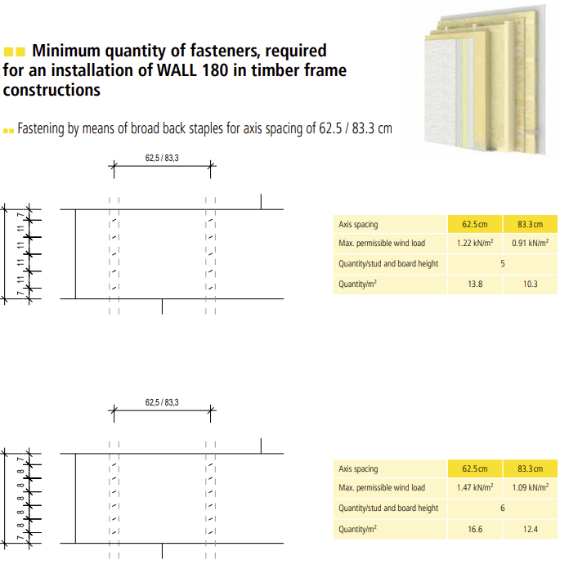
construction principles

Slide 23
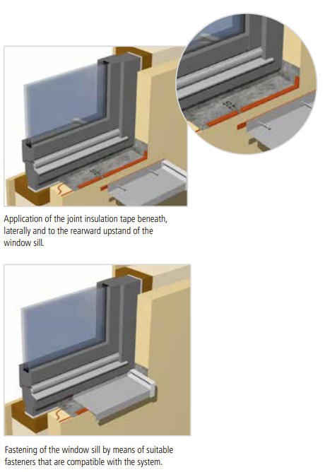
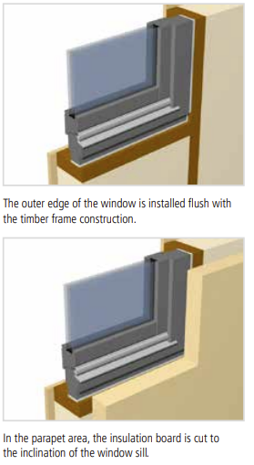
Construction principles

Slide 24
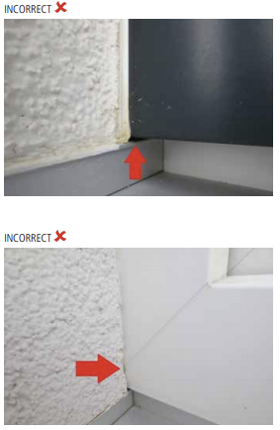
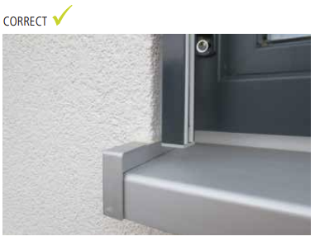
interface between the specialist companies

Slide 25
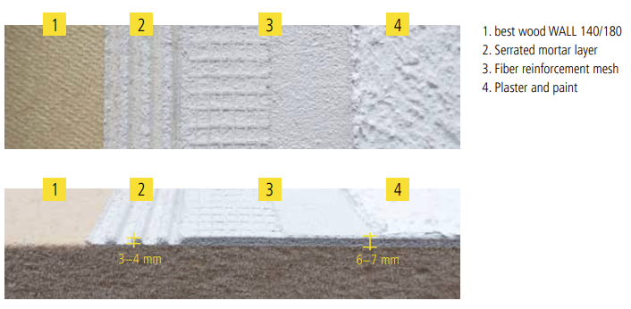
Structures and layer thickness

Slide 26
Source directory
Pech, Anton (Hrsg.) Holz im Hochbau, Springer Verlag
Wood Handbook, Wood as Engineering Material United Dep. Of Agriculture, Wisconsin, US
Manual for Engineered Wood Construction American Wood Concil
Richtlinie Sockelanschluss im Holzhausbau Holz Forschung Austria
Atlas Mehrgeschossiger Holzbau Edition Detail 2017
Auszug aus Vortragsreihe Modulbau rwt+ (Richard Woschitz)
www.proholz.at
www.dataholz.eu
www.frischeis.com
www.steico.com
www.clt.info
www.bruck33.at
www.strongtie.de/products
www.rothoblaas.de/produkte/verbindungstechnik
www.pitzl-connectors.com/produkte
www.halfen.com/at/780/produktbereiche/bau/stabsysteme/detan-stabsystem/einfuehrung/
www.sfs.ch/de/Holzbefestiger
www.sihga.com/
www.schrauben.at/schraubenwelten/produkte/uebersicht
www.sherpa-connector.com

