Slide 1
DESIGN COORDINATION
Łukasz Wesołowski : Pawel Mika
16-05-2022

Slide 2
Design coordination
Łukasz Wesołowski, Paweł Mika
SCHEMATIC DESIGN OPTIMIZATION – material / panel sizes:
Options for mass timber fabricators and suppliers
Maximize panel sizes to minimize machine cutting, material waste and costs.
Determine the thickness and grades of roof/floor panels based on preliminary loading. Minimize the thickness of floor/roof panels to control costs.
Approach mass timber design as a modular system.
For panels sourced from overseas, shipping container size limits will govern maximum panel sizes.

Slide 3
Design coordination
Łukasz Wesołowski, Paweł Mika
OPTIMIZATION – system coordination:
Structure, vibration, fire resistance, acoustics issues for the thickness of the floor/roof panels. These areas usually have the biggest influence on cost.
Coordinate the structure, vibration, fire resistance and acoustic systems. Meet with the project’s consultants/experts to discuss system options and how each impacts the others.
Correlate acoustic and fire-resistance solutions. (They are interdependent.)

Slide 4
Design coordination
Łukasz Wesołowski, Paweł Mika
OPTIMIZATION – structural systems:
Review the sequencing of installation. Do the lateral systems need to be installed prior to the mass timber?
Which are the best structural modules for designed function? Less columns, more columns but lower beams

Slide 5
Design coordination
Łukasz Wesołowski, Paweł Mika
OPTIMIZATION – fire resistance:
Optimize the construction type to minimize fire rating impacts. Taller mass timber buildings generally require higher fire-resistance ratings, which may impact timber sizes and material optimization.
Consider fire protection approaches and what should be discussed with the Authority Having Jurisdiction (AHJ) during design. AHJs may be unfamiliar with mass timber systems. Early pre-application meetings can help to align expectations and mitigate concerns far in advance of permit application.

Slide 6
Design coordination
Łukasz Wesołowski, Paweł Mika
OPTIMIZATION – acoustics:
Consider floor topping options and finishes.
Determine how the wet vs. dry weight of toppings impacts schedule and mass of structure.
Decide whether the mass timber floor/roof panels will be exposed on the ceiling side or concealed.
Consider the minimum level of acoustical performance required by code and expected by the owner/occupant

Slide 7
Design coordination
Łukasz Wesołowski, Paweł Mika
OPTIMIZATION – finish quality:
Start to consider the appearance of exposed mass timber elements and the species available from different fabricators. Selecting species provided by local fabricators will typically yield shipping/transportation cost savings.
Specify desired finish grades (architectural, industrial, etc.) for budgeting purposes.
Work with potential manufacturers to determine their appearance grade options and associated cost premiums in order to arrive at a solution that meets both aesthetic goals and budgetary constraints

Slide 8
Design coordination
Łukasz Wesołowski, Paweł Mika
DESIGN DEVELOPEMENT OPTIMIZATION – material / panel sizes:
Check with manufacturers for available panel sizes/spans. Machinery press sizes or the optimization of raw material sizes can influence panel sizes. Most manufacturers can produce panels in symilar lengths
For large panel/member sizes, consider transportation and shipping.
For competitively bid projects, size grids for a variety of manufacturer options.
Are there slight adjustments to the grids that can be made to help control costs?

Slide 9
Design coordination
Łukasz Wesołowski, Paweł Mika
OPTIMIZATION – system coordiantion:
Consider prefabricated exterior and interior wall elements that preserve the schedulesavings achieved by the structure

Slide 10
Design coordination
Łukasz Wesołowski, Paweł Mika
OPTIMIZATION – fire resistance:
For exposed panels, fire resistance provided by charring of wood can be calculated. Some manufacturers also have tested assemblies

Slide 11
Design coordination
Łukasz Wesołowski, Paweł Mika
OPTIMIZATION – MEPF Systems:
Compare a completely prefabricated approach for incorporating MEPF and fire protection systems to field accommodation techniques and decide on the best approach for your project.
With early engagement/design-assist, it is possible to prefabricate many openings and interface points that are much less costly and less prone to risk (damage, error, debris, etc.) than when completed in the field. Seek MEPF contractors skilled in prefabrication of their respective areas (piping, units, duct, etc.).
Consider solutions to accommodate openings without cutting holes in panels (i.e., at ends of panels or routing above/below). Also consider MEPF layout in structural grid placement.

Slide 12
Design coordination
Łukasz Wesołowski, Paweł Mika
OPTIMIZATION – finish quality:
Obtain material samples and consider finish grade and coatings. Specify several “range and finish” samples, perhaps 6 feet by 6 feet to convey an accurate sense of the outcome.
For cost savings, are there areas where industrial grade appearance can be specified?
Consider surface coatings that can be added for protection during construction, durability, staining, etc. Discuss coatings with fabricators and the GC. Consider whether the options are applied in the shop or field

Slide 13
Design coordination
Łukasz Wesołowski, Paweł Mika
OPTIMIZATION – specification:
Determine the thickness of panels, number of laminations, grade/species, finish, etc.
Use the manufacturer’s standard product options to help control costs.
Consider protection of steel connectors during construction (paint/primer). Prevent rust stains on exposed wood by priming connectors.
Protect panels during construction with sheathing and by taping seams; cover all end grains/joints; specify shop-applied sealants.
Specify a moisture mitigation plan during construction stating that the timber is to be protected.

Slide 14
Design coordination
Łukasz Wesołowski, Paweł Mika
OPTIMIZATION – specification:
Costs of stainless/galvanized connections vs. a shopprimed finish can be significant. Consider the cost of these special materials/coatings vs. protection in storage and once in place to mitigate staining.
Consult with fabricators for standard specifications

Slide 15
Design coordination
Łukasz Wesołowski, Paweł Mika
OPTIMIZATION – key details:
Consider panel-to-panel joint connection options. Determine which is the most appropriate for the project overall, including installation speed, lateral forces, and overall panel length to minimize waste.
For beam-to-column joints:
• Consider whether connections will be concealed or exposed. Where members such as beams, columns and floor/roof panels require a fire-resistance rating, connections between members must have sufficient protection to provide the same fire-resistance rating.
• Evaluate shrinkage and consider continuous columns or steel post stubs.
• Consider prefabricated vs. custom fabricated hangers and the need to CNC timber to accommodate hangers and hardware.

Slide 16
Design coordination
Łukasz Wesołowski, Paweł Mika
OPTIMIZATION – key details:
For column-to-foundation details:
• Consider prefabricated/preinstalled anchors for quick installation.
• Allow for field adjustment to accommodate tolerances of different materials.
• Detail for moisture and insect protection.
Detail for durability and keep moisture from building up, especially at end grains and joints.
Tolerances of mass timber are much tighter than other materials. Consider tolerances and discuss details with the builder and fabricators of all trades.
Determine how tolerances will be accommodated at the foundation/base level of the project. This area has the greatest potential for differences.

Slide 17
Design coordination
Łukasz Wesołowski, Paweł Mika
OPTIMIZATION – key details:
Hold a preconstruction coordination meeting with the GC, foundation subcontractor, and mass timber manufacturer/designer to address tolerances and base connections. This is a mandatory best practice with steel (AISC) and structural precast concrete (PCI) and should be the same for mass timber

Slide 18
Design coordination
Łukasz Wesołowski, Paweł Mika

Slide 19
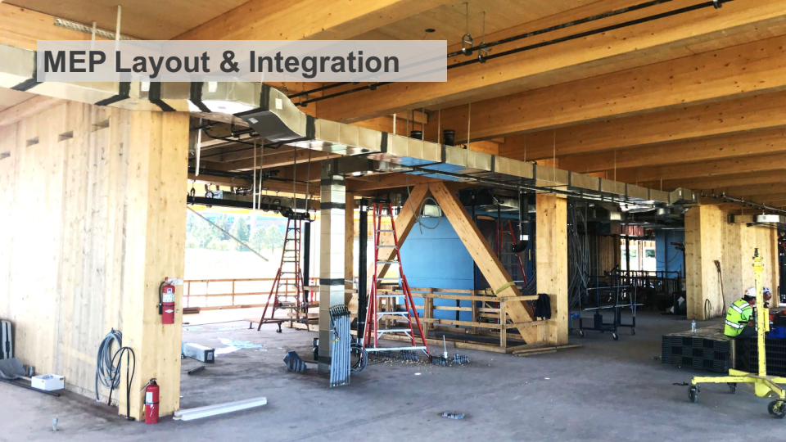
Design coordination
Łukasz Wesołowski, Paweł Mika

Slide 20
Design coordination
Łukasz Wesołowski, Paweł Mika

Slide 21
Design coordination
Łukasz Wesołowski, Paweł Mika

Slide 22
Design coordination
Łukasz Wesołowski, Paweł Mika

Slide 23
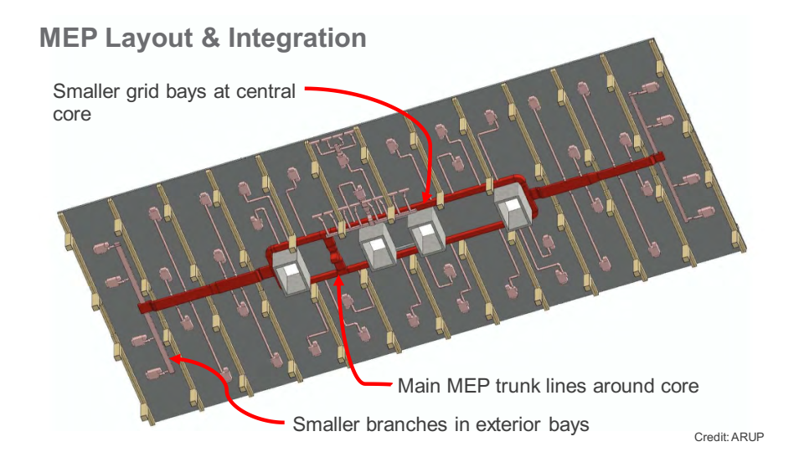
Design coordination
Łukasz Wesołowski, Paweł Mika

Slide 24
Design coordination
Łukasz Wesołowski, Paweł Mika

Slide 25
Design coordination
Łukasz Wesołowski, Paweł Mika

Slide 26
Design coordination
Łukasz Wesołowski, Paweł Mika

Slide 27
Design coordination
Łukasz Wesołowski, Paweł Mika

Slide 28
Design coordination
Łukasz Wesołowski, Paweł Mika

Slide 29
Design coordination
Łukasz Wesołowski, Paweł Mika

Slide 30
Design coordination
Łukasz Wesołowski, Paweł Mika

Slide 31
Design coordination
Łukasz Wesołowski, Paweł Mika

Slide 32
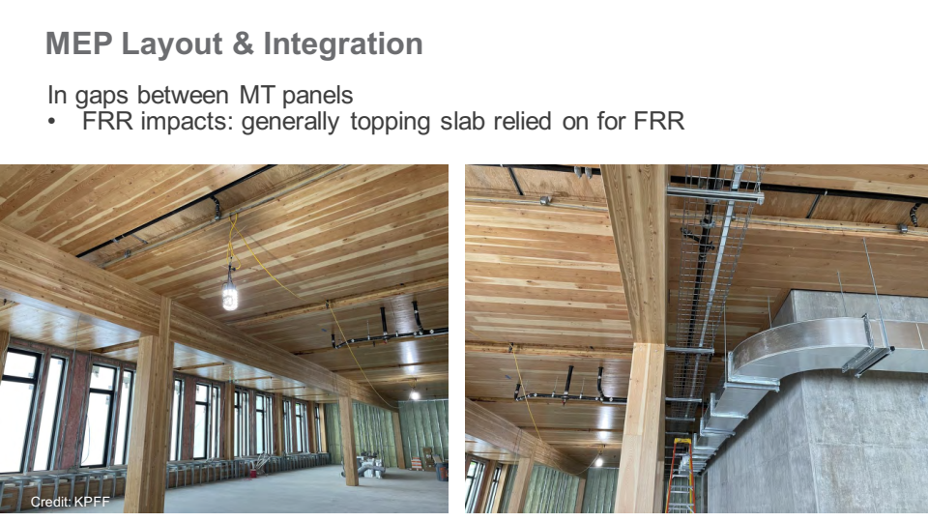
Design coordination
Łukasz Wesołowski, Paweł Mika

Slide 33
Design coordination
Łukasz Wesołowski, Paweł Mika

Slide 34
Design coordination
Łukasz Wesołowski, Paweł Mika

Slide 35
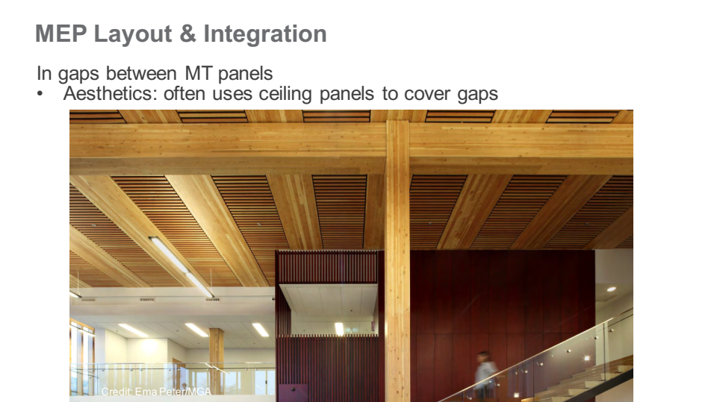
Design coordination
Łukasz Wesołowski, Paweł Mika

Slide 36
Design coordination
Łukasz Wesołowski, Paweł Mika

Slide 37
Design coordination
Łukasz Wesołowski, Paweł Mika

Slide 38
Design coordination
Łukasz Wesołowski, Paweł Mika

Slide 39
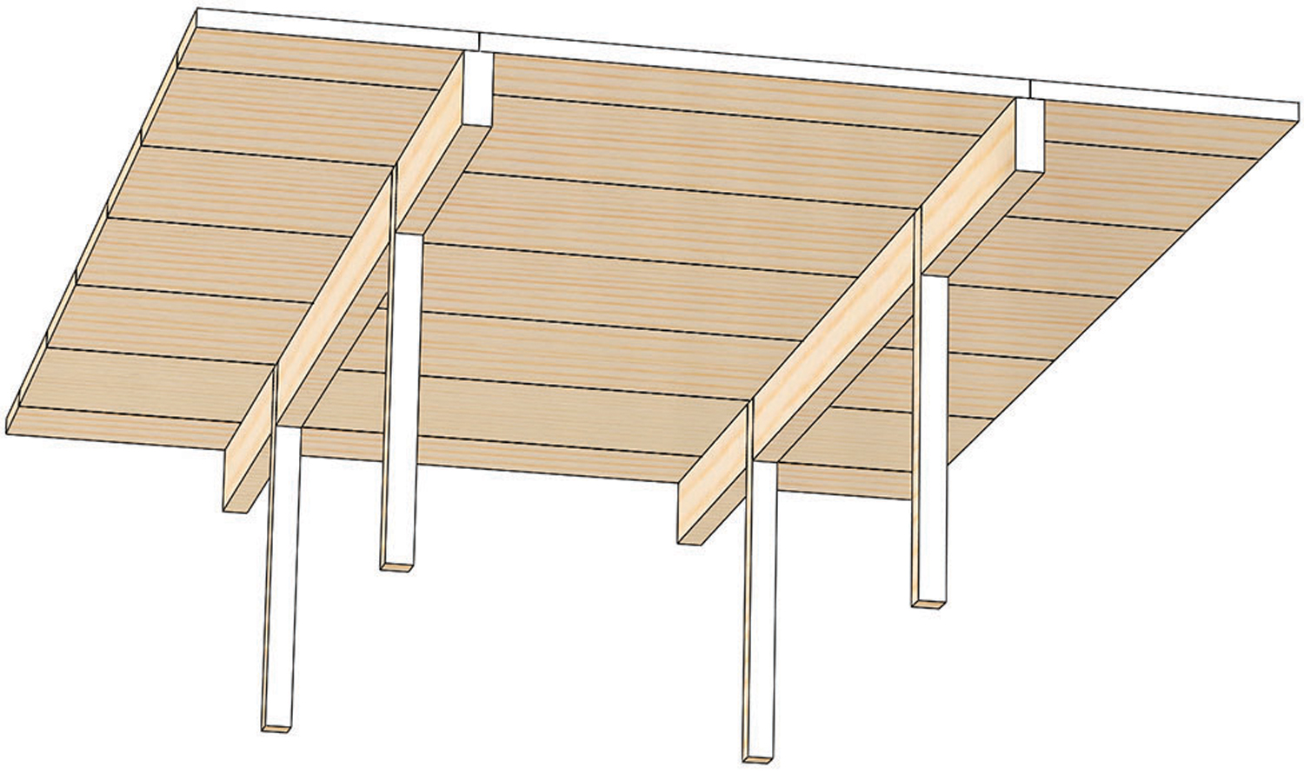
Design coordination
Łukasz Wesołowski, Paweł Mika
CLT, NLT, DLT principals:
Long Beam Short Deck

Slide 40
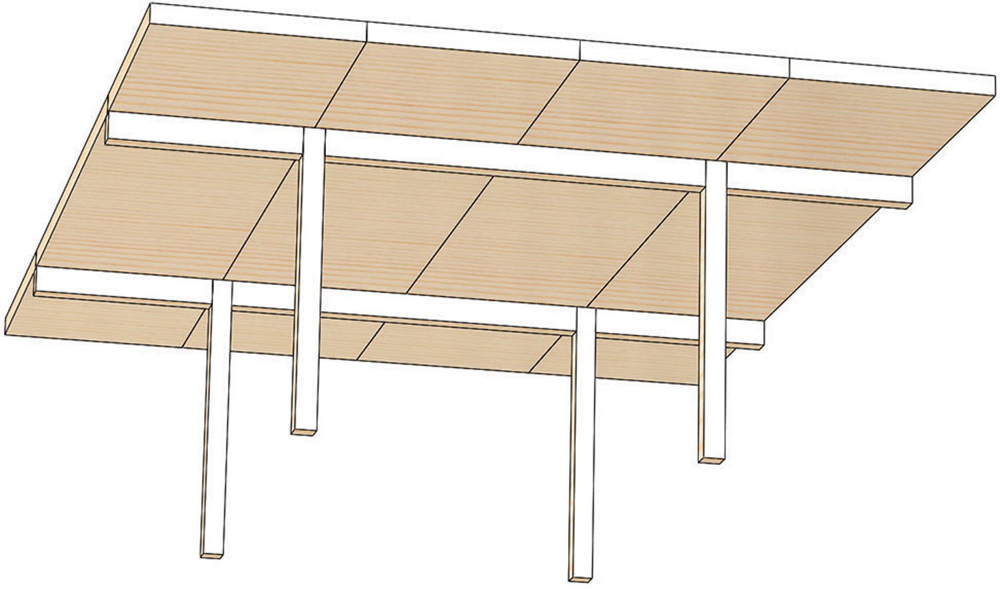
Design coordination
Łukasz Wesołowski, Paweł Mika
CLT, NLT, DLT principals:
Short Beam Long Deck

Slide 41
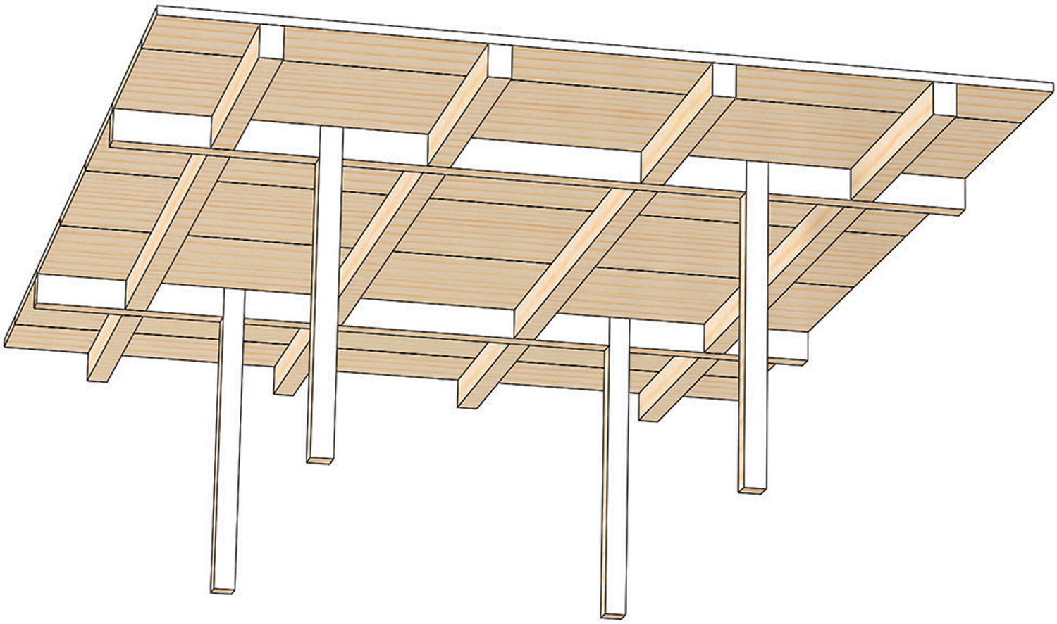
Design coordination
Łukasz Wesołowski, Paweł Mika
CLT, NLT, DLT principals:
Beams and Girders

Slide 42
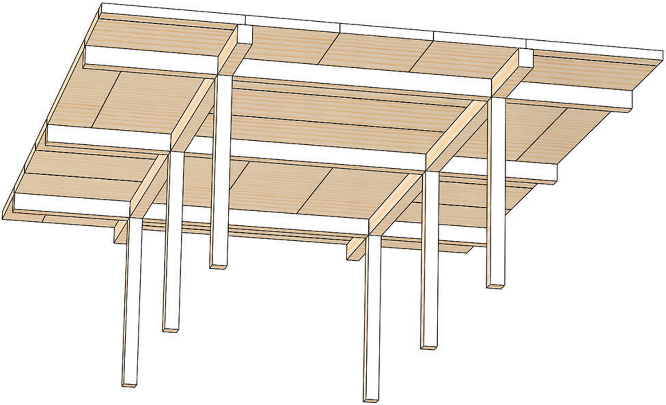
Design coordination
Łukasz Wesołowski, Paweł Mika
CLT, NLT, DLT principals:
Two-Way Beams

Slide 43
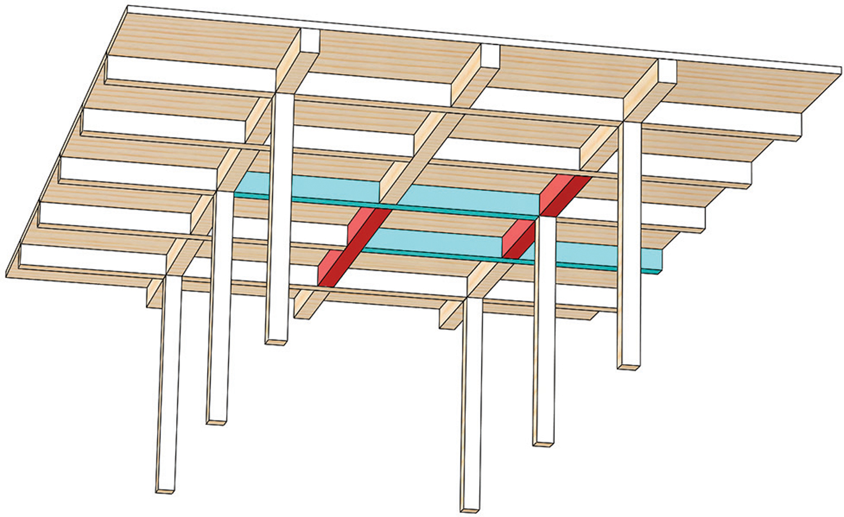
Design coordination
Łukasz Wesołowski, Paweł Mika
CLT, NLT, DLT principals:
Reciprocal Frame

Slide 44
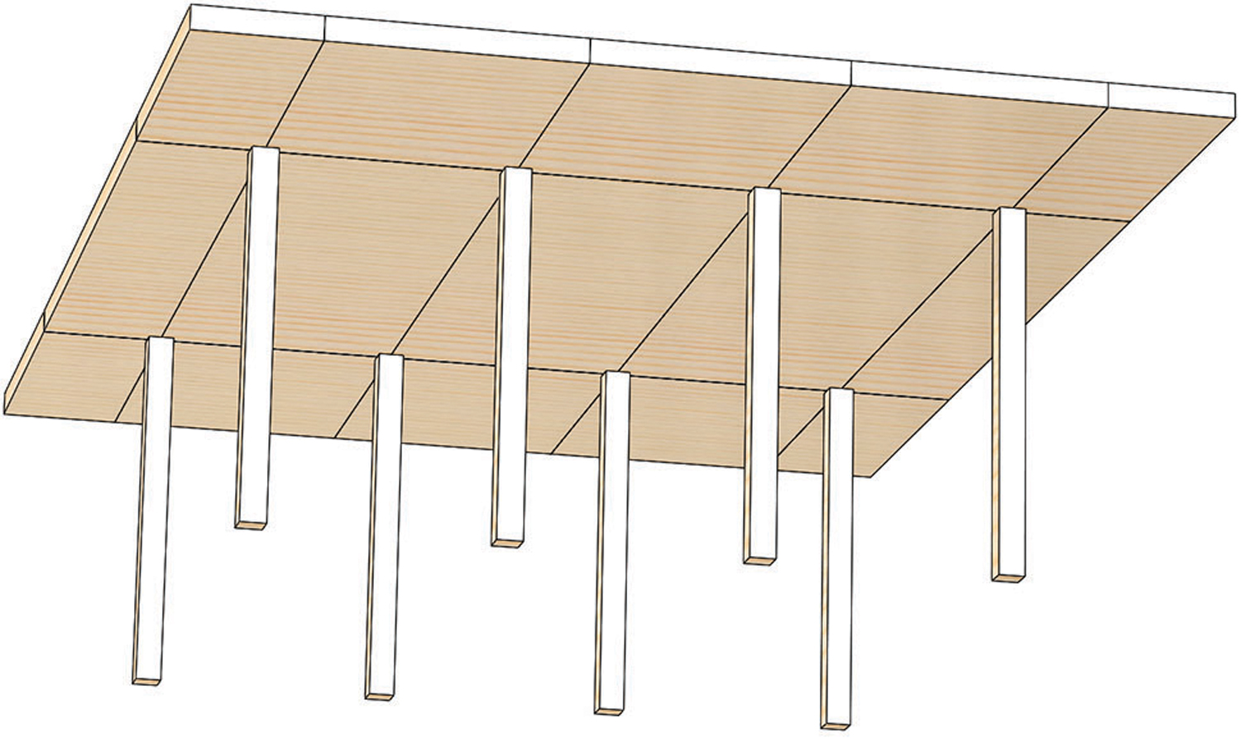
Design coordination
Łukasz Wesołowski, Paweł Mika
CLT, NLT, DLT principals:
Point Supported CLT

Slide 45
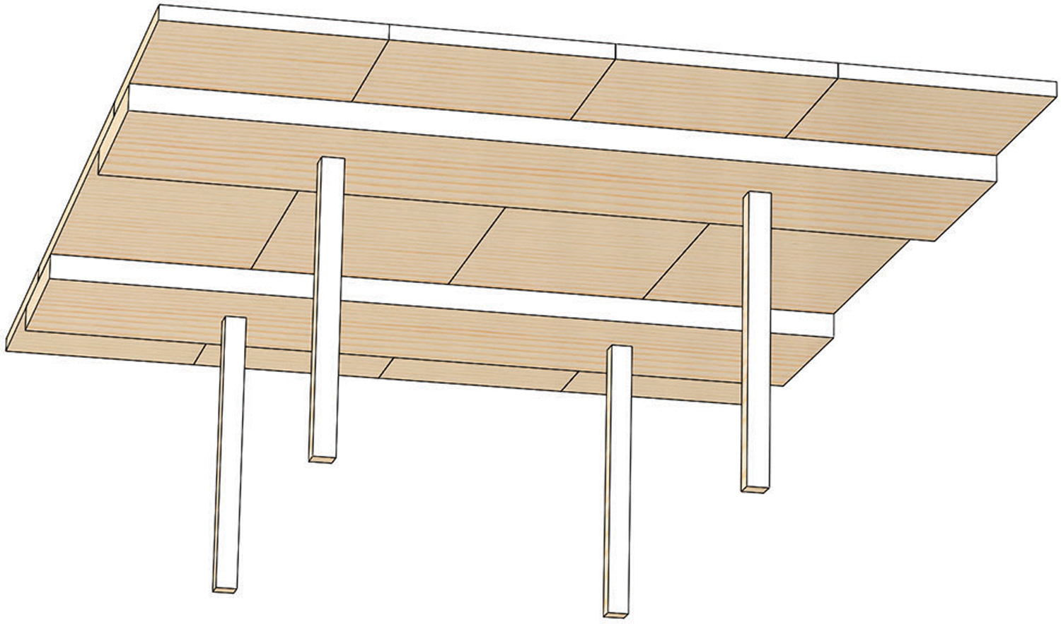
Design coordination
Łukasz Wesołowski, Paweł Mika
CLT, NLT, DLT principals:
Wide Flat Beams – Beams on the Bottom

Slide 46
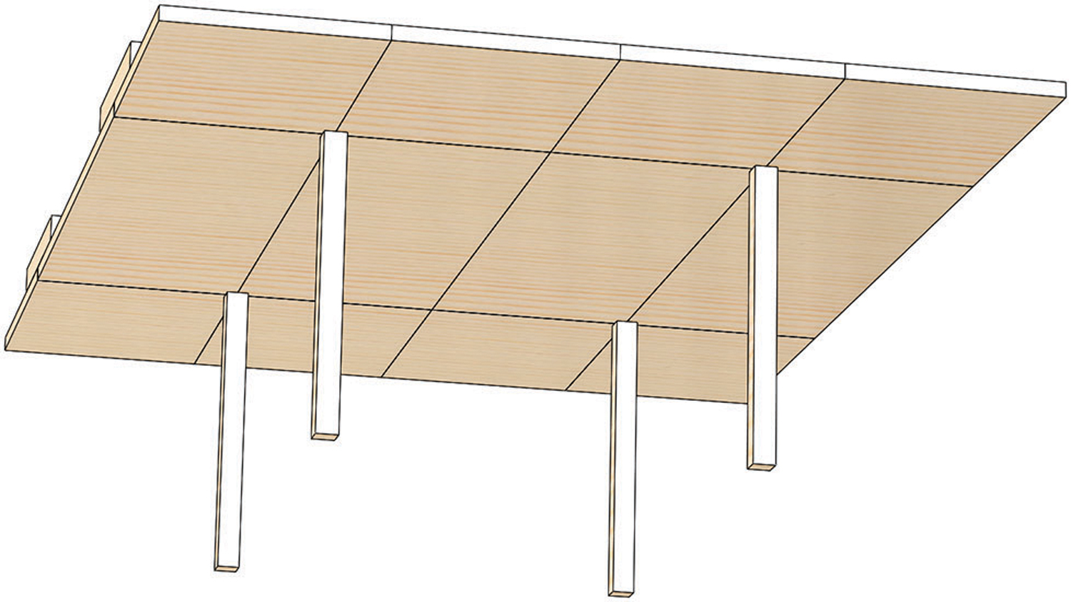
Design coordination
Łukasz Wesołowski, Paweł Mika
CLT, NLT, DLT proncipals:
Wide Flat Beams – Beams on Top

Slide 47
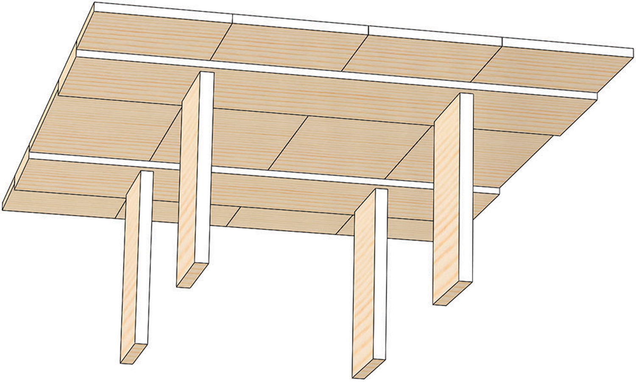
Design coordination
Łukasz Wesołowski, Paweł Mika
CLT, NLT, DLT principals:
Wide Flat Beams – Beams Flush

Slide 48
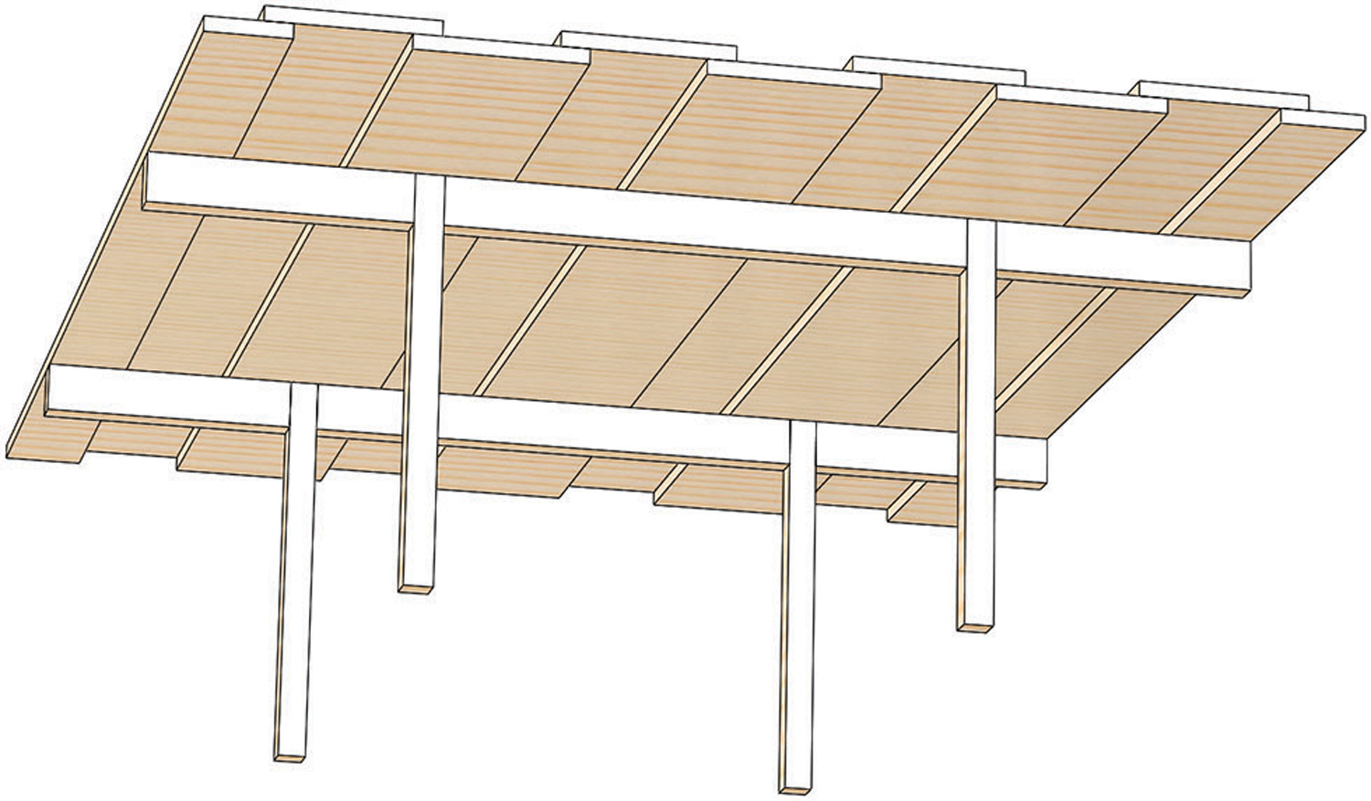
Design coordination
Łukasz Wesołowski, Paweł Mika
CLT, NLT, DLT proncipals:
Staggered Deck

Slide 49
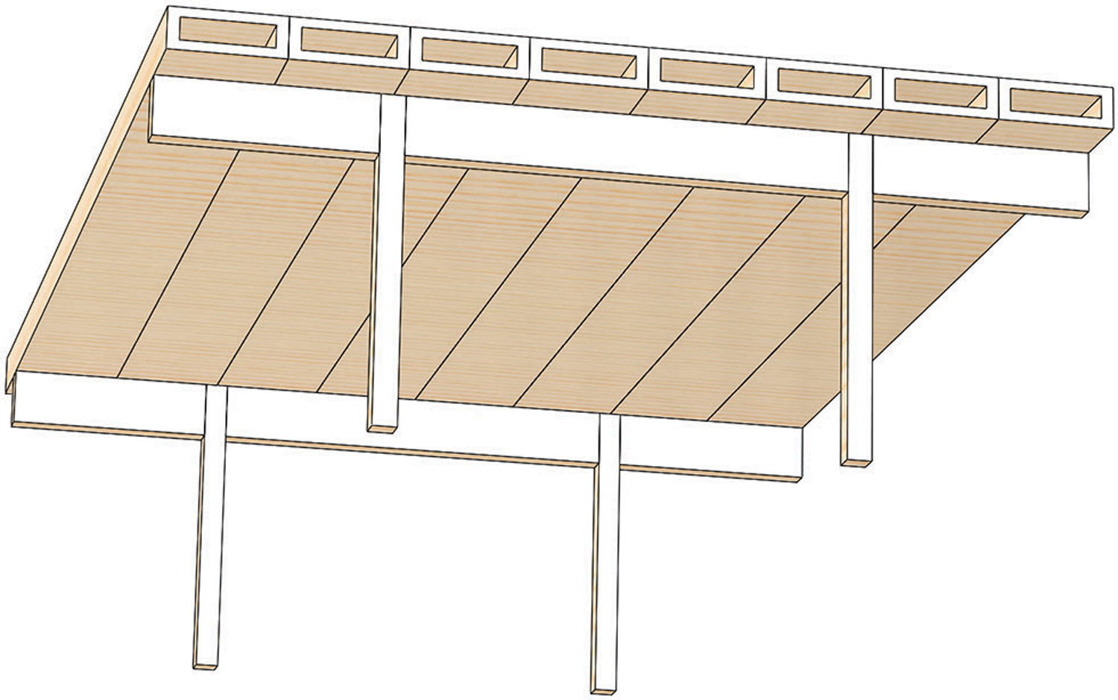
Design coordination
Łukasz Wesołowski, Paweł Mika
CLT, NLT, DLT principals:
Cassette

Slide 50
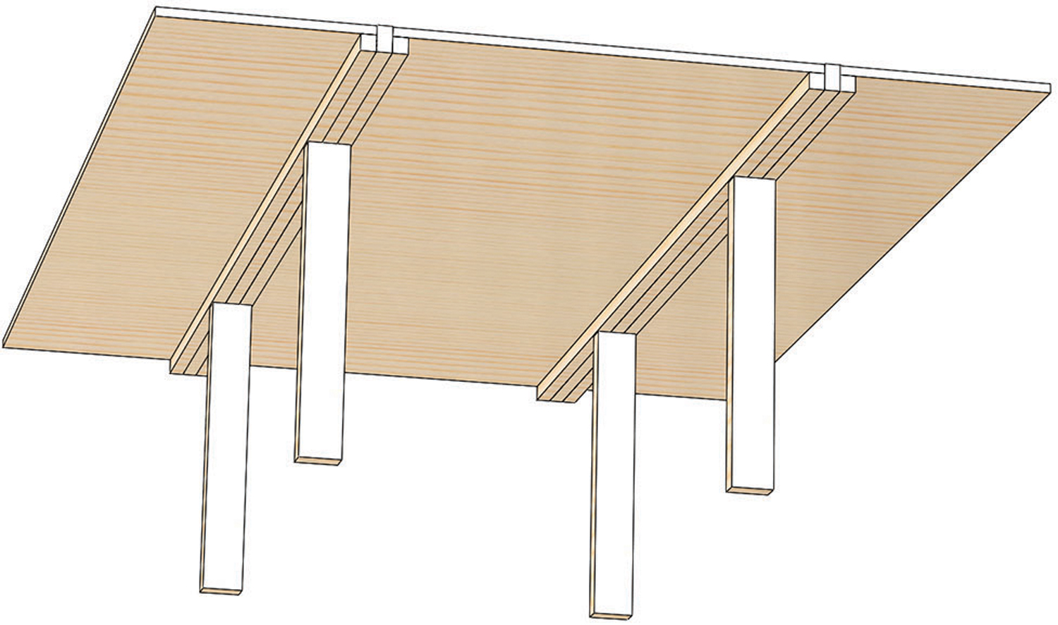
Design coordination
Łukasz Wesołowski, Paweł Mika
CLT, NLT, DLT principals:
Triple Beam

Slide 51
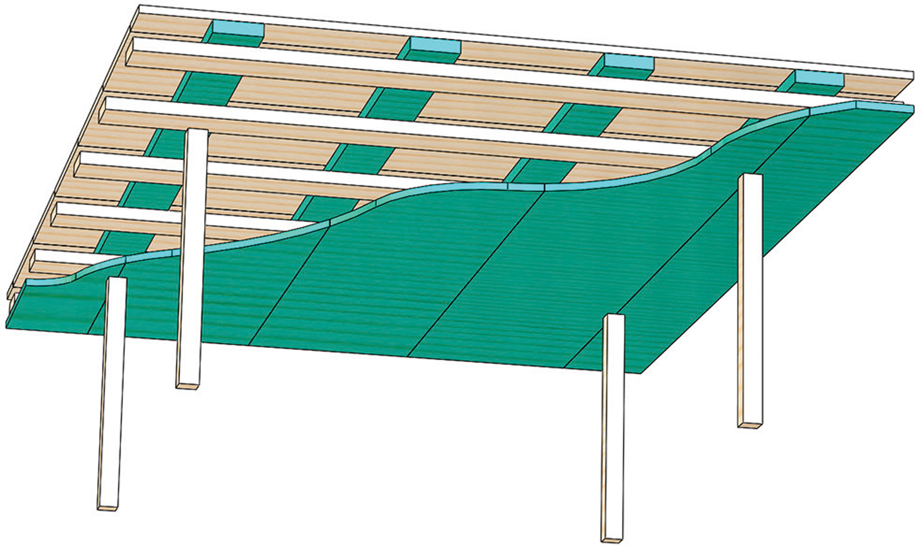
Design coordination
Łukasz Wesołowski, Paweł Mika
CLT, NLT, DLT principals:
Stressed Skin Lattice

Slide 52
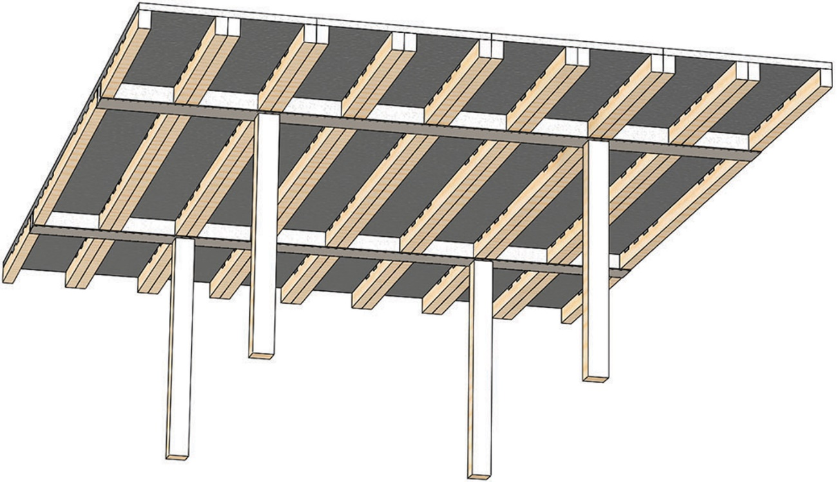
Design coordination
Łukasz Wesołowski, Paweł Mika
CLT, NLT, DLT principals:
Timberconcrete

Slide 53
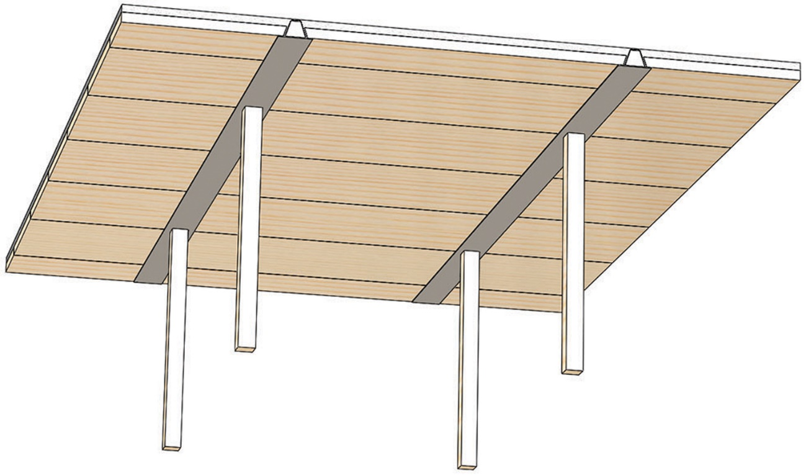
Design coordination
Łukasz Wesołowski, Paweł Mika
CLT, NLT, DLT principals:
Timberconcrete

Slide 54
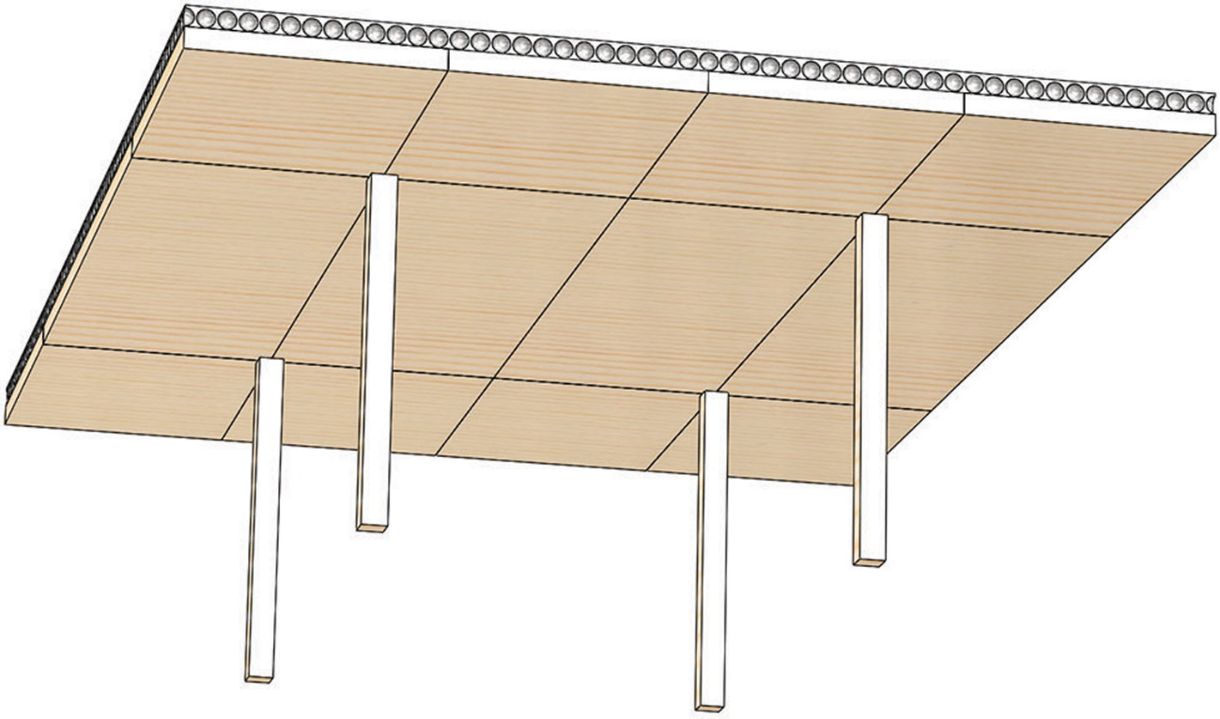
Design coordination
Łukasz Wesołowski, Paweł Mika
CLT, NLT, DLT principals:
Timberconcrete

Slide 55
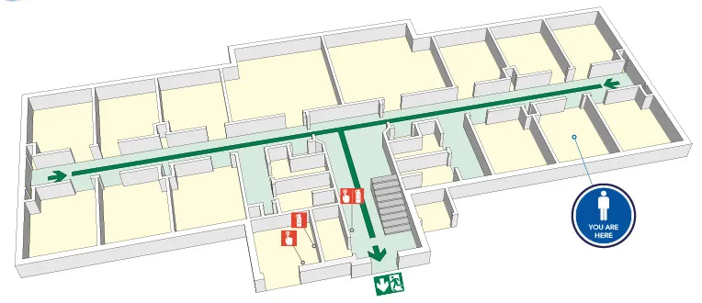
Design coordination
Łukasz Wesołowski, Paweł Mika
Fire safety (widths, divisions)

Slide 56
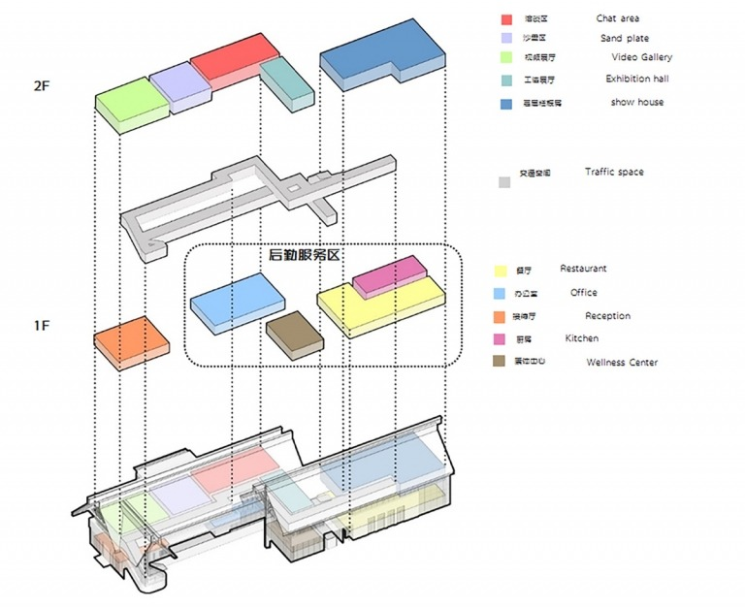
Design coordination
Łukasz Wesołowski, Paweł Mika
Fire safety
(widths, divisions)

