Slide 1
Flat roof solutions (construction, materials)
Sustainable, High-Performance Building Solutions in Wood (HiBiWood)
Vilma Vaičekauskienė

Slide 2
ROOFS
FLAT
SLOPED
EXPLOITABLE
NOT EXPLOITABLE
COLD ATTIC
WARM (EXPLOITABLE) ATTIC
TERRACE
ROOFING
ROOFING
FILM (MEMBRANE)
TILES
SHEETING METAL
OTHERS
PARKING
GREEN ROOF
MASTICS
- CERAMIC
- BITUMEN
- CONCRETE
- ROLLED SHEET
- PROFILED
- COMPOSITE
- SLATE
- ASBESTOS-FREE
POOL
ROLLER COATING
GLUED
FUSED
Notes:
Roofs are divided into two types - flat roofs with slope less than 7 degrees and sloped roofs with slope more than 7 degrees.
Flat roofs can be exploitable – they not serve only as roofs but they also can be used for various activities, for example – terraces, parking, green roof, pools and so on.
Other type of flat roofs are not exploitable and they serve only as roofs and provides protection agains rain, snow, sunlight, extremes of temperatura and wind.
Moost popular flat roof roofing are – film (membrane), various mastics and roller coating, which can be glued or fused.
Sloped roofs can be with cold attic, where ceiling are insulated and roof isn‘t and with warm, exploitable attic.
Most popular sloped roof roofing types are tiles – creamic, bitumen or concrete, sheeting metal – rolled or profiled and others, like composite, slate or asbestos-free.

Slide 3
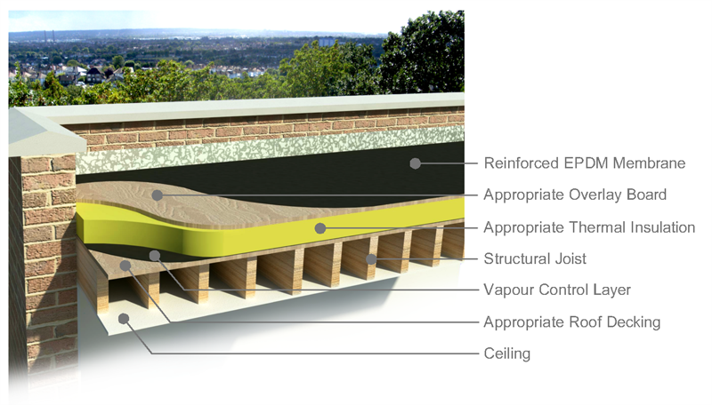
FLAT NOT EXPLOITABLE ROOFS
When designing and installing flat not exploitable roof structures, folowing layers must be considered:
Vapor barrier layer
Slope-forming layer
Thermal insulation
Windproof layer
Ventilated air gap
Vapor control layer
Additional waterproofing
layer (membranes, films)
Waterproofing coating
Waterproofing coating protective layer
https://joanacheongyear3.wordpress.com/2016/04/19/technical-study-lecture-3-roofs/

Slide 4
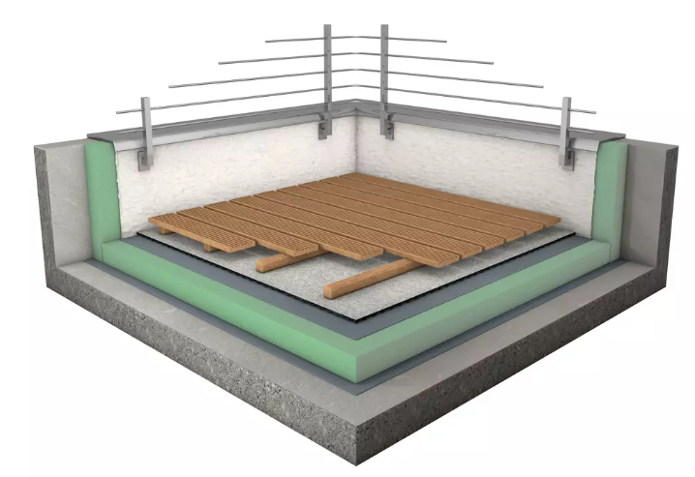
FLAT EXPLOITABLE ROOFS
When designing and installing flat exploitable roof structures, layers, same as for not exploitable roof, must be considered, with additional layers:
Water drainage layer
Flooring base layers
Flooring (tiles, planks)
https://antivibration-systems.com/product/regupol/

Slide 5
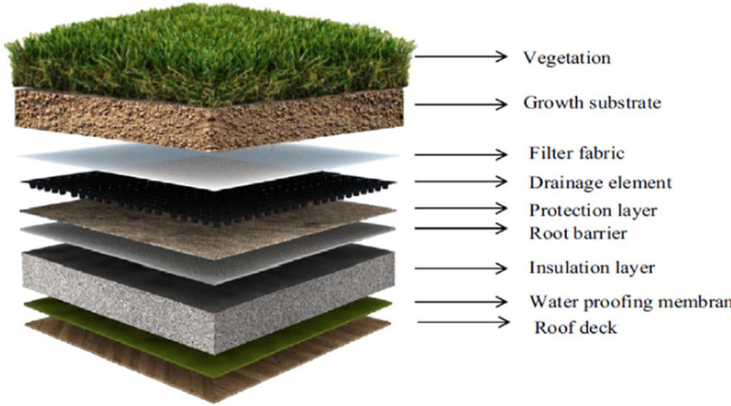
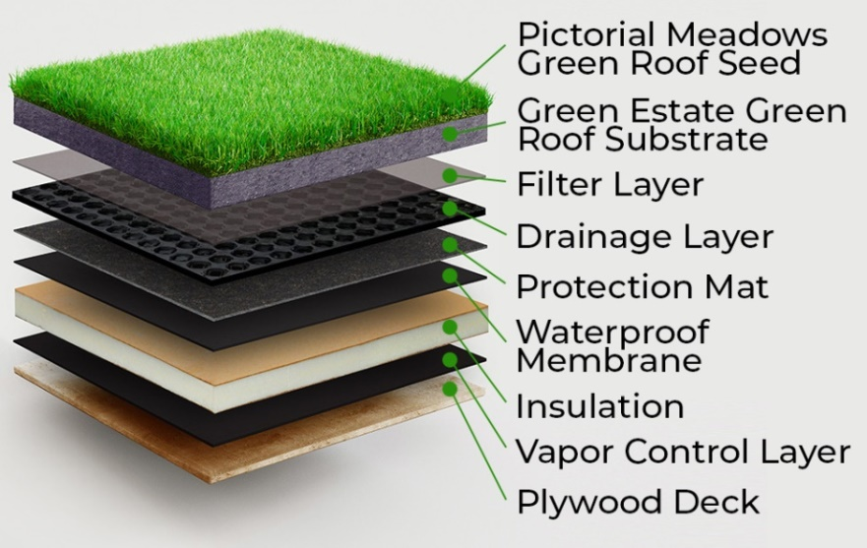
FLAT EXPLOITABLE (GREEN) ROOFS
When designing and installing flat green roof structures, layers, same as for not exploitable roof, must be considered, with additional layers:
Protection layer (root barrier, protection matt)
Water drainage layer
Filter layer
Substrate layer
Vegetation
https://www.researchgate.net/figure/Components-of-green-roof-25_fig2_328875883
https://www.iko.com/comm/blog/guide-to-commercial-green-roofs/

Slide 6
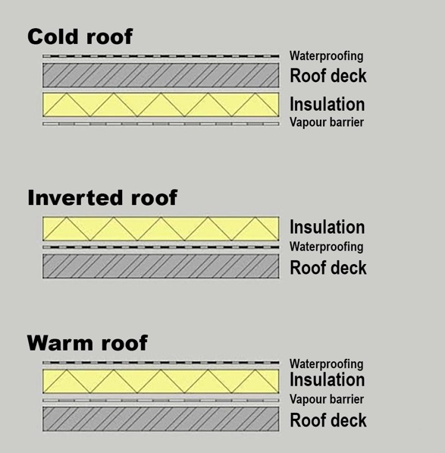
TYPES OF FLAT ROOF
Types of flat (timber) roofs are:
Cold roof
Inverted roof
Warm Roof
https://be.iko.com/en/do-you-know-the-difference-between-a-warm-a-cold-and-an-inverted-flat-roof/

Slide 7
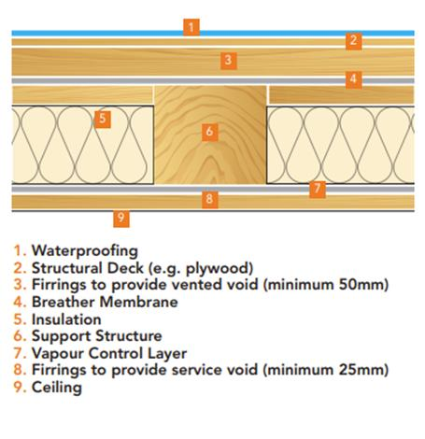
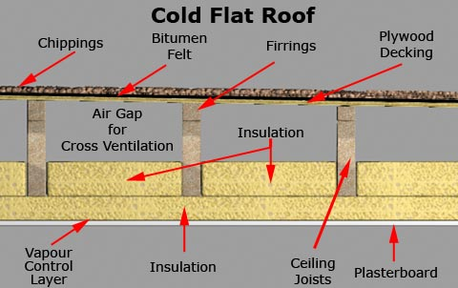
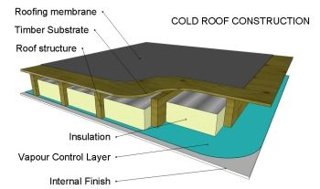
COLD ROOF
https://jtcroofing.co.uk/news/warm-flat-roof-cold-flat-roof/
https://www.bauder.co.uk/technical-centre/downloads/design-guides/flat-roof-design-guide.pdf
https://www.buildingregs4plans.co.uk/guidance_flat_roof_types.php
https://www.nicholsonsts.com/news/blog-dont-get-caught-out-ignoring-vapour-control-layer
Notes:
In cold roof construction insulation typicaly is installed below or betwwen load-bearing beams or joists, on top of which the roof covering is installed. Cold roofs have some disadvantages:
The timberwork sits right up against the roof covering and protected against temperature variations. This makes the entire roof construction much more liable to expansion and contraction, which may cause the roof covering to tear or burst.
While it is possible to install a vapour barrier below the insulation, it remains particularly difficult to ensure adequate ventilation with this construction method. This makes cold roofs sensitive to condensation, which may cause the wooden roof construction to rot.
To avoid condensation it is important that the void is well ventilated.
Ventilation openings should be provided to every roof void along two opposite sides of the roof and should be equivalent in area to a continuous opening of not less than 25 mm at each side.
The vapour check must be used to prevent condensation and any openings in the ceiling must be sealed. The vapour control layer should have a resistance of at least 250 mns/gm(Mega-Newton seconds per gram), and should have sealed laps to preserve its integrity over the whole roof. Gaps in the ceiling should be minimized and service openings should be avoided; it is recommended that a service cavity be used so that the vapour control layer remains intact.
This was the traditional way of flat roof construction and as insulation has increased over the years, the warm deck roof is now the commonly used method of construction.

Slide 8
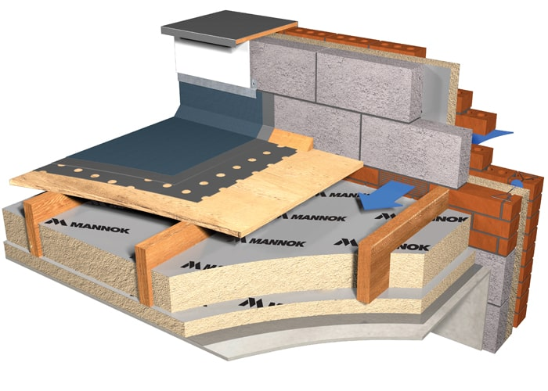
https://www.mannokbuild.com/insulation-boards/flat-roof/
Notes:
Another example of cold roof with parapet.
In this case, ventilation openings should be provided in the wall.

Slide 9
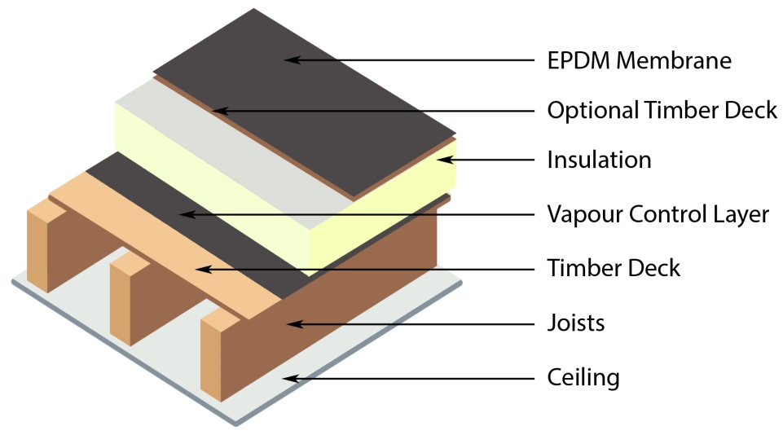
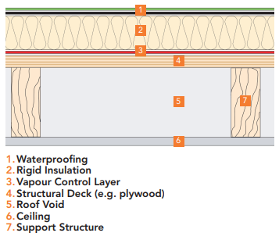
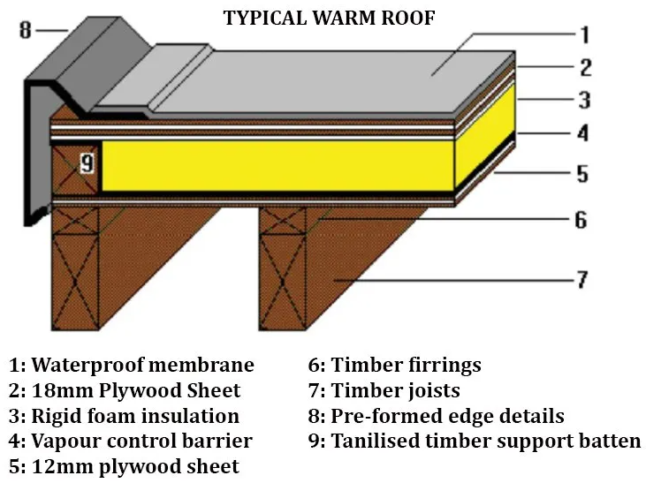
WARM ROOF
https://www.flexibleroofingsupplies.co.uk/guides/roof-build-ups
https://www.bauder.co.uk/technical-centre/downloads/design-guides/flat-roof-design-guide.pdf
https://www.grp-flatroof.co.uk/warm-roofs
Notes:
In a warm roof construction thermal insulation layer is located above the structural decking, resulting in the structural deck and support structure being at a temperature close to interior temperature of the building. In this case, wood structures won‘t be affected by temperature changes.
It is necessary to incorporate a vapour control layer beneath the insulation in order to prevent moisture vapour being forced into the insulation through thermal pressure from within the building.
The waterproofing membranes are placed over the insulation to completely encapsulate and protect it.
There is no requirement for roof void ventilation.
It is esier to eliminate cold bridging through the system because there are no interruptions from the structural supports as there is in a cold roof construction.
This is the most widely used type of flat roof construction, due to the simplicity of its design, and is suitable for most building types.

Slide 10
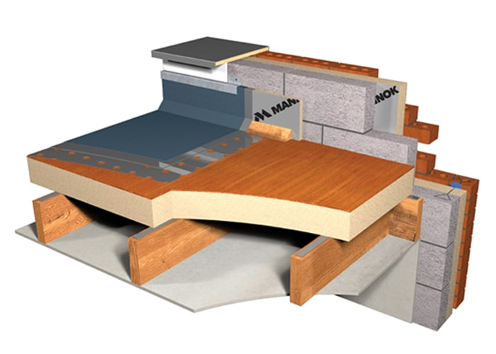
https://www.mannokbuild.com/insulation-boards/flat-roof/
Notes:
Another example of warm roof with parapet.

Slide 11
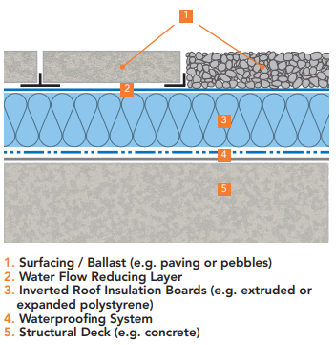
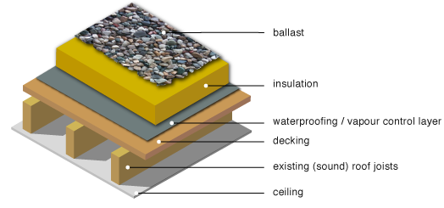
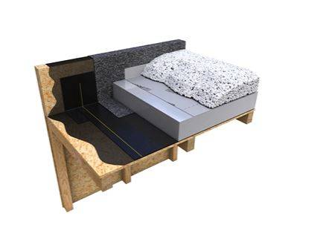
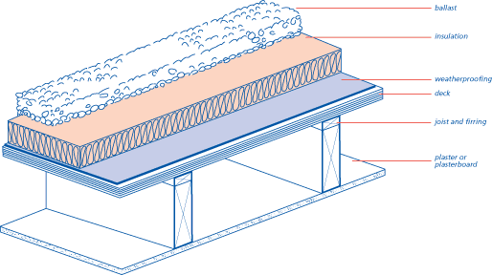
INVERTED ROOF
https://www.bauder.co.uk/technical-centre/downloads/design-guides/flat-roof-design-guide.pdf
https://www.greenspec.co.uk/building-design/timber-flat-roof-insulation/
https://source.thenbs.com/categories/overview/flat-roof-covering-systems/6Vz6uzmHfMeRK8xqMSzMGw
http://nhbccampaigns.co.uk/landingpages/techzone/previous_versions/2006/Part7/section1/appendix.htm
Notes:
Inverted roofs have similar construction to the warm roof as thermal insulation is above the load bearing beams, joists. The main difference between warm and inverted roofs, is that in inverted roofs, thermal insulation is above the waterproofing layer.
Thermal insulation should be highly resistant to water absorption – for example, an extruded polystyrene based product which will not be affected by water or repeated freeze/thaw cycles.
Any rain water will drain from the roof surface as well as passing through the gaps in the insulation layer.
It is recommended the use of double entry type drains so that the water can drain at surface and deck level.
This type of roof is widely used on civic buildings, hotels, apartment blocks and hospitals. It is ideally suited to roofs which are heavily trafficked, such as car park decks, patios and roof gardens.
The thermal insulation also have to be dense enough to support loads imposed upon it and have overlapping or interlocking joints to minimise thermal bridging.
To regulate the movement of water and protect against dirt and grit penetrating the joints between insulation boards, water flow reducing layer (WFRL) should be placed on the insulation layer; to assist the flow of water to drainage outlets.

Slide 12
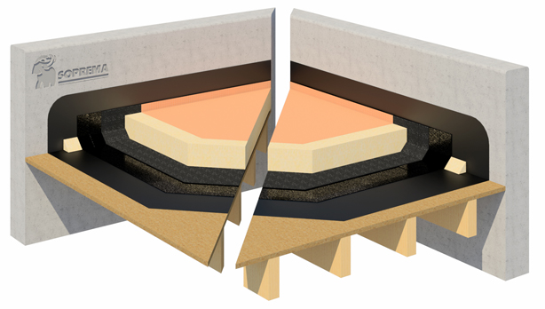
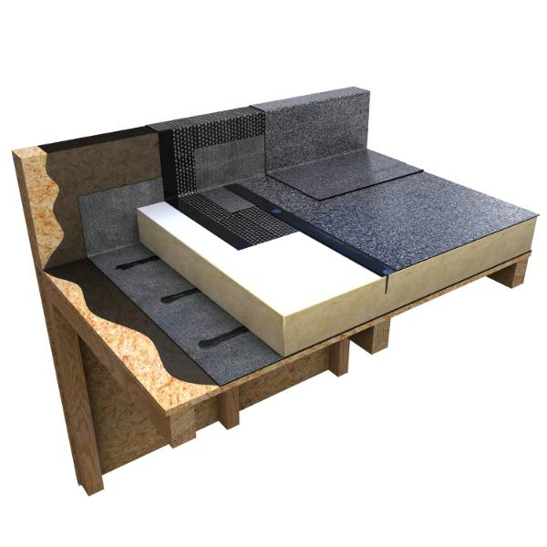
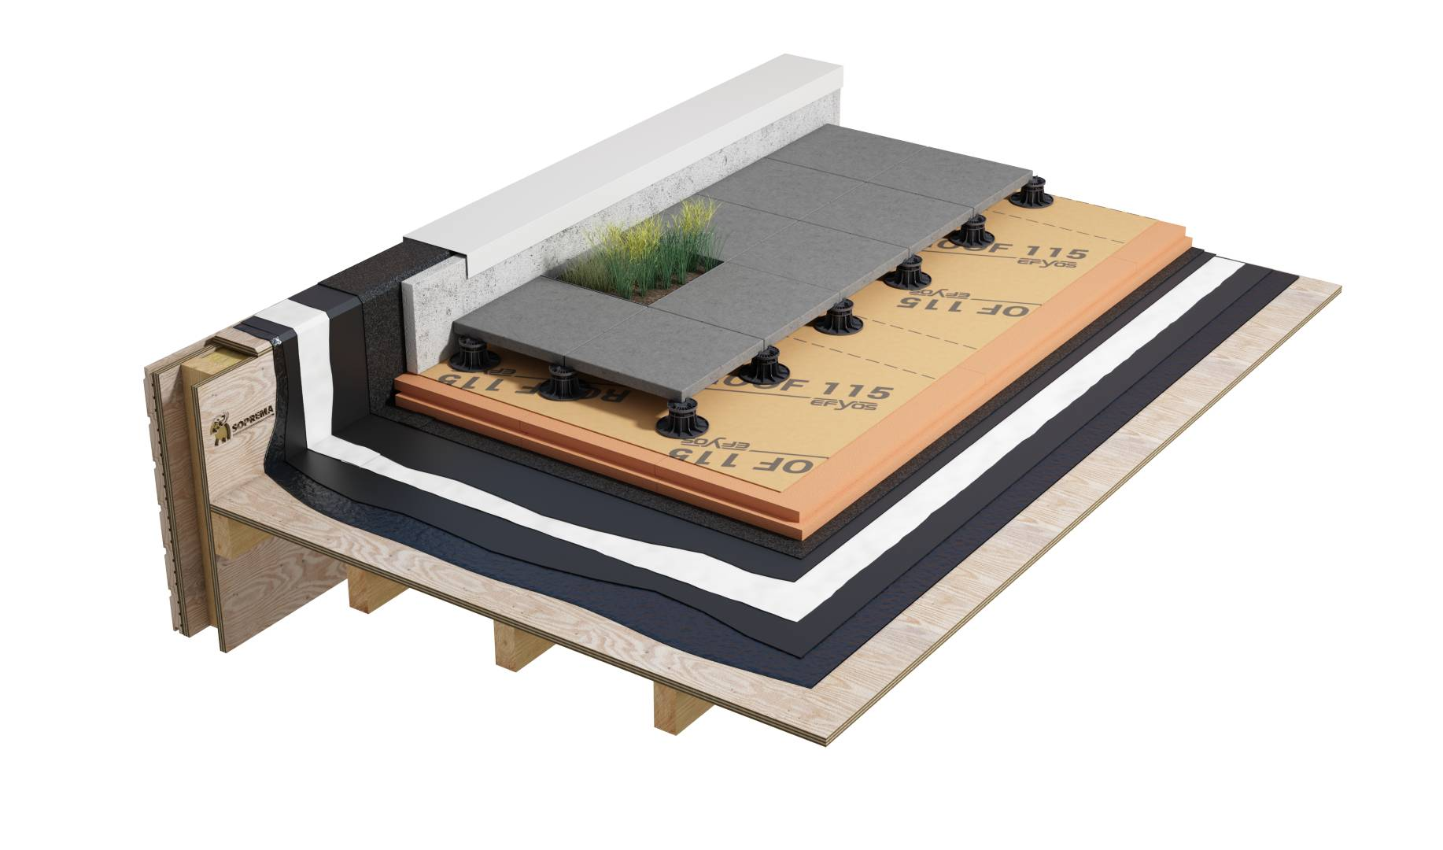
https://www.soprema.ie/en/selection-guide/solution/bitumen-inverted-warm-roof-system
https://source.thenbs.com/product/excel-fm-warm-roof-flame-free-mechanically-fixed-single-layer-system-timber-roof-deck-profile-metal-deck/nWEtMpU3JZjJzW7wX3D4ag/d1rFzPQdc37pt8Jyc3FwPZ
https://source.thenbs.com/product/duoflex-double-pour-hot-melt-inverted-roof-system-with-paving-slabs-timber-deck/g4NCEQ7W5Mssb5CELWQSX7/8Cr9GMcWV6wY4M31ZWQXSB
Notes:
There is usually no need to provide a vapour check with this type of roof but this can be confirmed by a condensation risk analysis.
Surface condensation is unlikely to occur due to the fast thermal response, provided that there is sufficient insulation to maintain the weatherproof finish above the dewpoint over the whole roof. with this type of roof, rainwater seeping below the insulation will cool the waterproof membrane intermittently, increasing the risk of condensation on the membrane.
When calculating the risk of interstitial condensation the thickness of insulation should be assumed to be 80 % of the actual thickness.

Slide 13
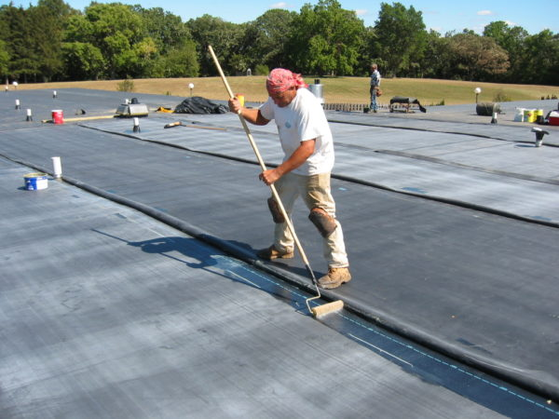
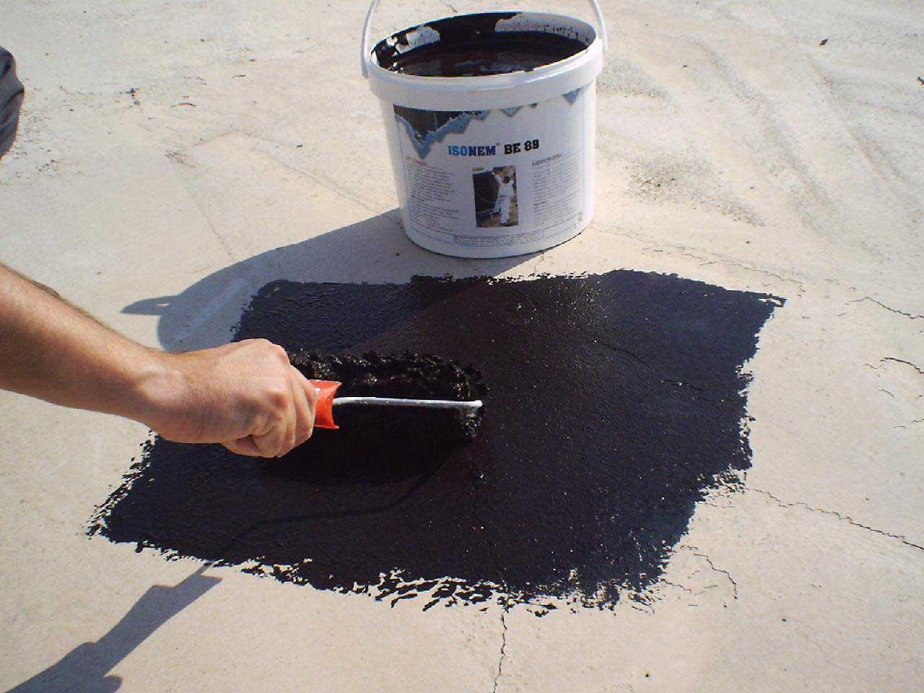
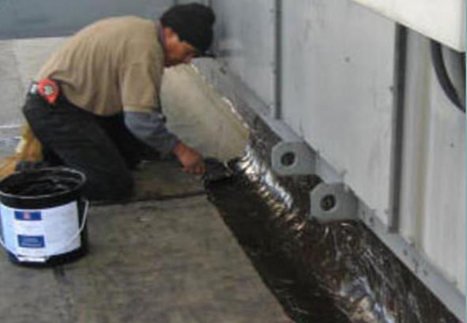
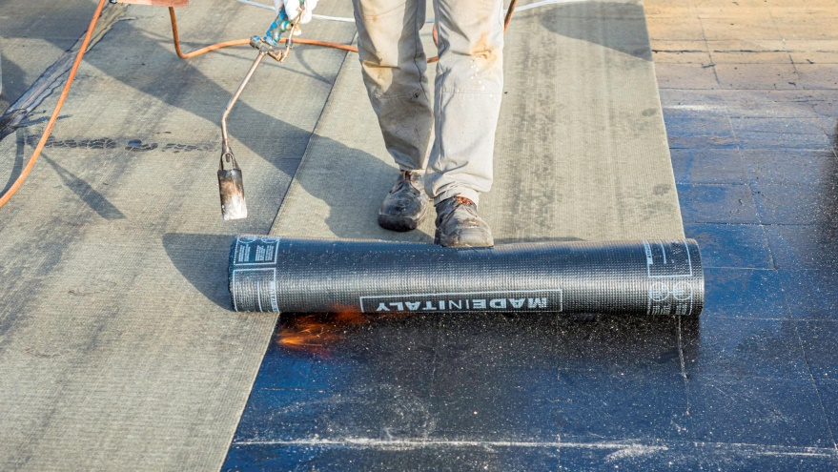
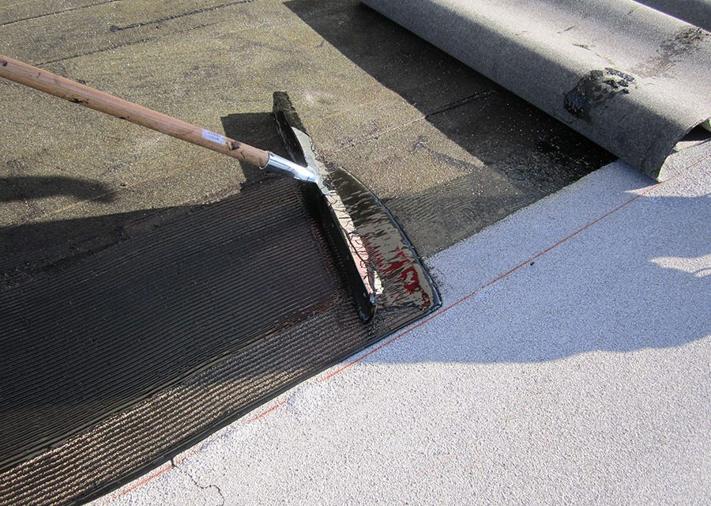
ROOFING MATERIALS
EPDM membrane
Roof mastic
Repair mastic
https://epdmroofs.org/what-is-epdm/epdm-in-the-field/
https://www.indiamart.com/proddetail/medium-setting-bitumen-emulsion-24223708362.html
https://inspectapedia.com/roof/Roof_Sealant_Application.php
Roller roof coating – torch down roofing
Roller roof coating – cold applied
https://www.thespruce.com/rolled-roofing-1821945
https://www.waterproofmag.com/2014/10/cold-liquid-applied-roofing/
Notes:
EPDM is one of the most versatile rubber roofing options on the market. Considered to be one of the best materials for flat roofs, rubber is a popular choice for industrial and commercial applications thanks to its ability to withstand extreme weather conditions. It requires little maintenance, is tear-resistant and has good insulation properties, which all contribute to its long lifespan.
EPDM flat roofs are designed to last about 25-30 years, but most manufacturers claim a life expectancy of up to 50 years.
Roof mastic is a roofing product used to seal a roof so water cannot penetrate. Several different kinds of products are referred to as mastic; generally speaking, roof mastics are sticky, drying to a flexible, rubbery finish after they are applied and allowed to cure.
Roof mastics can be classified by application: roofing, waterproffing, adhesive, protective and sealing. They can be bitumen, acrylic, silicone, polyurethane, urethane.
Roller roof coatings can be bituminous, polymeric, polymer modified and other composites. Installation of roller coatings can be done in two ways: torch down or cold applied.
Torch down roofing is so named because it requires an open-flame propane torch. In this installation method, sheets of modified bitumen are rolled out onto the roof, and a roofing professional uses a hand-held propane torch to heat the material and adhere it to the surface. Once the layers reach the right temperature, seams are melted together to create a waterproof seal.
Cold applied roofing utilises either a single or two-pack waterproofing solution that uses a cold process adhesive to bond with the substrate, as an alternative to traditional hot works.

Slide 14
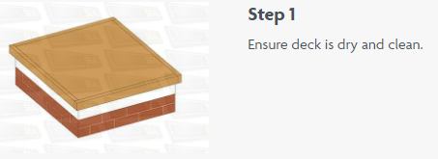
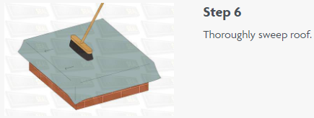
EPDM INSTALLATION – FULLY ADHERED SYSTEM
https://www.rubba-seal.co.uk/installation-guides/laying-membrane/
Notes:
Single ply roofing can be installed using mechanical fasteners, a ballasted system, or fully adhered with chemical adhesive.
Fully adhered roof systems tend to have great aesthetic appeal, they tend to have little trouble with roof membrane fluttering and is a time-tested roof securing method.
Fully adhered system installation process consists of following steps:
1. Preparation of the roof deck - the roof deck should be thoroughly clean from any oil or grime, and you should sand any sharp edges. Even a small amount of moisture can lead to problems with the adhesive, so it’s essential that everything is dry before you begin your EPDM installation.
2. Membrane placement – membrane shall be installed so that the seams shed or run parallel to the flow of water. First, place membrane panel, unroll without stretching, over the acceptable substrate leaving sufficient membrane for tie-ins, roof edges and seaming. Allow membrane to relax for a minimum of 30 minutes before adhering or splicing. During cold weather application, it is recommended that the smallest panels be used to minimize folds (larger panels have factory folds which may take longer to relax during cold weather). Placement of additional rolls of membrane shall provide for sufficient overlaps for seaming of membranes.
3. Folding membrane back - after making sure the sheet is placed in its final position allowing for the minimum lap width, fold it back evenly onto itself without wrinkles to expose the mating surface of the sheet.
4. Removing dusting agent and dirt - sweep the mating surfaces with a stiff broom to remove any dusting agent or dirt that may have accumulated.
5. Apply the Bonding Adhesive - apply bonding adhesive with either a solvent-resistant paint roller, power roller or a commercial-grade adhesive sprayer. Adhesive must be applied in a relatively uniform thickness to both surfaces at approximately the same time. If adhesive is spray-applied, it must be back-rolled with a paint roller to assure proper contact and uniform coverage.
Keep Bonding Adhesive off the membrane Seam Area. Care must be taken not to apply bonding adhesive over an area that is to be later spliced to another sheet or flashing. All bonding adhesives must be completely removed from the seam area.
Allow the bonding adhesive to flash-off. Touch the adhesive surface in several places with a clean, dry finger to be certain that the adhesive does not stick or string. As you are touching the adhesive, push forward on the adhesive at an angle to ensure that the adhesive is ready throughout its thickness. If either motion exposes wet or stringy adhesive when the finger is lifted, the adhesive is not ready for mating. Flash-off time will vary depending on ambient conditions of temperature and humidity.
6. Mate the membrane to the substrate - starting at the fold, roll the previously coated portion of the membrane into the coated substrate slowly and evenly to prevent wrinkles. Broom the membrane to assure proper contact, compress the bonded half of the membrane to the substrate with a stiff push broom.
7. Repeat procedures as necessary until all EPDM is adhered - complete the membrane installation fold the un-adhered half of the membrane back onto itself, and repeat the procedure.
8. Fabricate the lap splice - splice the outside edge of the top sheet. Apply patches at all 3-way sheet intersections and at all factory laps that intersect another sheet.

Slide 15
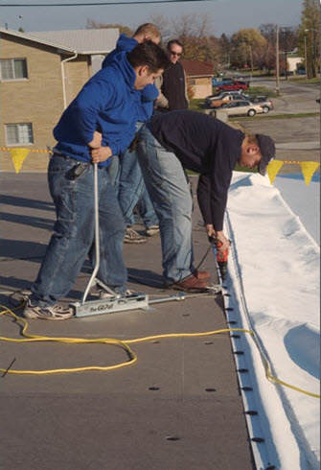
EPDM INSTALLATION – MECHANICALLY FASTENED SYSTEM
https://www.weatherbondroofing.com/what-is-single-ply/system-assemblies/mechanical-system-assembly/
https://carlislesyntec.com/en/Roofing-Products/Membranes/TPO
https://rtnroofing.com/blog/roofing/installation-methods/
Notes:
A mechanically-attached system has the benefit of guaranteeing that the roof is attached directly into the structure of the building.
A mechanically-attached system is usually less expensive than a comparable fully-adhered system.
A mechanically-attached system can be done in colder weather.
Mechanically attached system installation process consists of following steps:
1. Prepare roof deck – clean dust and dirt or any oild or grime and sand any sharp edged.
2. Place Membrane and Allow to Relax – ends of the membrane sheets have to overlap minimum of 75 mm up to 150 mm.
3. Layout fastening plates – install plates every 300 mm or as required by the specification. Install each fastener so that it is properly engaged in the deck and the head is seated in the plate. Use caution not to overdrive the fastener.
4. Fabricate the lap slplice - splice the outside edge of the top sheet.

Slide 16
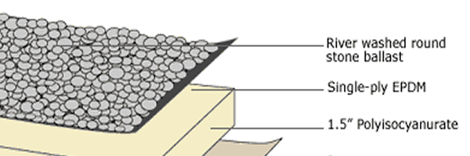
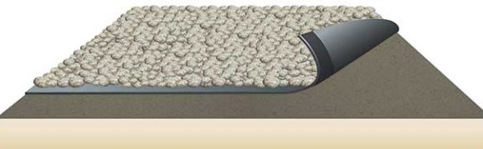
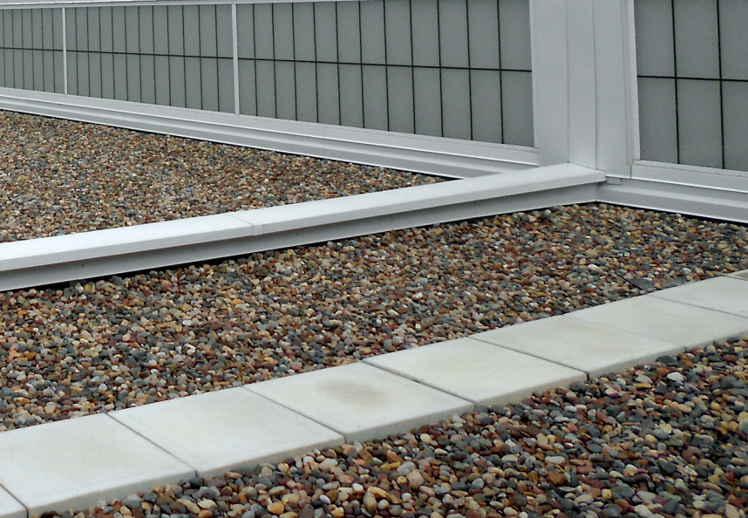
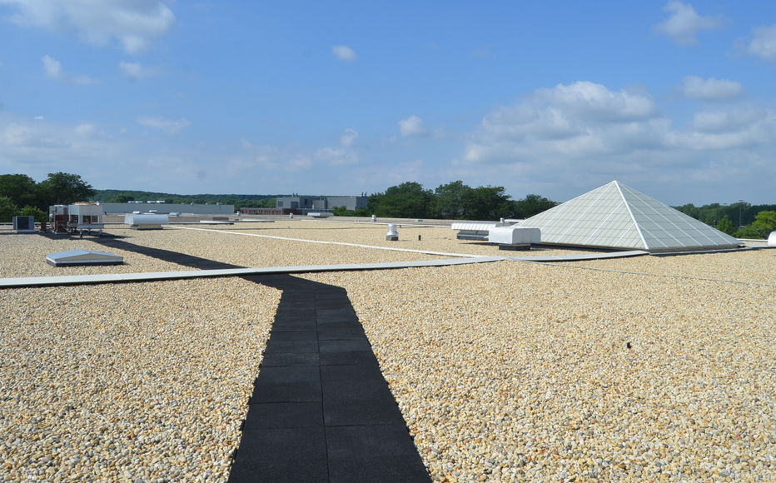
EPDM INSTALLATION – BALLAST SYSTEM
https://www.carlislesyntec.com/en/Roofing-Products/Membranes/EPDM
https://www.chasenw.com/blog/what-is-epdm-roofing/
https://www.carlislesyntec.com/dfsmedia/c9a15d476f364981b1124520f6258acf/9018-source
https://www.carlislesyntec.com/dfsmedia/c9a15d476f364981b1124520f6258acf/9193-source
Notes:
Ballasted systems offer reliable wind-uplift resistance, which can be enhanced by simply using larger and heavier ballast around perimeters.
Ballasted system installation process consists of following steps:
1. Prepare roof deck – clean dust and dirt or any oild or grime and sand any sharp edged.
2. Place Membrane and Allow to relax. Ballasted System must be installed so that the splices shed the flow of water.
3. Move the membrane panel to its final position allowing for a minimum 100 mm field seam onto adjacent panels and sufficient membrane for proper membrane terminations.
4. Ballast installation – stone ballast:
Spread ballast - the ballast shall be spread over the completed EPDM system at the rate specified by the project designer but never less than 50 kg/m². Ballast must be spread over the membrane using soft rubber tired ballast buggies. Spread ballast around penetrations by hand. Take care not to puncture/damage EPDM when distributing the ballast.
Protect membrane and insulation at ballast loading areas: at staging areas where ballast is loaded, protect the membrane and underlying insulation using insulation and/or plywood over an additional layer of protective membrane. Remove and replace all materials damaged from ballasting operation.
Distribute Ballast Around Walkway Pads: any ballast displaced by a walkway should be distributed around the pad to maintain the specified average ballast rate. Do not place a walkway and pads within 3.0 m of a roof edge. If needed around mechanical equipment, use appropriate ballast pavers.

Slide 17
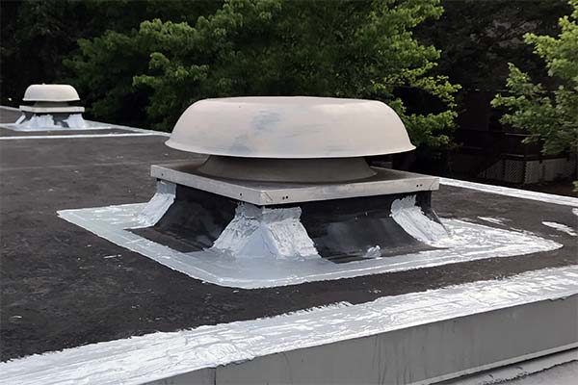
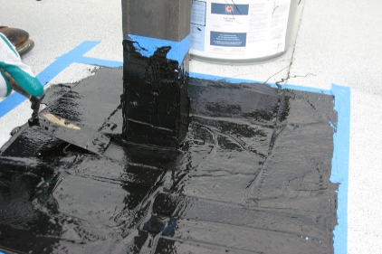
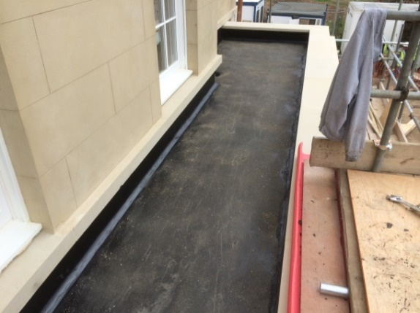
ROOFING MATERIALS – ROOFING AND WATERPROOFING MASTICS
https://www.buildingenclosureonline.com/articles/83571-liquid-roofing-mastic
https://www.americanweatherstar.com/roof-mastic-purpose/
https://shieldmembranes.com/shieldflexr/
https://msroofing.ie/services/mastic-asphalt-roof/
Notes:
Bitumen mastics and primers have a vast area of application. Right material choice often impacts lifetime of coating, its operational properties and costs.
Mastic roofing installation is chosen in several cases: when the roof is of a complicated shape and torch-on applied bitumen membranes cannot be used, and when torch-on application is difficult or cannot be conducted on industrial facilities with high level of fire-safety (power plants, elevators, etc.).
MASTIC ROOFING PROVIDES:
Seamless (monolithic) coating of a waterproofing layer
Possibility of installation of a waterproofing layer without the use of flame
Easy installation of a waterproofing layer in case of a large number of roofing elements
Mastic roofing installation is quite simple and does not require special equipment

Slide 18
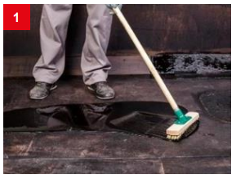
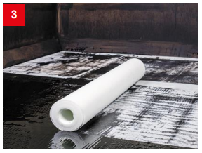
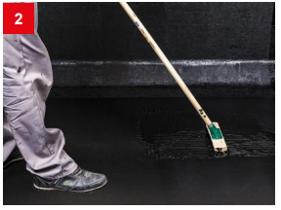
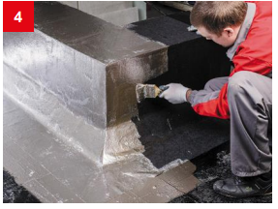
ROOFING MASTIC INSTALLATION
https://technonicol.in/upload/iblock/1cf/1cf523e93ce1dc189110a606ccec5125.pdf
Notes:
Prepare the surface and clean it from dust, dirt and grease in advance. Treat the surface with BITUMEN PRIME COATING. The primer should dry completely to conduct further works.
1. Apply the first layer of mastic on the primed surface.
2. Apply 3 layers of a roofing mastic (3-4 mm) by pouring and levelling over the surface with a squeegee or a brush.
3. Install reinforcement layers of a glass fiber between all the layers of mastic.
4. The resulting monolithic layer must be protected from the impacts of UV and temperatures.

Slide 19
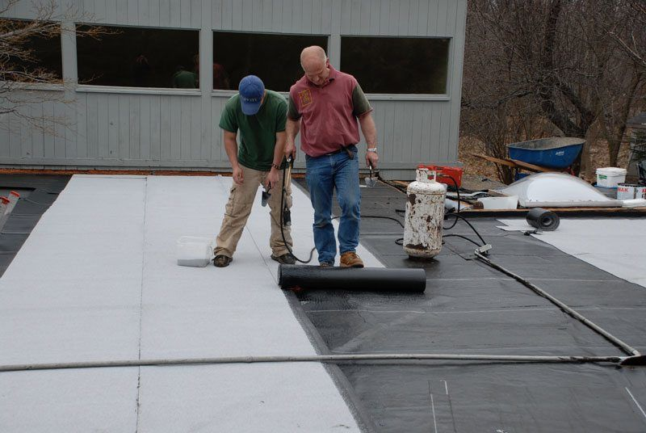
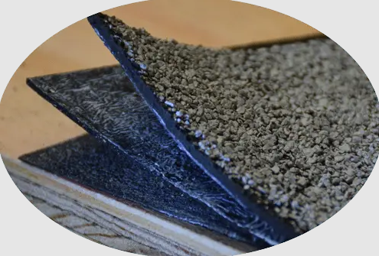
ROOFING MATERIALS – TORCH DOWN ROOFING
https://stl-roofing-commercial-and-residential.business.site/
https://commercialroofusa.com/torch-down-roofing-commercial-rubber/
Notes:
The membrane layers of a torch down roof are made of an asphalt compound called bitumen that is modified with either rubber or plastic.
The main strength of this type of roofing is that it can expand and contract without melting or cracking.
There are two different types of torch-down roofing systems: two-layer and three-layer.
A two-layer torch down roof consists of one base sheet and one smooth cap sheet.
A three-layer torch down roof features the same base and cap sheets, as well as an additional cap sheet with a granulated surface.
Two-layer torch down roofs may cost less to install, but they don’t last as long or offer as many benefits as three-lawyer torch down roofs do. The granulated cap layer of a three-layer roof adds to the roof’s energy efficiency, fire resistance, curb appeal, and durability.

Slide 20
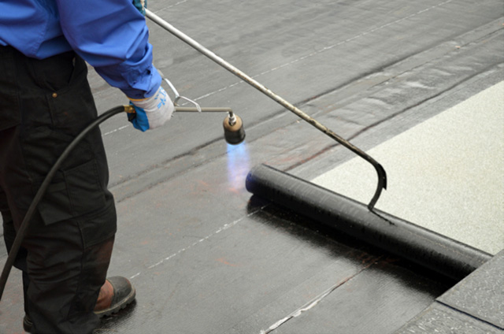
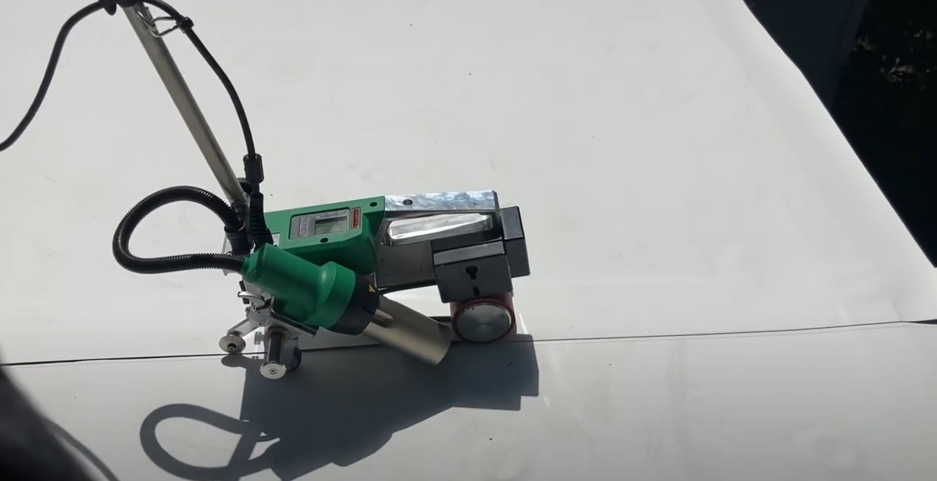
INSTALLATION OF TORCH DOWN ROOFING
https://improveitmd.com/torch-down-roofing-guide-materials-installation-benefits-and-disadvantages/
https://www.serviciodeasfalto.com.pe/servicio-de-impermeabilizacion-de-techos-en-lima/
Notes:
Both two-layer and three-layer roof systems feature the same base and support components, applied in the same order.
First of all, prepare the surface - remove all the dirt and dust.
Then install base sheet – first layer of torch down roofing material. There are two methods for installing base sheet:
Heat fusing method or adhesive
Next step is to install smooth cap sheet – second layer of the torch down roofing material. As this sheet of material is rolled out—on top of the base sheet — the roofer will heat the underside of the cap sheet material with a torch. As the heated cap sheet is pressed onto the base sheet underneath, they will fuse and form a watertight seal.
If installing a two-layer torch down roof, this is the final layer of rolled roofing material the contractor will apply. If installing a three-layer torch down roof, a third layer should be layed down—with a granulated surface—in the same way.
After that other finishing elements (flashing and etc.) are installed.

Slide 21
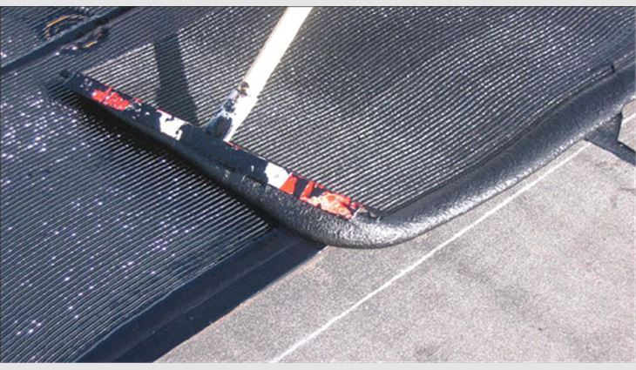
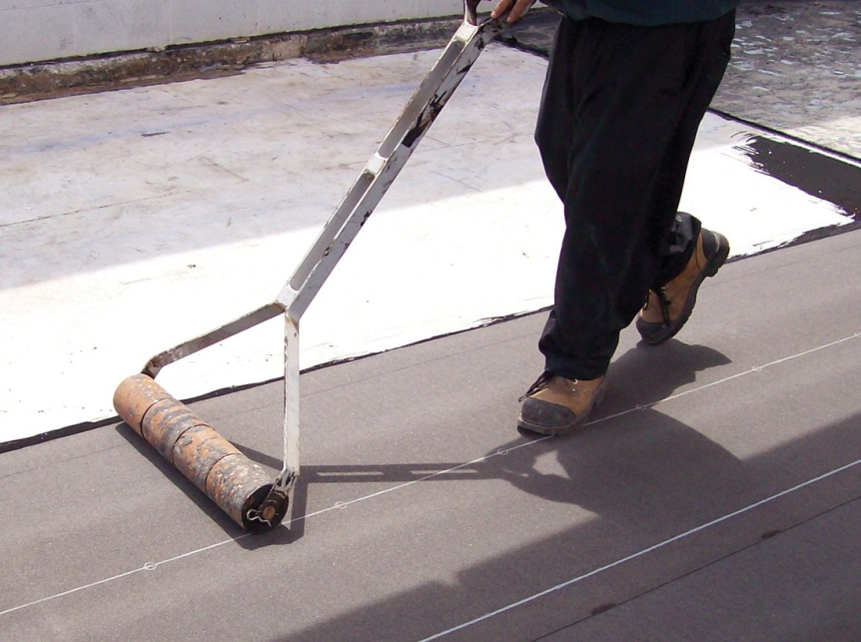
ROOFING MATERIALS – COLD APPLIED ROOFING
https://www.professionalroofing.net/Articles/Warming-up-to-cold-adhesives--12-01-2007/1191
https://www.iko.com/comm/cold-applied-roofing-systems/
Notes:
The seamless, durable waterproofing with high penetration resistance, can be applied to most complex projects that include penetrations, upstands and complex detailing.
Both single- and two-pack cold applied roofing solutions can be used on all roof types, including warm, inverted and full overlay applications.
Full bond can be achieved with most types of substrates, including existing layers if these are of adequate quality.
Benefits of cold applied roofing:
Long lasting system with a life expectancy of up to 25 years
Extremely fast installation and curing
Excellent adhesion to all kinds of surfaces, including existing substrates
Highly flexible in design application
Helps simplify complex detailing
Chemically resistant and UV stable
High resistance to extreme temperatures and hydrolysis
Completely seamless waterproofing without joints or fixings
No heat is needed, negating inherent risks associated with hot works
There is no requirement for any specialist installation equipment
Installation of cold applied roofing consists of following steps:
1. Prepare the roof – clean it and remove any debris from the surface.
2. Apply roofing cement - ou will need to apply roofing cement at different points of the project. Roofing cement has adhesive properties that help things stick together, which is why it’s commonly used in roll roofing and for other roof materials. To start off, add roofing cement to the edges before you attach the first sheet. Add roofing cement using a caulk gun and then spread it around using a brush.
3. Attach base sheet - Unroll the base sheet of the roofing material over the surface. It should overhang the drip edges by around 6 millimeters. Depending on the type of material you use, you either nail it in place, or it might be sticky enough to simply attach to the surface.
4. Attach second sheet - after adding the first sheet, spread roofing cement along the edges of it. Then cover the second sheet underneath with it before placing it overlapping the first sheet. The second sheet should overlap the first sheet anywhere from 10 to 15 centimeters. Use chalk so the second sheet gets rolled in the correct position.
5. After that seal the vents, overlap valleys and add flashings and so on.

Slide 22
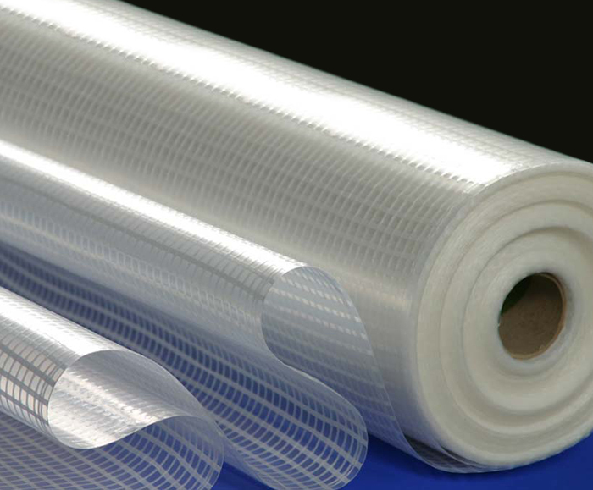
VAPOUR CONTROL LAYER
The primary function of a VCL is to keep warm moist air from inside the building – inside the building. Because of this, the VCL always sits at the warm side of the insulation.
https://www.proctorgroup.com/products/procheck-500
https://performancebuildingtapes.com/product/siga-majrex-200-siga-tapes/
Notes:
The Vapour Control Layer is often overlooked, underrated, punctured and sometimes even completely omitted, bet it is actually a very important part of the roof build-up.
In a cold roof build-up, the VCL normally ends up on the underside of the joists or rafters. VCL may be punctured when installing ceiling construction. For this reason, it’s very important that the cold roof has the correct ventilation to ensure that any potential condensation that forms can dry out without causing damage to the roof structure or covering materials.
In warm roof build-up, a vapour layer should be positioned under the insulation or, in some situations, immediately below the roof covering to minimise water vapour condensing beneath the membrane.

Slide 23
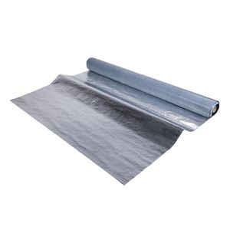
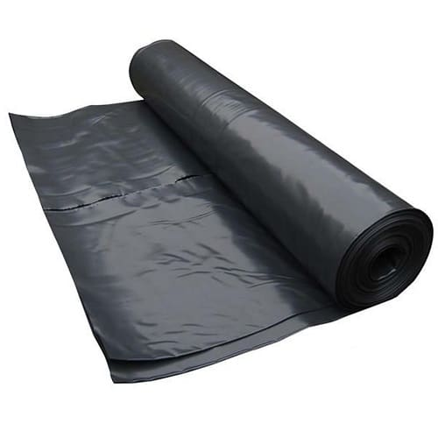
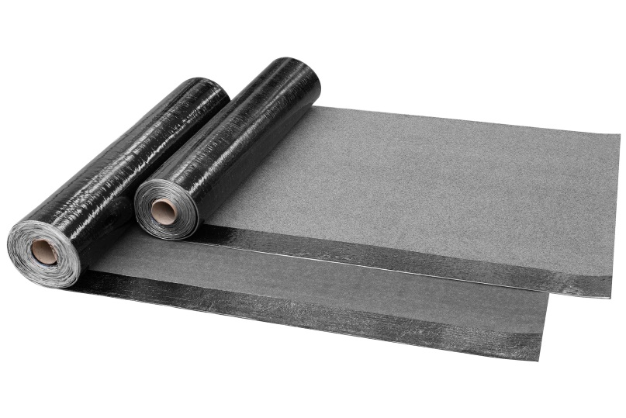
VAPOUR CONTROL LAYER - MATERIALS
Vapour control layer may be formed using any of the following.
Polythene
Reinforced bitumen sheet
Reinforced aluminum foil
https://www.keithbuilders.co.uk/polythene-dpm-damp-proof-membrane-3648-p.asp
https://www.environdec.com/library/epd3761
https://www.archiexpo.es/prod/bwk-dachzubehoer/product-56988-1920350.html
Notes:
A polythene sheet membrane loose laid and restrained by mechanical fasteners or nailed to the deck (timber decks) all laps should be sealed with an appropriate adhesive.
A reinforced bitumen sheet - one layer fully bonded or mechanically nailed to the deck.
Two layers of reinforced bitumen sheet fully bonded in hot bitumen. All laps must be sealed with bitumen.
For single-ply membranes, the VCL should be either polythene or reinforced aluminium foil.

Slide 24
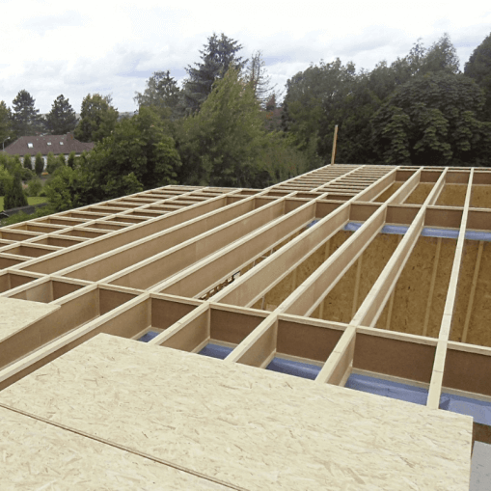
FLAT ROOF CONTRUCTION ELEMENTS
Wooden roof structure consists of following elements:
Joists, beams
Longitudinal and transverse firrings
Decks
https://www.weyerhaeuser.com/woodproducts/lumber/southern-lumber/premium-joist/
https://www.sveikastatyba.lt/prekiu-katalogas/steico-joist-dvitejiniu-siju-sistema/
https://popleroofing.com/carpentry-and-roof-construction.html

Slide 25
LOAD-BEARING BEAMS
Flat roof load-bearing beam types:
Construction timber
Glue laminated timber
LVL (Laminated Veneer lumber) wood beams
I-joist
Open (metal) web joist beams
https://wesbeam.com/resources/news/timbered-presents-designing-to-embrace-prefabricat
https://tartak-halama.pl/drewno-c24/
https://www.hess-timber.com/en/products/glued-laminated-timber/
https://www.archdaily.com/catalog/us/products/18271/glued-laminated-timber-hess-timber/203442
https://bwp.lt/wood-for-construction/lvl/
https://www.aberrooftruss.co.uk/benefits-of-metal-web-joists/
Notes:
Construction timber is dried to the 16-18% moisture content level, calibrated timber is then graded (its strength category is determined) as per stress and strength requirements appilcable to C16 or C24 category timber. Also other categories are available from C14 to C40, but these two are the most common. In order to prolong and ensure the expected service life of timber as a construction material, it is recommend to further treat it as required. One of the methods is impregnating, which prevents mould, decay, insects, bacteria and fungi.
Glue laminated timber is created from several layers of structural timber merged together with adhesives to make bigger sections which can be curved and can cover larger spaces whithout additional supports.
Laminated vaneer lumber is a composite product manufactured from multiple thin layers of veneer that are aligned with the length of the finished lumber. Major advantages of LVL include its dimension, shape, high strength properties and low cost.
I-joists are strong, lightweight, "I" shaped engineered wood structural members that meet demanding performance standards. They are comprised of top and bottom flanges, which usually are made from construction timber, which resist bending, united with webs, which usually are made from OSB (Oriented Strand Board ) and provide outstanding shear resistance.
Metal web system is a combination of timber chords and pressed metal webs which together form an „open-web“ joist. Their open web design allows for the installation of services such as pipework, cabling, mechanical heat recovery systems and other services to be passed through the metal webs without the need for notching or drilling.

Slide 26
DECK TYPES
DECK TYPES:
Close Boarded Timber
Plywood
Oriented Strand Board (OSB)
Wood Particle Board (Chipboard)
https://www.indiamart.com/proddetail/oriented-strand-board-osb-21675106330.html
https://www.boardmart.co.za/chipboard
http://www.southernwoodspecialties.com/product/2x6-tg-v-roof-decking/
https://www.artdepotcr.net/product-p/231212.htm
Notes:
Close Boarded Timber -Timber boarding suitable for roof decks should be a minimum 19mm nominal thickness, planed and closely clamped together, tongued and grooved or closely butted. When using this type of deck in conjunction with bonded vapour control layers, it will be necessary to first install a random nailed isolating layer prior to the installation of the main roofing system to cover the joints between adjacent boards.
Plywood -Plywood binds resin and wood fibre sheets to form a composite material sold in panels. A typical plywood panel has face veneers of a higher grade than the core veneers. The function of the core layers is to increase the separation between the outer layers where the bending stresses are highest, improving resistance to bending forces.
Plywood panels are fabricated from multiple layers or plys of softwood veneer glued together with the grain direction of each layer of veneer perpendicular to that of the adjacent layers.
Plywood used for roof decks is generally 18mm thick, but it is possible to specify a minimum 15 mm if the supporting structure is more closely spaced. The plywood is normally square-edged. Longitudinal joints should occur on the centre line of supporting joists. Cross joints should be staggered and will require additional support.
Oriented Strand Board (OSB) - OSB is a widely used, versatile engineered wood panel made using waterproof heat-cured adhesives and rectangularly shaped wood strands that are arranged in cross-oriented layers. It is similar in strength and performance as plywood, resisting deflection, warping and distortion.
OSB is made from wood strands 8 to 15 centimetres long. It uses the whole tree and makes use of crooked, knotty and deformed trees that would otherwise go unused.
OSB used for flat roof decking should be type OSB/3 or OSB/4, conforming to BS EN 300: Thickness and fixing recommendations are similar to those for plywood. Suitable for use with all Bauder systems.
Chipboard
Chipboard, also known as Particle Board or Low Density Fibreboard, is created by combining small wood particles with epoxy resin, which is then pressed together under intense heat and pressure to create a rigid board with a smooth surface.
Chipboard has a wide usage such a chipboard flooring, chipboard loft panels. There are chipboard sheets that are used to make chipboard flooring, furniture, and countertops.
This type of deck is no longer recommended for use in flat roof applications due to its long term structural instability, especially if contaminated by moisture

Slide 27
FASTENERS
The most common fasteners for wood construction are nails, screws, lag screws, and bolts.
Metal straps and hangers of various types are also available.
Fasteners used for wood construction are typically manufactured from mild steel, stainless steel.
https://www.constructioncanada.net/fastening-in-wood-frame-construction/
https://www.barbourproductsearch.info/restraint-straps-prod006121.html
https://www.architectmagazine.com/design/the-basics-of-wood-frame-connection-design
https://www.howtodiyeverything.com/how-to-connect-beams-when-building/
Notes:
Nails are the simplest and one of the cheapest and most practical fasteners used by carpenters and joiners.
The advantage of wood screws in joining parts and fastening materials is that the wood screw initially creates a stronger connection. They are easy to unscrew and take less time to pull than pulling a nail or staple. This is why wood screws are used where disassembly of parts or coatings is likely.
The advantage of joints using bolts is that these joints are resistant to bending. Washers are also used to prevent the screw heads from sticking to the wood during tightening and operation.
Steel plates are another important element in joining wood parts. They can be bended or straight. Steel plates are produced with and without prepared holes. Joining wooden parts with steel plates can be done with both screws and nails.

Slide 28
DRAIN SYSTEMS
There are three types of drain systems commonly used on flat roofs:
Inner drains
Scuppers
Gutters
https://www.raingutterssolution.com/blog/why-you-need-a-drainage-system-if-you-have-a-flat-roof/

Slide 29
GUTTERS
https://nhbc-standards.co.uk/2019/7-roofs/7-1-flat-roofs-and-balconies/7-1-10-detailing-of-flat-roofs/
http://www.maimprove.co.uk/roofline/flat-roofs/
https://roofingmagazine.com/bermuda-style-roof-composed-aluminum-includes-intricate-hips-ridges-vents-gutters/3/
http://www.southcoastflatroofsolutions.co.uk/index.php/9
Notes:
Rain gutters are the most common drain system in use for all types of roofs.
Advantages:
Inexpensive – gutters are the easiest types of drain systems to get and install
Keeps water from pouring off of the roof in an uncontrollable manner
Protects doorways and window openings
Can keep water from pooling and building up near the building foundation
Disadvantages:
High maintenance – gutters need continual cleaning and upkeep all year long
Gutter brackets can make them hard to clean – installing screens can reduce this problem
Gutters may become brittle and crack. The brackets may also give way due to water or wet leaf weight
Winter freezing – ice builds up causing a dam which leads to cracking

Slide 30
SCUPPERS
https://commercialroofusa.com/scuppers-drains-commercial-flat-roofs/
https://www.copper.org/applications/architecture/arch_dhb/arch-details/gutters_downspouts/scuppers.html
https://www.enviroplyroofing.co.uk/what-are-the-drainage-options-for-flat-roofs/
https://www.accusealroofing.com/flat-roof-drainage-systems/
Notes:
To put it simply, scuppers are openings in the outer walls or curbs along the roof line.
They allow water to run through the wall via a metal box protecting and surrounding the scupper.
Advantages:
Low cost
Easy to almost negligible maintenance required
No clogging issues if scupper is large or wide enough
No leaf or debris build-up, everything washes or blows off the roof
Water shoots out away from the building instead of down the side
Can add architectural appeal to roof line with custom scuppers
The only real negative with scuppers occurs when they hook up to a downspout or gutter. Because of the clogging habits of both of these attachments, it is a better idea to leave them off of the system.

Slide 31
INNER DRAIN SYSTEM
https://www.iko.com/comm/blog/commercial-roof-drains/
https://basc.pnnl.gov/images/roof-drain-installed-existing-flat-roof-retrofitted-above-deck-rigid-foam-insulation
http://www.ilajos.lt/
https://inspectapedia.com/roof/Flat_Roof_Drainage_Repairs.php
Notes:
Inner drains are found many times on large building roofs.
Residential homes may also have this type of commercial roof installed.
Inner drains keeps the water safely away from the walls and foundation.
The drains are usually placed near the center of the building. They attach to pipes that drain the water down through the building’s roof.
Advantages:
Inner drains will not freeze up and crack or fail during the winter.
Inner drains are customizable as an attractive feature of your flat roof. Increase your building’s curb appeal and beauty with custom fittings.
Strainers for inner drains are best when custom-made to fit your roof and your particular climate. They assist in keeping any debris from clogging the drain.
Disadvantages:
Inner drains are the costliest of the three drain systems to install.
Maintenance and repair of an inner drain system usually require a professional technician. This leads to an even larger expense.
Vigilance is necessary regarding debris on the flat roof with inner drains. A small amount of debris can completely clog the system. This can become a domino effect as water will have nowhere to go, creating standing pools of water.
Be sure there is an adequate and appropriate number of drains for the size of your roof. Not enough drains will cause a problem with water building up.

Slide 32
COMBINATION OF DRAIN SYSTEMS
https://www.copper.org/applications/architecture/arch_dhb/arch-details/gutters_downspouts/scuppers.html
https://galeco.pl/produkty/system-galeco-dachy-plaskie/informacje-techniczne
Notes:
There are also combination of drain systems where multiple systems are used.
For example, scupper combined with gutter.
Scupper combined with down pipe.
Other variations of inner drain type system: through the insulation to down pipe or through the parapet to down pipe.

Slide 33
SIPHONIC ROOF DRAINAGE SYSTEM
https://akcladding.com/drainage-systems/
https://www.aco-accesscovers.com/solutions/roof-drainage/siphonic-drainage
https://www.researchgate.net/figure/Siphonic-Roof-Drainage-System_fig3_238078488
Notes:
Also there is another drain system, called siphonic drainage system.
In principle, syphonic drainage is a very simple process. Unlike traditional roof drainage, which is designed to flow part full, a syphonic system operates at full capacity, when water is sucked or syphoned from the roof down into the drain at high velocity. The Fullflow system allows architects, consultants and contractors alike to specify a lower number of roof outlet drains and have them flow into a single downpipe.
Whereas a conventional outlet is simply a hole set into the lowest point on the roof, into which the water pours, the syphonic drain incorporates an anti-vortex plate that acts as a baffle, allowing only water to be drawn of the roof. During heavy rainfall the outlet drain fills to above the anti-vortex plate, cutting off air flow into the pipe. This lack of air, coupled with the downward pull of the water creates a vacuum. The drainage pipes then flow at 100% full over the entire system. The priming of a Fullflow syphonic system takes place in four typical stages: Gravity Flow, Plug Flow, Bubble Flow and Full Bore.
Several outlet drains can be connected to a single collector pipe. This means that the pipe can be laid without fall directly under the roof covering, with numerous outlet drains discharging into it. The collector pipe is routed to a single downpipe. When the pipes fill, the water in the downpipe wants to fall. This action causes the water in the horizontal collector pipe to be pulled through the downpipe to replace the water flowing out. The water pressure in the system falls below atmospheric pressure and water on the roof is sucked into the connected drains. On reaching the ground, the water travels into a vented manhole or inspection chamber where it is discharged at atmospheric pressure into the storm sewer.
Benefits of a Fullflow Syphonic Rainwater Drainage System:
*Syphonic systems require fewer outlets and downpipes than a Gravity equivalent
*Collection mains can be routed horizontally throughout the building, no need for pipes to be fitted on a gradient
*Multiple rainwater outlets can be connected to a single connector
*Up to 80% fewer downpipes are required, resulting in cost savings in materials and reducing associated groundwork. Also gives architects more freedom with design
*Pipe diameters are smaller due to full volume discharge
*Complete control over downpipe discharge location gives increased design and programme flexibility
*Rainwater can be easily routed to collection tanks for future recycling, e.g. irrigation, fire ponds, sanitation etc.
*The rainwater pipes are designed to run 100% full of water at high velocity from roof level to ground level, vastly increasing the capacity of the system when compared to traditional methods of roof drainage
*Acceleration of construction programme due to reduced installation period
*Designs can be varied to cater for a range of specifier requirements (for example protection levels & pipe specification)
*The system is technically sophisticated with each individual building requiring its own specially-designed system based on well-established hydraulic engineering principles
*Syphonic systems are self-cleansing because of the high flow rates, thereby minimising maintenance costs
*Downpipes are generally located inside buildings which provides visual enhancement in the majority of situations

Slide 34
ROOF SLOPE
Formation of flat roof slope can be achieved by using :
Sloped roof joists
Tapered firrings
Tapered insulation boards
https://civilsir.com/roof-pitch-to-angle-pitch-roof-angle-angle-to-roof-pitch-conversion/
Notes:
The standard recommends that flat roofs should have a design fall of 1:40 and a minimum “as-built” fall of 1:80. Failure to provide a suitable fall will often result in water ponding. If untreated, this can lead to a number of further issues including alkaline formation and mould growth. The additional roof loading can cause further deflection, aggravating the issue and potentially reducing the design life of the roof.

Slide 35
TAPERED FIRRINGS
https://www.donaldsontimberengineering.co.uk/products/joists/firring-timbers/
https://roofing-cambridge.co.uk/portfolios/cambridge-flat-roofing-epdm-rubber-roof-houghton/
https://www.nottagetimber.co.uk/blog/what-are-timber-firrings
https://nhbc-standards.co.uk/2021/7-roofs/7-1-flat-roofs-and-balconies/7-1-5-drainage/
Notes:
A firring is a thin strip of timber (or 'batten') that has been cut along its length diagonally so that it tapers, with one end deeper than the other. Firrings strips are ideal to be used on flat roofs in order to create a sloped angle for the rain to fall off.
A firring is a thin strip of timber (or ‘batten’) that has been cut along its length diagonally so that it tapers, with one end deeper than the other. Firrings are used in the construction of flat roofs to create a fall, ensuring that water runs to the lower side. Typically they are designed to a fall of 1:40, which given on-site inaccuracies should result in a minimum fall of 1:80 in the finished construction.
They are manufactured by cutting at an angle along the length of a timber batten. As this requires specialist cutting equipment, firrings are often manufactured off site.
Firrings are cut in pairs, with the pieces on both sides of the cut line being used so as to minimise waste. They can be cut in identical pairs or folding pairs. Identical pairs are the same when cut, whereas a folding pair are cut to form a continuous fall when placed end to end.

Slide 36
TAPERED INSULATION BOARDS
https://www.constructioncanada.net/how-tapered-insulation-can-eliminate-ponding-on-low-slope-roofs/
https://www.insulfoam.com/tapered-eps-economical-roof-insulation/
Notes:
The goal of tapered roof insulation systems is to eliminate ponding/standing water on a membrane when the roof deck does not provide adequate slope. A properly designed tapered roof insulation system not only provides the necessary R-value and the support for the roof system, but it helps extend the life of the roof system because it provides the required drainage.
Ponding water has the potential to add enormous stress to a building’s roof with most warranties voided in areas where ponding water exists for more than 48 hours.
When designing a tapered insulation system, PIR insulation is likely to be the type of insulation used. It’s a rigid foam insulation used in the majority of low slope commercial roof construction. PIR insulation is compatible with virtually every roof membrane as well as a variety of composite products and provides superior R-values among other advantages

Slide 37
TAPERED INSULATION SYSTEM
FOUR-WAY
https://www.gaf.com/.../Guide__Tapered_Insulation_Design_Guide.pdf
TWO-WAY
https://www.constructioncanada.net/how-tapered-insulation-can-eliminate-ponding-on-low-slope-roofs/
https://www.constructioncanada.net/how-tapered-insulation-can-eliminate-ponding-on-low-slope-roofs/
Notes:
There are numerous ways to design a tapered insulation system, but the most commonly used designs are the two-way and four-way tapered systems. Industry professionals recommend the use of a four-way system as the most effective way of moving water off the roof.
The primary goal of a tapered insulation system is to move water to the specified drainage points. Two-way (two-directional slope) or four-way (four-directional slope) systems are the most common designs. A two-way tapered insulation system is commonly used on roofs where multiple drains are in straight lines. In this scenario, there is a continuous low-point between the drains, and it often extends to the parapet walls. Crickets are installed in between the drains and between the building or parapet walls and the drains

Slide 38
TAPERED INSULATION SYSTEM
https://wncroofing.com/flat-roof-crickets/
https://www.gaf.com/.../Guide__Tapered_Insulation_Design_Guide.pdf
https://www.billraganroofing.com/blog/what-roof-cricket
https://wncroofing.com/flat-roof-crickets/
Notes:
Cricket
Crickets are a secondary application of tapered insulation used to divert water from rooftop curbs, valleys and low points to drains and scuppers. Crickets are most often used in conjunction with two-way tapered systems in the low points of the tapered system. They are typically diamond or triangle in shape, and slope upwards from the drainage location, scupper or drain to keep water from remaining in the low points and also help direct water around rooftop mechanical units
When designing a cricket, two items need to be designed – slope and configuration of the cricket. A general rule for designing sufficient slope in crickets is that its slope shall be twice the slope of the adjacent roof field. Typically, that will keep water from remaining on the cricket surface. Some residual water could be expected but it should dissipate within 48 hours.

Slide 39
CONCLUSIONS
In todays construction there are wide range of different materials, to chose when building new or repairing existing roof, with its own field of application (according to slope, waterproofing, fire safety, economy, energy saving and so on).
Many methods have been developed to adapt to different climate conditions and other requirements (fire safety, heat preservation, longevity and so on).
Over the years, the methods have been improved, as well as the properties of the materials.
To furhter improve existing methods and the use of materials, it is necessary to learn from mistakes made in the past and correct them while renovating, repairing existing buildings or building new ones.

Slide 41
GLUE LAMINATED TIMBER (GLULAM) MANUFACTURING
Glulam manufacturing - Glulam production process
https://www.youtube.com/watch?v=XhofUEwsLAQ
GluLam: fabrication and structural testing
https://www.youtube.com/watch?v=zqFv-xghYlA
Production Process of Curved Beams
https://www.youtube.com/watch?v=iwJumCpVmmg

