Slide 1
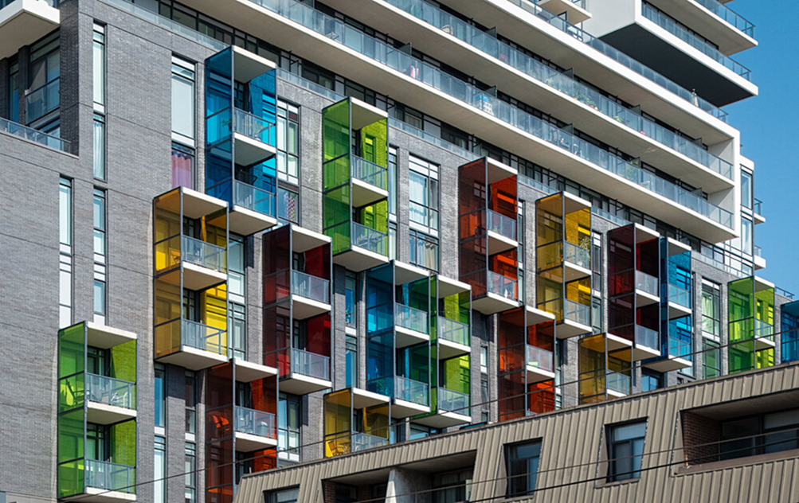
PRESENTATION TITLE:
Multi-Disciplinary Balcony Design and Construction
Name: Roger Howard Taylor
Date: May 2022

Slide 2
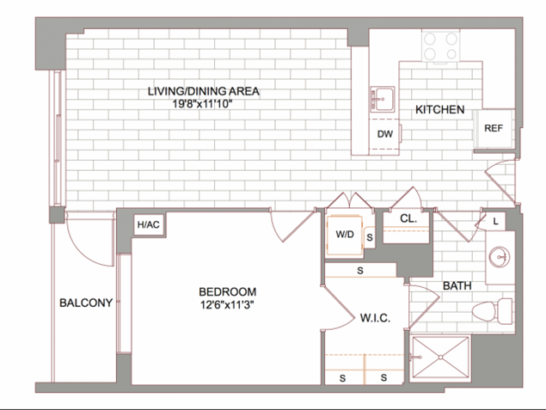
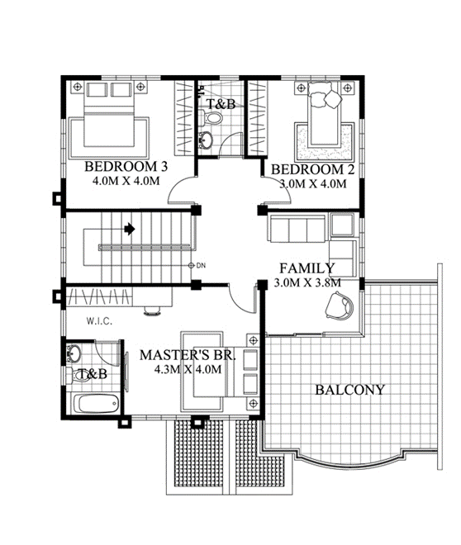
WHAT TO ANAYSIS
WHEN DESIGNING AND DETAILING A BALCONY
DESIGNING A BALCONY
Balcony use
Balcony type
Access balcony
Open or closed balcony
Privacy on the balcony
Balcony construction materials
Railings and hand rails
Thermal cold bridges
Load bearing structure
Orientation of the balcony
Building regulations
Water drains and drain pipes

Slide 3
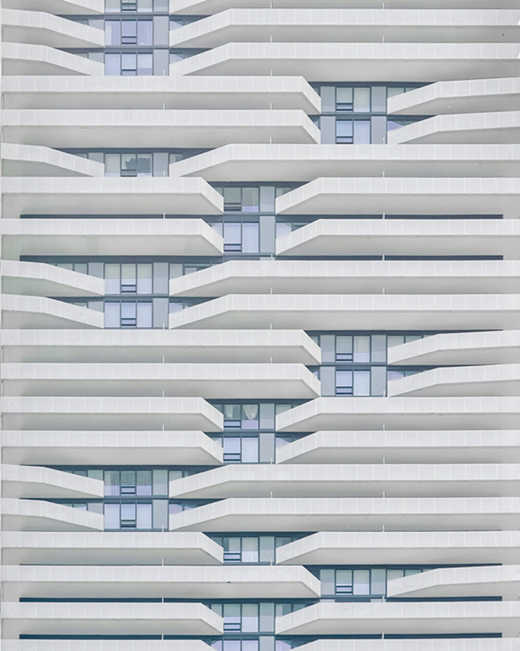
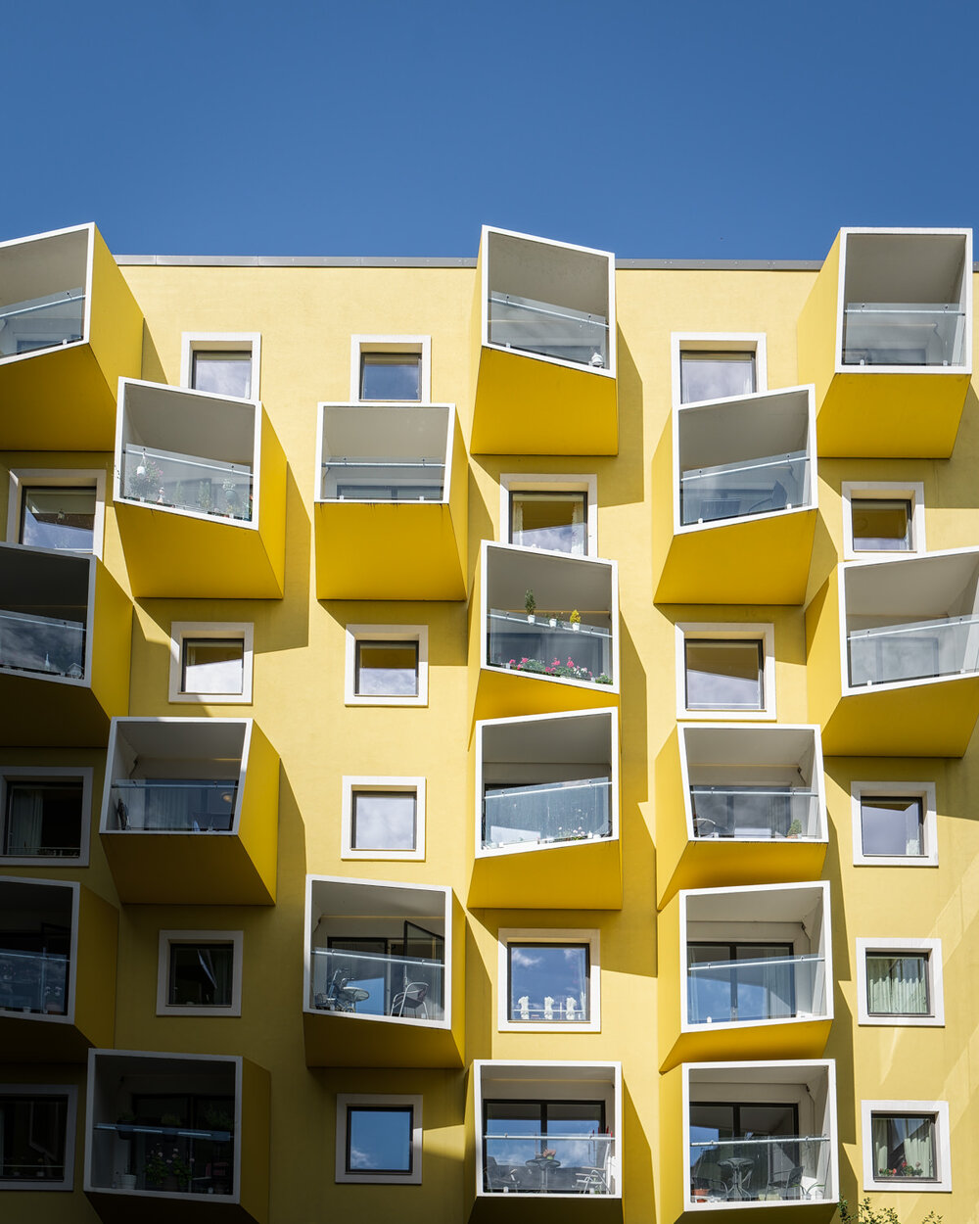
Toronto, Canada
Toronto, Canada
Copenhagen, Denmark

Slide 4
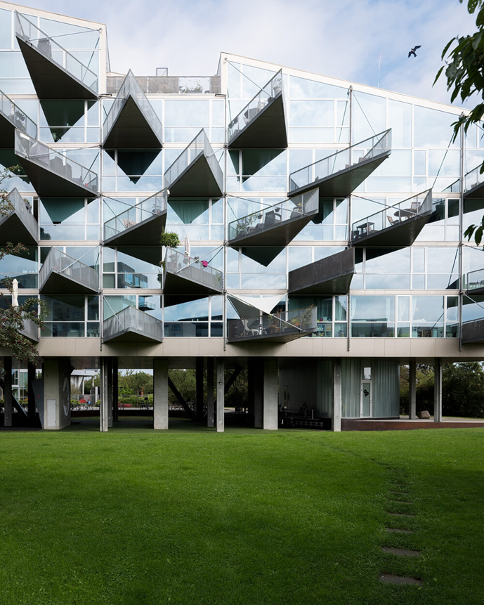
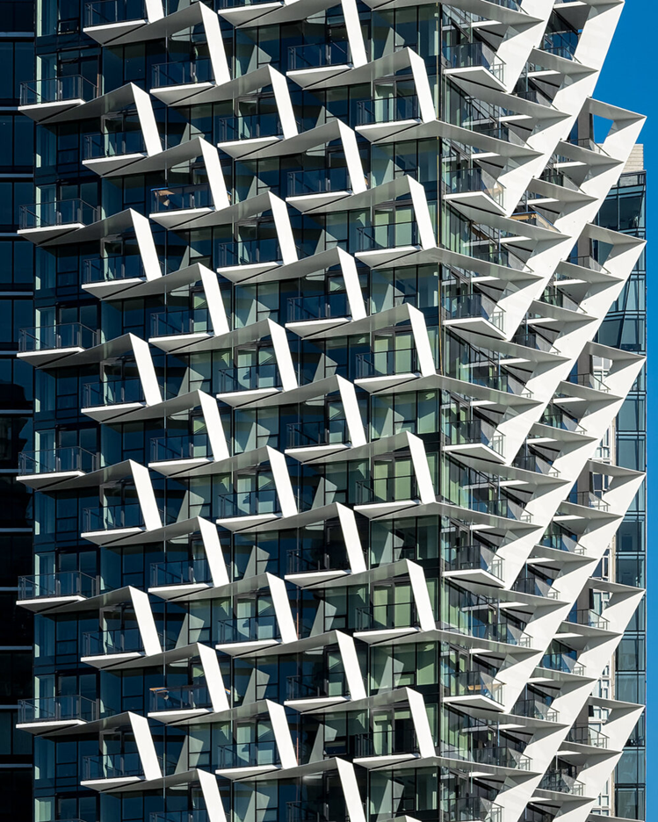
Copenhagen, Denmark |
Vancouver harbour, Canada

Slide 5
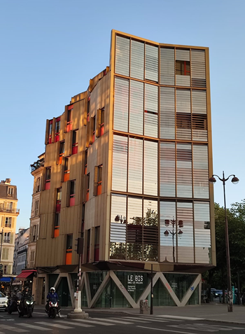
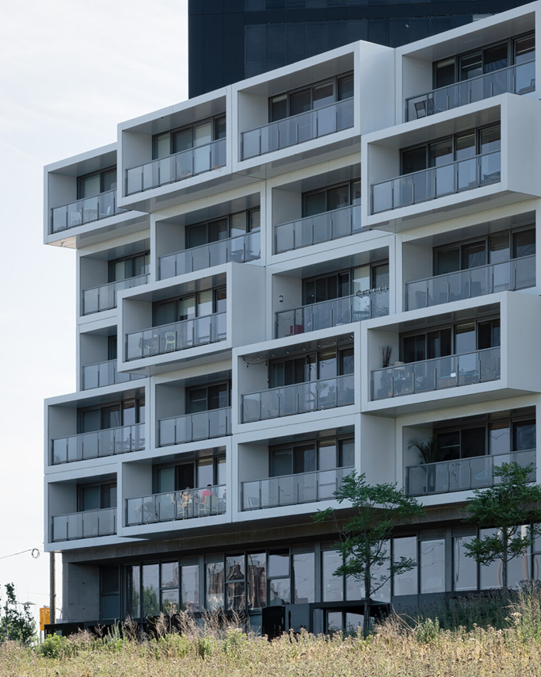
Toronto, Canada
Paris, France

Slide 6
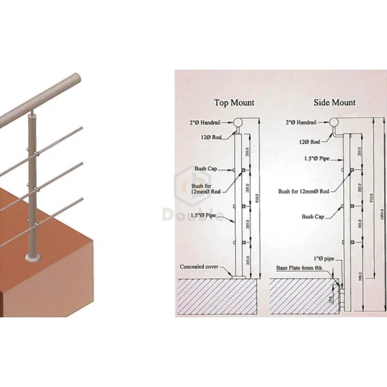
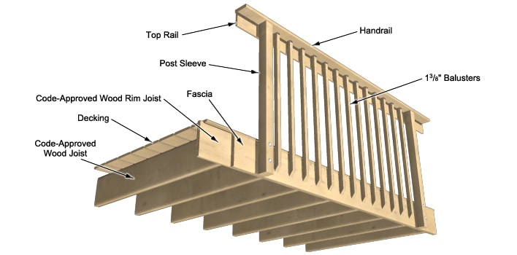
Balcony Terminology

Slide 7
Types of Balcony Connections
How a balcony connects to the building and it load bearing system is the most important element in balcony.
Also corrosion, thermal bridges, fire safety and moisture are a concern in balcony design and construction.
Moisture is a big concern for wood balconies, as rot can go undetected. Additionally, balcony connections relate to deflection or a feeling of rigidity or bounce.
In any case, an engineer will make sure of the use of appropriate connections.

Slide 8
Different Types of Balconies
Many balcony design options exist today for construction projects.
Cantilever Balconies
Stacked Balconies
Bolt-On or Hung Self-Supporting Balconies
Post Tension Slab Balconies
French or Juliet Balcony

Slide 9
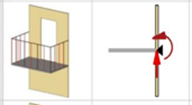
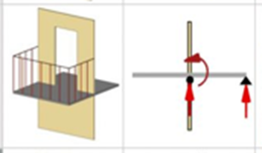

Cantilevered
Balcony
The purpose of a cantilevered balcony is to give clear span space without any columns or braces. In other words, this balcony type has no visible means of support, for these cantilever balconies need a support beam within a wall.

Slide 10
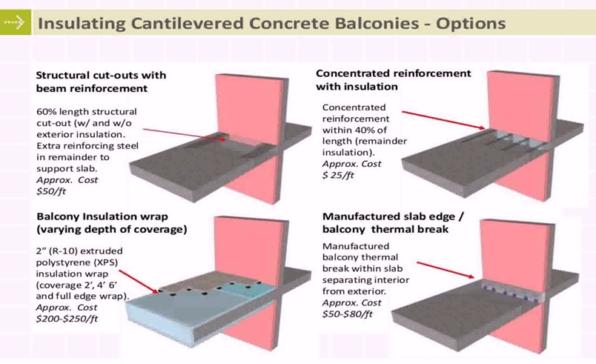
Cantilevered Balcony
Typical construction materials for the cantilever style are steel and concrete.
The use of concrete or steel is popular for structural use, but thermal conductivity is an issue. For this reason, a cantilevered balcony requires a thermal break. Thermal break connectors must be fixed into the building during mainframe construction.

Slide 11
Cantilevered Balcony
Cantilever balconies act as a thermal bridges between the outside and inside of the building.
Cantilever balconies need thermal breaks to prevent heat loss and the case of wooden balconies rot and fungus growth.
Thermal insulation help maintain temperature control between the outside and inside air in and around the building. A temperature imbalance forms condensation and creates fungus growth and rot
Thus the fixing detail needs insulation to break the transfer of heat through the external walls.

Slide 12
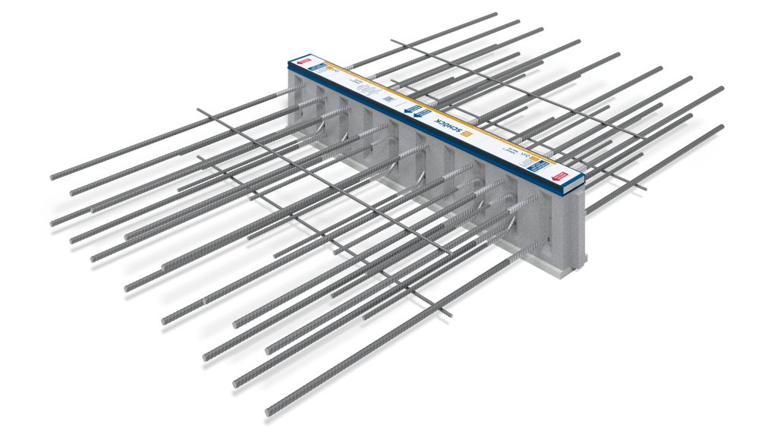
Thermal break for balconies concrete to concrete

Slide 13
Cantilever load bearing system

Slide 14
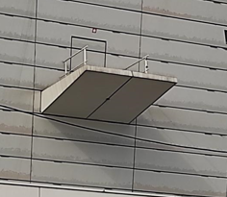
Cantilevered Balcony
Post tension slabs use high strength steel to stabilize and strengthen concrete. The result is more capacity to resist tensile forces. This allows the architect to design with thinner concrete slabs and greater spans.

Slide 15
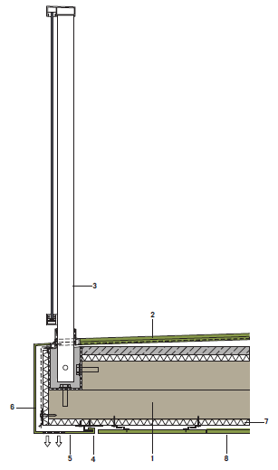
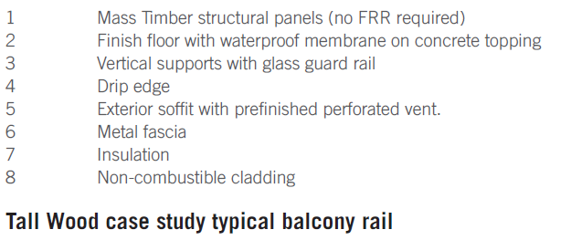
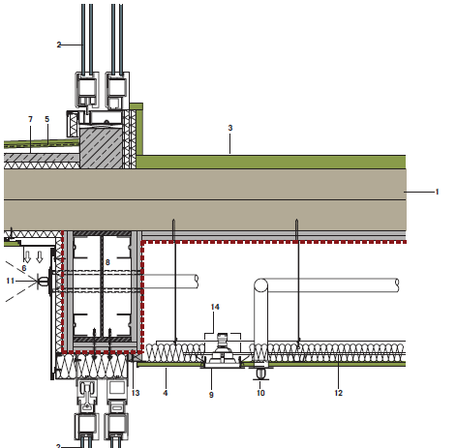
Hybrid Timber Cantilevered Balcony
THE CASE FOR Tall Wood BUILDINGS

Slide 16
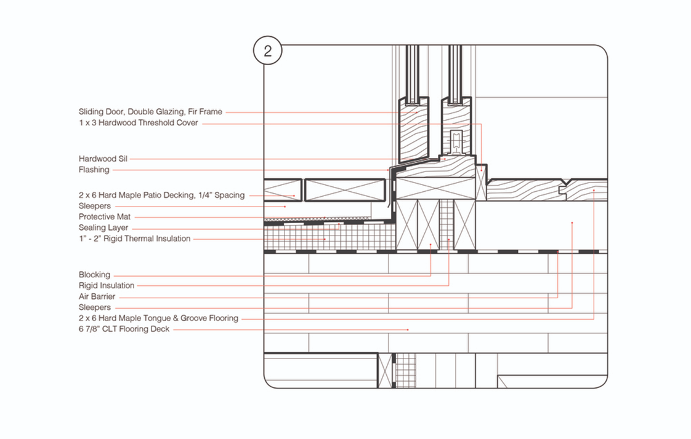
Hybrid Timber Cantilevered Balcony
Timber construction is popular because of low thermal conductivity.
A timber balcony must be precisely designed to prevent moisture penetration.

Slide 17
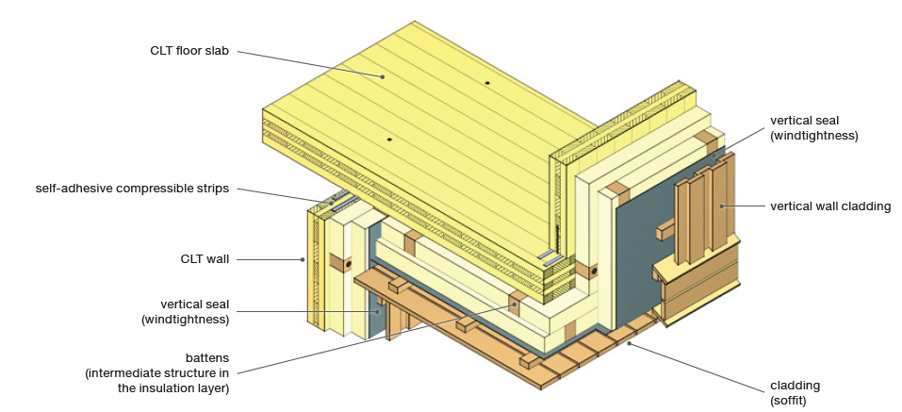
Cantilevered closed Balcony

Slide 18
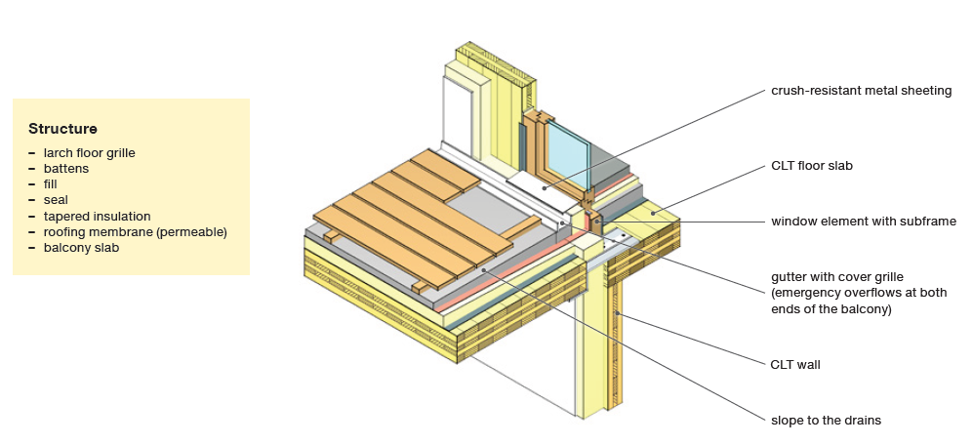
Cantilevered (timber planking on tapered insulation)

Slide 19
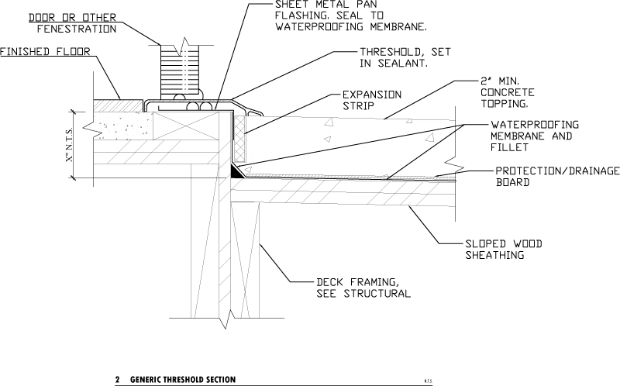
Water and moisture
The design of a wood balcony either attaches to a wall or cantilevers through the building facade. Flashing for Water Protection
Flashing provides water protection and is important to preserve wood cantilever balconies. The flashing areas for balcony waterproofing include the door and the balcony perimeter.

Slide 20
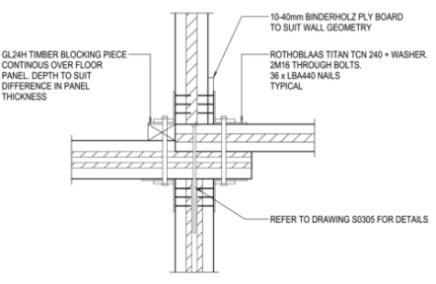
CLT Balcony fixture methods

Slide 21
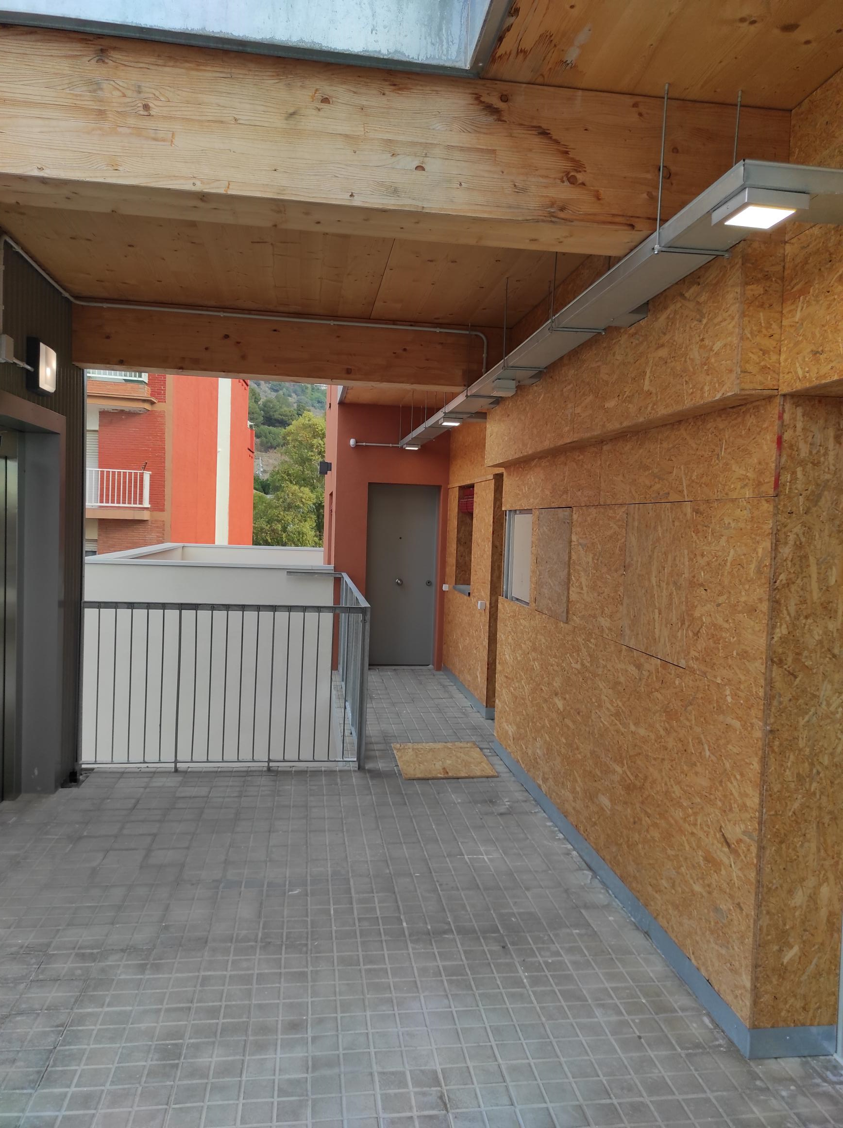
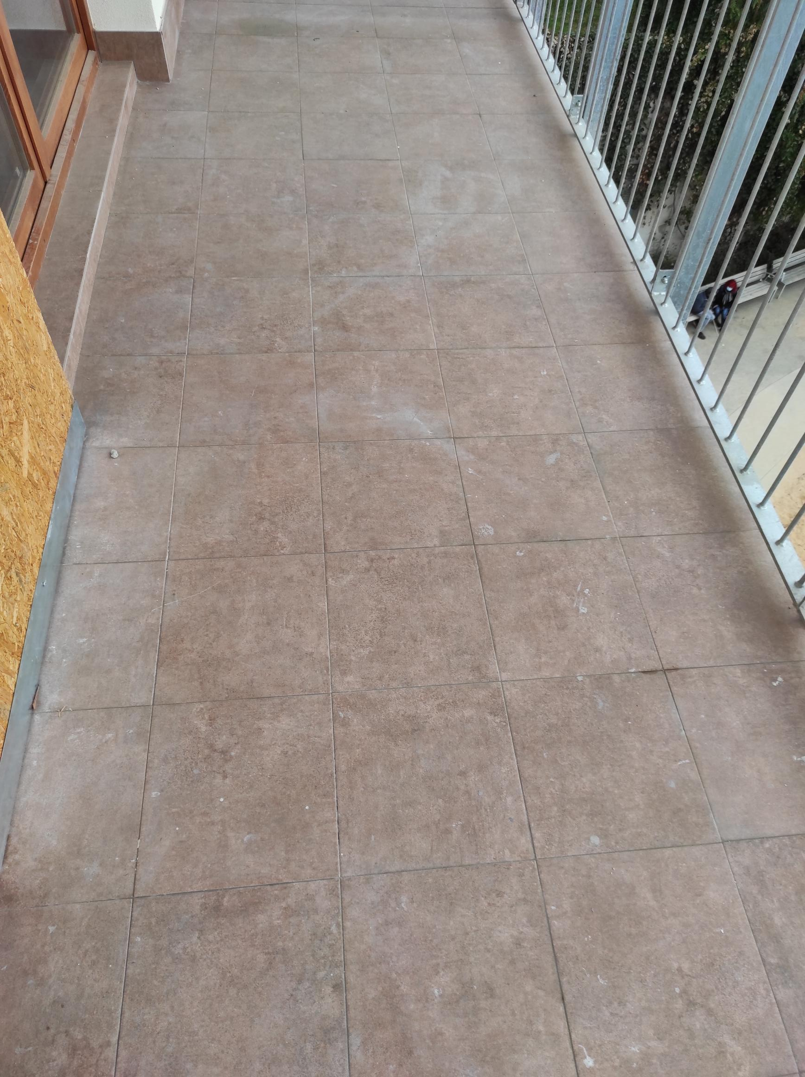
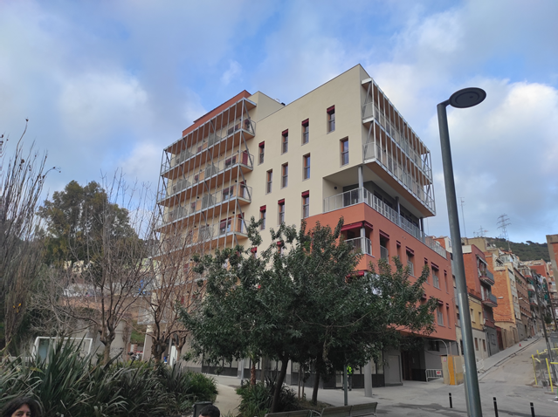
Water and moisture
Barcelona high-rise timber building 2022

Slide 22
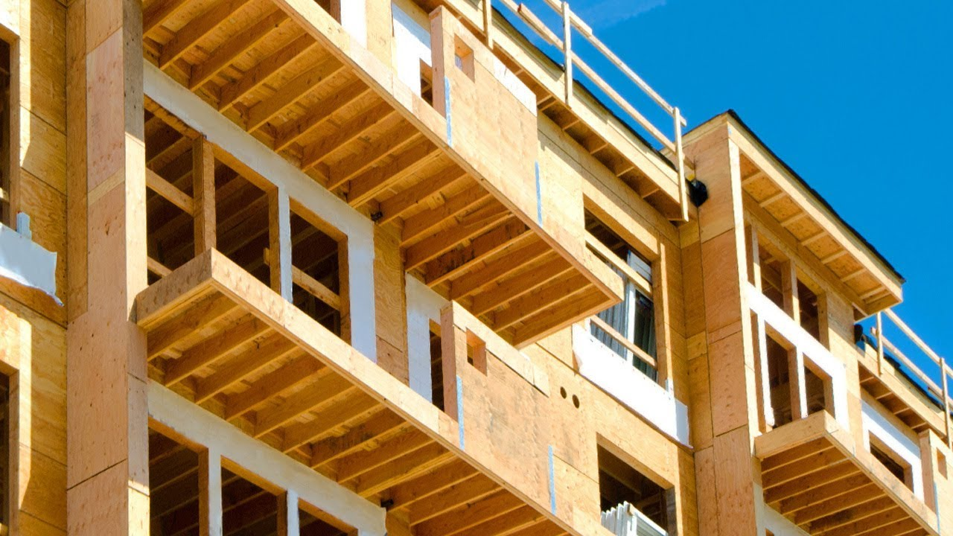
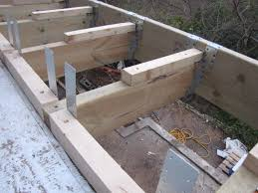
Cantilevered Timber Balcony

Slide 23
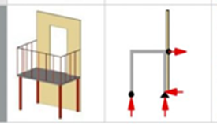
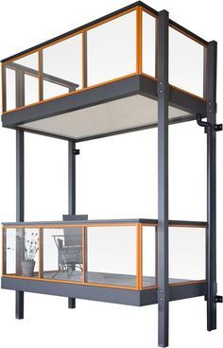
Stacked Balcony
A stacked balcony has vertical support pillars or posts. This pillared balcony method is simplistic with minimal building load implications.
The stacked balcony can be an independent part of the buildings construction or part load bearing on the buildings facades.

Slide 24
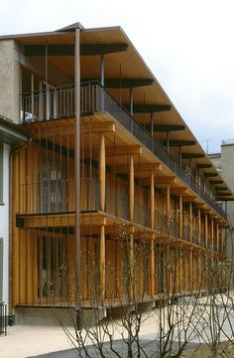
Stacked Balcony
To do this, posts hold the balconies in place, and the weight transfers to the concrete pads on the ground. The resulting vertical support structure gives a stacked balcony look. However, this method does need design consideration to avoid an unpleasant appearance.

Slide 25
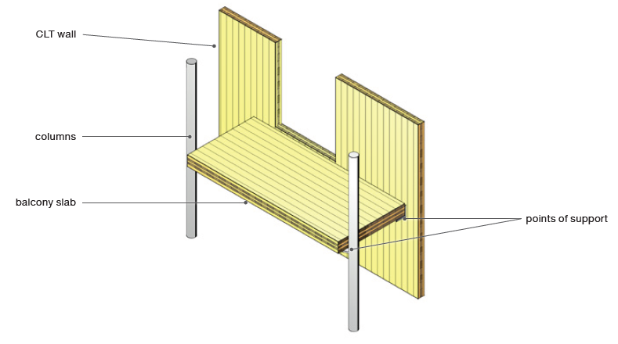
CLT Stacked balcony

Slide 26
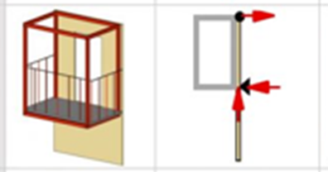

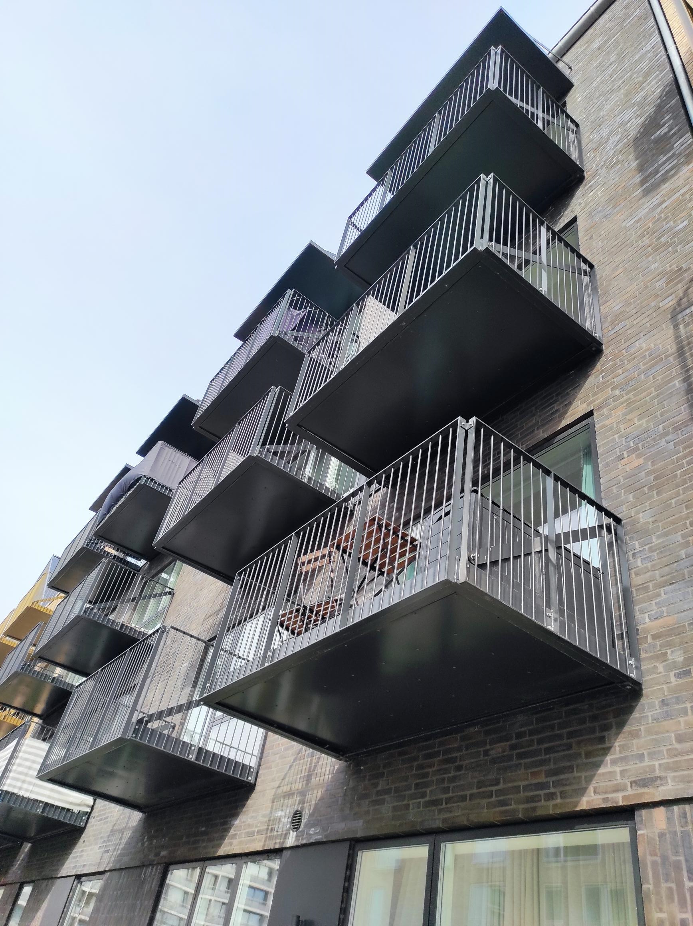
Hung Self-Supporting and Framed Balcony
A bolt-on balcony, bolts on to the building without the need of underside beams.
A hung or bolt-on balcony style is self-supporting.
To do this a bolt-on balcony system connects with bolts, tension rods, and connector plates to the building.

Slide 27
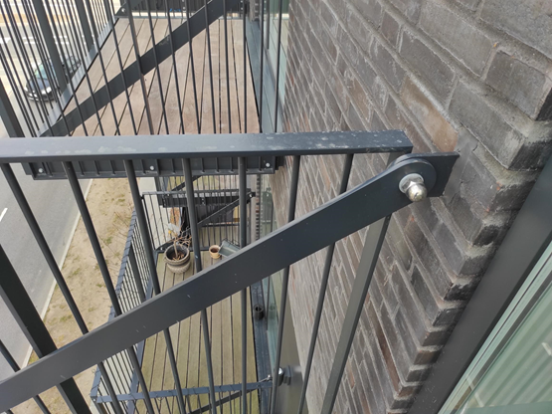
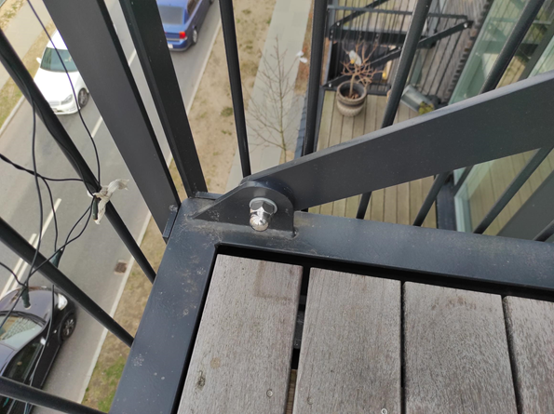
Hung Self-Supporting and Framed Balcony
Brackets, connectors, bolts and plates

Slide 28
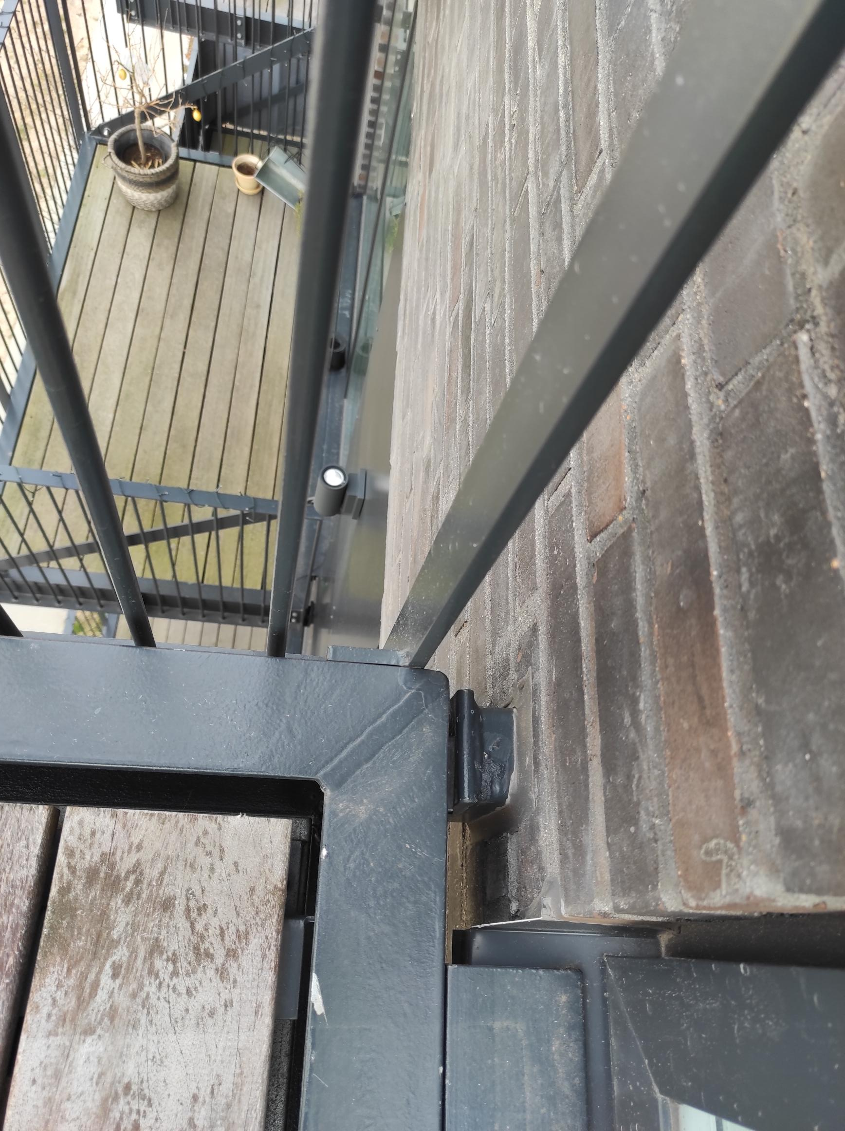
Hung Self-Supporting and Framed Balconies
The balconies arrive prefabricated and ready to bolt-on. The balconies can be lifted off a truck and onto the building.
Before balcony arrival, the buildings facades construction are fixed with connection points.

Slide 29
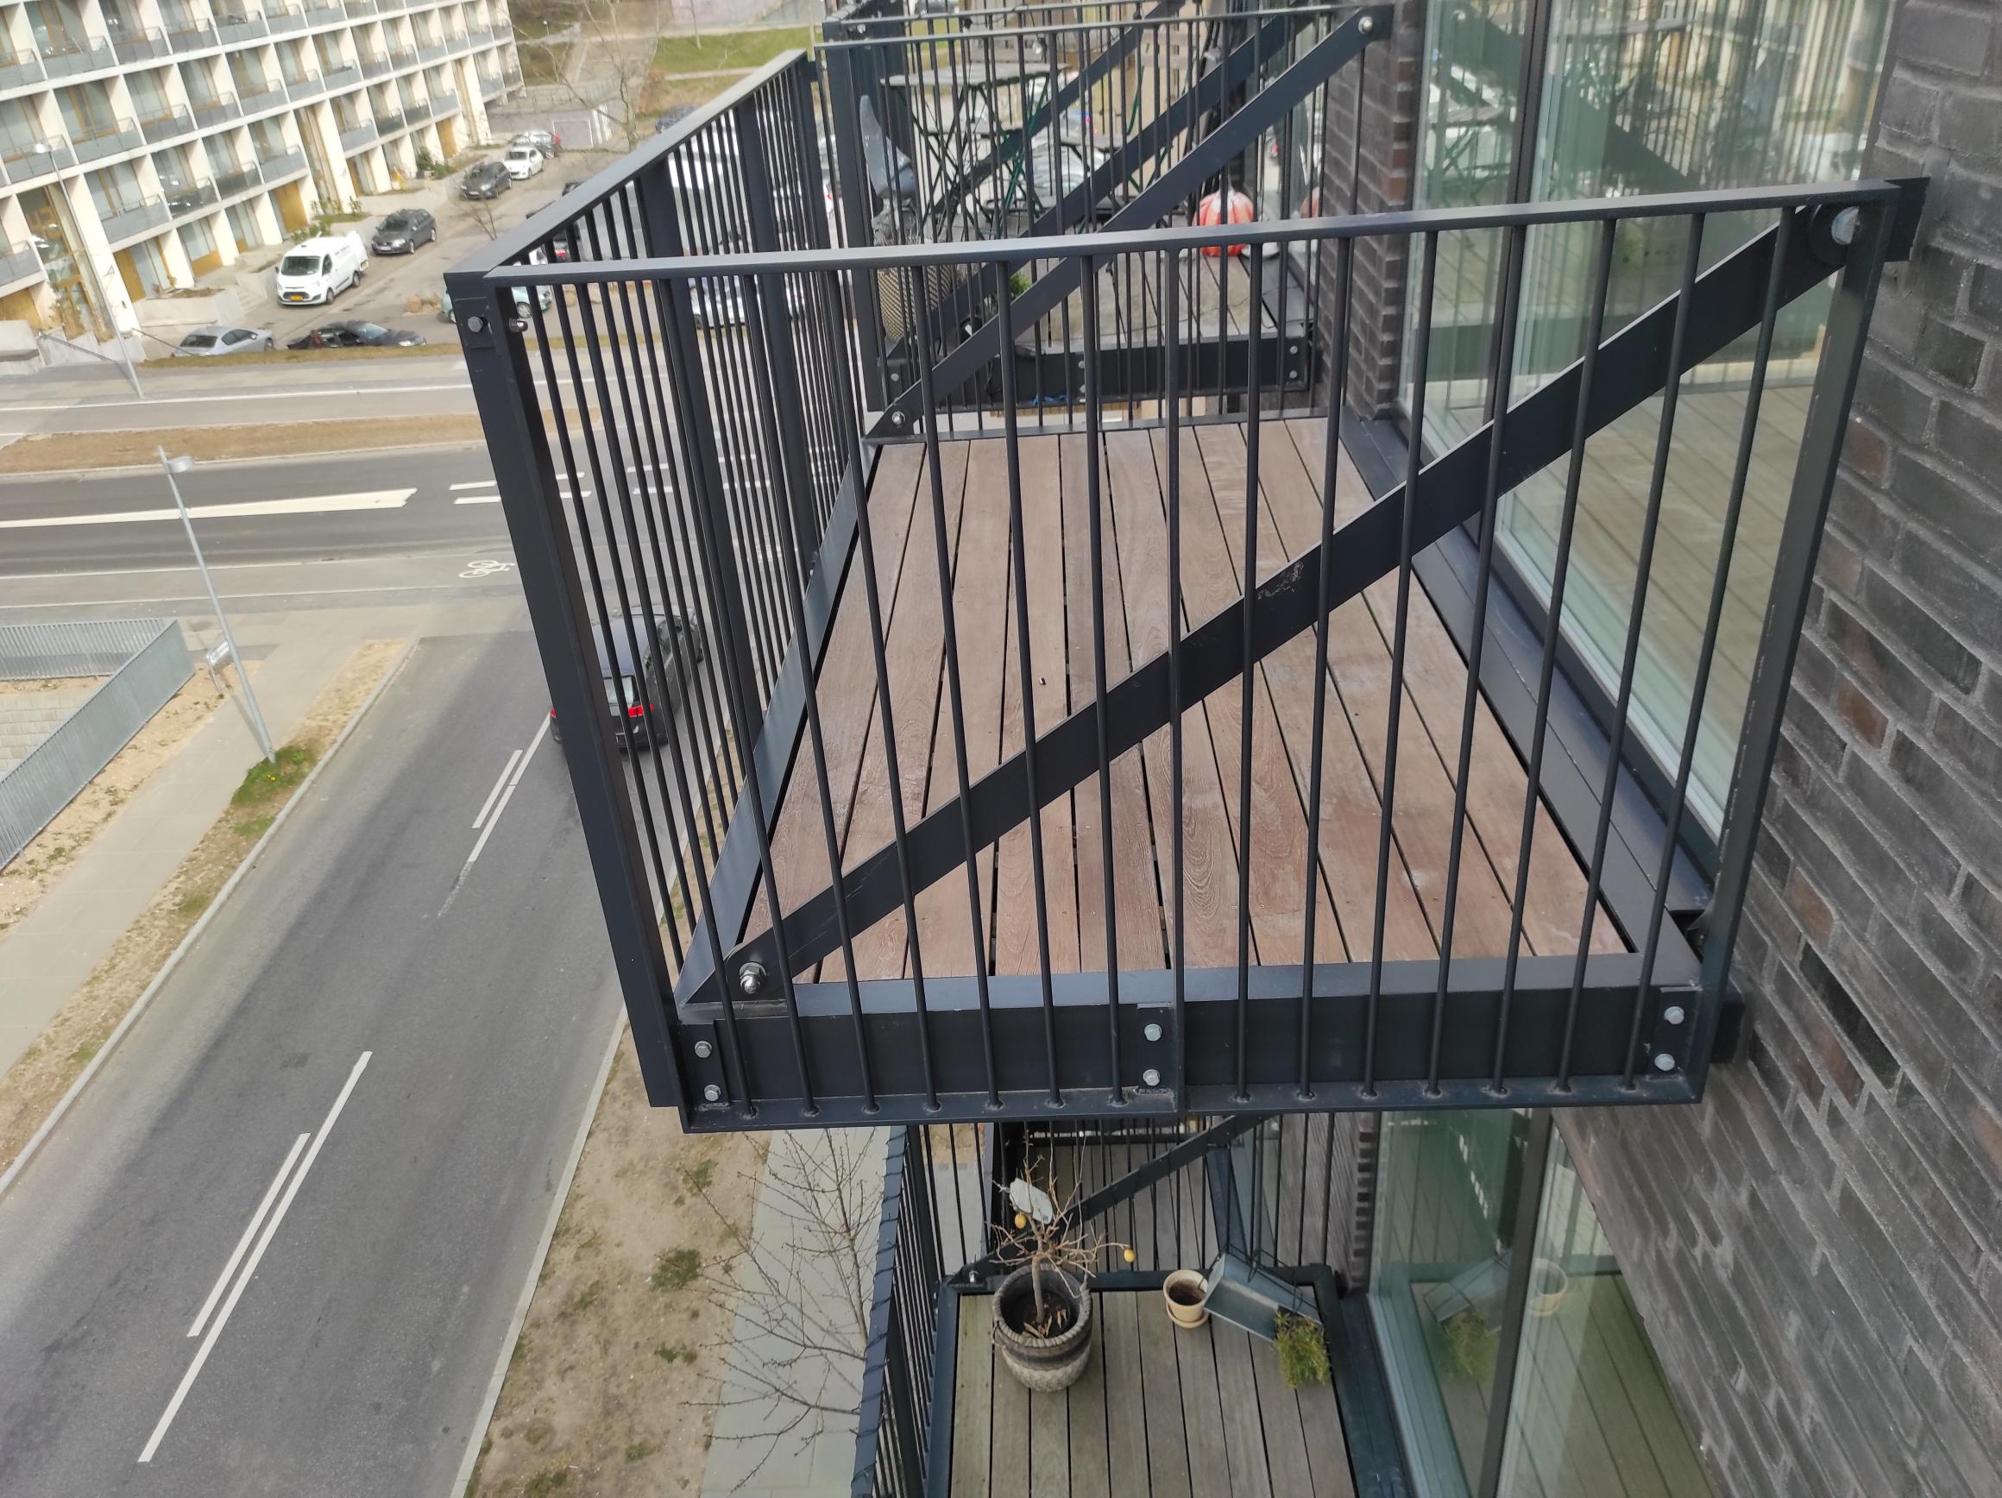
Hung Self-Supporting and Framed Balcony
Then a crane lifts the assembled balcony, and the balcony bolts into place. On average, a bolt-on balcony installation is very fast.

Slide 30
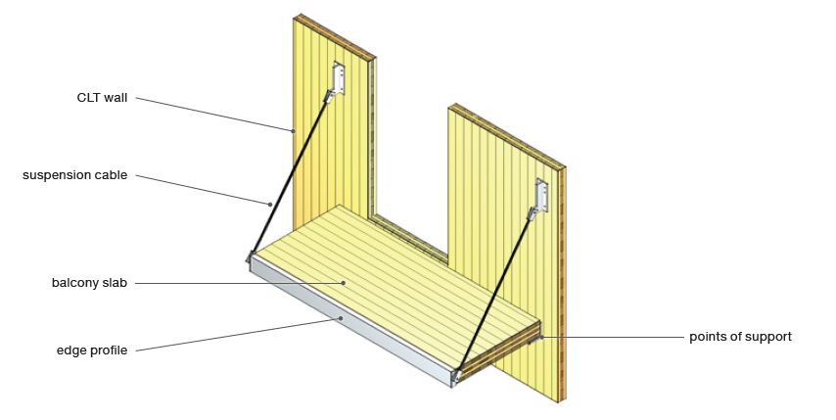
CLT Balcony slab (suspended)

Slide 31

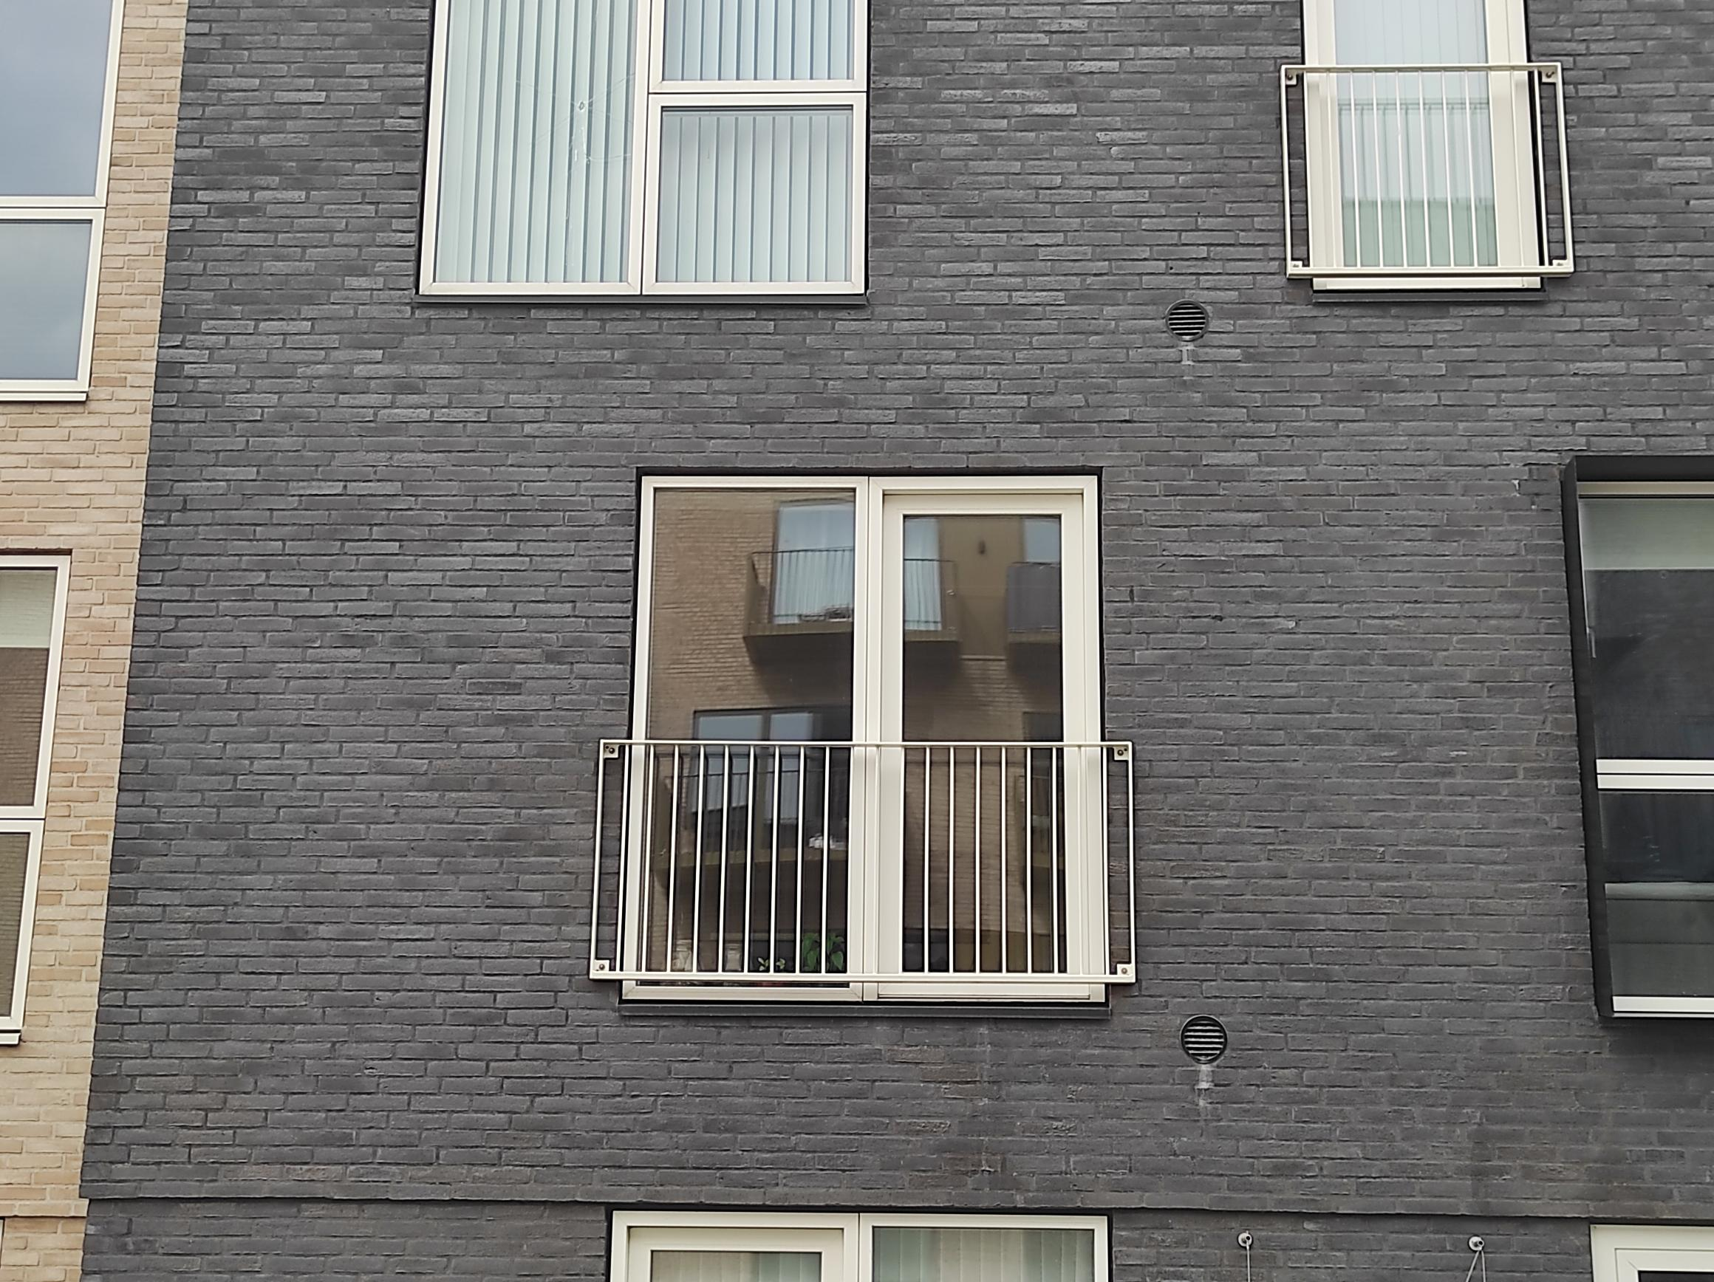
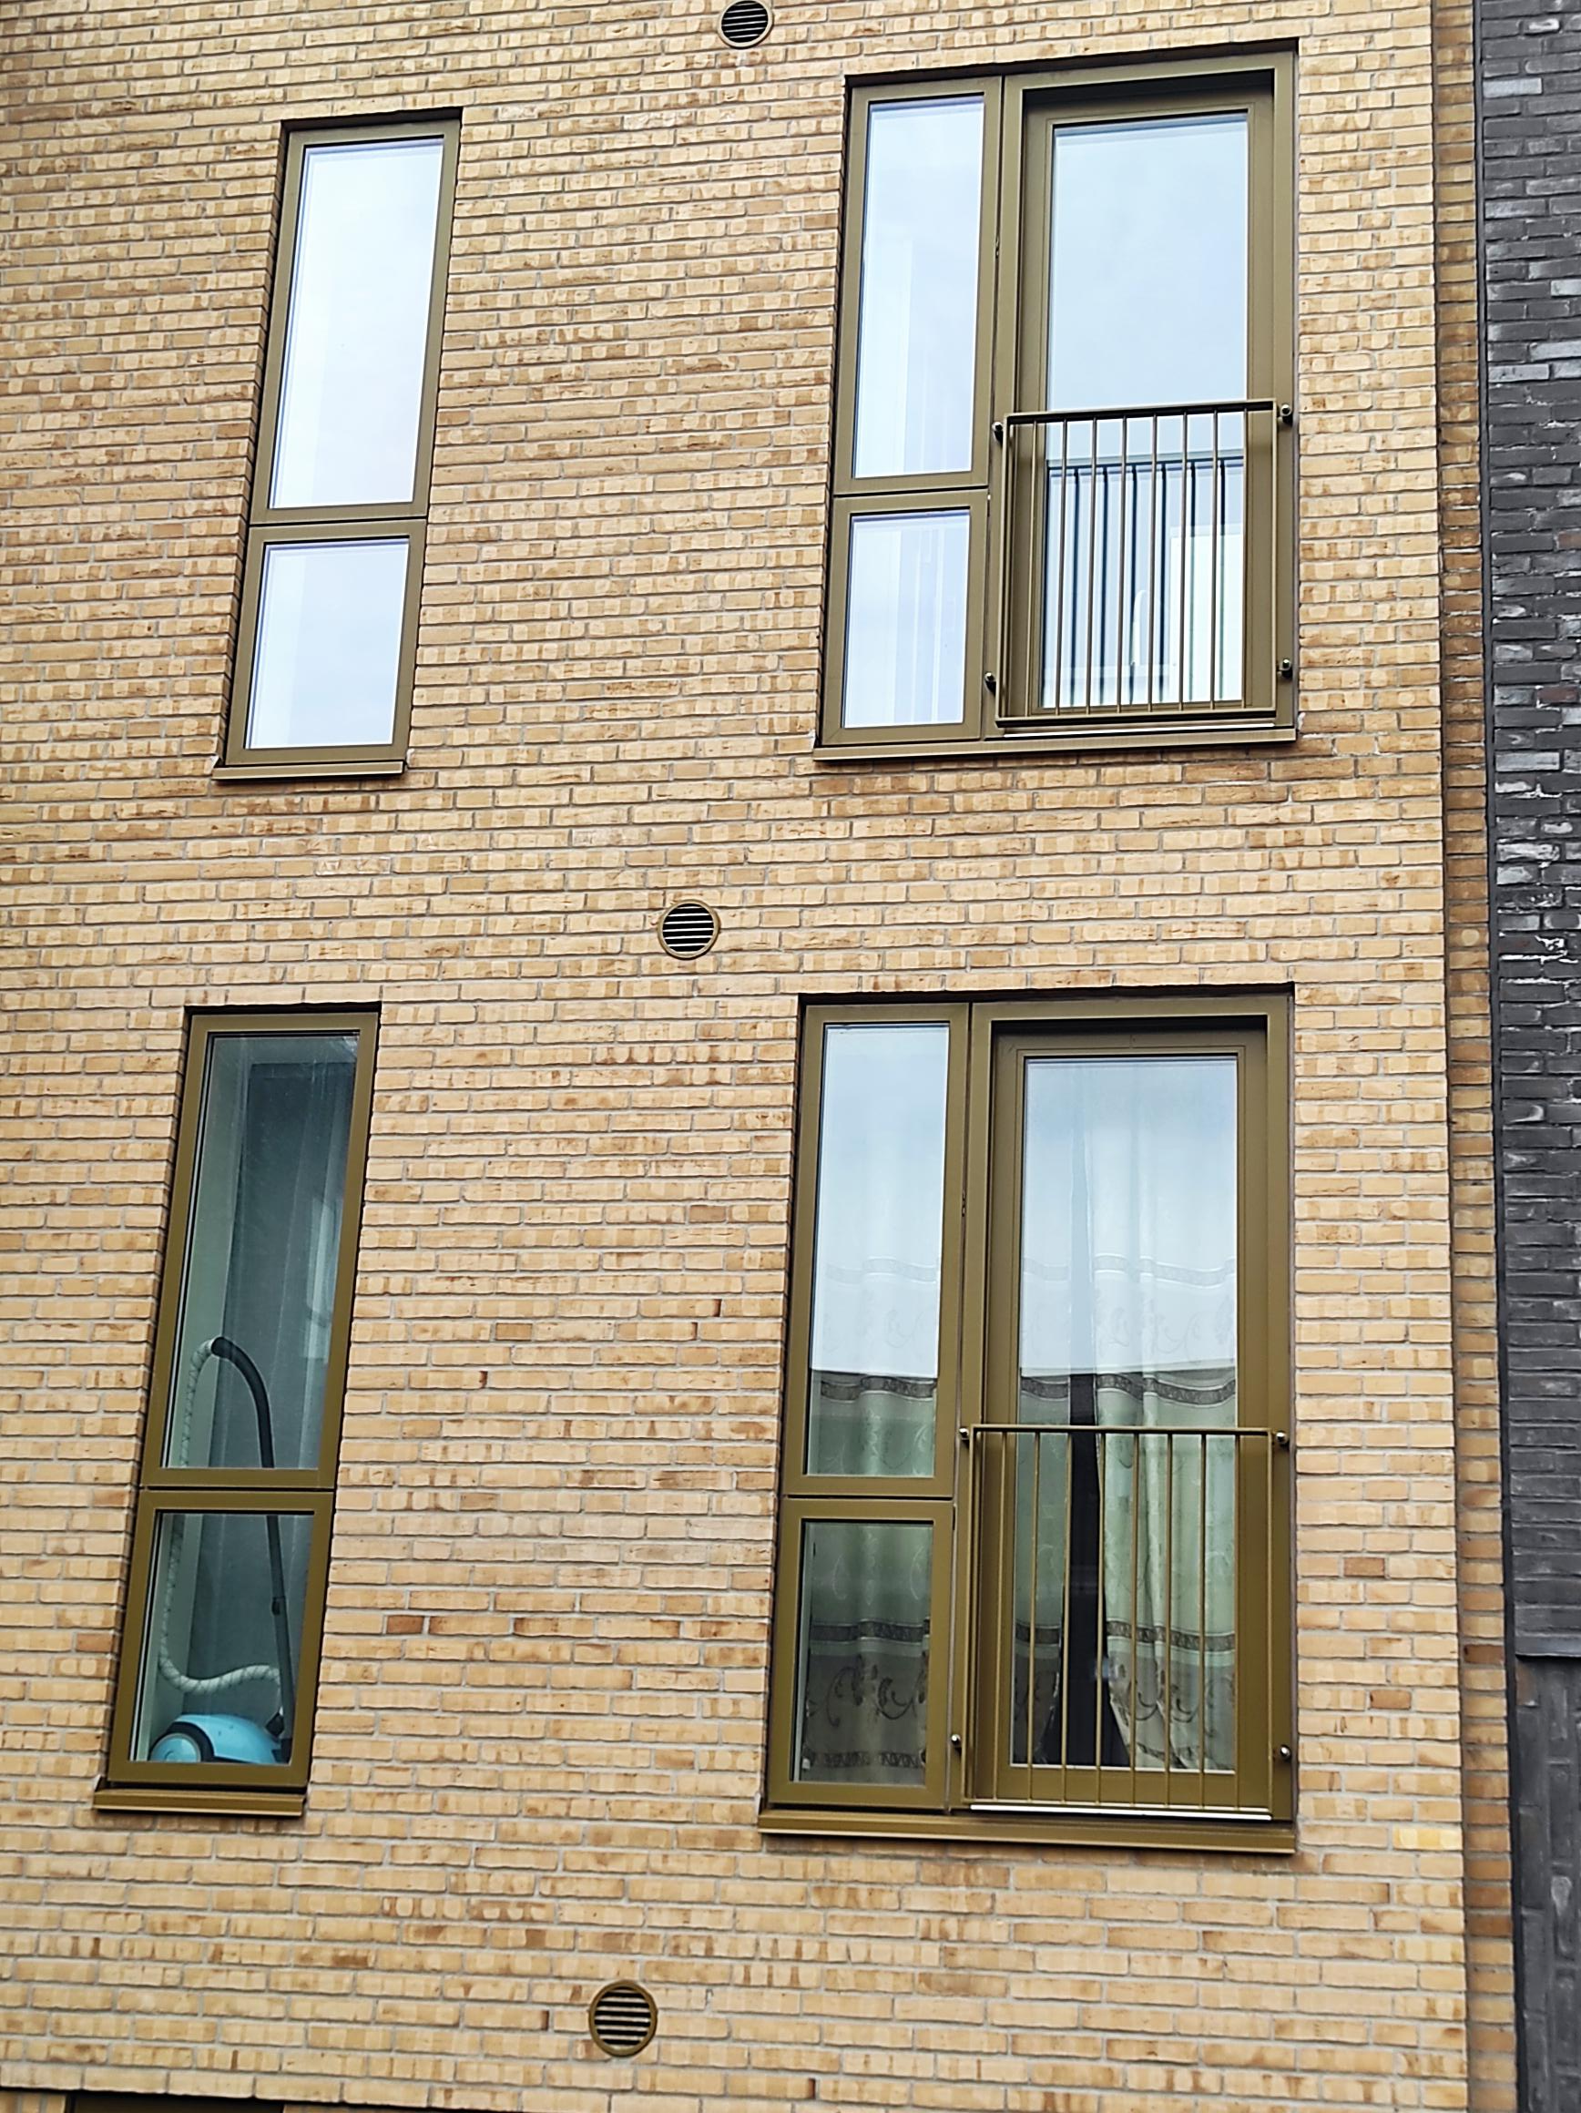
French Balcony
French balcony or Juliet balcony
A French balcony is a fixed balcony with a railing and may be ornamental in nature. Sometimes a Juliet balcony may feature a very small standing area.

Slide 32
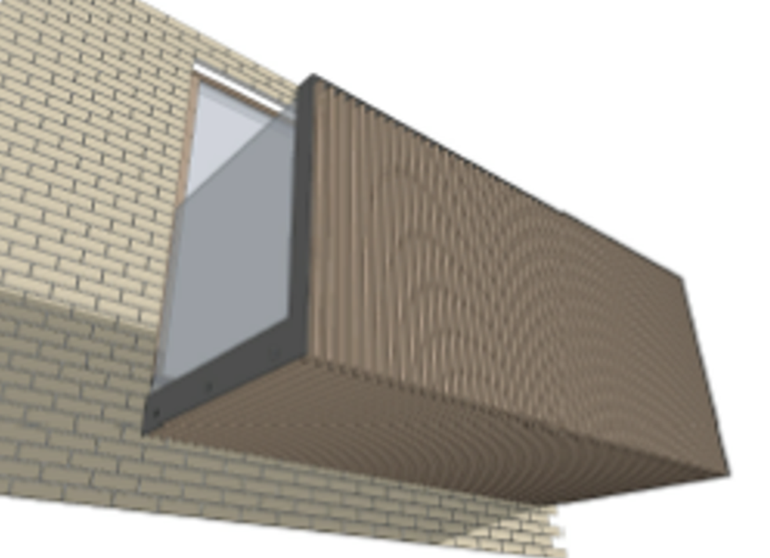
Hybrid timber balcony construction (example)

Slide 33
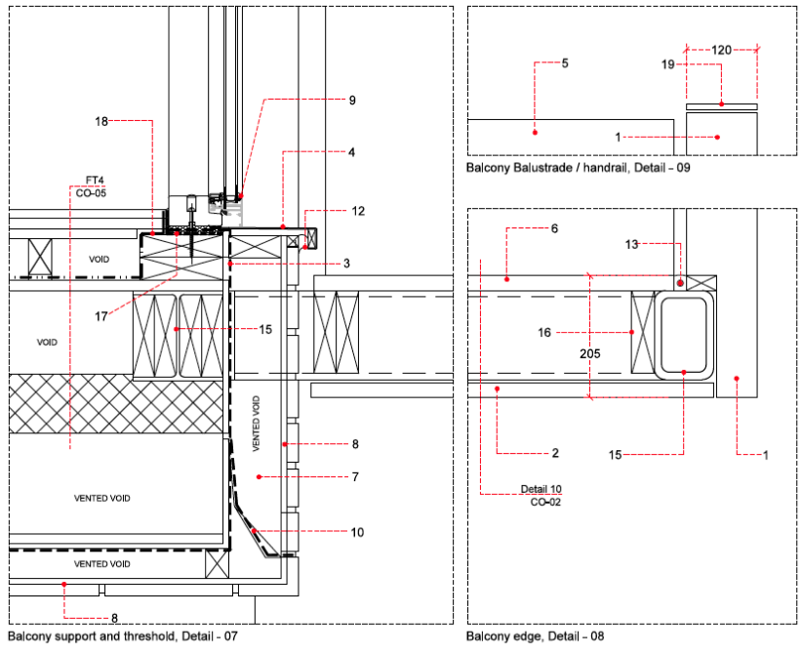
Hybrid timber balcony construction (example)

Slide 34
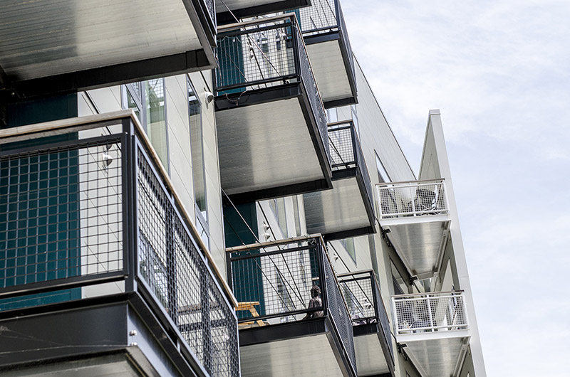
Balcony railings and fittings

Slide 35
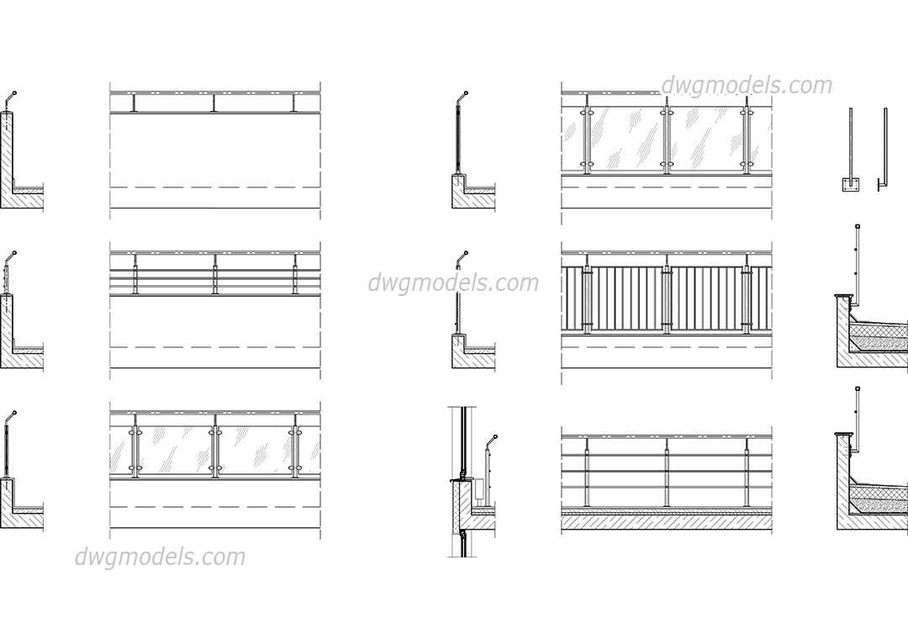
Balcony railings and fittings

Slide 36
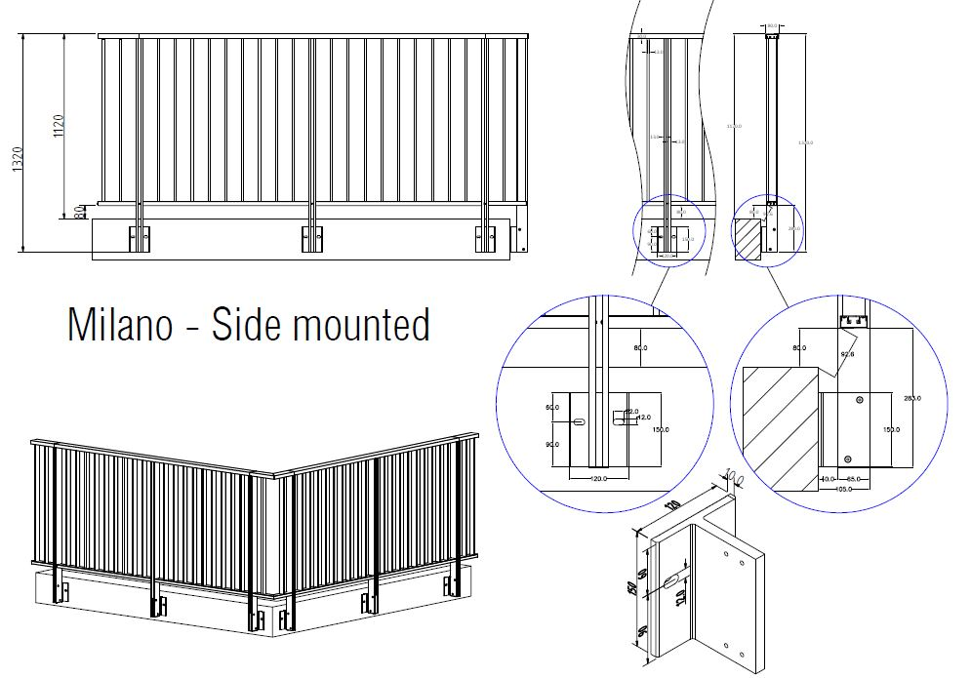
Balcony railings and fittings

Slide 37
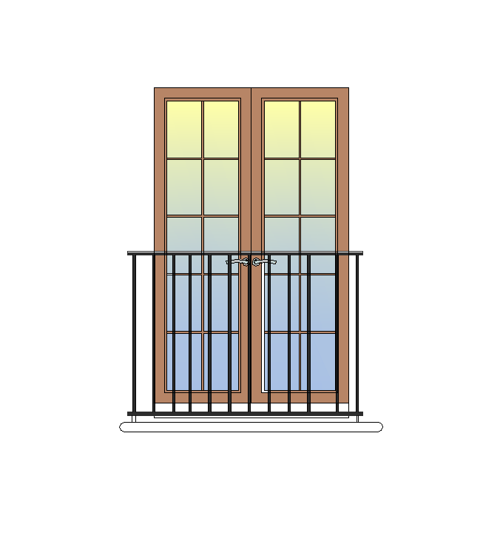
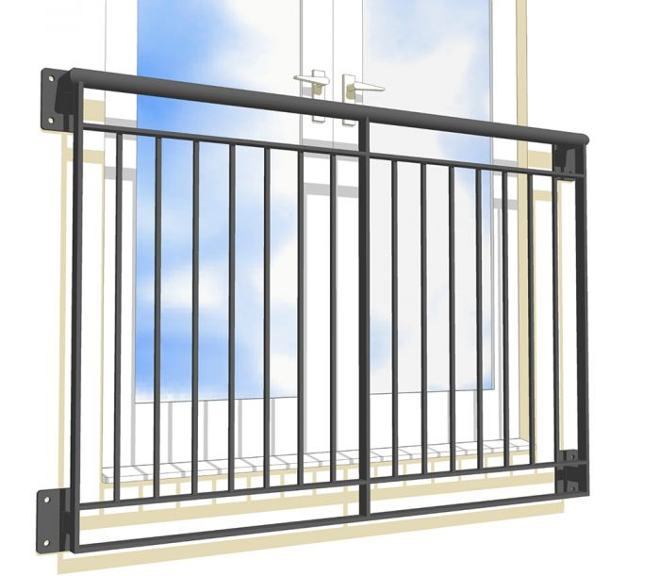
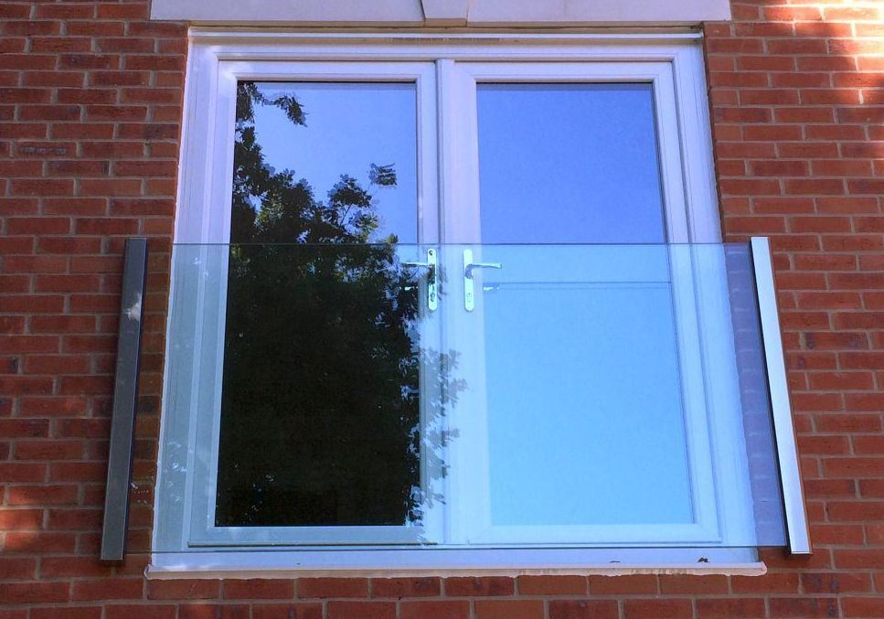
Balcony railings and fittings

Slide 38

Roof terrace construction

Slide 39


Balcony rain water drainage

Slide 40


Balcony rain water drainage

Slide 41






Good luck with your design

