Slide 1
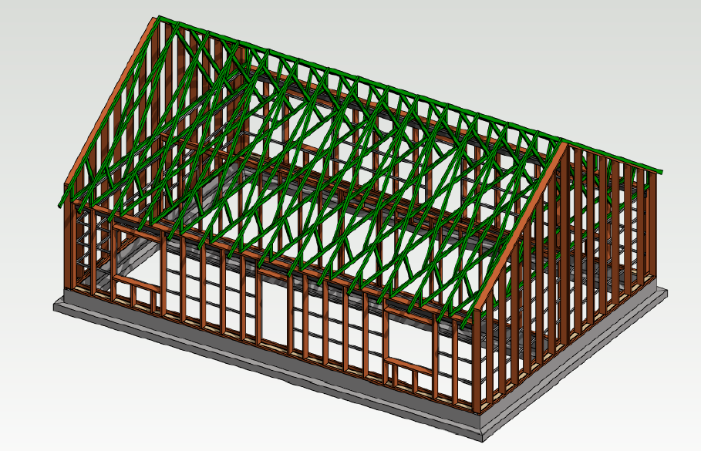
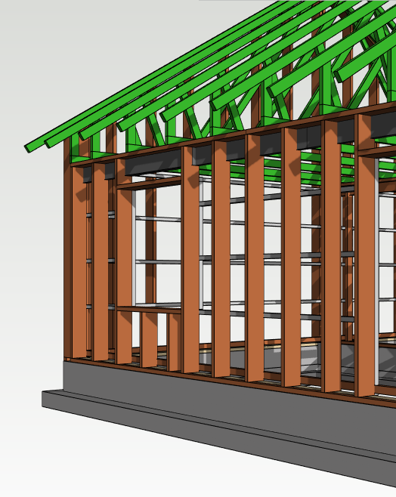
Timber BIM Modeling
Kalle Rohola, architect SAFA
17.05.2022

Slide 2
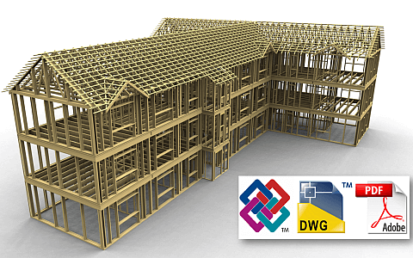
Timber BIM Modeling
Kalle Rohola, architect SAFA
Content:
BIM terminology
LOD
BIM levels
Uses of BIM
BIM Workflows
BIM Common Tools
BIM Product libraries for Timber
Image: Vertex.fi
Notes:
Basic terms used in conjunction with BIM
LOD – What does it mean?
Different levels of BIM (collaboration, distribution of information (model))
Workflows – project from start to finish in BIM perspective
Common tools : both design and manufacturing
Content for timber BIM (products, structures, etc.)
Conclude the lecture by demoing an short workflow of timber BIM modeling

Slide 3
Timber BIM Modeling
Kalle Rohola, architect SAFA
BIM Terminology
BIM Building Information Modeling
DfMA Design for Manufacturing and Assembly
2D (CAD) designing and documentation in two dimensions, coordination is based on individual drawings, = BIM level 0
3D (BIM) drawing documentation, reports, material combinations, etc. created from the model
4D (BIM) 3D BIM + time of installation
5D (BIM) 3D BIM + time of installation + cost of elements
6D (BIM) 3D BIM + impact of construction on the environment
7D (BIM) 3D BIM + information for the management and operation of the construction
IFC Industry Foundation Class, open format for information transfer and coordination
(inc. Geometry, location in space, individual elements data, element attributes)
BIM Level BIM Level 0, BIM Level 1, BIM Level 2, BIM Level 3
LOD LOD 100, LOD 200, LOD 300, LOD 400, LOD 500
Level of development – American Institute of Arhitects (AIA) classification of model detail
LOD LOD 1, LOD 2, LOD 3, LOD 4, LOD 5, LOD 6, LOD 7
Level of detail – Applied in Great Britain

Slide 4
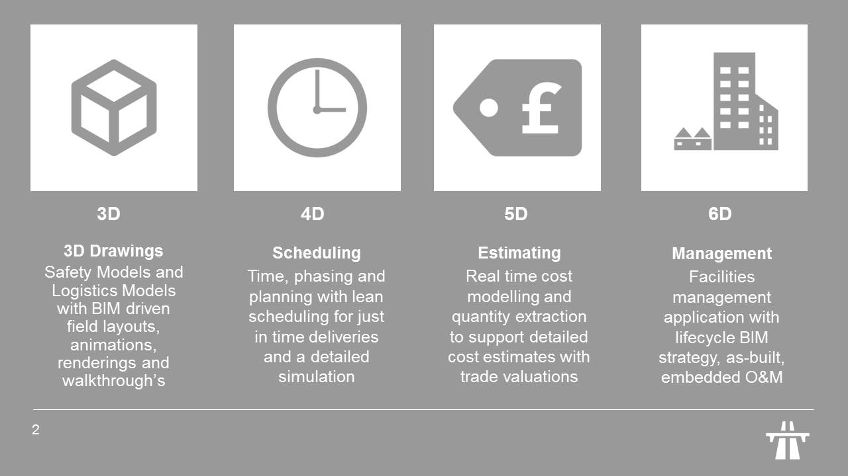
Timber BIM Modeling
Kalle Rohola, architect SAFA
Notes:
The levels of D (Dimensions, Detail)

Slide 5
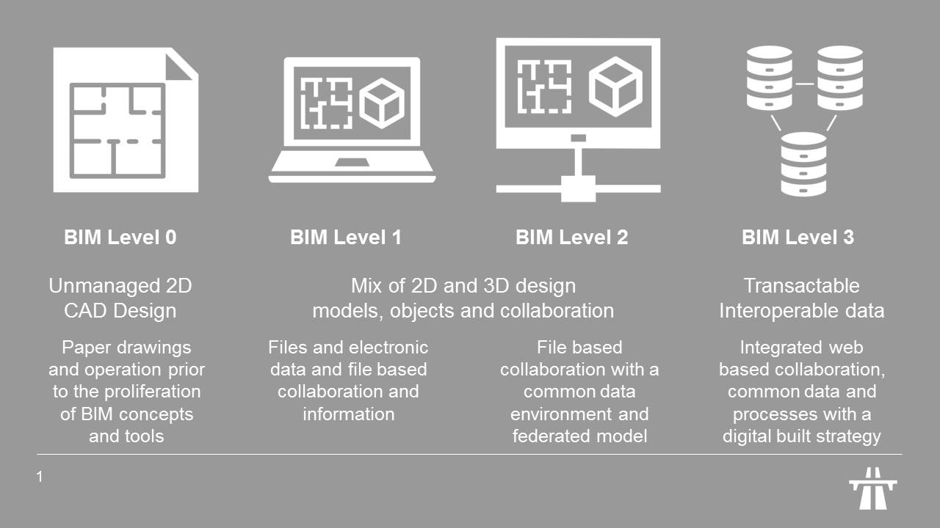
Timber BIM Modeling
Kalle Rohola, architect SAFA
Notes:
BIM Level 0 = unmanaged CAD, usually 2D, documents shared by paper drawings or PDF
BIM Level 1 = 2D and 3D design information, collaboration tool proviving Common Data Environment (CDE), may be web based database
BIM Level 2 = collaborative BIM, information is shared within CDE
BIM Level 3 = open standards (f.ex. IFC), working on a single model stored in web service or cloud

Slide 6
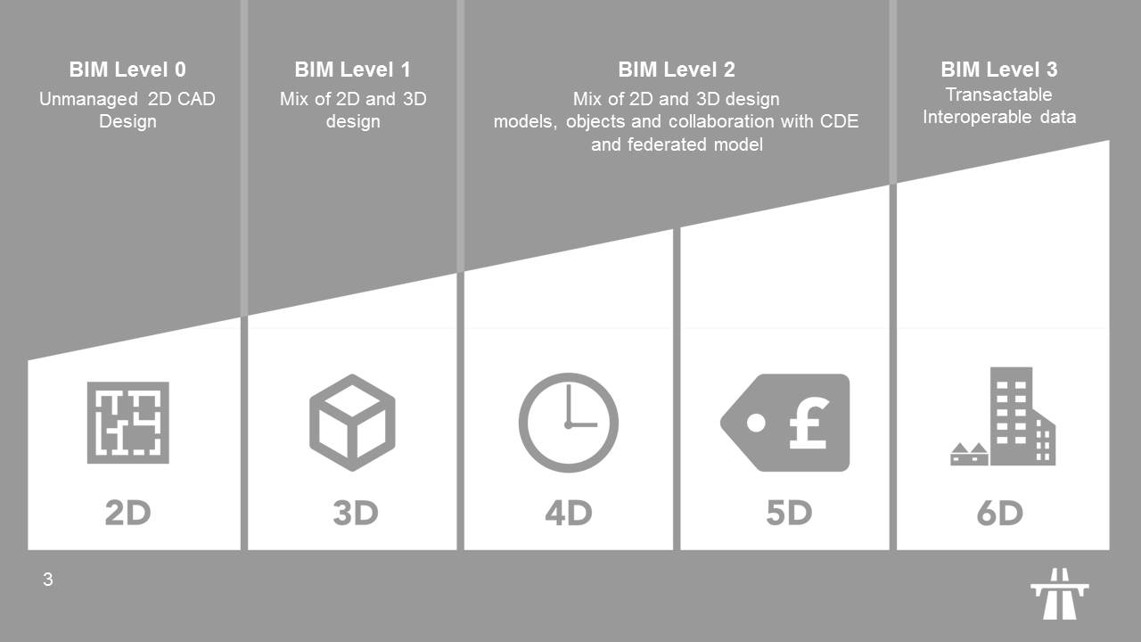
Timber BIM Modeling
Kalle Rohola, architect SAFA
Notes:
Link between BIM levels and Dimensions

Slide 7
Timber BIM Modeling
Kalle Rohola, architect SAFA
LOD (AIA)
LOD 100 (symbolic representation) – is the elementary model of the project and is represented graphically with a symbol or other generic and schematic representation;;
LOD 200 (generic system) – the model element is graphically represented within the model as a generic object with still approximate quantity, size, shape, position and orientation. Non-graphical information may also be attached to the geometric elements;
LOD 300 (specific system) – the model element is graphically represented within the model as a specific system, in which the object has specific quantities, dimensions, shapes, position and orientation. Non-graphic information is also linked to the geometric elements, which is more in-depth than the previous level;
LOD 400 (fabrication) – the model element is graphically represented within the model as a specific system, in which the object has specific dimensions, shape, position, quantity and orientation with further details for its fabrication, assembly or installation. More in-depth non-graphical information is linked to the geometric elements than in the previous level;
LOD 500 (verified representation – as built) – the model element is a verified representation on site in terms of size, shape, position, quantity and orientation. Definitive non-graphical information is linked to the geometric elements.
LOD (UK)
LOD 1 (brief) – block model with performance requirements and site constraints
LOD 2 (concept) – conceptual or volumetric model including basic areas and volumes, orientation and cost
LOD 3 (developed design) – generalised systems with approximate quantity, size, shape, location and orientation
LOD 4 (production) – technical design model with accurately modelled and coordinated elements that can be used to estimate costs and verify regulatory compliance
LOD 5 (installation) – model suitable for construction and assembly, with accurate requirements and specific components
LOD 6 (as constructed) – a model with details describing how the asset has been constructed and which can be used in the operation and maintenance phase
LOD 7 (in use) – a model of asset information to be used for ongoing maintenance and monitoring operations.
Notes:
LOD = Level of Detail (UK) / Development (US)

Slide 8
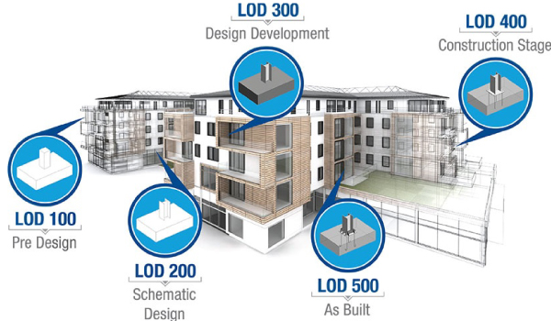
Timber BIM Modeling
Kalle Rohola, architect SAFA
LOD (AIA)
Notes:
Levels of development:
LOD100 symbolic representation [symbol of a footing and a column]
LOD200 generic system (approximate shape + position) [footing and a steel column]
LOD300 specific system [1200x1200 concrete footing and IPE 300 column]
LOD400 details for fabrication, assembly and installation
LOD500 verified representation [position and size etc. has been measured as built)
Non-graphical information can be added to the objects in levels 200-500

Slide 9
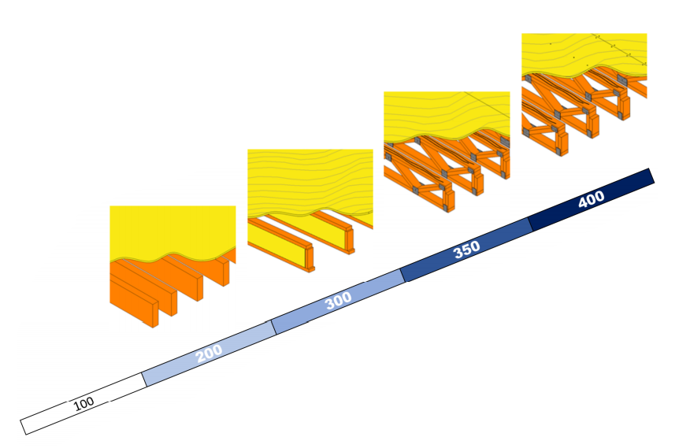
Timber BIM Modeling
Kalle Rohola, architect SAFA
LOD (AIA)
Notes:
Different levels of development for a intermediate floor or roof object:
LOD100 the object is not necessarily shown or is a sigle object
LOD200 beams + cover sheets
LOD300 beams with different parts cover sheet identified as veneer
LOD350 actual beam structures with individual sheet
LOD400 connections, fasteners (nails or screws)

Slide 10
Timber BIM Modeling
Kalle Rohola, architect SAFA
LOD (UK)
Notes:
An examle of different levels of detail (UK)
LOD1: a symbol of a column
LOD2: a steel profile is selected for the column
LOD3: a base plate is added to the column
LOD4: the actual dimensions for both column and base plate is used, places for fasteners are selected
LOD5: welding, bolts and nuts, a pour element between base plate and footing
LOD6: measured and updated as built

Slide 11
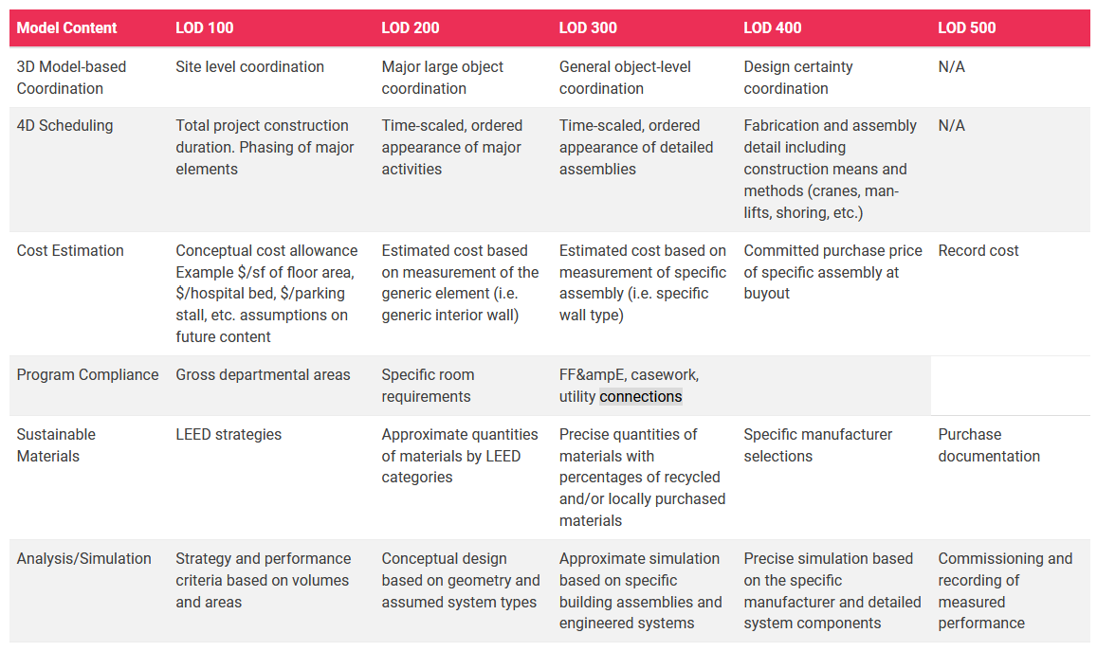
Timber BIM Modeling
Kalle Rohola, architect SAFA
The capability of a
BIM Model according to LOD level (AIA)
Notes:
4D Scheduling and Cost estimation as examples
LEED = Leadership in Energy and Enviromental Design

Slide 12
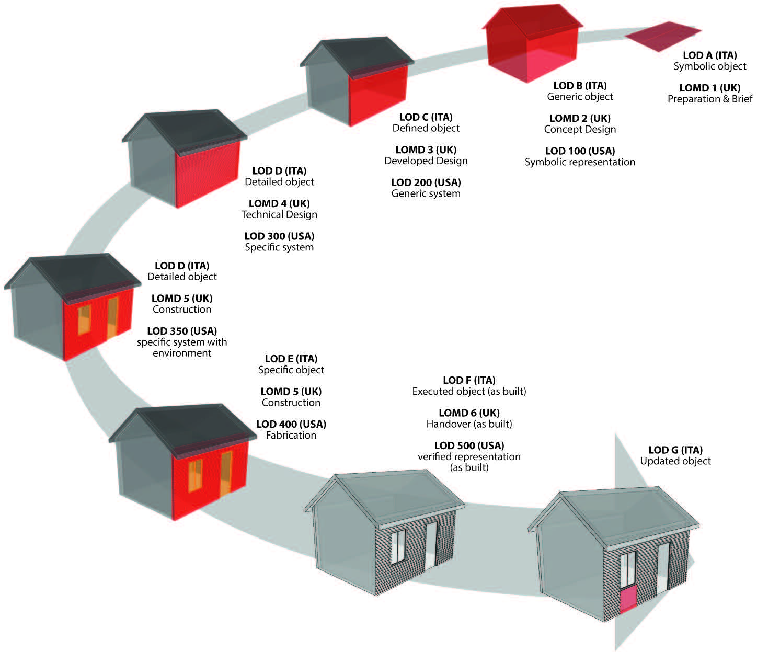
Timber BIM Modeling
Kalle Rohola, architect SAFA
LOD in USA, UK and in Italy
Notes:
Here also an italian LOD system is displayed in correlation with UK and US systems

Slide 13
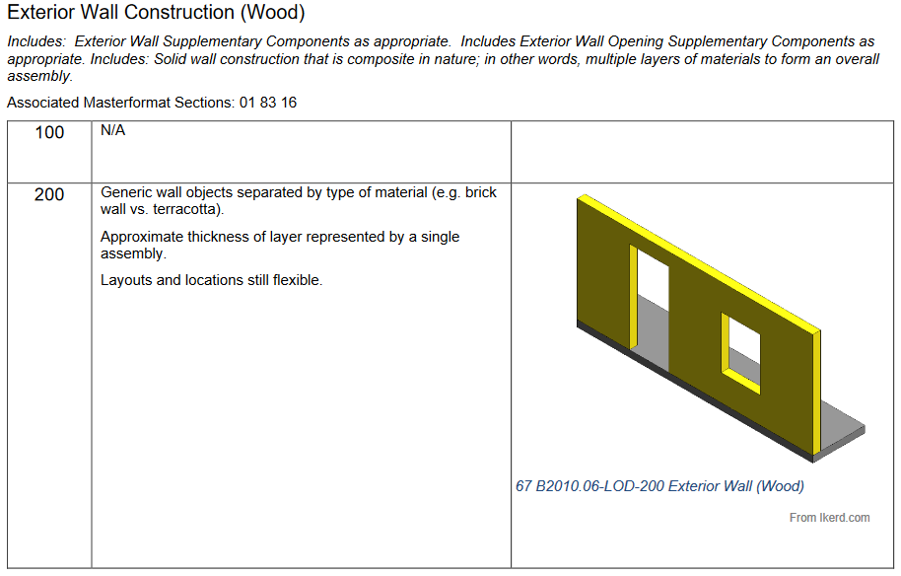
Timber BIM Modeling
Kalle Rohola, architect SAFA
LOD (AIA)
Notes:
Here’s yet another examle of LOD (Level of development) – a timber frame wall BIM element

Slide 14
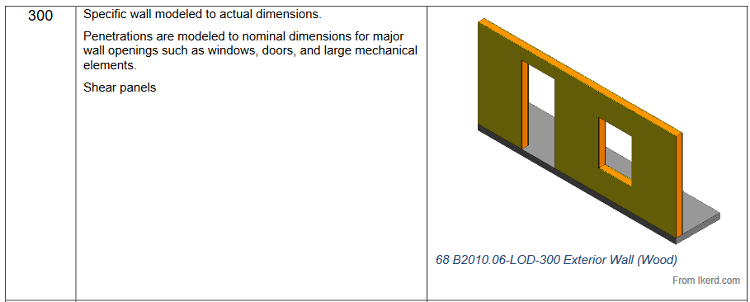
Timber BIM Modeling
Kalle Rohola, architect SAFA
LOD (AIA)

Slide 15
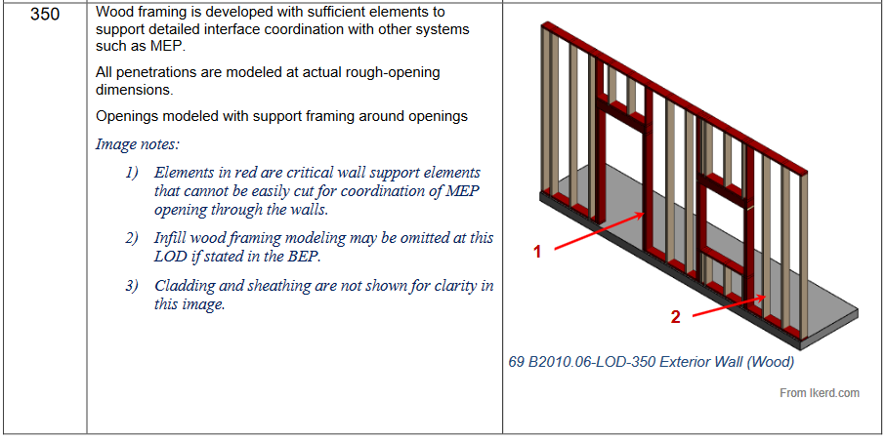
Timber BIM Modeling
Kalle Rohola, architect SAFA
LOD (AIA)

Slide 16
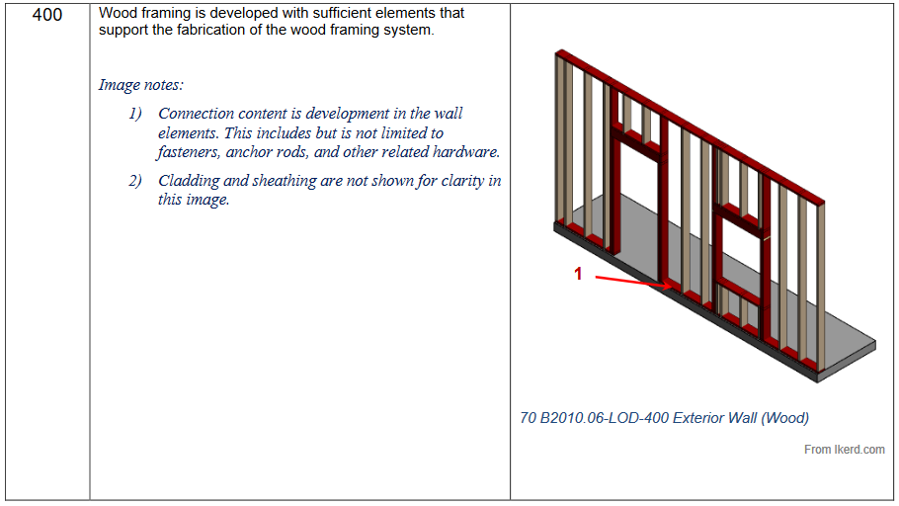
Timber BIM Modeling
Kalle Rohola, architect SAFA
LOD (AIA)

Slide 17
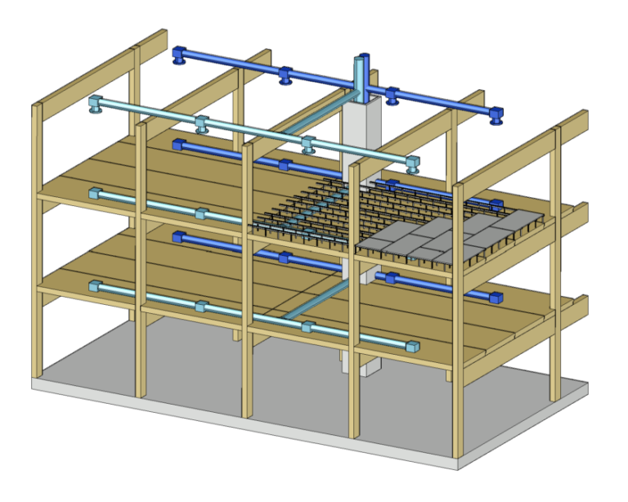
Uses of BIM
Timber BIM Modeling
Kalle Rohola, architect SAFA
Visualization
Visualization of different systems combined
Visualization of the end-product incl. interiors
Structural analysis
Analysis of structural systems using software packages (RFEM, ETABS)
Geometry can be imported from information model or exported from architectural model
BIM Coordination and Clash Detection
Integration of discipline-specific models and identification of conflicts between systems
Interfaces between MEP systems and walls and floors (f.ex. Pentrations)
Clash detection using specific clash detection software
Image: Puuinfo.fi
Notes:
RFEM and ETABS are able to run analysis on mass timber structures

Slide 18
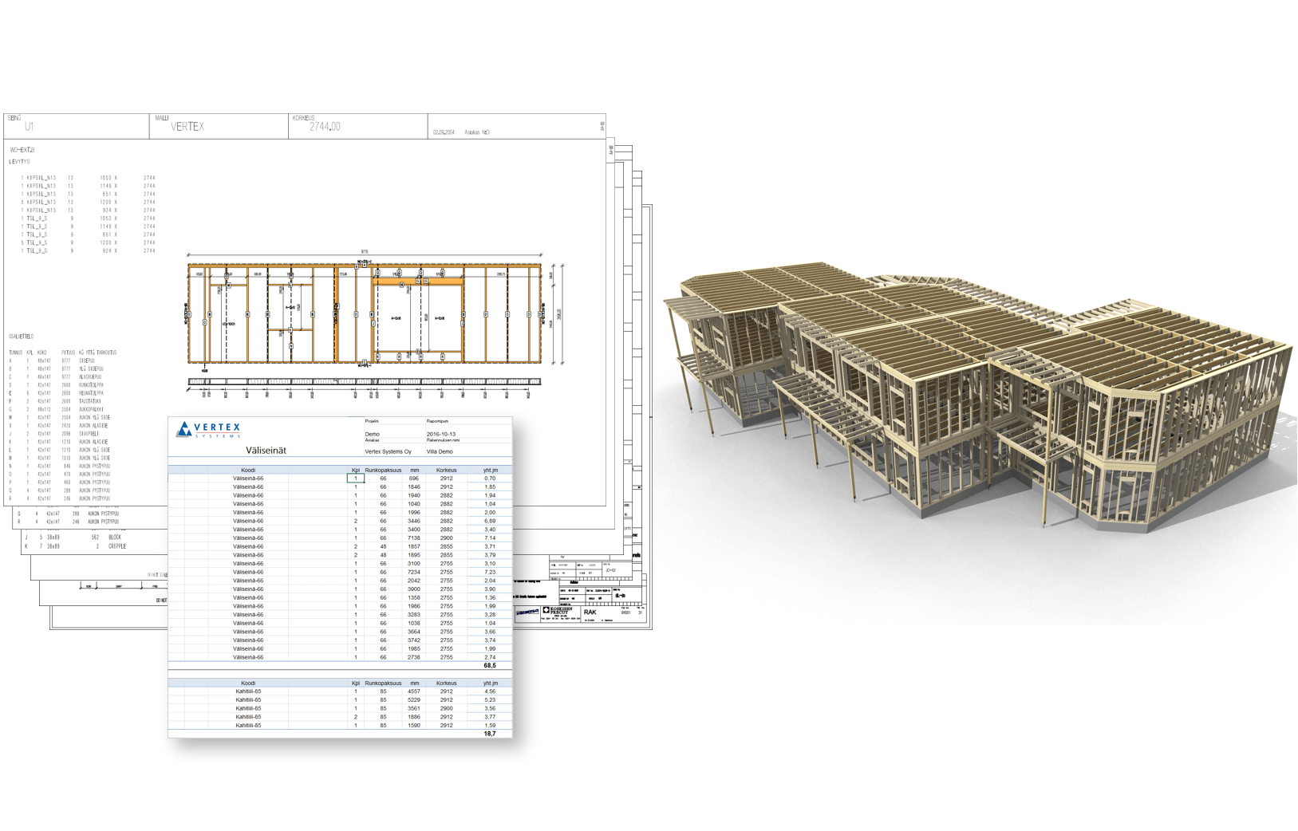
Uses of BIM
Timber BIM Modeling
Kalle Rohola, architect SAFA
Constructability Review
Identification of suboptimal and infeasible working conditions
Construction of a project virtually allows issues to be identified and resolved before the construction phase (4D simulations, f.ex. Temporal structural bracing)
Generation of project Documentation
2D documentation generated directly from the model
Documents for tender and speciality trades (shop- and installation drawings)
Quantity Takeoff to support Cost Estimating
Automatic extraction of material quantities from BIM models
Image: Vertex.fi

Slide 19
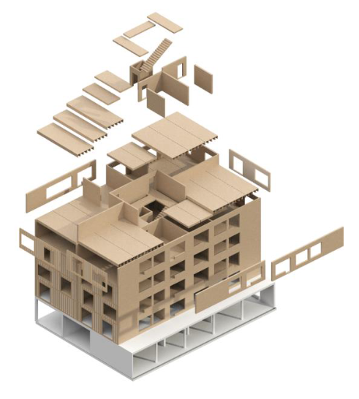
Uses of BIM
Timber BIM Modeling
Kalle Rohola, architect SAFA
Planning Construction Methods
Study of different construction sequences prior to building phase
Other planning, f.ex. Safety and water management
Transportation and Delivery Logistics
coordination of deliveries to the building site
Positions of elements in transportation
4D Scheduling and Progress Tracking
4D model can be used to visualize the construction process
Expected state of the project at different stages in time
Comparison of the scheduled/planned state to the actual state
Image: Storaenso

Slide 20
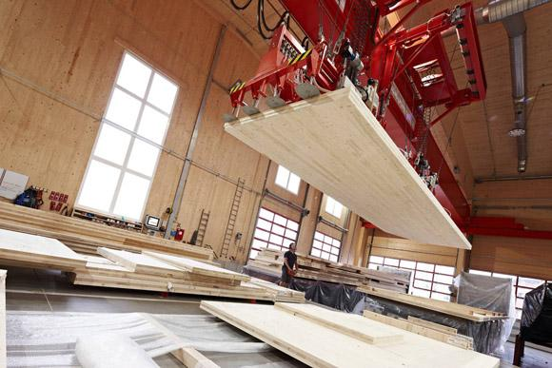
Uses of BIM
Timber BIM Modeling
Kalle Rohola, architect SAFA
Lifting and Center of Gravity Analysis
Facilitation of lifting and center of gravity analysis
Pre-installed fasteners act as lifting anchors
Increase crane efficiency, decrease lifting cycles
Enhancement of site safety
Digital Fabrication
computer-assisted design and processes and robotic controlled precision tools
CNC (Computer numerical controlled) machines
Image: Puuinfo.fi

Slide 21
BIM Workflows
Timber BIM Modeling
Kalle Rohola, architect SAFA
Project stages:
Conceptual design
Main conceptual architectural model:
Building shape, layout, height, number of levels, site plan, space allocation
Preliminary load estimation, structural system
Manufacturer and construction manager involved
Preliminary MEP design models
Design Development
Further development and detailing of the model
Structural and MEP components
Structural analysis
Detailed mechanical, electrical and plumbing design layout
Coordination between different models (clash detection, f.ex. Autodesk Navisworks)
Involvement of Construction manager and manufacturer
Typical Mass-timber project disciplines:
Architect
Structural Consultant
MEP Consultant
Construction manager
Mass-timber manufacturer
Mass-timber Installer

Slide 22
BIM Workflows
Timber BIM Modeling
Kalle Rohola, architect SAFA
Project stages:
Construction Documentation
Models and designs from structural engineer and MEP engineer to architect, coordinated design model to construction manager for time, cost and labour estimation
Quantity take-offs from coordinated model and calculation of costs
Development of detailed construction schedule of the project
Bids for the sub-contractiong fabrication and installation work
Detailing
Coordinated design models to manufacturer, development of shop drawings
Connections, screws, bolts, penetration, etc.
Fabrication information
Detailing information to the installer
Fabrication
Installation drawings to the installer
Development of installation sequences ny the installer
Optimized installation sequence to the manufacturer
Production plan of the prefabricated components by the manufacturer, CNC commands , coordinated fabrication sequence
Coordinated just-in-time delivery of timber components
Onsite coordination strategy for the assembly process
Assembly
Design models + 2d plans used in site meetings
Model is updated according to timber installers installation status updates
Updated model is used for quality control
4D simulations to track the construction activities
Quantity take-offs for ordering materials for just-in-time deliveries

Slide 23
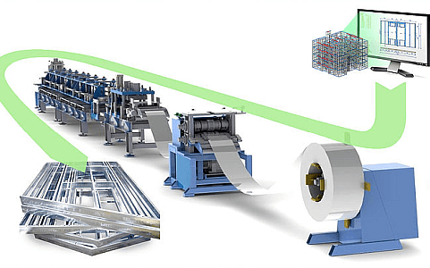
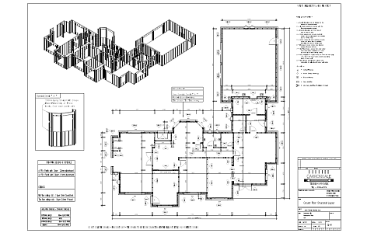
Images: Vertex.fi

Slide 24
BIM Tools
Timber BIM Modeling
Kalle Rohola, architect SAFA
Common Design Tools
Autodesk Revit
Architectural, Structural and MEP models
Most dominant BIM tool in North America and many European countries
Analysis tools incl. Heating and cooling, daylight, lighting, structural calculations, etc.
Timber extensions f.ex. hsbTimber by hscad
Does not support STEP files, has to be in combination with manufacturing tool
Tekla Structures
Specializes in structural steel and concrete detailing and fabrication, support for timber in growing
Is able to interact with most planning and automation systems that are in use in steel and concrete fabrication
Logistic plans, assembly status , schedules and material traceability can be included in Tekla model
Rhinoceros 3D (Rhino) and Grasshopper
Rhino parametric modeling and CAD/CAM software
Grasshopper is a visual programming environment for Rhino
PlanCAD (Dietrich’s)
Modules for timber structures, frames and trusses
Mostly used in Europe
Archicad
Specializes in architectural design
ArchiFrame add-on, support for interactiong with CNC machines

Slide 25
BIM Tools
Timber BIM Modeling
Kalle Rohola, architect SAFA
Common Manufacturing Tools
Cadwork
Leading 3D CAD/CAM software specializing in timber construction
Joint details, element modules, preset wood panel construction, stud frame construction, other system methods
Shop drawings, components can be sent directly to the CNC machines
Autodesk Inventor
Parametric modeling, 3D mechanical design, documentation, product simulation
Simulation analysis, basic stress analysis, surface modeling
Not widely used in timber (mostly in equipment and automotive design)
Woodwork –extension (wooden furniture, CNC support) can be used in timber fabrication
SEMA software
3D CAD/CAM software for planning, designing and production for timber (and stairs) construction
Standardized component libraries, timber fasteners/connections
Shop drawings, direct communication with CNC machines
CATIA
Leading engineering and design software in the manufacturing domain, CAD, CAE/M
Mostly used in aerospace and automotive industries
Limited construction-specific features
Cambium
Communicates with all Hundegger machines
Tailored for timber construction and fabrication

Slide 26
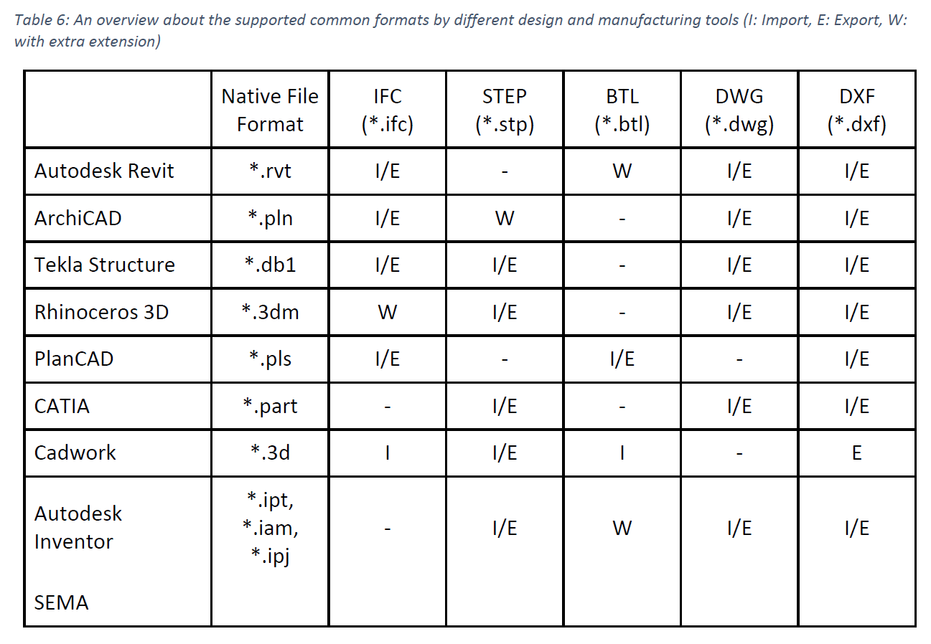
Notes:
Supported file formats of different BIM software

Slide 27
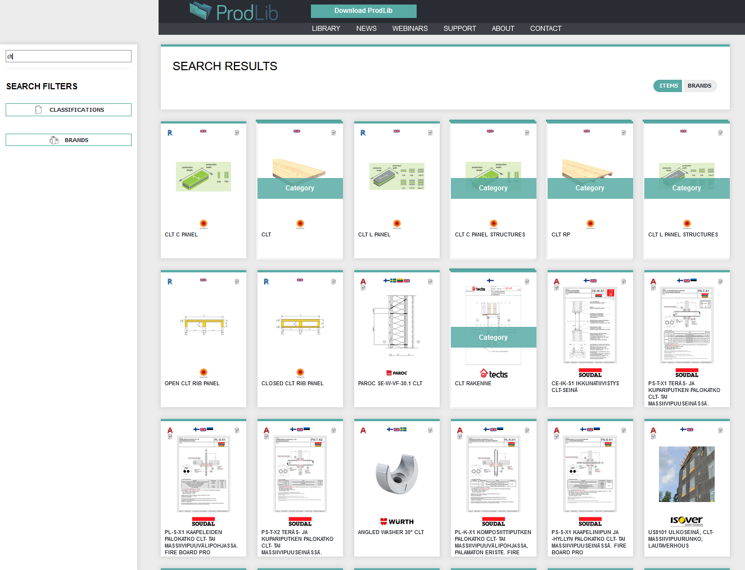
BIM Product Libraries for Timber
Timber BIM Modeling
Kalle Rohola, architect SAFA
Compared to steel and concrete, timber is the structural system that has had least development in tools and platform development
A selection of wood-specific platforms, software and object libraries
BIM for timber:
Bimm.eu (Austria)
BIMstore.co.uk (UK)
NBS National BIM Library (UK)
Prodlib.com (FI)

