Slide 1
BEST PRACTICE DETAILS, CONSTRUCTION, ARCHITECTURE
Łukasz Wesołowski : Pawel Mika
17-05-2022

Slide 2
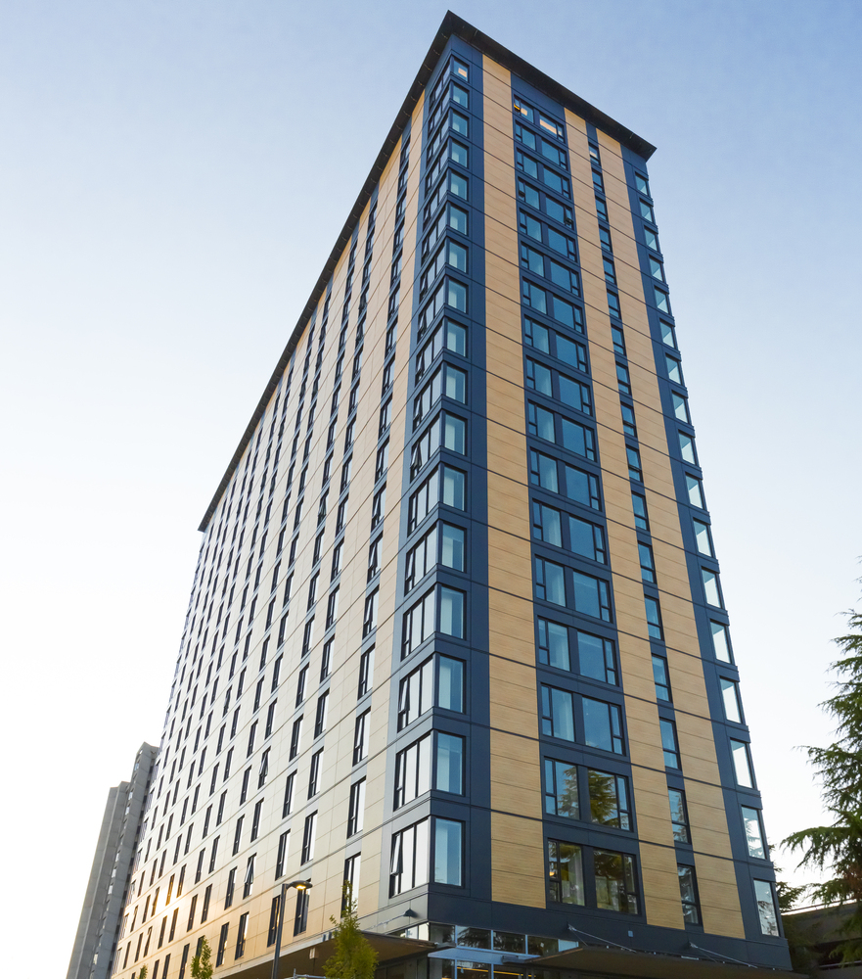
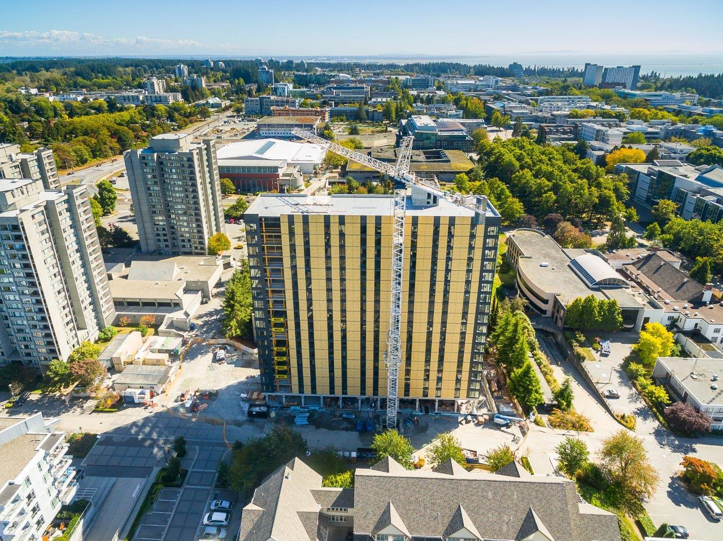
Best practice Details, Construction, Architecture
Łukasz Wesołowski, Paweł Mika
Architecture:
Brock Commons // 53 m tall // Canada-Vancouve // 2017

Slide 3
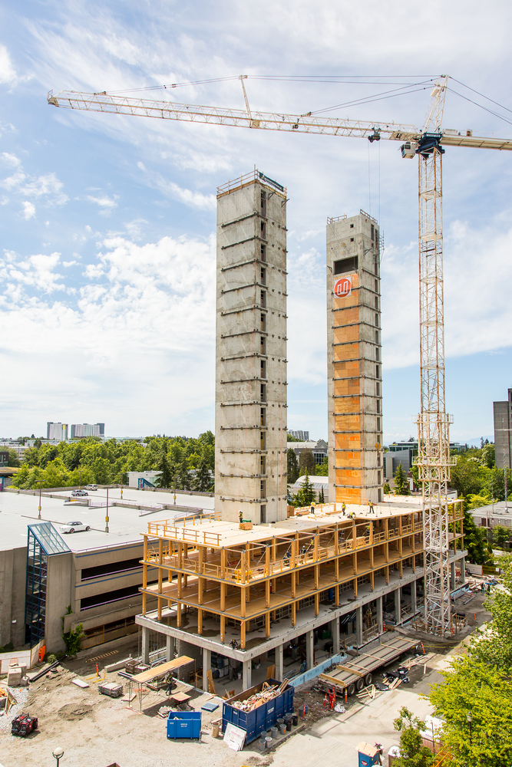
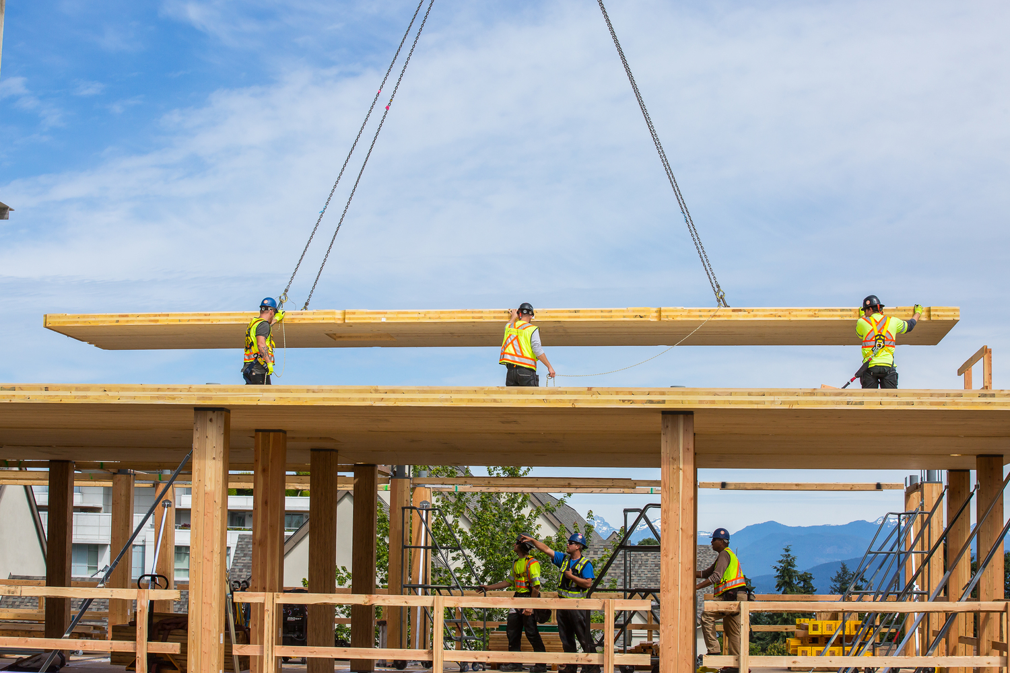
Best practice Details, Construction, Architecture
Łukasz Wesołowski, Paweł Mika
Architecture:
Brock Commons // 53 m tall // Canada-Vancouve // 2017

Slide 4
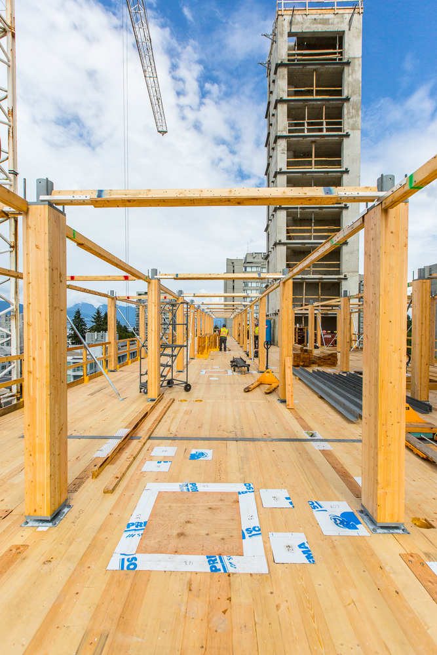
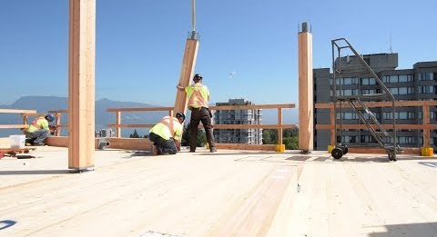
Best practice Details, Construction, Architecture
Łukasz Wesołowski, Paweł Mika
Architecture:
Brock Commons // 53 m tall // Canada-Vancouve // 2017

Slide 5
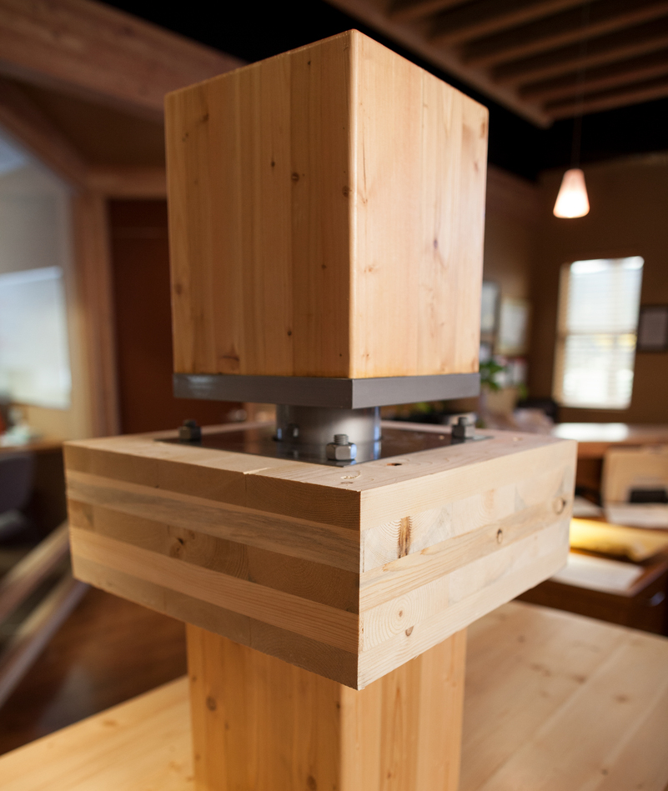
Best practice Details, Construction, Architecture
Łukasz Wesołowski, Paweł Mika
Architecture:
Brock Commons // 53 m tall // Canada-Vancouve // 2017

Slide 6
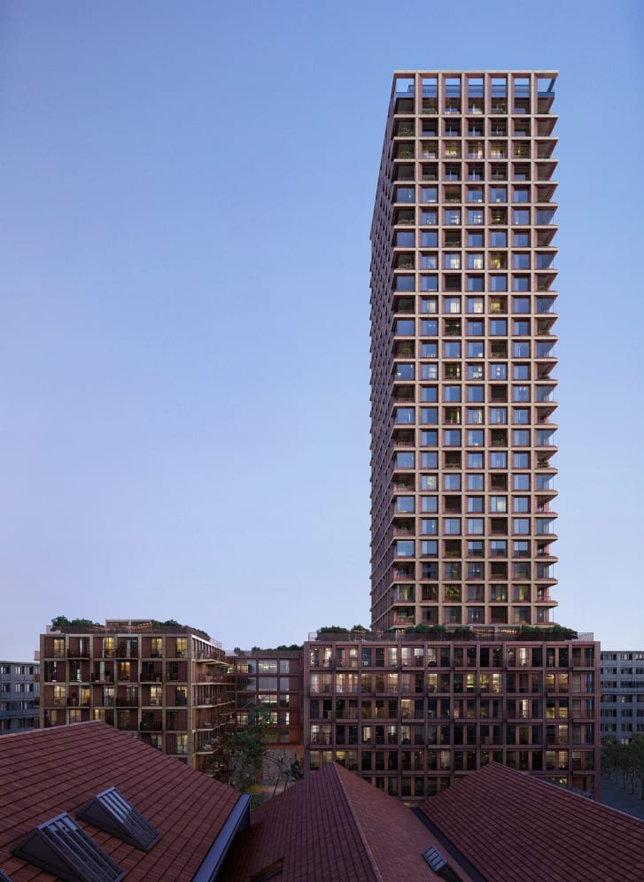
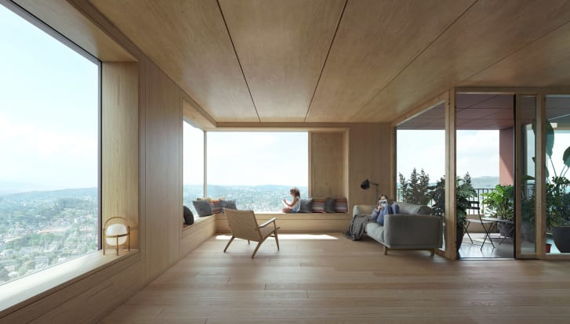
Best practice Details, Construction, Architecture
Łukasz Wesołowski, Paweł Mika
Architecture:
Rocket&Tigerli // 100m tall // Switzerland-Winterthur // Project

Slide 7
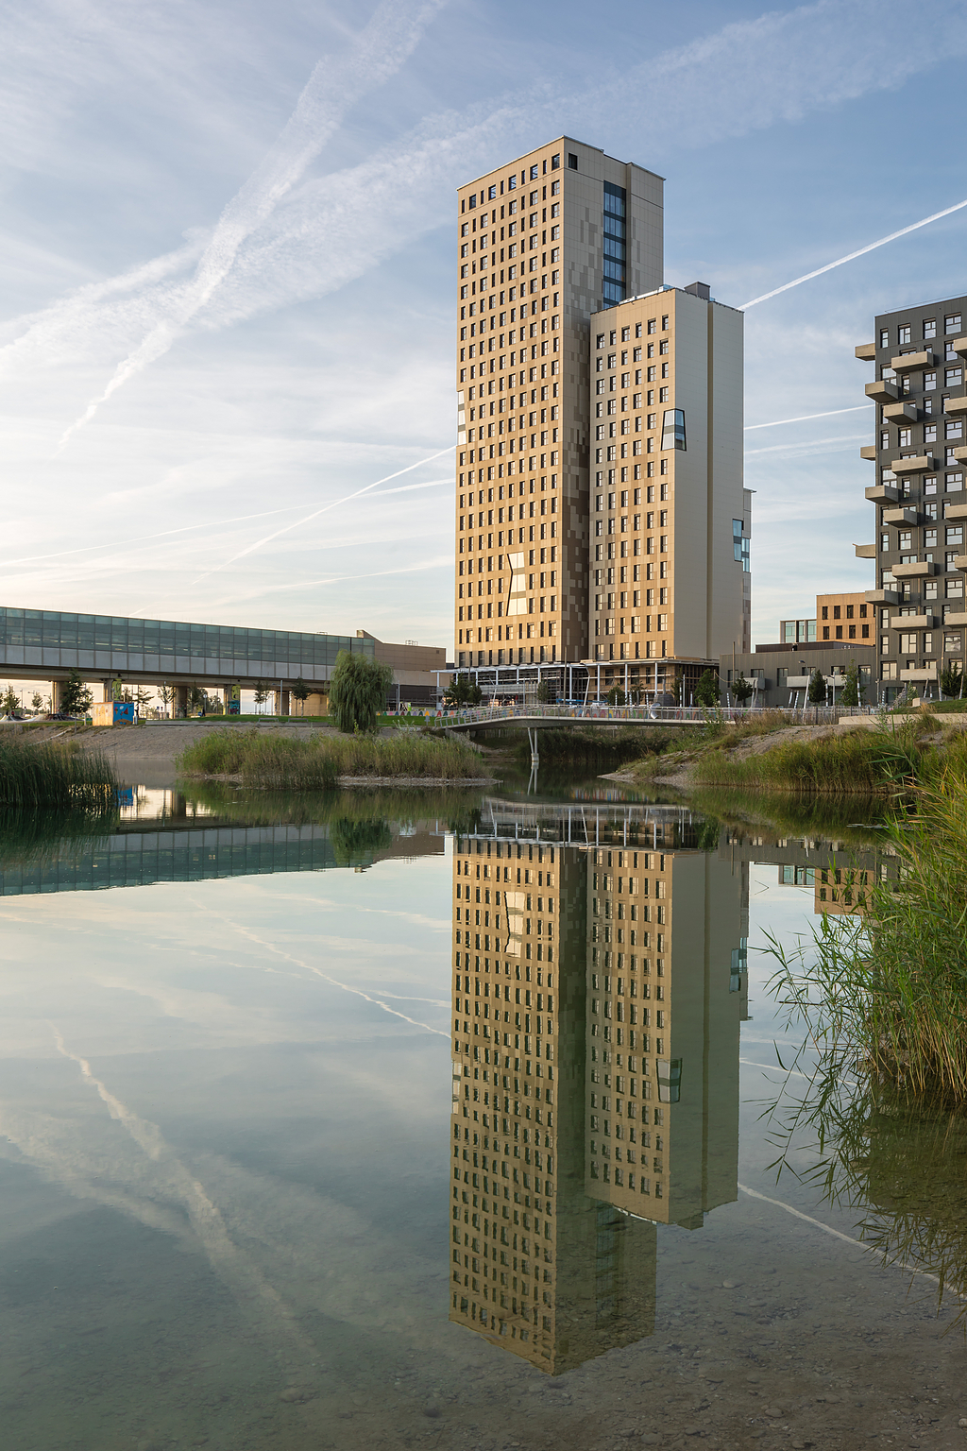
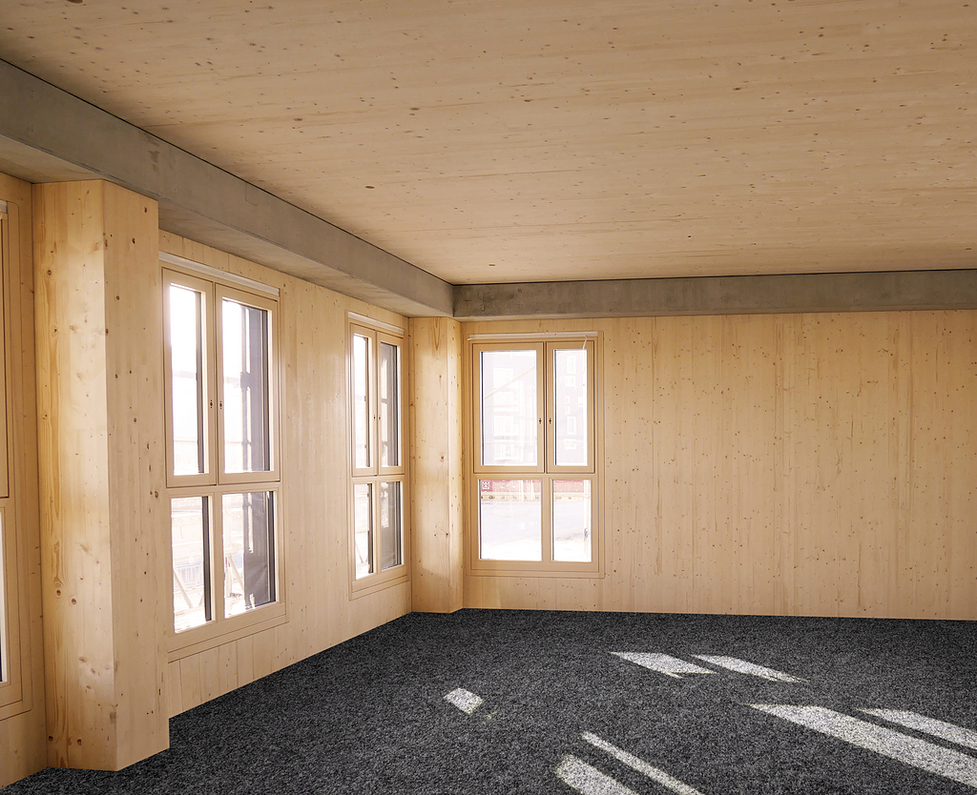
Best practice Details, Construction, Architecture
Łukasz Wesołowski, Paweł Mika
Architecture:
Hoho TOwer // 84m tall // Austria-Wiena // 2019

Slide 8
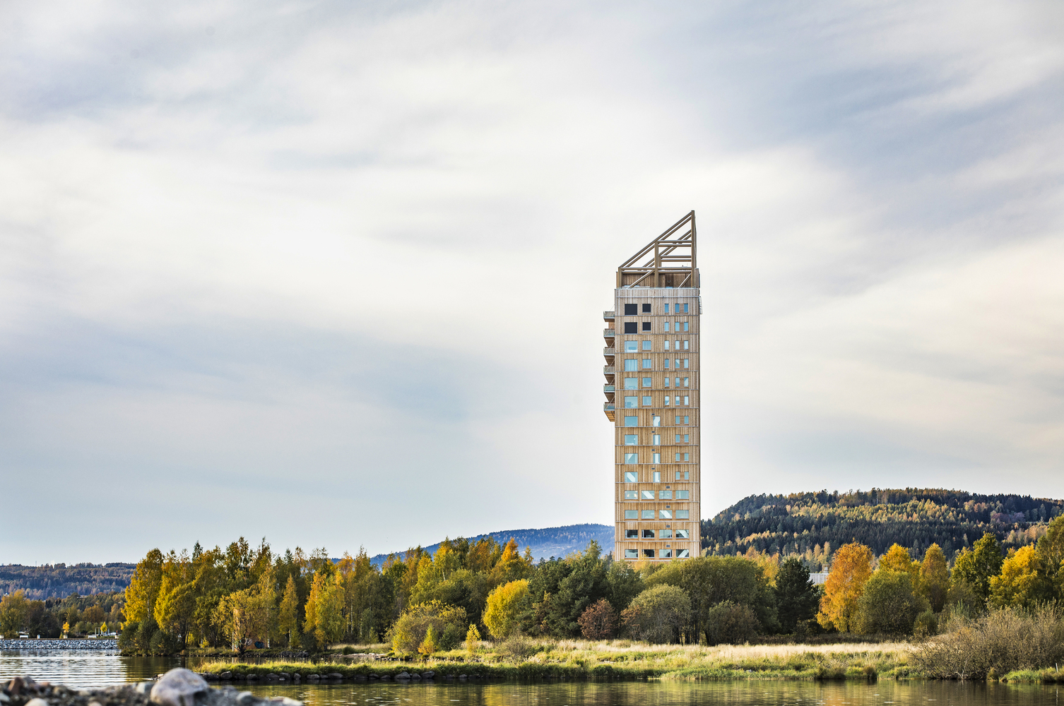
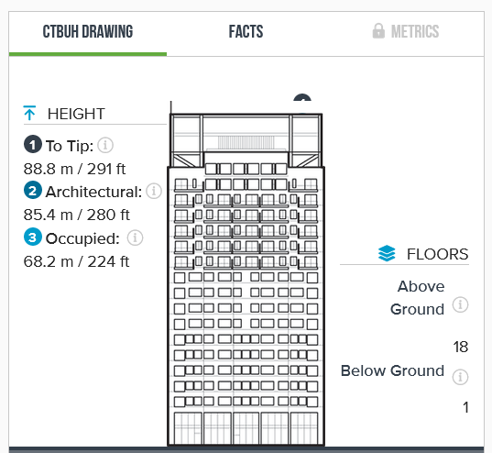
Best practice Details, Construction, Architecture
Łukasz Wesołowski, Paweł Mika
Architecture:
Mjøstårnet // 85,4m tall // Norway-Brumunddal // 2019

Slide 9
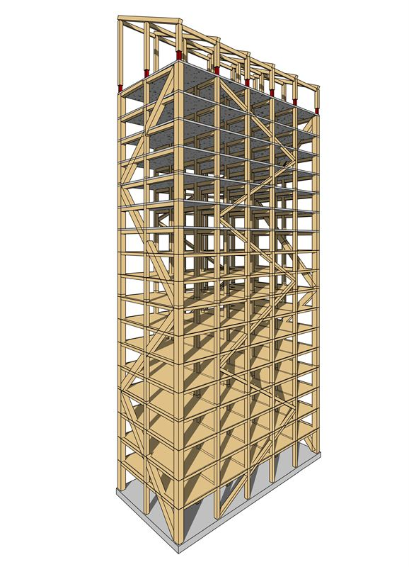
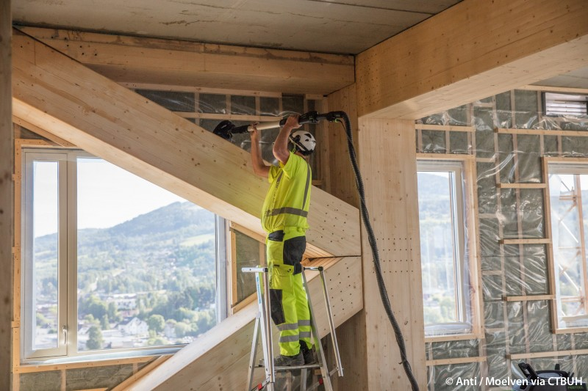
Best practice Details, Construction, Architecture
Łukasz Wesołowski, Paweł Mika
Architecture:
Mjøstårnet // 85,4m tall // Norway-Brumunddal // 2019

Slide 10
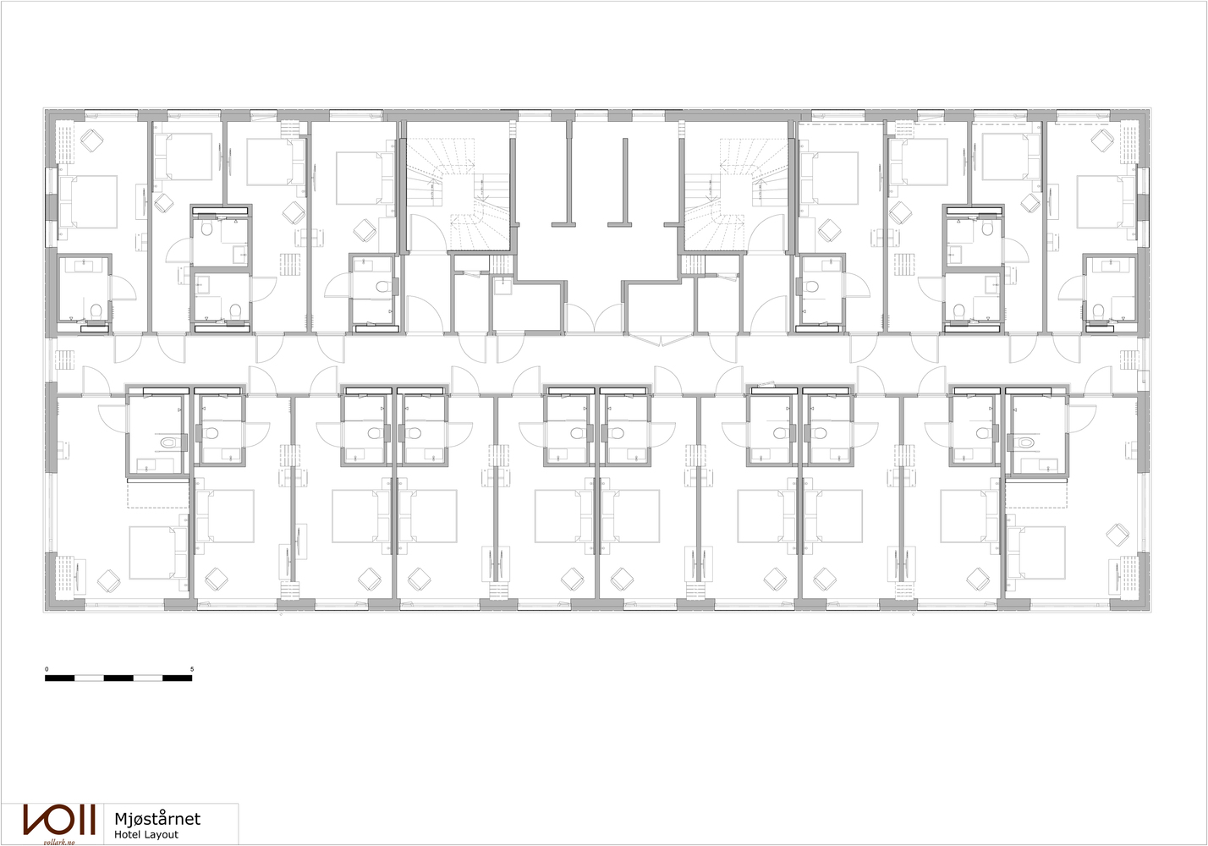
Best practice Details, Construction, Architecture
Łukasz Wesołowski, Paweł Mika
Architecture:
Mjøstårnet // 85,4m tall // Norway-Brumunddal // 2019

Slide 11
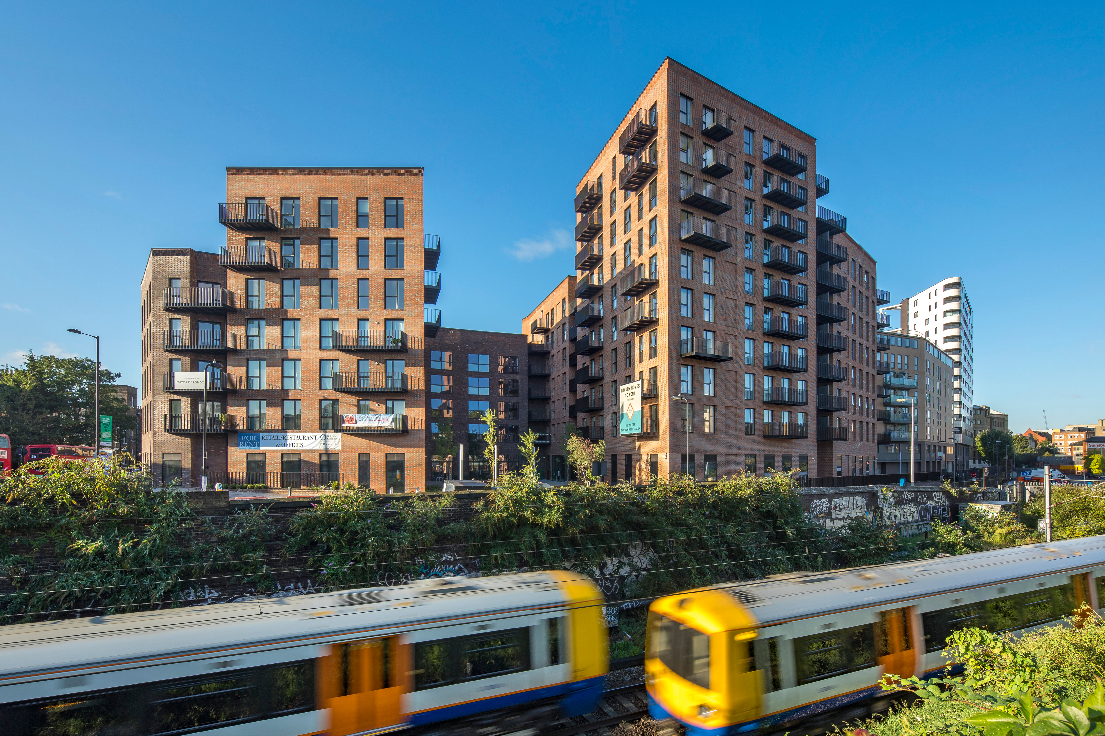
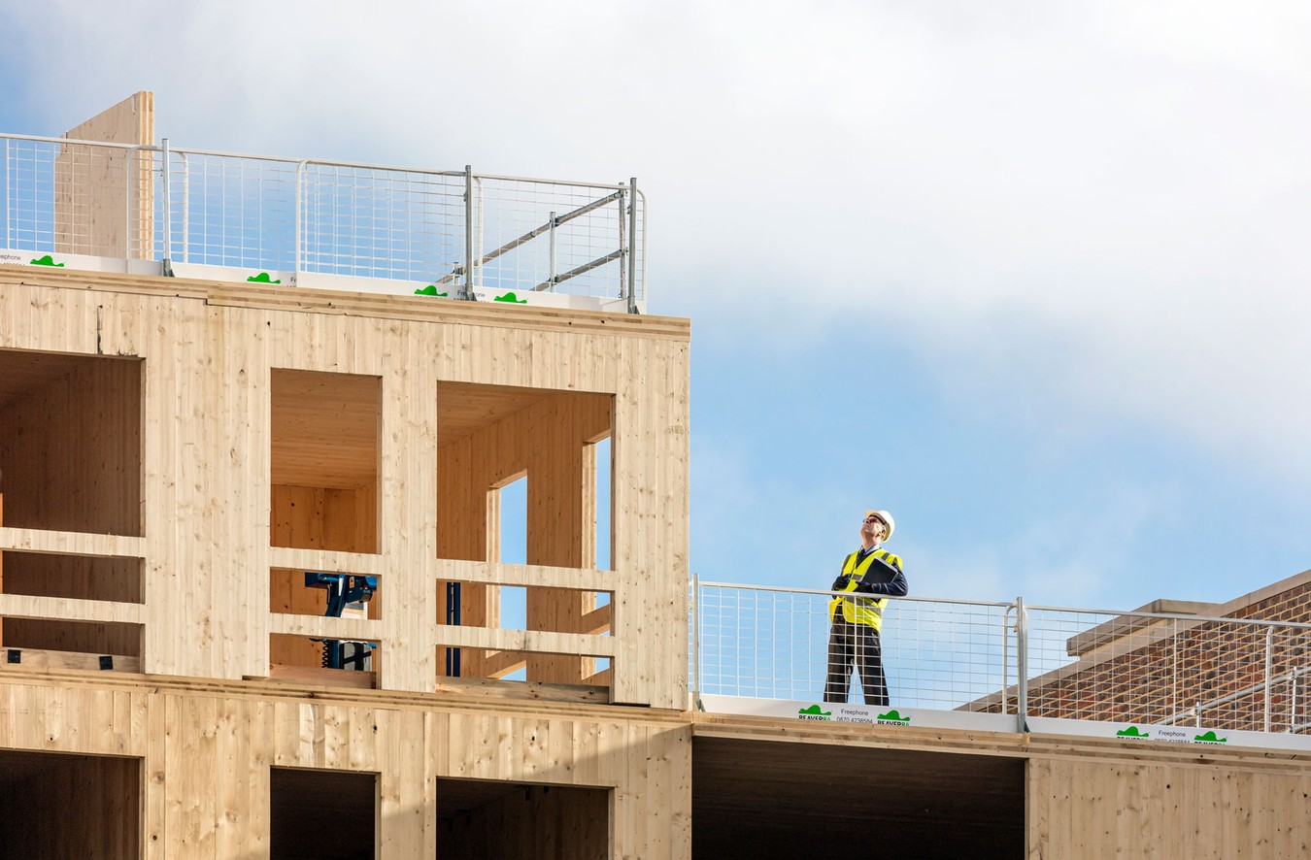
Best practice Details, Construction, Architecture
Łukasz Wesołowski, Paweł Mika
Architecture:
Dalston Works // 34m tall // Great Britain-London // 2017

Slide 12
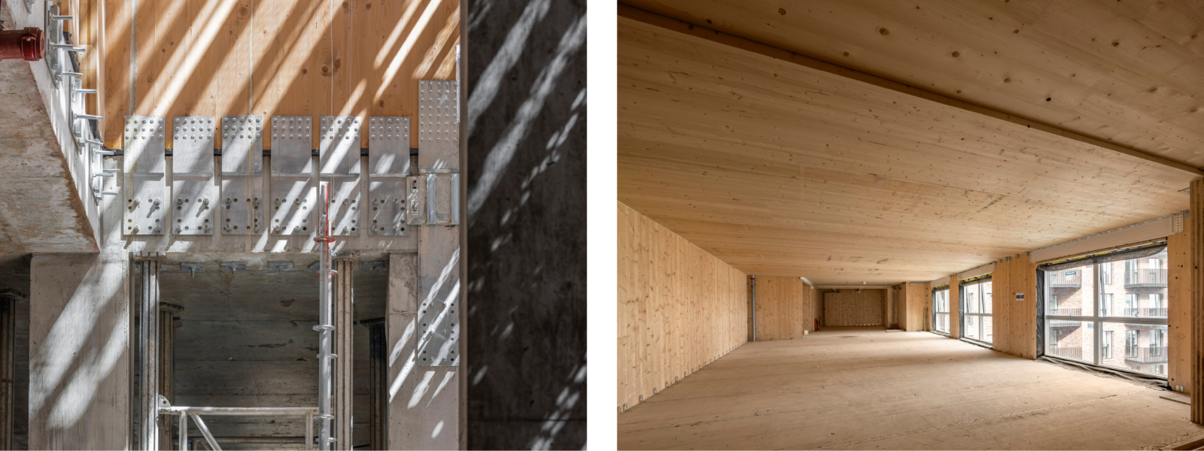
Best practice Details, Construction, Architecture
Łukasz Wesołowski, Paweł Mika
Architecture:
Dalston Works // 34m tall // Great Britain-London // 2017

Slide 13
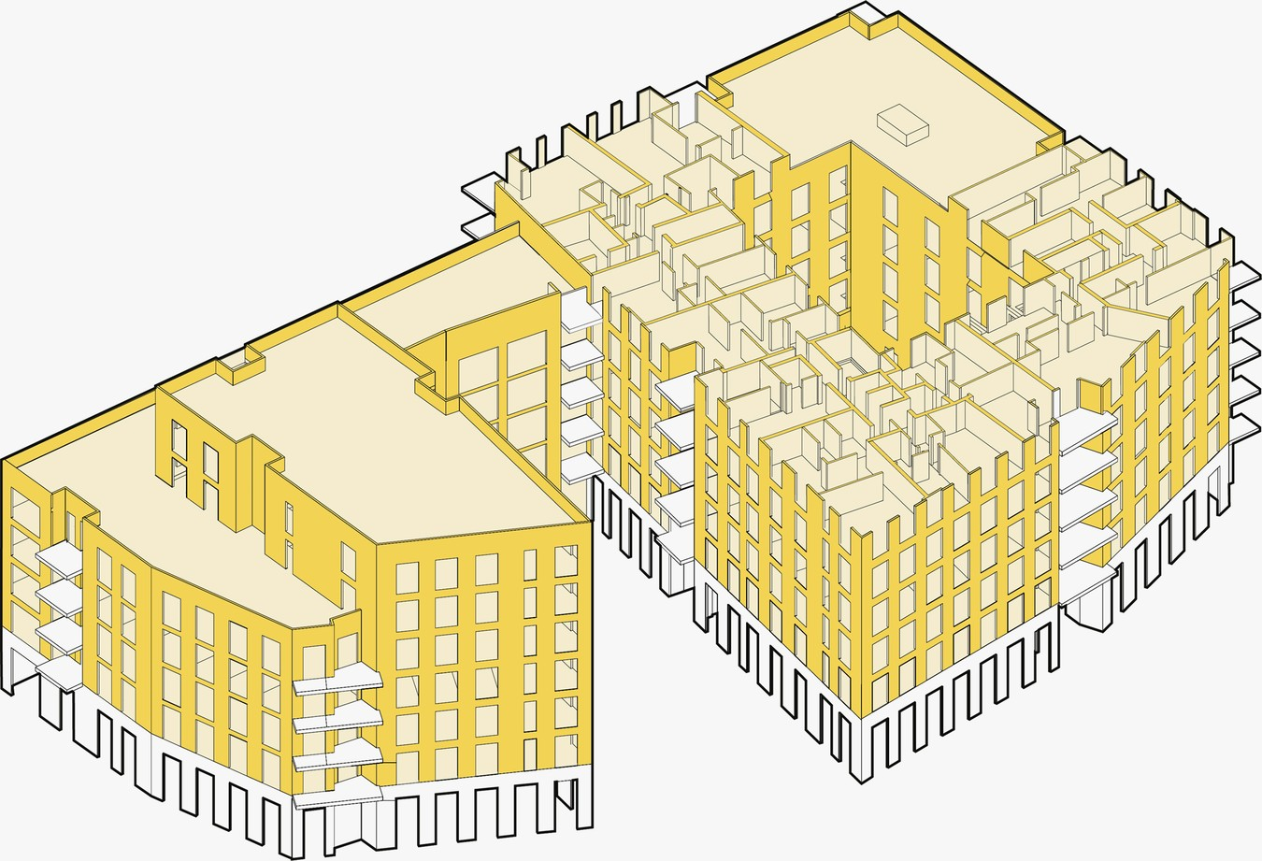
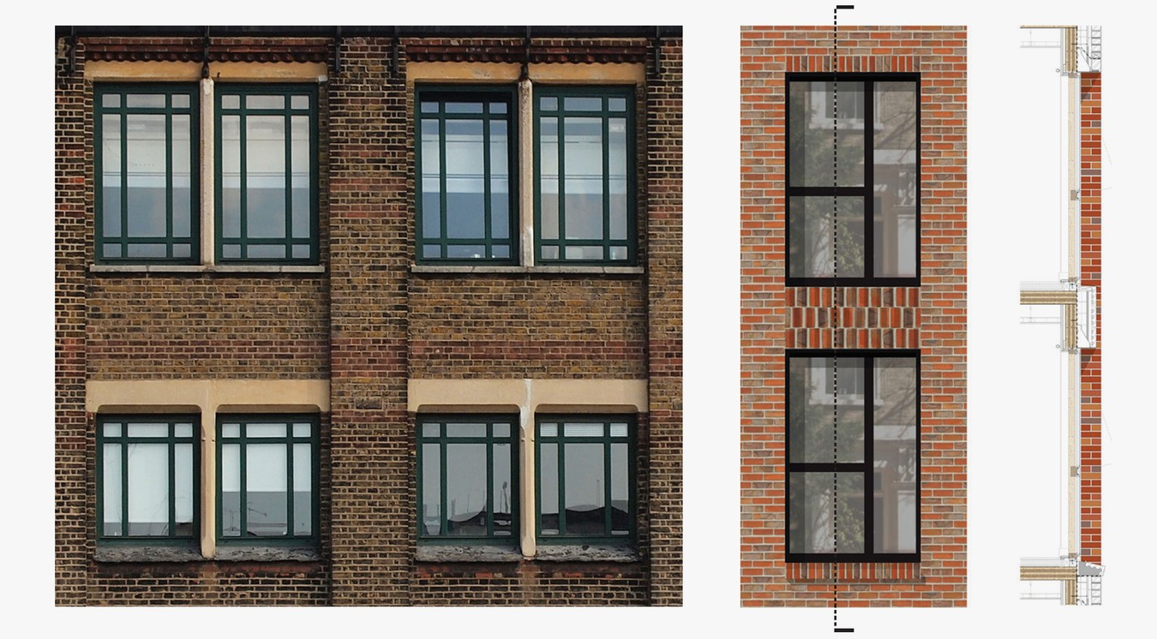
Best practice Details, Construction, Architecture
Łukasz Wesołowski, Paweł Mika
Architecture:
Dalston Works // 34m tall // Great Britain-London // 2017

Slide 14
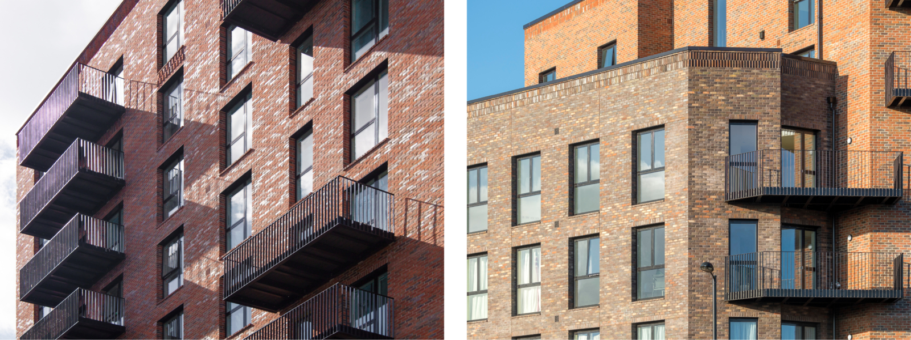
Best practice Details, Construction, Architecture
Łukasz Wesołowski, Paweł Mika
Architecture:
Dalston Works // 34m tall // Great Britain-London // 2017

Slide 15
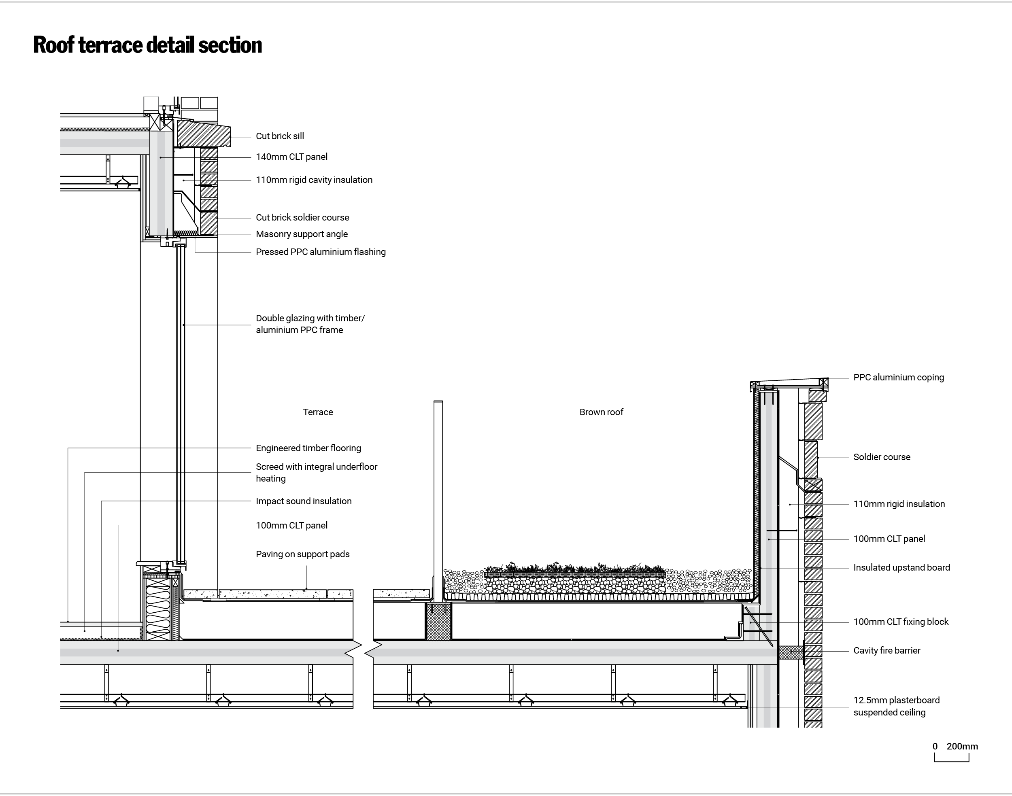
Best practice Details, Construction, Architecture
Łukasz Wesołowski, Paweł Mika
Architecture:
Dalston Works // 34m tall // Great Britain-London // 2017

Slide 16
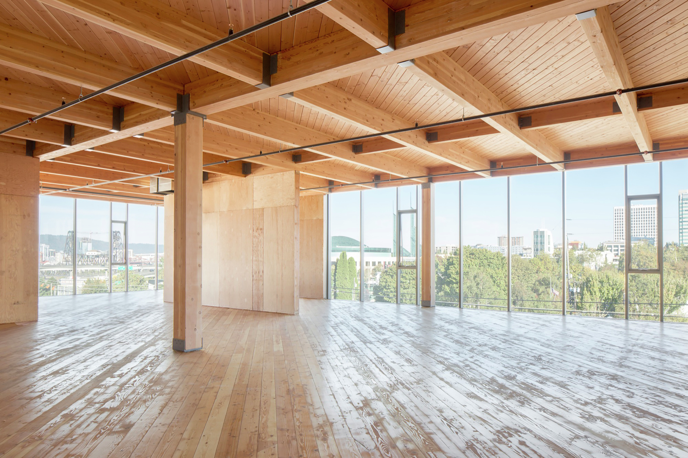
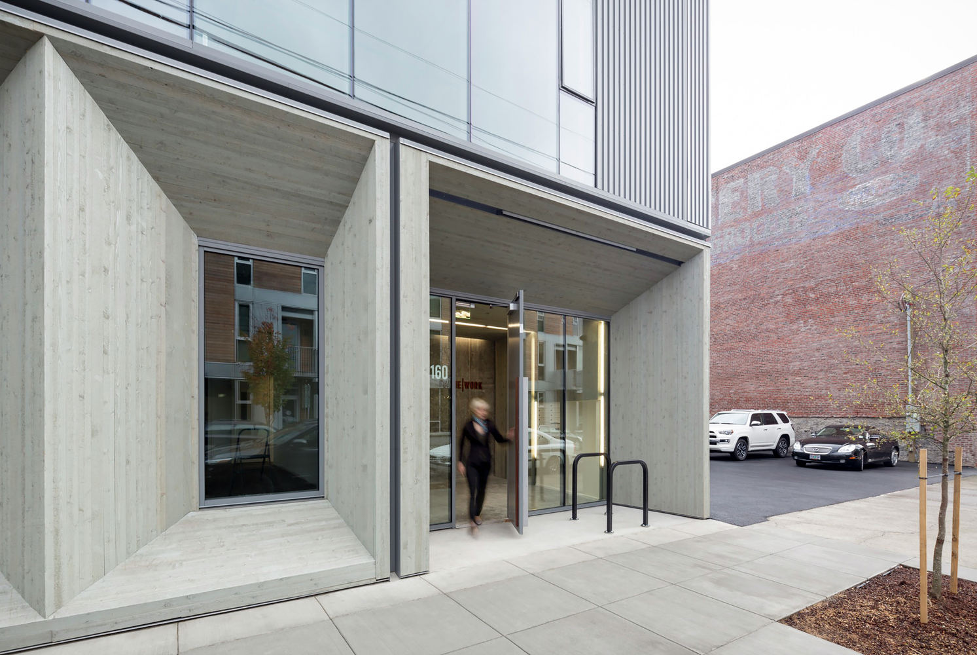
Best practice Details, Construction, Architecture
Łukasz Wesołowski, Paweł Mika
Architecture:
Framework HQ // wood grain // USA-Portland // YYYY

Slide 17
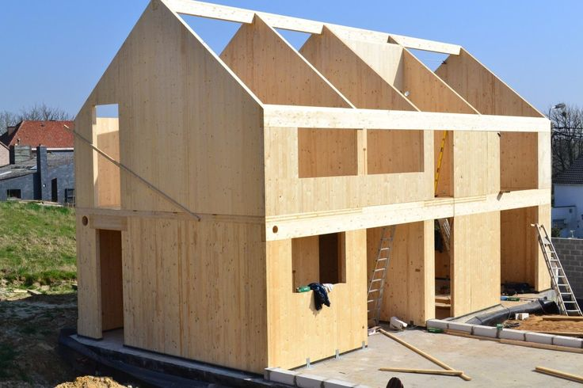
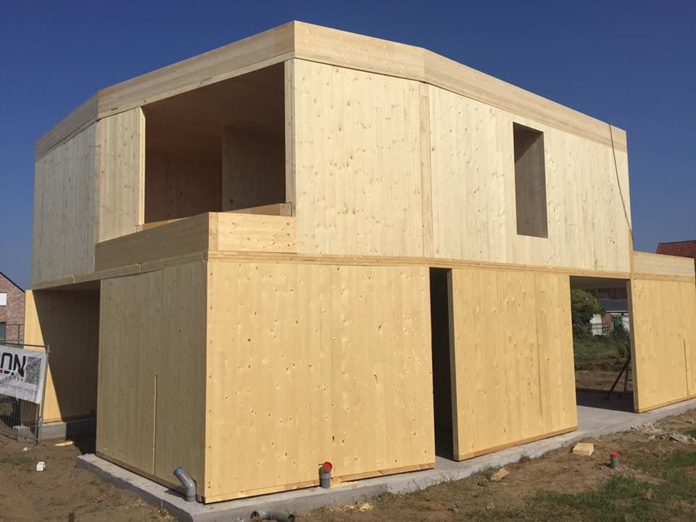
Best practice Details, Construction, Architecture
Łukasz Wesołowski, Paweł Mika
Architecture:
Housing // efficient //

Slide 18
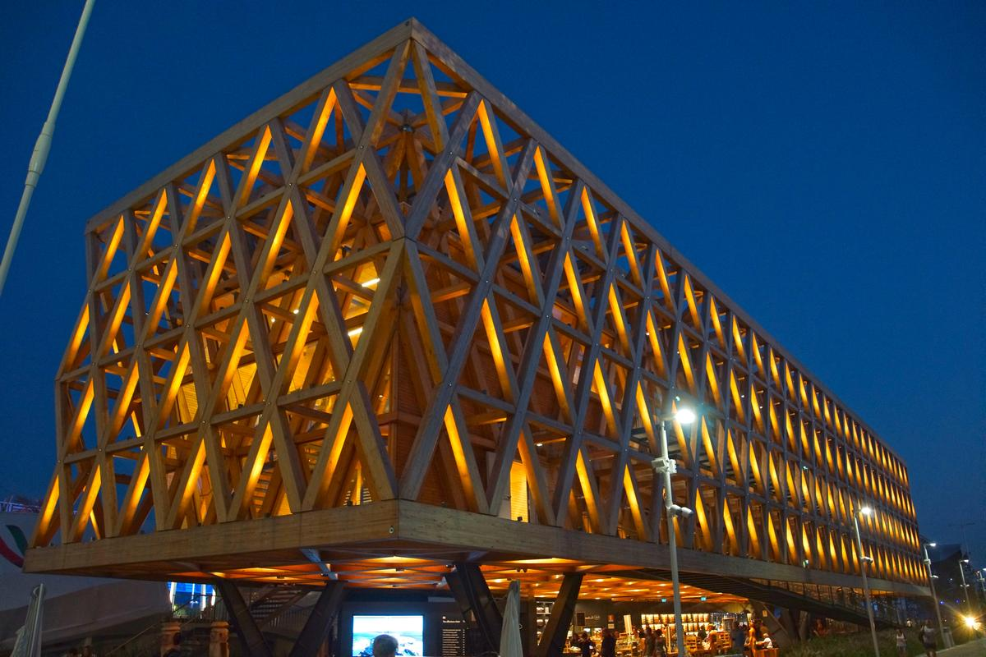
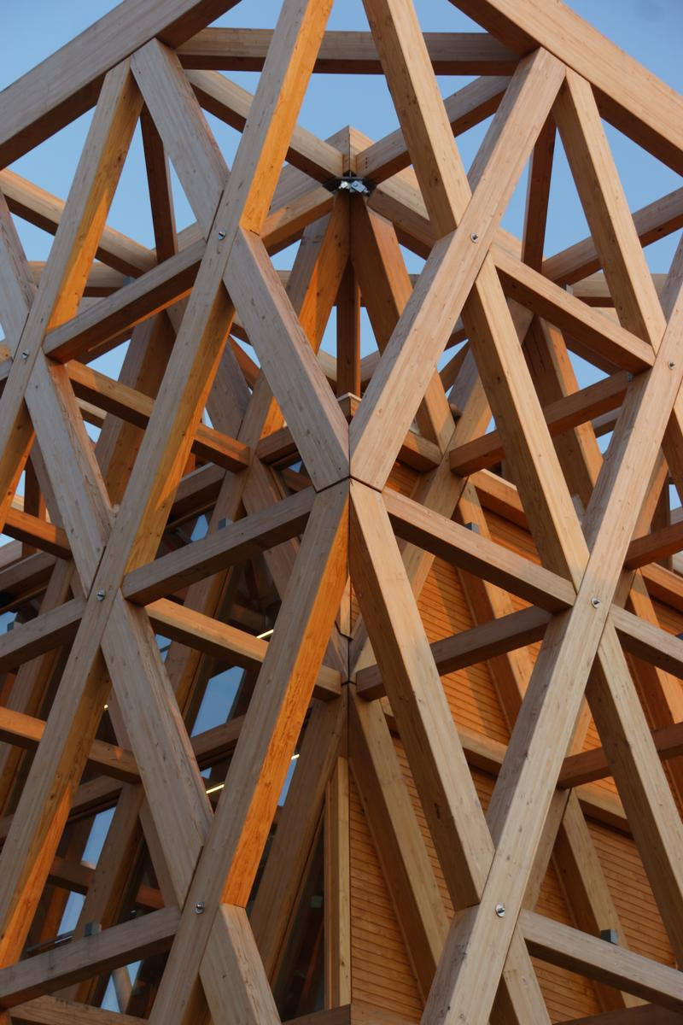
Best practice Details, Construction, Architecture
Łukasz Wesołowski, Paweł Mika
Architecture:
Chile Pavilion // structures // Italy-Milan // 2015

Slide 19
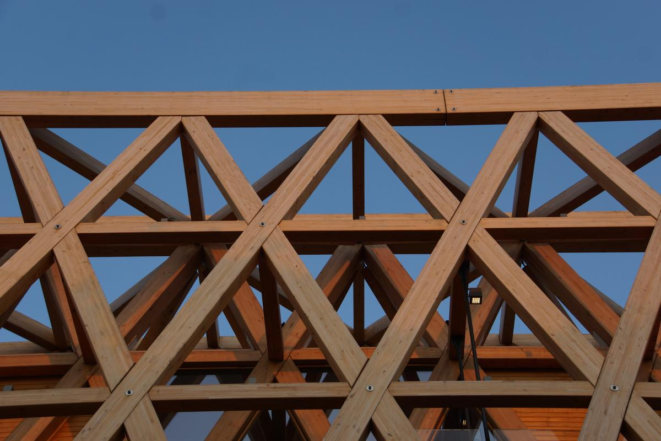
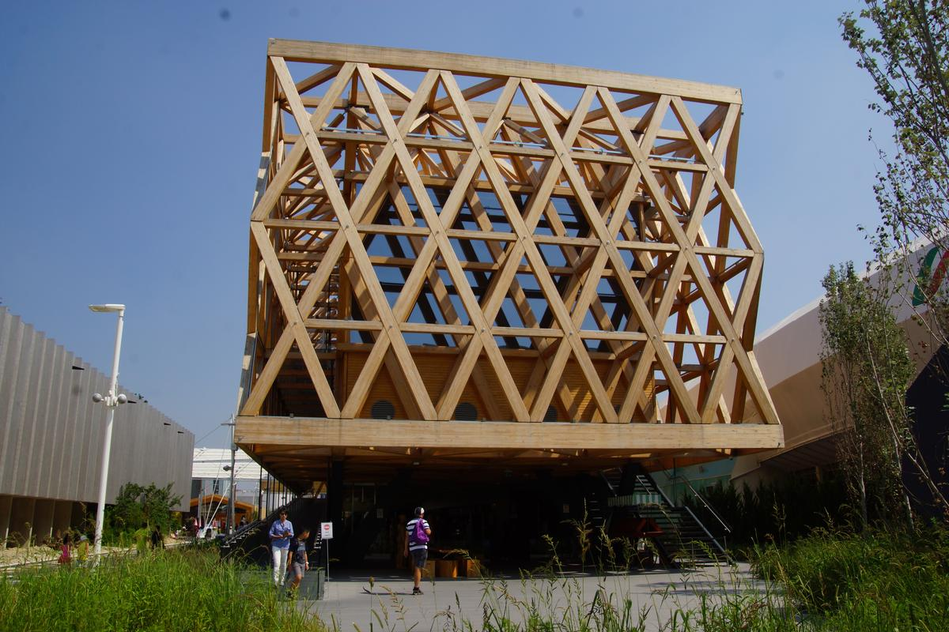
Best practice Details, Construction, Architecture
Łukasz Wesołowski, Paweł Mika
Architecture:
Chile Pavilion // structures // Italy-Milan // 2015

Slide 20
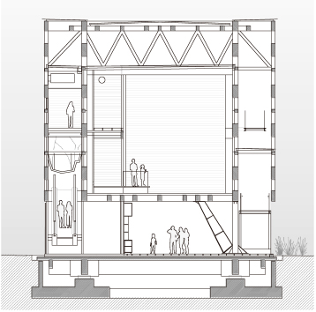
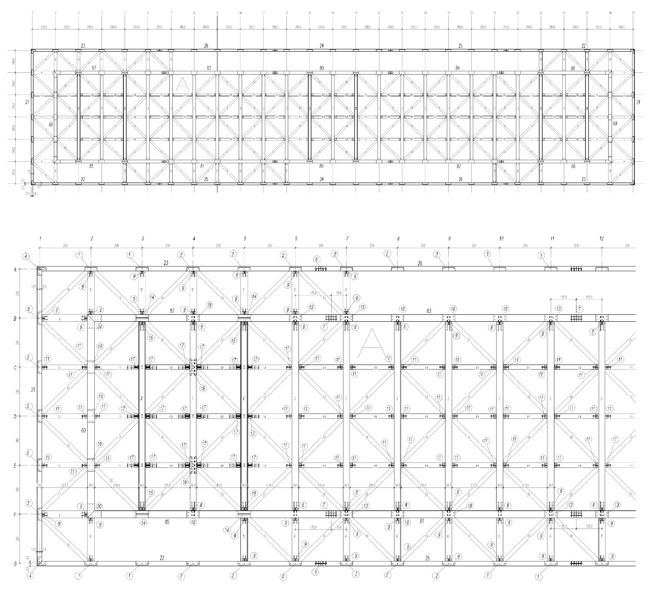
Best practice Details, Construction, Architecture
Łukasz Wesołowski, Paweł Mika
Architecture:
Chile Pavilion // structures // Italy-Milan // 2015

Slide 21
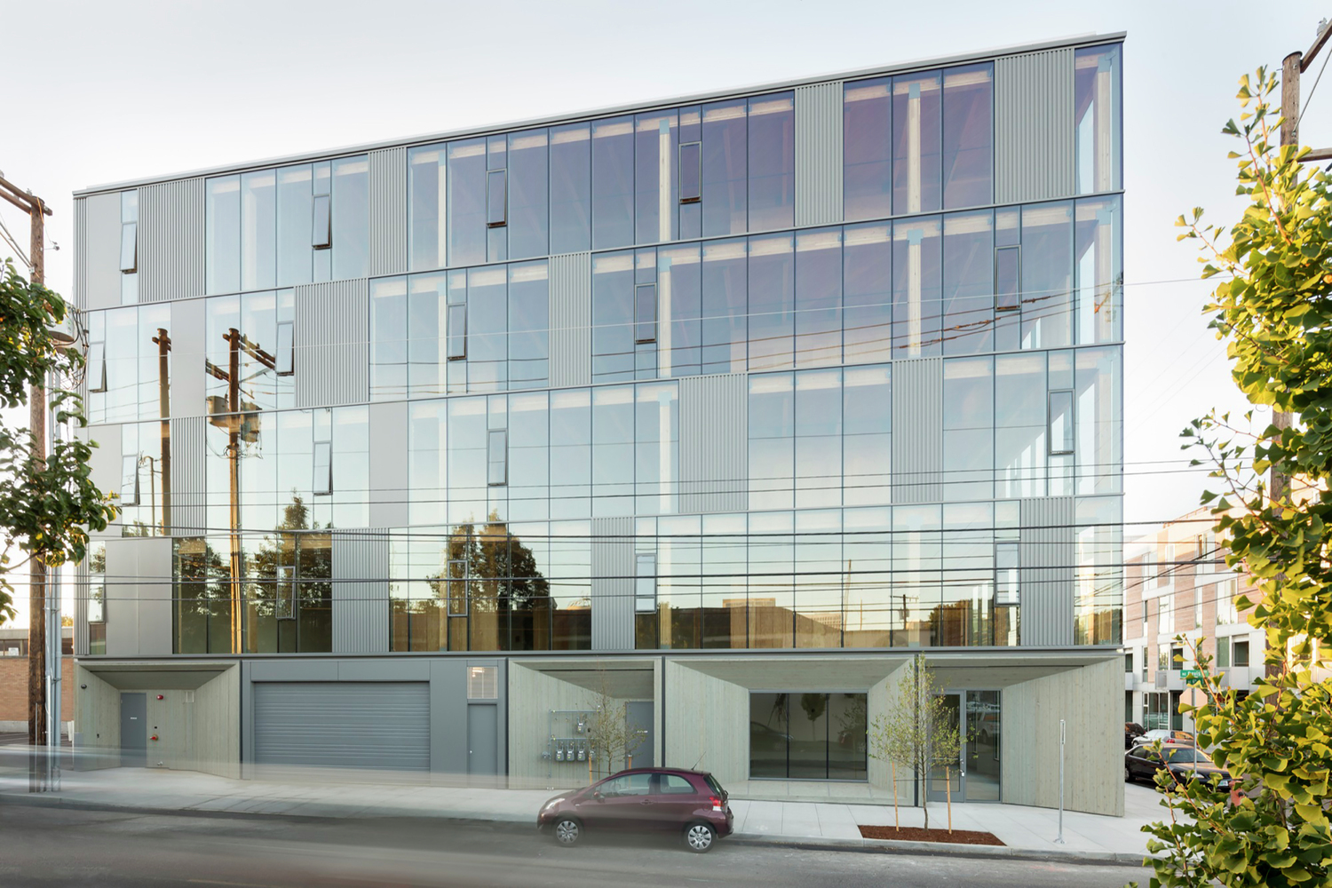
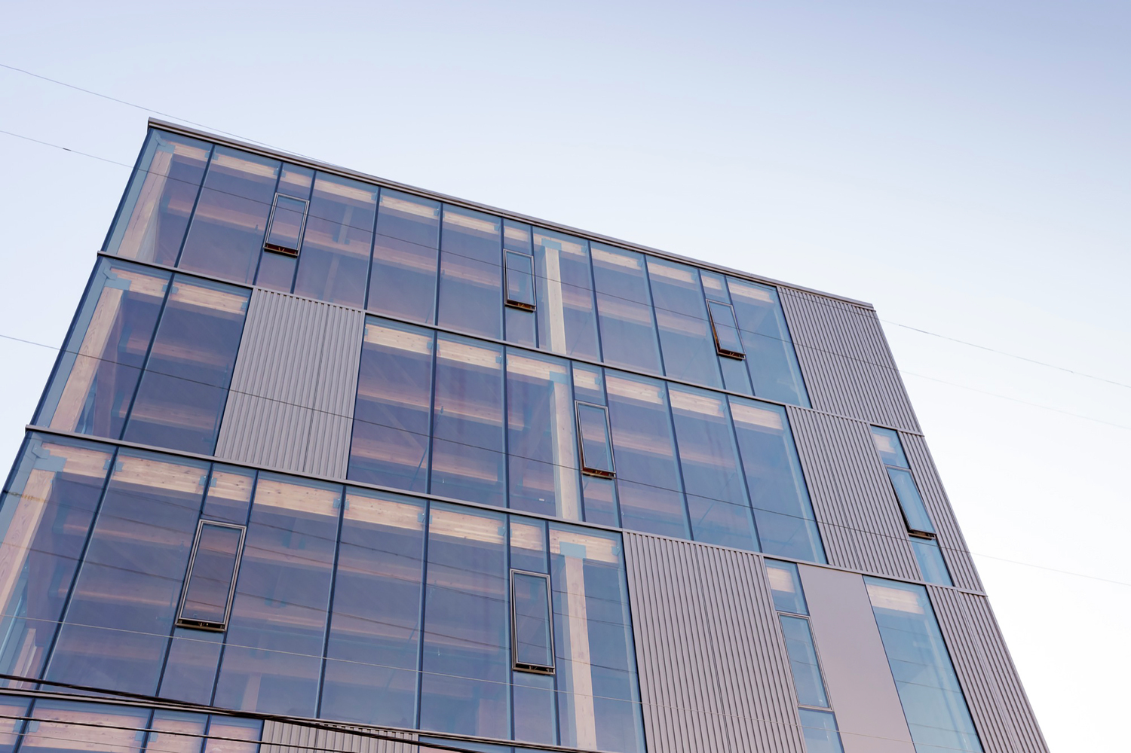
Best practice Details, Construction, Architecture
Łukasz Wesołowski, Paweł Mika
Architecture:
Framework HQ // wood grain // USA-Portland // YYYY

Slide 22
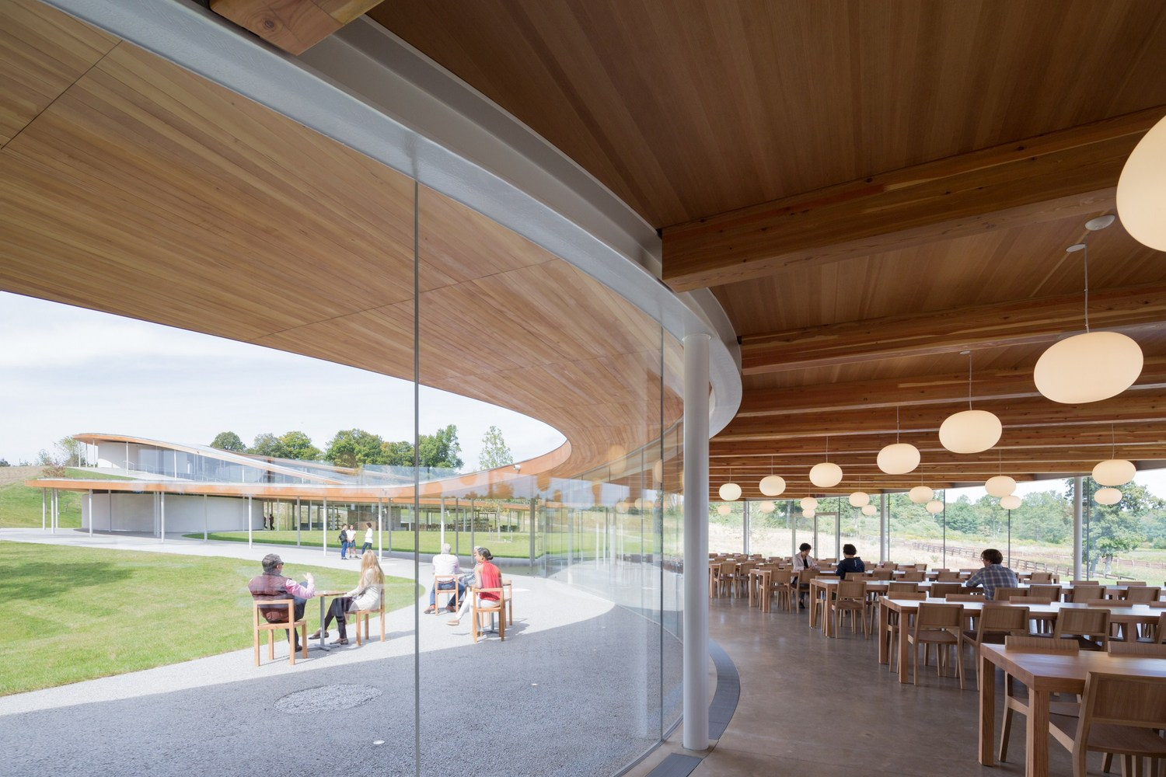
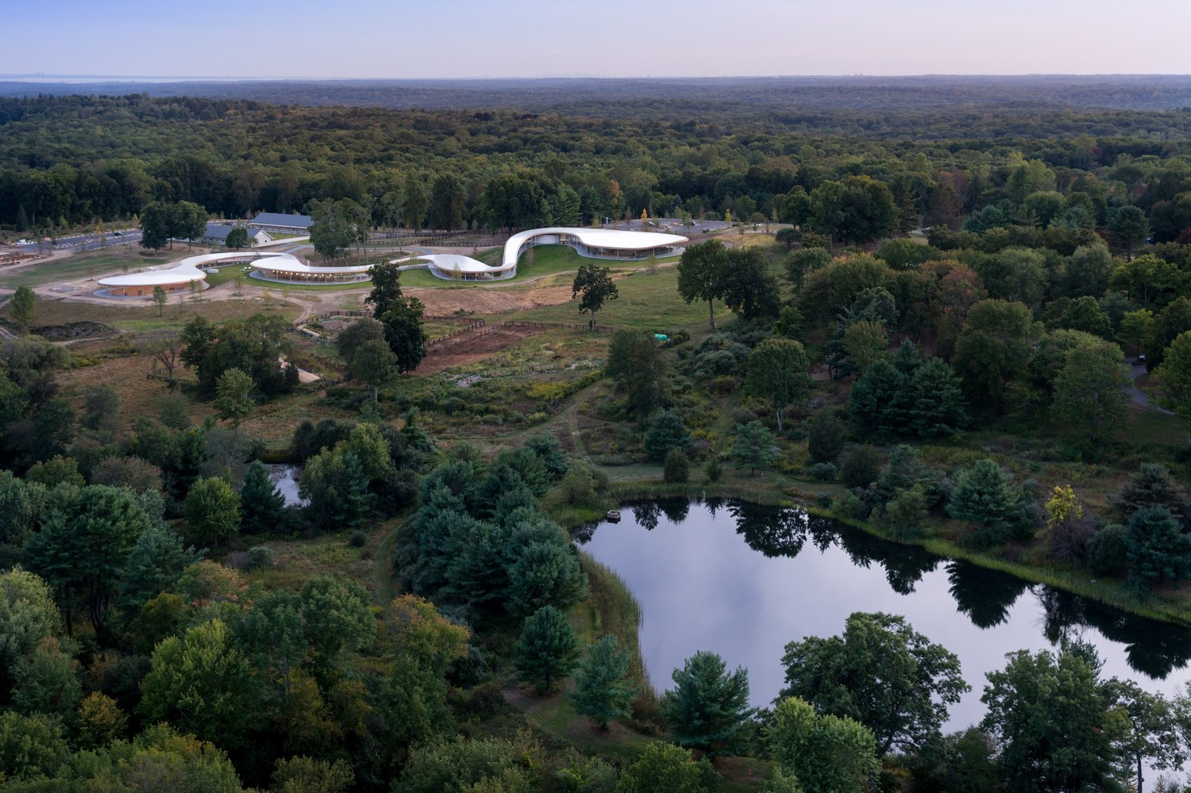
Best practice Details, Construction, Architecture
Łukasz Wesołowski, Paweł Mika
Architecture:
Grace Farms // flexibility+efficiency // USA-New Canaan // 2015

Slide 23
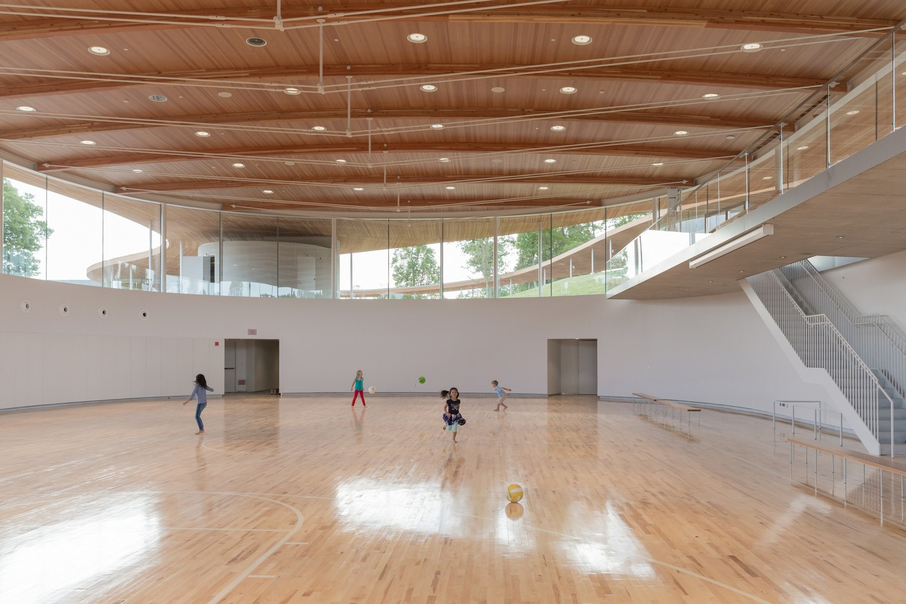
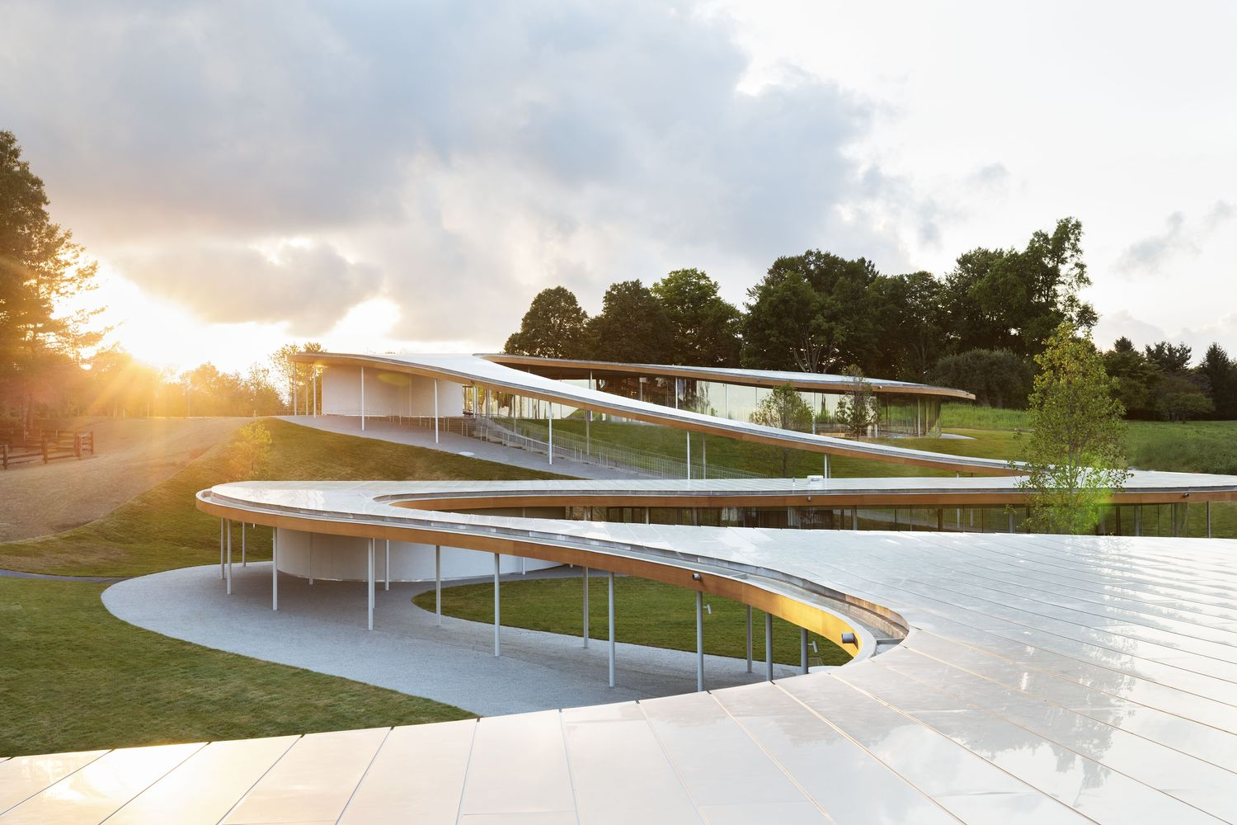
Best practice Details, Construction, Architecture
Łukasz Wesołowski, Paweł Mika
Architecture:
Grace Farms // flexibility+efficiency // USA-New Canaan // 2015

Slide 24
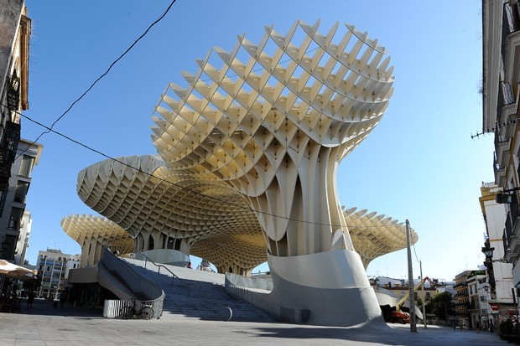
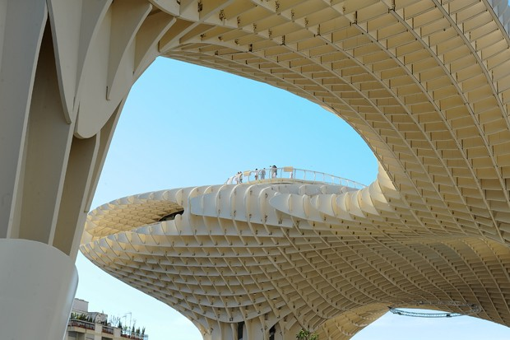
Best practice Details, Construction, Architecture
Łukasz Wesołowski, Paweł Mika
Architecture:
Metropol Parasol// LVL // Spain-Seville // 2011

Slide 25
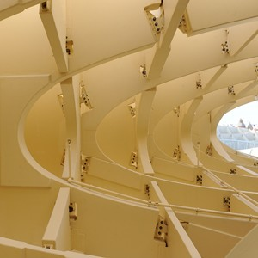
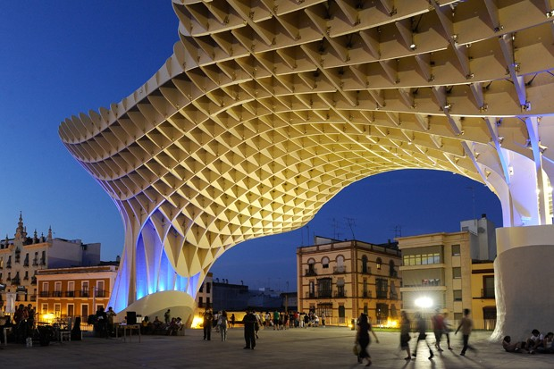
Best practice Details, Construction, Architecture
Łukasz Wesołowski, Paweł Mika
Architecture:
Metropol Parasol// LVL // Spain-Seville // 2011

Slide 26
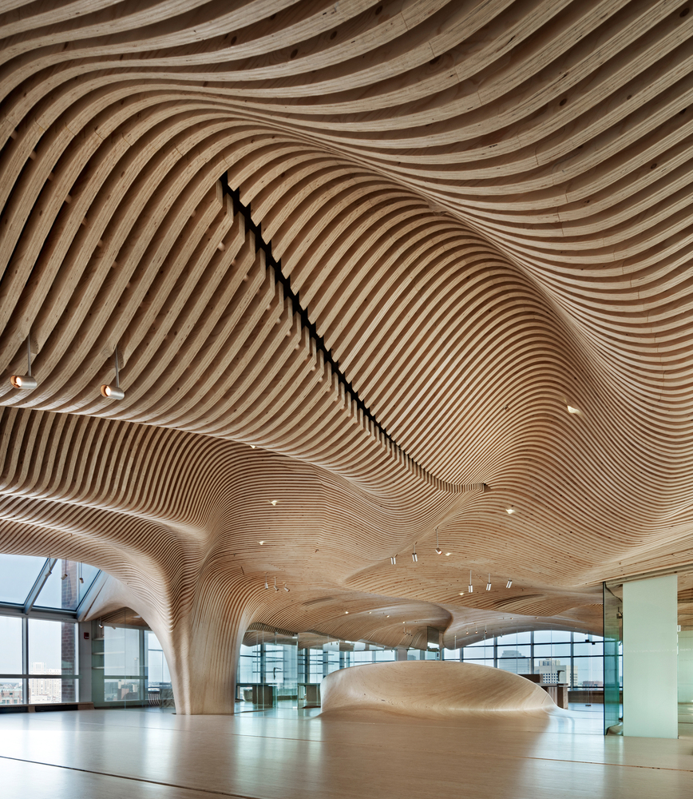
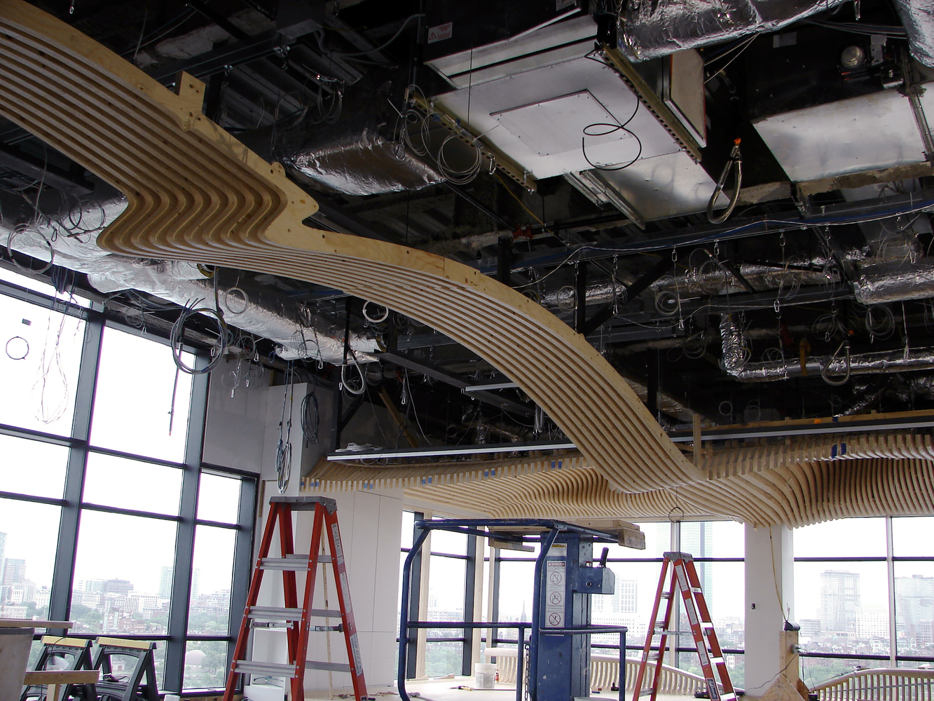
Best practice Details, Construction, Architecture
Łukasz Wesołowski, Paweł Mika
Interiors:
One Maine Office interiors // USA-Cambridge // 2009

Slide 27
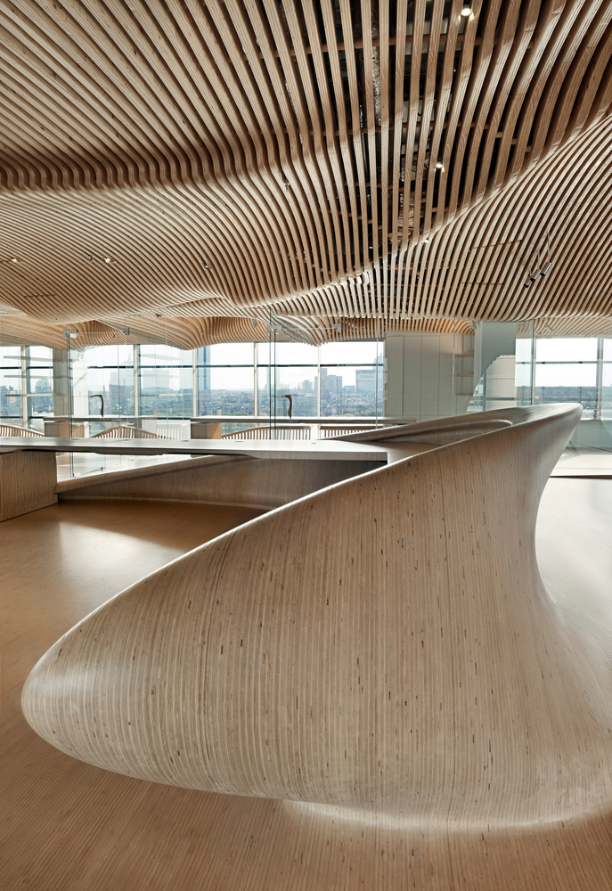
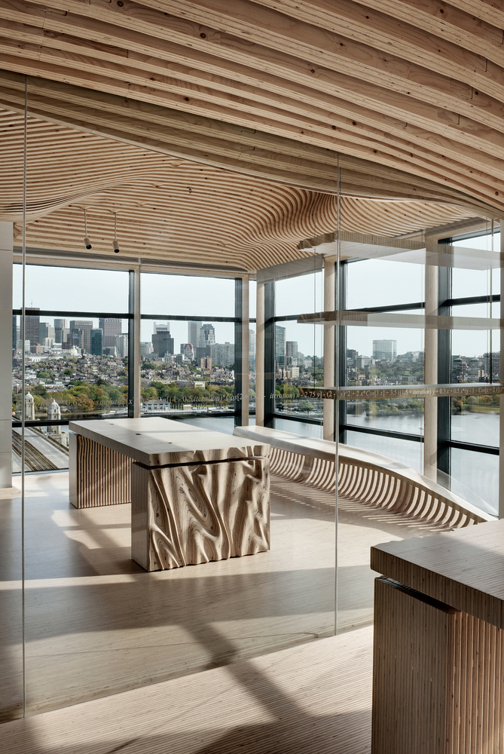
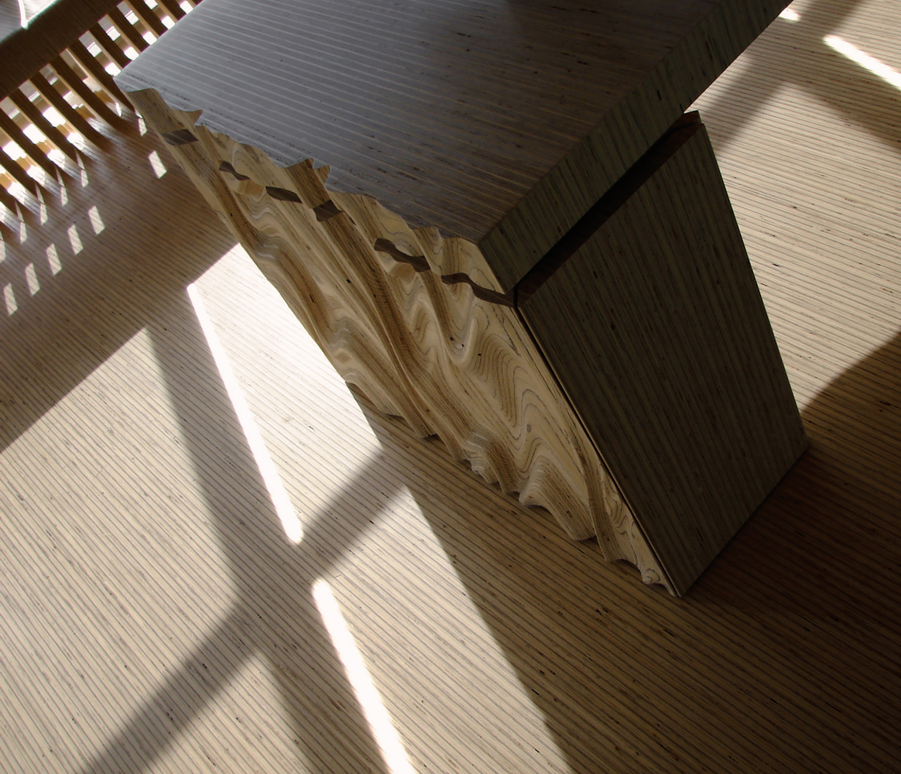
Best practice Details, Construction, Architecture
Łukasz Wesołowski, Paweł Mika
Interiors:
One Maine Office interiors // USA-Cambridge // 2009

Slide 28
Best practice Details, Construction, Architecture
Łukasz Wesołowski, Paweł Mika
Interiors:
CLT staircases // Australia-Sydey // 2009

Slide 29
Best practice Details, Construction, Architecture
Łukasz Wesołowski, Paweł Mika
Interiors:
CLT staircases // Australia-Sydey // 2009

Slide 30
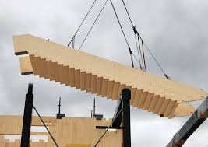
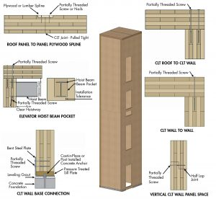
Best practice Details, Construction, Architecture
Łukasz Wesołowski, Paweł Mika
Interiors:
Staircase / liftshafts

Slide 31
Best practice Details, Construction, Architecture
Łukasz Wesołowski, Paweł Mika
Details:
Prefabrication //

Slide 32
Best practice Details, Construction, Architecture
Łukasz Wesołowski, Paweł Mika
Details:
Prefabrication //

Slide 33
Best practice Details, Construction, Architecture
Łukasz Wesołowski, Paweł Mika
Details:
MT // technology //

Slide 34
Best practice Details, Construction, Architecture
Łukasz Wesołowski, Paweł Mika
Details:
MT // technology //

Slide 35
Best practice Details, Construction, Architecture
Łukasz Wesołowski, Paweł Mika
Details:
MT // technology //

Slide 36
Best practice Details, Construction, Architecture
Łukasz Wesołowski, Paweł Mika
Details:
MT // technology //

Slide 37
Best practice Details, Construction, Architecture
Łukasz Wesołowski, Paweł Mika
Details:
MT // preparation //

Slide 38
Best practice Details, Construction, Architecture
Łukasz Wesołowski, Paweł Mika
Details:
MT // preparation //

Slide 39
Best practice Details, Construction, Architecture
Łukasz Wesołowski, Paweł Mika
Details:
MT // technology //

Slide 40
Best practice Details, Construction, Architecture
Łukasz Wesołowski, Paweł Mika
Details:
MT // conections //

Slide 41
Best practice Details, Construction, Architecture
Łukasz Wesołowski, Paweł Mika
Details:
MT // use //

Slide 42
Best practice Details, Construction, Architecture
Łukasz Wesołowski, Paweł Mika
Construction:
MT // use //

Slide 43
Best practice Details, Construction, Architecture
Łukasz Wesołowski, Paweł Mika
Construction:
MT // use //

Slide 44
Best practice Details, Construction, Architecture
Łukasz Wesołowski, Paweł Mika
Construction:
Seismic

Slide 45
Best practice Details, Construction, Architecture
Łukasz Wesołowski, Paweł Mika
Construction:
efficient

Slide 46
Best practice Details, Construction, Architecture
Łukasz Wesołowski, Paweł Mika
Construction:
multifunctional

Slide 47
Best practice Details, Construction, Architecture
Łukasz Wesołowski, Paweł Mika
Construction:
multifunctional

Slide 48
Best practice Details, Construction, Architecture
Łukasz Wesołowski, Paweł Mika
Construction:
connections

Slide 49
Best practice Details, Construction, Architecture
Łukasz Wesołowski, Paweł Mika
Construction:
connections

Slide 50
Best practice Details, Construction, Architecture
Łukasz Wesołowski, Paweł Mika
Construction:
connections

Slide 51
Best practice Details, Construction, Architecture
Łukasz Wesołowski, Paweł Mika
Construction:
MT // use //

Slide 52
Best practice Details, Construction, Architecture
Łukasz Wesołowski, Paweł Mika
Construction:
Shigeru Ban

Slide 53
Best practice Details, Construction, Architecture
Łukasz Wesołowski, Paweł Mika
Construction:
Shigeru Ban

