Slide 1
Building physics - fire
S.Kuc, P.Mika, Ł.Wesołowski
Wed. 10.09.2021 09:00 – 10:20

Slide 2
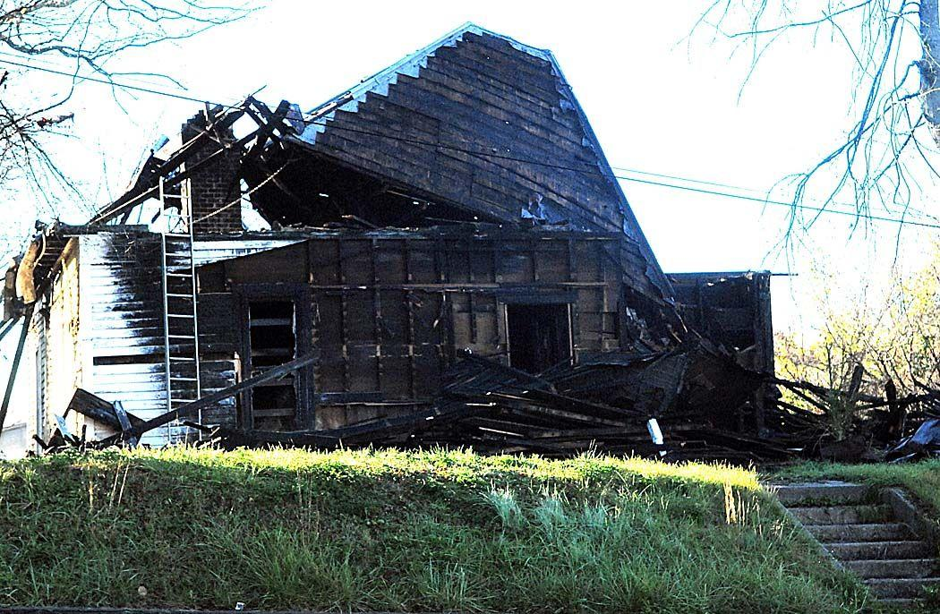
Building physics - fire
Łukasz Wesołowski (CUT)
Timber and fire

Slide 3
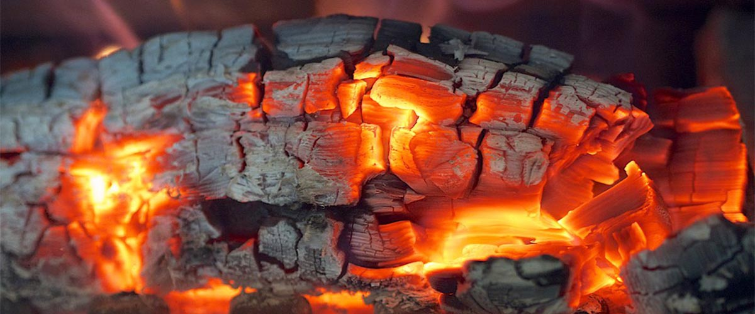
Building physics - fire
Łukasz Wesołowski (CUT)
Combustible material

Slide 4
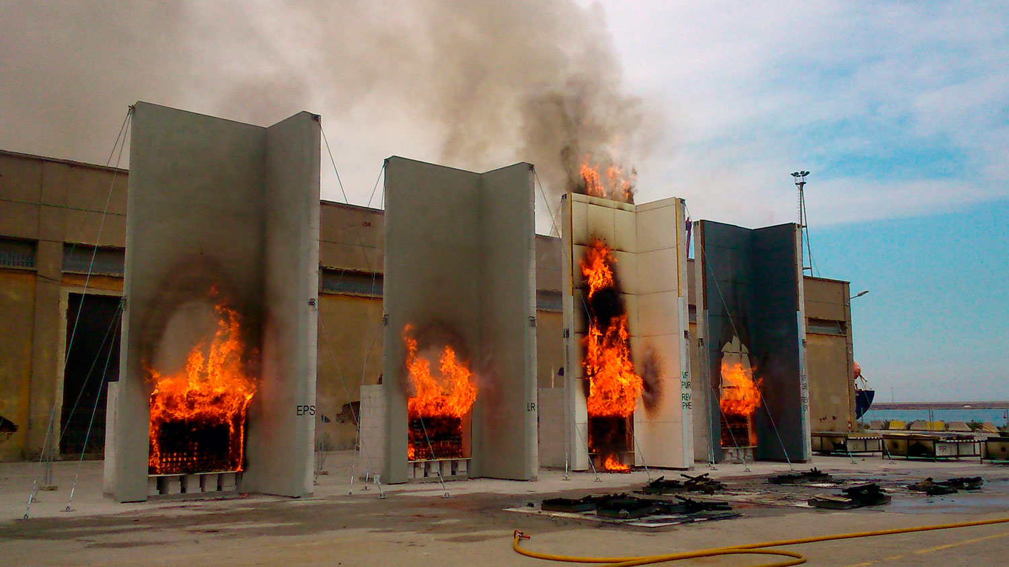
Building physics - fire
Łukasz Wesołowski (CUT)
Eurocodes
Unify
Research
Testing
Store results materialwise
Update
Fire prevention

Slide 5
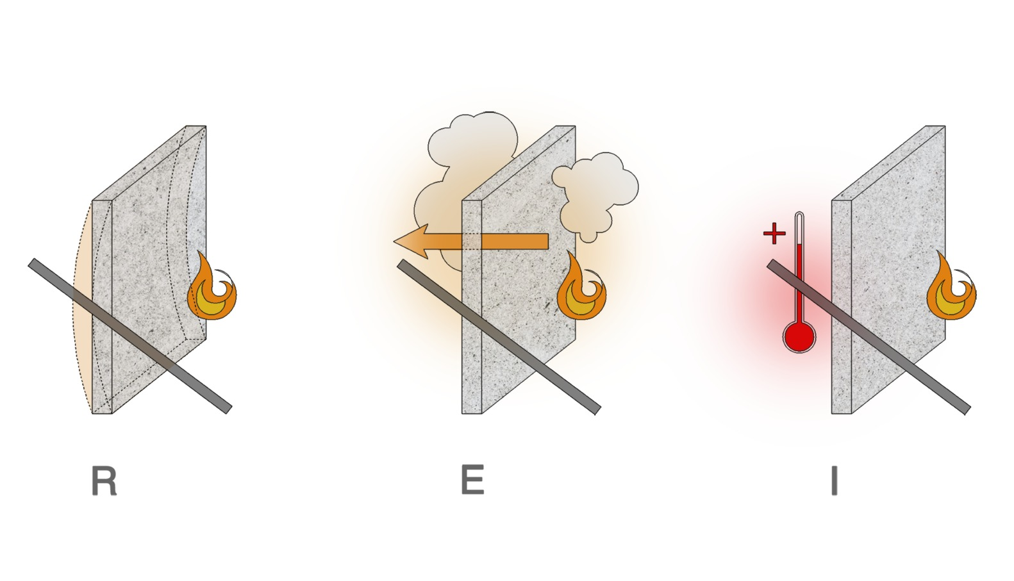
Building physics - fire
Łukasz Wesołowski (CUT)
Fire resistance:

Slide 6
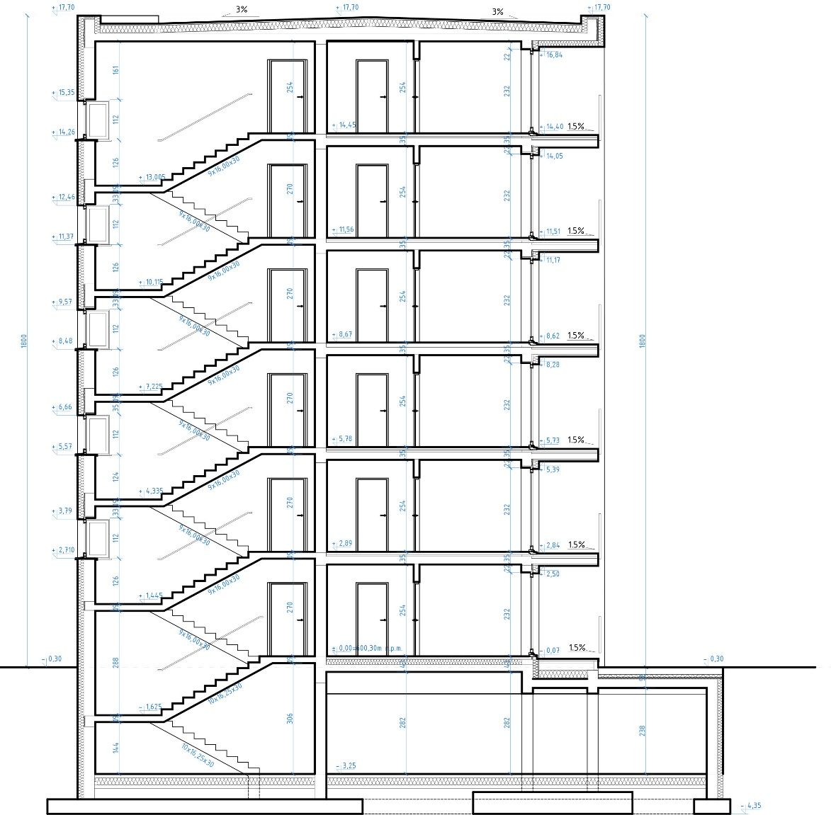
Building physics - fire
Łukasz Wesołowski (CUT)
Fire spreading

Slide 7
Building physics - fire
Łukasz Wesołowski (CUT)
Fire spreading

Slide 8
Building physics - fire
Łukasz Wesołowski (CUT)
Smoke

Slide 9
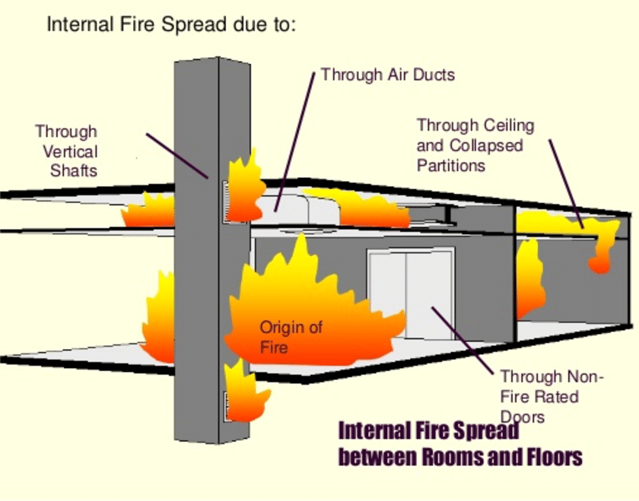
Building physics - fire
Łukasz Wesołowski (CUT)
Where the fire would go?

Slide 10
Building physics - fire
Łukasz Wesołowski (CUT)
Reaction Ratings:
A1, A2, B-F
class F - products without a determined reaction to fire rating. Products that have a good reaction to fire rating, paired (jointed), or coated (with a facer) with combustible material, may also belong to this class
Class E-B – products organic and nonorganic flame tested
Class D-B – products with additional 30s flame test
Class A(A1, A2) – products inorganic – Energy measured + analysys of incombustibility
For classes A2-D – analysys of smoke quantity
For class A2 –E – hot droplets analysys

Slide 11
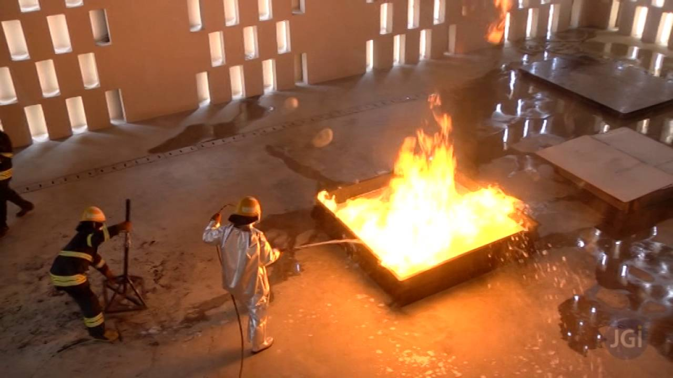
Building physics - fire
Łukasz Wesołowski (CUT)
Combined materials and prefabricated elements:
testing a sample wall
precalculation
fire scenarios symulations
case studies

Slide 12
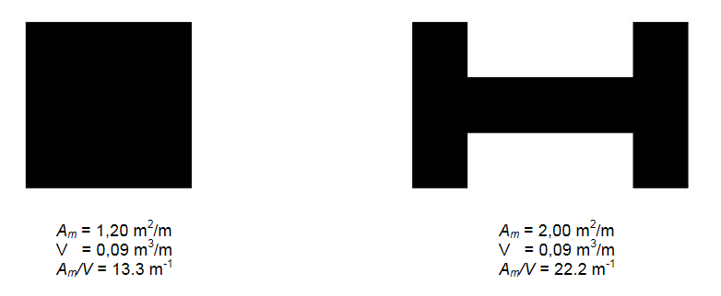
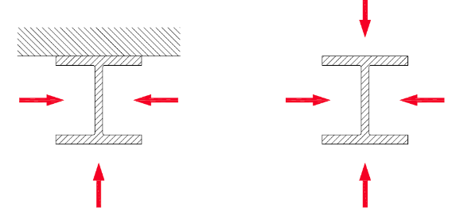
Building physics - fire
Łukasz Wesołowski (CUT)
Section factor + location

Slide 13
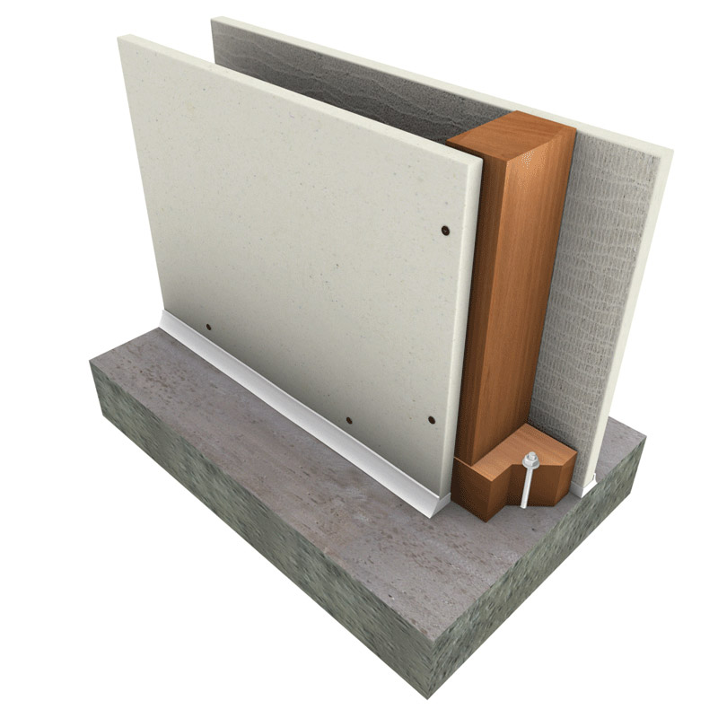
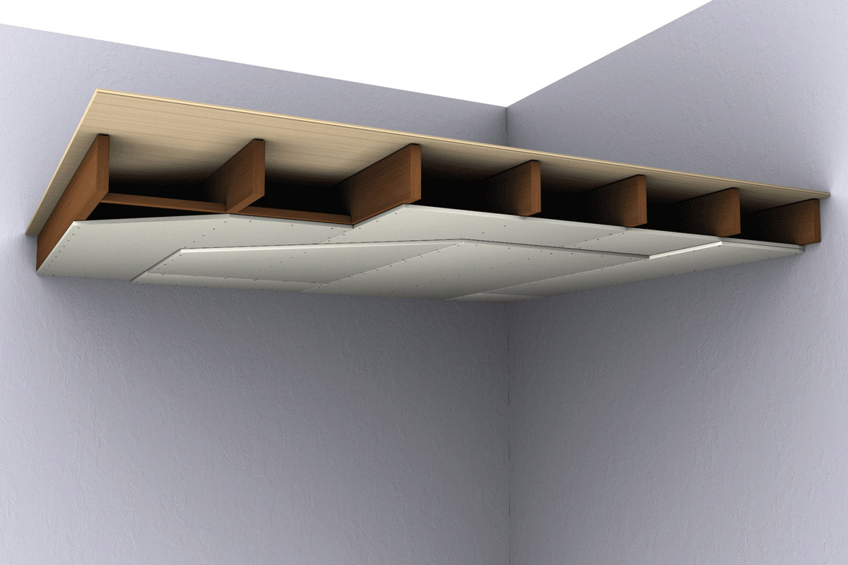
Building physics - fire
Łukasz Wesołowski (CUT)
Fire coveres:
Boards
Paints
Sprays
Expanding
materials

Slide 14
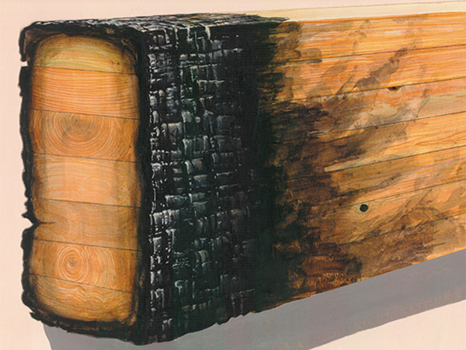
Building physics - fire
Łukasz Wesołowski (CUT)
Timber – non comustible material?

Slide 15
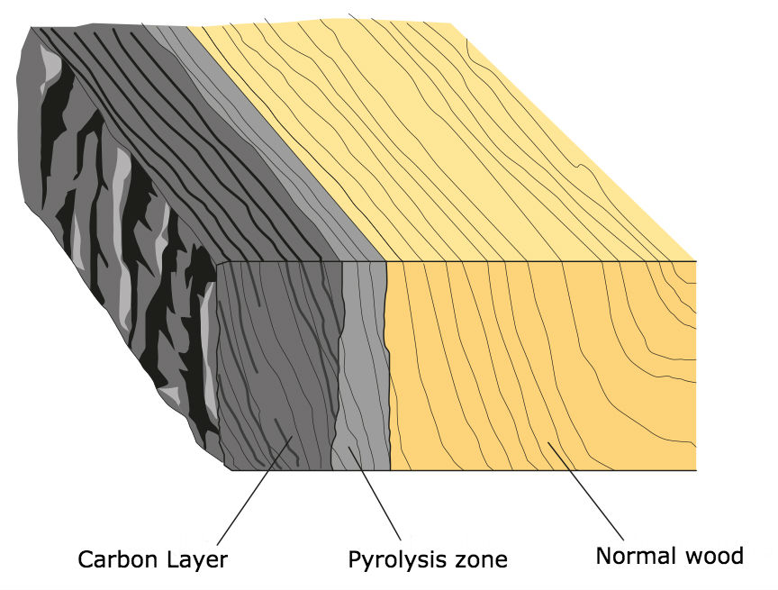
Building physics - fire
Łukasz Wesołowski (CUT)
Timber – non comustible material !

Slide 16
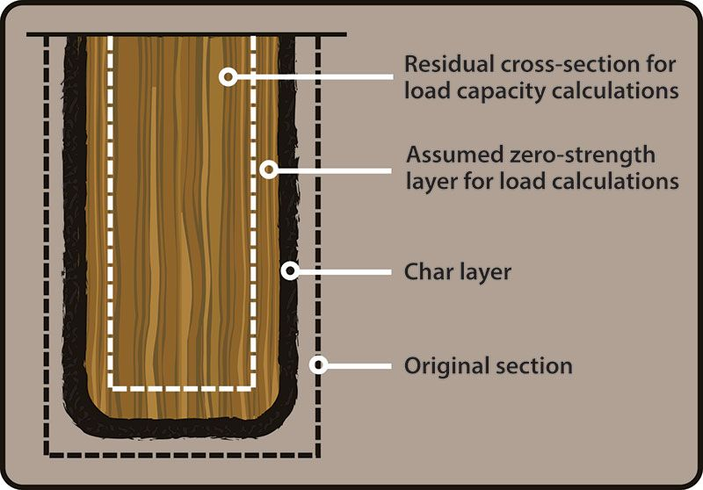
Building physics - fire
Łukasz Wesołowski (CUT)
Timber – non comustible material !

Slide 17
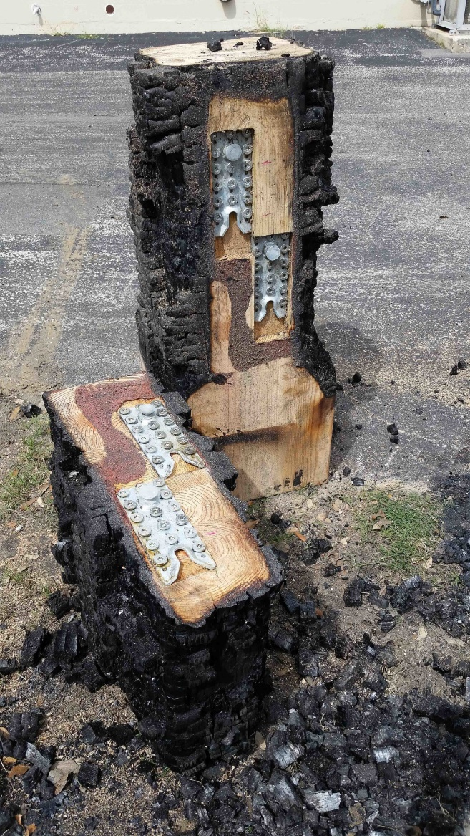
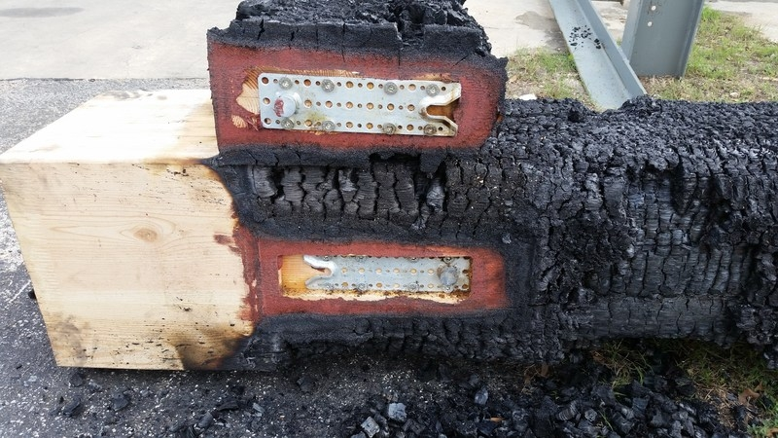
Building physics - fire
Łukasz Wesołowski (CUT)
Joints:

Slide 18
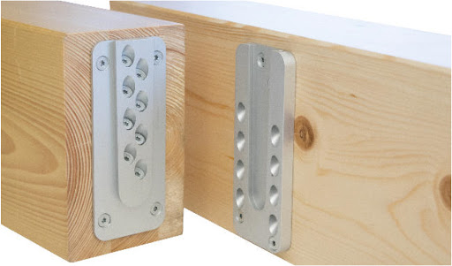
Building physics - fire
Łukasz Wesołowski (CUT)
Joints:

Slide 19
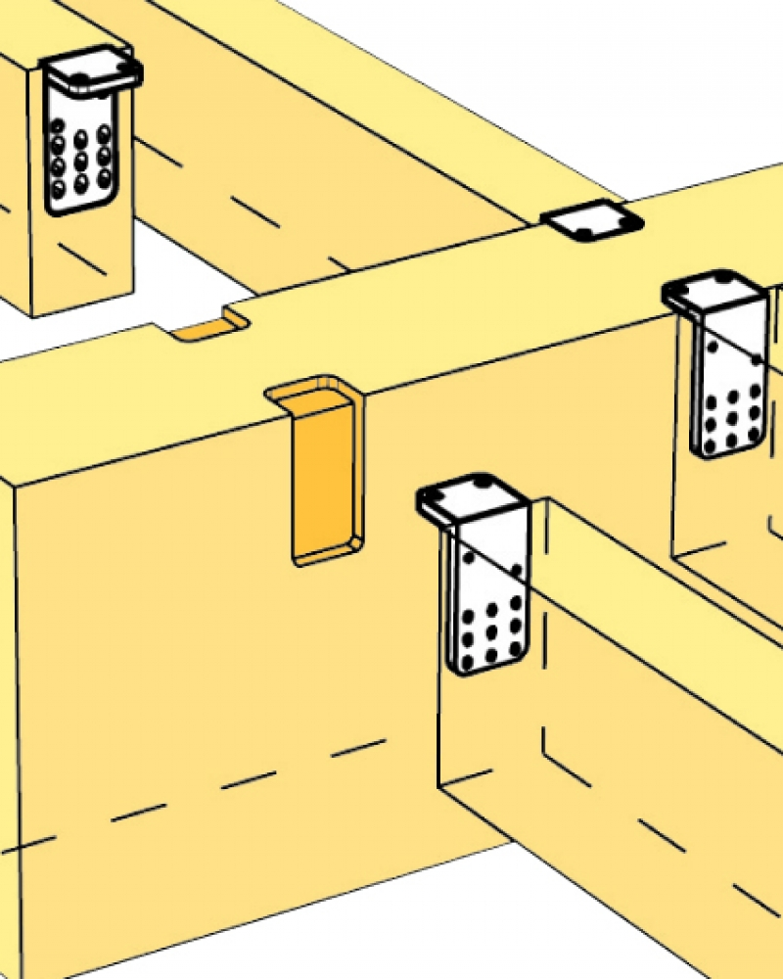
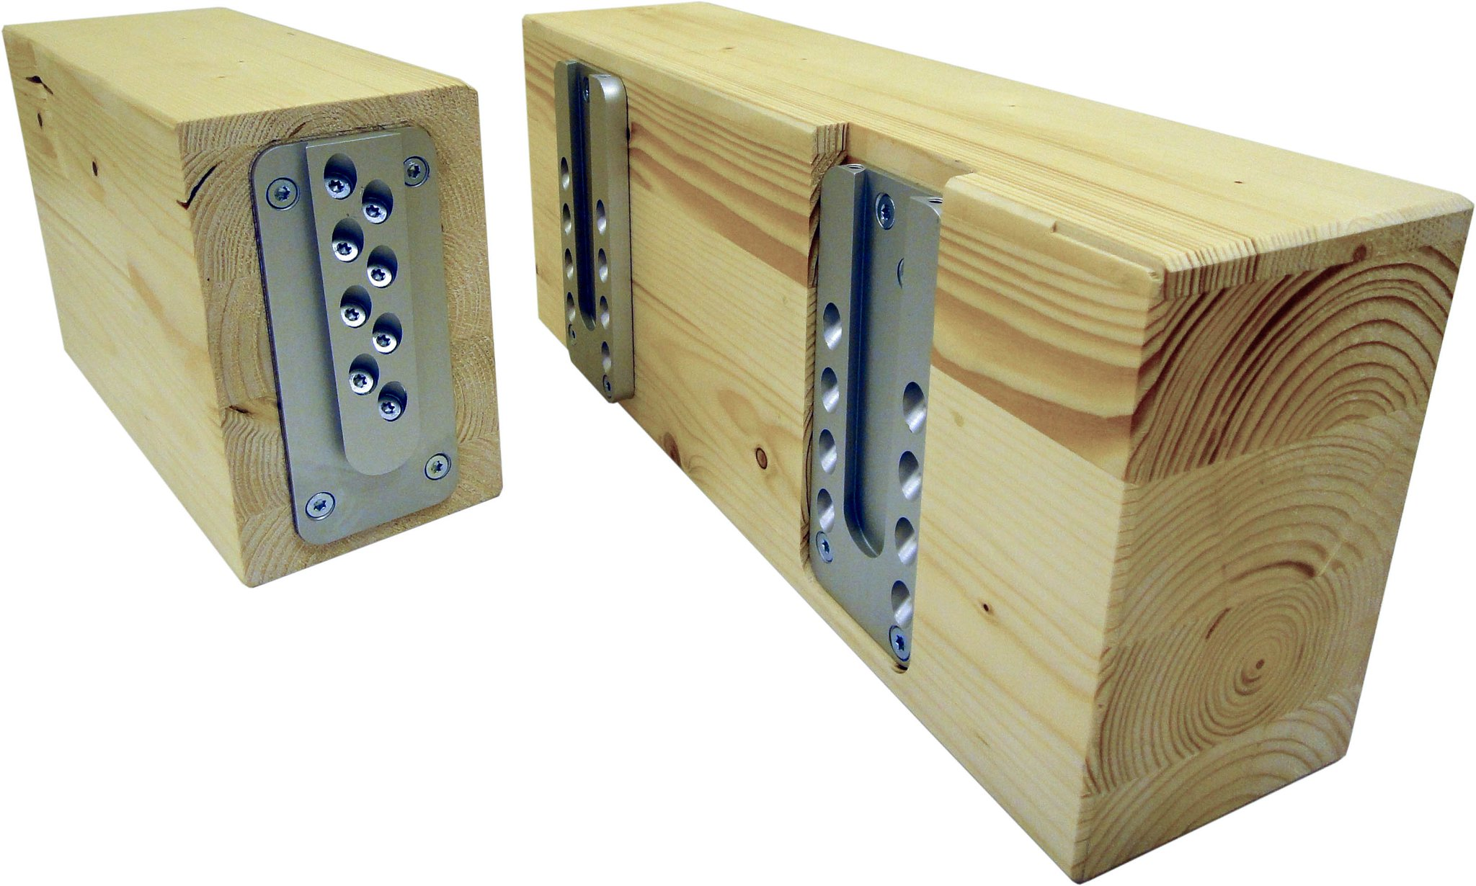
Building physics - fire
Łukasz Wesołowski (CUT)
Joints:

Slide 20
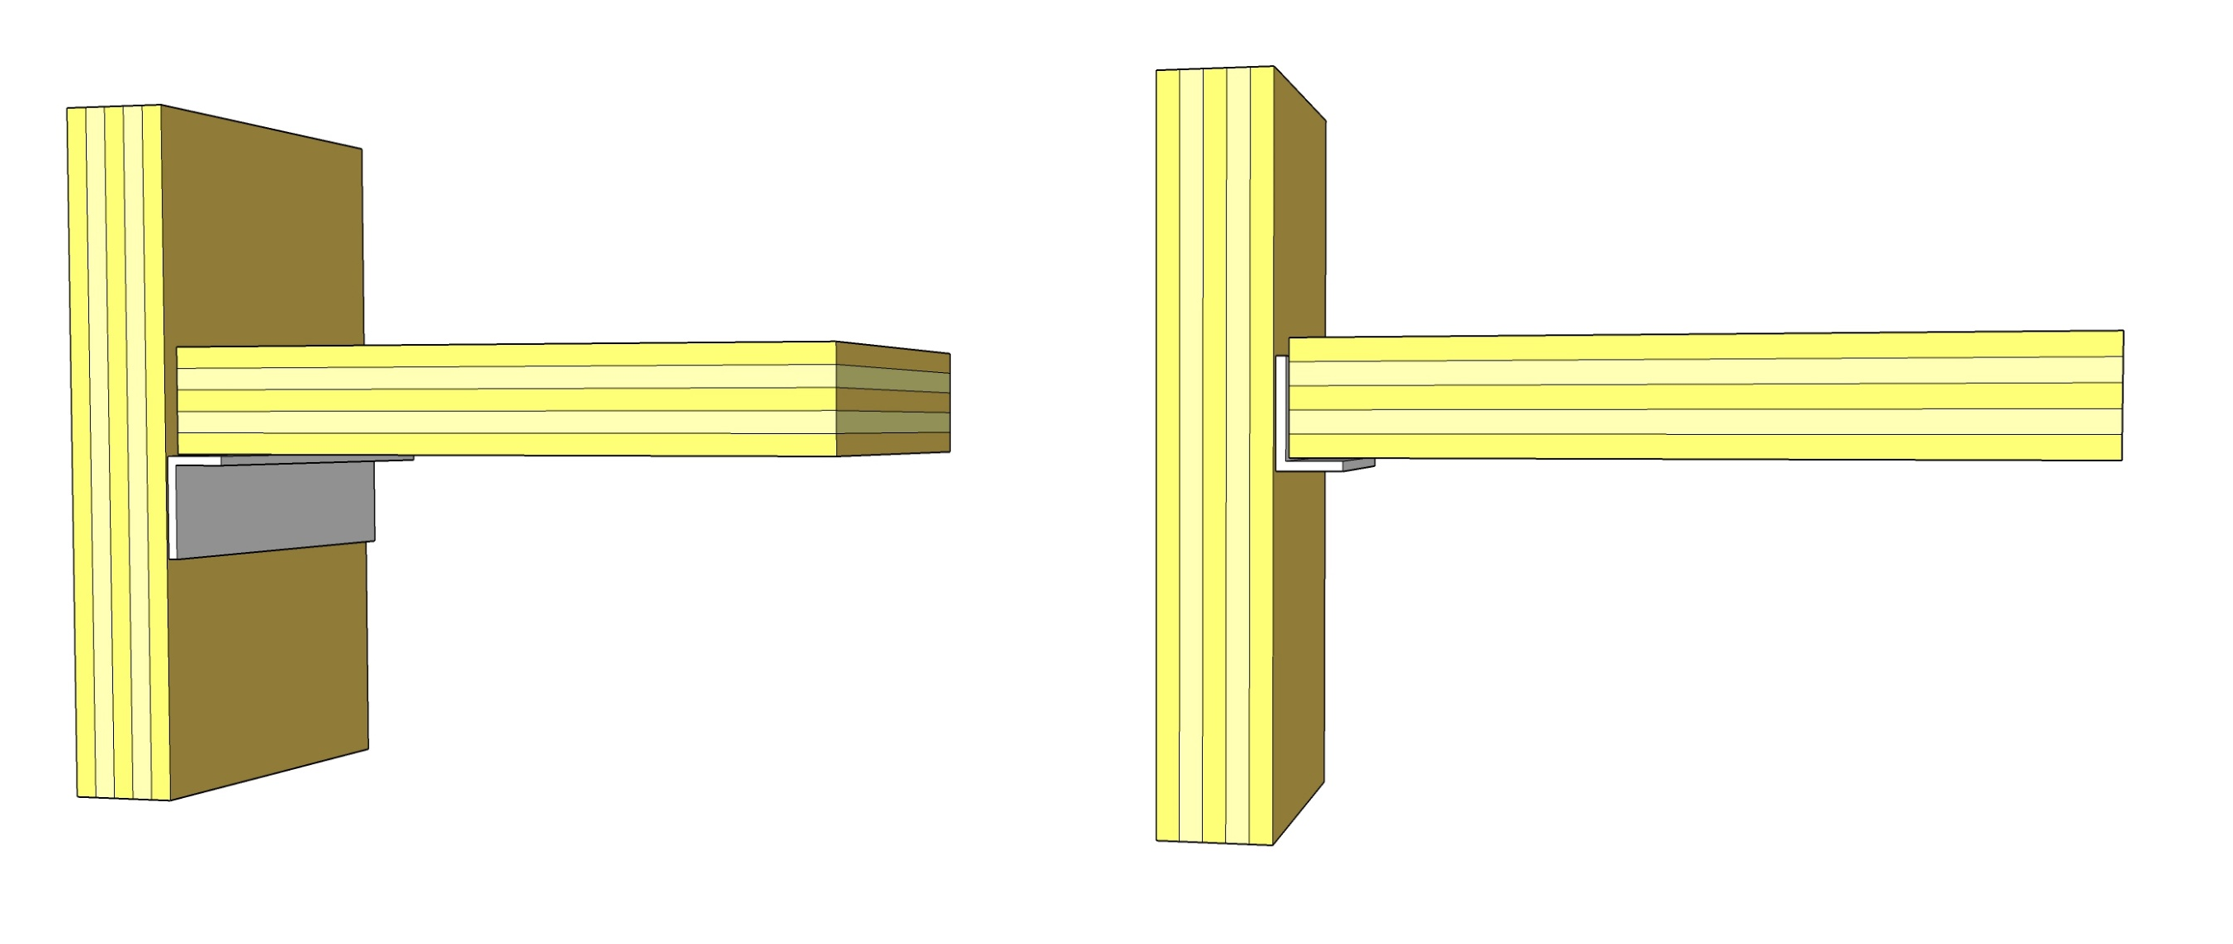
Building physics - fire
Łukasz Wesołowski (CUT)
Joints:

Slide 21
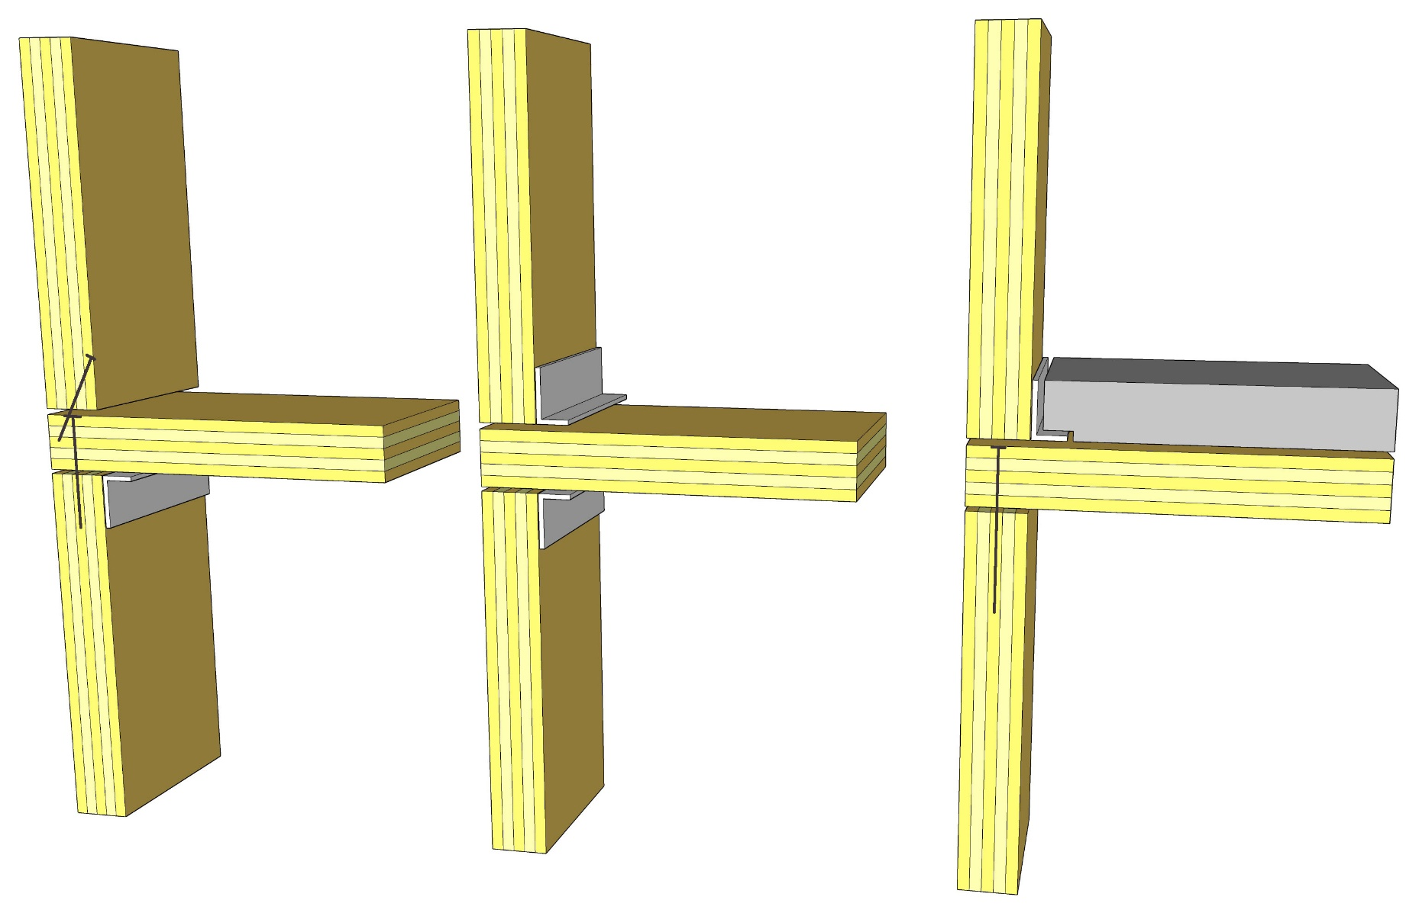
Building physics - fire
Łukasz Wesołowski (CUT)
Joints:

Slide 22
Building physics - fire
Łukasz Wesołowski (CUT)
BUILDING LOCATION = LOCAL REGULATIONS
- Each country is free to set more strict regulations

Slide 23
Building physics - fire
Łukasz Wesołowski (CUT)
Poland:
3 types of zones: People, Livestock, Storage and production
(1) – for >50 non-users but nut qualified for (2)
(2) – hospitals, social houses, kindergardens and daily care for newborns
(3) – commercial buildings not in (1) or (2)
(4) – residential buildings
(5) – hotels, guesthouses not in (1) or (2)

Slide 24
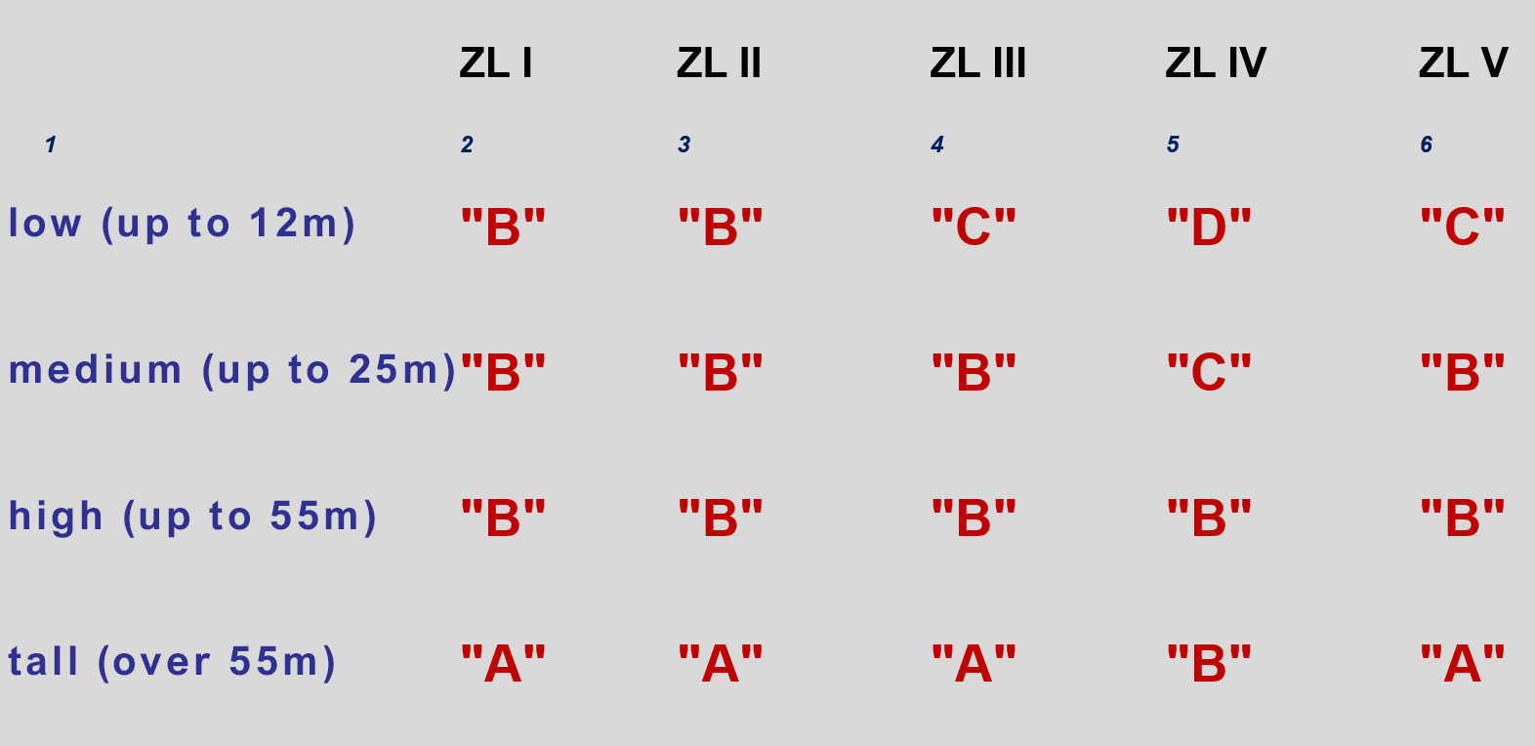
Building physics - fire
Łukasz Wesołowski (CUT)
Poland: fire resistance

Slide 25
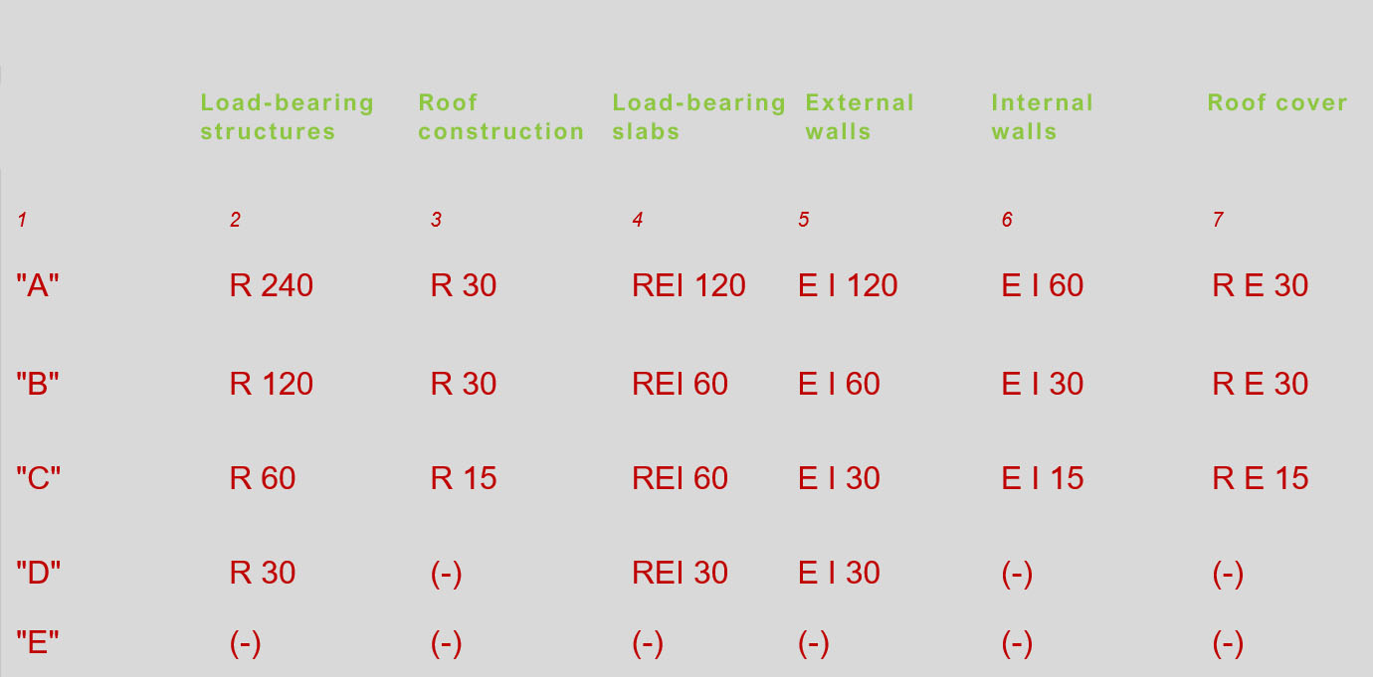
Building physics - fire
Łukasz Wesołowski (CUT)
Poland: fire resistance class of elements

Slide 26
Building physics - fire
Łukasz Wesołowski (CUT)
Poland: fire resistance of fire divisions

Slide 27
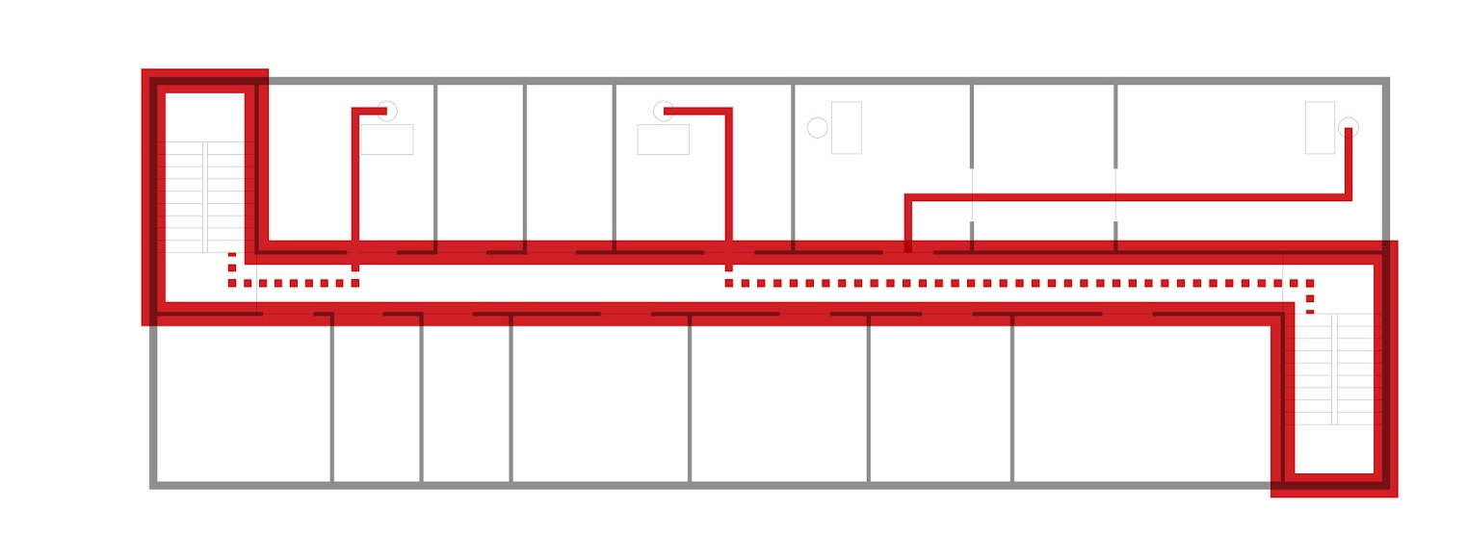
Building physics - fire
Łukasz Wesołowski (CUT)
Poland: fire resistance of fire divisions

Slide 28
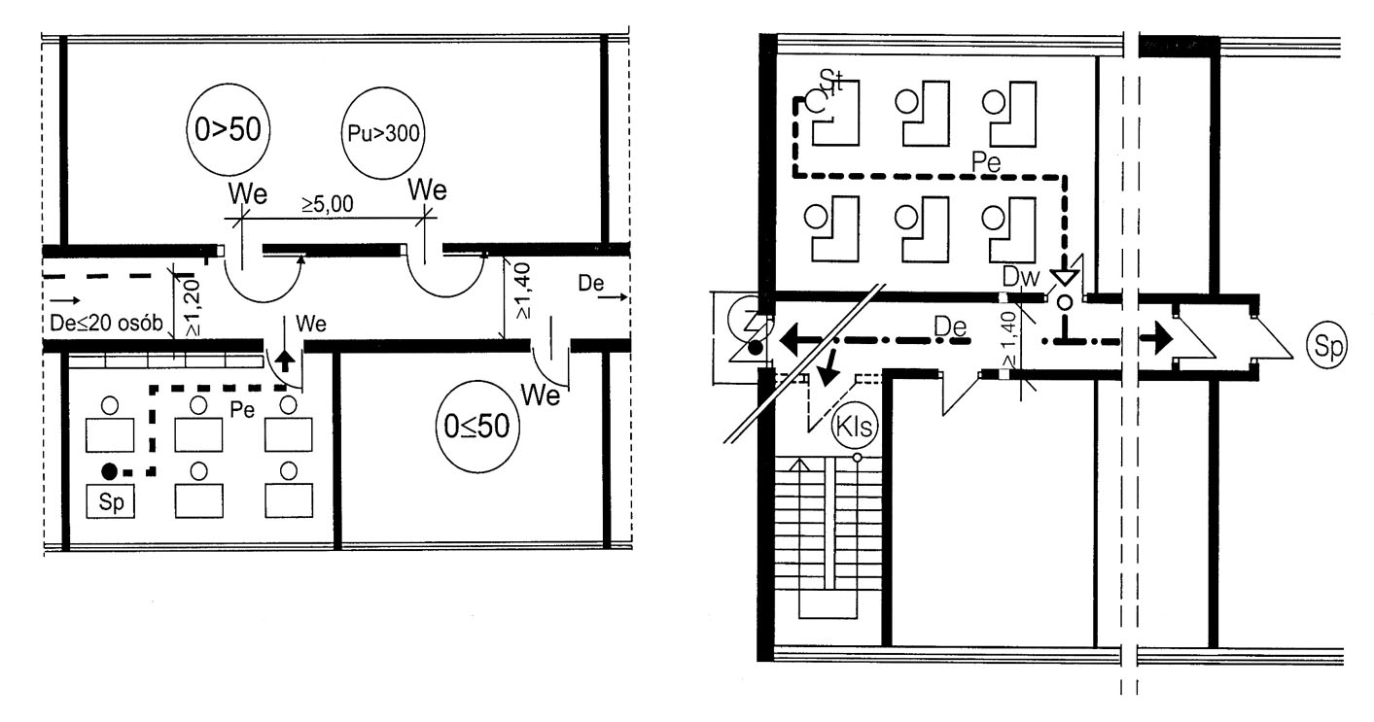
Building physics - fire
Łukasz Wesołowski (CUT)
Poland: Evacuation

Slide 29
Building physics - fire
Łukasz Wesołowski (CUT)
Thank you very much !

