Slide 1
Building Physics in Timber Constructions
Hämeen Amattikorkeakoulu / HAMK
Cristina Tirteu
Wien 10.09.2021

Slide 2
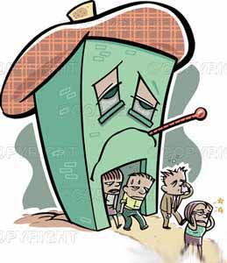
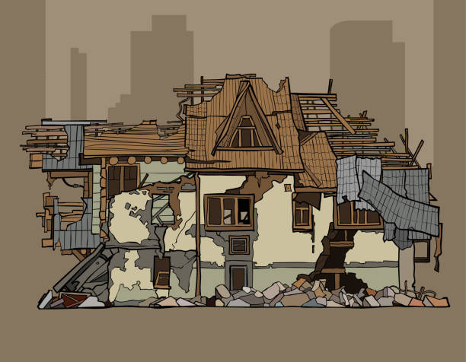
Why building physics?
Presentation Title
UNIVERSITY/TEAM
Persisting moisture problems,
Thermal discomfort,
Visual uneasiness,
Olfactory discomfort,
Complaints about sick buildings,
Notes:
Until the first energy crisis of 1973, building physics was a relatively inactive field in building engineering, with apparently limited applicability. While soil mechanics, structural mechanics,
building materials, building construction and HVAC were seen as essential, designers only demanded advice on room acoustics, moisture tolerance, summer comfort or lighting when
really needed or problems arose. Energy efficiency was not even a concern, while thermal comfort and indoor environmental quality were presumably guaranteed thanks to infiltration, window operation and the HVAC system. The crises of the 1970s, persisting moisture problems, complaints about sick buildings, thermal, visual and olfactory discomfort, and the move towards more sustainability changed all that.
The societal pressure to diminish energy consumptions in buildings without degrading usability opened the door for the notion of performance based design and construction. As a result, building physics and its potentiality to quantify performances suddenly moved into the frontline of building innovation.
The term "sick building syndrome" (SBS) is used to describe situations in which building occupants experience acute health and comfort effects that appear to be linked to time spent in a building, but no specific illness or cause can be identified.

Slide 3
Building Physics is an applied science that studies the hygro-thermal, acoustical and light-related properties, and the performance of materials, building assemblies (roofs, façades, windows, partition walls, etc.), spaces, whole buildings, and the built environment.
Moisture
Sound
Heat

Slide 4
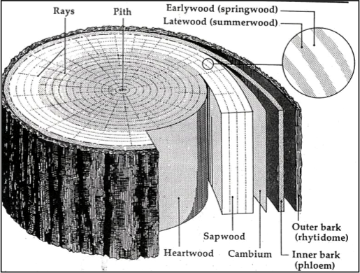
Main Structural Features of Tree Trunk
From outside to inside:
Bark
Cambium (very thin layer) – location of wood growth
Sapwood (lighter) – transports the sap
Heartwood (darker) – provides structural support
Pith – center stem
Rays
Annual rings
Notes:
Structural timber is sawn (milled) from the trunk of the tree, which provides rigidity, mechanical strength and height to maintain the crown.
Trunk resists loads due to gravity and wind acting on the tree and also provides for the transport of water and minerals from the tree roots to the crown.
Roots, by spreading through the soil and acting as a foundation, absorb moisture-containing minerals from the soil and transfer them via the trunk to the crown.
Crown, comprising branches and twigs to support leaves, provides a catchment area producing chemical reactions that form sugar and cellulose that cause the growth of the tree.
A typical cross section of a tree trunk, shown in Figure 1.1, illustrates its main features such as bark, the outer part of which is a rather dry and corky layer and the inner living part. The cambium, a very thin layer of cells underside the inner bark, is the growth center of the tree. New wood cells are formed on the inside of the cambium (over the old wood) and new bark cells are formed on the outside and as such increasing the diameter of the trunk. Although tree trunks can grow to a large size, in excess of 2 m in diameter, commercially available timbers are more often around 0.5 m in diameter.
The annular band of the cross-section nearest to the bark is called sapwood. The central core of the wood, which is inside the sapwood, is heartwood. The sapwood is lighter in colour compared to heartwood and is 25–170 mm wide depending on the species. It contains both living and dead cells and acts as a medium for transportation of sap from the roots to the leaves, whereas the heartwood, which consists of inactive cells, functions mainly to give mechanical support or stiffness to the trunk. As sapwood changes to heartwood, the size, shape and the number of cells remain unchanged. In general, in hardwoods the difference in moisture content of sapwood and heartwood depends on the species but in softwoods the moisture content of sapwood is usually greater than that of heartwood. The strength and weights of the two are nearly equal. Sapwood has a lower natural resistance to attacks by fungi and insects and accepts preservatives more easily than heartwood.
Wood, in general, is composed of long thin tubular cells. The cell walls are made up of cellulose and the cells are bound together by a substance known as lignin. Most cells are oriented in the direction of the axis of the trunk except for cells known as rays, which run radially across the trunk.
The rays connect various layers from the pith to the bark for storage and transfer of food. Rays are present in all trees but are more pronounced in some species such as oak. In countries with a temperate climate, a tree produces a new layer of wood just under the cambium in the early part of every growing season. This growth ceases at the end of the growing season or during winter months. This process results in clearly visible concentric rings known as annular rings, annual rings, or growth rings. In tropical countries, where trees grow throughout the year, a tree produces wood cells that are essentially uniform. The age of a tree may be determined by counting its growth rings.

Slide 5
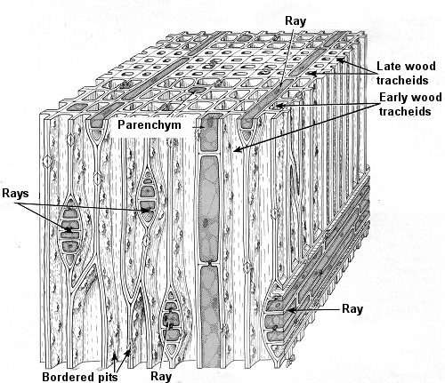
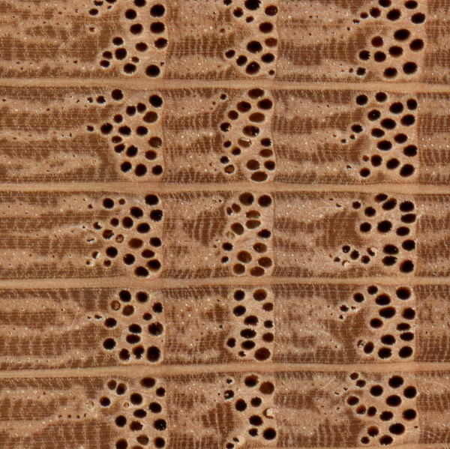
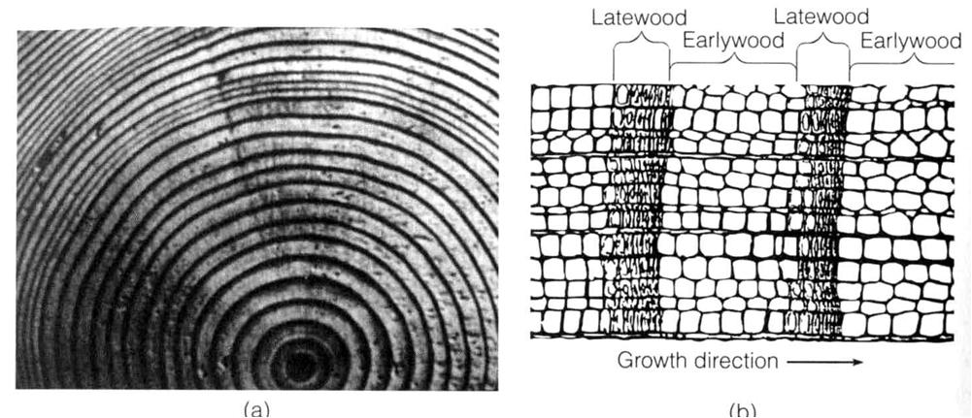
Structure of Timber
Each annual ring is composed of:
Earlywood (light ring): rapid spring growth of hollow thin-walled cells
Latewood (dark ring): dense summer growth of thick-walled cells which are much harder & stronger
Notes:
In many trees and particularly in temperate climates, where a definite growing season exists, each annular ring is visibly subdivided into two layers: an inner layer made up of relatively large hollow cells called springwood or earlywood (due to the fast growth), and an outer layer of thick walls and small cavities called summerwood or latewood (due to a slower growth). Since summerwood is relatively heavy, the amount of summerwood in any section is a measure of the density of the wood.

Slide 6
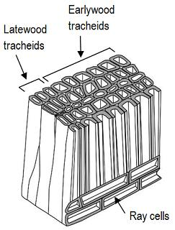
Anisotropic Nature of Wood
Longitudinal
parallel to the long axis (grain)
strongest and least shrinkage
Radial
perpendicular to the growth rings (out from center)
Tangential
tangent to the growth rings
weakest and most shrinkage
Directions influence strength, modulus, thermal expansion, conductivity, shrinkage, etc.
Notes:
Wood is an anisotropic material in that it has different and unique properties in each direction. The three axis orientations in wood are longitudinal, or parallel to the grain; radial, or cross the growth rings; and tangential, or tangent to the growth rings. The anisotropic nature of wood affects physical and mechanical properties such as shrinkage, stiffness, and strength.
The anisotropic behavior of wood is the result of the tubular geometry of the wood cells.
The wood cells have a rectangular cross section. The centers of the tubes are hollow, whereas the ends of the tubes are tapered. The length-to-width ratio can be as large as 100. The long dimension of the majority of cells is parallel to the tree’s trunk. However, a few cells, in localized bundles, grow radially, from the center to the outside of the trunk. The preponderance of cell orientation in one direction gives wood its anisotropic characteristics.
The hollow tube structure is very efficient in resisting compressive and tensile stresses parallel to its length, but readily deforms when loaded on its side. Also, fluctuations in moisture contents expand or contract the tube walls but have little effect on the length of the tube.

Slide 7
Building Physics is an applied science that studies the hygro-thermal, acoustical and light-related properties, and the performance of materials, building assemblies (roofs, façades, windows, partition walls, etc.), spaces, whole buildings, and the built environment.
Moisture
Sound
Heat

Slide 8
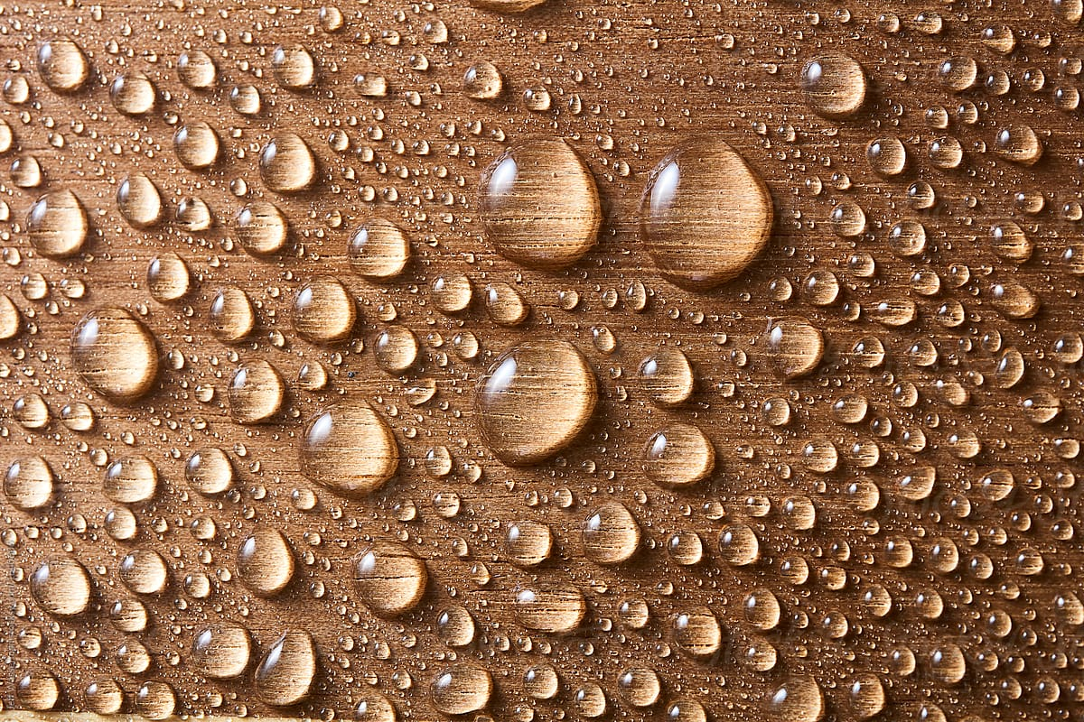
Moisture Content
The moisture (water) content of wood is measured as the relationship between the moisture content in kg and the amount of dry material in kg. The moisture content, 𝜇, is specifically defined as the ratio between the weight of the water in the wet material and the weight of dried wood after drying at 103°C.
Notes:
Hygroscopicity is the tendency of a solid substance to absorb moisture from the surrounding atmosphere.

Slide 9
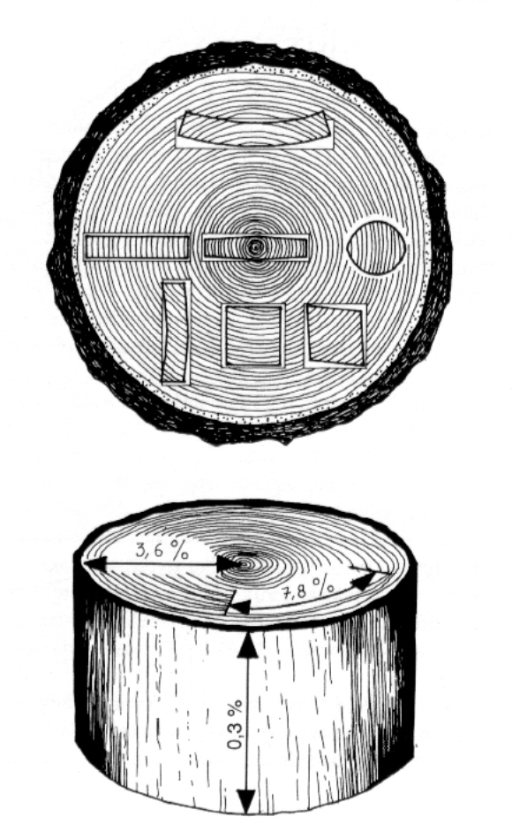
Moisture Content – Key Points
Under normal conditions there is always some moisture in timber
Timber may absorb moisture in it (hygroscopicity)
Timber tries to adjust moisture content according to moisture content of ambient air (equilibrium moisture content)
Timber shrinks and swells differently in different directions => anisotropic material
Since too high moisture content is harmful, timber must be dried before use close to the final operating moisture content
Notes:
Wood is a hygroscopic construction material, which means that it is able to absorb and release water vapour from the surrounding air. Wood’s moisture content is thus constantly adapting to the immediate climate around it – damp timber shrinks in a dry environment and dry timber expands in a humid environment. When the moisture content of the wood eventually adapts fully to the ambient conditions, the wood is said to have reached its equilibrium moisture content. The equilibrium moisture content is influenced by the relative humidity (RH) and the temperature, with relative humidity having the greatest impact in the temperature range 0–20°C.
As the climate varies over the course of the year, the wood’s moisture content will also change. Indoors, wood will dry out and shrink during the winter months and then absorb moisture again in the summer.
Hygroscopicity is the tendency of a solid substance to absorb moisture from the surrounding atmosphere.

Slide 10
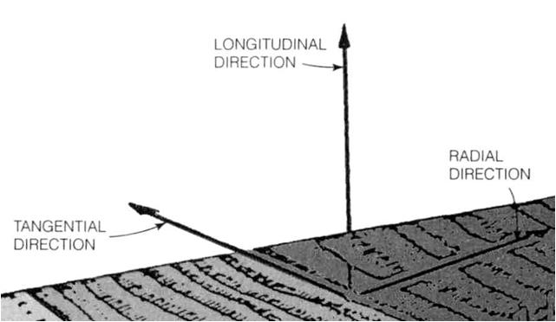
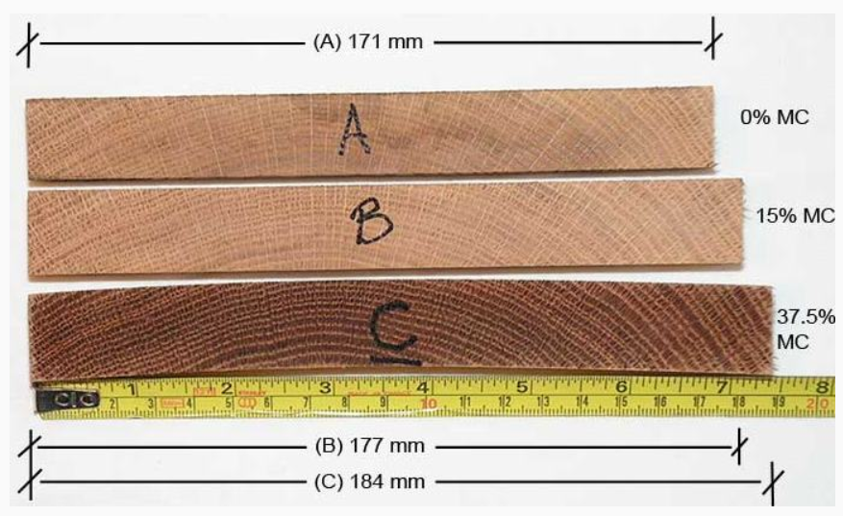
Shrinkage
water inside cell cavities doesn't affect shrinkage
Fiber saturation point (FSP)- moisture content when cells are completely saturated with bound water but no free water inside cell cavities.
FSP = 21-32%
Above FSP
changes affect only on weight
Below FSP
small changes strongly affect all physical and mechanical properties
As an average the 4% change in moisture content causes about 1% change in dimensions
The moisture content of timber used for frame structures is typically 15 …24 % (as an average 20 %)
held tightly in cell walls, wood shrinks on removal
https://www.kaltimber.com/blog/2017/2/6/equilibrium-moisture-content-who-why-when-how
Notes:
Moisture and water have an effect on the properties of wood during both processing and use. The moisture content affects planing, gluing and surface treatment, for example, along with key properties such as dimensions, strength and resistance to degradation (durability). It is therefore important to know how wood is affected by moisture and how to check its moisture content.

Slide 11
Moisture Management
Building assemblies need to be protected from wetting via snow, rainwater, groundwater, air transport and vapor diffusion.
The typical strategies used:
drainage planes,
air barriers,
air pressure control,
vapor retarders and
control of interior moisture levels through ventilation and dehumidification.
Climate location and season determine the location of air barriers and vapor retarders, pressurization versus depressurization, and ventilation versus dehumidification.

Slide 12
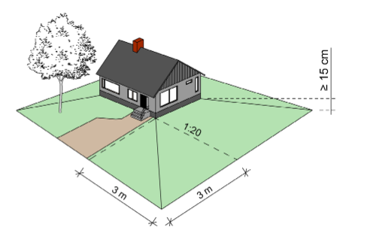
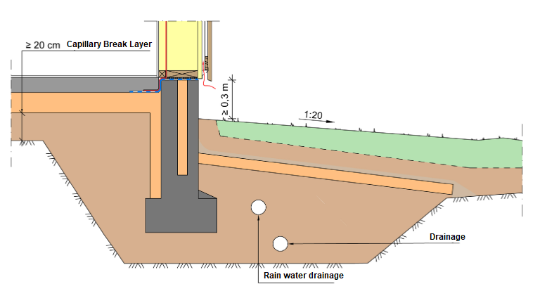
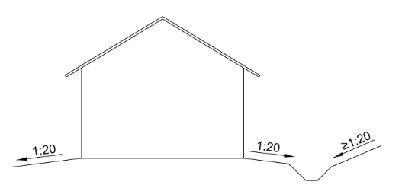
Drainage Planes
Ground drainage and stormwater management must be designed and implemented in such a way that the water is drained away from the building by means of a stormwater system without causing harm to the building or its use.
Notes:
Rainwater refers to rainwater and meltwater removed from the ground, the roof of a building or other similar surfaces. Stormwater is removed from the vicinity of the building by ground formation, drainage and a rainwater drainage system, Figures 5 and 6.
The ground immediately surrounding the building is shaped to be removed from the building. Primarily to remove stormwater, a solution is sought in which stormwater is delayed or absorbed on the property. Rainwater and meltwater are absorbed into the soil if a bottom survey has shown that the soil is sufficiently permeable and that the stormwater does not cause harm to the building, a neighboring plot or other environment. In some cases, in order to regulate the load on the municipal stormwater network, it may be necessary to delay the discharge of stormwater from the site by means of a system designed and implemented for this purpose.
Drainage of stormwater is planned and implemented on the terms of the building and terrain. In the design, the ground level of the yard areas is expected to rise on the ground due to rust. The entry of stormwater into the drainage system is prevented by a sufficiently dense surface structure and the structural layers of the yard area. The roof water is diverted through downspouts to a rainwater drain or otherwise away from the building in such a way that the water unnecessarily irrigates the anti-ground build. In addition, it is ensured that the rainwater drains are installed deep enough or thermally insulated to prevent freezing. The principle picture of stormwater management is shown in Figure 7.

Slide 13
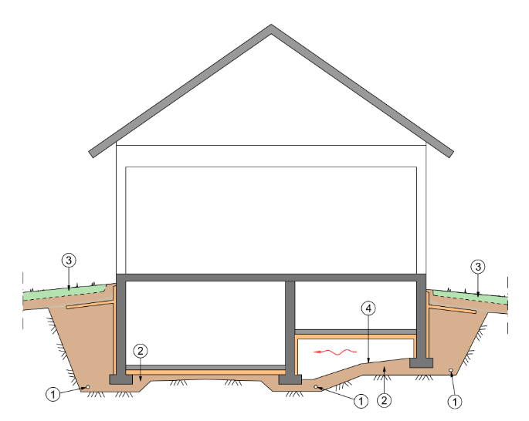
Schematic Diagram Of The Need For Drainage
1 - Drainage pipes to divert water away from the foundations of the building.
2 - Uniform capillary break layer and base soil design towards drainage pipes.
3 - Compact topsoil, tilting the topsoil away from the building and a water-retaining layer prevent surface water from entering the drainage layer.
4 - The capillary break layer reduces moisture infiltration from the ground to the crawl space. If necessary, drainage is installed in the crawl space.
Notes:
The drainage of the subsoil must be designed and implemented in such a way that the capillary flow of water into the above-ground structures is prevented and the groundwater level remains at a sufficient distance from the subsoil structure or the ground surface of the crawling space. The subsoil is drained if the water permeability of the subsoil has not been determined separately and the highest groundwater level is detrimental to the structures. When preparing a design solution, the special designer must have sufficient initial information about the need for drainage. Drainage is implemented with a drainage system that includes drainage pipes, a drainage layer, inspection wells and pipes, and a collector well. The capillary fracture layer that interrupts the water capillary flow and the drainage pipes installed in the floor ensure the drainage of water under the foundations and the subfloor. The thickness of the unitary layer of capillary rupture made of aggregate under the lower base must be at least 20 cm. In addition, in the case of any drainage pipes below the bottom, the thickness of the drainage layer must be at least 40 cm from the top surface of the drainage pipe.

Slide 14
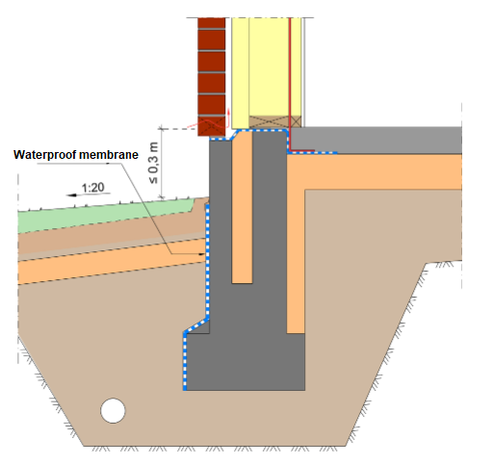
First Floors And Underground Structures
The upper layer of the underground floor must be at least 0.3 m above the ground outside the building, except for the floors of spaces partially or completely below the ground.
If, for a special reason, this condition is not fulfilled, the transfer of stormwater is prevented, for example, by waterproofing the foundation wall, or efficient drainage of surface water .
Notes:
Subfloor of the building and above-ground wall structures. The upper surface of the floor of the subsoil must be at least 0.3 m above the ground outside the building, except for the floors of spaces partially or completely below the ground. This protects the edge areas of the lower base and the lower parts of the outer walls from external and soil moisture stress. The building and special designer must pay special attention to the moisture technical functionality of the subterranean subfloor if, for a special reason, the upper surface of the subterranean floor is lower than 0.3 meters above the ground. In this case, the transfer of stormwater to the lower floor and wall structures is prevented, for example, by waterproofing the foundation wall, efficient drainage of surface water and drainage, Fig. 12.
Figure 12. Schematic diagram of the waterproofing of the foundation wall. When the floor surface is closer than 0.3 meters to the adjacent ground surface, the penetration of stormwater and the transfer to the subfloor and wall structures is prevented by waterproofing the foundation wall.
The crawl space below the subfloor must be designed and constructed in such a way that no water accumulates in the crawl space, the crawl space is adequately ventilated and the moisture in the air of the crawl space does not impair the function and durability of the structures. Stormwater can enter and remain in the crawl space from outside the building by means of a stormwater drainage system, ground contouring and, if necessary, drainage of the building floor. Ponded water must not be allowed in the crawl space. Especially in repair sites, the controlled accumulation of water in the planned sites can be allowed on a case-by-case basis, if it cannot be reasonably prevented and does not adversely affect the building and its use. The special designer shall assess the amount of damage on the basis of adequate baseline data and the condition of the crawl space structures. The creep space is most reliable in terms of moisture technology if the ground surface of the crawl space is at or above the level of the ground surrounding the building. This is especially the case with wooden crawl space subfloors. The crawl space ventilation must be designed on a case-by-case basis so that the crawl space has adequate ventilation all year round. The crawl space is ventilated to the outside air through ventilation openings or pipes in the foundation wall, Fig. 13. The crawl space must not have enclosed or unventilated spaces separated by partitions or beams. The ventilation of the crawl space can also be enhanced mechanically or by gravity, for example through ventilation pipes leading to the roof. When using a mechanical system, its continuous operation is ensured by a separate alarm system and regular maintenance measures. More detailed guidance on crawl space ventilation is given, for example, in RIL107 Guidelines for water and moisture insulation of Ra buildings [15].

Slide 15
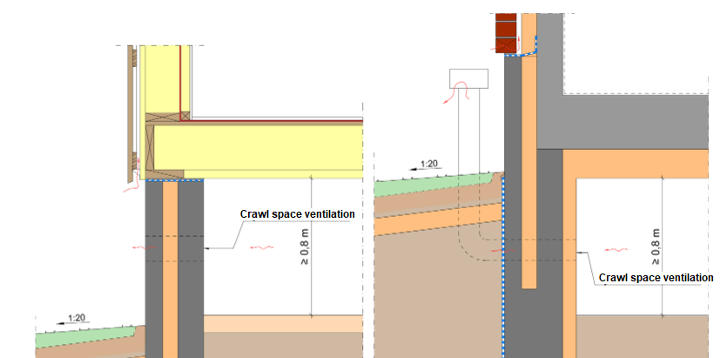
First Floors And Underground Structures
Water must not accumulate in the crawl space below the bottom.
The crawl space must be ventilated.
Moisture in the crawl space must not impair the function and durability of the structures.
The height of the crawl space in a new building must be at least 0.8 meters on average.
The crawl space must be accessible for inspection and maintenance of the equipment and systems located there.
Notes:
The crawl space below the subfloor must be designed and constructed in such a way that no water accumulates in the crawl space, the crawl space is adequately ventilated and the moisture in the air of the crawl space does not impair the function and durability of the structures. Stormwater can enter and remain in the crawl space from outside the building by means of a stormwater drainage system, ground contouring and, if necessary, drainage of the building floor. Ponded water must not be allowed in the crawl space. Especially in repair sites, the controlled accumulation of water in the planned sites can be allowed on a case-by-case basis, if it cannot be reasonably prevented and does not adversely affect the building and its use. The special designer shall assess the amount of damage on the basis of adequate baseline data and the condition of the crawl space structures. The creep space is most reliable in terms of moisture technology if the ground surface of the crawl space is at or above the level of the ground surrounding the building. This is especially the case with wooden crawl space subfloors. The crawl space ventilation must be designed on a case-by-case basis so that the crawl space has adequate ventilation all year round. The crawl space is ventilated to the outside air through ventilation openings or pipes in the foundation wall, Fig. 13. The crawl space must not have enclosed or unventilated spaces separated by partitions or beams. The ventilation of the crawl space can also be enhanced mechanically or by gravity, for example through ventilation pipes leading to the roof. When using a mechanical system, its continuous operation is ensured by a separate alarm system and regular maintenance measures. More detailed guidance on crawl space ventilation is given, for example, in RIL107 Guidelines for water and moisture insulation of Ra buildings [15].
FIGURE: Figure 13. Example of crawl space ventilation with ventilation openings in the foundation wall in both wooden and concrete subfloors (left and right figures). It is recommended to implement the ground floor of the crawl space of the wooden subfloor at or above the level of the surrounding ground (left picture)

Slide 16
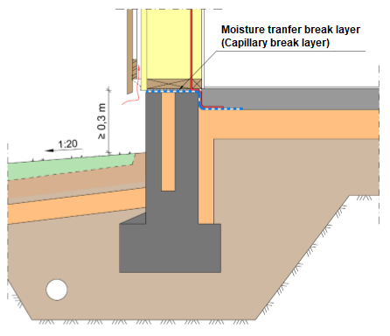
Moisture transferred between the foundation wall and upper structures
The moisture must not be transferred from the foundation wall and the concrete slab of the subfloor to the lower timber beam or to the wall and floor structures above.
The rise of the capillary moisture of the subsoil in the subsoil structure is interrupted by a capillary break layer.
Placing thermal insulation under the slab raises the temperature of the slab and lowers its moisture content.
The choice of subfloor materials takes into account the subfloor structure and soil moisture yield. In the case of underground floors, efforts must be made to avoid the use of dense floor coverings and to favor water vapor-permeable coverings or moisture-resistant indoor coatings.
Notes:
FIGURE: Schematic diagram of the moisture transfer interrupting layer. The transfer of moisture from the foundation wall or concrete slab of the subfloor to the lower brick wood or the wall and floor structures above it must be prevented, for example with bitumen membrane.
The foundation wall and subfloor structures are designed and implemented in such a way that the transfer of moisture from the foundation wall or the concrete slab of the subfloor to the lower brick wood or to the wall and floor structures above it is prevented. The wall structures adjoining the outside air are connected to the foundation wall and the underground subfloor structure in such a way that harmful transfer and accumulation of moisture to the wall structure through the foundation wall or adjacent subfloor structure is prevented and drying of the bottom wall is possible. The lower binder wood must be separated from the stone structure by a layer that interrupts the transfer of moisture, such as bitumen cream, Fig. 15. A partition wall with a wooden frame set up on its own foot is also made in a similar way. Harmful transfer of moisture from the foundation wall and bottom to the top .
The rise of the capillary moisture of the subsoil in the subsoil structure is interrupted by a capillary break layer. Placing thermal insulation under an anti-earth slab raises the temperature of the slab and lowers its moisture content. Thermal insulation can also be installed on a slab on a case-by-case basis, especially in repair sites, if the moisture performance of the structure and other related structures can be demonstrated to be functional by a special designer. The choice of subfloor floor materials takes into account the subfloor structure and soil moisture yield. In the case of underground floors, efforts must be made to avoid the use of dense floor coverings and to favor water vapor-permeable coverings or moisture-resistant indoor coatings.

Slide 17
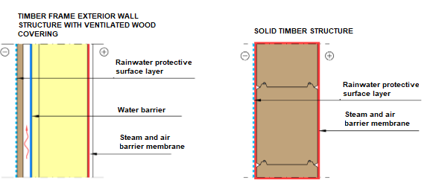
Exterior Wall Structures
The outer wall and its various layers must form a whole that prevents water's harmful access into the structures.
The water vapor resistance and airtightness of the outer wall must be such that the moisture content of the wall is not detrimental to the moisture performance of the structure due to indoor water vapor diffusion or convection.
If an air or vapor barrier is used in the construction, the seams, edges, and penetrations must be airtight.
Notes:
The outer wall and its various layers form a whole that prevents the harmful passage of water inside the structures. The outer part of the outer wall must be designed and constructed to be watertight with its joints so that water flowing along the outer surface of the structure does not enter the structure. The background of the exterior cladding of the layered outer wall with a separate outer cladding is usually ventilated and the leakage waters are directed away from the ventilation gap in a controlled manner. The background of the external cladding is ventilated whenever a separate external cladding of the external wall structure, such as a brick, strongly absorbs water. In layered exterior wall structures that do not have a separate ventilation gap, such as plastered facades, the building materials are selected so that they do not generate increasing moisture accumulation. In addition to internal moisture stresses, external moisture stresses, in particular the possible penetration of oblique rain into the structure, are taken into account when assessing moisture accumulation and the drying capacity of the structure. The open-cell thermal insulation used in the outer wall is protected from wind-induced air currents by wind protection. Only products that are suitable for the intended use and that can withstand the stresses on the structure are used as wind protection. For example, the windscreen must be able to withstand any wetting that may occur during construction before the external cladding is installed, as well as intermittent wetting during use without damage. The windscreen must be watertight at the joints and joints, such as windows and doors, and through penetrations and equipment installations. In particular, the fault tolerance of a wooden frame brick-clad outer wall structure is improved by using a heat-insulating and water-vapor permeable wind protection material outside the frame. It is recommended that the heat-insulating wind protection material be made of wind protection mineral wool with a thermal resistance of at least 50 mm. The moisture bound by the outer casing surface, for example a brick shell wall soaked in rain, is taken into account when designing the structural layers behind. The water-vapor resistance and airtightness of the outer wall and its various layers, as well as the structures and joints of the outer wall and the outer wall, shall be such that the moisture content of the wall is not detrimental to the moisture performance of the structure. The harmfulness of diffusable water vapor is prevented by the correct choice of vapor resistors in the different layers of the outer wall structures; the water vapor permeability of the structural layers increases towards the outer part of the structure. On a case-by-case basis, a different structure can be used if it is ensured that no harmful amounts of moisture enter the structure during construction and use. An example of such a structure is the unventilated outer wall structures with a steel sheet surface.
Harmful convection of water vapor into the external wall structure is prevented by an airtight layer of material, an air barrier and by controlling the pressure ratios in the building. For example, in a layered outer wall structure, a separate vapor barrier film often also acts as an air barrier, while in concrete sandwich structures, the concrete inner shell with its seams forms a sufficiently tight structure, Fig. 17.
FIGURE: Schematic diagram of the structural layers affecting the water and moisture transport of various external wall structures. Rainwater protective surface layer: The treatment on the surface of the structure reduces the transfer of rainwater to other structural layers. Rainwater protective surface structure: A structural layer that reduces the transfer of rainwater to other structural layers. Rainwater protective layer / structure: A material or structural layer that, with its seams and joints, reduces the ingress of water into the inner structural layers. Water barrier layer: A dense layer of material inside the ventilation gap that prevents harmful moisture from entering the structural layers. Vapor and air barrier film: A uniform, dense film-like layer of material on the warm side of the structure to prevent harmful ingress of water vapor into the structure. Vapor and air barrier structure: A solid structure which, together with its seams and joints, forms a tight vapor barrier layer.
In the case of an external wall structure in which an air or vapor barrier is used, the joints, edges and penetrations must be airtight. The seams, edges and penetrations of the vapor and air barrier are sealed with sealing accessories suitable for the product. Deformation of structures must be taken into account when installing and sealing the vapor and air barrier at the connections. For example, the connections of the external wall structure to windows and doors must be tight between the components, Figure 18. When using layered external wall structures, the building is designed and maintained mainly under slightly reduced pressure to prevent the disadvantages caused by moisture convection. In layered structures, where the water vapor tightness of the windscreen is higher than that of the open-cell thermal insulation used in the structure, the risk of overpressure due to overpressure condensation or harmful rise of humidity is higher than in monolithic structures. This risk exists, for example, in a whole consisting of mineral wool thermal insulation and a building board that acts as a windbreak.

Slide 18
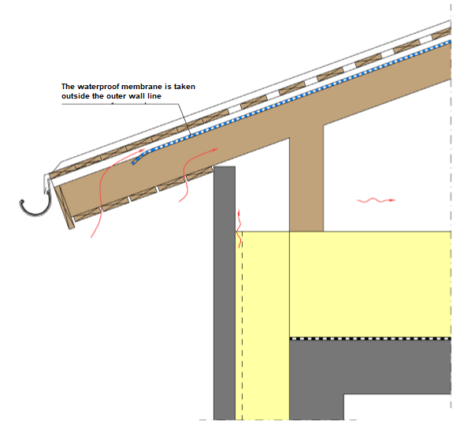
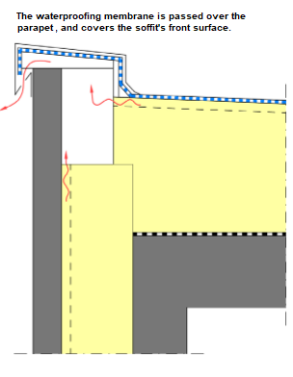
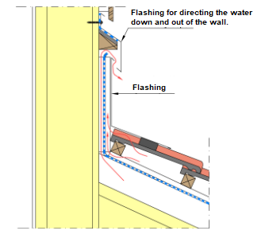
The Roof Water Drainage
Water must be drained from the roof without damaging the building.
Therefore, together with its structures and joints, the roof must have a suitable slope and airtightness to drain the water.
Notes:
The water roof is designed and implemented in such a way as to prevent rainwater, snow and meltwater from penetrating the structures. From the water roof, rainwater is led in a controlled manner with sufficient slopes to the rainwater system, such as roof wells or through gutters and downspouts outside the building. When using manholes, the water roof may have several drainage areas. When drainage becomes blocked, water must be allowed to drain from the roof without penetrating the structures. For a flooding situation, a drainage route can be arranged, for example, through a flood-indicating ejector or to an adjacent roof well area. Primarily, the movement seams of the water roof are avoided. If necessary, the movement joints can be placed at the highest point of the roof slopes so that the amount of water passing over the movement joints is minimized. Melting of snow and freezing of water on the water roof and eaves is prevented by adequate thermal insulation of the upper floor, airtightness (thermal leaks) and a ventilation gap below the water cover. Water flow paths and runoff distances are designed so that melt water does not freeze in the cold parts of the roof. Freezing of water can be prevented with defrost cables, for example in gutters and downspouts, as well as in rainwater wells. In particular, wide eaves protect the upper part of the outer walls from oblique rain. The gutter must not be built into or over the outer wall. In areas where eaves or retracted eaves are used, special attention must be paid to the Details of the structures during the design and implementation phase. More detailed guidance on the design of eaves is given in RIL107 Guidelines for waterproofing and moisture insulation of buildings [15]. The water roof, with its structures and joints, must have a suitable slope and tightness for the roof to drain water. The adequate slope of the roof depends on the material of the roof. The slope of the roof must be such that no harmful ponding can occur on the roof after rain. In connection with repair and alteration work on the water roof of a building, the slope of the water roof must be improved or the roofing material made more suitable for the selected slope, when the low slope of the water roof has been found to be detrimental to the building's moisture performance. generally continuous cream coatings as well as brushable or injectable elastomers, Figure 20. The joints and joints of the water cover must be sufficiently tight. Water roof lifts are carried out tightly and high enough to protect against rain, melting snow and droughts. The top edges of the roof lifts must be tight
Figure 20Figure 20. Schematic diagram of a sloping roof outer wall-roof joint, eaves joint and ventilation arrangements
For steep roofs (1:10 or steeper), discontinuous roofing can be used, under which, as a rule, underlayment is used. The underlay may be omitted in certain special cases, provided that minor leaks in the water cover or condensation on the cover do not adversely affect the operation of the building. Such buildings include, for example, warehouses. Discontinuous roofing, such as brick and sheet metal roofing, including machine-jointed sheet metal roofing, does not retain pressurized water. The roof and underlay together act as waterproofing. The underflow must direct the water flowing along it to a sufficiently long distance outside the outer wall line, Fig. 21. The overlaps, perforations and joints of the underlayment are made so that the water flowing from the top of the underlayment is directed along the underlayment. The water cover together with the underlay must be watertight in all conditions. Climatic stresses on the cover include water and snow, wind and its pressure effects, the effects of solar radiation and its temperature, and the chemical and biological effects of the air. These effects are taken into account in the selection and fixing of the cover. In addition, the compatibility of the cover with the underlay is ensured.
FIGURE Schematic diagram of the connection between a steep roof and an external wall, water control over the underlayment and ventilation arrangements.
The entry of rainwater and snow into structures due to wind is prevented. In addition to the storm protection and cladding of the eaves, the water rising along the outer surface of the wall due to the wind is taken into account. In the case of hoists, the harmful transport of blizzard and stagnant and melting snow to the structures is prevented. Storm protection can be arranged with separate dampers that protect against sloping rain and restrict wind and airflow, as well as with dense mesh nets, Fig. 23
Placing bushings such as chimney structures, building services installations, skylights and vacuum fans close to the roof ridge and away from roof wells reduces the risk of water leaks. Passages close to each other are avoided. Grommet connections are designed and implemented to be watertight. Around the passages, water is led past the passage, for example on steep roofs at flues with counter-slopes. Leakage water from roof waters and gutters must be prevented from entering the façade surface and external wall structures. In the external walls related to the lifting of the water roof, rainwater and moisture penetrating through the outer shell surface of the external walls must not enter the upper floor structures. In the lifting of the water roof, leakage water control is arranged in the outer walls for the water roof. In inverted roof structures, the water insulation is below the thermal insulation. Most of the dewatering takes place along the surface structure, and on top of the waterproofing dewatering is arranged for rainwater wells, for example with drainage mats. In inverted roof and deck structures, the base of the waterproofing is a uniform dense concrete casting, to which the waterproofing is attached throughout. Together, the concrete base and the waterproofing act as a tight structure in which leakage water cannot pass between the waterproofing and the concrete. The movement joints of inverted roof structures are usually placed outside the trough formed by the subgrade concrete structure, Fig. 23. Green roofs are also often implemented as inverted roof structures, with the exception of peat roofs. Green roofs are designed separately for each site, taking into account, for example, drainage, waterproofing and the vegetation to be planted on the roof. The functionality of glass roofs is based on the co-operation of the product system. The glass roof with its joints is planned as a whole. The extensions of the leakage and condensate drainage gutters of the glass roof system shall be watertight and the water flowing through them shall be directed in a controlled manner to the outside of the structure at the lower eaves. The stress on the glass roof caused by melting and freezing water at the lower end of the glass cover is reduced by melt holding cables.

Slide 19
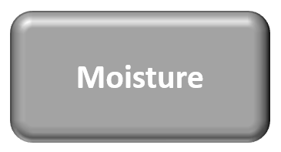
Building Physics is an applied science that studies the hygro-thermal, acoustical and light-related properties, and the performance of materials, building assemblies (roofs, façades, windows, partition walls, etc.), spaces, whole buildings, and the built environment.
Moisture
Sound
Heat

Slide 20
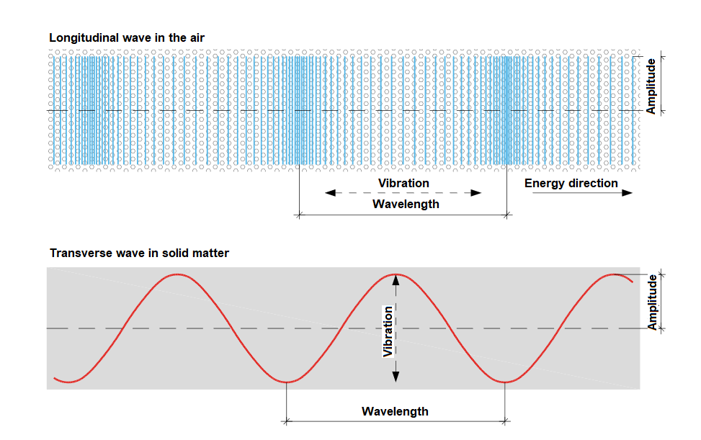
Definition Of Sound
In physics, sound is a vibration that propagates as an acoustic wave, through a transmission medium such as a gas, liquid or solid.
In the air, sound propagates as a longitudinal wave, but in solid matter, sound travels in both transverse and longitudinal waves.
Notes:
Sound is a propagating wave motion in a medium. The medium can be a gas, a liquid or a solid. In the air, sound propagates as a longitudinal wave. In solid matter, sound travels in both transverse and longitudinal waves. Sound is named based on the medium in which the sound travels.

Slide 21
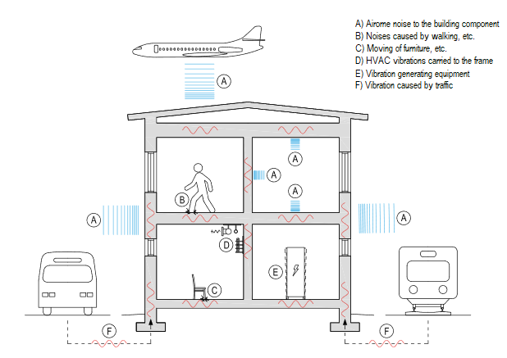
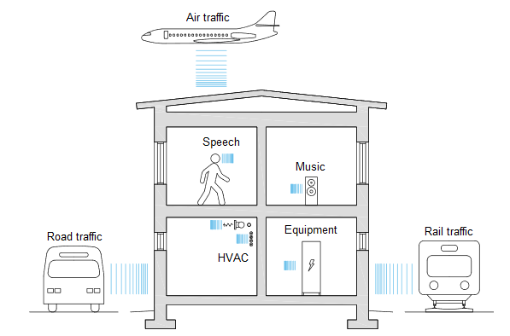
Airborne Noise & Impact/Frame Noise
Notes:
Sound propagating in the air is called airborne sound. We sensed airborne sound primarily through our hearing when the sound frequency is 20 ... 20,000 Hz. We also sensed a strong low frequency vibration in our body (vibration). Airborne noise is generated inside the building, but airborne noise generated outside the building must also be taken into account in the acoustic design of the building. External noise control plays a significant role when a building is located in the vicinity of traffic routes or an airport. The sound propagating in the frame of a building is called the sound of the frame. There is an interrelationship between the body sound and the air sound, as the body sound generates air sound and the air sound produces body sound. In practice, the vibration of the building component produces a vibration in the air surrounding the building component, which generates air noise. Correspondingly, the air sound applied to the building part causes the building part to vibrate, whereby a body sound is generated which propagates along the building part. Frame sounds are generated inside the building, but frame sounds from outside the building must also be taken into account in the acoustic design of the building. The body noise due to the base area may play a very significant role when the building is located in the vicinity of a railway track, for example.

Slide 22
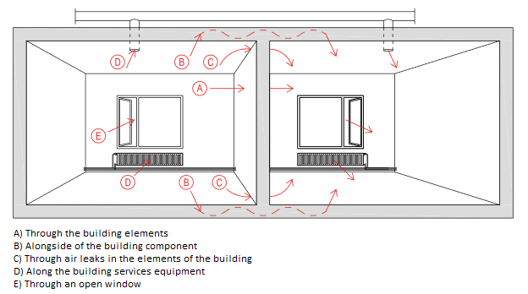
Sound Propagation Paths
Notes:
Inside the building, there are several paths of air and body sound. Because of this, the acoustic design of a building must always be implemented by looking at the building as a whole, taking into account all sound sources and sound propagation paths. Consideration by building component alone is not sufficient, as, for example, lateral road displacements may significantly impair the sound insulation between spaces.

Slide 23
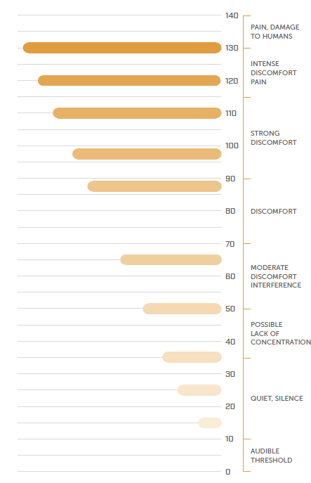
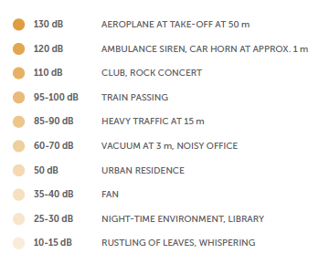
Noise Perception
As it spreads, a sound wave causes a local variation of the atmospheric pressure detectable by the human ear.
The range of sensitivity of the human ear to pressure variation is very broad, therefore, its value is expressed with respect to a reference term in logarithmic scale.
Sound pressure level (L_{p}) or sound level is a logarithmic measure of the effective sound pressure of a sound relative to a reference value. It is measured in decibels (dB) above a standard reference level.
The standard reference sound pressure in the air or other gases is 20 µPa, which is usually considered the threshold of human hearing (at 1 kHz).
The decibel is the logarithmic unit used to measure the level of noise.
Notes:
Sound pressure p [Pa] is the change in barometric pressure to static barometric pressurein relation to. The larger the change in barometric pressure, thethe stronger our senses of sound. Minimum change in barometric pressure, which a person hears as a voice is 0.00002 Pa. This is called the hearing threshold(p0). Correspondingly, the pain threshold of human hearing is reached with a change in air pressure of 20 Pa. As can be seen from the above,man is able to sense as sound very small and largechanges in air pressure.A logarithmic has been developed to represent the sound pressure level Lp [dB]decibel scale, because the sound pressure level is the representation of sound pressurep is challenging. This is due to sound pressurethe numerical values ​​are very small and have a wide range. For examplethe ratio of hearing threshold to pain threshold sound pressuresis a million times. A logarithmic decibel scale makes it easierin practice, also the perception of the sound pressure level. For examplea numerical value of 60 dB indicates the volume more than0.02 Pa. However, as an order of magnitude, it should be noted thatdoubling the sound pressure p increases the sound pressure levelLvvain 6 dB. The logarithmic scale of the sound pressure level Lp followsalso the fact that the sound pressure level produced jointly by several sound sourcesLp, tot is determined by Equation 1. The effect of multiple sound sources on the total sound pressure levelLp, tot is illustrated in Table 2.

Slide 24
Some definitions
Building acoustics is a branch of acoustics that deals with the control of noise propagation in buildings. It specifically deals with the verification and optimization of airborne sound insulation, impact sound insulation
(or insulation against footsteps) and of building installations.
Weighted standardized level difference (D_{nT,w}) single number value of the airborne sound insulation between room, used to characterize the sound insulation between rooms in buildings.
Weighted standardized impact sound pressure level (L’_{nT,w}) means the measure describing the impact sound insulation between room spaces;
Reverberation time (T) - the time required by a stationary sound field to decay by 60 dB after the sound source has been switched of

Slide 25
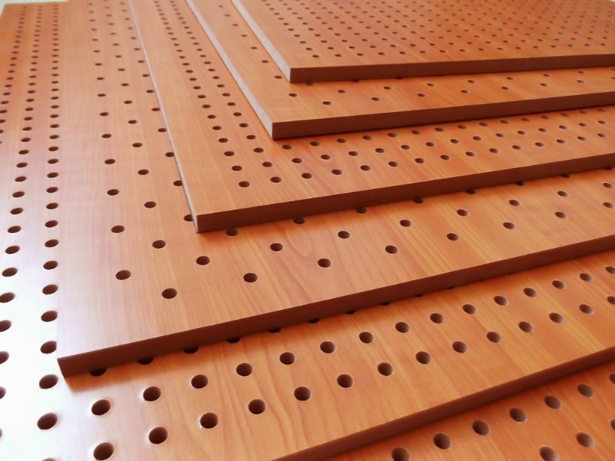
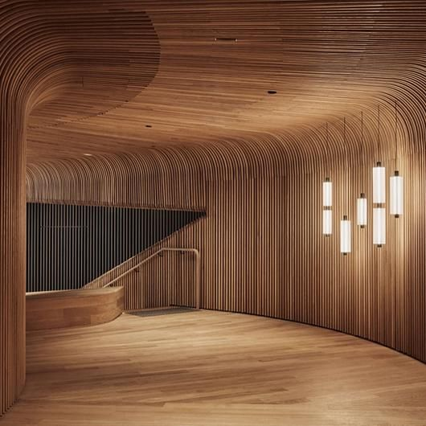
Acoustic Properties Of Wood
Wood is a light material → sound insulation performance is not particularly good.
Anisotropic nature o wood → wood conducts sound better in the longitudinal direction of the grain than perpendicular to it.
A dense wooden structure reflects sound and can easily be made into surfaces that channel sound reflections
Sound insulation in wooden buildings:
multi-layered constructions
wooden battening or by making holes in wooden surfaces
In multi-storey wooden buildings → separate frames, sound stops) are challenging, because they are contrary to how structural rigidity is achieved (reinforcement, joints, continuous structures).
Notes:
Wood is a light material, so as such its sound insulation performance is not particularly good. Neither does a thick, dense-surfaced and smooth wooden structure dampen sound particularly well, so wood alone is not a good absorption material. Wood conducts sound better in the longitudinal direction of the grain than perpendicular to it. A dense wooden structure reflects sound, and can easily be made into surfaces that channel sound reflections. This property is utilised, for example, in musical instruments and concert halls.
A sufficient level of sound insulation in wooden buildings can usually be achieved structurally by using multi-layered constructions. By positioning porous absorption material behind the board or panelling in addition to an air gap, for example a layer of thermal insulation, a so-called board resonator is formed which, when it vibrates, effectively dampens low sounds that are problematic for light structures. Furthermore, by making wooden battening or by making holes in wooden surfaces, a perforated resonator can be created that also efficiently dampens medium-to-high-pitched sounds.
In multi-storey wooden buildings, the means of controlling sound insulation (separate frames, sound stops) are challenging, because they are contrary to how structural rigidity is achieved (reinforcement, joints, continuous structures). The footstep insulation of wooden floors can be improved by increasing the mass of the floor, for example using a concrete cast on the surface or so-called floating surface tiles on top of a flexible layer on the upper surface of the floor.
A batten is most commonly a strip of solid material, historically wood^{[1]} but can also be of plastic, metal, or fiberglass. Battens are variously used in construction, sailing, and other fields.

Slide 26
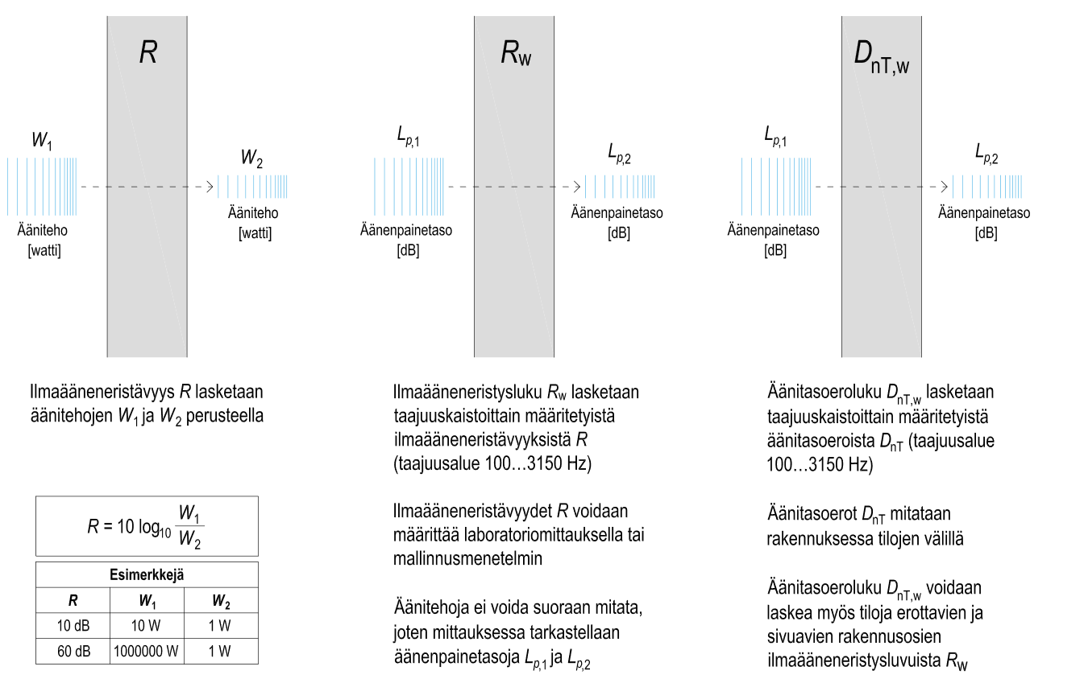
The airborne sound insulation R is calculated based on the sound powers W1 and W2
A Weighted Sound Reduction Index or Rw, is the rating used to measure the level of sound insulating abilities of walls, floors, windows and doors. It is expressed in decibels (dB) and is used for a partition or single component only.
The higher the Rw figure, the better the sound isolation that is provided.
Sound power cannot be measured directly, so the sound pressure levels are considered in the measurement Lp,1 and Lp,2.
The sound level difference index D_{n,T,w} is calculated from the sound level differences D_{nT}
The weighted standardized level difference D_{nT,w} is a single number value of the airborne sound insulation measured two between rooms.
Notes:
The airborne sound insulation R is calculated on the basis of the sound powers W1 and W2
The airborne sound insulation index Rw is calculated from the airborne sound insulation R (determined in the frequency bands) (frequency range 100 ... 3150Hz)
A Weighted Sound Reduction Index or Rw, is the rating used to measure the level of sound insulating abilities of walls, floors, windows and doors. It is expressed in decibels (dB), and is used for a partition or single component only.
The higher the Rw figure, the better the sound isolation that is provided. It must be noted, however, that the Rw figure is not reliable for sounds which contain a significant amount of low frequencies – for example music or sounds emanating from home theatre systems.
Weighted standardized level difference (D_{nT,w}) single number value of the airborne sound insulation beteen room, used to characterize the sound insulation between rooms in buildings.
Sound power cannot be measured directly, so the sound pressure levels are considered in the measurement L and L.
Sound pressure level (SPL) or sound level is a logarithmic measure of the effective sound pressure of a sound relative to a reference value. It is measured in decibels (dB) above a standard reference level. The standard reference sound pressure in the air or other gases is 20 µPa, which is usually considered the threshold of human hearing (at 1 kHz). The following equation shows us how to calculate the Sound Pressure level (Lp) in decibels [dB] from sound pressure (p) in Pascal [Pa].
the sound level difference number is calculated from the sound level differences DnT determined by frequency bands sound level differences DnT are measured in a building between rooms the sound level difference figure DnT, w can also be calculated from the airborne sound insulation figures Rw of the building components separating the spaces la

Slide 27
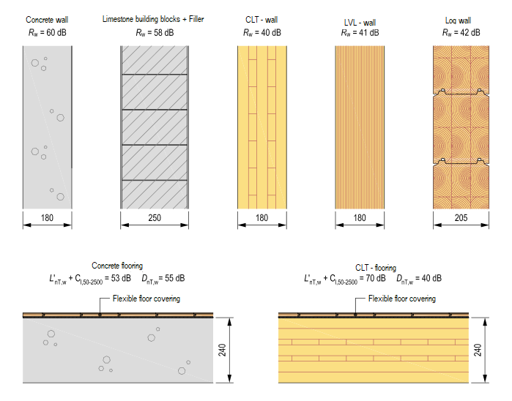
Simple Structures
Acoustically, a structure is simple when it is the same material throughout or when the different layers of material are so closely connected to each other that they vibrate as a whole.
The airborne sound insulation of an airtight simple structure is mainly based on mass and stiffness.
Transmission of airborne sound across a solid wall or a single skin partition will obey what is known as the mass law.
According to the mass law, the airborne sound insulation of a structure increases by about 6 dB when the mass of the structure doubles.
Due to the above, increasing the mass of the structure is a very effective way to improve the airborne sound insulation of a simple structure.
Notes:
The airborne sound insulation of an airtight simple structure is mainly based on mass and stiffness. According to the Mass Act, the airborne sound insulation of a structure increases by about 6 dB when the mass of the structure doubles. This is also the case in the frequency range of the Mass Act (Fig. 19), when the frequency of sound under consideration doubles. Due to the above, increasing the mass of the structure is a very effective way to improve the airborne sound insulation of a simple structure. The airborne sound insulation of such a concrete structure increases very effectively above the cut-off frequency of the coincidence up to the shear wave range. In the shear wave range, the increase in airborne sound insulation according to frequency is no longer as strong, because the effect of shear waves weakens the airborne sound insulation at high frequencies. This is particularly pronounced with concrete structures with a mass> 500 kg / m2. It should also be taken into account that the coincidence phenomenon significantly reduces the airborne sound insulation of a concrete structure when the mass of the structure is <300 kg / m2.

Slide 28
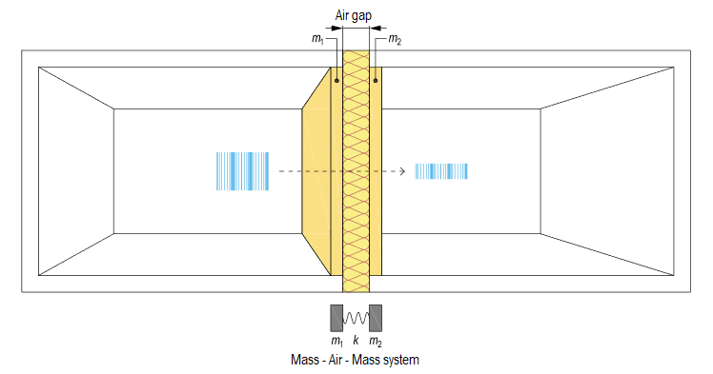
Double Layer Structures
Because the simple solid wood structures are often not able to achieve sufficient sound insulation wooden building component must almost always form an acoustically double structure.
Acoustically, the structure is double, when it consists of two plate-like masses (m1 and m2) and the air gap (k) between them, also called spring.
The air gap acts as a spring when its thickness is greater than the wavelength of the sound applied to the structure. The looser the spring, the less it transmits vibration between the plate-like masses m1 and m2 and the better the airborne sound insulation of the structure. In other words, the thin air gap does not act as a spring, but connects the plate-like masses to each other, whereby the airborne sound insulation of the structure is impaired.
Notes:
DOUBLE STRUCTURE It can be seen from Figure 18 that simple solid wood structures are often not able to achieve sufficient sound insulation.
Due to this, the sound-insulating wooden building component must almost always form an acoustically double structure. This applies to both wall and subfloor structures.
Acoustically, the structure is double when it consists of two plate-like masses (m1 and m2) and the air gap (k) between them. The air gap of a double structure is called a spring, the operation of which depends on the thickness of the air gap. The air gap acts as a spring when its thickness is greater than the wavelength of the sound applied to the structure. The looser the spring, the less it transmits vibration between the plate-like masses m1 and m2 and the better the airborne sound insulation of the structure.
In other words, the thin air gap does not act as a spring, but connects the plate-like masses to each other, whereby the airborne sound insulation of the structure is impaired.
Such a structure does not achieve significant airborne sound insulation due to the aforementioned mechanical coupling. Such a structure is an ideal mass-air-mass-sa system that can achieve a very efficient increase in airborne sound absorption above the resonant frequency of the system, even if the structure is light. However, it is not easy to implement an ideal double structure in a building, because the mechanical coupling of the plate-like masses may occur, for example, in the joining areas of the building components. Similarly, in some midsole types, the load-bearing frame inevitably slightly interconnects the plate-like masses.The following are relevant factors in the design of double structure airborne sound insulation: Figure 21. Principle of ideal double structure in a building. system resonant frequency • Mechanical coupling of plate-like masses • Air gap thickness (spring stiffness) • Effect of structural lateral displacements

Slide 29
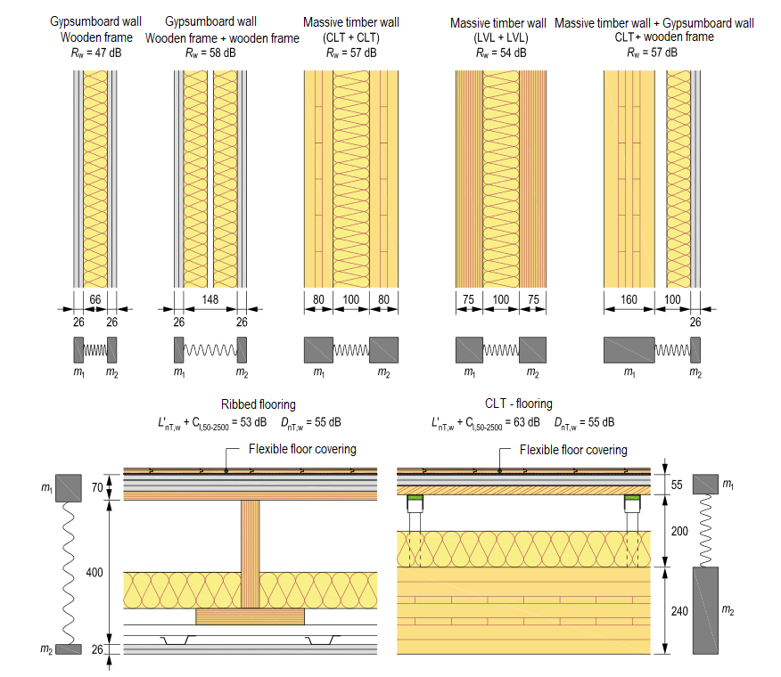
Relevant factors in the design of double structure airborne sound insulation include:
Weight of plate-like masses, cut-off frequency and airtightness.
The resonant frequency of a mass-spring-mass system.
Mechanical coupling of plate-like masses.
Air gap thickness (spring stiffness).
Effect of structural lateral displacements.
Sources: https://puuinfo.fi/wp-content/uploads/2021/05/Aanikirja_kokonainen-1.pdf
Notes:
Cutoff frequency: Of an anechoic wedge or set of wedges, the lowest frequency above which the normal incidence sound absorption coefficient is at least .990 ...

Slide 30
The 4 Most Soundproof Wood Types
Cork Cork’s sustainability stems from the fact that the trees don’t need to be cut down to produce the material. Rather, the bark of the cork oak tree is stripped to make the product, and the trees continue thriving without it.
Acoustic Plywood Acoustic plywood has to be perforated to let air pass through and subsequently dissipate sound waves. Typically, manufacturers use round, square, channeled or oblong perforations. Some mix things up to improve aesthetics and sound absorption effectiveness.
Medium Density Fiberboard (MDF) MDF is a type of engineered wood made by fusing broken-down softwood or hardwood fibers with resin binder and wax under heat and pressure to create panels. MDF’s excellent soundproofing capabilities are courtesy of its high density, thickness, and STC rating. With such characteristics, it can effectively contain all sound frequencies, something that many wood products struggle to achieve. And since it’s made of wood, it can also absorb sound, making it one of the best types of soundproof wood if you’re looking for complete noise isolation.
Oriented Strand Board (OSB) Thanks to its high density and mass, OSB can block sound to reduce its transmission from one room to another, especially when combined with other materials such as glass wool. But its ability to block sound is admirable; its sound absorption is what really stands out.
Notes:
What Makes Cork a Good Soundproofing Material?
As mentioned earlier, complete soundproofing requires a combination of sound blocking and sound absorption.
In terms of sound blocking, cork isn’t necessarily the best option. Effective sound blocking requires a combination of great mass and density. When sound comes across any soundproofing material with these two characteristics, it bounces off, effectively stopping unwanted transmission.
Unfortunately, cork—and wood in general—is lightweight and relatively low on density.
The good news, however, is that cork is great at sound absorption. Generally, sound absorption requires porous materials with plenty of air spaces to trap sound. Thanks to the honeycomb-like cellular structure of cork oak, cork has plenty of such air spaces and is one of the reasons it’s often used for insulation and sealing.
To put things into perspective, let’s take a look at the latest sound test results, and compare the STC rating of 12mm APC cork to that of the Proflex RCU 250. When tested on 6” (152.4mm) slab, the APC cork gave an STC rating of 72. This is significantly higher than the STC rating of an 8-inch(203.2mm) slab of Proflex RCU, which is about 56.
So while it may not be great at blocking sound, cork’s great acoustic properties can help you effectively soundproof your home. In a nutshell, these include:
Sound absorption: due to its small cells, cork has lots of air spaces that help trap sound. In 1cm3 (0.0610237 in³), there are around 40 million cells. Such a high surface area to volume ratio increases porosity and enhances cork’s ability to trap and absorb sound—which stops transmission.
Noise reduction: Cork’s unique cell structure also helps it reduce sound vibrations. This comes in handy when you want to stop low-frequency sounds from traveling through walls or prevent the impact of your feet from disturbing the downstairs neighbor.
Acoustic Insulation: Cork’s great sound absorption capability excels at minimizing acoustic transmission through ceilings, floors, and walls. By absorbing mid to upper frequencies, it prevents echo and reverberation.
What Makes Plywood a Good Soundproofing Material?
To improve its density and weight, acoustic plywood is often combined with other materials such as Amorim cork rubber to form soundproof plywood panels. Doing this improves the sound blocking capability of plywood, and the result is a panel that can block and absorb sound.
Without other additives, acoustic plywood can still serve as a sound control material and is often used in home theatres and concert halls to reduce frequency acoustics and enhance sound clarity.
With regards to soundproofing at home, you can use acoustic plywood to:
Fragment standing sound waves caused by resonance within a room. Typically, resonance amplifies low-frequency sounds, which causes walls to vibrate. So by fragmenting standing sound waves, you can prevent amplification of low-frequency sounds—such as bass from music, for instance—within your room, thus effectively dampening noise.
Absorb bass from loud music. Plywood’s NRC rating is higher at low frequencies, meaning it’s more effective at absorbing bass and other low-frequency sounds.
Minimize impact vibrations on the ceiling of your downstairs neighbor when you walk around or move items. In addition to its great soundproofing qualities, non-sanded plywood makes a great material for sheathing floors because it’s cheaper and resists moisture better than many commonly used materials, including MDF.
Reduce echoes and sound reverberation. By dissipating sound waves, acoustic plywood prevents echoes and sound reverberation.
Sound Transmission Class (or STC)

Slide 31
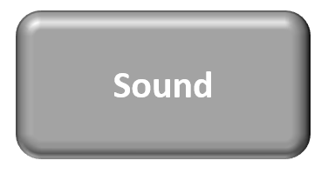
Building Physics is an applied science that studies the hygro-thermal, acoustical and light-related properties, and the performance of materials, building assemblies (roofs, façades, windows, partition walls, etc.), spaces, whole buildings, and the built environment.
Moisture
Sound
Heat

Slide 32
Thermal Mass
Thermal mass describes a material's capacity to absorb, store and release heat.
Though thermal mass has always been an aspect of buildings, only in recent years has it evolved as a tool to be deployed in the conservation of energy.
Factors that determine thermal mass
Thermal conductivity
Specific heat capacity
Density
Notes:
For example water and concrete have a high capacity to store heat and are referred to as 'high thermal mass' materials. Insulation foam, by contrast, has very little heat storage capacity and is referred to as having 'low thermal mass’.
A common analogy is thermal mass as a kind of thermal battery. When heat is applied (to a limit) by radiation or warmer adjoining air, the battery charges up until which time it becomes fully charged. It discharges when heat starts to flow out as the adjoining air space becomes relatively cooler.

Slide 33
Thermal Conductivity
Thermal conductivity measures the ease with which heat can travel through a material. For 'high' thermal mass, thermal conductivity usually needs to be moderate so that the absorption and release of heat synchronizes with the building's heating and cooling cycle.
The R-value is a measure of resistance to heat flow through a given thickness of material. (R = 1 /λ)
So the higher the R-value, the more thermal resistance the material has and therefore the better its insulating properties.
Thermal conductivity λ is measured in units of W/mK
The thermal conductivity of wood is relatively low because of the porosity of timber
much better than metals (0.12 W/mK– structural wood vs 239 W/mK) – aluminum)
slightly worse than insulation (0.12 W/mK) – structural wood vs 0.04W/mk – wool
Notes:
Thermal Conductivity Thermal conductivity is a measure of the rate at which heat
flows through a material. The reciprocal of thermal conductivity is the thermal resistance
(insulating) value (R). Wood has a thermal conductivity that is a fraction of that
of most metals and three to four times greater than common insulating materials. The
thermal conductivity ranges from 0.06 W/(m°K) [0.34 Btu/(h-ft-°F)] for balsa to
0.17 W/(m°K) [1.16 Btu/(h-ft-°F)] for rock elm. Structural woods average 0.12 W/(m°K)
[0.07 Btu/(h-ft-°F)] as compared to 200 W/(m°K) [115 Btu/(h-ft-°F)] for aluminum and
0.04 W/(m°K) [0.025 Btu/(h-ft-°F)] for wool. The thermal conductivity of wood
700 kg/m3
1000 kg/m3
160 kg/m3
depends on several items including (1) grain orientation, (2) moisture content, (3) specific
gravity, (4) extractive content, and (5) structural irregularities such as knots.
Heat flow in wood across the radial and tangential directions (with respect
to the growth rings) is nearly uniform. However, heat flow through wood in the
longitudinal direction (parallel to the grain) is 2.0 to 2.8 times greater than in the
radial direction.
Moisture content has a strong influence on thermal conductivity. When the
wood is dry, the cells are filled with air and the thermal conductivity is very low. As
the moisture content increases, thermal conductivity increases. As the moisture content
increases from 0% to 40%, the thermal conductivity increases by about 30%.
Because of the solid cell wall material in heavy woods, they conduct heat
faster than light woods. This relationship between specific gravity and thermal
conductivity for wood is linear. Also affecting the heat transfer in wood are
increases in extractive content and density (i.e., knots) which increase thermal
conductivity.
The thermal conductivity of wood depends on several items including (1) grain orientation, (2) moisture content, (3) specific
gravity, (4) extractive content, and (5) structural irregularities such as knots.
(1) grain orientation
Heat flow in wood across the radial and tangential directions (with respect to the growth rings) is nearly uniform. However, heat flow through wood in the longitudinal direction (parallel to the grain) is 2.0 to 2.8 times greater than in the radial direction.
(2) moisture content
Moisture content has a strong influence on thermal conductivity. When the wood is dry, the cells are filled with air and the thermal conductivity is very low. As
the moisture content increases, thermal conductivity increases. As the moisture content increases from 0% to 40%, the thermal conductivity increases by about 30%.
3) Specific gravity
(The specific gravity is the ratio between the density of an object, and a reference substance. The specific gravity can tell us, based on its value, if the object will sink or float in our reference substance. Usually, our reference substance is water which always has a density of 1 gram per cubic centimeter. )
Because of the solid cell wall material in heavy woods, they conduct heat faster than light woods. This relationship between specific gravity and thermal conductivity for wood is linear. Also affecting the heat transfer in wood are increases in extractive content and density (i.e., knots) which increase thermal conductivity.
For both hard and soft woods, the longitudinal (parallel to the grain) coefficient values range from 0.009 to 0.0014 mm/m/°C (0.0000017 to 0.0000025 in./in./°F). The expansion coefficients are proportional to density and therefore are five to ten times greater across the grain than those parallel to it.

Slide 34
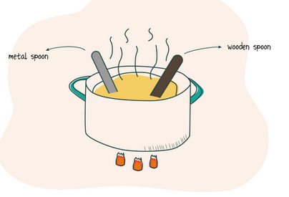
Specific Heat
Specific heat capacity refers to a material's capacity to store heat for every kilogram of mass.
A material of 'high' thermal mass has a high specific heat capacity.
Specific heat capacity is measured in J/kgK
Temperature and moisture content largely control the specific heat of wood, with species and density having little to no effect.
The value of specific heat for the wet wood is higher than just the sum of the specific heats for the wood and water combined.
An increase in temperature increases the energy absorption of wood and results in an increase in the specific heat.
Notes:
Specific Heat Specific heat of a material is the ratio of the quantity of heat
required to raise the temperature of the material one degree to that required to
raise the temperature of an equal mass of water one degree. Temperature and moisture
content largely control the specific heat of wood, with species and density
having little to no effect. When wood contains water, the specific heat is increased
because the specific heat of water is higher than that of dry wood. However, the
value of specific heat for the wet wood is higher than just the sum of the specific
heats for the wood and water combined. This increase in specific heat beyond
the simple sum is due to the wood–water bonds absorbing energy. An increase in
temperature increases the energy absorption of wood and results in an increase in
the specific heat.

Slide 35
Specific Gravity and Density
Specific gravity of wood depends on cell size, cell wall thickness, and number and types of cells.
Regardless of species, the substance composing the cell walls has a
specific gravity of 1.5.
The density refers to the mass (or 'weight') per unit volume of a material and is measured in kg/m3.
The majority of wood types have densities in the range of 300 to 700 kg/m³
Notes:
Specific Gravity and Density
Specific gravity of wood depends on cell size, cell wall thickness, and number and types of cells. Regardless of species, the substance composing the cell walls has a
specific gravity of 1.5. Because of this consistency, specific gravity is an excellent index for the amount of substance a dry piece of wood actually contains. Therefore,
specific gravity, or density, is a commonly cited property and is an indicator of mechanical properties within a clear, straight-grained wood.
The dry density of wood ranges from (10 pcf) for balsa to more than (65 pcf) for some species. The majority of wood types have densities in
the range of 300 to 700 kb/m3(20 to 45 pcf).

Slide 36
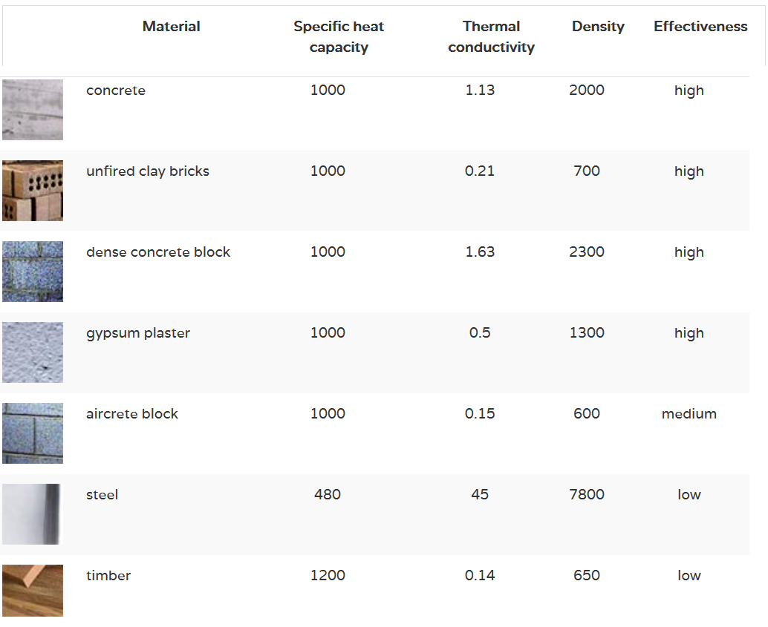

Slide 37
Thermal Mass and Energy Efficiency
Interest in how thermal mass can be used to save energy in buildings has been growing. This is caused in part by rising energy costs, the urgent need to reduce greenhouse-gas emissions.
Materials with thermal mass readily absorb excess heat without getting hot. This heat may be from the sun or from internal loads, such as lights and computers. Once ambient temperatures drop, the thermal mass will slowly release stored heat to the surrounding space without getting cold.
Optimal use of thermal mass can reduce a building’s energy use, environmental footprint and peak-energy loads, as well as increase occupant thermal comfort. Smaller peak loads mean HVAC systems can be downsized and expensive energy-demand charges can be minimized. Properly integrated into a building project, there even are synergies between thermal mass and other green-building practices.
Notes:
Early research into thermal mass addressed the question, “Does thermal mass save energy?” Researchers have moved away from measuring thermal-mass effects in full-scale environmental chambers and now are simulating energy use in buildings using sophisticated thermal modeling. Recent research attempts to answer the question, “How much energy can you save with thermal mass?” Ongoing research is trying to determine how much thermal mass is enough. The answers, however, are not simple.

Slide 38
Thank you and have a nice weekend! ☺

Slide 39
Exercise
Think about floor structure out of timber. Why timber often shrinks during winter and swells during summer?
We have a 50 mm x 100 mm timber stud with 20 % moisture content. Estimate (roughly) the dimensions when the timber is dried to 12 % moisture content
Notes:
20%-12% = 8%
that means a change of 2 % for the dimensions
50x2/100=1 – 49 mm
100x2/100 =2 – 98 mm

