Slide 1
Building materials from tree to slab to "by-products"
S.Kuc, P.Mika, Ł.Wesołowski
08.09.2021

Slide 2
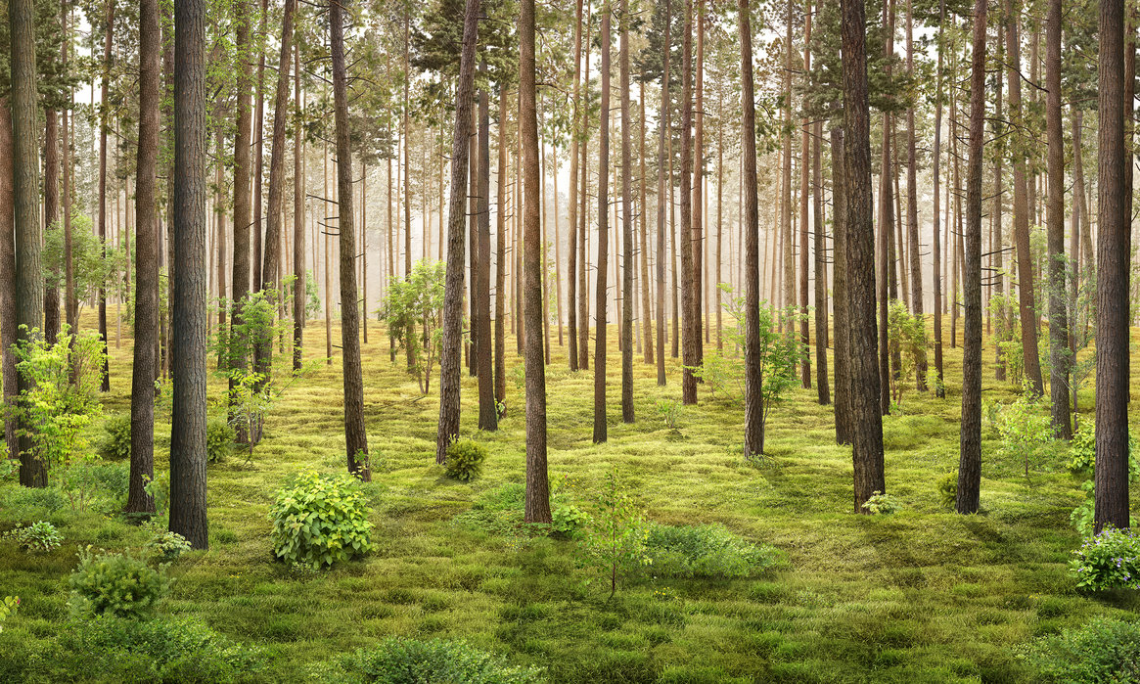
Building materials from tree to slab to "by-products"
Łukasz Wesołowski (CUT)
Wood is a natural
material:
Kind
Geo location
Climate
Speed of growing
Diseases / insects

Slide 3
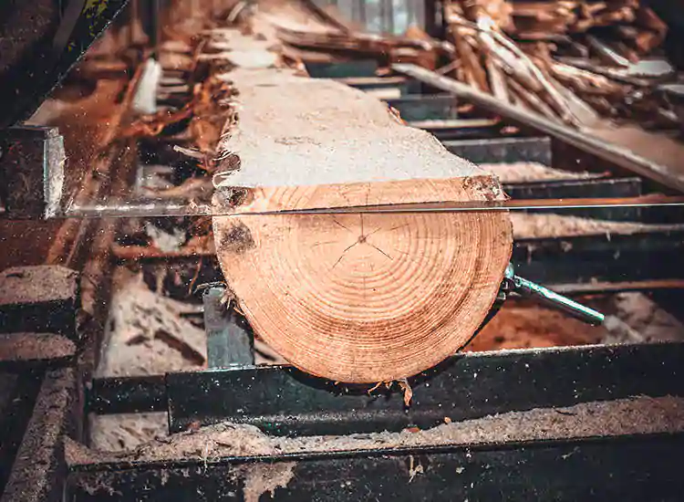
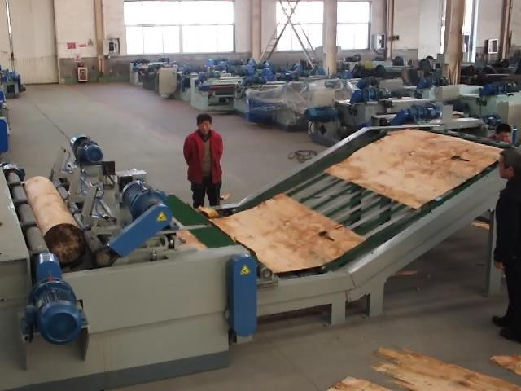
Building materials from tree to slab to "by-products"
Łukasz Wesołowski (CUT)
Transforming wood into timber

Slide 4
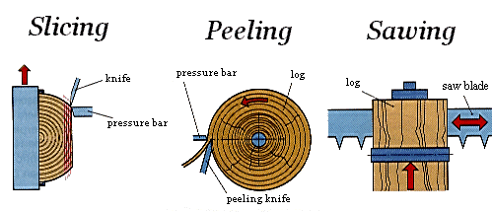
Building materials from tree to slab to "by-products"
Łukasz Wesołowski (CUT)
Transforming wood into timber

Slide 5
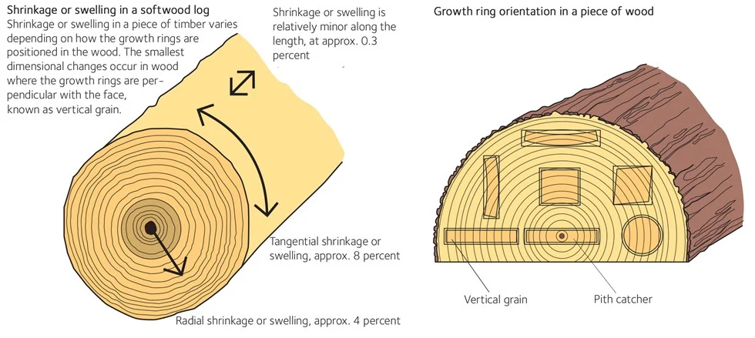
Building materials from tree to slab to "by-products"
Łukasz Wesołowski (CUT)

Slide 6
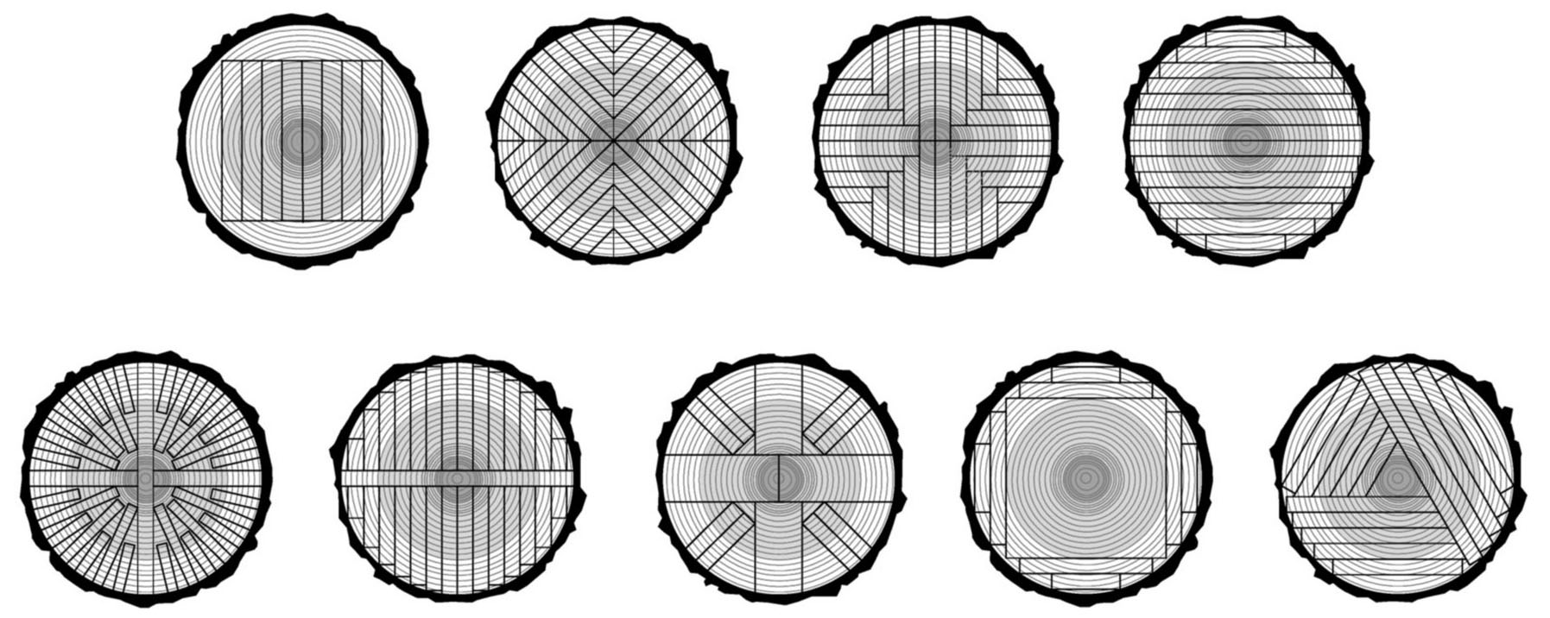
Building materials from tree to slab to "by-products"
Łukasz Wesołowski (CUT)
Optymizing timber for various products:

Slide 7
Building materials from tree to slab to "by-products"
Łukasz Wesołowski (CUT)
Wood is a natural
material:
Strenght
Density
Flexibility
Visual aspects
Lenght
Grain direction

Slide 8
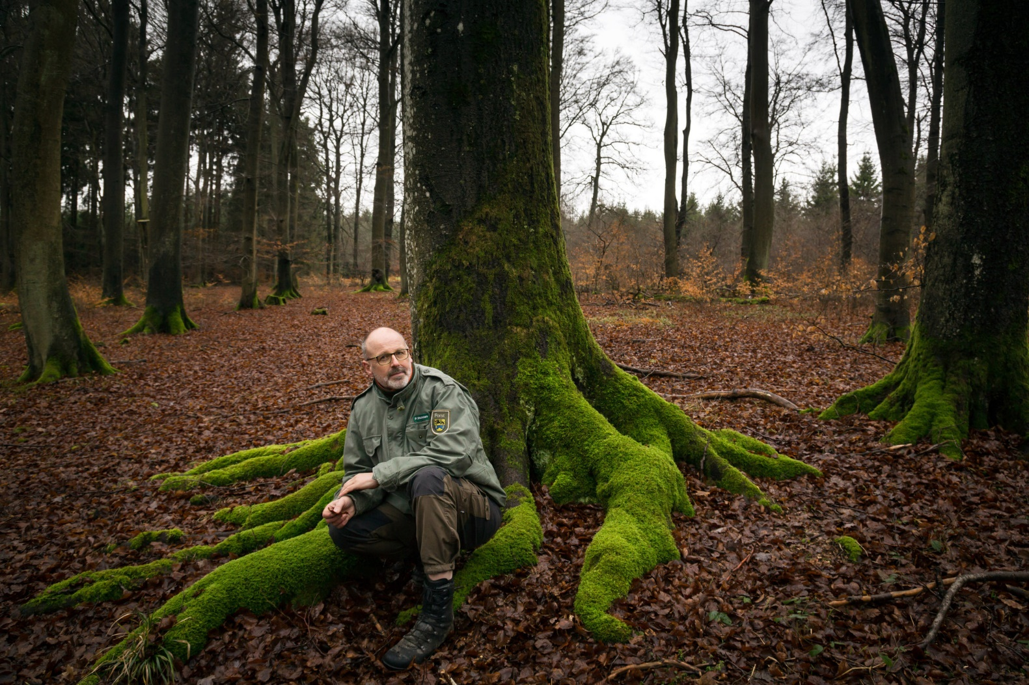
Building materials from tree to slab to "by-products"
Łukasz Wesołowski (CUT)
Peter Wohlleben

Slide 9
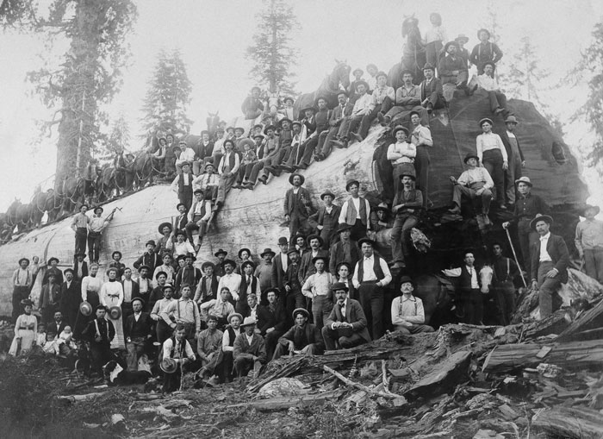
Building materials from tree to slab to "by-products"
Łukasz Wesołowski (CUT)
~100 years ago

Slide 10
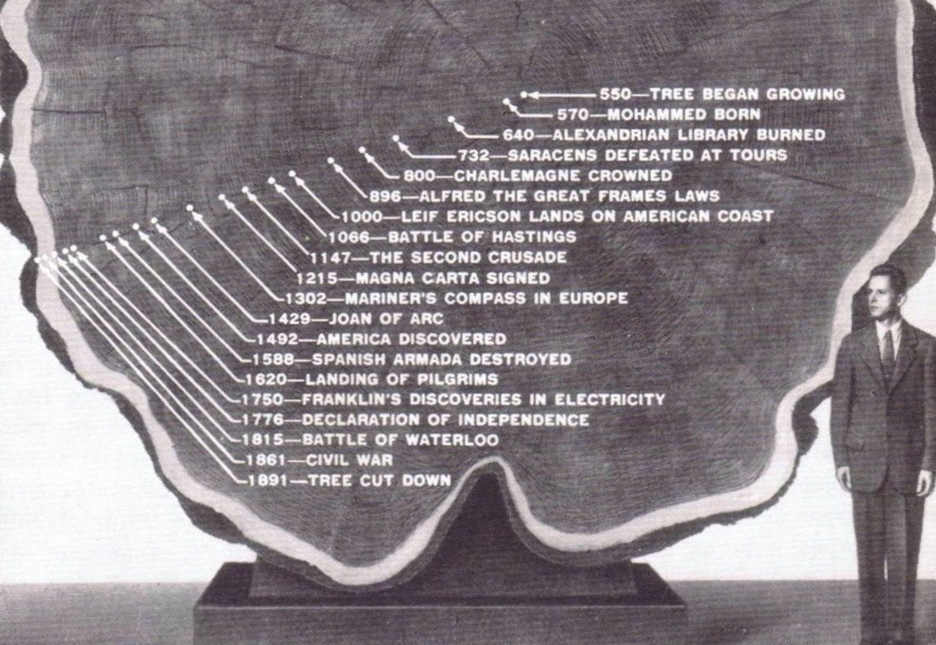
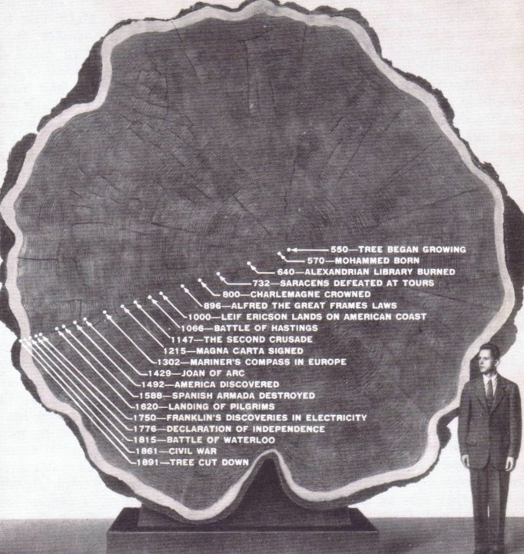
Building materials from tree to slab to "by-products"
Łukasz Wesołowski (CUT)
~100 years ago

Slide 11
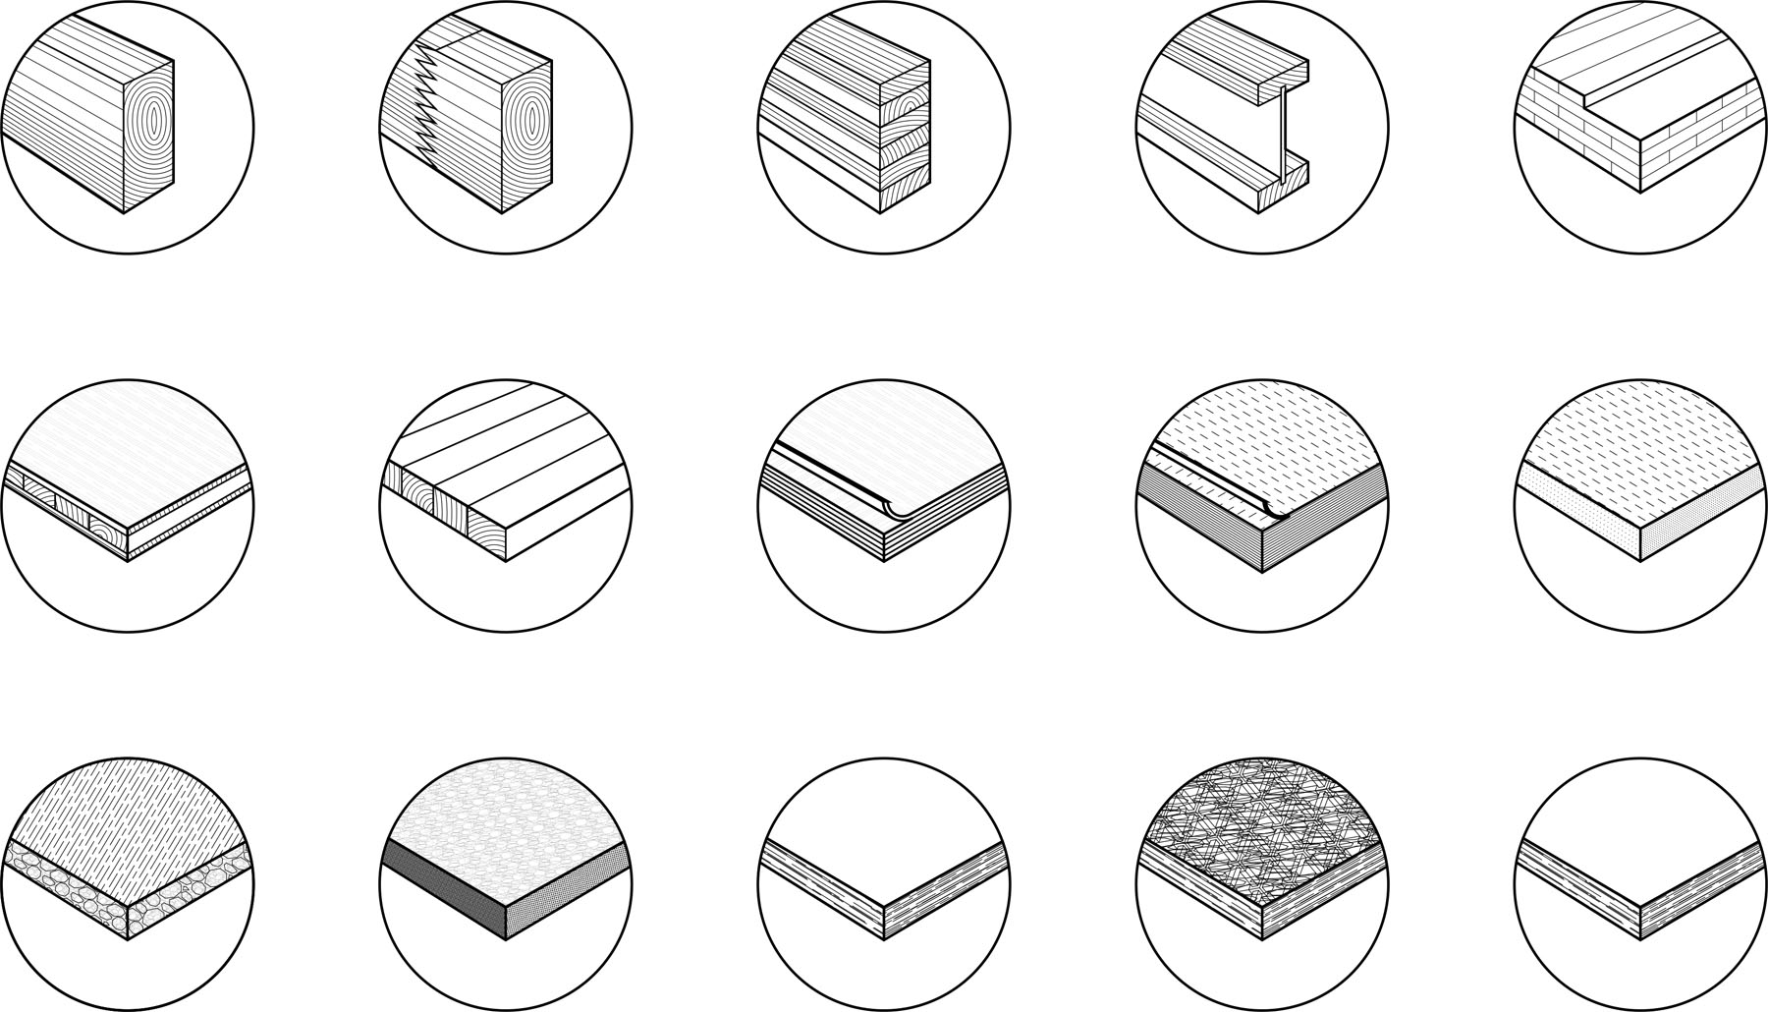
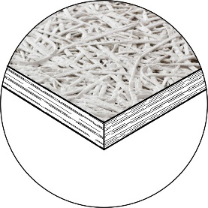
Building materials from tree to slab to "by-products"
Łukasz Wesołowski (CUT)
Products:
Solid wood
FJ/Solid constr. timber
GLT (DLB/TLB)
Liteweight timber beams
CLT
Three-ply laminate sheeting
Single-ply sheeting
Veneered plywood
LVL
MDF (medium density fiberboard)
Porous wood fiberboard
Cement bonded chipboard
Chipboard
OSB
WW (wood wool)

Slide 12
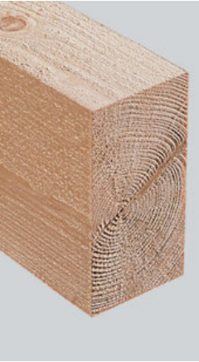
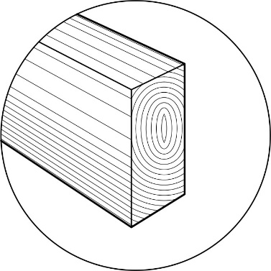
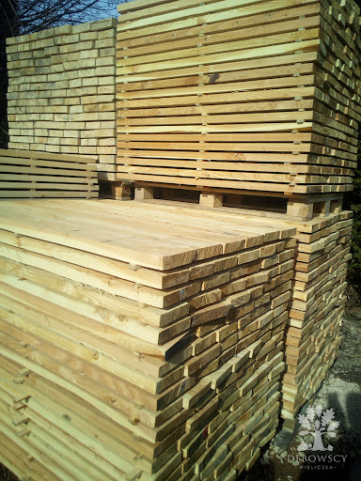
Building materials from tree to slab to "by-products"
Łukasz Wesołowski (CUT)
Solid wood
(bar shaped material):
Softwood - Spruce, fir, pine, larch
Load-bearing structures, formwork, cladding, ceilings, walls, roofs, framing
Hardwood – Beech, oak, maple, birch, cedar
Structural reinforcement for interiors, superior visual qualities

Slide 13
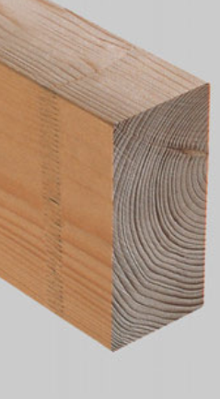
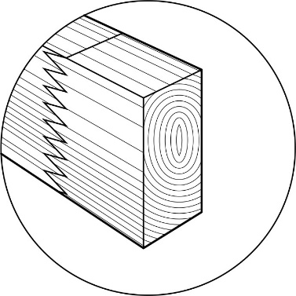
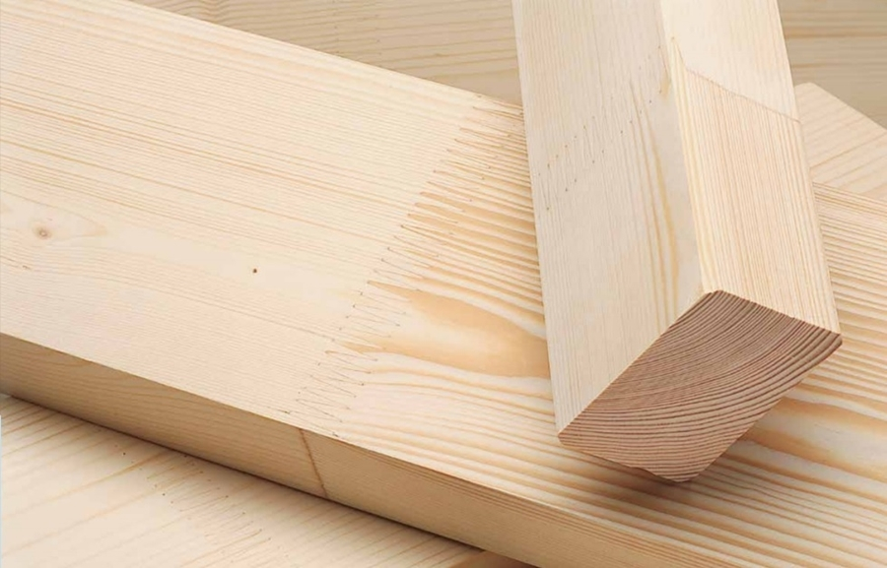
Building materials from tree to slab to "by-products"
Łukasz Wesołowski (CUT)
Finger-Joined / Solid construction timber
(bar shaped material):
Spruce, fir, pine, larch
Load-bearing cross sections for ceilings, walls, roofs and framing sections
Stacked elements
Semi product for engineered wood
Seasoned (acurate dimensions)
Elements inside the envelope

Slide 14
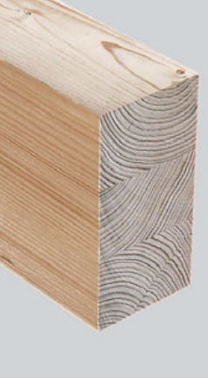
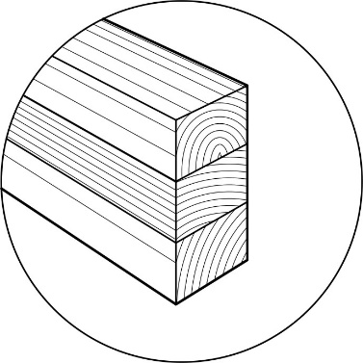
Building materials from tree to slab to "by-products"
Łukasz Wesołowski (CUT)
Double and Triple laminate beams
(bar shaped material):
Spruce, fir, pine, larch
Visible wall, ceiling and roof structures with large cross sections
Structures with longer spans

Slide 15
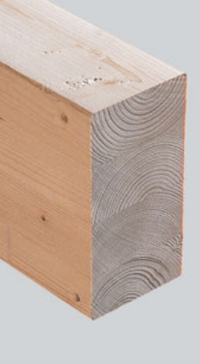
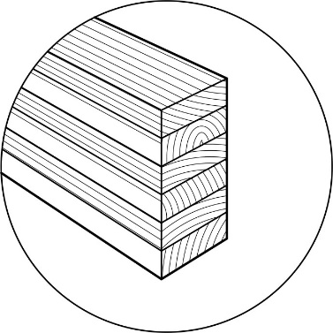
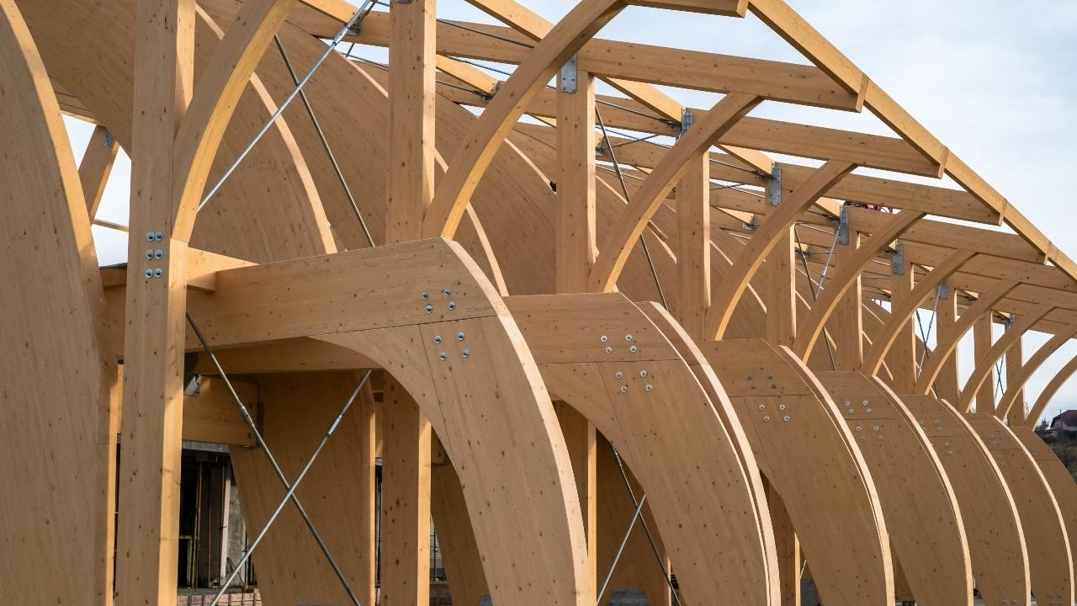
Building materials from tree to slab to "by-products"
Łukasz Wesołowski (CUT)
Glulam (bar shaped material):
Spruce, fir, pine, larch, westerm hemlock, cedar,
Universal applications for all bar-shaped structural components, ceiling elements, long-span structural components subject to heavy loads
Straight and curved beams with very stable forms and high visual quality

Slide 16
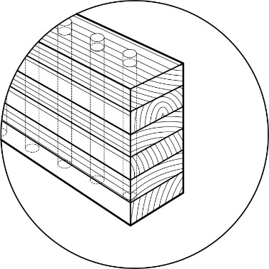
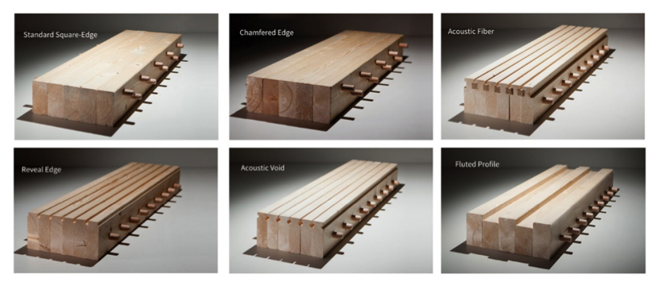
Building materials from tree to slab to "by-products"
Łukasz Wesołowski (CUT)
DLT (dowels) -NLT (nais) (bar shaped material):n
No adhesive – mechanical fixing
For wood+concreto compositesctural components, ceiling elements, long-span structural components subject to heavy loads
Straight and curved beams with very stable forms and high visual quality

Slide 17
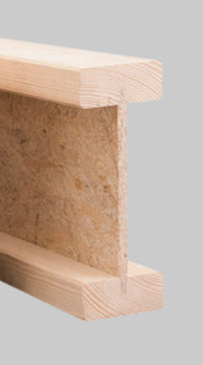
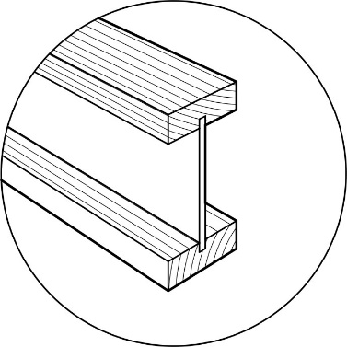
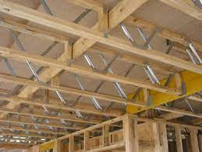
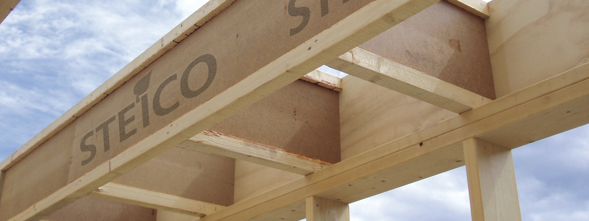
Building materials from tree to slab to "by-products"
Łukasz Wesołowski (CUT)
Lightweight timber beams (mixed products):
Wall supports, ceiling and roof beams, framing with high thermal insulation requirements
Supports for concrete formwork

Slide 18
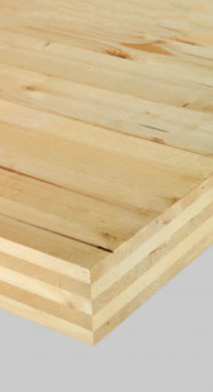
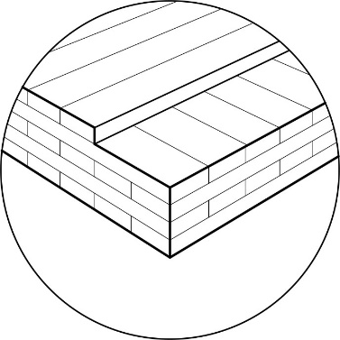
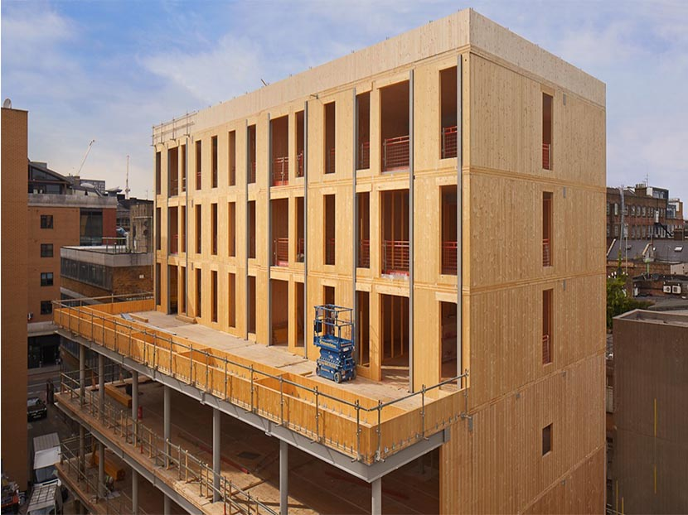
Building materials from tree to slab to "by-products"
Łukasz Wesołowski (CUT)
CLT – Cross laminated timber (planks, laminated material)
Spruce, fir – rarely pine, larch
Non-load-bearing and load-bearing structural elements, sheeting or panel elements, walls, ceilings and roofs
Non-load-bearing walls

Slide 19
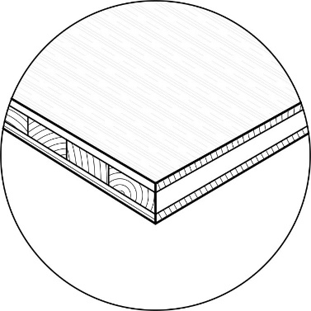
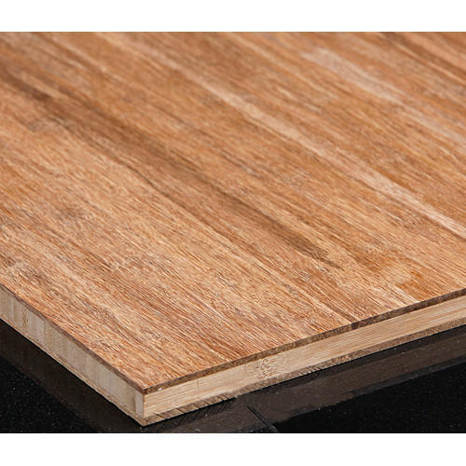
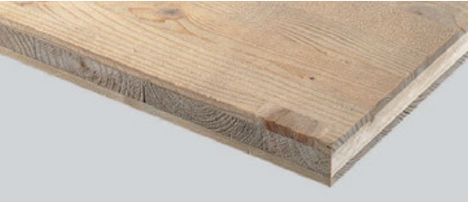
Building materials from tree to slab to "by-products"
Łukasz Wesołowski (CUT)
Three-Ply laminate sheeting
(planks, Wood based mat.):
Softwood - Spruce, fir, pine,
Non-load-bearing, loadbearing and reinforcing planking for walls, ceilings, roofs, box elements and facade cladding
Formwork, interiors, furniture

Slide 20
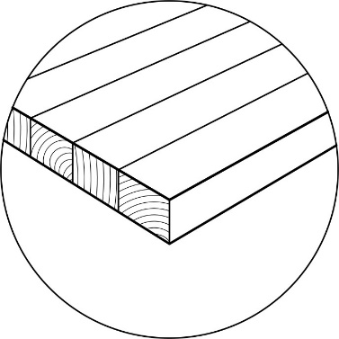
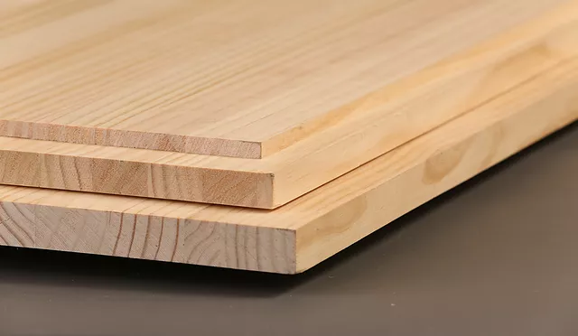
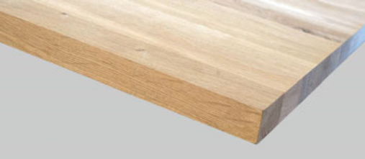
Building materials from tree to slab to "by-products"
Łukasz Wesołowski (CUT)
Single-Ply sheeting
(planks, Wood based mat.):
Softwood - Spruce, fir, pine,
Furniture and interiors visible surfaces

Slide 21
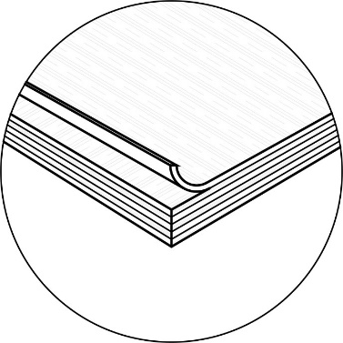
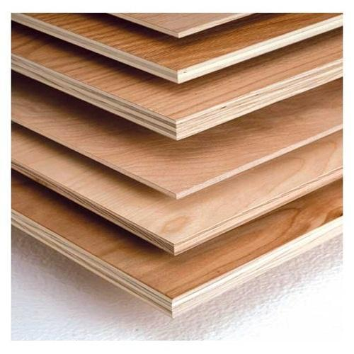
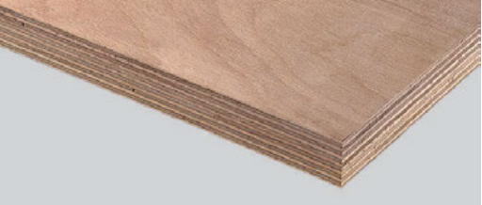
Building materials from tree to slab to "by-products"
Łukasz Wesołowski (CUT)
Veneere plywood
(Breech Veneree
plywood)
(veneere, Wood based
material):
Spruce, fir, pine, hemlock – Breech is for very strong sheets
Load-bearing ceilings and walls, load-bearing and bracing planking for walls, ceilings and roofs
Weather-proof cladding, formwork, scaffolding, interiors, furniture

Slide 22
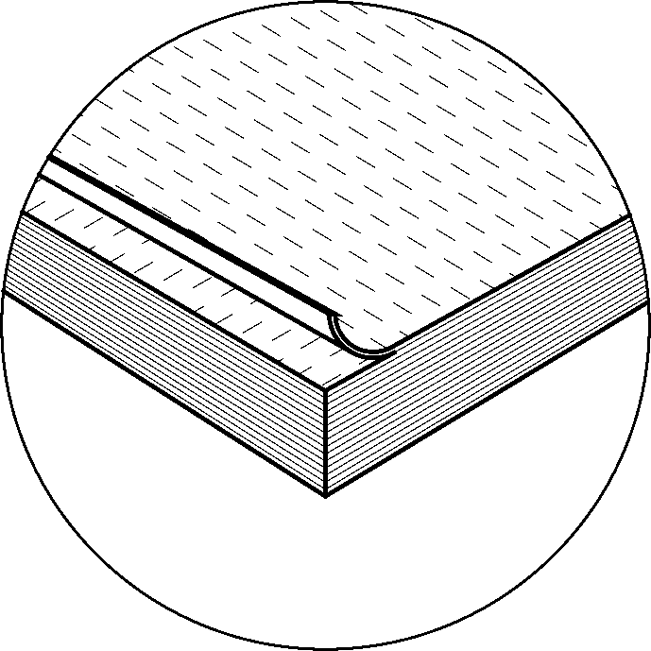
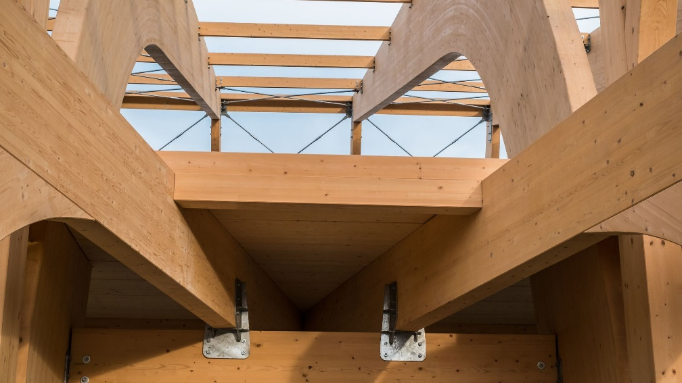
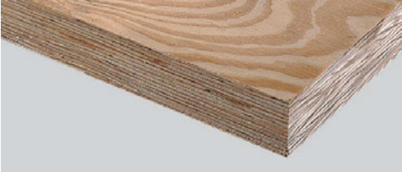
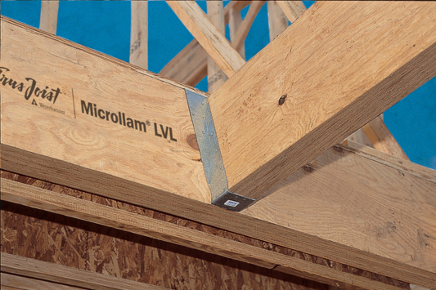
Building materials from tree to slab to "by-products"
Łukasz Wesołowski (CUT)
LVL – Laminated
Veneer Lumber
(veneere, Wood based
material):
Spruce, beech, fir, pine,
Load-bearing structures, beams, supports, flanges and struts of truss beams and spatial trusses, support structures for large halls
Interiors and furniture

Slide 23
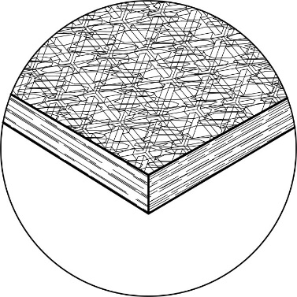
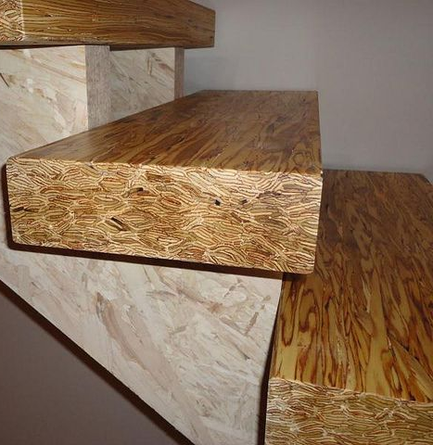
Building materials from tree to slab to "by-products"
Łukasz Wesołowski (CUT)
PSL (Parallel strand
lumber)(strands,
Wood Based material):
Poplar, fir, pine
Applications with extreme structural requirements e.g. bottom plates, edging boards or lintel areas, wall, roof and ceiling plates, supports and beams
Ceiling and floring panels

Slide 24
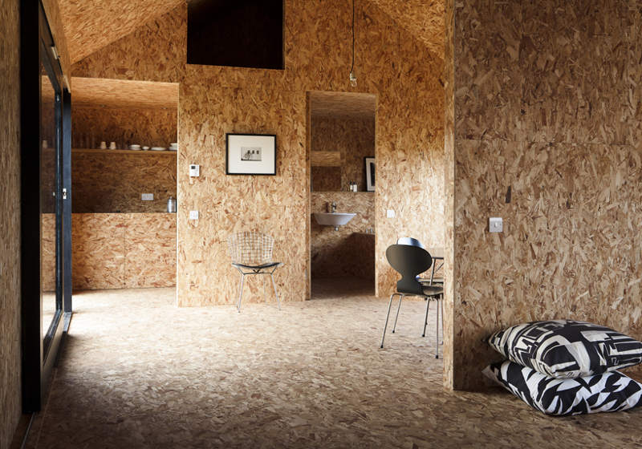
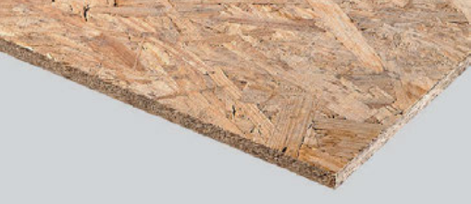
Building materials from tree to slab to "by-products"
Łukasz Wesołowski (CUT)
OSB (Oriented strand
board)(strands, Wood
Based material):
Poplar, fir, pine, adler,
Load-bearing walls, load-bearing and bracing planking for floors, walls, ceilings, box elements and roofs (outside with weather protection), webs of I-beams
Mounting panels for flooring, concrete formwork, interiors, furniture

Slide 25
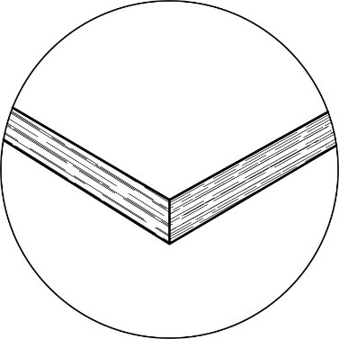
Building materials from tree to slab to "by-products"
Łukasz Wesołowski (CUT)
Chipboard (strands,
Wood Based
material):
Pine, spruce, beech, birch,
alder, ash, oak, poplar, chestnut,
Can be universally used for non-load-bearing, loadbearing and bracing planking and as filling panels in timber frame construction
Interiors, furniture

Slide 26
Building materials from tree to slab to "by-products"
Łukasz Wesołowski (CUT)
Cement bonded
Chipboard (strands,
Wood Based
material):
Spruce, fir, softwood, chips bonded in cement,
Fire-resistant panels, load-bearing and bracing planking for interiors and exteriors, facade cladding
Non-loadbearing interior walls, sound and thermal insulation

Slide 27
Building materials from tree to slab to "by-products"
Łukasz Wesołowski (CUT)
MDF – medium density
fibreboard (fibre,
Fibre Based
material):
Spruce, pine, fir, beech, birch,
poplar, eucalyptus,
Interiors, acoustic elements, furniture
Limited use as load-bearing and bracing planking and to make wall, ceiling and roof panels

Slide 28
Building materials from tree to slab to "by-products"
Łukasz Wesołowski (CUT)
Porous wood
fibreboard (fibre,
Fibre Based material):
Spruce, fir, pine, beech,
birch, poplar, eucalyptus
Insulation inside and out and between frames and rafters of walls and roofs, insulation of partition walls, footfall sound insulation
Underlay boards for roofs or to make the building envelope more windproof

Slide 29
Building materials from tree to slab to "by-products"
Łukasz Wesołowski (CUT)
Lightweight wood
wool board(wood
wool, Fibre Based
material):
Spruce, pine,
Plaster base for ceilings and soffits, acoustic panels for soundproofing
Interior and exterior planking, thermal insulation in summer

Slide 30
Building materials from tree to slab to "by-products"
Łukasz Wesołowski (CUT)
Products:
BAR SHAPED
PLANKS
VENEERE
FIBRES
CHIPS
WOOL
Solid wood
FJ/Solid constr. timber
GLT (DLB/TLB)
Liteweight timber beams
CLT
Three-ply laminate sheeting
Single-ply sheeting
Veneered plywood
LVL
MDF (medium density fiberboard)
Porous wood fiberboard
Cement bonded chipboard
Chipboard
OSB
WW (wood wool)

