Slide 1
Forestry and Sustainable Aspects
Sustainable, High-Performance Building Solutions in Wood (HiBiWood)
Dainora Jankauskienė, Indrius Kuklys, Lina Kuklienė, Mantas Anužis
Klaipeda State University of Applied Sciences, Lithuania
Name of presenter, Date and place

Slide 2
Presentation plan
1. Introduction;
2. Forest and climat changes;
3. Forest monitoring using satelites data;
4. UAV, Remote Sensing Sensors for Environment monitoring

Slide 3
KLAIPEDA STATE UNIVERSITY OF APPLIED SCIENCES
THE 3RD BIGGEST UNIVERSITY OF APPLIED SCIENCES IN LITHUANIA WHICH COUNTS 100 YEAR OF EXPERIENCE IN PREPARING PROFFESIONAL PRACTITIONERS.

Slide 5
FACULTIES
TECHNO-LOGIES
HEALTH
SCIENCES
BUSINESS

Slide 6
Study programmes
TECHNOLOGY
FACULTY
Informatics
Informatics Engineering
Electrical and Automation Engineering
Departments
Mechanical Engineering
Automobile Transport Engineering
Department of Engineering and Informatics
Construction Engineering
Department of Transport Engineering
Digital Geodesy
Department of Food Technology and
Nutrition
Food Technologies
Department of Environmental and
Civil Engineering
Dietetics

Slide 7
Research fields:
Sustainable Environment (thematic New Production Processes, Materials and Technologies, Territorial Digital and Surveillance and Healthy Environment Formation);
Information technologies (thematic Big and Distributed Data, their analysis and use and Software Development Technologies);
Inclusive and creative society (thematic Modern educational technologies and processes, Social and cultural innovations for the development of products and services for the development of society and Flexible and applied process management technologies).

Slide 8
PROJECTS:
Creation of Joint GI Education to Increase Job Opportunities in the Region (GISEDU) (01.04.2017 - 31.03.2019);
GLOCAL - innovative training of future engineers responding to problems of contemporary cities. Erasmus+ (01.09.2019 - 31.05.2022);
HiBiWood - Sustainable, High-Performance Building Solutions in Wood. Erasmus+ (2020-09-01 - 2023-08-31).

Slide 9
We've Always Relied on Forests
Scholars as far back as Darwin have recognized that the ecology and biodiversity of forested regions have a powerful impact on the nature of human societies, human distribution across landscapes, and the history of civilizations.
Today, nothing has changed and everything has changed.
We still depend on forests and biodiversity, although some feel that dependence more acutely. Over 100 million people in the EU regularly consume wild food, and some 2.4 billion use wood-based energy for cooking. And it doesn’t stop there — forests also provide over 86 million green jobs and support the livelihoods of many more. And an estimated 880 million depend on forests for basic survival, collecting fuelwood and producing charcoal for cooking. And for the 252 million people that survive on less than $1.25/day in countries with high forest cover and biodiversity, the health of their forests is literally a life or death issue.

Slide 10
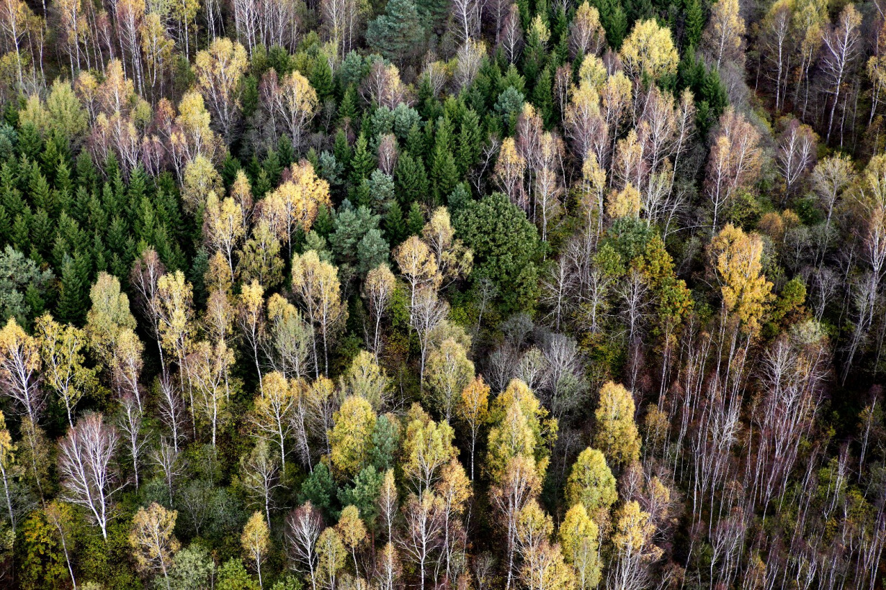
Europe Needs Healthy Forests To Fight Climate Change
https://multimedia.europarl.europa.eu/en/europe-needs-healthy-forests-to-fight-climate-change_N01-AFPS-201012-FORE_ev

Slide 11
October 2020 the European Commission is taking a step forward in its work against global deforestation. The new multi-stakeholder platform launched today to help protect and restore world’s forests brings together an unprecedented range of stakeholders and expertise: consumer and producer countries, civil society organizations, and industry associations.
In addition to being a forum for exchanges, the platform is to serve as a policy-making tool – informing the Commission’s ongoing work on a legislative proposal to minimise the risk that products linked to deforestation be sold in the European market, planned for the second quarter of 2021.

Slide 12
Commissioner for the Environment, Oceans and Fisheries Virginijus Sinkevičius said:
Forests are indispensable for the wellbeing of all people on Earth, and yet we are losing them at an alarming rate. The EU is determined to act to change this course, using all tools at our disposal to help protect the world’s forests. But we cannot do it alone. I hope this platform of most relevant stakeholders will be an excellent catalyser for cooperation to halt and reverse deforestation.
German Minister of Agriculture Julia Klöckner said:
One of the biggest drivers of forest destruction worldwide is the legal and illegal conversion of forests into farmland. This is why we need to turn to agricultural commodities that are produced in a deforestation-free way. Food security and poverty alleviation have to go hand in hand with a more careful stewardship of forests. We all have a responsibility to protect forests – from industry, lawmakers up to consumers with their everyday choices.
https://www.youtube.com/watch?v=chybTkBYMNE

Slide 13
Sustainable Aspects
https://www.youtube.com/watch?v=EndXW-OnSG0
Interplay of the environmental, economic, and social aspects of sustainable development.
Credit: Mark Fedkin. Adopted from the University of Michigan Sustainability Assessment [Rodriguez et al., 2002]

Slide 14
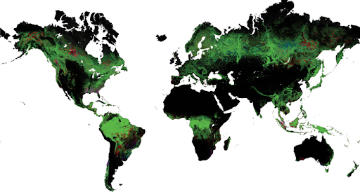
Forests cover 30% of the Earth's land area, host 80% of the world's terrestrial biodiversity, provide essential goods and services, including climate and water regulation and give subsistence and income to almost 2 billion people worldwide. Protecting and restoring world's forests is crucial for maintaining and increasing human well-being and putting our societies on to a sustainable path.
Source: European Comision
Source: Lietuvos geografijos mokytojų asociacija

Slide 15
https://youtu.be/O1t-8snBMrA?t=31
Source: https://onetreeplanted.org/blogs/stories/state-of-the-worlds-forests

Slide 16
Deforestation is an Ongoing Issue
Although the rate of deforestation has decreased over the last 30 years, it hasn’t decreased enough — and over 420 million hectares of forest have been lost since 1990. In 2019 we lost 11.9 million hectares in the tropics, which is the equivalent of losing a football pitch full of biodiverse forests every 6 seconds.
In the last 5 years, the rate of deforestation has slowed to around 10 million hectares lost each year, but that’s still a lot of trees getting cut down. As a result, global forest area decreased by 178 million hectares between 1990 and 2020, which is an area about the size of Libya. And we aren’t moving fast enough to meet the targets set by the UN Strategic Plan for Forests — to increase global forest cover by 3% by 2030.

Slide 17
MEPs also propose stepping up the fight against illegal logging and curbing the import of illegal timber, in particular by simplifying the tracing of imported products, as well as stepping up the promotion of sustainable forestry worldwide.
They also call on the Commission to set up a European forest research and conservation system based on a monitoring system using the global navigation satellite system (GALILEO and Copernicus) and to provide adequate funding for research and innovation in this area.
Source: https://www.europarl.europa.eu/news/lt/headlines/priorities/klimato-kaita/20201015STO89416/tvari-miskininkyste-ep-ragina-kovoti-su-misku-naikinimu

Slide 18
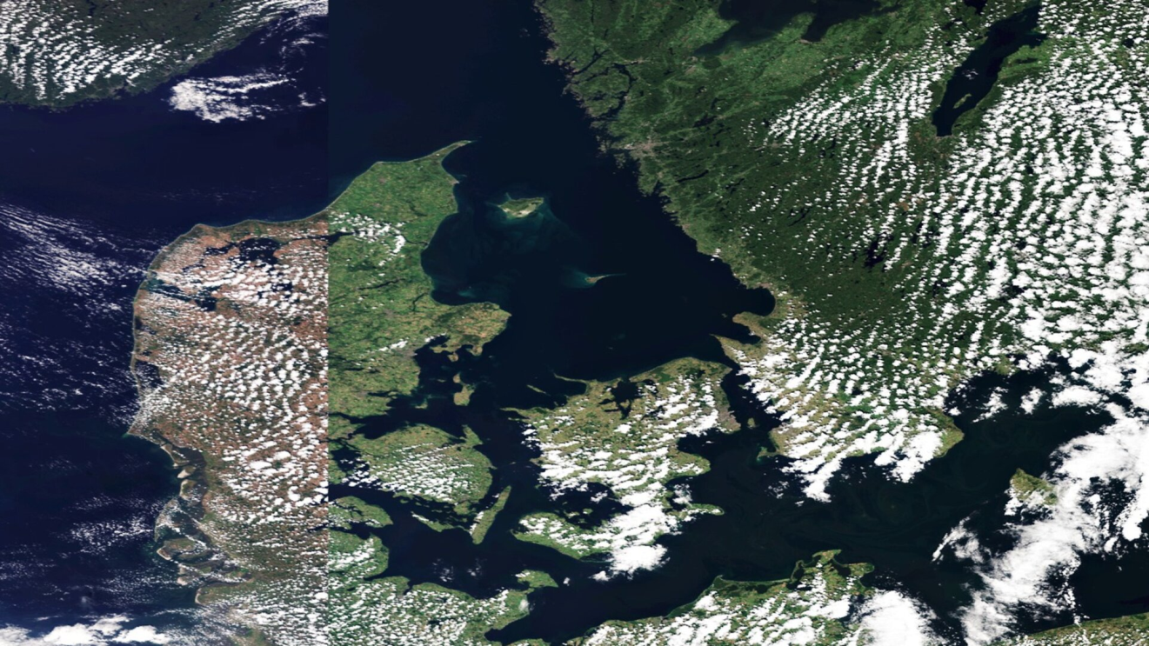
An example of how forest monitoring can be performed using Copernicus Sentinel-3
https://www.esa.int/ESA_Multimedia/Videos/2018/07/European_drought

Slide 19
UAV, Remote Sensing Sensors for Environment monitoring

Slide 20
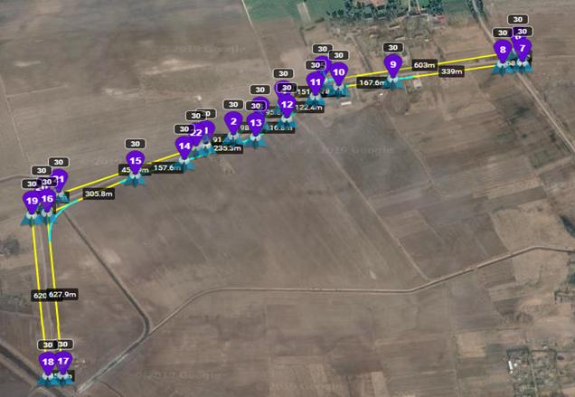
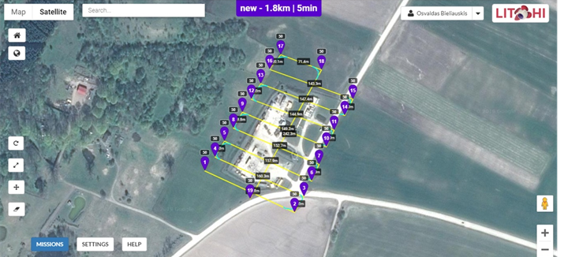
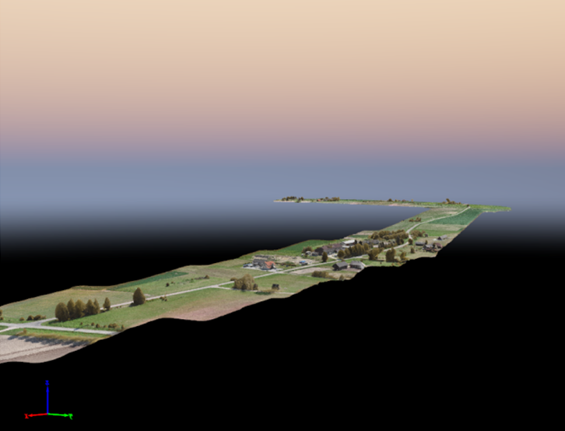
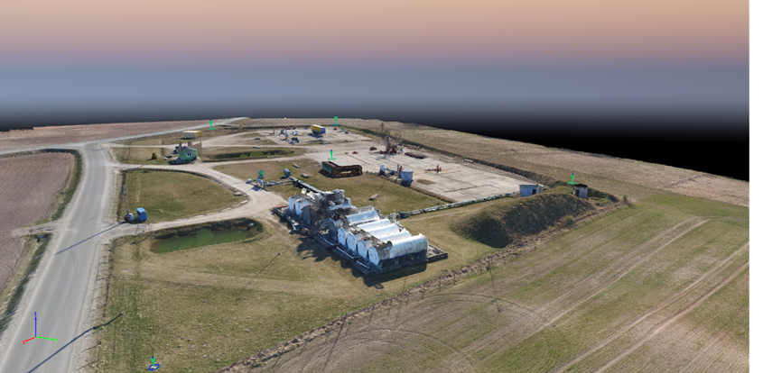
OUR EXPERIENCE...
Remote sensing measurements in the part of the road Mezeliai – Joksai no.224 in Lithuania with LiDAR ,,YellowScan Mapper II“and the ,,ZenMuse X5“ camera. 3D Modeling creation with ,,Pix4D“ and ,,Bentley MicroStation“. The following settings were selected for the flight: overlapping 85% front and 60% sideways.
Remote Sensing measurements in the Oil Production site Nausodzio I. The following settings were selected for the flight: overlapping 85% front and 75% sideways.

Slide 21
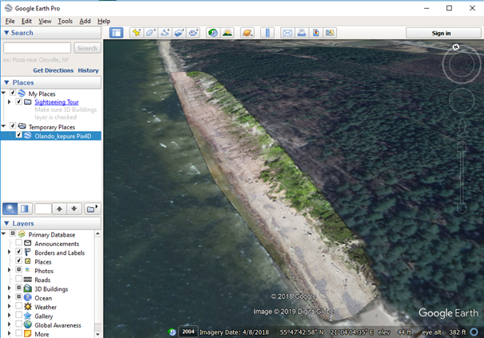
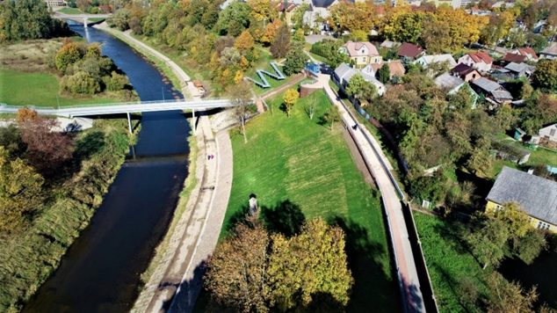
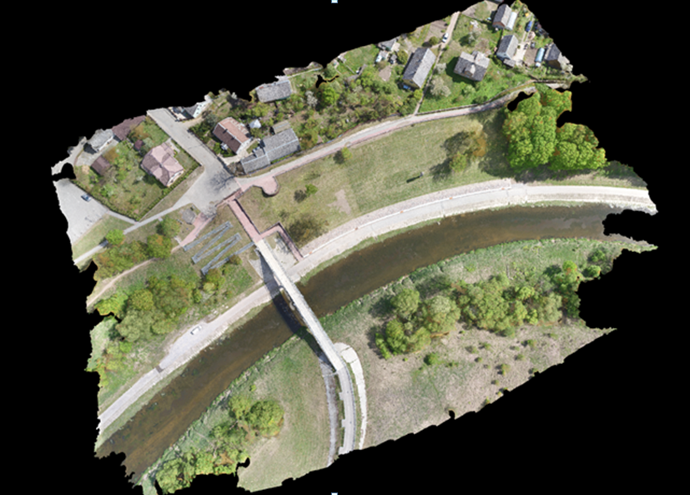
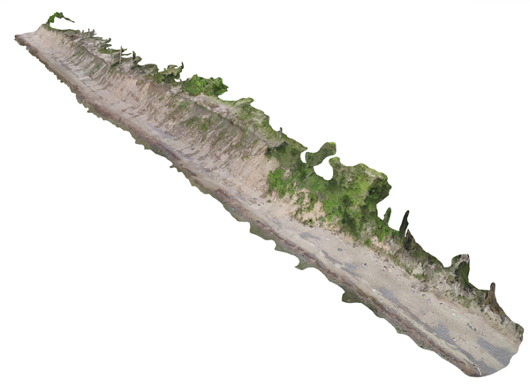
Valley „Meilės alėja“ by the river Jūra in Tauragė has been scanned with the help of remote measurement technology using devices such as DJI Matrice Pro drone, Zenmuse X5 camera and YellowScan Mapper II scanner with integrated LiDar system. Orthophotographic map has been made using programme „Pix4D“ and the 3D model has been created using „Bentley microstation“ programme.
The shore lines of the Baltic Sea at Holland`s Hats remote sensing measuring with “DJI Matrice 600 Pro” unmanned aircraft, orthophotographic map and 3D modeling with “Pix4D” and “Bentley Microstation” program 3D Surface Modeling.

Slide 22
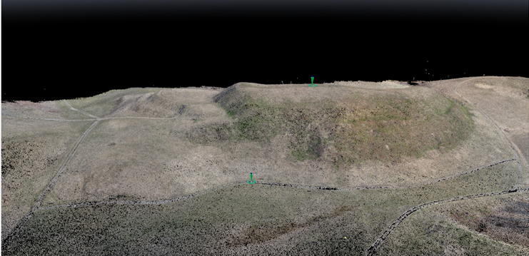
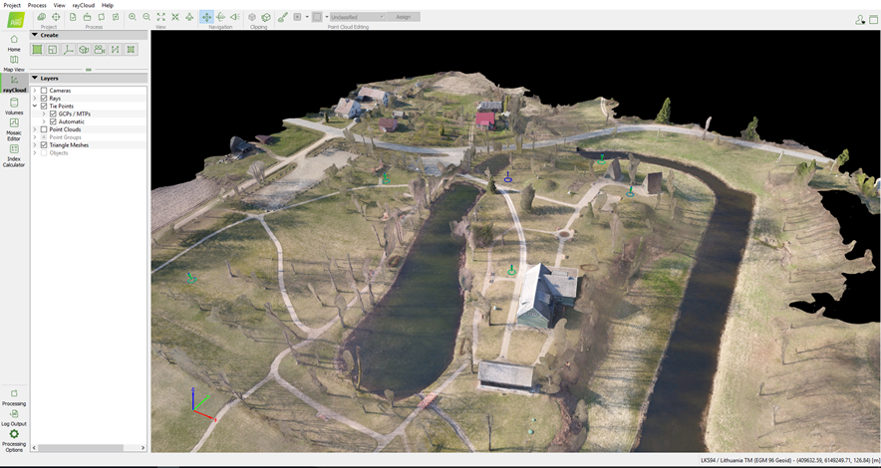
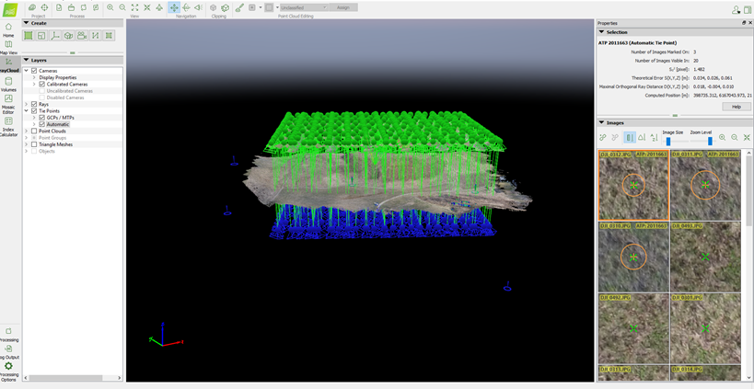
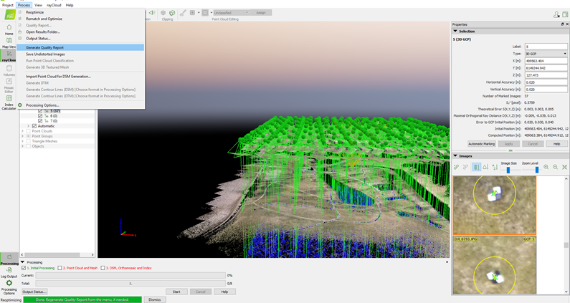
OUR EXPERIENCE...
Remote sensing measurements in The first museum (1812 y.) in Lithuania, located inside the oak stem scanning whit „Zenmuse X5“ camera and drone „DJI matrice 600“ assistance, orthophotographic mape and 3D model making whit „Pix4D“ and „Bentley Microstation“ programs. The following settings were selected for the flight: overlapping 85% front and 75% sideways.
The Medvėgalis mound scanning by drone „DJI Matrice 600 pro“ and Lidar „YellowScan Maper II“ scanner, ortophotographic map created by program „Pix4D“ and 3D model created by „Bentley MicroStation“ program.

Slide 23
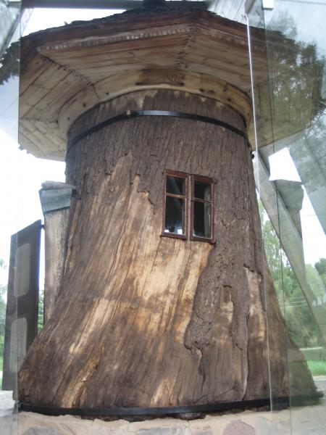
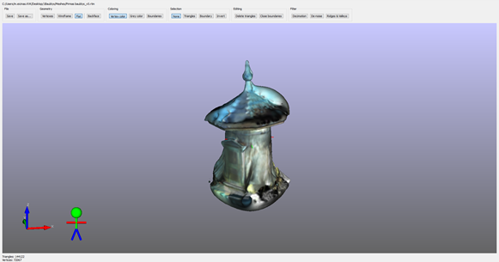
OUR EXPERIENCE... Scanning and Modeling of The Museum Bijotai
Aim of the work – to scan Bijotai museum territory and make Baubliai 3D model.

Slide 24
Baubliai – the first museum in Lithuania. The small museum was created in 1812 by the writer, historian Dionizas Poska (1765-1830) in the hollowed-out trunk of an old oak, determined to be about 1000 years old.

Slide 25
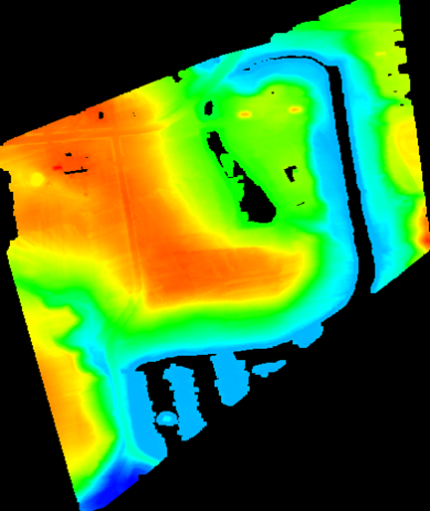
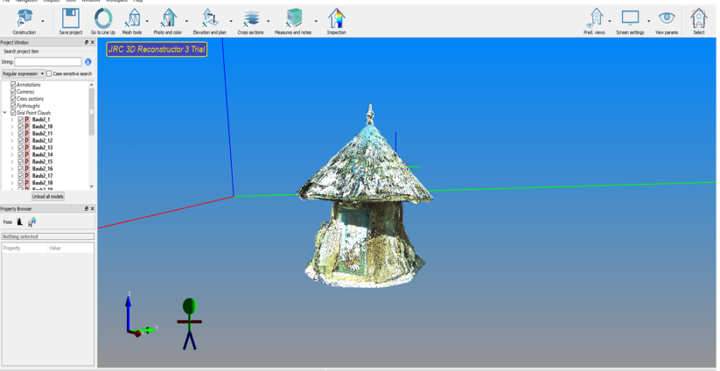
All measurements in the Museum of Bijotai:
Creation of an orthophotographic map of the museum and a 3D model with Pix4D;
Scanning of Museum of Bijotai and creation of Territory DTM (Digital Earth Model) 3D model with Bentley Microstation;
Scanning of Baubliai with The Stonex X 300 3D scanner and creation 3D models.

Slide 26
Valley „Meilės alėja“ by the river Jūra in Tauragė has been scanned with the help of remote measurement technology using devices such as DJI Matrice Pro drone, Zenmuse X5 camera and YellowScan Mapper II scanner with integrated LiDar system. Orthophotographic map has been made using programme „Pix4D“ and the 3D model has been created using „Bentley microstation“ programme.
The shore lines of the Baltic Sea at Holland`s Hats remote sensing measuring with “DJI Matrice 600 Pro” unmanned aircraft, orthophotographic map and 3D modeling with “Pix4D” and “Bentley Microstation” program 3D Surface Modeling.

Slide 27
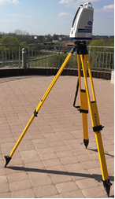
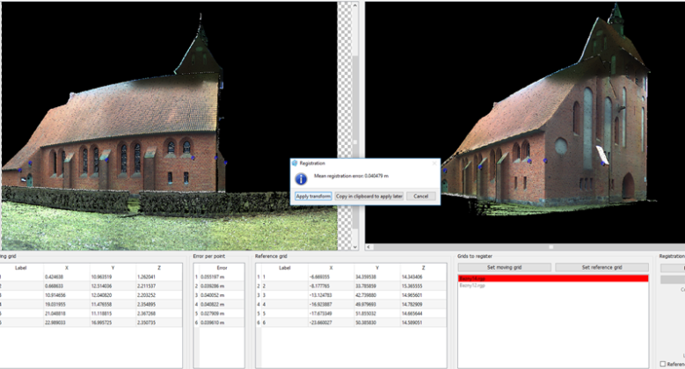
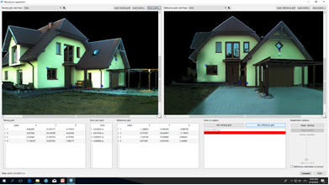
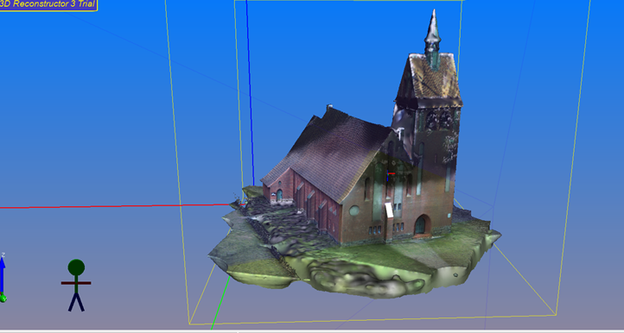
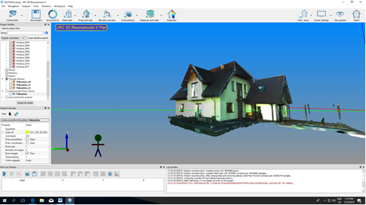
Other measurements with students ...
The scanning and 3D modeling of the church in Vanagu village Klaipeda Region.
The 3D modeling of the Living House in Slengiai village.

Slide 28
Smiltynė forest monitoring
The Curonian Spit is a peninsula with sand dunes that separates the Curonian Lagoon from the Baltic Sea. Curonian Spit in 2000 included in the UNESCO World Heritage List.
The Curonian Spit was formed 3–5 thousand years ago before our era. Peninsula until the 17th cent. was overgrown with forests, but in 1674–1679. during the Seven Years' War, forests were massively felled for military purposes. 19th century pr. forests on the spit occupied 10% of the territory. As the forests disappeared, dunes began to slide, which flooded many villages.
1825 Thanks to the efforts of Kuvertas and Wilhelm Franco Efas, forests have been replanted and now cover 75% and dunes 12% of the Curonian Spit.
Video No1 and Video No2 ☺

Slide 29
https://www.youtube.com/watch?v=8SX8hr-DpgU

