Slide 1
HISTORY OF MULTI-STOREY TIMBER CONSTRUCTION
Name: Paweł Mika, Sabina Kuc, Łukasz Wesołowski [CUT]
Date: 07 09 2021

Slide 2
LECTURE AGENDA:
Introduction
Reasons for multi-storey construction
History of wooden construction
Examples of the oldest buildings
Development of wooden construction
Industrial Revolution
Mass construction
Contemporary wooden buildings
3. Historical types of wooden structures
Log construction
Post and plank
Half-timbered
Balloon Framing
Platform Framing
Other types of construction
Evolution of the wooden construction

Slide 3
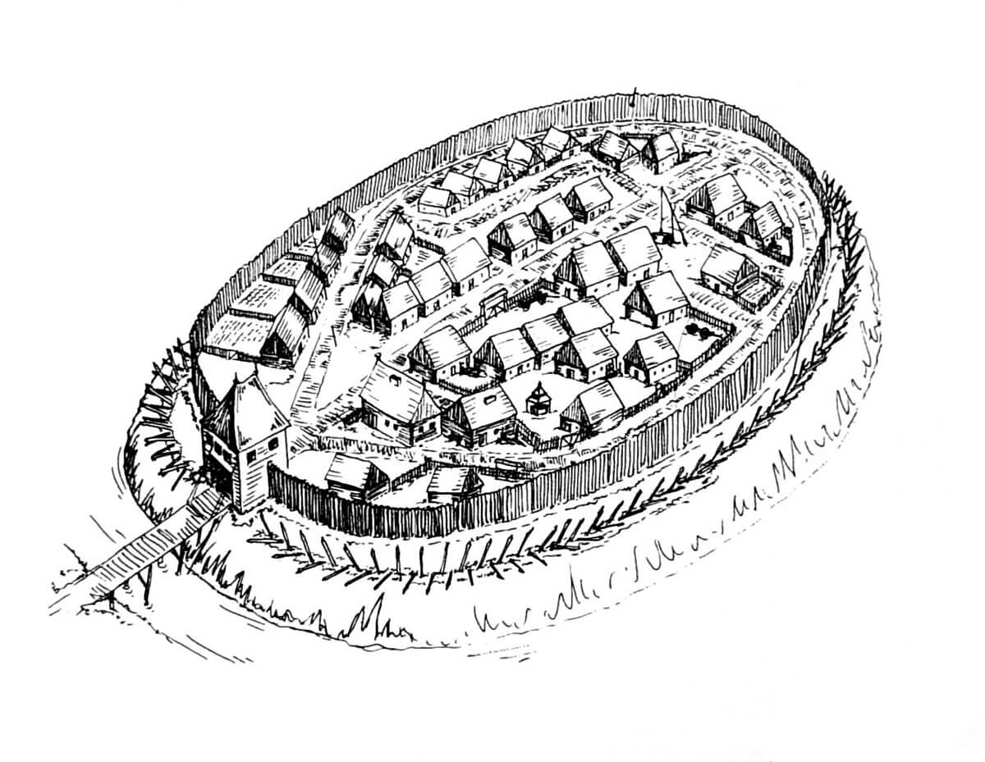
1. INTRODUCTION: Reasons for multi-storey construction
a lack of space inside fortifications
prestige
defense
source: https://medievalheritage.eu/wp-content/uploads/2020/05/Pu%C5%82tusk-rekonstrukcja-01.jpg

Slide 4
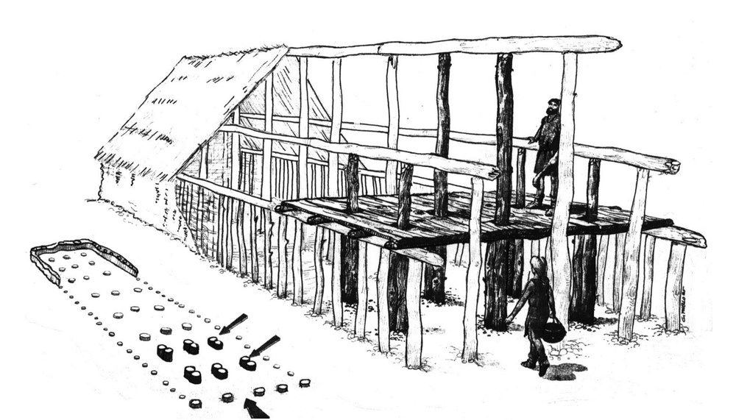
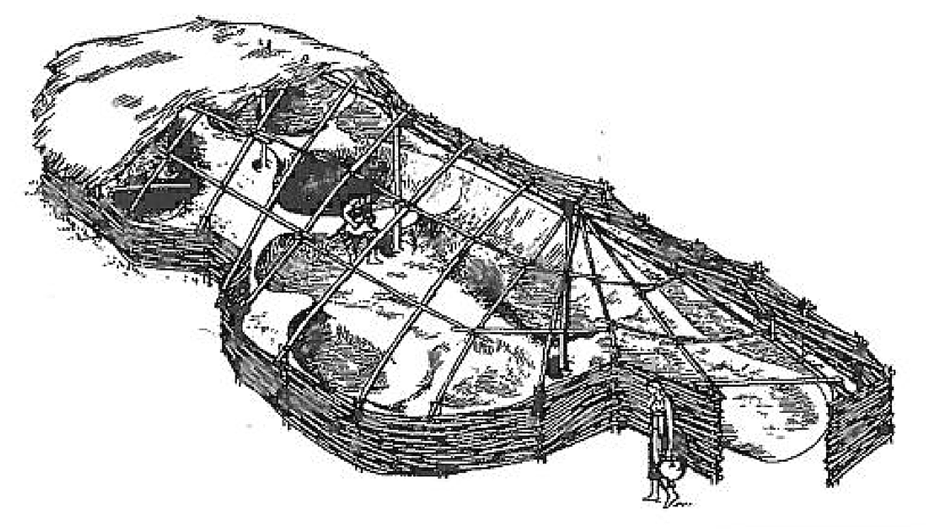
2. HISTORY OF WOODEN CONSTRUCTION: Examples of the oldest wooden buildings
Reconstruction of the
Bandkeramik house
5-4c BC
House from Neolithic period
Loadbearing roof structure
(after Vitruvius) 1c BC
source: Timber Construction Manual, Birkhäuser 2004 https://exarc.net/issue-2013-3/ea/reconstruction-danubian-neolithic-house-and-scientific-importance-architectural-studies

Slide 5
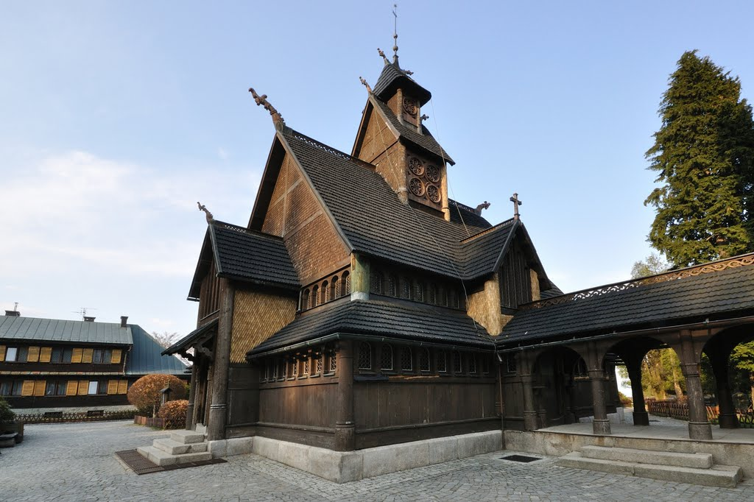
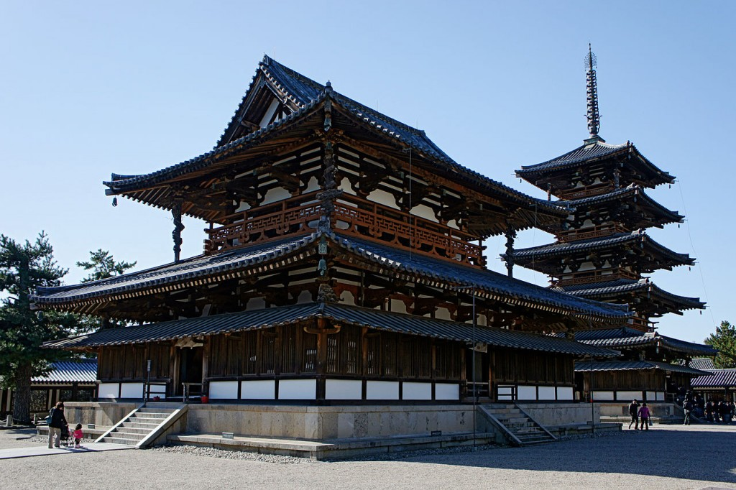
2. HISTORY OF WOODEN CONSTRUCTION: Development of wooden construction
The Wang Temple in Karpacz, 12c AD, Poland
Horyu-ji (Temple of the Flourishing Dharma) 607 AD, Japan
The Wang Church was moved to Poland in 1842 from the town of Vang Norway. It was built of pine logs between the 12th and 13th centuries.
Pagoda was originally built in 607 AD, stands out as the oldest wooden construction in the world: it is more than 1,400 years old.
http://wypadnaweekend.blogspot.com/2011/09/swiatynia-wang.html https://www.pinterest.fr/pin/634866878702956305/?d=t&mt=login

Slide 6
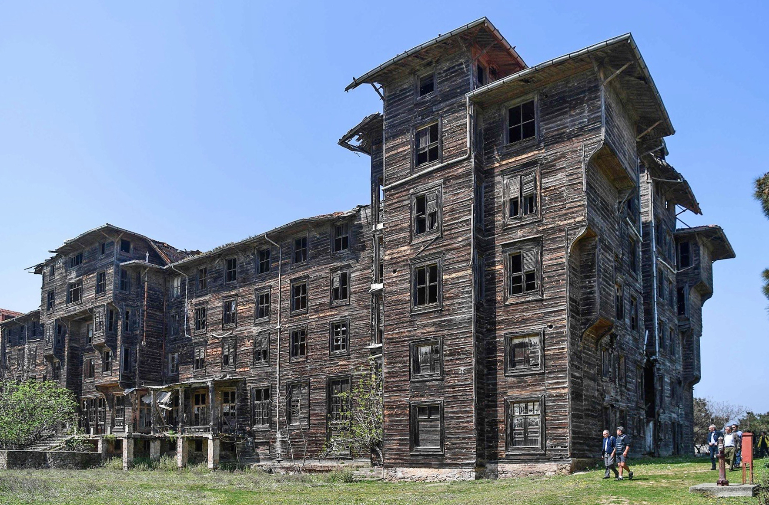
2. HISTORY OF WOODEN CONSTRUCTION: Development of wooden construction
Hotel/orphanage,
Büyükada, Istanbul, Turkey
The building is 101 metres long and around 24 metres high, and appears to be the largest wooden building in Europe. Designed by the architect Alexandre Vallaury,, hotel was completed in 1898 -- but never managed to get an operating license. In 1903, was turned it into an orphanage. Timber-framed structure.
https://www.dailysabah.com/istanbul/2018/05/29/europes-largest-wooden-building-in-istanbul-awaits-restoration-1581415338

Slide 7
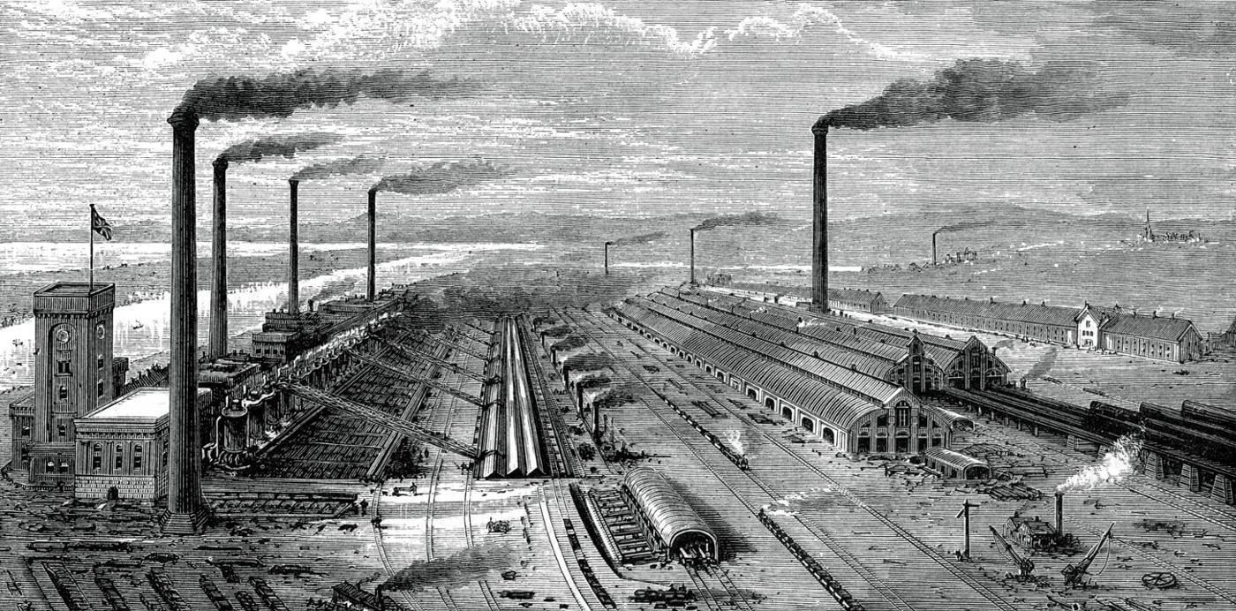
2. HISTORY OF WOODEN CONSTRUCTION: Industrial Revolution
Industrial Revolution ( 1820 - 1840 )
Source: https://www.sutori.com/story/world-history-comprehensive-timeline--B5cs7RJR1n3ndGNdMM8z6EhP

Slide 8
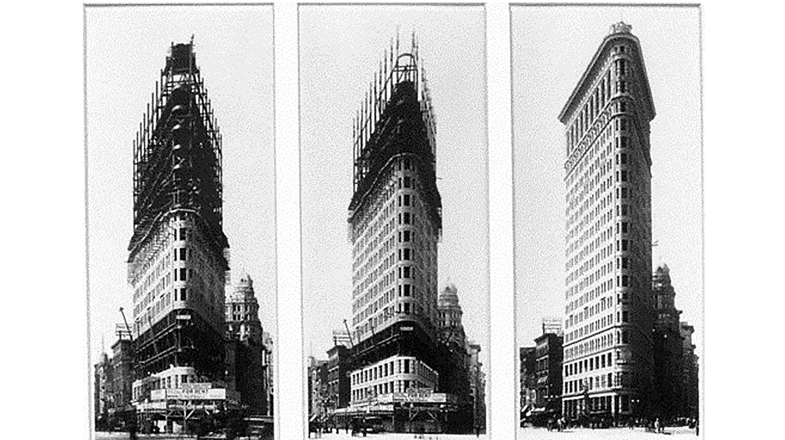
2. HISTORY OF WOODEN CONSTRUCTION: Industrial Revolution
Manhattan, New York, USA, 22-storey, 86.9 m tall, steel-framed , Daniel H. Burnham, 1902
Source: https://www.skyscrapercity.com

Slide 9
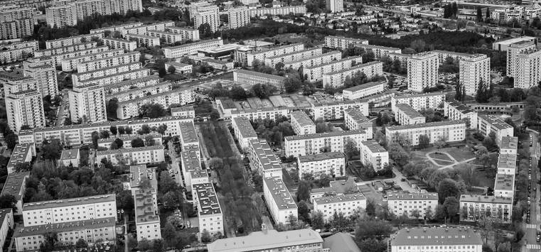
2. HISTORY OF WOODEN CONSTRUCTION: Mass construction
Prefabricated multi-family housing
Source: https://expressbydgoski.pl

Slide 10
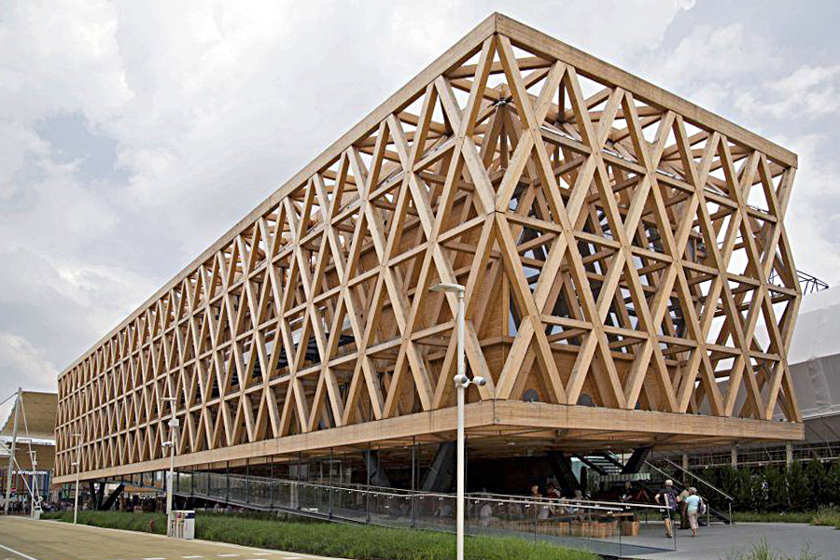
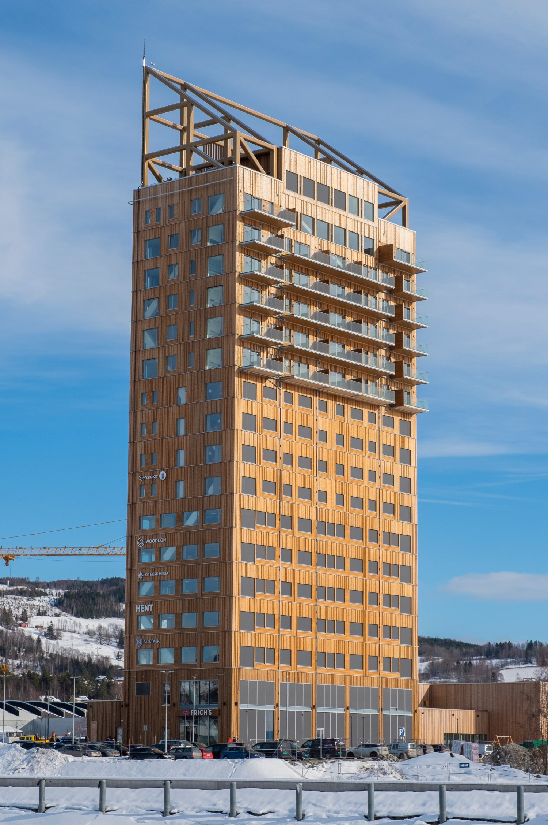
2. HISTORY OF WOODEN CONSTRUCTION: Contemporary wooden buildings
Chilean Pavillion at Expo Milan 2015,
by Cristián Undurraga
Mjøstårnet (18 stories), the tallest
timber-frame building in the world,
by Voll Arkitekter
Source: https://media.architecturaldigest.com https://www.guiding-architects.net/fr/nouvelle-culture-du-bois-au-chili/

Slide 11
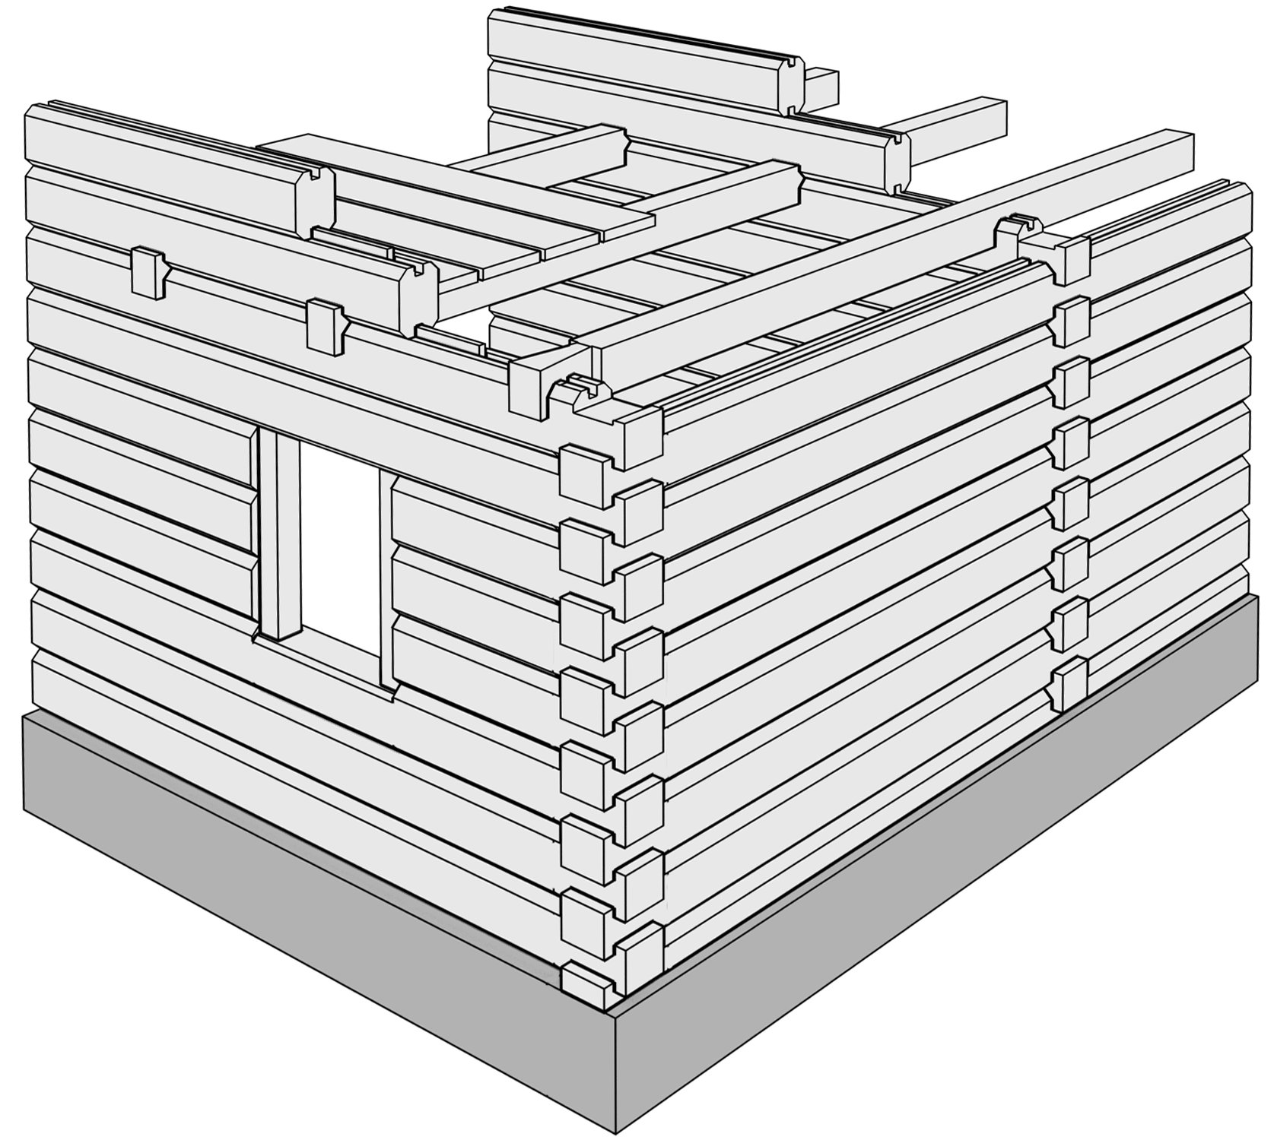
3. HISTORICAL TYPES OF WOODEN STRUCTURES: Log construction
log construction - one of the oldest methods of timber construction and one practised since the Neolithic Age, made it possible to build buildings with several storeys. This method was common in densely forested regions of Asia and Europe well into modern times and is still used in some areas. Closed, windproof insulating walls are created by stacking blocks or logs and by dovetailing, lapping or notching corners and bracing interior walls. Although tall buildings made of horizontally stacked logs can settle significantly, buildings of surprising height were built in areas with highly skilled craftsmen.
The shape of the beams can be varied. The beams lying on one another are connected with oak pegs, protecting them from shifting. The gap between the beams is sealed with e.g. straw, rope, tow, shavings, heather, dried moss or a tongue-and-groove joint.
H. Kaufmann S. Krötsch S. Winter, Manual of Multistorey Timber Construction Author: Paweł Mika

Slide 12
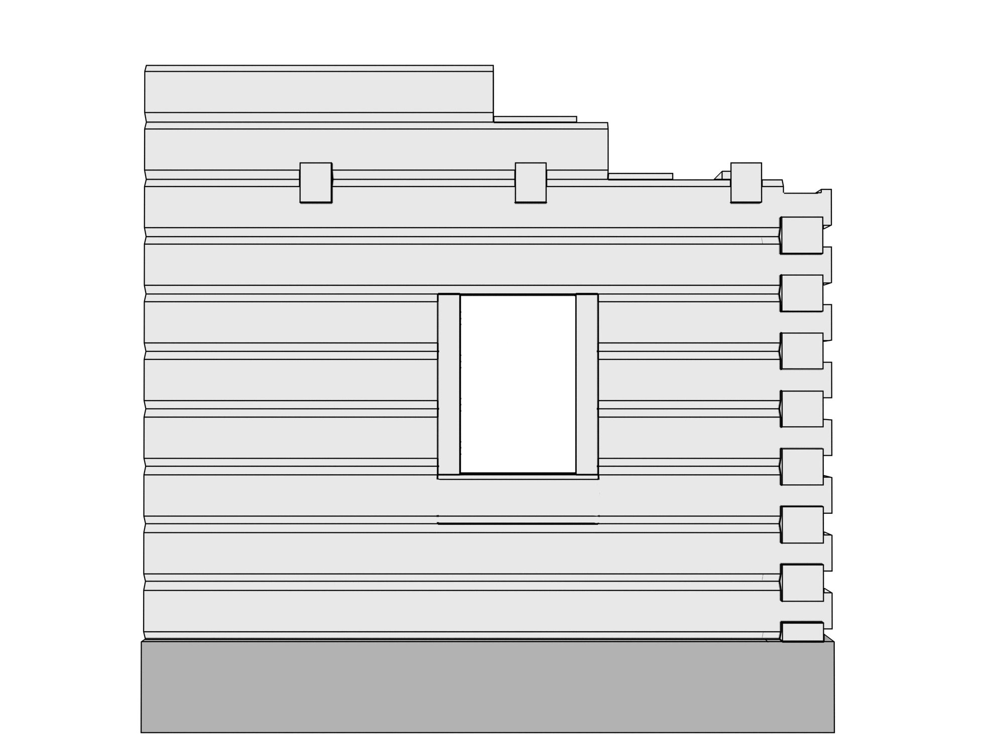
3. HISTORICAL TYPES OF WOODEN STRUCTURES: Log construction
Foundations,
2. Waterproof insulation,
3. Log,
4. Wooden pegs,
5. Lintel,
6. Floor beams,
7 Floor planks,
8. Window opening post,
9. Tongue,
10 Groove,
11. Insulation
12. Rafters
Author: Paweł Mika

Slide 13
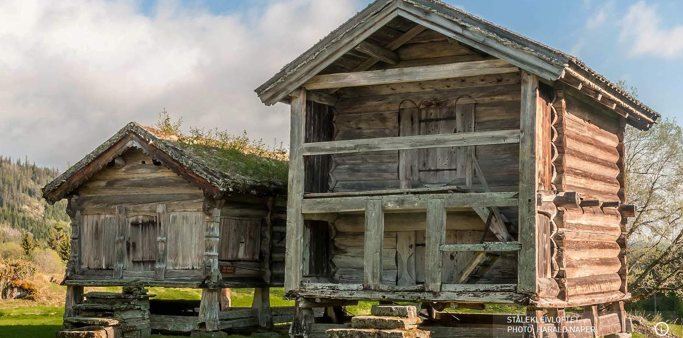
3. HISTORICAL TYPES OF WOODEN STRUCTURES: Log construction
Storehouse, Vindlaus, Norway
Museum of Vest-Telemark in Eidsborg
When the storehouse was dated by the Norwegian Center of Cultural Heritage Research (NIKU), it was revealed that the thimber had been cut just shortly after year 1167. This makes this storehouse the oldest profane wooden building in Norway and maybe in the World.
https://www.visitnorway.com/listings/st%C3%A5lekleivloftet-one-of-the-oldest-wooden-buildings-in-the-world/207516/

Slide 14
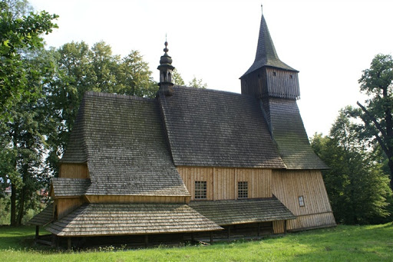
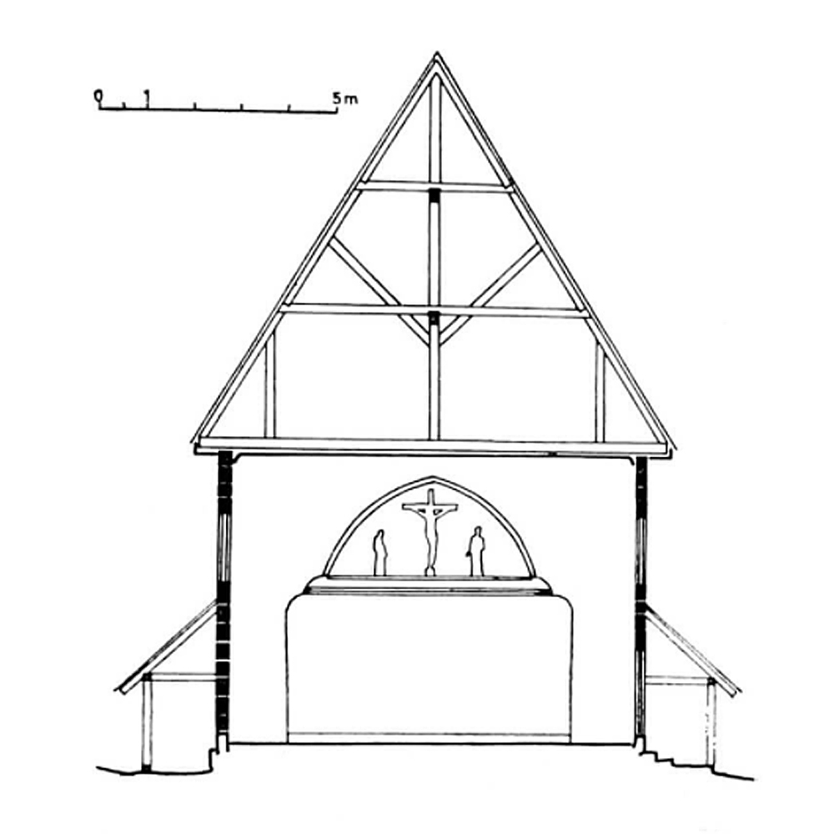
3. HISTORICAL TYPES OF WOODEN STRUCTURES: Log construction
Church in Osiek, Poland
Built in 1538–1549. It was built in the late Gothic style, typical for the wooden buildings of the Silesia..
http://www.polskaniezwykla.pl/web/place/9183,osiek-drewniany-kosciol-sw--andrzeja-apostola-(1538-1549).html

Slide 15
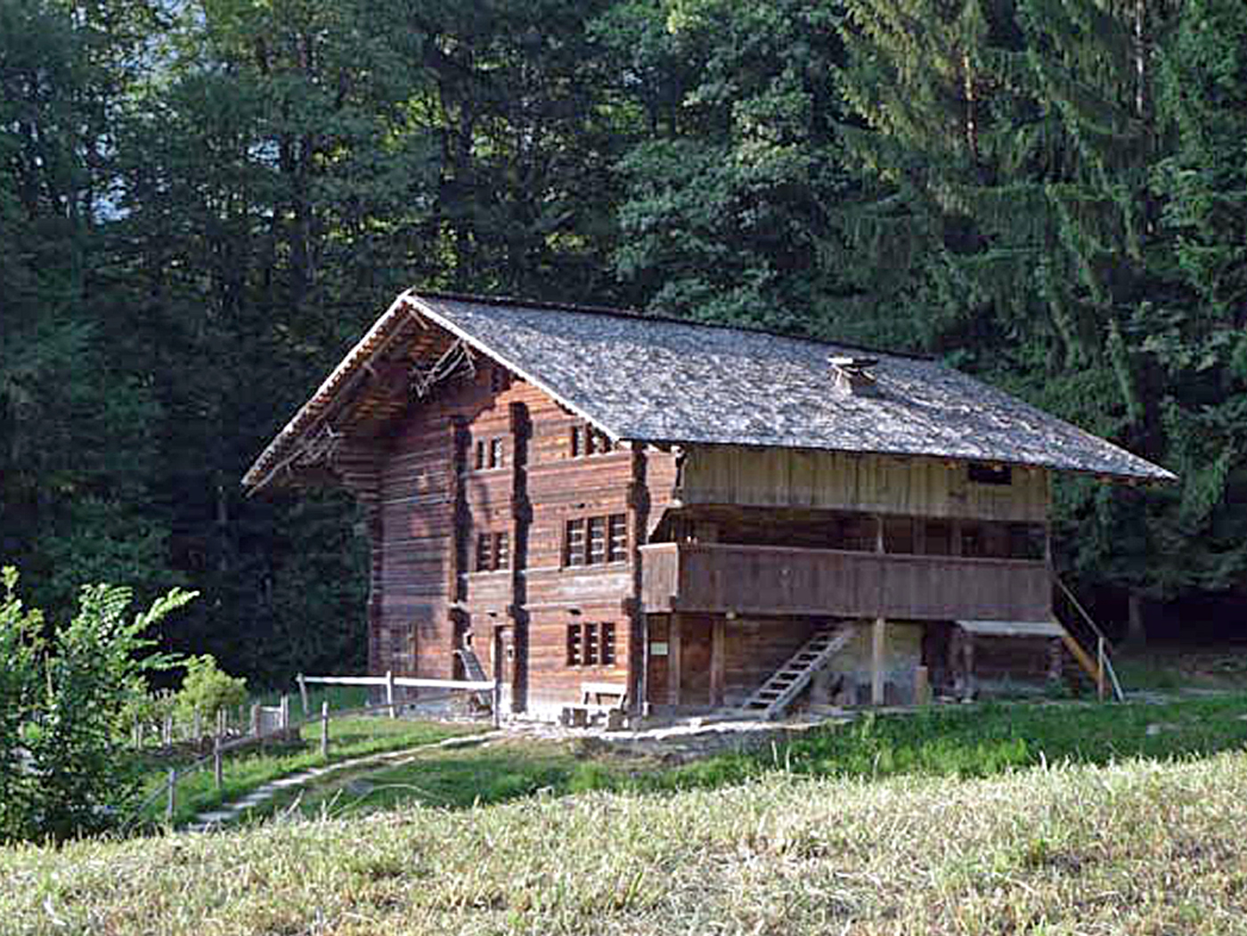
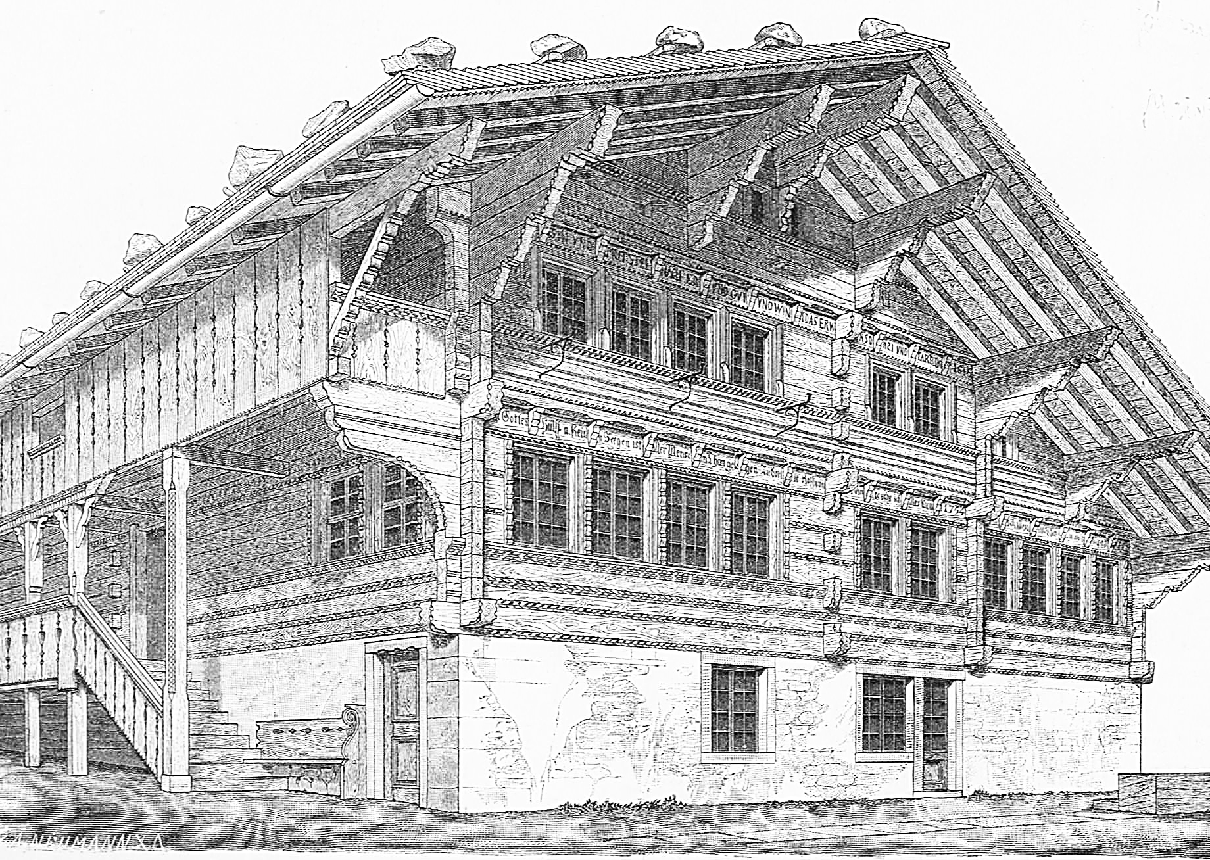
3. HISTORICAL TYPES OF WOODEN STRUCTURES: Log construction
Farmhouse from Bonderlen/Adelboden, Switzerland, 1698
In the Kander valley in the 15th century, people decided to build this type of multipurpose house instead of having to build and maintain a number of separate buildings. Stall, barn and dwelling are all under one roof and their functions are visible on the facade.
https://www.ballenberg.ch/en/themes/house-styles/10-bernese-oberland/1011:

Slide 16
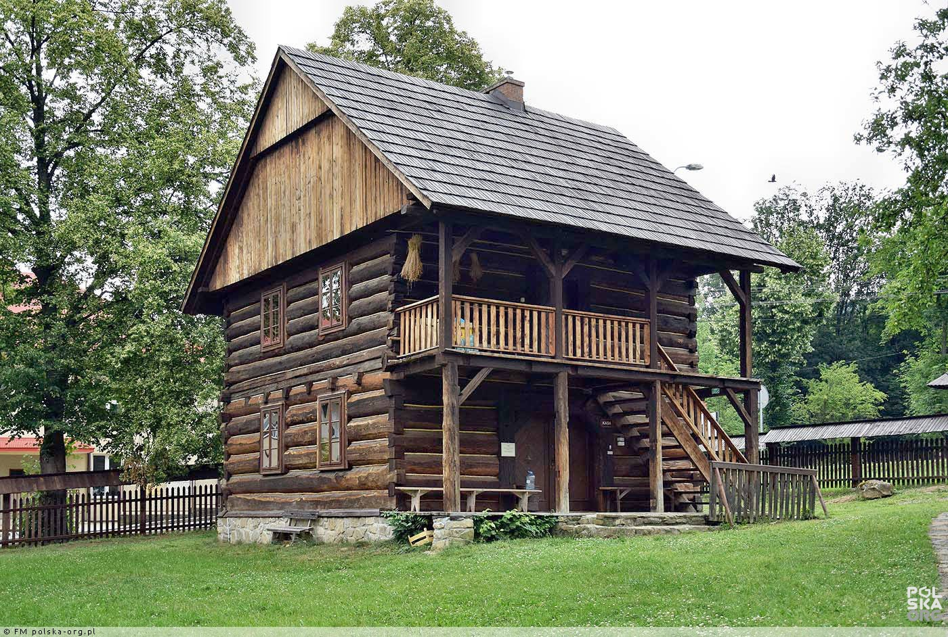
3. HISTORICAL TYPES OF WOODEN STRUCTURES: Log construction
Granary from Rożnowice,
Open air museum in Szymbark, Poland
End of XVIII-th century.
https://polska-org.pl/7699498,foto.html

Slide 17
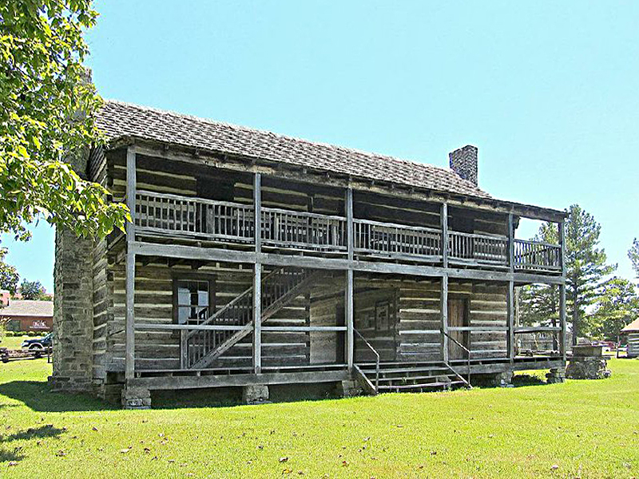
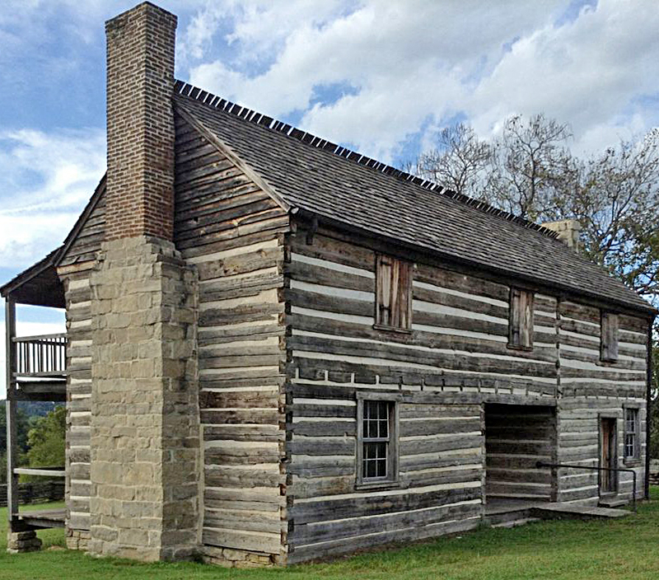
3. HISTORICAL TYPES OF WOODEN STRUCTURES: Log construction
The Jacob Wolf House, Norfork, Arkansas, USA
It is a log structure, built in 1825 by Jacob Wolf, the first documented white settler of the area. Architecturally it's a "saddle bag", which is a two-story dog trot with the second floor built over the open breezeway. A two-story porch extends on one facade, with an outside stair giving access to the upper floor rooms. The building's original chinking has been replaced by modern mortaring.
https://en.wikipedia.org/wiki/Jacob_Wolf_House https://www.arkansasonline.com/news/2014/aug/21/norfork-house-stands-as-state-s-oldest-/

Slide 18
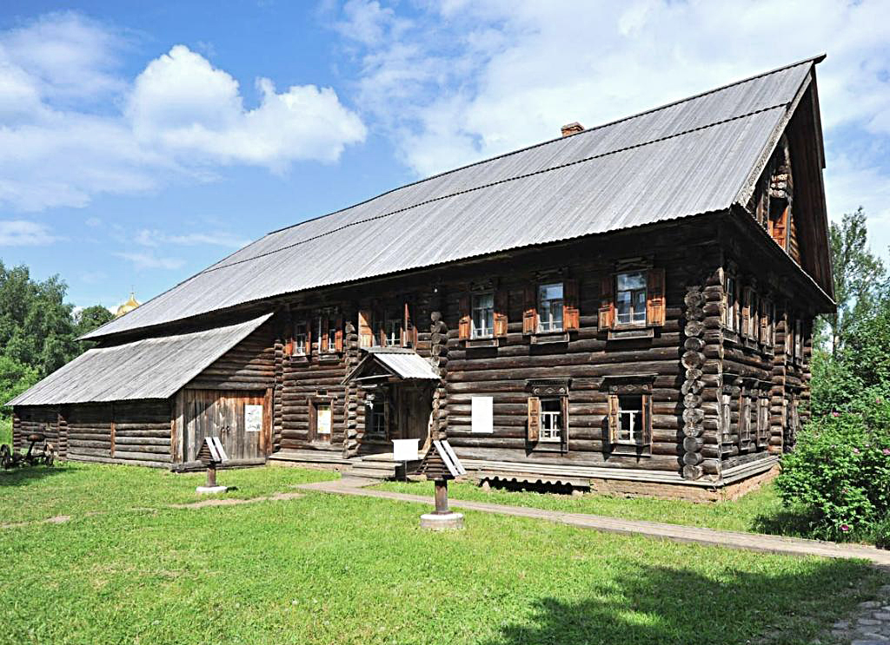
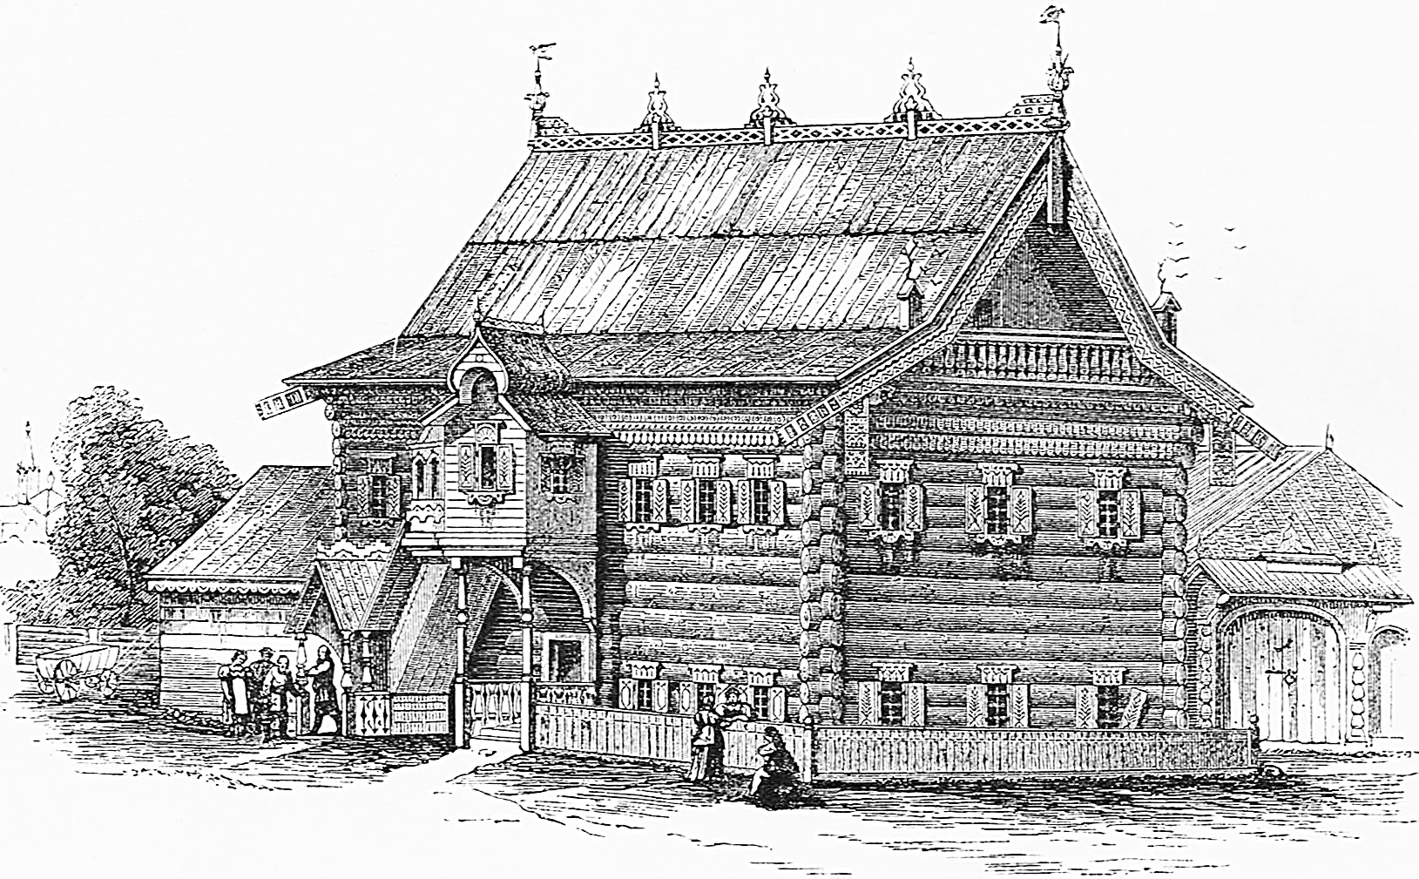
3. HISTORICAL TYPES OF WOODEN STRUCTURES: Log construction
Home of Lipatov from village Zhuravlevo (formerly Kobylino) Russia
It is a log structure, built in 1854 in Zhuravlevo. Now in Kostroma Architectural-Ethnographic and Landscape Museum.
https://www.nationalrussianshow.ru/en/dacha/excursion_program/museum_kostroma_sloboda/

Slide 19
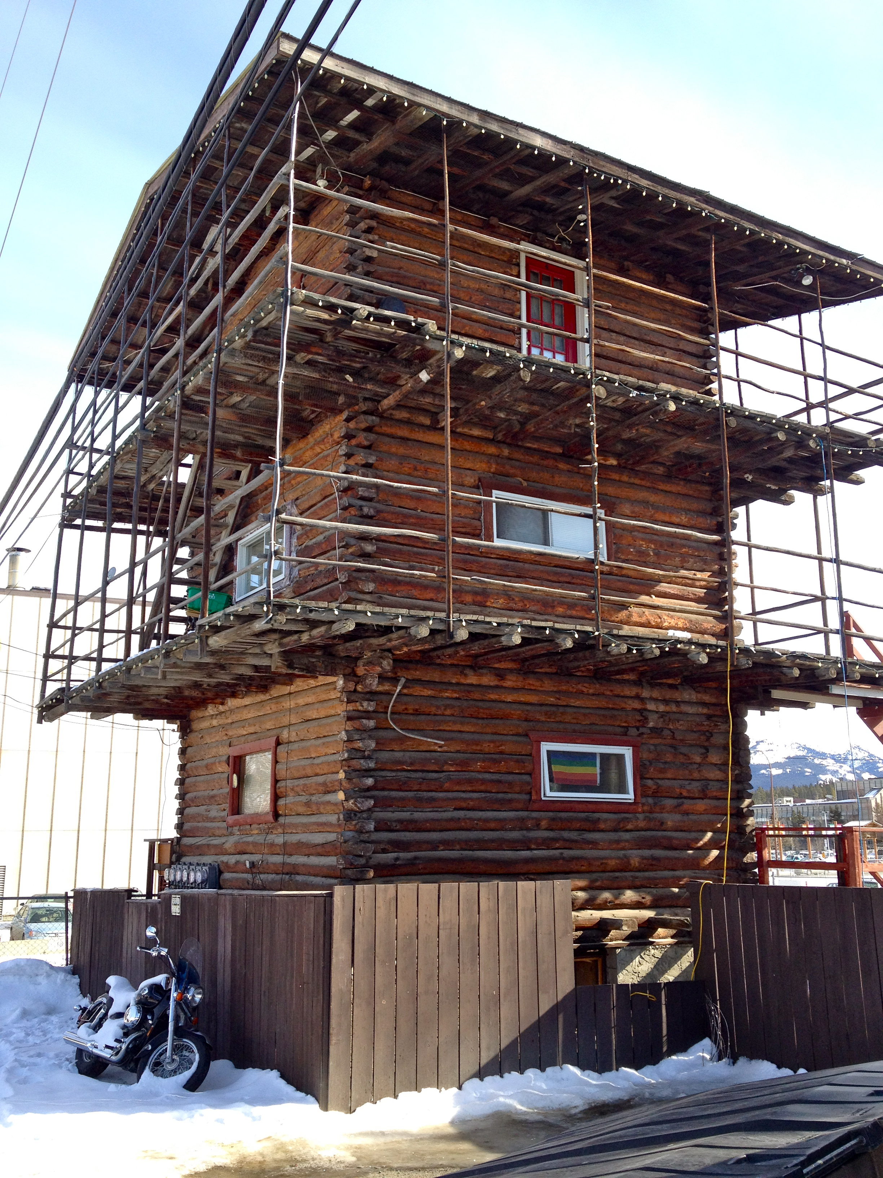
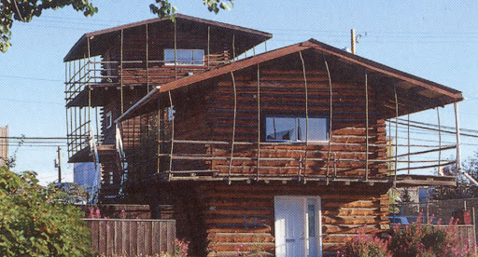
3. HISTORICAL TYPES OF WOODEN STRUCTURES: Log construction
Whitehorse Log Skyscraper, Canada
Builder Martin Berrigan constructed in 1947 the Log Skyscrapers, the first privately built multiple-dwelling rental accommodation in Whitehorse. These two buildings are the only buildings of this type in Canada and their architectural significance lies in their unusual appearance. The multi-storied log construction has given them landmark status within the Yukon Territory. The cantilevered balconies with their pole railings combined with the extended eaves of the low pitched roofs create a wrap-around, hanging, open lattice enveloping the upper floors.
http://register.yukonhistoricplaces.ca/Place/3239 https://yukonanimator.files.wordpress.com/2012/03/logskyscraper1.jpg

Slide 20
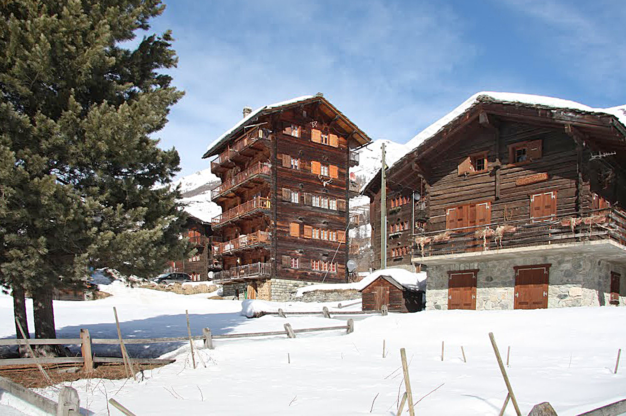
3. HISTORICAL TYPES OF WOODEN STRUCTURES: Log construction
Five-storey building in Evolène, Valais (CH) 1958, Follonier brothers
H. Kaufmann S. Krötsch S. Winter, Manual of Multistorey Timber Construction https://mapio.net/images-p/67784058.jpg

Slide 21
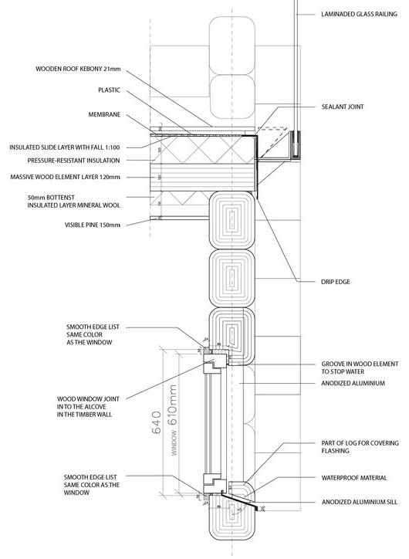
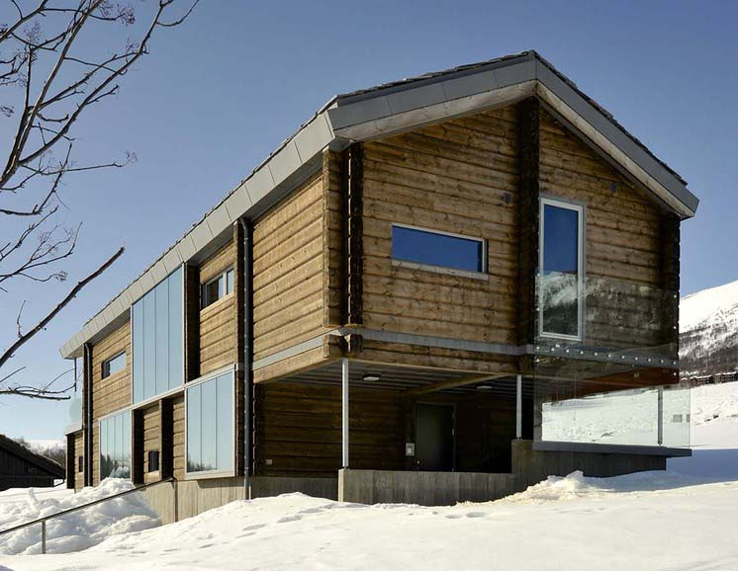
3. HISTORICAL TYPES OF WOODEN STRUCTURES: Log construction
House in Oppdal, Norway JVA, 2012
https://www.archdaily.com/778756/log-house-jva?ad_medium=gallery

Slide 22
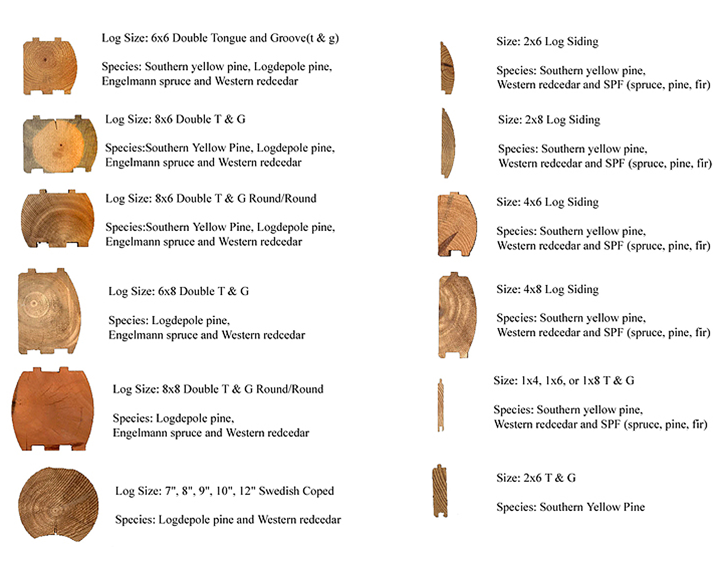
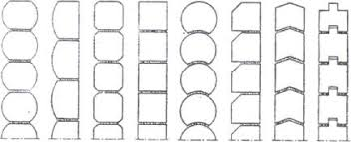
3. HISTORICAL TYPES OF WOODEN STRUCTURES: Log construction
Tree Species and Log Types
https://www.westernloghomesupply.com/log-types.html

Slide 23
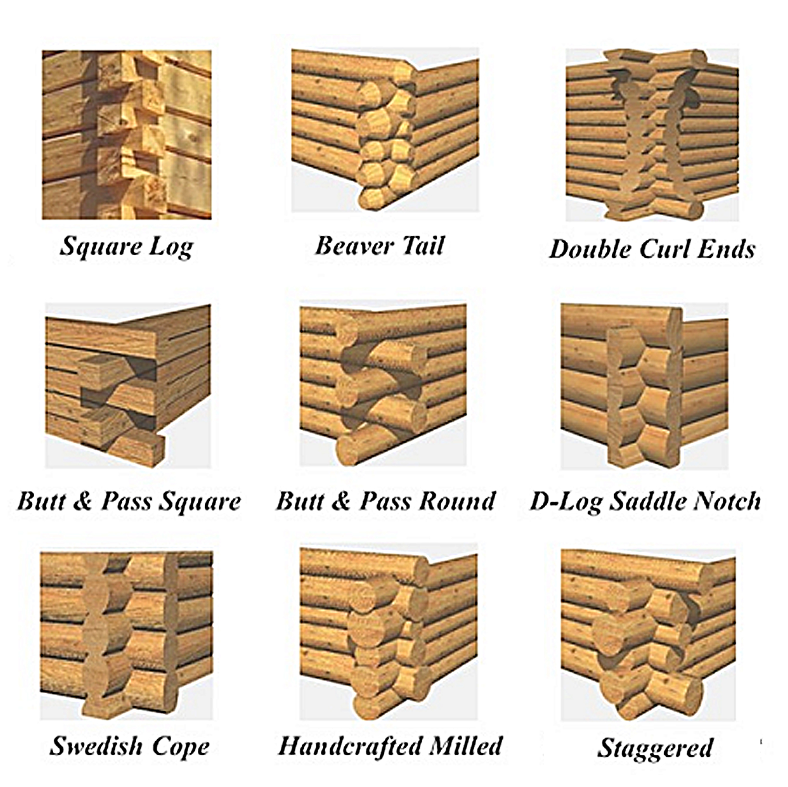
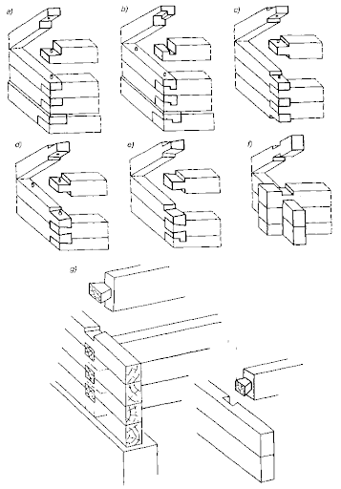
3. HISTORICAL TYPES OF WOODEN STRUCTURES: Log construction
Log Corner Types
http://www.dialektologia.uw.edu.pl/cmsimg/ekrhttps:// pl.pinterest.com/pin/408490628685326796//

Slide 24
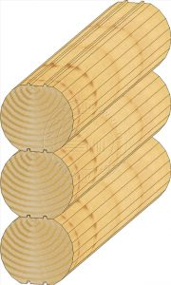
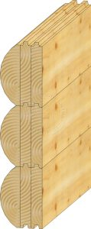
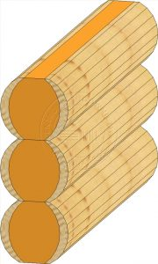
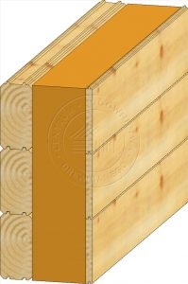
3. HISTORICAL TYPES OF WOODEN STRUCTURES: Log construction
Types of contemporary log walls
http://budujzdrewna.pl/domy-drewniane/domy-z-bali/wszystko-o-domach-z-bali

Slide 25
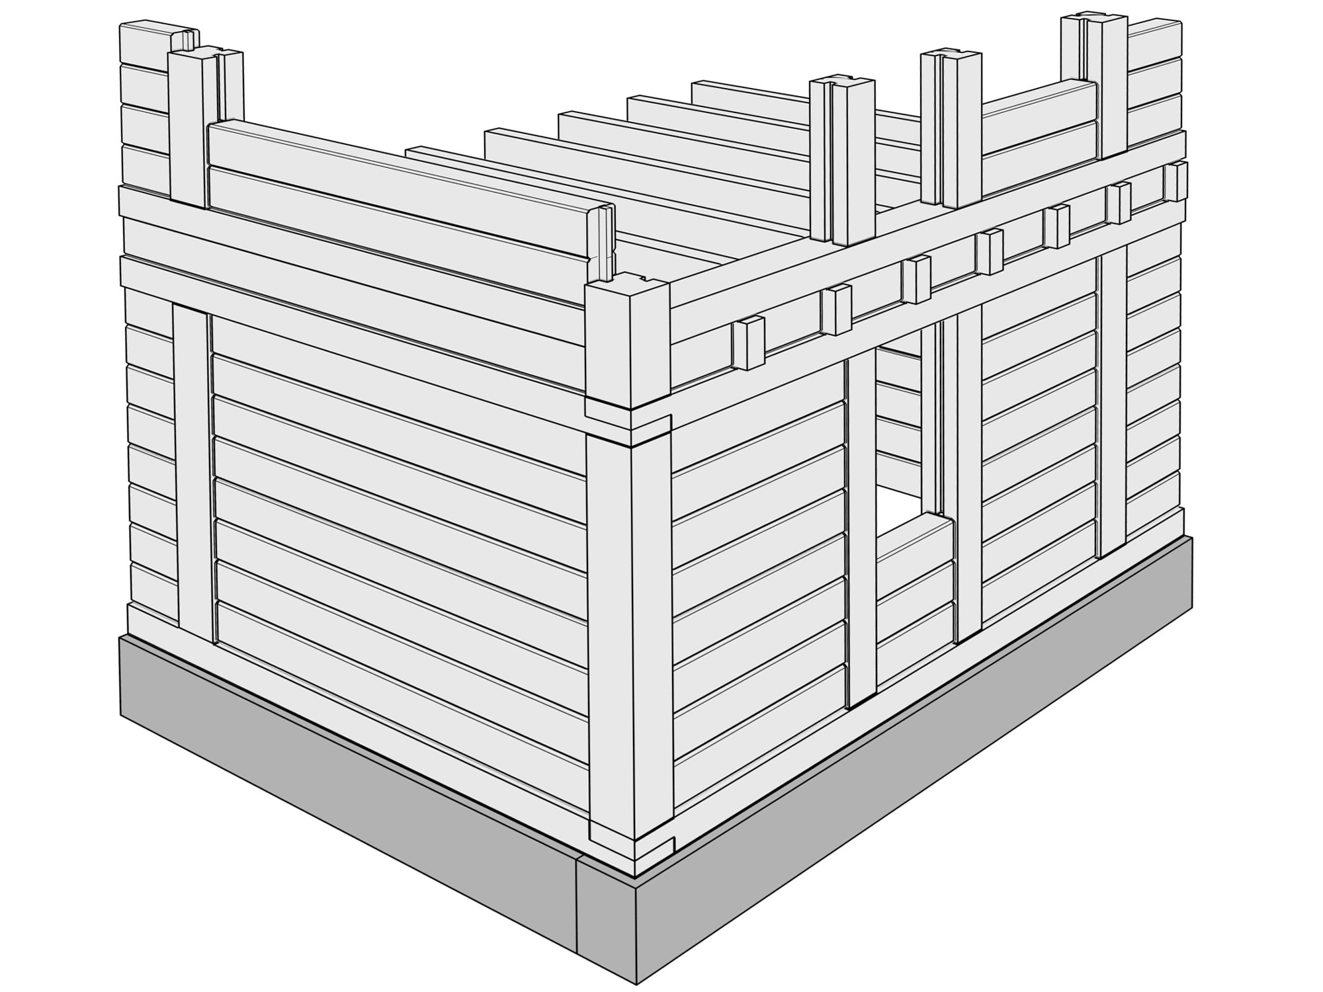
3. HISTORICAL TYPES OF WOODEN STRUCTURES: Post and Plank Construction
The method of building wooden buildings with a traditional timber frame with horizontal plank or log infill. This carpentry was used from parts of Scandinavia to Switzerland to western Russia. Though relatively rare now, two types are found in a number of regions in North America, more common are the walls with planks or timbers which slide in a groove in the posts and less common is a type where horizontal logs are tenoned into individual mortises in the posts.
Other names: piece sur piece (French) corner post construction, Ständerbohlenbau (German) skiftesverk (Swedish), Bulhus
This traditional building method is believed to be the predecessor to Half-Timber construction widely known by its German name Fachwerkbau which has wall infill of wattle and daub, brick, or stone.
Author: Paweł Mika

Slide 26
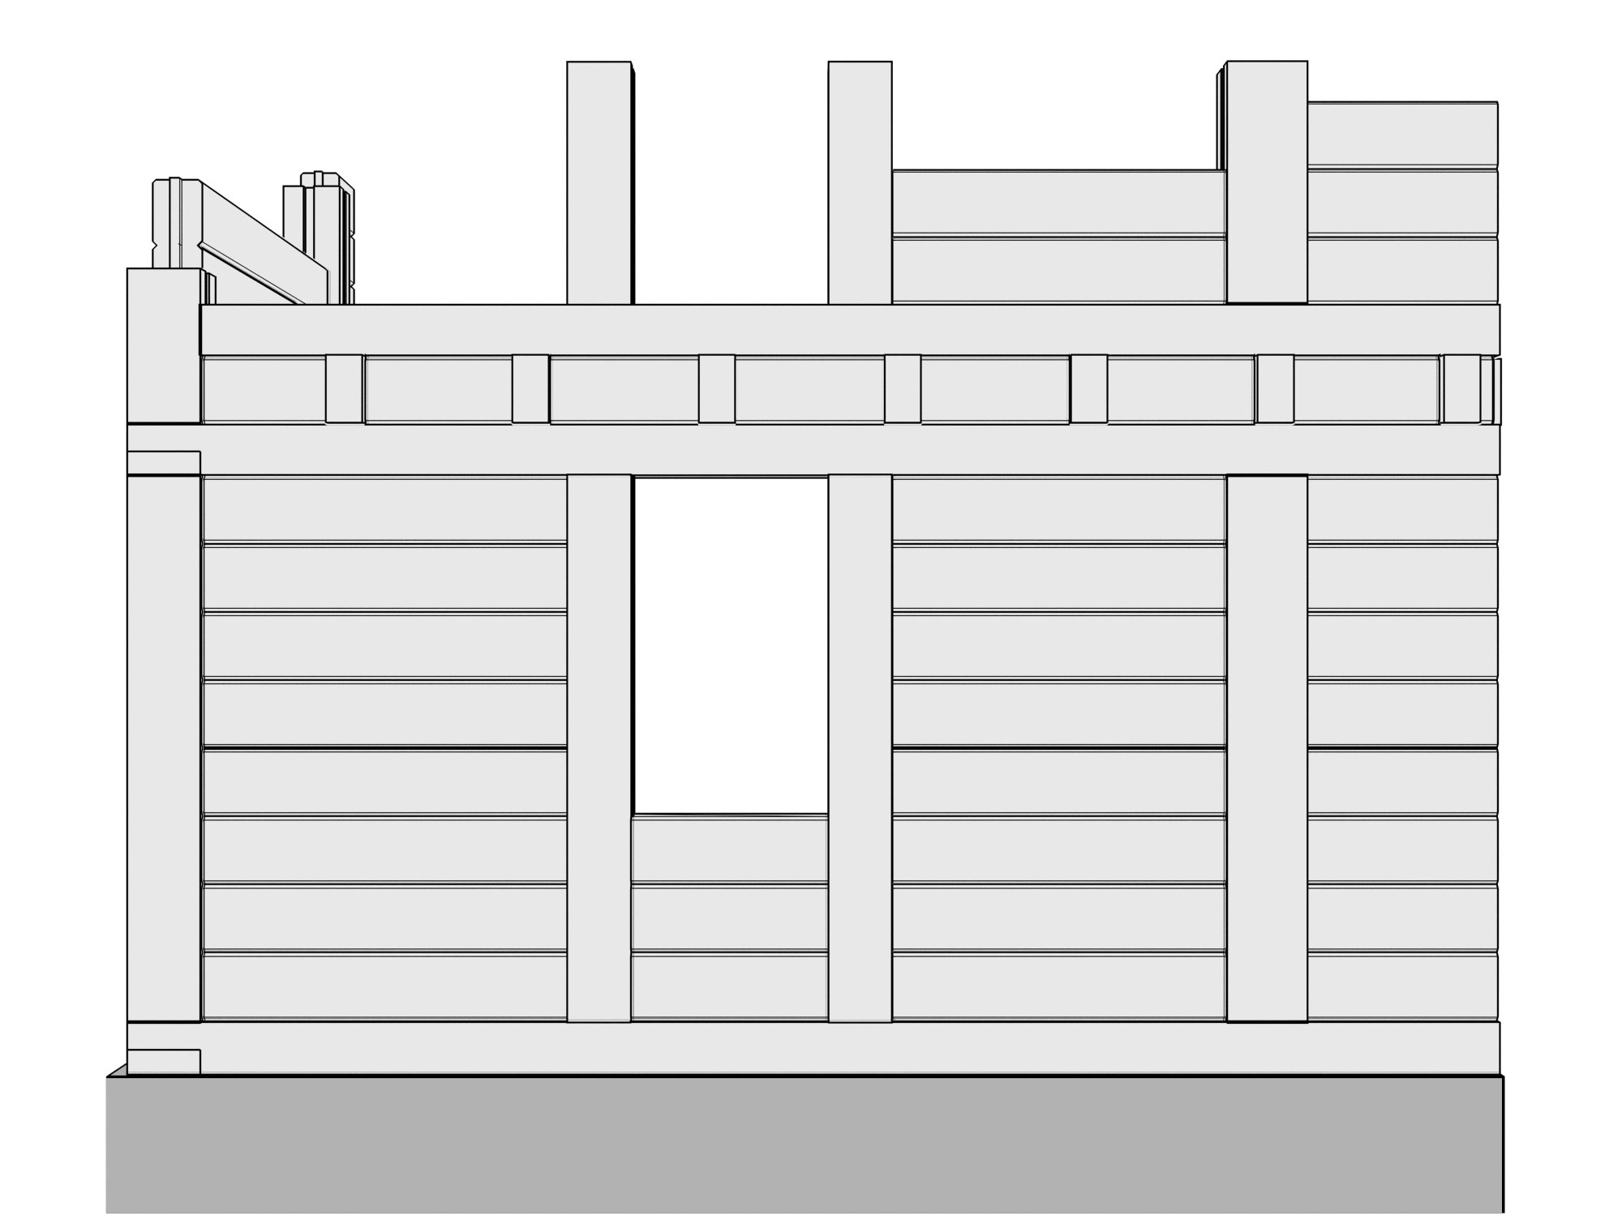
3. HISTORICAL TYPES OF WOODEN STRUCTURES: Post and Plank Construction
Foundations,
2. Waterproof insulation,
3. Sole plate
4. Plank or Log
5. Corner post
6. Post
7 Top plate
8. Floor beam
Author: Paweł Mika

Slide 27
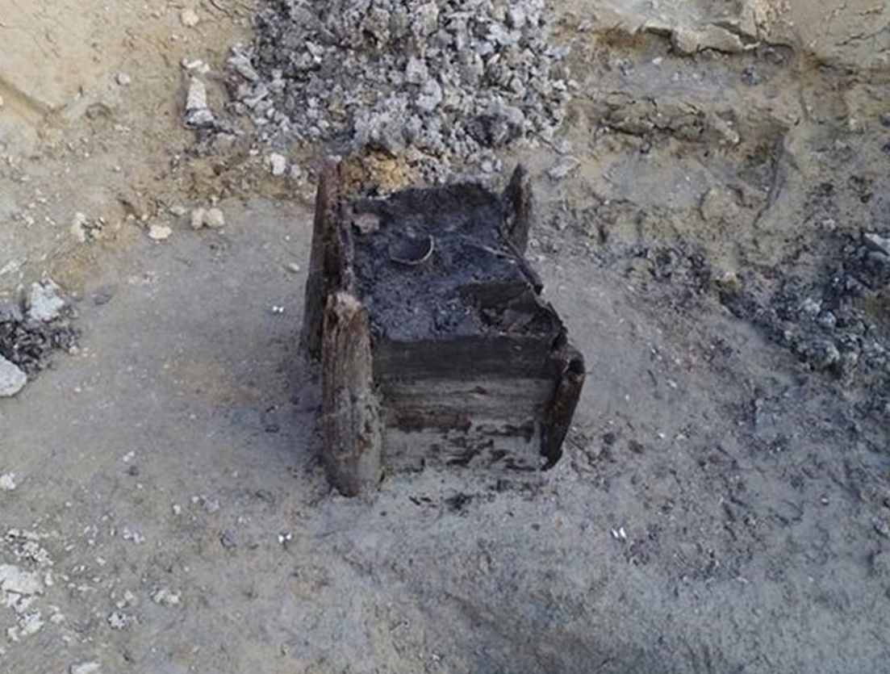
3. HISTORICAL TYPES OF WOODEN STRUCTURES: Post and Plank Construction
World’s Oldest Man-Made Wooden Structure.
Found in the Czech Republic in 2018
The well dates to 5,256 or 5,255 BC – the Neolithic period, or the end of the Stone Age – making it 7,275 years old. The structure has been dated using the internal rings of the wood, which are visible in cross-sections.Oldest Man-Made Wooden Structure.
Found in the Czech Republic in 2018
It bears marks of construction techniques used in the Bronze and Iron Ages and even the Roman Age.
https://praguemorning.cz/worlds-oldest-man-made-wooden-structure-found-in-the-czech-republic/

Slide 28
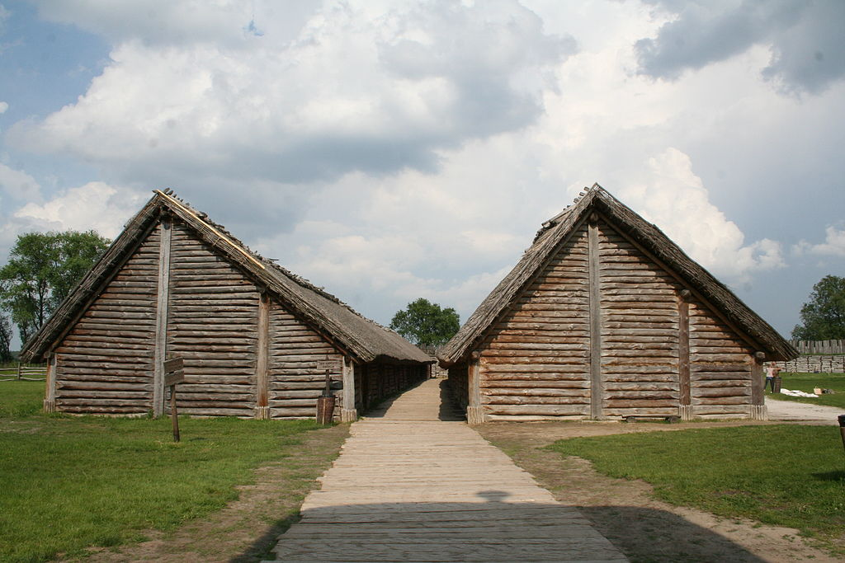
3. HISTORICAL TYPES OF WOODEN STRUCTURES: Post and Plank Construction
Reconstruction of building remains found at Biskupin, Poland. from circa 738 B.C.
"The support of horizontal timbers by corner posts is an old form of construction in Europe. It was apparently carried across much of the continent from Silesia by the Lausitz urnfield culture in the late Bronze Age."[1] The Lausitz culture is also known as the Lusatian culture and within their territory is an archaeological site and archaeological open-air museum at Biskupin, Poland, where remnants of such structures were found and reconstructed. The structures found dated from 747–722 B.C
1. Upton, Dell, and John Michael Vlach. Common places: readings in American vernacular architecture. Athens: University of Georgia Press, 1986, referencing V. Gordon Childe, The Bronze Age, (NY, Macmillan, 1930, pp. 206-8)
https://en.wikipedia.org/wiki/Post-and-plank#/media/File:Biskupin_40.JPG

Slide 29
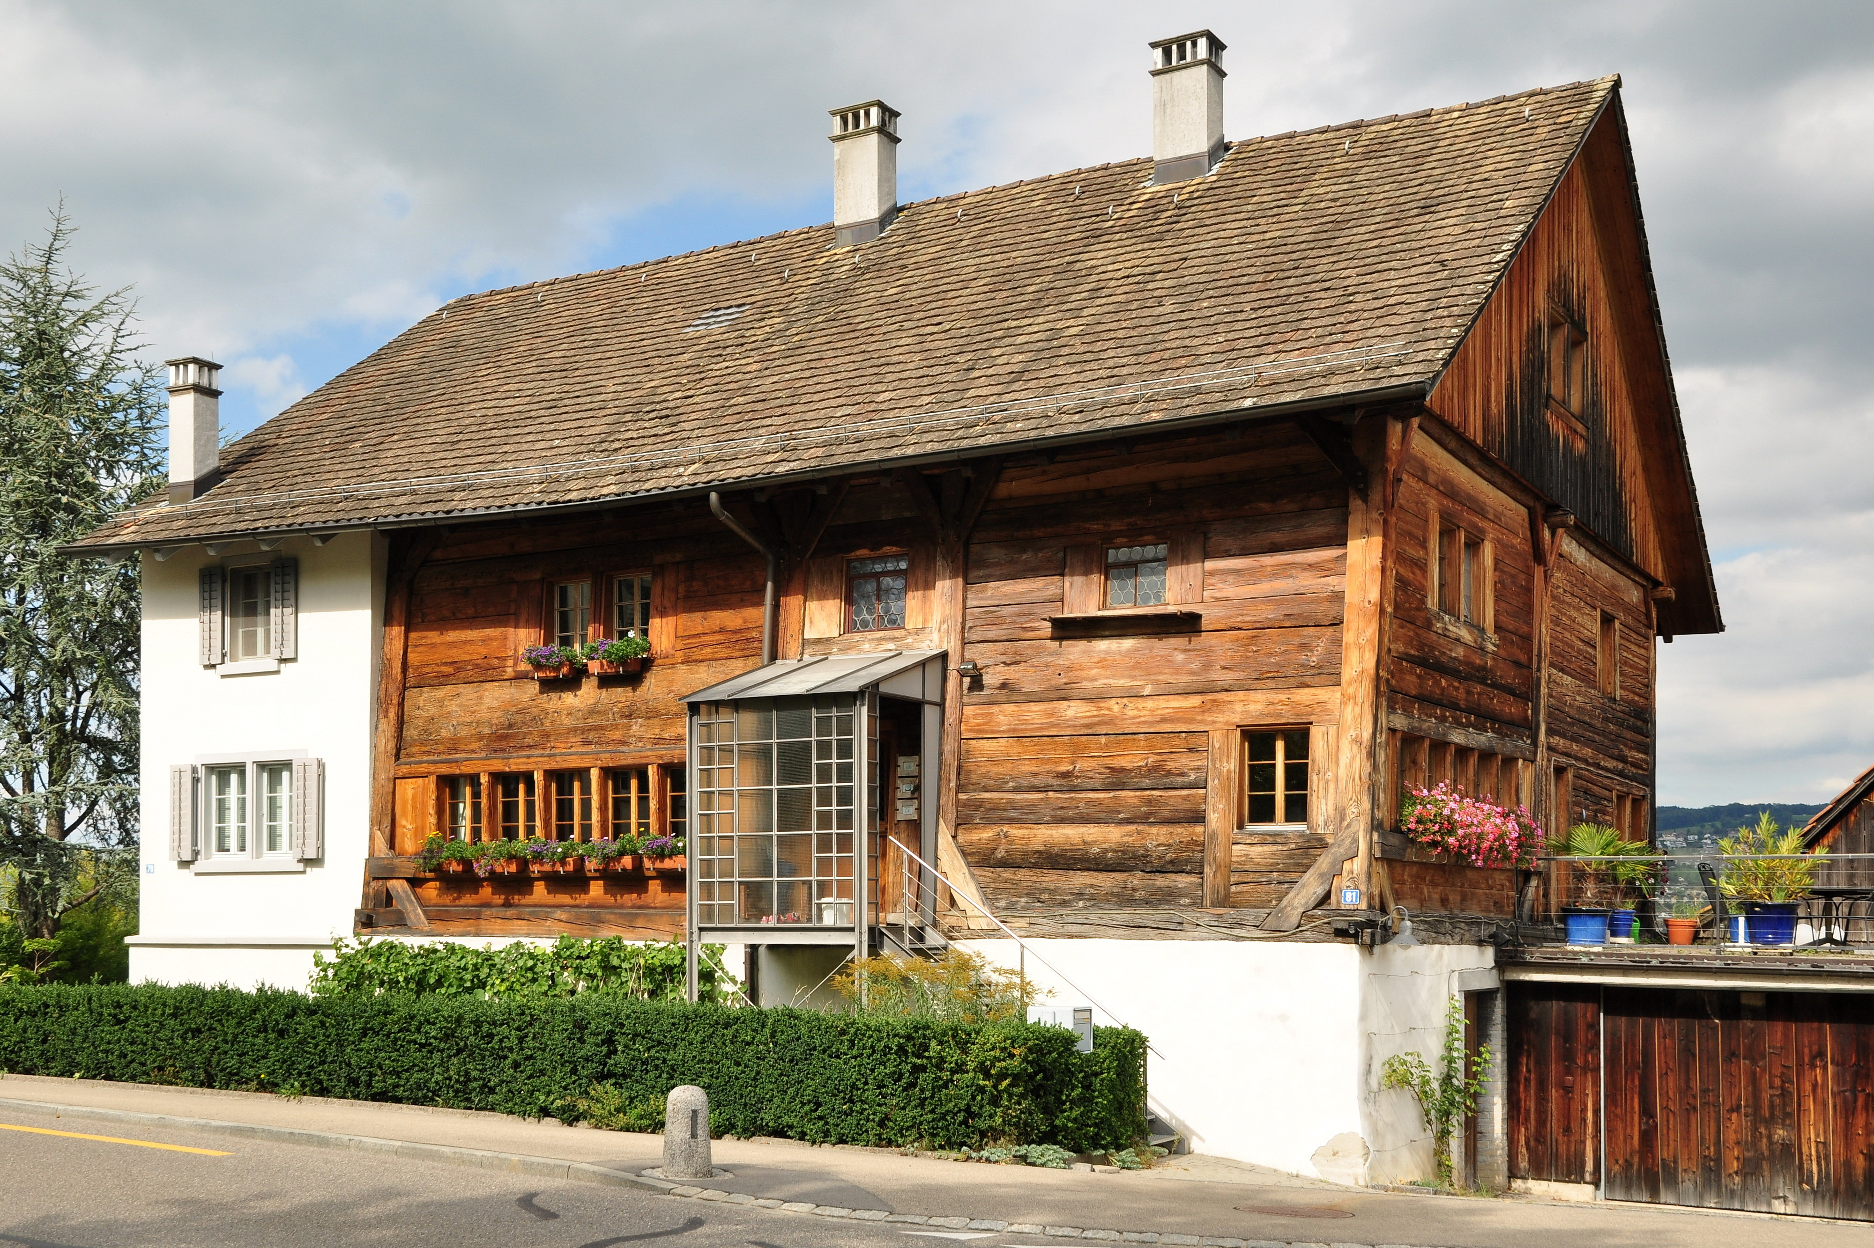
3. HISTORICAL TYPES OF WOODEN STRUCTURES: Post and Plank Construction
2-storey house with a post and plank construction. Alte Landstrasse 79/81 w Oberrieden (Switzerland).
Foundations,
2. Waterproof insulation,
3. Sole plate
4. Plank or Log
5. Corner post
6. Post
7 Top plate
8. Floor beam
https://pl.wikipedia.org/wiki/Konstrukcja_sumikowo-%C5%82%C4%85tkowa

Slide 30
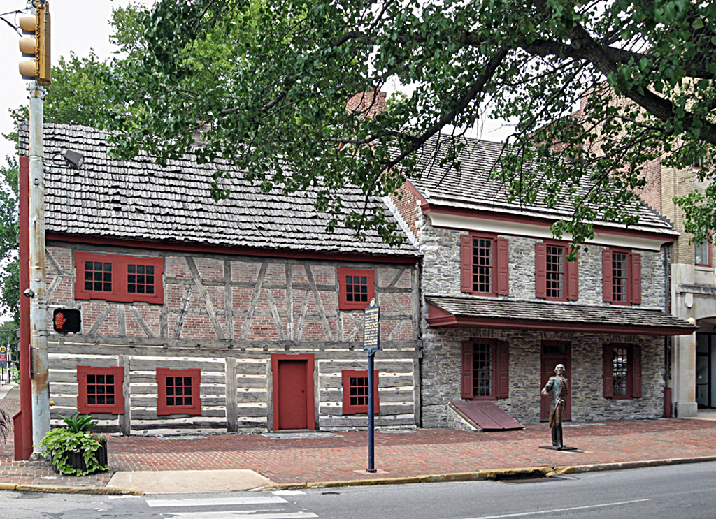
3. HISTORICAL TYPES OF WOODEN STRUCTURES: Post and Plank Construction
The Golden Plough Tavern 1741
Its a two-story, Germanic influenced medieval style building.
The ground floor wall construction is a rare type which blends timber framing with log building. These walls are framed and the spaces between the posts are infilled with hewn beams, each beam fitted into its own mortise, and the gaps between the beams chinked with stones and mud like a log cabin. This construction technique is similar to timber framing infilled with planks known by many names including post-and-plank.
The upper walls are half timbered in a Germanic style with brick nog and wattle and daub infill. Half timbered buildings in America are relatively rare, generally found in some areas settled by German immigrants.
https://en.wikipedia.org/wiki/Golden_Plough_Tavern

Slide 31
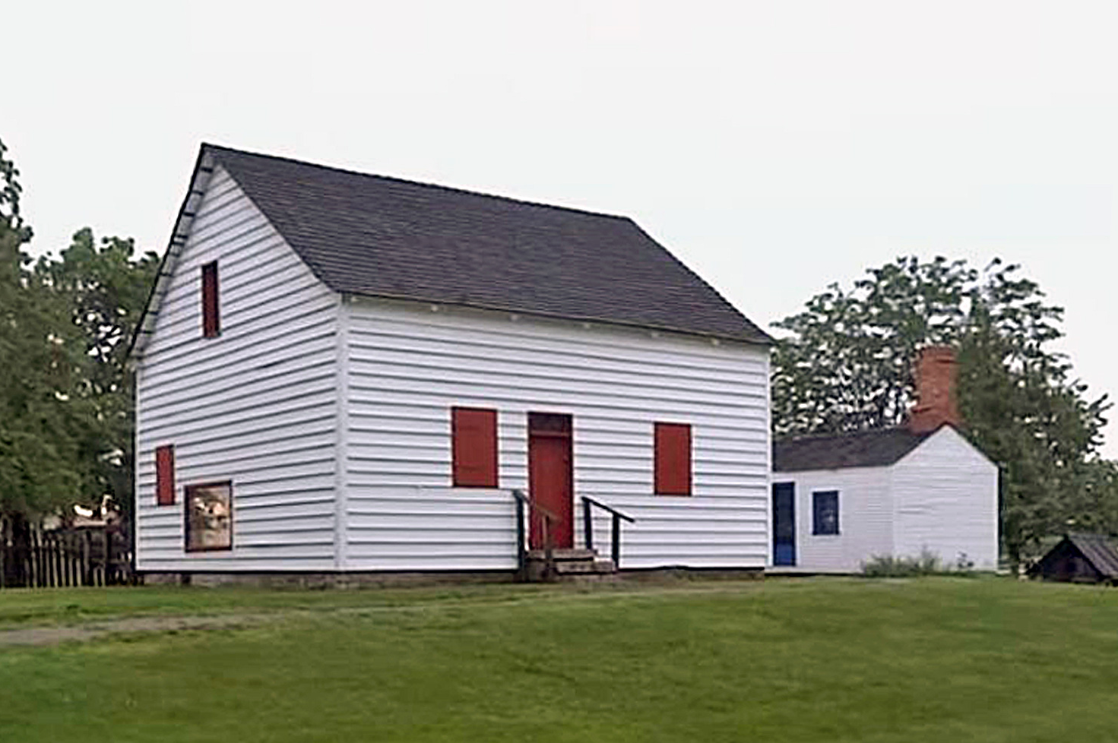
3. HISTORICAL TYPES OF WOODEN STRUCTURES: Post and Plank Construction
Navarre Anderson Trading Post Complex, Monroe, MI, USA 1789
.The Trading Post complex is set up to represent a French pioneer homestead along the River Raisin. The main building, built in 1789 by Utreau Navarre, is the oldest wooden residence still standing in Michigan. It is the most complete example of French-Canadian "piece-sur-piece" construction in the Old Northwest. It has been restored to 1797. Other buildings include an 1810 cookhouse and a replica 1790's French-Canadian style barn.
https://k1025.com/navarre-anderson/

Slide 32
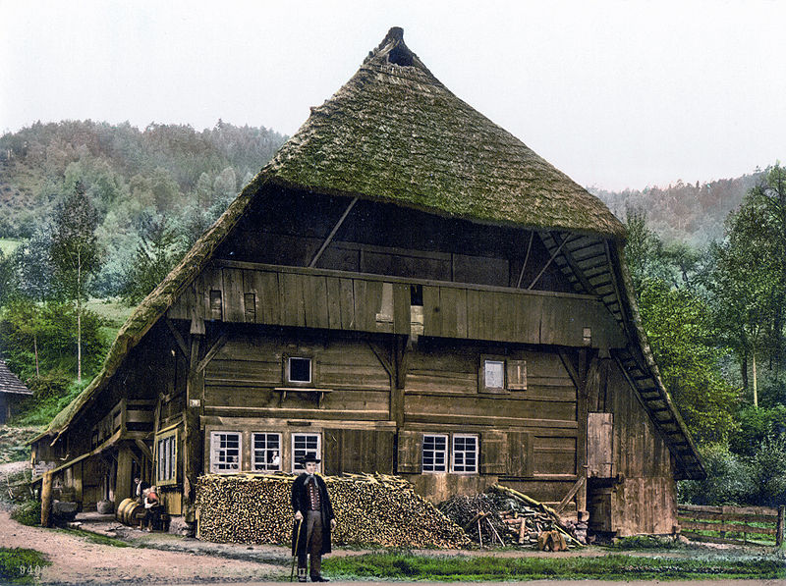
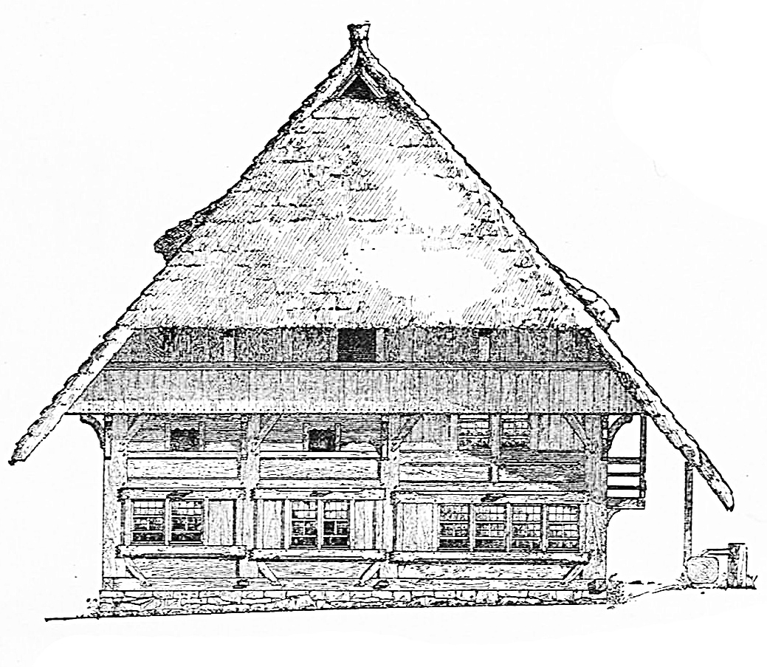
3. HISTORICAL TYPES OF WOODEN STRUCTURES: Post and Plank Construction
House of a Black Forest ~1900 , Germany
The Black Forest house (Schwarzwaldhaus) is a byre-dwelling that is found mainly in the central and southern parts of the Black Forest in southwestern Germany. It is characterised externally by a long hipped or half-hipped roof that descends to the height of the ground floor. This type of dwelling is suited to the conditions of the Black Forest: hillside locations, broad tracks, high levels of snowfall and heavy wind loading.
https://en.wikipedia.org/wiki/Black_Forest_house

Slide 33
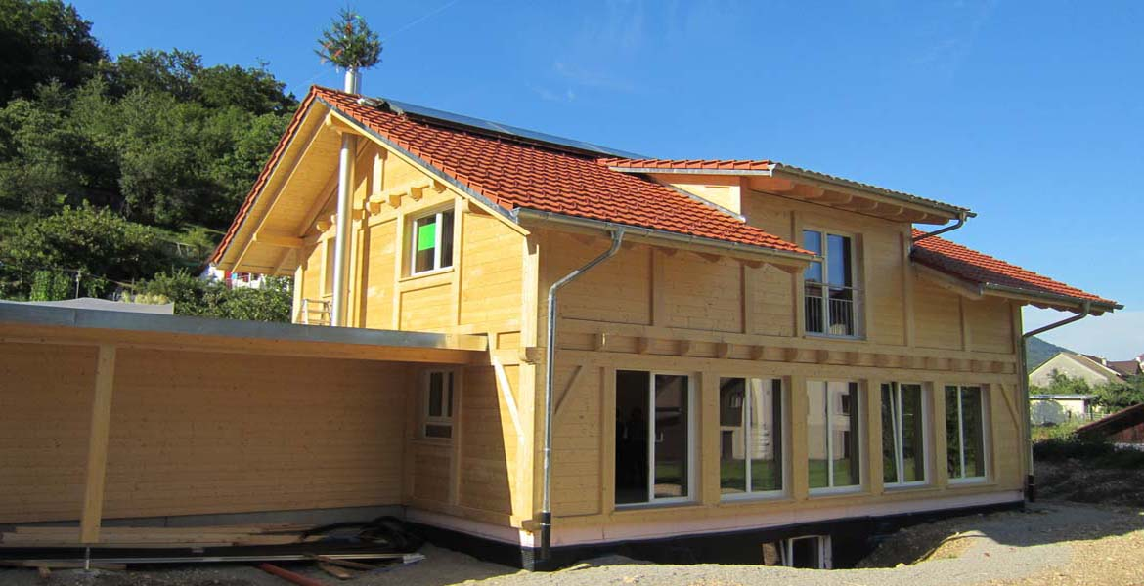
3. HISTORICAL TYPES OF WOODEN STRUCTURES: Post and Plank Construction
https://www.ebi-holzwerkstatt.de/files/content/images/referenzen/hausbau/staender-bohlen-haus/2016-12-22%20Guildem.jpg

Slide 34
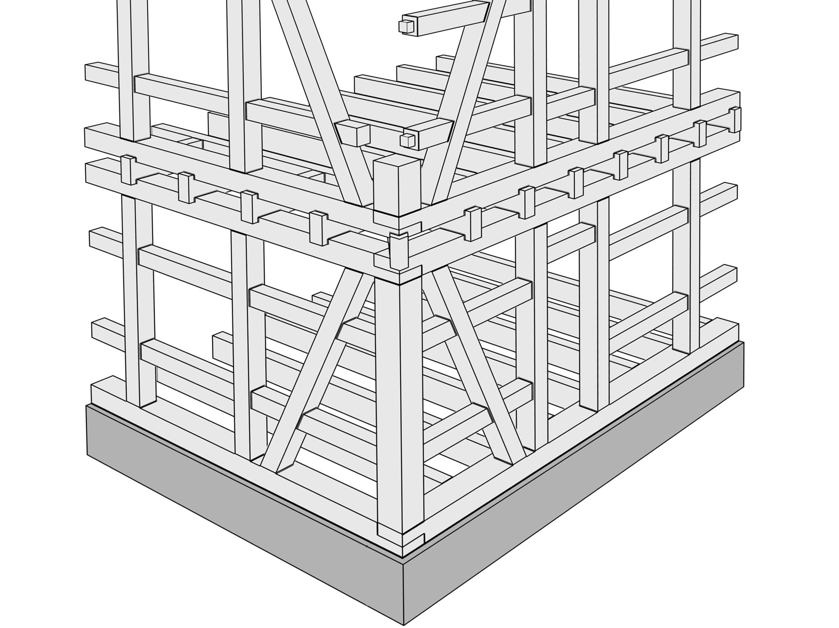
3. HISTORICAL TYPES OF WOODEN STRUCTURES: Half-Timbered construction / Post and Beam
Post-and-beam structures were the precursors of half-timbered buildings. Half-timbered construction was the main method used to build buildings in centralEuropean cities from the Middle Ages until the 19th century.
Half-timbered construction represented a revolution in construction. It was now possible to build timber structures which would last several hundred years because individual load-bearing elements could be replaced without jeopardising the entire structure. (H. Kaufmann S. Krötsch S. Winter, Manual of Multistorey Timber Construction )
Half-timber work (post and beam) - method of building in which external and internal walls are constructed of timber frames and the spaces between the structural members are filled with such materials as brick, plaster, or wattle and daub. Traditionally, a half-timbered building was made of squared oak timbers joined by mortises, tenons and wooden pegs. The building’s cagelike structural skeleton is often strengthened at the corners with braces. This method of timber framing was adapted to both low, rambling country homes and six- or seven-storied buildings in crowded towns.
https://www.britannica.com/technology/half-timber-work Author: Paweł Mika

Slide 35
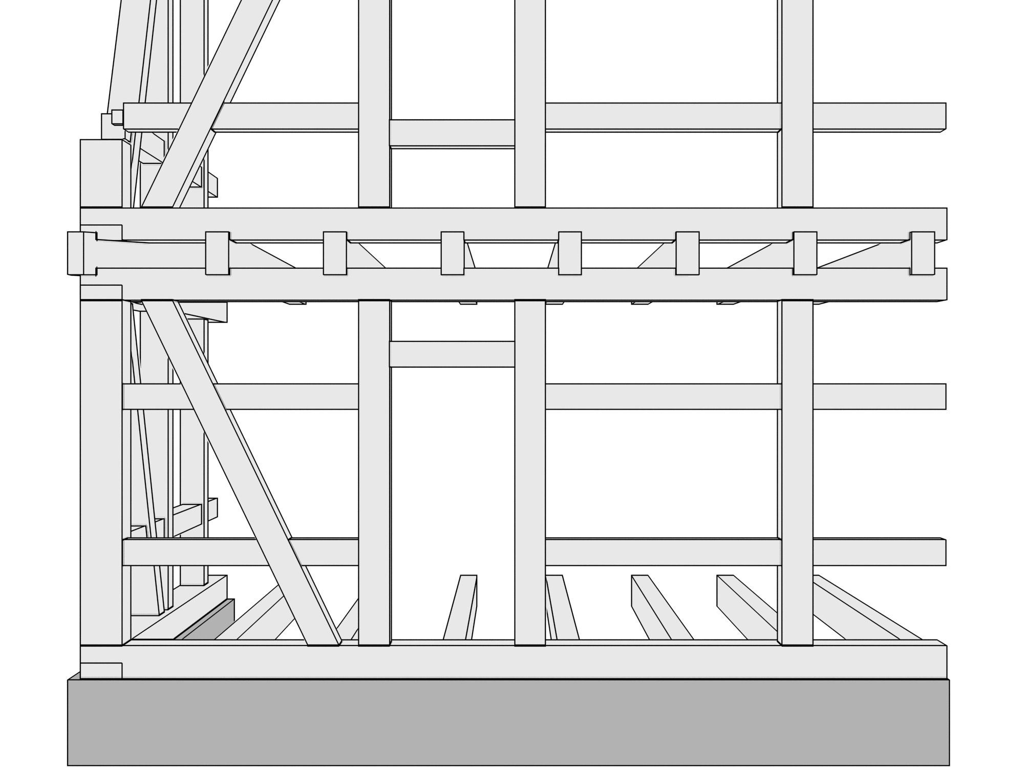
3. HISTORICAL TYPES OF WOODEN STRUCTURES: Half-Timbered construction / Post and Beam
Foundations,
2. Waterproof insulation,
3. Sole plate
4. Brace
5. Main post
6. Secondary post (1-1,2m)
7. Lintel
8 Top plate
9. Floor beam
10. Girt
Author: Paweł Mika

Slide 36
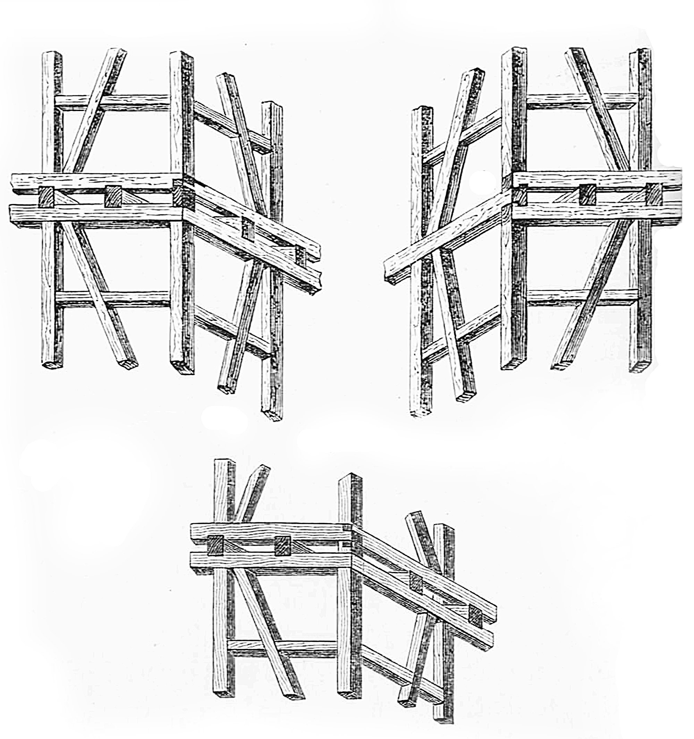
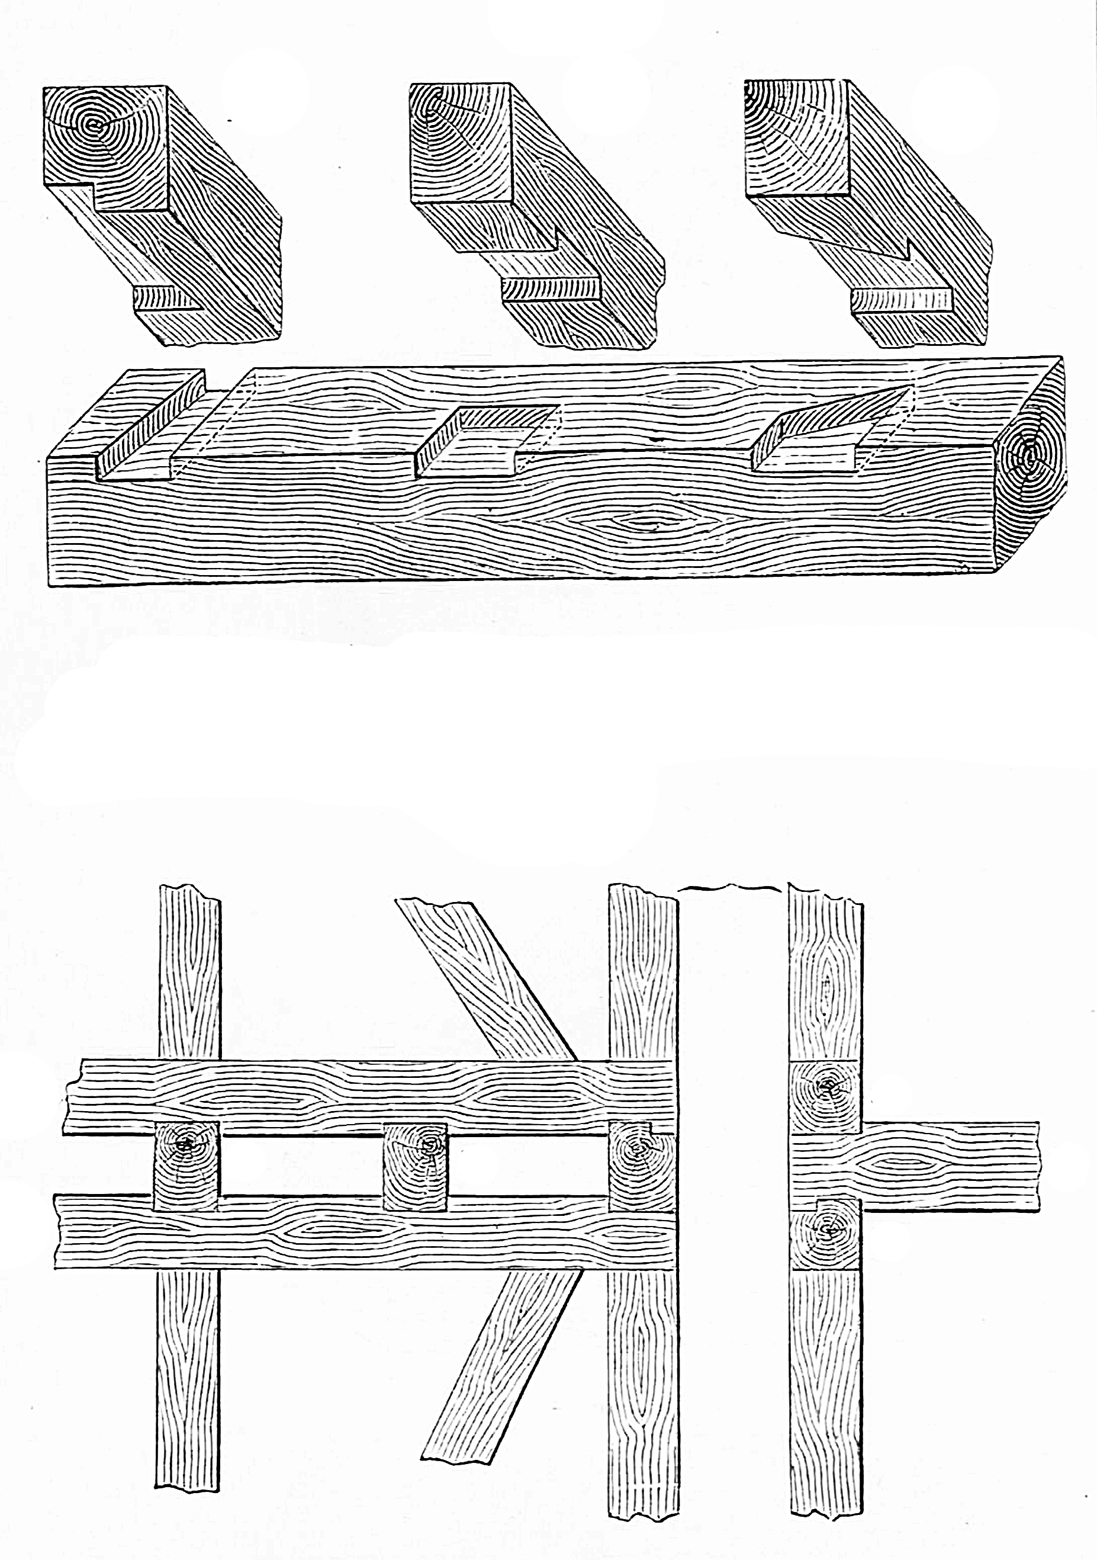
3. HISTORICAL TYPES OF WOODEN STRUCTURES: Half-Timbered construction / Post and Beam
Author: Paweł Mika

Slide 37
3. HISTORICAL TYPES OF WOODEN STRUCTURES: Half-Timbered construction / Post and Beam
Jokhang Temple, Tibet, 7c A.D.
The oldest part of the temple was built in 652. Over the next 900 years, the temple was enlarged several times with the last renovation done in 1610
https://www.wikiwand.com/en/Jokhang

Slide 38
3. HISTORICAL TYPES OF WOODEN STRUCTURES: Half-Timbered construction / Post and Beam
Alter Bau ("Old Building") in Geislingen, Germany, 1445.
Built 600 years ago as a granary for grain and dried fruits for the Free Imperial City of Ulm, this is one of the largest surviving half-timbered building in the world. The massive frame was built in the local tradition known as Allemanic frame construction. The monumental character, widely spaced posts, symmetrical jettying and characteristic "Wild Man" diagonal struts - all together create extremely sturdy and stable structure, able to counteract sagging or warping for hundreds of years. The main material is an old-growth oak timbers, the dendrochronological analysis have confirmed that most of the oaks for this structure were felled between 1442 and 1445. Once felled, the oaks would be precut, airdried for about a year or two, and then assembled on site at once - making this one of the earliest types of pre-fabricated construction
https://www.reddit.com/r/architecture/comments/m4ahpx/eightfloors_high_alter_bau_old_building_in/

Slide 39
3. HISTORICAL TYPES OF WOODEN STRUCTURES: Half-Timbered construction
Borchersche Haus in Hildesheim (~1500)
probably the largest half-timber building in the world - gone with the rest of the city after a 15 minute bombing raid by the Royal Air Force on March 22, 1945
https://www.reddit.com/r/Lost_Architecture/comments/dnj35x/borchersche_haus_in_hildesheim_1500_once_probably/

Slide 40
3. HISTORICAL TYPES OF WOODEN STRUCTURES: Half-Timbered construction / Post and Beam
Little Moreton Hall, Cheshire, England, 1508
A moated half-timbered manor house. The earliest parts of the house were built for the prosperous Cheshire landowner William Moreton in about 1504–08, and the remainder was constructed in stages by successive generations of the family until about 1610.
https://en.wikipedia.org/wiki/Little_Moreton_Hall#/media/File:LittleMoretonHall.jpg

Slide 41
3. HISTORICAL TYPES OF WOODEN STRUCTURES: Half-Timbered construction
Freudenberg, North Rhine-Westphalia, in Germany
medieval town located in the Siegen-Wittgenstein district, in North Rhine-Westphalia, in Germany. The old part of the town called “Alter Flecken” consists entirely of half-timbered houses – about 50 of them, arranged in rows. They are almost the same size, are all whitewashed and have similar-looking slate roofs. Most of these houses are from the 17th century when the town was ravaged by fire and had to be rebuilt.
https://www.amusingplanet.com/2014/08/the-half-timbered-houses-of-freudenberg.html https://www.flickr.com/photos/poly-image/10847805096

Slide 42
3. HISTORICAL TYPES OF WOODEN STRUCTURES: Half-Timbered construction
Bernd Becher, Hilla Becher. Framework Houses, 1959-73
https://www.archdaily.com/900345/three-defining-movements-in-architectural-photography?ad_medium=gallery

Slide 43
3. HISTORICAL TYPES OF WOODEN STRUCTURES: Half-Timbered construction
Contemporary buildings, Poland
http://budujzdrewna.pl/forum/viewtopic.php?p=22246#p22183

Slide 44
3. HISTORICAL TYPES OF WOODEN STRUCTURES: Balloon Framing
Timber framing, historically called a braced frame, was the most common method of building wooden buildings in America[2] from the 17th-century European settlements until the early 20th century when timber framing was replaced by balloon framing and then platform framing in houses.
Balloon framing originated in the American Mid-west near Chicago in the 1830s. It is a rare type of American historic carpentry which was exported from America. Balloon framing is very important in history as the beginning of the transition away from the centuries-long method of timber framing to the common types of wood framing now in use.
(https://www.wikiwand.com/en/American_historic_carpentry)
https://www.britannica.com/technology/half-timber-work Author: Paweł Mika

Slide 45
3. HISTORICAL TYPES OF WOODEN STRUCTURES: Balloon Framing
Foundations,
2. Waterproof insulation,
3. Sill plate
4. Joist
5. Subflooring
6. Firestop blocking
7. Stud
8. Ribbon
9. Double Topplate
10. Roofjoist
11. Rafter
12. Lintel
13. Cripple stud
14. Rough sill
15. Trimmer stud
Author: Paweł Mika

Slide 46
3. HISTORICAL TYPES OF WOODEN STRUCTURES: Balloon Framing
In 1833, a breakthrough in building technology revolutionized the construction of private homes, making them affordable to middle- and low-income families.
[A popular myth suggests that a Chicago carpenter, George W. Snow, invented the balloon frame in 1832 and revolutionized construction practice - http://www.encyclopedia. chicagohistory.org/pages/105.html]
Home construction previously was expensive. Houses were built using stout pieces of lumber fitted together with heavy joints. For example, the traditional New England frame house was built using hardwood beams connected with mortise-and-tenon joints fastened by hand-cut dowels or hand-wrought nails. An entire frame wall was fitted on the ground and then lifted into place by a crew of about twenty laborers. These homes were durable but expensive and unwieldy to construct, requiring much labor and the expertise of skilled craftsmen
Balloon frame was developed, making its first appearance in Chicago. Partially a result of the incipient industrialization occurring in the young nation, the balloon frame was based on much lighter precut two-by-four-inch studs positioned sixteen inches apart and held together by factory-produced nails.
Ten men building a balloon frame house, Omaha Reservation, Nebraska, 1877
https://www.oldhousefix.com/balloon-framed-houses/ http://jeanhuets.com/wp-content/uploads/2013/10/05_Balloon-Framing.jpg

Slide 47
3. HISTORICAL TYPES OF WOODEN STRUCTURES: Platform Framing
Platform framing is very similar to the balloon frame. It uses 2x4s spaced 16″ on center and requires the same basic layout except for a few key differences.
A platform frame uses shorter lengths of lumber because each story of the building is built individually and placed on top of the one below. Shorter 2x4s cost less per foot than longer ones and the break between each floor created the much needed fire block not present in the balloon frame.
Also, platform frames could be built without the use of scaffolding. Since each story was constructed on top of the previous one the second story floor could be used by workers to build the the second story walls upon resulting in much faster and easer construction.
https://thecraftsmanblog.com/framing-timber-balloon-platform/ Author: Paweł Mika

Slide 48
3. HISTORICAL TYPES OF WOODEN STRUCTURES: Platform Framing
Foundations,
2. Waterproof insulation,
3. Sill plate
4. Joist
5. Sole plate
6. Rim joist
7. Subflooring
8. Stud
9. Double Topplate
10. Roofjoist
11. Rafter
12. Lintel
13. Cripple stud
14. Rough sill
15. Trimmer stud
Author: Paweł Mika

Slide 49
3. HISTORICAL TYPES OF WOODEN STRUCTURES: Platform Framing
https://www.finiteccanada.com/Images/Blogs/Large/4132.jpg

Slide 50
3. HISTORICAL TYPES OF WOODEN STRUCTURES: Platform Framing
Multifamily residential building, Gdańsk, Dolne Młyny
Platform framing was traditionally limited to four floors but some jurisdictions have modified their building codes to allow up to six floors with added fire protection.
http://fachowydekarz.pl/drewniane-budynki-wielorodzinne/

Slide 51
3. HISTORICAL TYPES OF WOODEN STRUCTURES: Other types of construction
Himeji Castle, ~1600 , the Hyōgo Prefecture, Japan
The castle is regarded as the finest surviving example of prototypical Japanese castle architecture. The highest walls in the castle complex have a height of 26 m. Externally, the keep appears to have five floors, because the second and third floors from the top appear to be a single floor; however, it actually has six floors and a basemen. For almost 700 years, Himeji Castle has remained intact, even throughout the bombing of Himeji in World War II, and natural disasters including the 1995 Great Hanshin earthquake. (https://en.wikipedia.org/wiki/Himeji_Castle)
https://journal.eahn.org/articles/10.5334/ah.393/eahn-7-393-g2.jpg/?action=download https://www.justonecookbook.com/himeji-castle/

Slide 52
3. HISTORICAL TYPES OF WOODEN STRUCTURES: Other types of construction
Upper Lusatian house, moved to Zgorzelec from Wygancice
A structure system that makes the ground floor walls independent of the roof based on a set of purlins and columns. In Poland, they are found in rural and small-town construction, most often in the south-western part of the country.
https://cdn.galleries.smcloud.net/t/galleries/gf-B4Lg-6qMo-wPU5_dom-przyslupowy-664x442-nocrop.jpg
https://journal.eahn.org/articles/10.5334/ah.393/eahn-7-393-g2.jpg/?action=download https://www.justonecookbook.com/himeji-castle/

Slide 53
3. HISTORICAL TYPES OF WOODEN STRUCTURES: Other types of construction
Stackwall or cardwood masonry: construction consisting of a grate made of fire wood filled with clay, cement or sand-lime mass.
https://tasdevri.net/building-a-cordwood-house/building-a-cordwood-house-6/
https://journal.eahn.org/articles/10.5334/ah.393/eahn-7-393-g2.jpg/?action=download https://www.justonecookbook.com/himeji-castle/

Slide 54
3. HISTORICAL TYPES OF WOODEN STRUCTURES: Evolution of the wooden construction
Log construction Post and plank construction Half-timbered construction Platform framing
Author: Paweł Mika

Slide 55
3. HISTORICAL TYPES OF WOODEN STRUCTURES: Evolution of the wooden construction
H. Kaufmann S. Krötsch S. Winter, Manual of Multistorey Timber Construction

